Slide 1
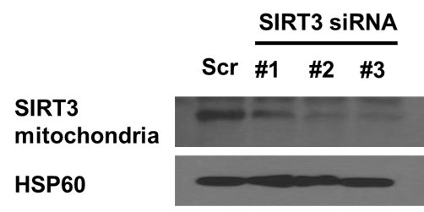
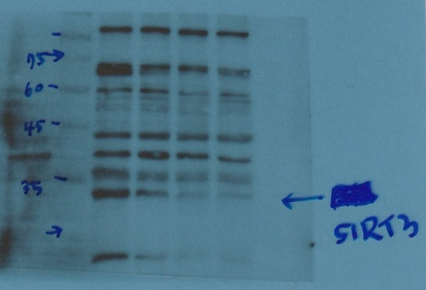
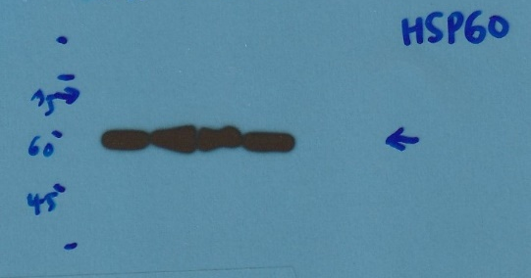
Supplementary Figure 1. Cropped (A) and uncropped (B) blots confirming mitochondrial SIRT3 expression upon treatment with three custom-designed SIRT3 siRNAs and scramble control. The #3 siRNA was selected for subsequent experiments.
A
B
SIRT3 mitochondria
HSP60

Slide 2
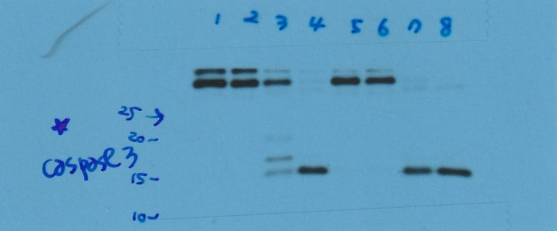
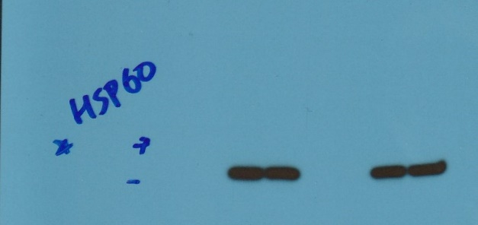
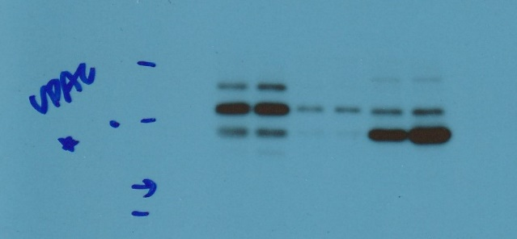
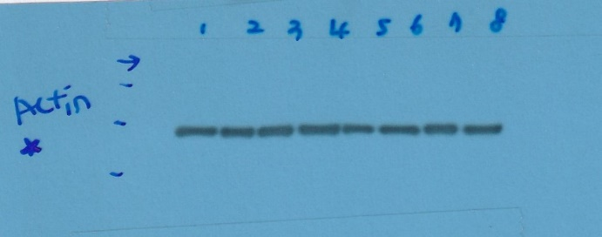
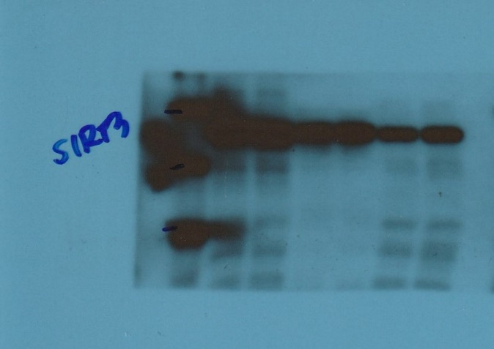
Supplementary Figure 2. Original blots of westerns in Figure 1A & 1B.
1A
1B
HSP60
SIRT3 whole lysate
Cleaved caspase-3
48 -
75
60
35 -
VDAC
β-actin
SIRT3 mitochondria
45
35
45
25
35
20
SIRT3 cytosol
SIRT3
35 -
HSP60
45
35
60 -
25

Slide 3
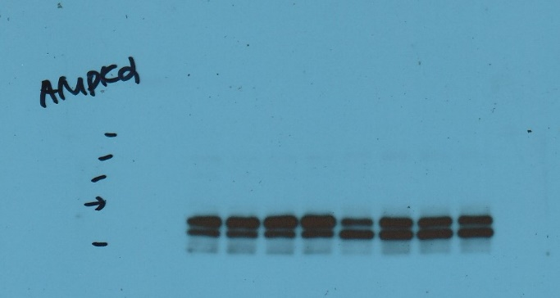
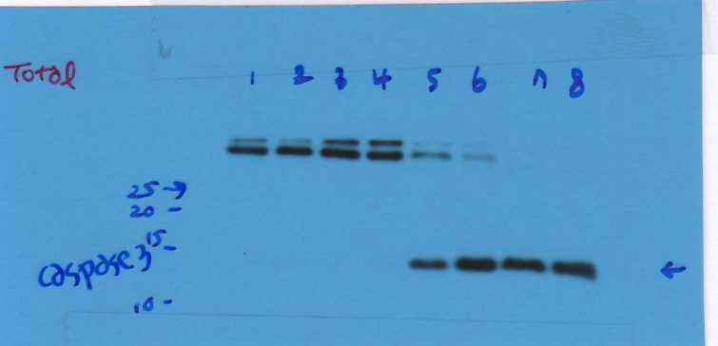
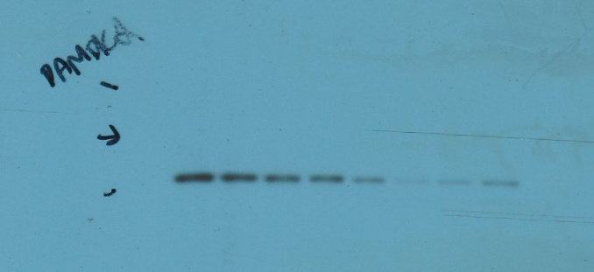
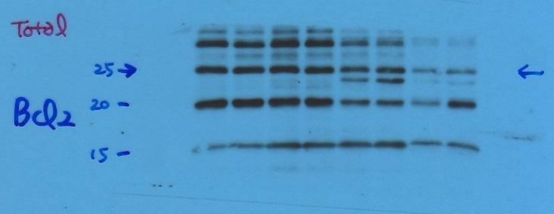
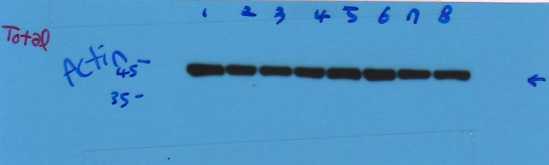
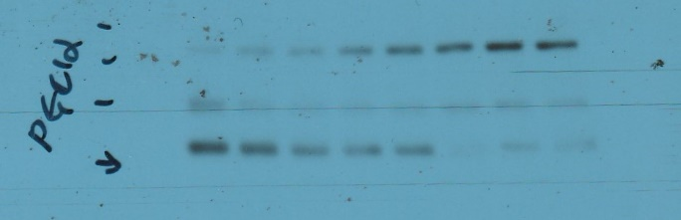
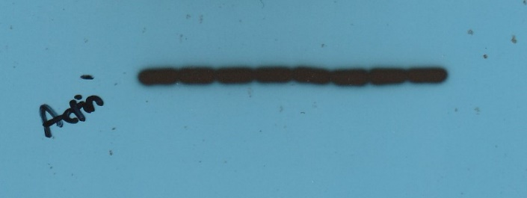
Supplementary Figure 3. Original blots of westerns in Figure 2A & 2B.
2B
2A
AMPKα
Cleaved caspase-3
180
140
100
75
60
p-AMPKα
Bcl-2
100
75
60
β-actin
PGC1α
180
140
100
75
β-actin
45

Slide 4
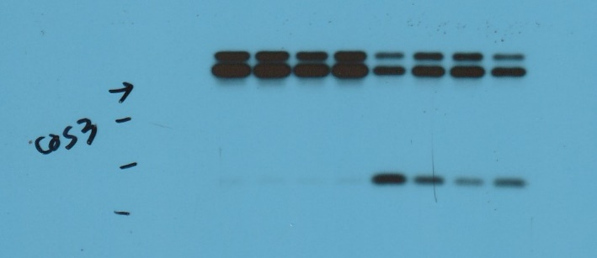
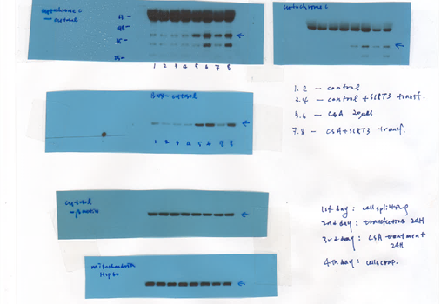
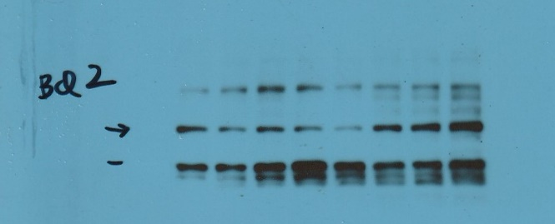
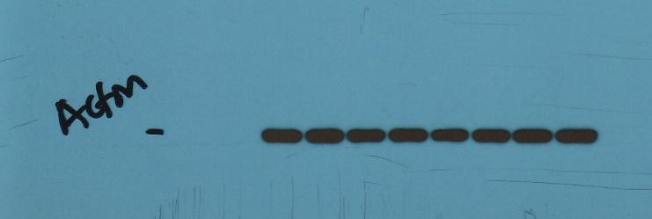
Supplementary Figure 4. Original blots of westerns in Figure 3B & 3C.
3B
3C
Cleaved caspase-3
Cytochome C
25
20
15
10
Bcl-2
Bax
25
20 -
20
β-actin
β-actin
45
45 -

Slide 5
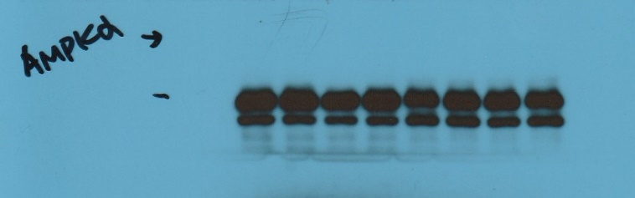
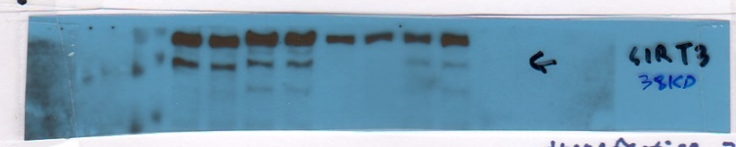
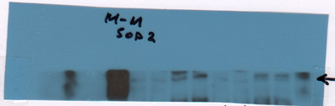


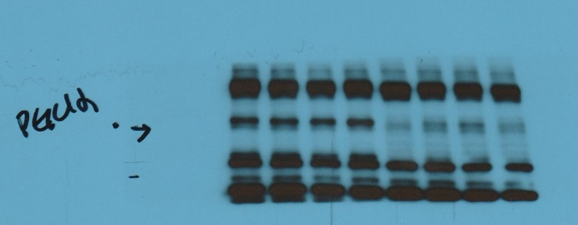
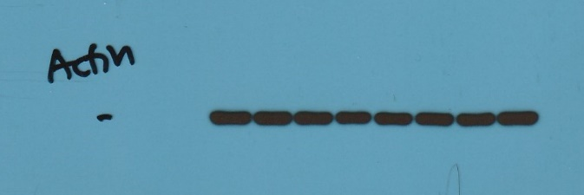
Supplementary Figure 5. Original blots of westerns in Figure 3D & 3E.
3E
3D
AMPKα
SIRT3
75
35 -
60
SOD2
p-AMPKα
20 -
HSP60
PGC1α
75
60
60 -
β-actin
45

Slide 6
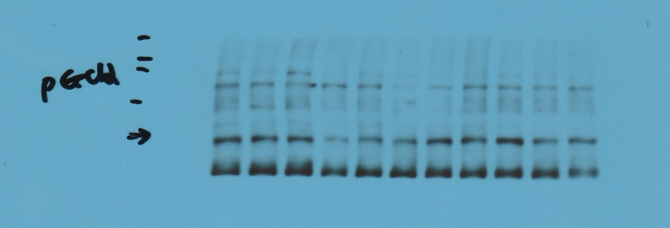
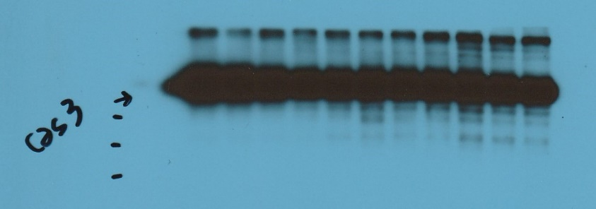
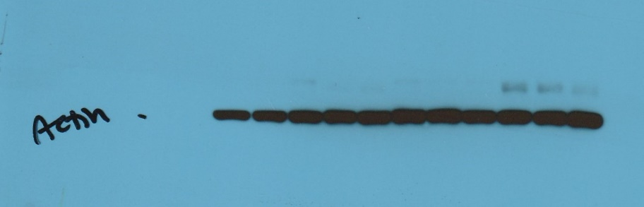
Supplementary Figure 6. Original blots of westerns in Figure 4B.
4B
PGC1α
180
140
100
75
Cleaved caspase-3
25
20
15
10
β-actin
45

Slide 7
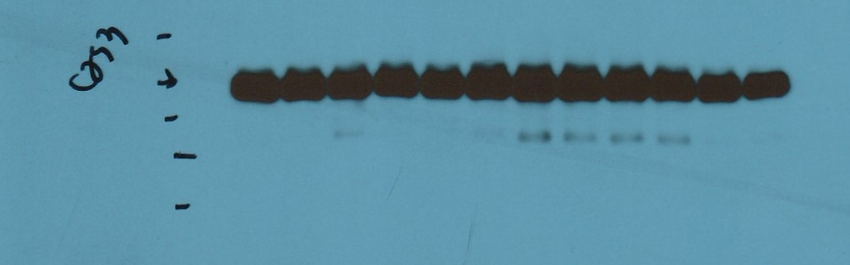
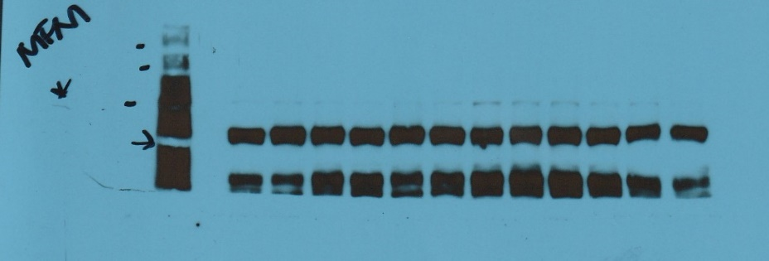
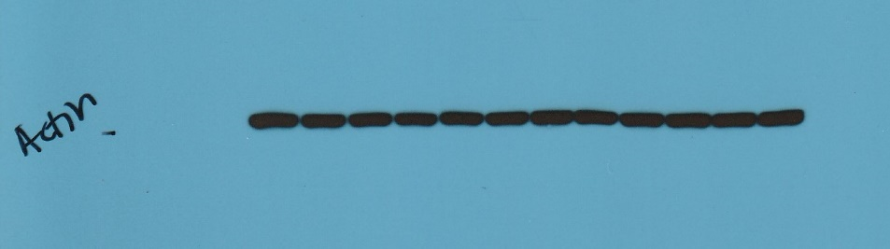
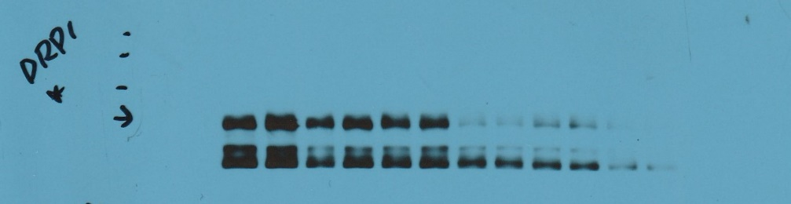
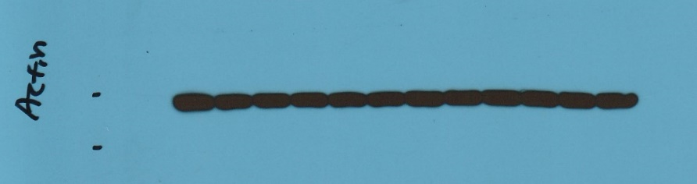
Supplementary Figure 6. Original blots of westerns in Figure 5B.
5B
Cleaved caspase-3
MFN1
25
180
140
20
100
15
75
10
β-actin
DRP1
180
140
45
100
75
β-actin
45
35

