Slide 1
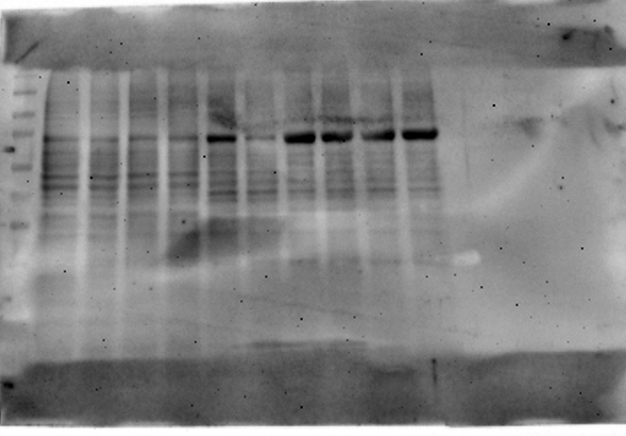
TMPRSS11D – N1
CTL
Cur
EXT
Me08
Me23
50kDa

Slide 2
GAPDH – N1
CTL
Cur
EXT
Me08
Me23
35kDa

Slide 3
TMPRSS11D – N2
CTL
Cur
EXT
Me08
Me23
50kDa

Slide 4
GAPDH – N2
CTL
Cur
EXT
Me08
Me23
35kDa

Slide 5
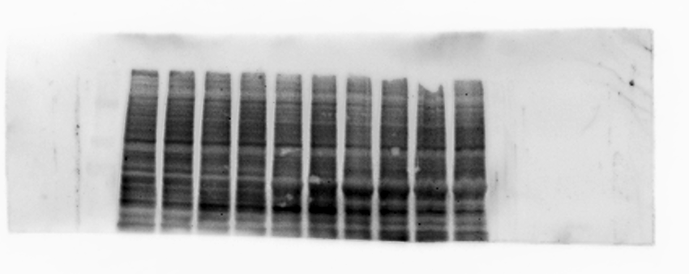
ACE2 – N1
CTL
Cur
EXT
Me08
Me23
100kDa

Slide 6
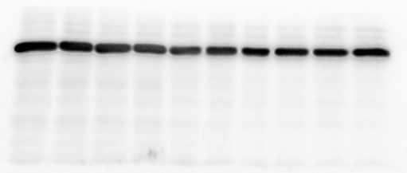
GAPDH – N1
CTL
Cur
EXT
Me08
Me23
35kDa

Slide 7
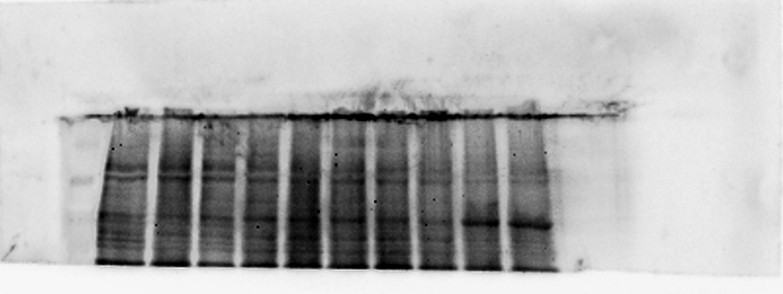
ACE2 – N2
CTL
Cur
EXT
Me08
Me23
100kDa

Slide 8
GAPDH – N2
CTL
Cur
EXT
Me08
Me23
35kDa

Slide 9
TMPRSS2 – N1
CTL
Cur
EXT
Me08
Me23
50kDa

Slide 10
GAPDH – N1
CTL
Cur
EXT
Me08
Me23
35kDa

Slide 11
TMPRSS2 – N2
CTL
Cur
EXT
Me08
Me23
50kDa

Slide 12
GAPDH – N2
CTL
Cur
EXT
Me08
Me23
35kDa

