Slide 1
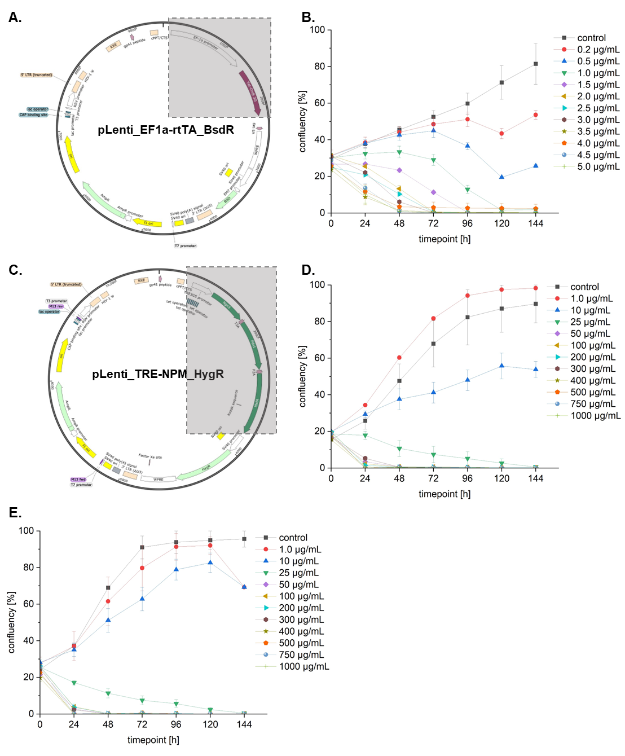
Supplementary Figure 1: Final lentiviral plasmid design and antibiotic kill curves. A. Lentiviral plasmid design of
pLenti_EF1a-rtTA_BsdR with the regions of interest in the gray box. B. Un-transduced hiPSCs were used to determine the optimal concentration of Blasticidin needed to select for successfully transduced cells and 1.0 µg/mL of Blasticidin S HCl for five days was chosen.
C. Lentiviral plasmid design of
pLenti_TRE-NPM_HygR with the regions of interest in the gray box. D. Un-transduced hiPSCs and E. hiPSCs with
pLenti_EF1a-rtTA_BsdR were used to determine the optimal concentration of HygromycinB needed to select for successfully transduced cells and 25.0 µg/mL of HygromycinB for six days was chosen.

Slide 2
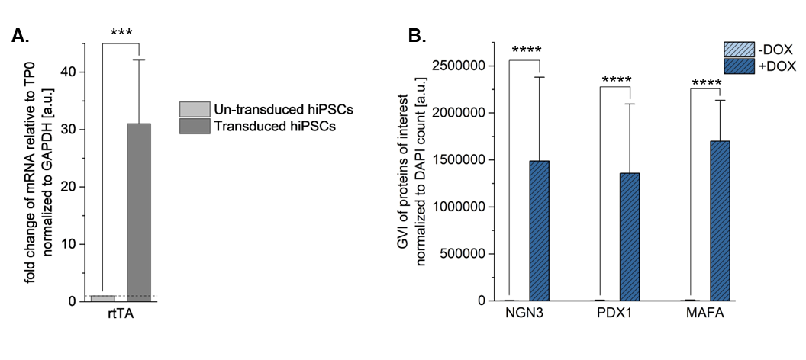
Supplementary Figure 2: Gene expression analysis of rtTA and semi-quantification of marker expression of the markers of interest in cells cultured for five days. A. Gene expression analysis of un-transduced and transduced hiPSCs for rtTA relative to un-transduced, normalized to GAPDH levels. Unpaired t-test (N = 3), *** p ≤ 0.001. B. Semi-quantification analysis using GVI of the protein expression of the markers of interest in cells cultured with and without DOX for five days, normalized to DAPI counts. Unpaired t-test (N = 3, n ≥ 9), **** p ≤ 0.0001. Error bars represent standard deviation.

Slide 3
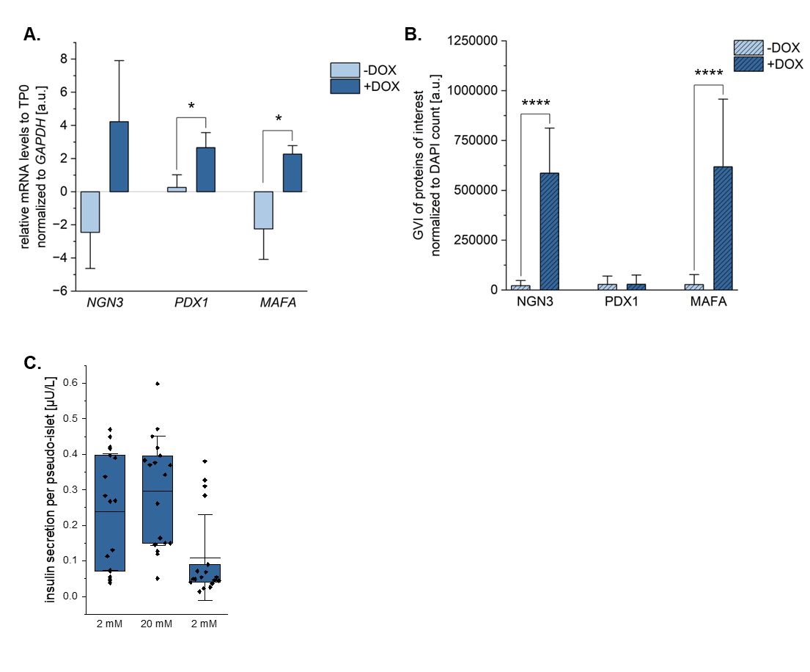
Supplementary Figure 3: Gene expression and semi-quantification of marker expression of cells cultured for ten days. A. Gene expression of the markers of interest after ten days of culture with and without DOX. All values relative to day 0 at the stem cell stage and normalized to GAPDH.
Unpaired t-test (N = 3), * p ≤ 0.05. B. Semi-quantification analysis using GVI of the protein expression of the markers of interest in cells cultured with and without DOX for ten days, normalized to DAPI counts. Unpaired t-test (N = 3, n ≥ 9), **** p ≤ 0.0001. C. Dynamic GSIS results: amount of insulin secreted upon consecutive stimulation with 2 mM, 20 mM, and again 2 mM glucose normalized to cell count. Unpaired t-test (N = 3, n = 18), * p ≤ 0.05, **** p ≤ 0.0001. Error bars represent standard deviation.

Slide 4
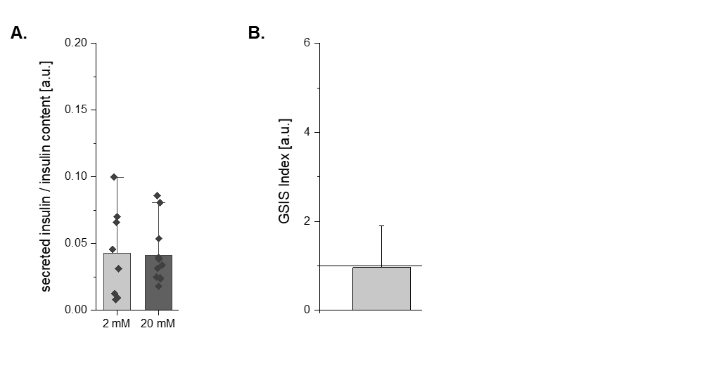
Supplementary Figure 4: Parallel GSIS results of donor human islets. A. Parallel GSIS results of human donor islets: amount of insulin secreted upon stimulation with 2 mM and 20 mM glucose normalized to the insulin content. B. GSIS index as represented by the fold change in insulin secretion between the 2 mM and 20 mM glucose challenges. Solid line at 1 represents the threshold needed to be considered a functional response. Unpaired t-test (n = 8). Error bars represent standard deviation.

Slide 5
Target | ThermoFisher Gene Expression Assay ID or Sequence | Dye | Quencher | Notes
Oct4 | Hs00999634_gH | FAM-MGB | TAMRA
Sox2 | Hs01053049_s1 | FAM-MGB | TAMRA
Nanog | Hs02387400_g1 | FAM-MGB | TAMRA
Klf4 | Hs00358836_m1 | FAM-MGB | TAMRA
Ngn3 | Hs00360700_g1 | FAM-MGB | TAMRA | Marker of interest
Pdx1 | Hs00236830_m1 | FAM-MGB | TAMRA | Marker of interest
MafA | Hs04419852_s1 | FAM-MGB | TAMRA | Marker of interest
Nkx6.1 | Hs00232355_m1 | FAM-MGB | TAMRA
MafB | Hs00534343_s1 | FAM-MGB | TAMRA
β-actin | Hs01060665 | FAM-MGB | TAMRA
GAPDH | Hs99999905_m1 | FAM-MGB | TAMRA
Fwd_rtTA | TGC CCT GCC AAT CGA GAT | - | - | designed by Primer Express 3.0 of 7500 Fast Real Time PCR System from Applied Biosystems
Rev_rtTA | GCC ATG ACT CGC CTT CCA | - | -
rtTA Probe | ACAGGCATCATACCCACTCCTGCCC | FAM-MGB | TAMRA
Supplementary Table 1: List of qPCR primers used.

Slide 6
Target | Company, Catalog Number | Notes
OCT4 | Santa Cruz, sc8629
NANOG | Cell Signalling Technologies, 4903
GATA4 | Santa Cruz, sc788
SOX2 | New England Biolabs, 3579S
NGN3 | Sigma Aldrich, AB5684 | Marker of interest
PDX1 | Thermo Fisher, PA5-84405 | Marker of interest
MAFA | Abcam, ab26405 | Marker of interest
NKX6.1 | Developmental Studies Hybridoma Bank, F55A12-S
Insulin | Dako, A0564
C-peptide | Cell Signalling Technologies, 4593S
Supplementary Table 2: List of primary antibodies used.

Slide 7
Reagent | Concentration | Company, Catalog Number
NaCl | 115.0 mM | Carl Roth, 3957.3
KCl | 5.0 mM | Carl Roth, 6781.3
CaCl₂ | 1.0 mM | Sigma Aldrich, 12095
MgCl₂ | 1.0 mM | Serva, 28305
NaHCO₃ | 24.0 mM | Sigma Aldrich, S5761
HEPES | 10.0 mM | Sigma Aldrich, H4034
BSA | 1% | Sigma, A9576
Glucose | 0.5 mM | Sigma, G7528
Supplementary Table 3: Recipe for β-Krebs buffer.

