Slide 1
Directional sensitivity of bone conduction stimulation on the otic capsule in a finite element model of the human temporal bone
Paweł Borkowski
S2. Vibration modes of the petrous part of the temporal bone for four BC stimulation directions

Slide 2
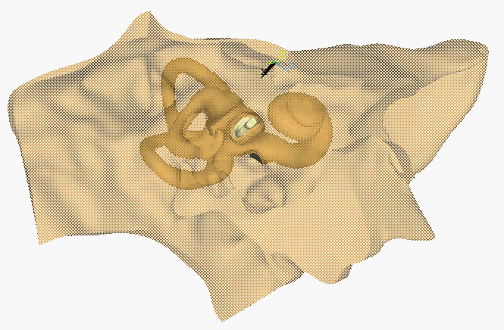
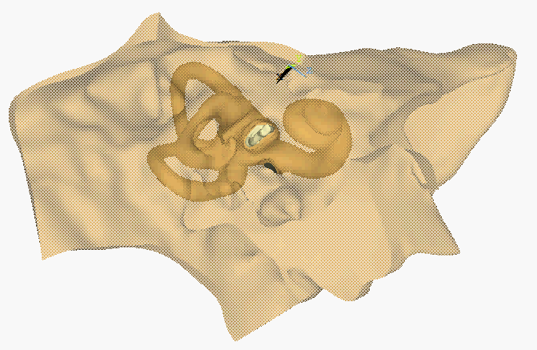
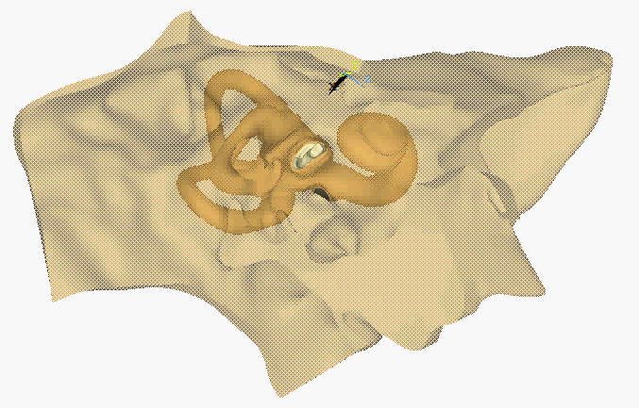



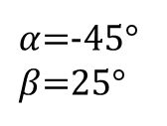


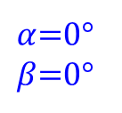

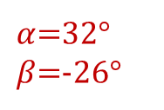
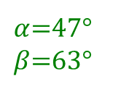

200 Hz
$$primary$$
$$V_{max}^{crit}$$
$α$=0°
$β$=0°
$α$=-45°
$β$=25°
( )ꓵ( )
Ʇ
$${\overline{w}}_{max}^{crit}$$
Ʇ
$${\overline{w}}_{max}^{crit}$$
$$V_{max}^{crit}$$
$α$=47°
$β$=63°
$α$=32°
$β$=-26°
F_{a} = 0.1 N
Displacement scale factor: 20000

Slide 3
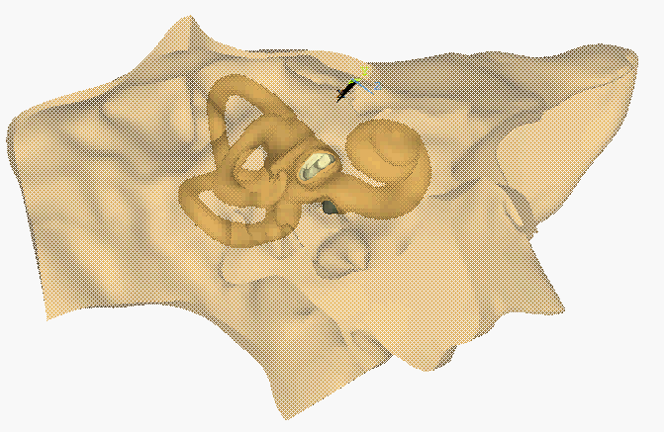



1000 Hz
$$primary$$
$$V_{max}^{crit}$$
$α$=0°
$β$=0°
$α$=-45°
$β$=25°
( )ꓵ( )
Ʇ
$${\overline{w}}_{max}^{crit}$$
Ʇ
$${\overline{w}}_{max}^{crit}$$
$$V_{max}^{crit}$$
$α$=47°
$β$=63°
$α$=32°
$β$=-26°
F_{a} = 0.1 N
Displacement scale factor: 12000

Slide 4
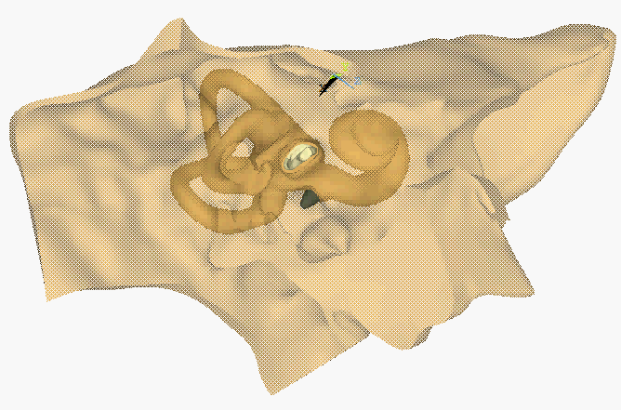
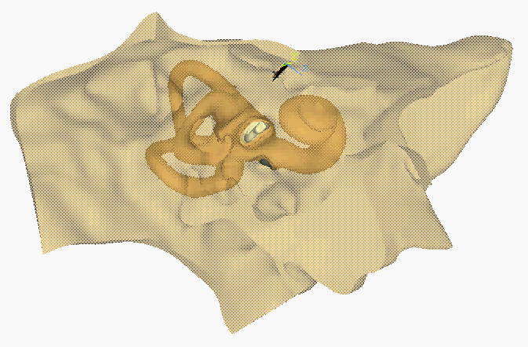


1250 Hz
$$primary$$
$$V_{max}^{crit}$$
$α$=0°
$β$=0°
$α$=-45°
$β$=25°
( )ꓵ( )
Ʇ
$${\overline{w}}_{max}^{crit}$$
Ʇ
$${\overline{w}}_{max}^{crit}$$
$$V_{max}^{crit}$$
$α$=47°
$β$=63°
$α$=32°
$β$=-26°
F_{a} = 0.1 N
Displacement scale factor: 8000

Slide 5

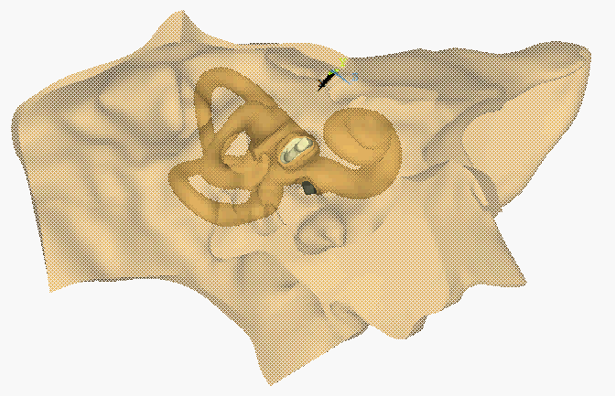


1600 Hz
$$primary$$
$$V_{max}^{crit}$$
$α$=0°
$β$=0°
$α$=-45°
$β$=25°
( )ꓵ( )
Ʇ
$${\overline{w}}_{max}^{crit}$$
Ʇ
$${\overline{w}}_{max}^{crit}$$
$$V_{max}^{crit}$$
$α$=47°
$β$=63°
$α$=32°
$β$=-26°
F_{a} = 0.1 N
Displacement scale factor: 8000

Slide 6
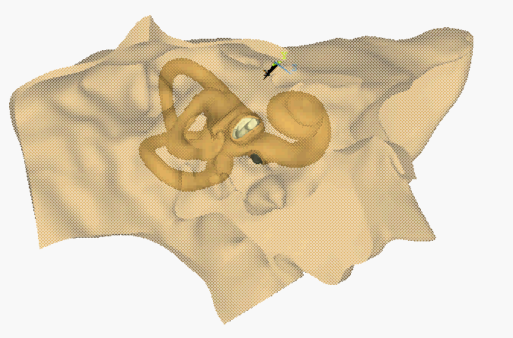
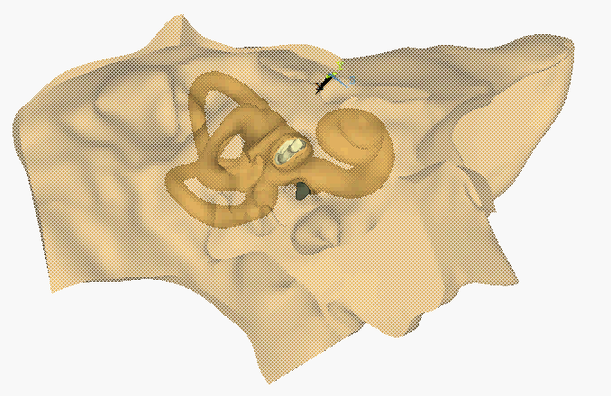
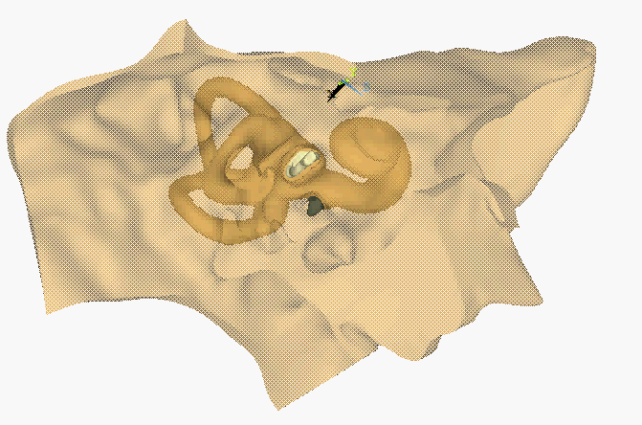
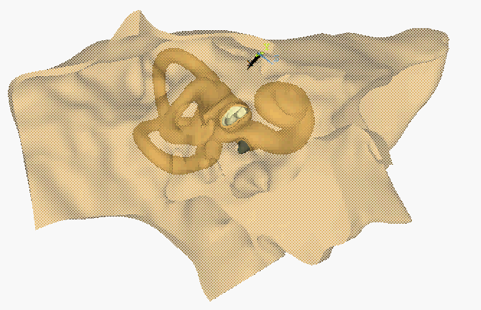
2000 Hz
$$primary$$
$$V_{max}^{crit}$$
$α$=0°
$β$=0°
$α$=-45°
$β$=25°
( )ꓵ( )
Ʇ
$${\overline{w}}_{max}^{crit}$$
Ʇ
$${\overline{w}}_{max}^{crit}$$
$$V_{max}^{crit}$$
$α$=47°
$β$=63°
$α$=32°
$β$=-26°
F_{a} = 0.1 N
Displacement scale factor: 8000

Slide 7
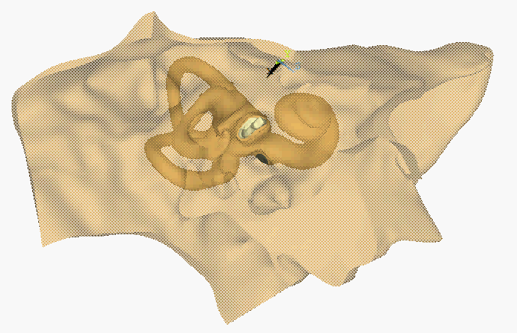

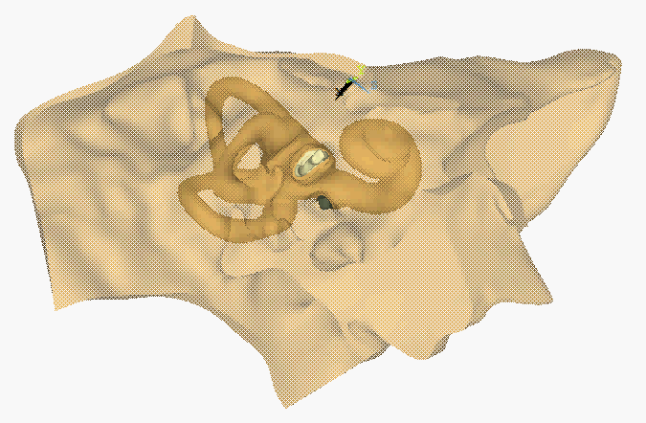
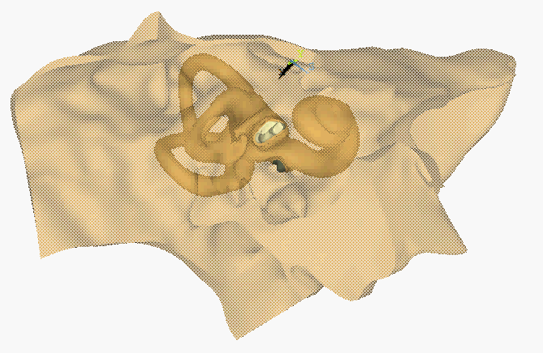
2500 Hz
$$primary$$
$$V_{max}^{crit}$$
$α$=0°
$β$=0°
$α$=-45°
$β$=25°
( )ꓵ( )
Ʇ
$${\overline{w}}_{max}^{crit}$$
Ʇ
$${\overline{w}}_{max}^{crit}$$
$$V_{max}^{crit}$$
$α$=47°
$β$=63°
$α$=32°
$β$=-26°
F_{a} = 0.1 N
Displacement scale factor: 8000

Slide 8
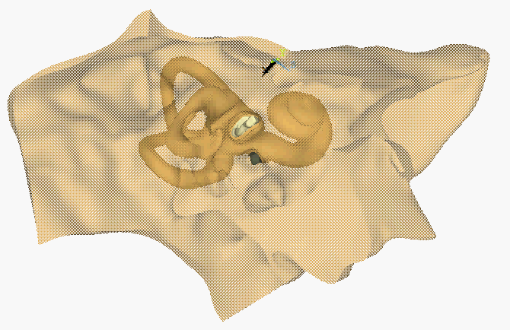

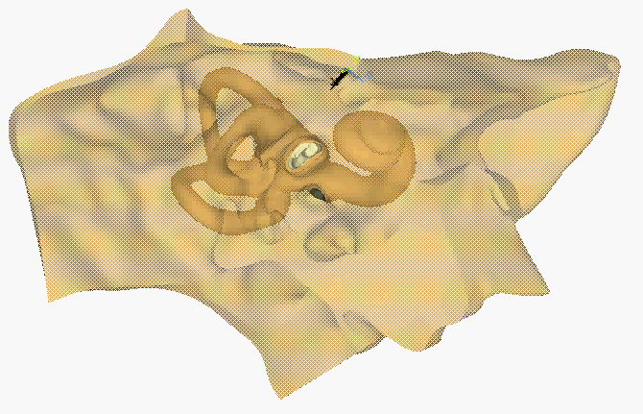
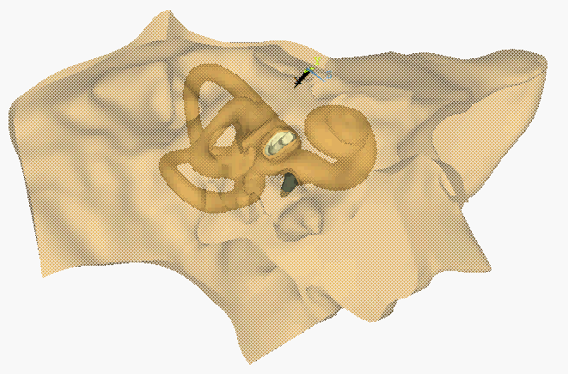
3150 Hz
$$primary$$
$$V_{max}^{crit}$$
$α$=0°
$β$=0°
$α$=-45°
$β$=25°
( )ꓵ( )
Ʇ
$${\overline{w}}_{max}^{crit}$$
Ʇ
$${\overline{w}}_{max}^{crit}$$
$$V_{max}^{crit}$$
$α$=47°
$β$=63°
$α$=32°
$β$=-26°
F_{a} = 0.1 N
Displacement scale factor: 12000

Slide 9
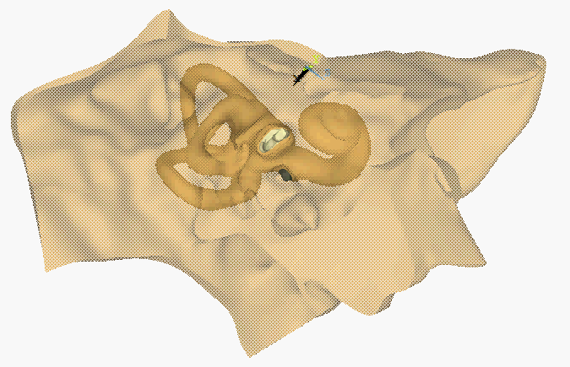

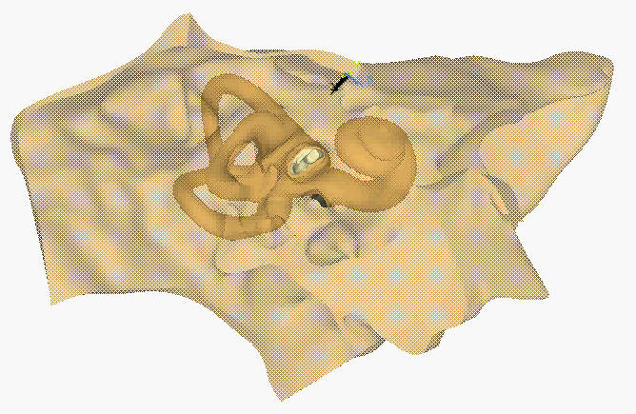
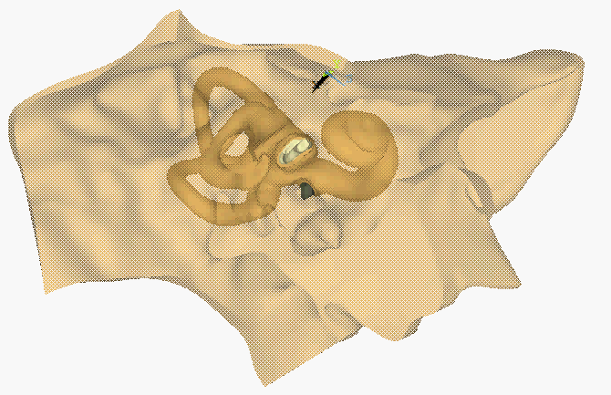
4000 Hz
$$primary$$
$$V_{max}^{crit}$$
$α$=0°
$β$=0°
$α$=-45°
$β$=25°
( )ꓵ( )
Ʇ
$${\overline{w}}_{max}^{crit}$$
Ʇ
$${\overline{w}}_{max}^{crit}$$
$$V_{max}^{crit}$$
$α$=47°
$β$=63°
$α$=32°
$β$=-26°
F_{a} = 0.1 N
Displacement scale factor: 15000

Slide 10

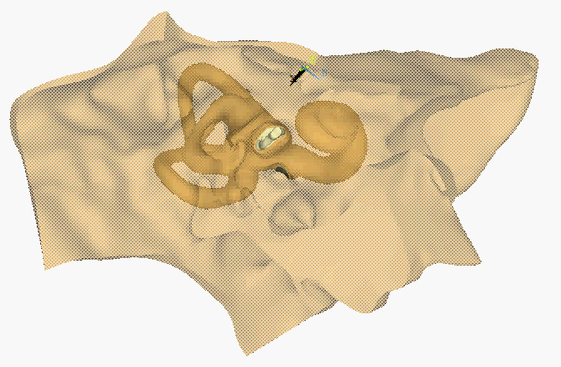
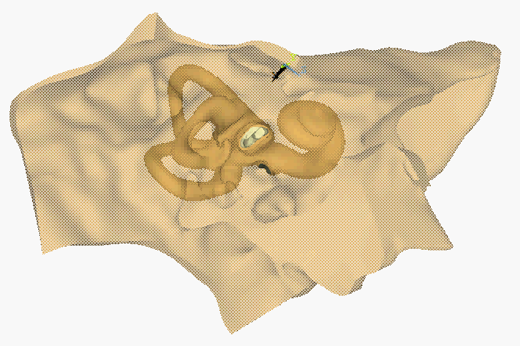

5000 Hz
$$primary$$
$$V_{max}^{crit}$$
$α$=0°
$β$=0°
$α$=-45°
$β$=25°
( )ꓵ( )
Ʇ
$${\overline{w}}_{max}^{crit}$$
Ʇ
$${\overline{w}}_{max}^{crit}$$
$$V_{max}^{crit}$$
$α$=47°
$β$=63°
$α$=32°
$β$=-26°
F_{a} = 0.1 N
Displacement scale factor: 15000

Slide 11

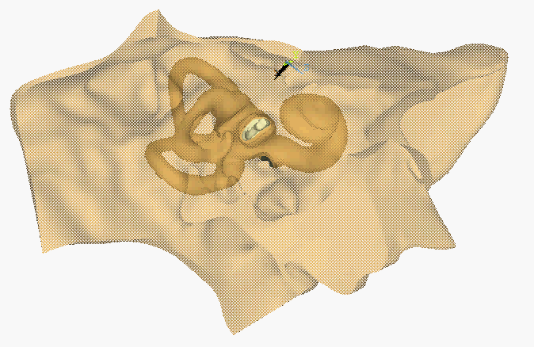


6300 Hz
$$primary$$
$$V_{max}^{crit}$$
$α$=0°
$β$=0°
$α$=-45°
$β$=25°
( )ꓵ( )
Ʇ
$${\overline{w}}_{max}^{crit}$$
Ʇ
$${\overline{w}}_{max}^{crit}$$
$$V_{max}^{crit}$$
$α$=47°
$β$=63°
$α$=32°
$β$=-26°
F_{a} = 0.1 N
Displacement scale factor: 20000

Slide 12




8000 Hz
$$primary$$
$$V_{max}^{crit}$$
$α$=0°
$β$=0°
$α$=-45°
$β$=25°
( )ꓵ( )
Ʇ
$${\overline{w}}_{max}^{crit}$$
Ʇ
$${\overline{w}}_{max}^{crit}$$
$$V_{max}^{crit}$$
$α$=47°
$β$=63°
$α$=32°
$β$=-26°
F_{a} = 0.1 N
Displacement scale factor: 20000

Slide 13




10000 Hz
$$primary$$
$$V_{max}^{crit}$$
$α$=0°
$β$=0°
$α$=-45°
$β$=25°
( )ꓵ( )
Ʇ
$${\overline{w}}_{max}^{crit}$$
Ʇ
$${\overline{w}}_{max}^{crit}$$
$$V_{max}^{crit}$$
$α$=47°
$β$=63°
$α$=32°
$β$=-26°
F_{a} = 0.1 N
Displacement scale factor: 30000

