Slide 1
Original Figure 1A
MDA-MB-231
Anti-BCL-xL
Anti-MCL-1
Anti-BCL-2
Anti-actin
Anti-actin
Anti-actin

Slide 2
Original western-blot figure 4C
MCL-1
Actin
BCL-xL

Slide 3
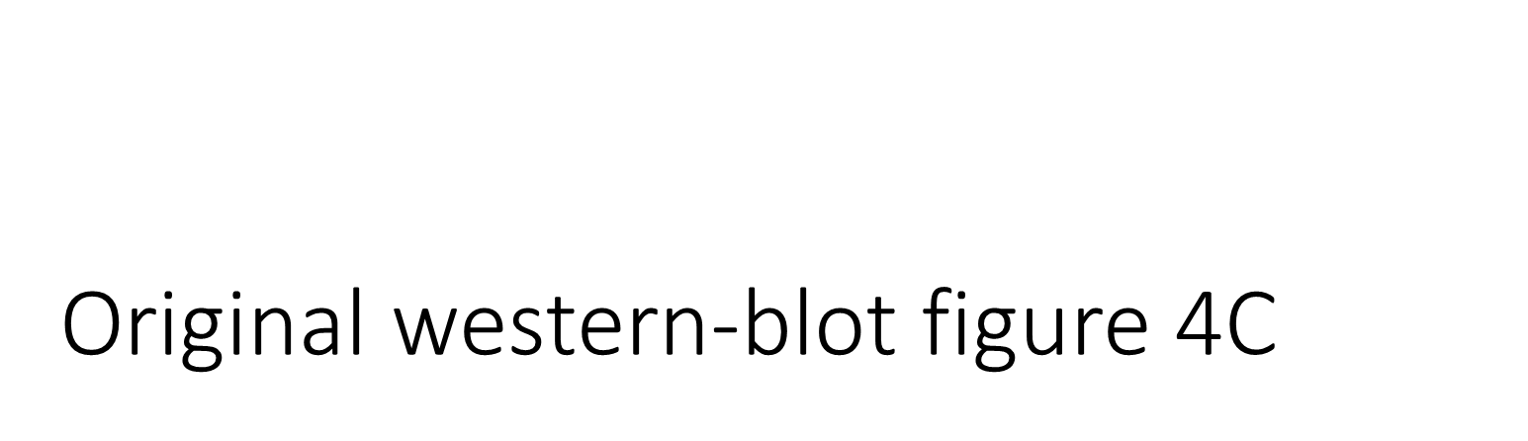
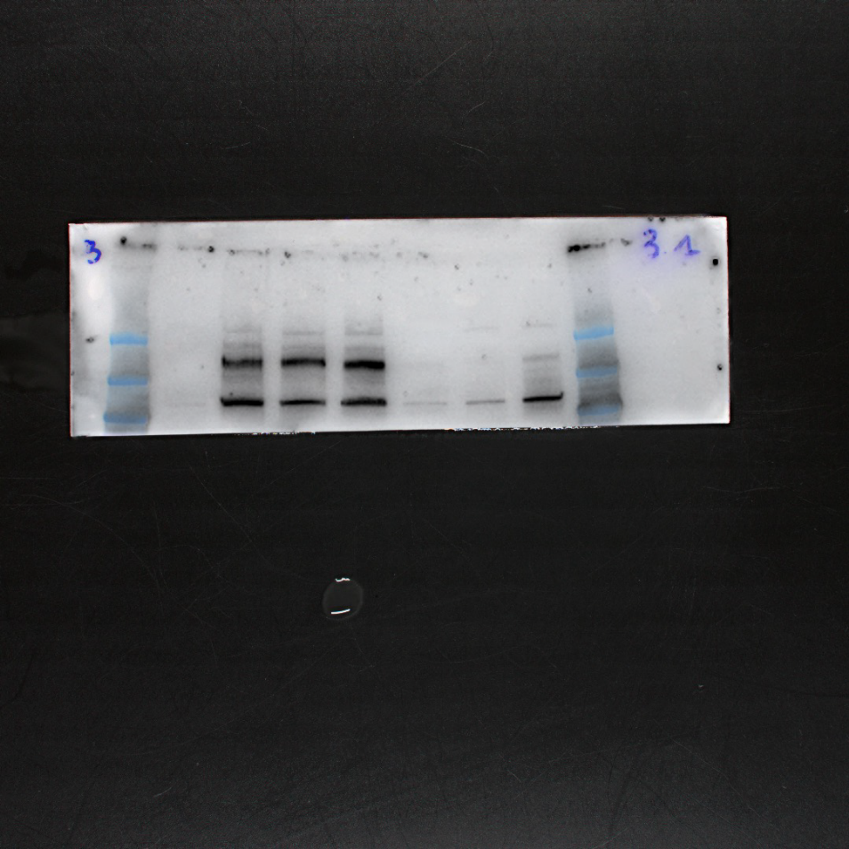
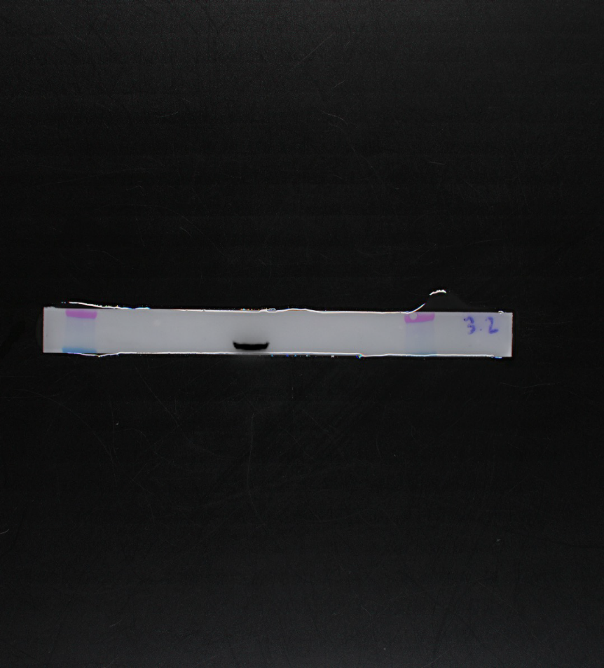
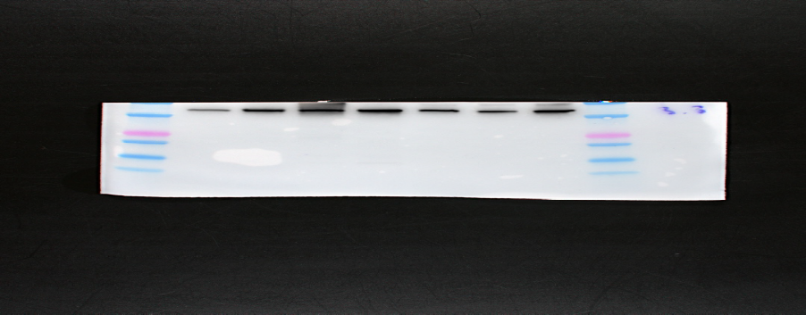
ER
HER-2
actin

Slide 4
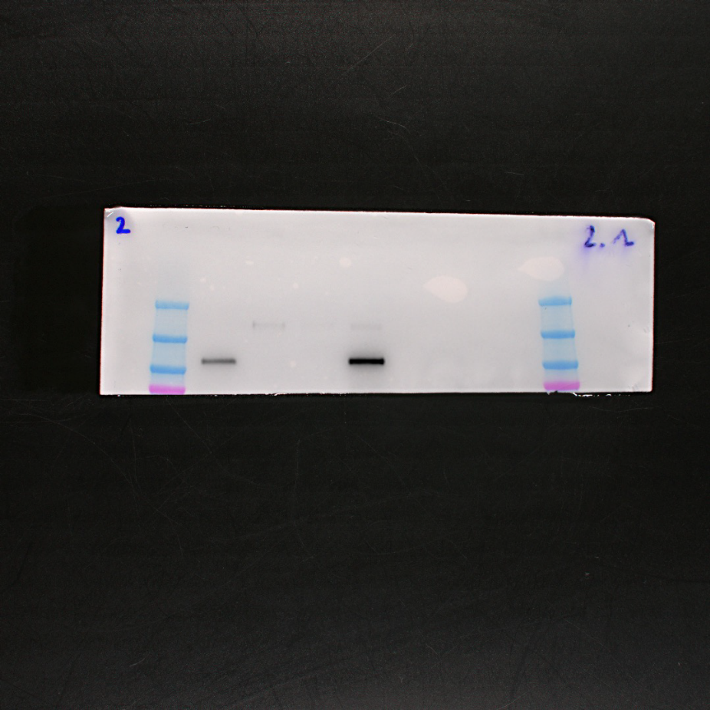
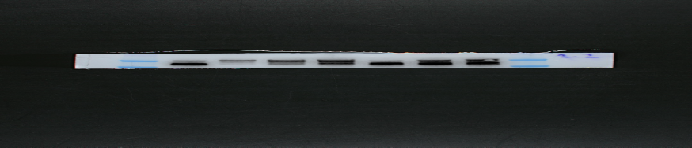
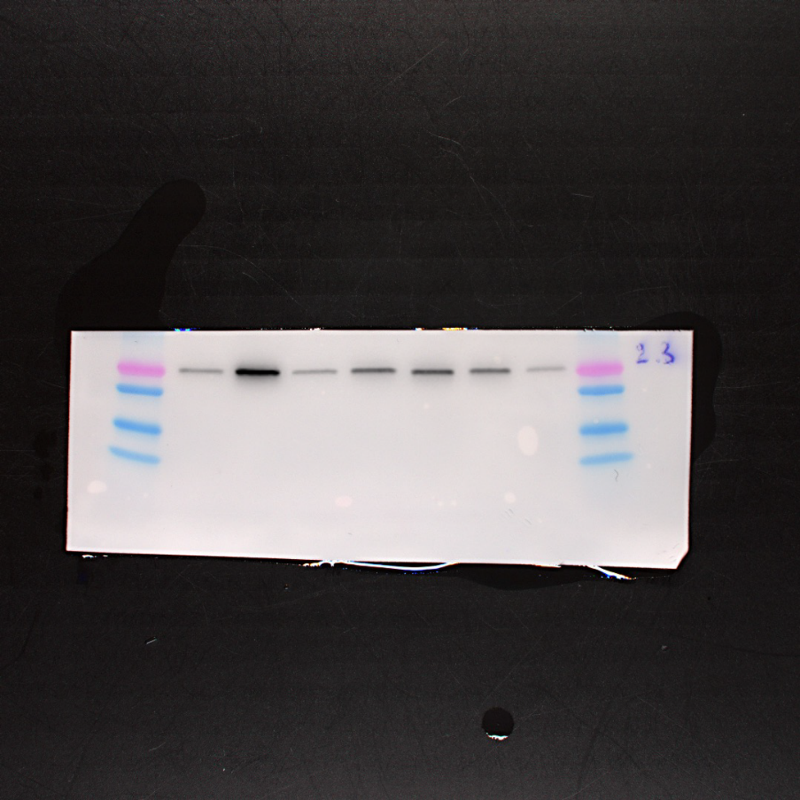
Keratin 8
PR
BCL-2

Slide 5
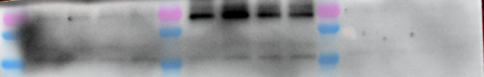
Figure 1C
MCL1 (4sec)
Ref. D2W9E, CellSignaling
Bim (1min)
Ref. AB17003, Sigma
Input
IP MCL1
FT IP MCL1
Input
IP MCL1
FT IP MCL1
A13 0h 1h 2h 3h 0h 1h 2h 3h 0h 1h 2h 3h
A13 0h 1h 2h 3h 0h 1h 2h 3h 0h 1h 2h 3h
Bim (1min30sec)
Ref. AB17003, Sigma
Input
IP MCL1
FT IP MCL1
A13 0h 1h 2h 3h 0h 1h 2h 3h 0h 1h 2h 3h

