Slide 1
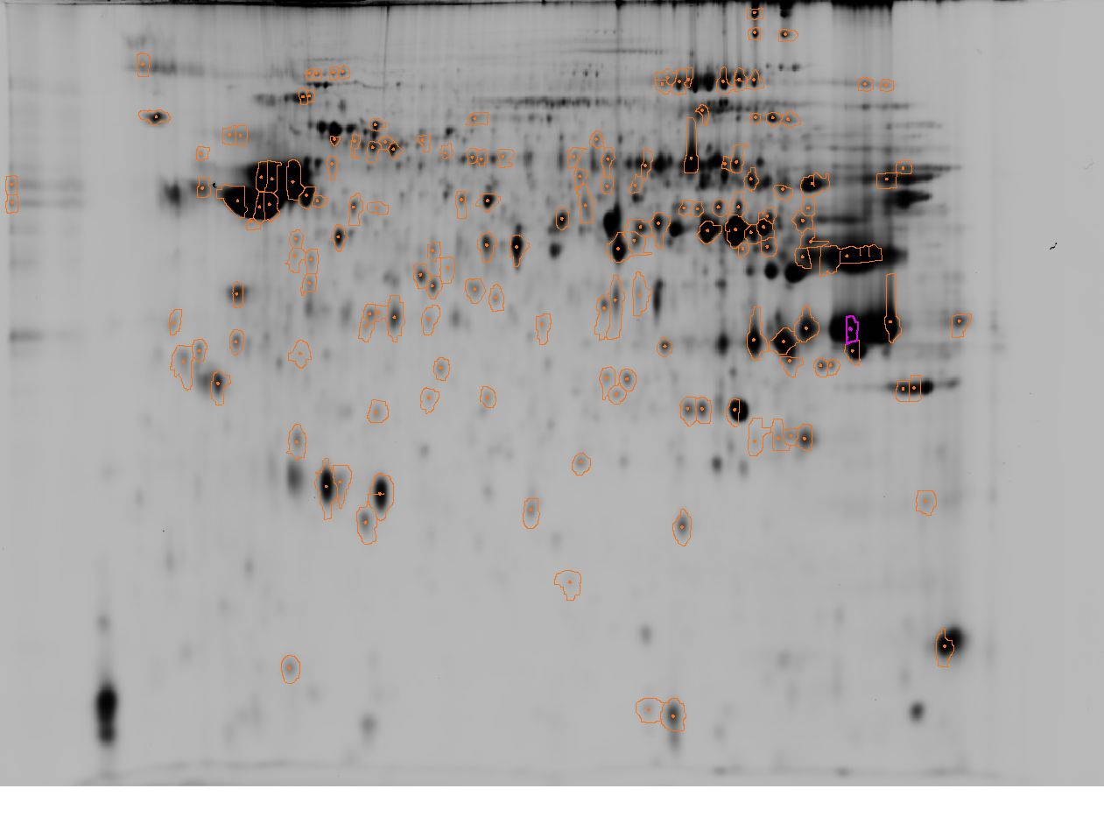
A) Spermatozoa cryopreserved with MeOH
3
pI
10
42
187
193
378
435
432
408
2441
2461
439
425
403
473
465
591
430
440
434
792
793
584
721
673
602
639
640
641
676
2438
820
836
884
885
767
894
1065
842
854
860
911
869
872
908
909
956
1021
944
1077
859
878
921
923
1004
1056
2458
1015
1076
2447
938
1122
983
1047
1010
1149
1105
1153
1176
1053
1137
1130
1138
1196
1156
MW
1183
1190
1175
1135
1206
1127
1201
1243
1197
1314
1358
2455
1209
1263
1240
1304
2462
1309
2449
1236
2450
1323
1387
1405
1429
1359
1301
1280
1516
1446
1507
1518
1344
1367
1622
1474
1588
1492
1537
1607
1503
1684
1687
1638
2466
1690
1734
1581
1620
2457
1545
1639
1617
1715
1636
1691
2451
1783
1804
1755
1765
1752
1815
1802
1872
1884
1764
1841
1843
1899
1860
1857
1853
1879
1945
1949
1968
1958
2444
2442
2005
2460
2454
2087
2077
2101
2117
2176
2272
2250
2320
2329
Supplementary Figure S1. Fluorescent two-dimensional difference gel electrophoresis (2D-DIGE) of Siberian sturgeon spermatozoa after cryopreservation with MeOH (A) compared to fresh spermatozoa (B) with overlay of Cy3 and Cy5 channel images (C). Numbers indicate spots with significantly different abundances following cryopreservation. The selected spots were picked from the gel, digested and identified using mass spectrometry (MALDI-TOF). The results of spot identification are presented in Supplementary Table S4.

Slide 2
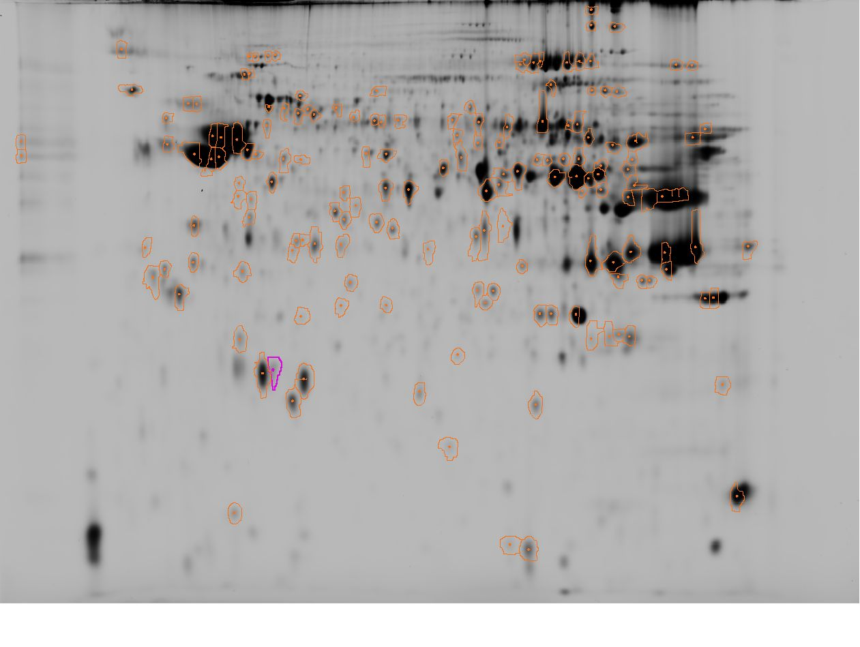
B) Fresh spermatozoa
3
pI
10
42
187
193
378
435
439
432
408
403
2441
2461
473
465
425
434
591
673
430
440
639
640
641
792
793
584
721
836
602
676
2438
842
820
884
911
885
767
894
1065
854
860
869
872
908
909
956
1015
1021
944
1077
859
878
921
923
1004
1056
2458
1076
2447
938
1122
983
1047
1010
1149
1153
1176
1053
1137
1130
1138
1196
1156
1105
1183
1190
1175
1135
1206
1127
1201
MW
1243
1197
1314
1358
2455
1209
1263
1240
1304
2462
1309
2449
1236
2450
1323
1387
1405
1429
1359
1301
1280
1516
1446
1507
1518
1344
1367
1622
1474
1588
1492
1537
1607
1503
1684
1687
1638
2466
1690
1734
1581
1620
2457
1545
1639
1617
1715
1636
1691
2451
1783
1804
1755
1765
1752
1815
1802
1872
1884
1764
1841
1843
1899
1860
1857
1853
1945
1949
1879
1968
1958
2444
2442
2005
2460
2454
2087
2077
2101
2117
2176
2272
2250
2320
2329
Supplementary Figure S1. Fluorescent two-dimensional difference gel electrophoresis (2D-DIGE) of Siberian sturgeon spermatozoa after cryopreservation with MeOH (A) compared to fresh spermatozoa (B) with overlay of Cy3 and Cy5 channel images (C). Numbers indicate spots with significantly different abundances following cryopreservation. The selected spots were picked from the gel, digested and identified using mass spectrometry (MALDI-TOF). The results of spot identification are presented in Supplementary Table S4.

Slide 3
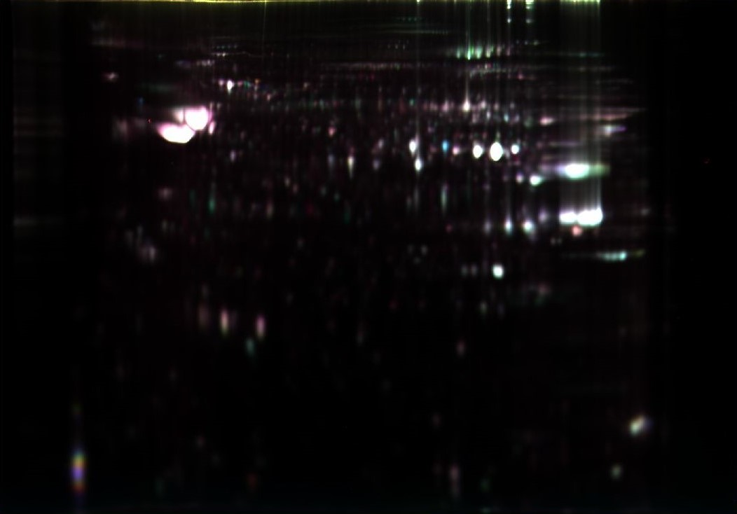
3
pI
10
C)
Overlay of cryopreserved and fresh spermatozoa
MW
Supplementary Figure S1. Fluorescent two-dimensional difference gel electrophoresis (2D-DIGE) of Siberian sturgeon spermatozoa after cryopreservation with MeOH (A) compared to fresh spermatozoa (B) with overlay of Cy3 and Cy5 channel images (C). Numbers indicate spots with significantly different abundances following cryopreservation. The selected spots were picked from the gel, digested and identified using mass spectrometry (MALDI-TOF). The results of spot identification are presented in Supplementary Table S4.

