Slide 1
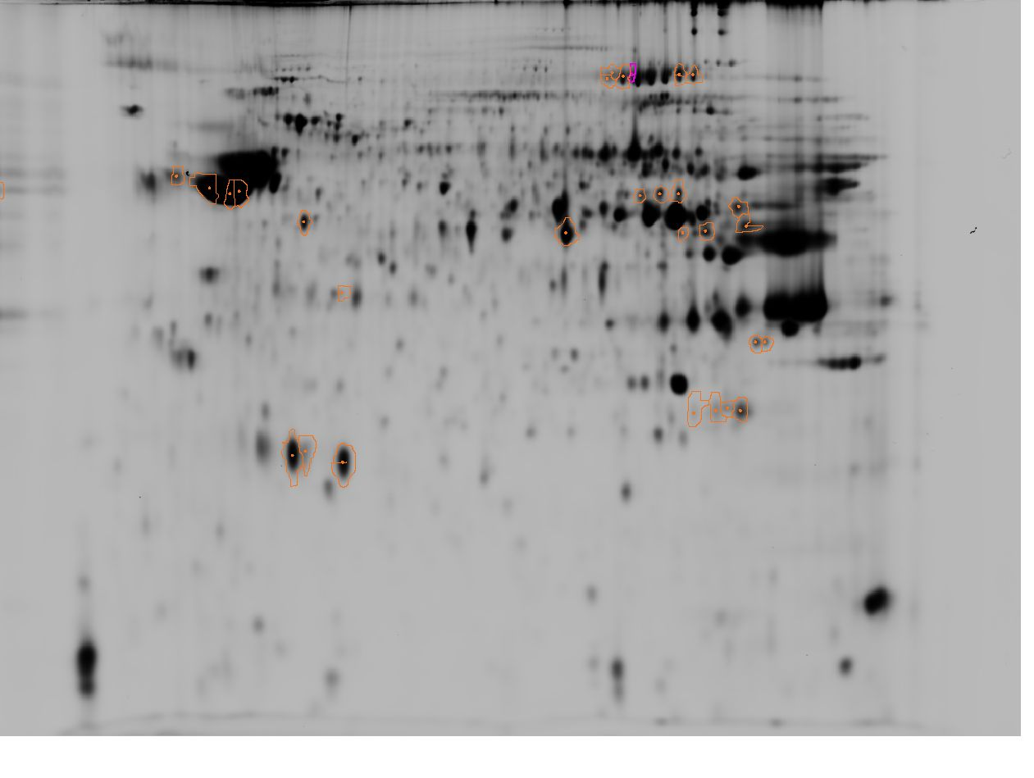
A) Spermatozoa cryopreserved with MeOH
3
pI
10
408
403
2461
440
434
430
1076
1105
1149
1130
1138
1201
1183
1197
1190
1309
1323
1304
1359
1344
Mw
1581
1764
1765
1945
1958
2454
1968
2444
2442
2460
Supplementary Figure S3. Fluorescent two-dimensional difference gel electrophoresis (2D-DIGE) of Siberian sturgeon spermatozoa after cryopreservation with MeOH (A) and DMSO (B) with the selected spots identified as both up and down-regulated due to cryopreservation. The results of spot identification are presented in Supplementary Table S4.

Slide 2
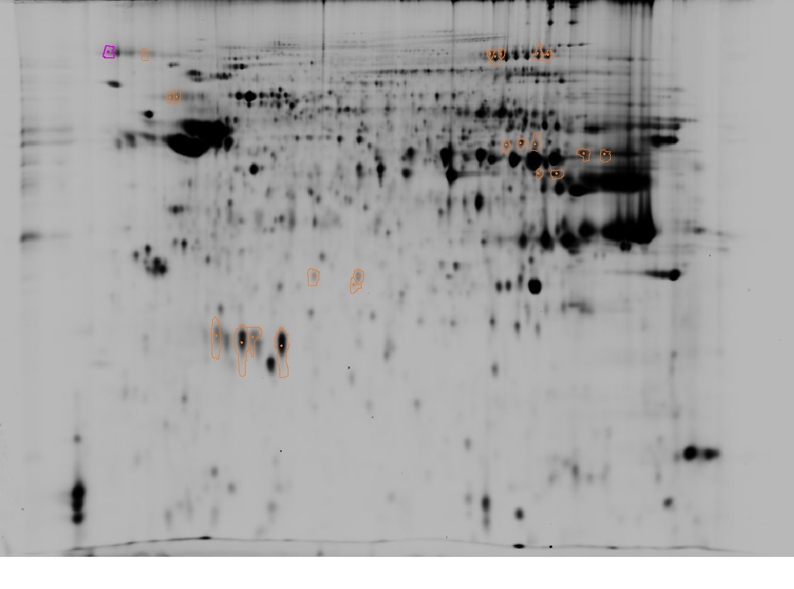
3
pI
10
A) Spermatozoa cryopreserved with DMSO
378
395
408
403
2461
440
434
792
793
1149
1130
1138
1201
1210
1323
1344
Mw
1860
1857
1888
2453
2454
2444
2442
Supplementary Figure S3. Fluorescent two-dimensional difference gel electrophoresis (2D-DIGE) of Siberian sturgeon spermatozoa after cryopreservation with MeOH (A) and DMSO (B) with the selected spots identified as both up and down-regulated due to cryopreservation. The results of spot identification are presented in Supplementary Table S4.

