Slide 1
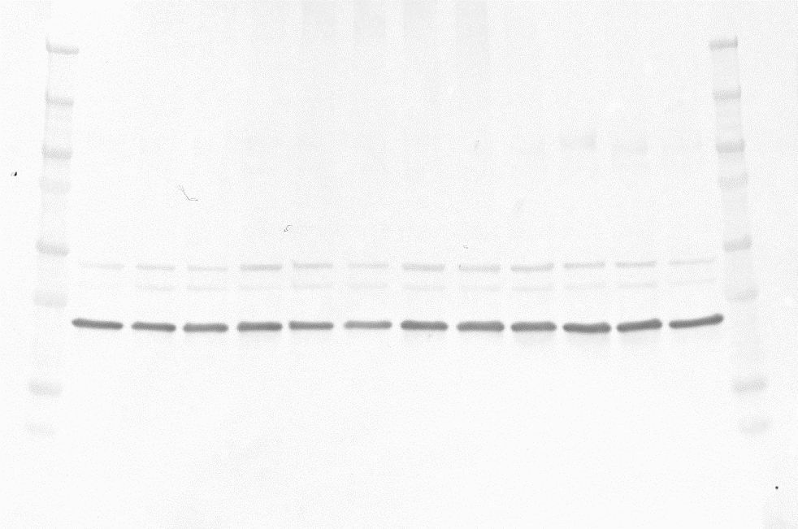
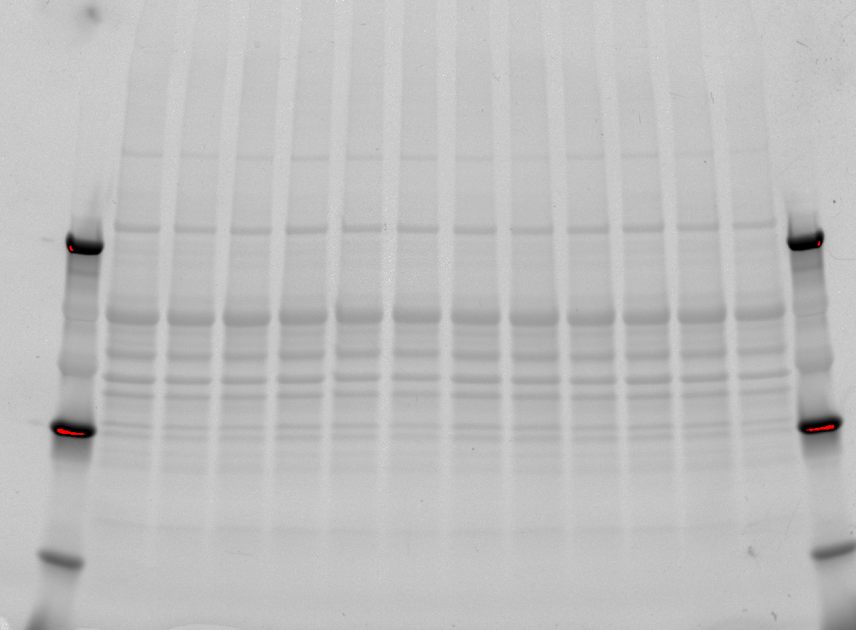
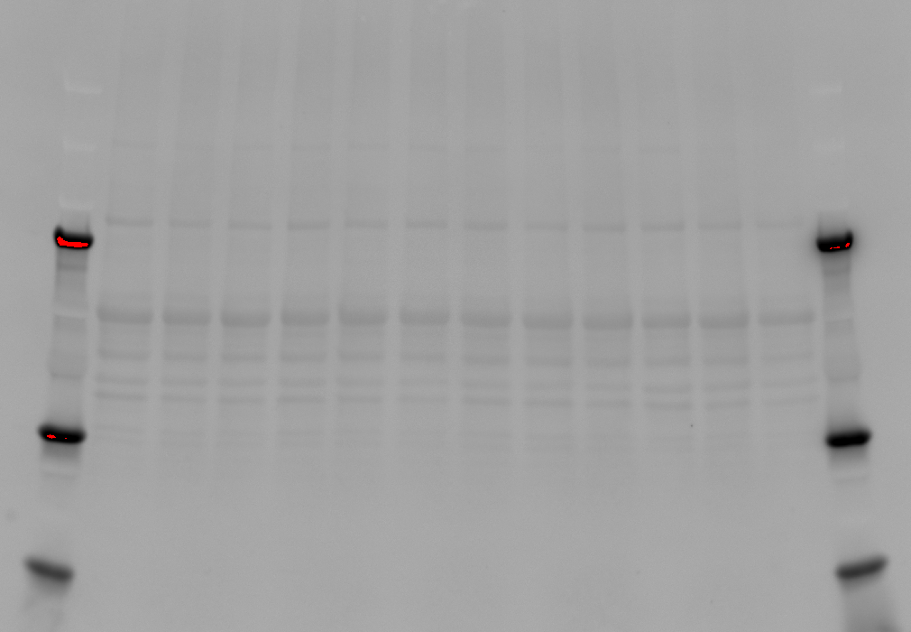
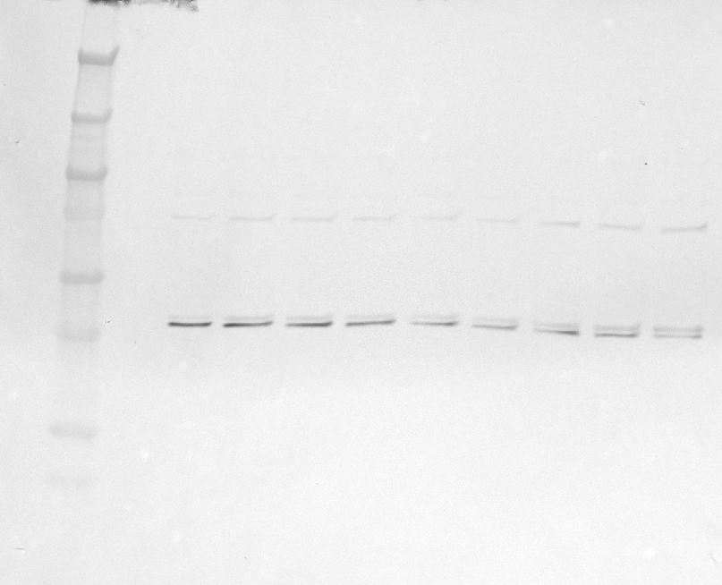
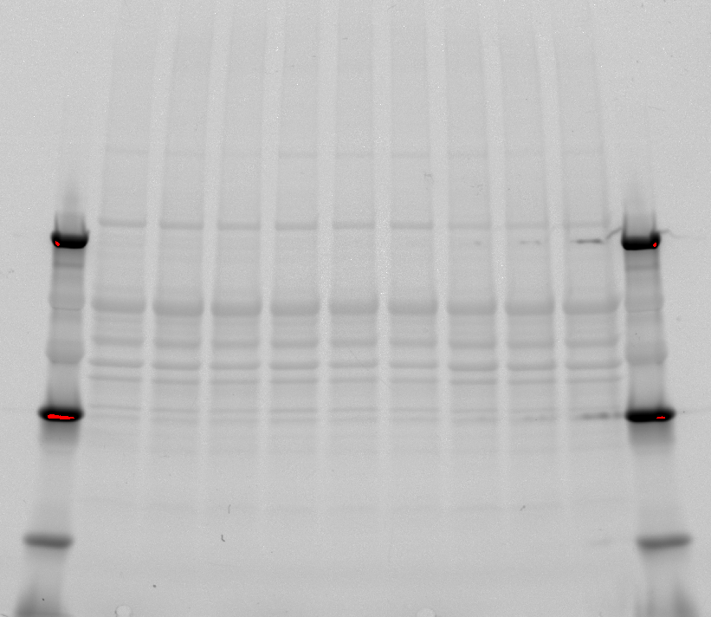
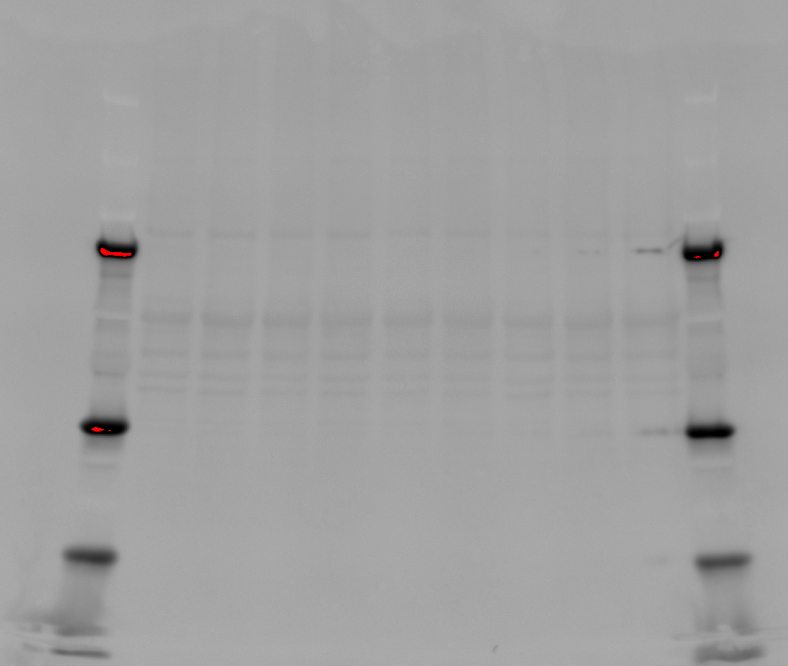
Fresh_2
DMSO_2
MeOH_2
Fresh_3
DMSO_3
MeOH_3
Fresh_4
DMSO_4
MeOH_4
Fresh_5
DMSO_5
MeOH_5
Fresh_2
DMSO_2
MeOH_2
Fresh_3
DMSO_3
MeOH_3
Fresh_4
DMSO_4
MeOH_4
Fresh_5
DMSO_5
MeOH_5
Fresh_2
DMSO_2
MeOH_2
Fresh_3
DMSO_3
MeOH_3
Fresh_4
DMSO_4
MeOH_4
Fresh_5
DMSO_5
MeOH_5
A) LDHA
Fresh_6
DMSO_6
MeOH_6
Fresh_7
DMSO_7
MeOH_7
Fresh_8
DMSO_8
MeOH_8
Fresh_6
DMSO_6
MeOH_6
Fresh_7
DMSO_7
MeOH_7
Fresh_8
DMSO_8
MeOH_8
Fresh_6
DMSO_6
MeOH_6
Fresh_7
DMSO_7
MeOH_7
Fresh_8
DMSO_8
MeOH_8
Supplemntary Fig S7. Immunoblotting validation of L-lactate dehydrogenase (LDH) of fresh and cryopreserved spermatozoa with DMSO and MeOH (left panel). The images of the gels after SDS-PAGE electrophoresis (middle panel) and membranes after transfer and before incubation with primary antibodies (right panel) are provided to check the quality of the spermatozoa samples separations and as a control for equal protein loading among samples. Blue frames indicate which parts of the blots were presented as Fig 12.

Slide 2
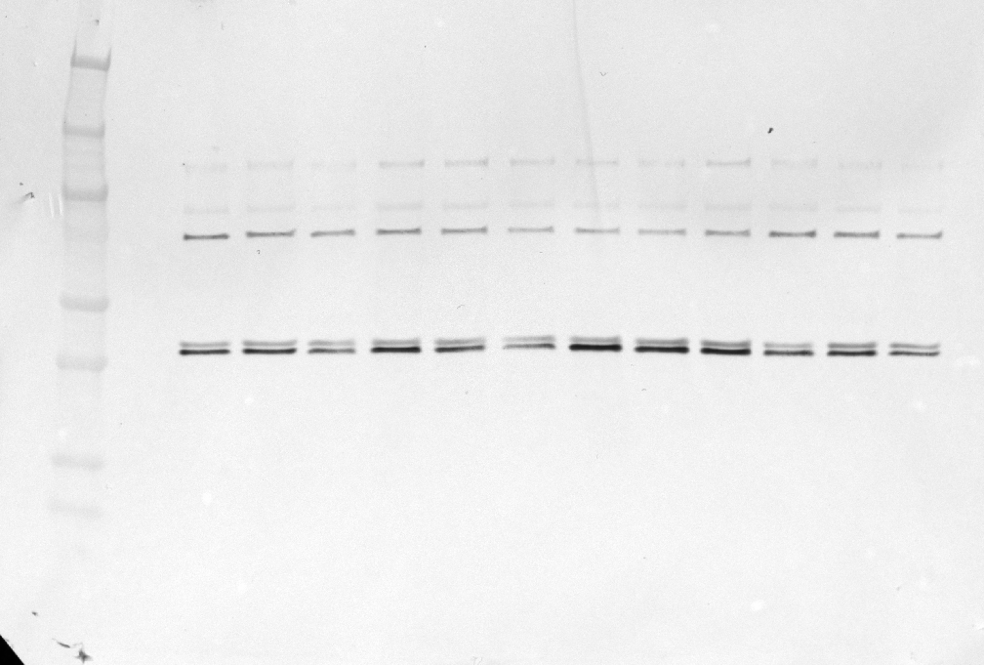
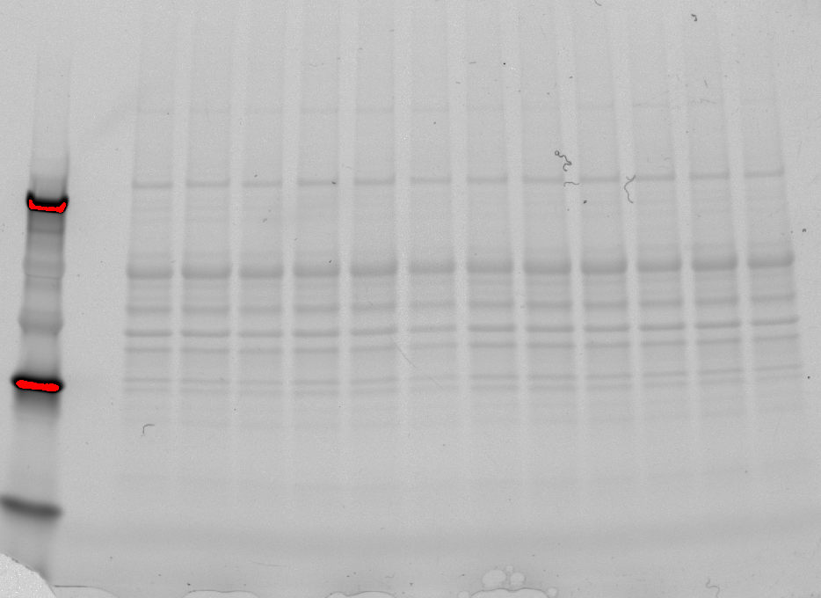
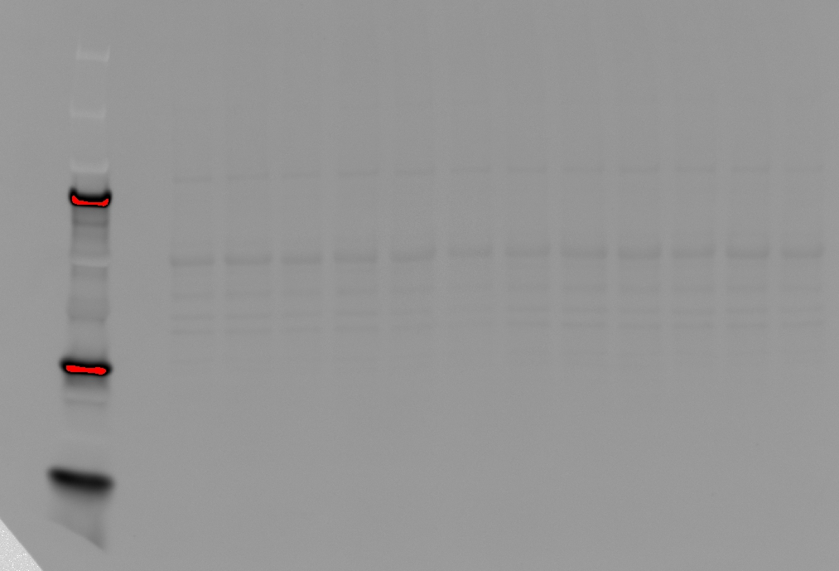
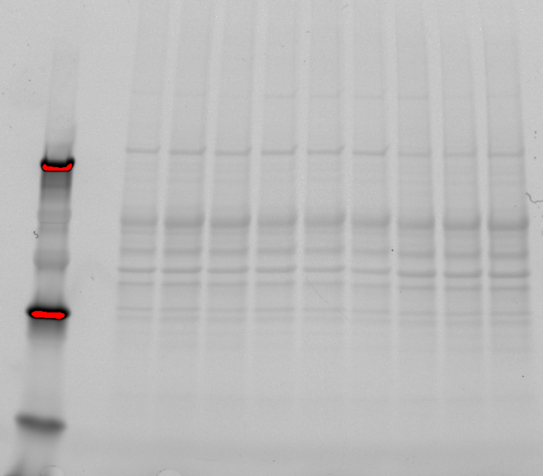
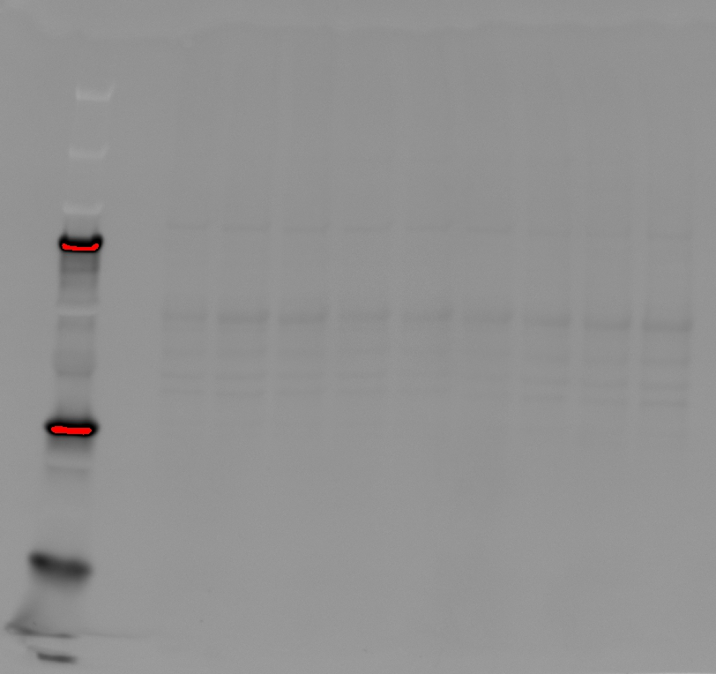
Fresh_2
DMSO_2
MeOH_2
Fresh_3
DMSO_3
MeOH_3
Fresh_4
DMSO_4
MeOH_4
Fresh_5
DMSO_5
MeOH_5
Fresh_2
DMSO_2
MeOH_2
Fresh_3
DMSO_3
MeOH_3
Fresh_4
DMSO_4
MeOH_4
Fresh_5
DMSO_5
MeOH_5
Fresh_2
DMSO_2
MeOH_2
Fresh_3
DMSO_3
MeOH_3
Fresh_4
DMSO_4
MeOH_4
Fresh_5
DMSO_5
MeOH_5
B) CKB
Fresh_6
DMSO_6
MeOH_6
Fresh_7
DMSO_7
MeOH_7
Fresh_8
DMSO_8
MeOH_8
Fresh_6
DMSO_6
MeOH_6
Fresh_7
DMSO_7
MeOH_7
Fresh_8
DMSO_8
MeOH_8
Fresh_6
DMSO_6
MeOH_6
Fresh_7
DMSO_7
MeOH_7
Fresh_8
DMSO_8
MeOH_8
Supplemntary Fig S7. Immunoblotting validation of creatine kinase type B (CKB) of fresh and cryopreserved spermatozoa with DMSO and MeOH (left panel). The images of the gels after SDS-PAGE electrophoresis (middle panel) and membranes after transfer and before incubation with primary antibodies (right panel) are provided to check the quality of the spermatozoa samples separations and as a control for equal protein loading among samples. Blue frames indicate which parts of the blots were presented as Fig. 12.

Slide 3
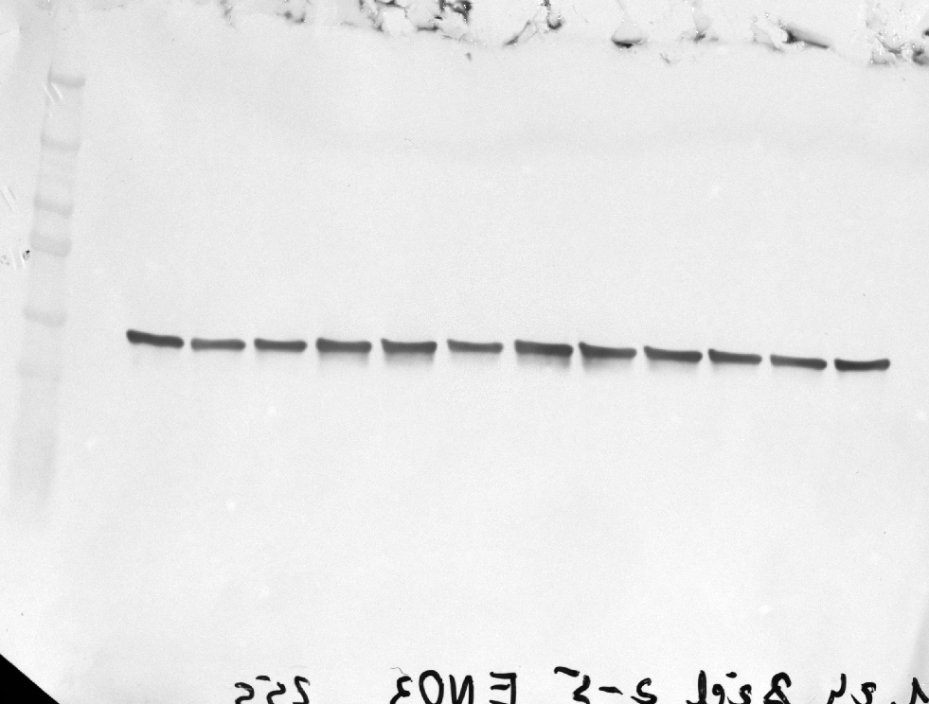
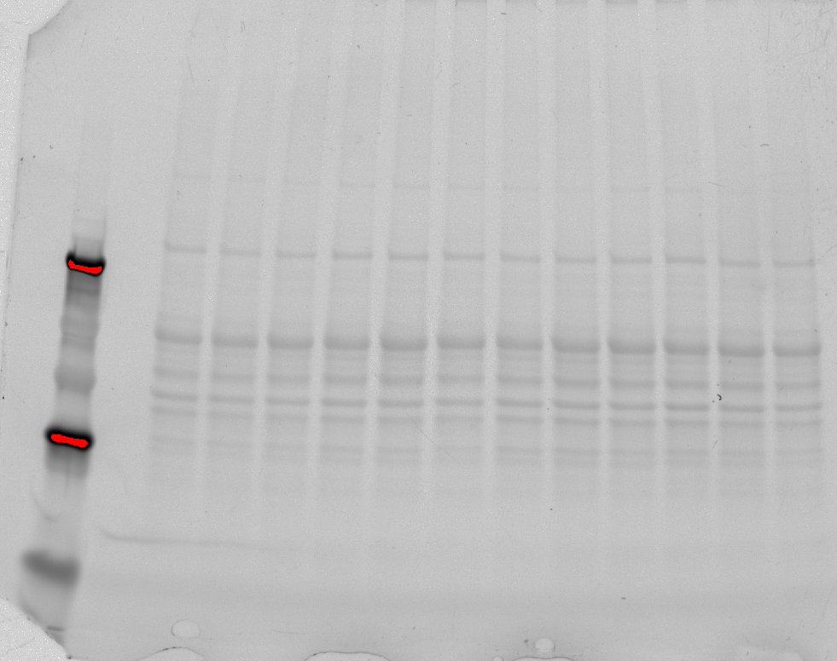
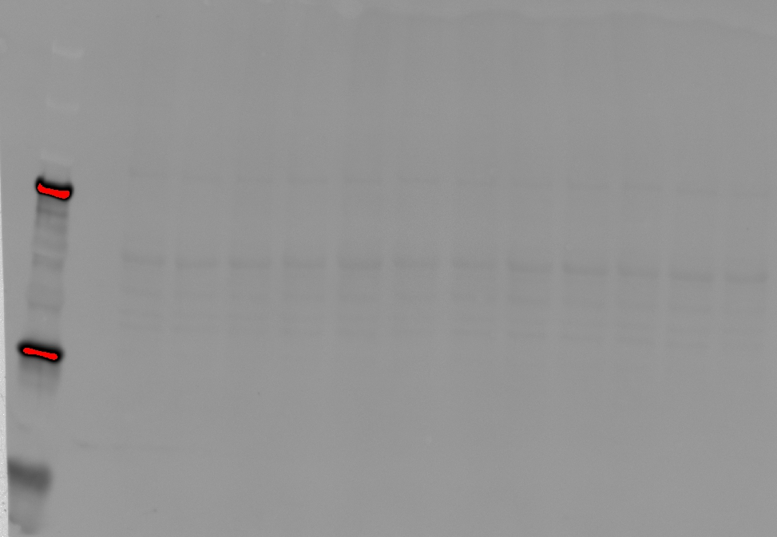
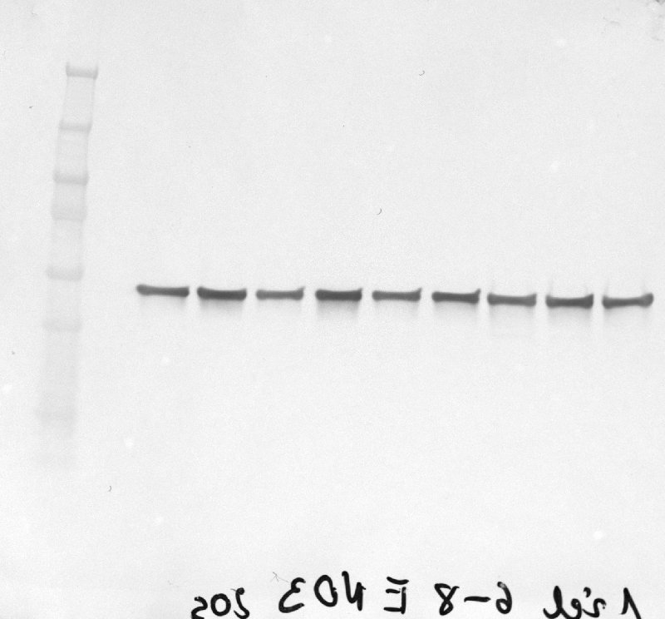
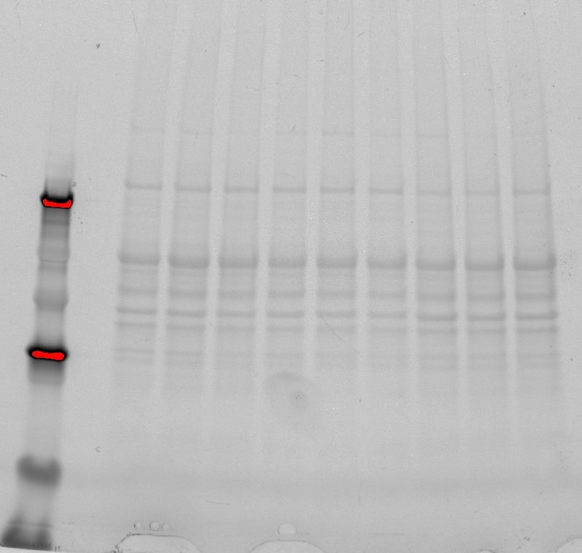
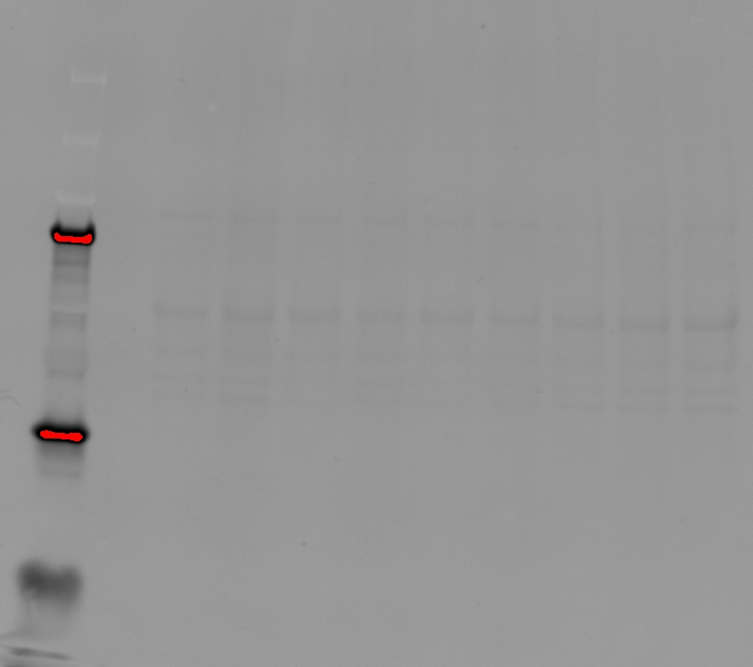
C) ENO3
Fresh_2
DMSO_2
MeOH_2
Fresh_3
DMSO_3
MeOH_3
Fresh_4
DMSO_4
MeOH_4
Fresh_5
DMSO_5
MeOH_5
Fresh_2
DMSO_2
MeOH_2
Fresh_3
DMSO_3
MeOH_3
Fresh_4
DMSO_4
MeOH_4
Fresh_5
DMSO_5
MeOH_5
Fresh_2
DMSO_2
MeOH_2
Fresh_3
DMSO_3
MeOH_3
Fresh_4
DMSO_4
MeOH_4
Fresh_5
DMSO_5
MeOH_5
Fresh_6
DMSO_6
MeOH_6
Fresh_7
DMSO_7
MeOH_7
Fresh_8
DMSO_8
MeOH_8
Fresh_6
DMSO_6
MeOH_6
Fresh_7
DMSO_7
MeOH_7
Fresh_8
DMSO_8
MeOH_8
Fresh_6
DMSO_6
MeOH_6
Fresh_7
DMSO_7
MeOH_7
Fresh_8
DMSO_8
MeOH_8
Supplemntary Fig S7. Immunoblotting validation of enolase 3 (ENO3) of fresh and cryopreserved spermatozoa with DMSO and MeOH (left panel). The images of the gels after SDS-PAGE electrophoresis (middle panel) and membranes after transfer and before incubation with primary antibodies (right panel) are provided to check the quality of the spermatozoa samples separations and as a control for equal protein loading among samples. Blue frames indicate which parts of the blots were presented as Fig

Slide 4
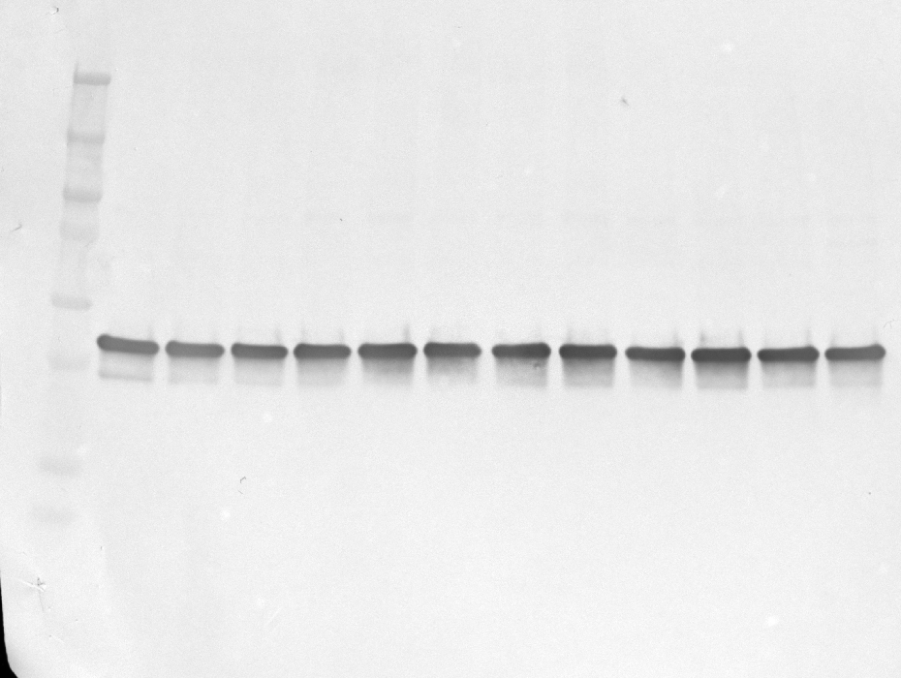
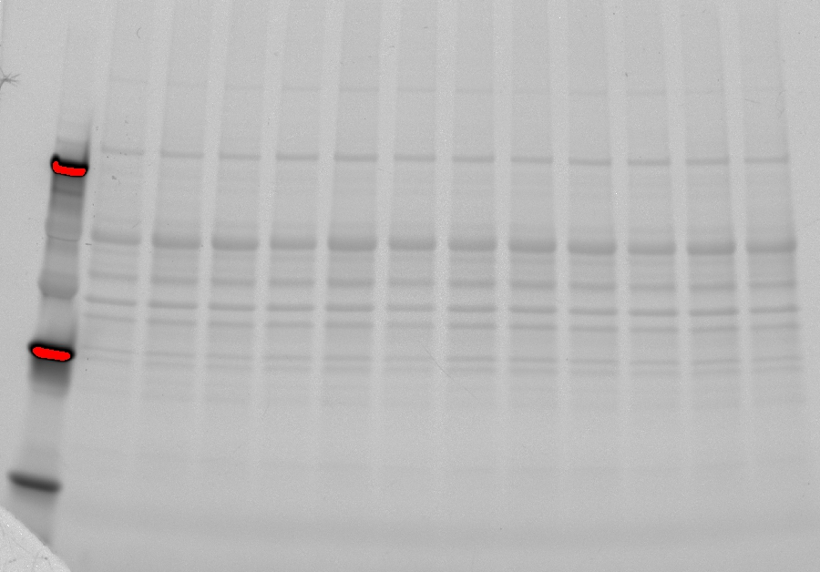
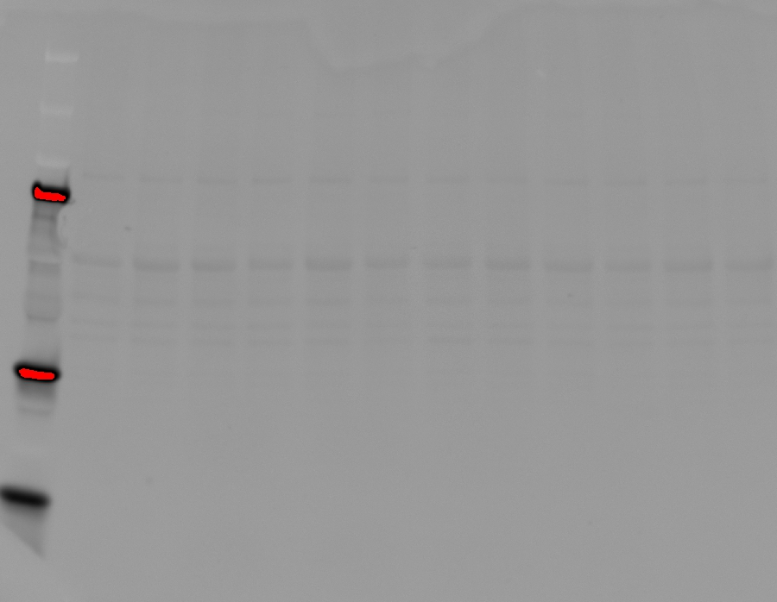
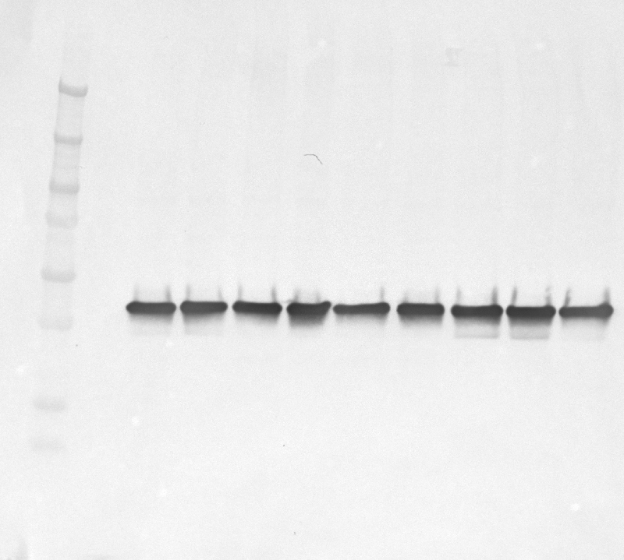
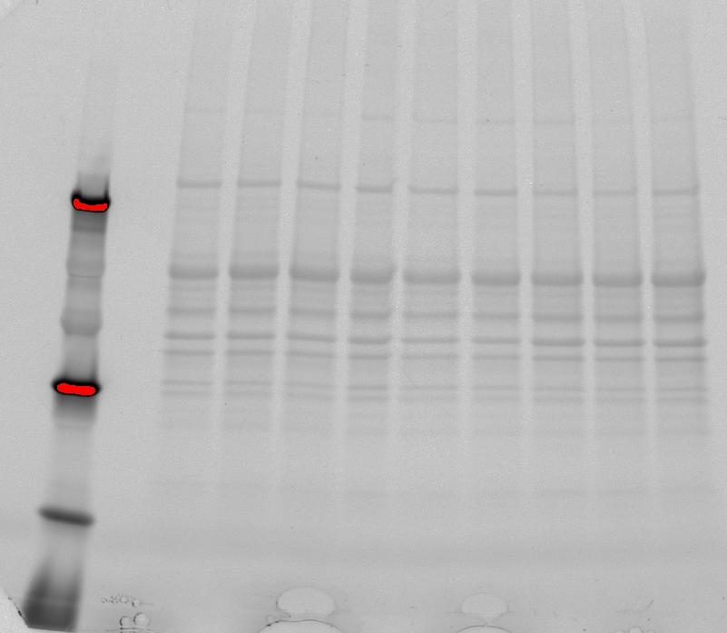
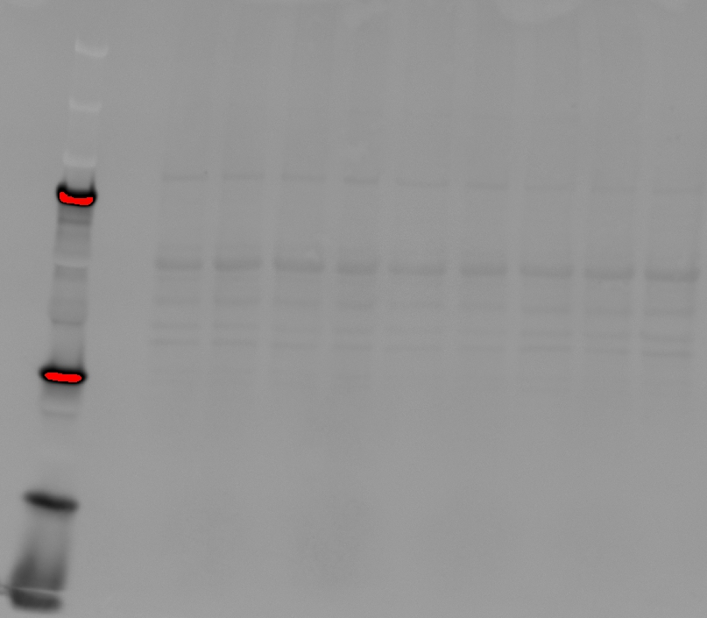
D) ALDOA
Fresh_2
DMSO_2
MeOH_2
Fresh_3
DMSO_3
MeOH_3
Fresh_4
DMSO_4
MeOH_4
Fresh_5
DMSO_5
MeOH_5
Fresh_2
DMSO_2
MeOH_2
Fresh_3
DMSO_3
MeOH_3
Fresh_4
DMSO_4
MeOH_4
Fresh_5
DMSO_5
MeOH_5
Fresh_2
DMSO_2
MeOH_2
Fresh_3
DMSO_3
MeOH_3
Fresh_4
DMSO_4
MeOH_4
Fresh_5
DMSO_5
MeOH_5
Fresh_6
DMSO_6
MeOH_6
Fresh_7
DMSO_7
MeOH_7
Fresh_8
DMSO_8
MeOH_8
Fresh_6
DMSO_6
MeOH_6
Fresh_7
DMSO_7
MeOH_7
Fresh_8
DMSO_8
MeOH_8
Fresh_6
DMSO_6
MeOH_6
Fresh_7
DMSO_7
MeOH_7
Fresh_8
DMSO_8
MeOH_8
Supplemntary Fig S7. Immunoblotting validation of aldolase A (ALDOA) of fresh and cryopreserved spermatozoa with DMSO and MeOH (left panel). The images of the gels after SDS-PAGE electrophoresis (middle panel) and membranes after transfer and before incubation with primary antibodies (right panel) are provided to check the quality of the spermatozoa samples separations and as a control for equal protein loading among samples. Blue frames indicate which parts of the blots were presented as Fig. 12.

Slide 5
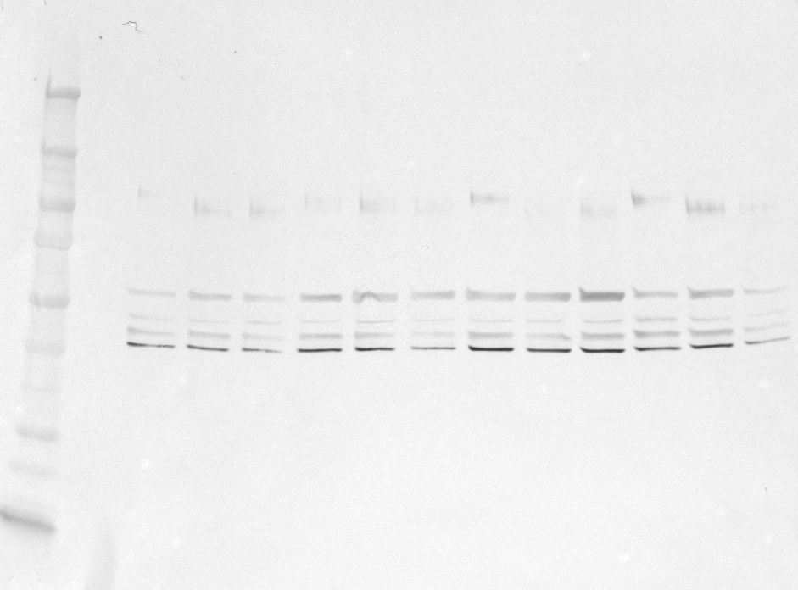
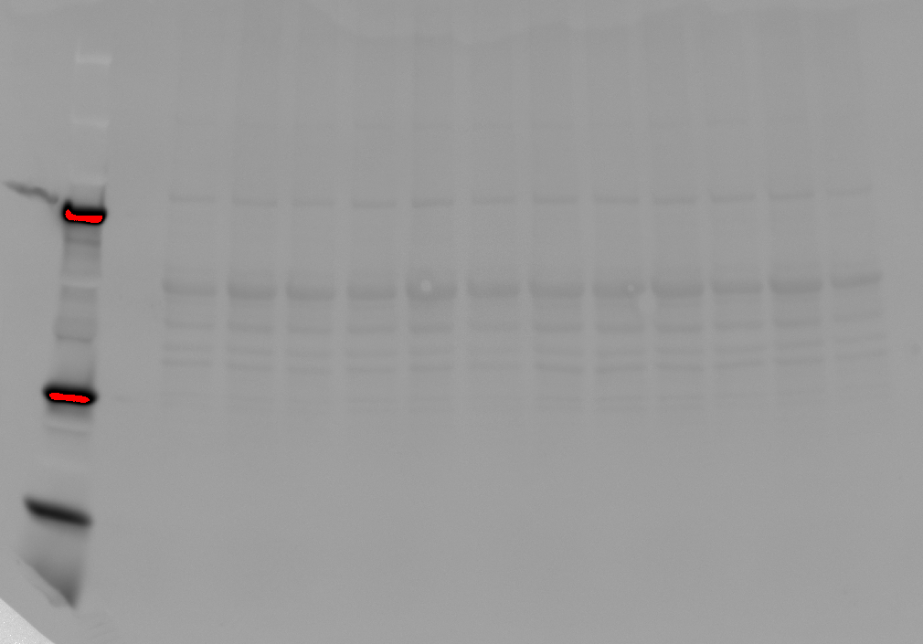
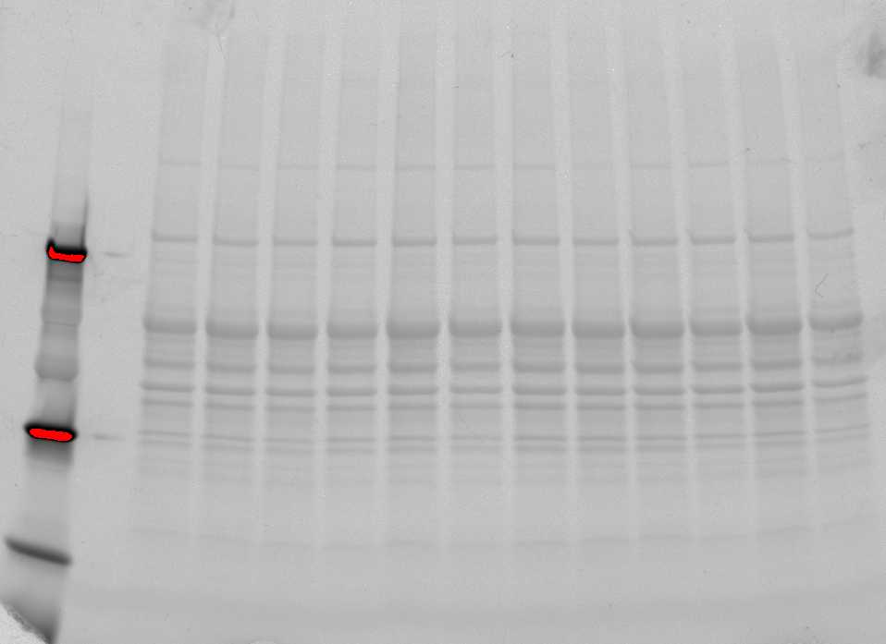
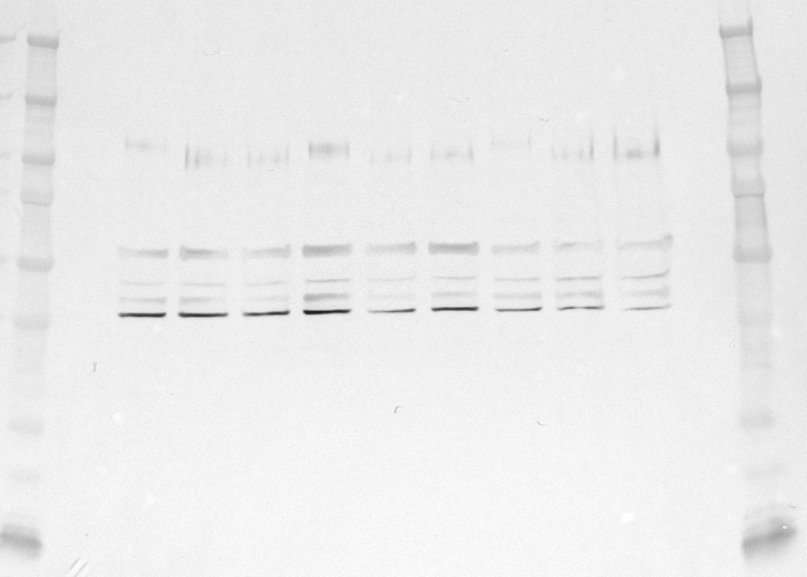
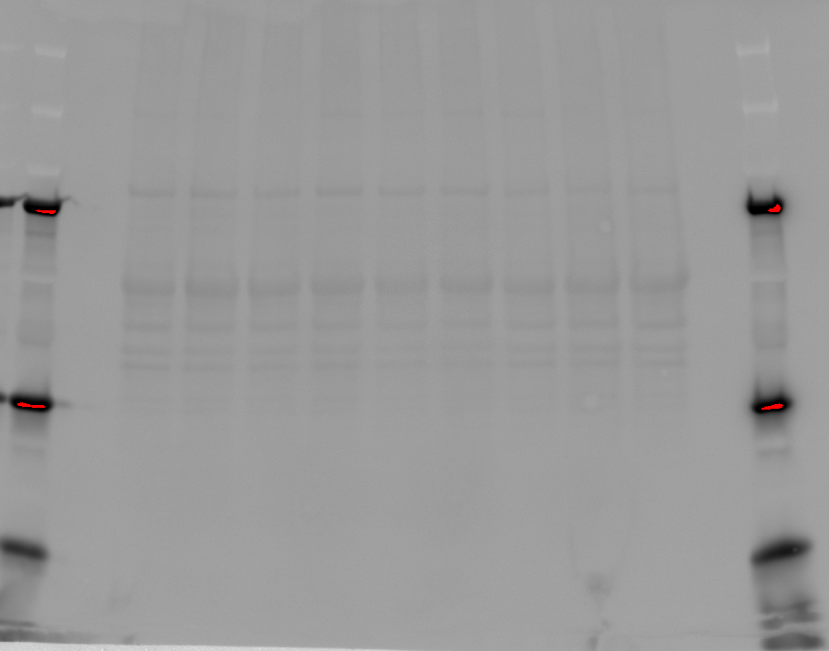
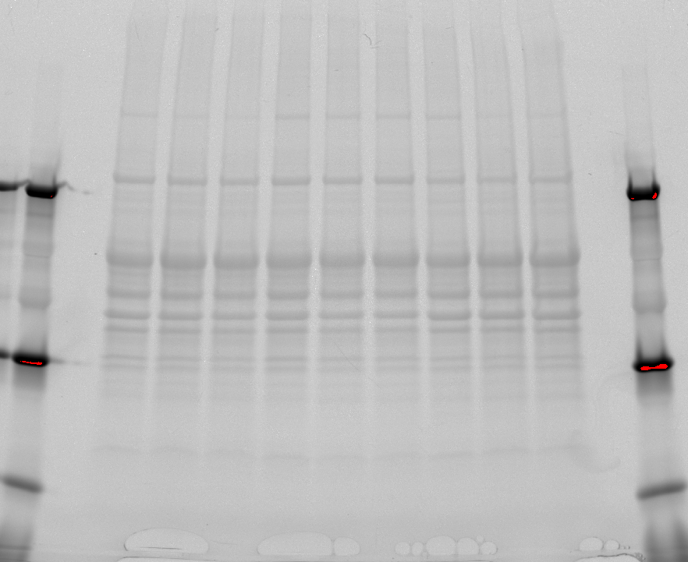
E) H2A.Z
Fresh_2
DMSO_2
MeOH_2
Fresh_3
DMSO_3
MeOH_3
Fresh_4
DMSO_4
MeOH_4
Fresh_5
DMSO_5
MeOH_5
Fresh_2
DMSO_2
MeOH_2
Fresh_3
DMSO_3
MeOH_3
Fresh_4
DMSO_4
MeOH_4
Fresh_5
DMSO_5
MeOH_5
Fresh_2
DMSO_2
MeOH_2
Fresh_3
DMSO_3
MeOH_3
Fresh_4
DMSO_4
MeOH_4
Fresh_5
DMSO_5
MeOH_5
Fresh_6
DMSO_6
MeOH_6
Fresh_7
DMSO_7
MeOH_7
Fresh_8
DMSO_8
MeOH_8
Fresh_6
DMSO_6
MeOH_6
Fresh_7
DMSO_7
MeOH_7
Fresh_8
DMSO_8
MeOH_8
Fresh_6
DMSO_6
MeOH_6
Fresh_7
DMSO_7
MeOH_7
Fresh_8
DMSO_8
MeOH_8
Supplemntary Fig S7. Immunoblotting validation of histone 2A.Z (H2A.Z) of fresh and cryopreserved spermatozoa with DMSO and MeOH (left panel). The images of the gels after SDS-PAGE electrophoresis (middle panel) and membranes after transfer and before incubation with primary antibodies (right panel) are provided to check the quality of the spermatozoa samples separations and as a control for equal protein loading among samples. Blue frames indicate which parts of the blots were presented as Fig. 12.

Slide 6
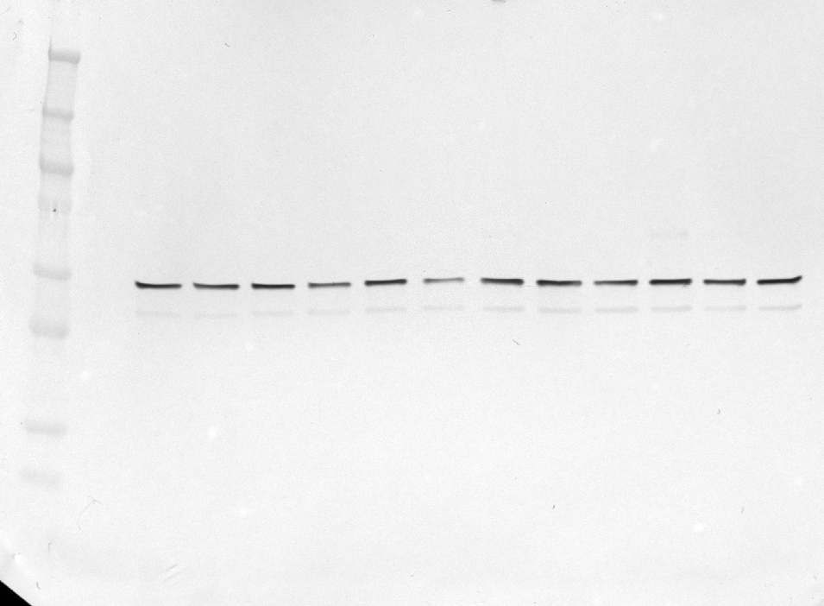
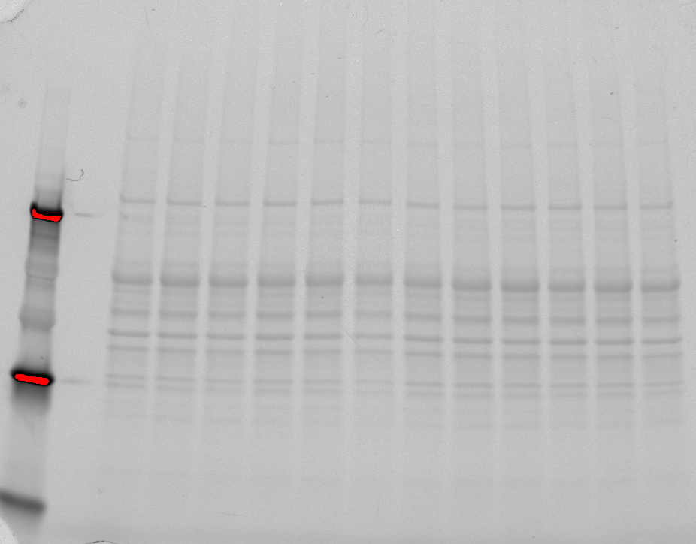
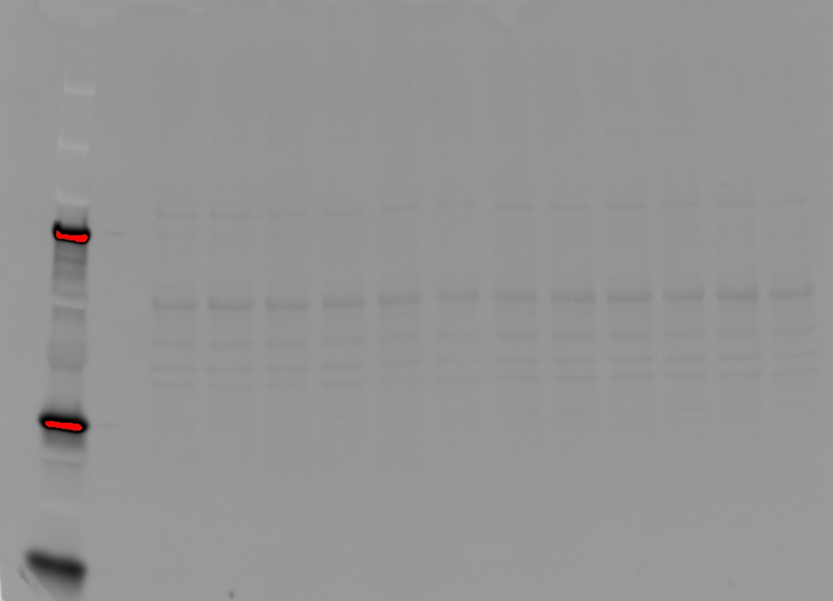
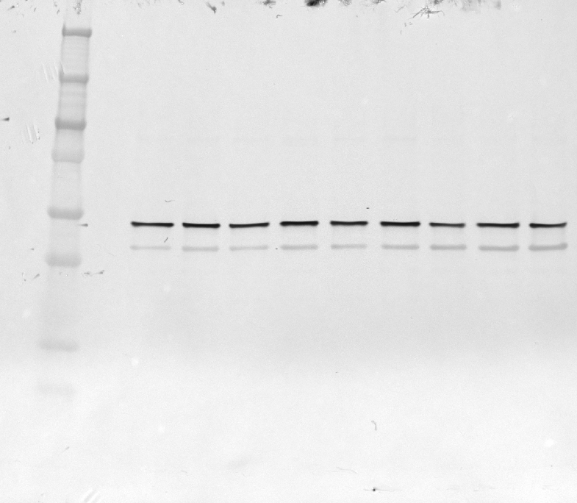
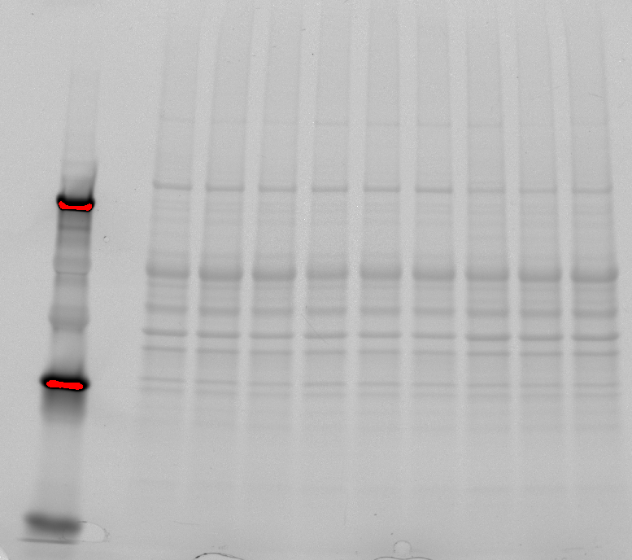
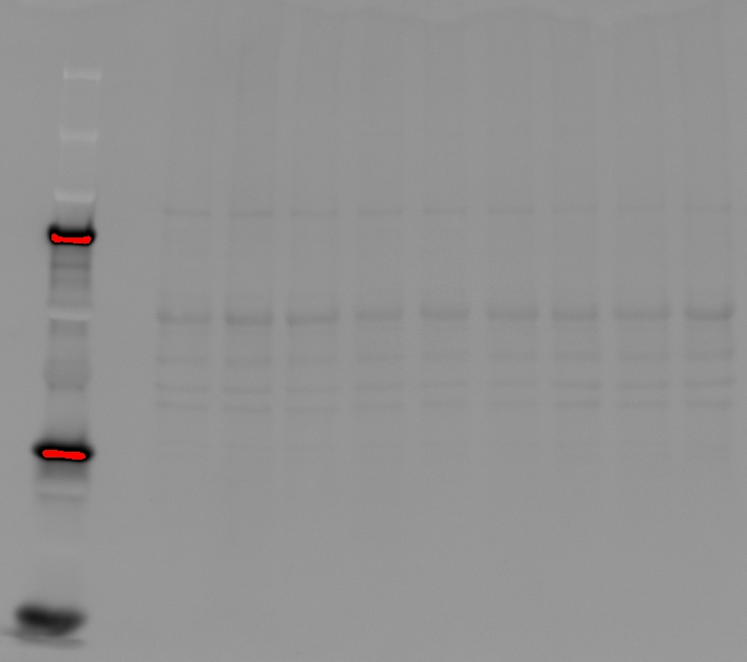
Fresh_2
DMSO_2
MeOH_2
Fresh_3
DMSO_3
MeOH_3
Fresh_4
DMSO_4
MeOH_4
Fresh_5
DMSO_5
MeOH_5
Fresh_2
DMSO_2
MeOH_2
Fresh_3
DMSO_3
MeOH_3
Fresh_4
DMSO_4
MeOH_4
Fresh_5
DMSO_5
MeOH_5
Fresh_2
DMSO_2
MeOH_2
Fresh_3
DMSO_3
MeOH_3
Fresh_4
DMSO_4
MeOH_4
Fresh_5
DMSO_5
MeOH_5
F) FH
Fresh_6
DMSO_6
MeOH_6
Fresh_7
DMSO_7
MeOH_7
Fresh_8
DMSO_8
MeOH_8
Fresh_6
DMSO_6
MeOH_6
Fresh_7
DMSO_7
MeOH_7
Fresh_8
DMSO_8
MeOH_8
Fresh_6
DMSO_6
MeOH_6
Fresh_7
DMSO_7
MeOH_7
Fresh_8
DMSO_8
MeOH_8
Supplemntary Fig S7. Immunoblotting validation of fumarate hydratase (FH) of fresh and cryopreserved spermatozoa with DMSO and MeOH (left panel). The images of the gels after SDS-PAGE electrophoresis (middle panel) and membranes after transfer and before incubation with primary antibodies (right panel) are provided to check the quality of the spermatozoa samples separations and as a control for equal protein loading among samples. Blue frames indicate which parts of the blots were presented as Fig. 12.

Slide 7
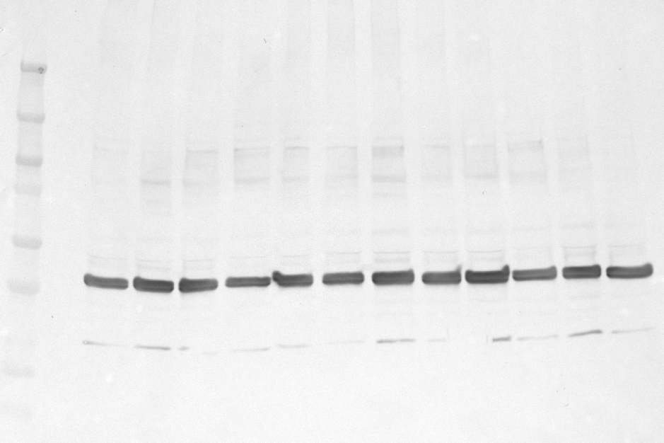
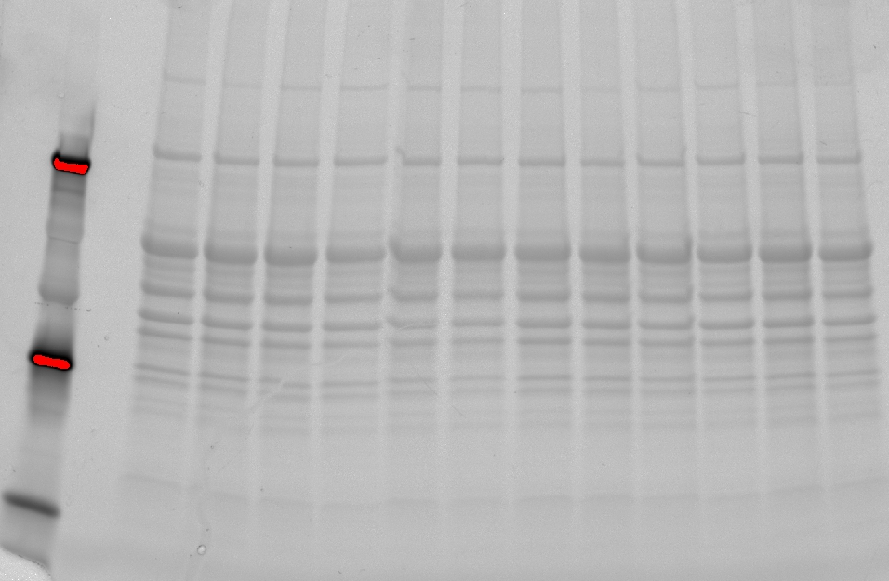
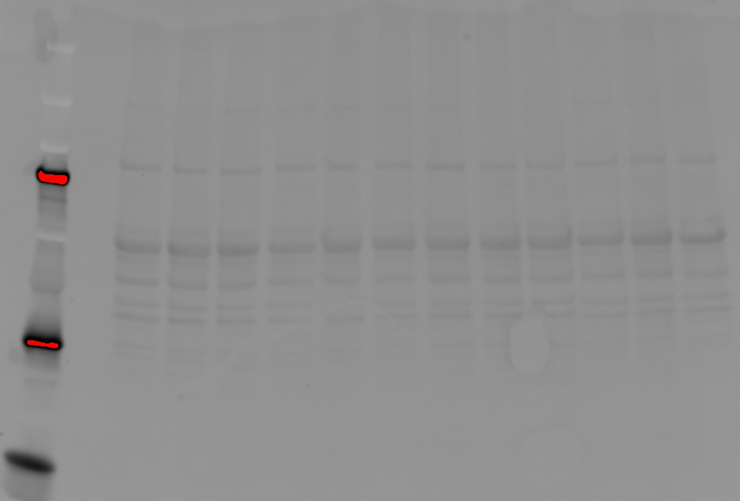
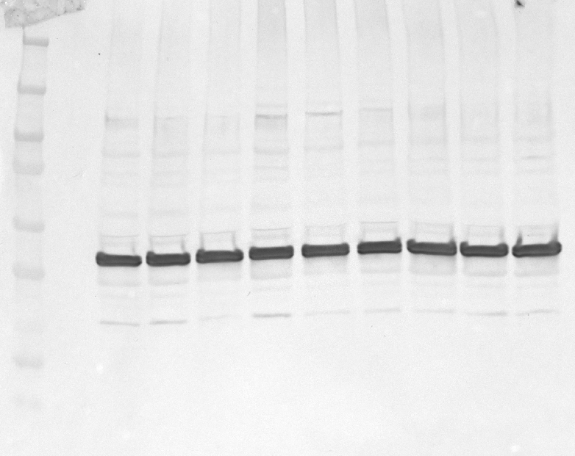
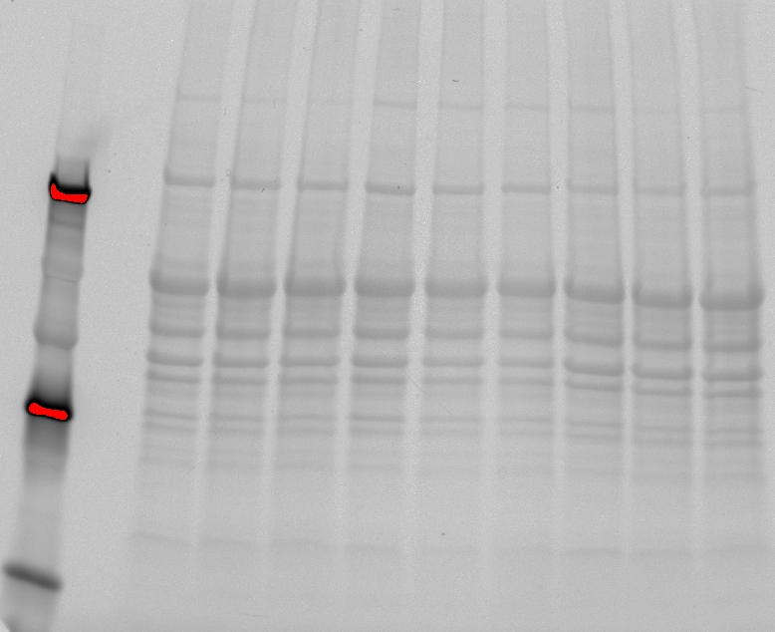
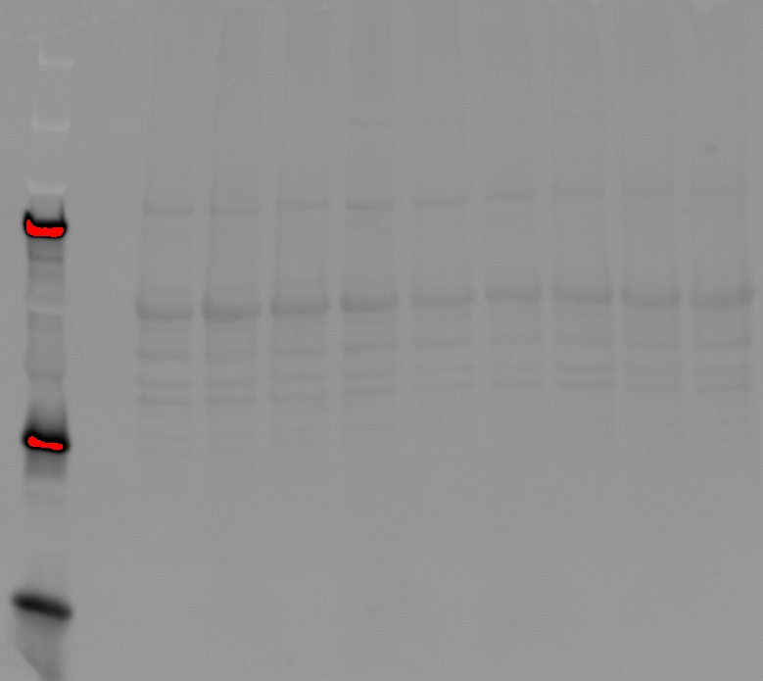
Fresh_2
DMSO_2
MeOH_2
Fresh_3
DMSO_3
MeOH_3
Fresh_4
DMSO_4
MeOH_4
Fresh_5
DMSO_5
MeOH_5
Fresh_2
DMSO_2
MeOH_2
Fresh_3
DMSO_3
MeOH_3
Fresh_4
DMSO_4
MeOH_4
Fresh_5
DMSO_5
MeOH_5
Fresh_2
DMSO_2
MeOH_2
Fresh_3
DMSO_3
MeOH_3
Fresh_4
DMSO_4
MeOH_4
Fresh_5
DMSO_5
MeOH_5
H) ACR
Fresh_6
DMSO_6
MeOH_6
Fresh_7
DMSO_7
MeOH_7
Fresh_8
DMSO_8
MeOH_8
Fresh_6
DMSO_6
MeOH_6
Fresh_7
DMSO_7
MeOH_7
Fresh_8
DMSO_8
MeOH_8
Fresh_6
DMSO_6
MeOH_6
Fresh_7
DMSO_7
MeOH_7
Fresh_8
DMSO_8
MeOH_8
Supplemntary Fig S7. Immunoblotting validation of acrosin (ACR) of fresh and cryopreserved spermatozoa with DMSO and MeOH (left panel). The images of the gels after SDS-PAGE electrophoresis (middle panel) and membranes after transfer and before incubation with primary antibodies (right panel) are provided to check the quality of the spermatozoa samples separations and as a control for equal protein loading among samples. Blue frames indicate which parts of the blots were presented as Fig. 12.

