Slide 1
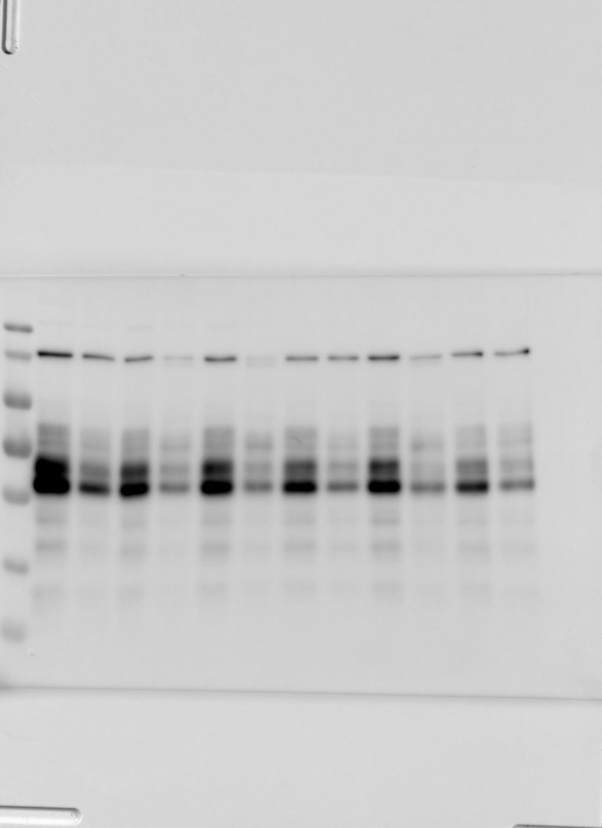
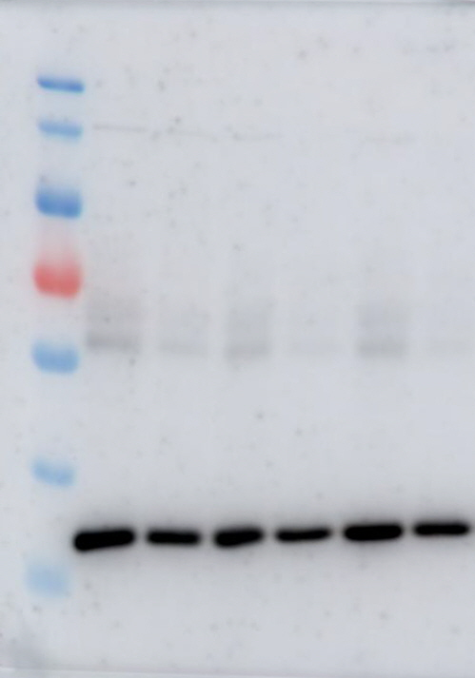
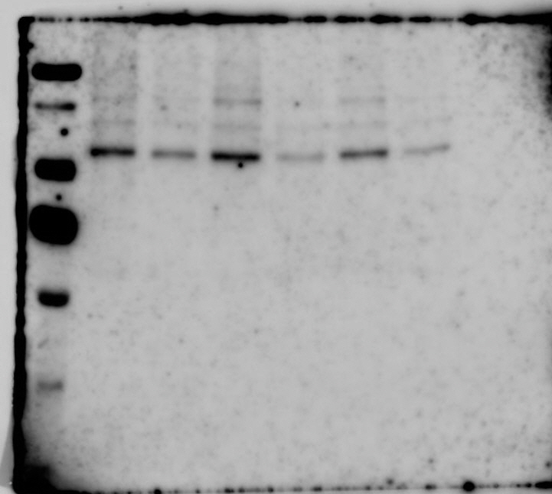
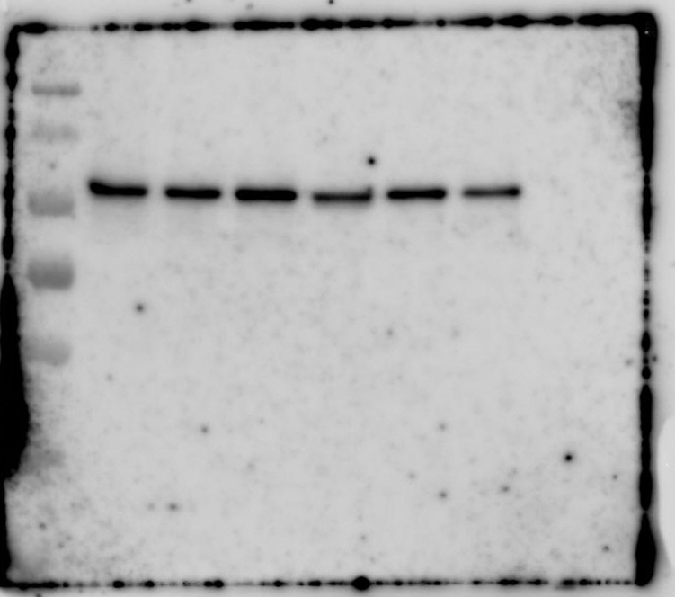
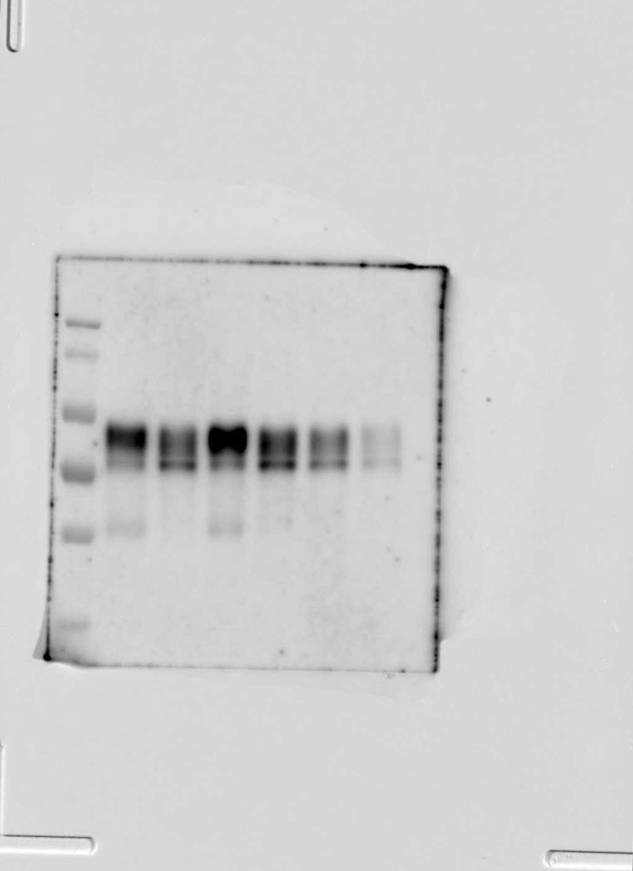
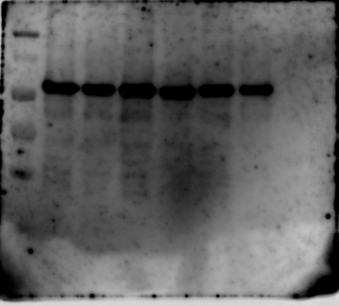
Source Data_Figure 3B
Donor #1
Donor #2
Donor #3
MW
(kDa)
Donor #1
Donor #2
Donor #3
LP - + - + - +
140KDa
140KDa
115KDa
115KDa
80KDa
80KDa
65KDa
65KDa
50KDa
50KDa
40KDa
40KDa
MITF
GAPDH
p−β-catenin (S675)
Donor #1
Donor #2
Donor #3
Donor #1
Donor #2
Donor #3
LP - + - + - +
140KDa
115KDa
80KDa
140KDa
65KDa
115KDa
50KDa
80KDa
40KDa
65KDa
50KDa
40KDa
p−β-catenin (S552)
Tyrosinase
β-catenin (total)

Slide 2
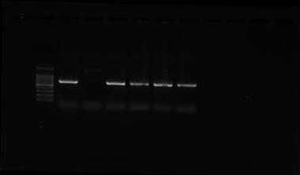
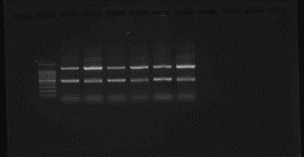
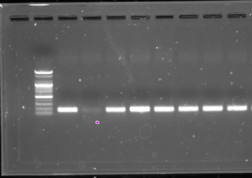
Source Data_Figure 3C
MITF
Tyrosinase
GAPDH

Slide 3
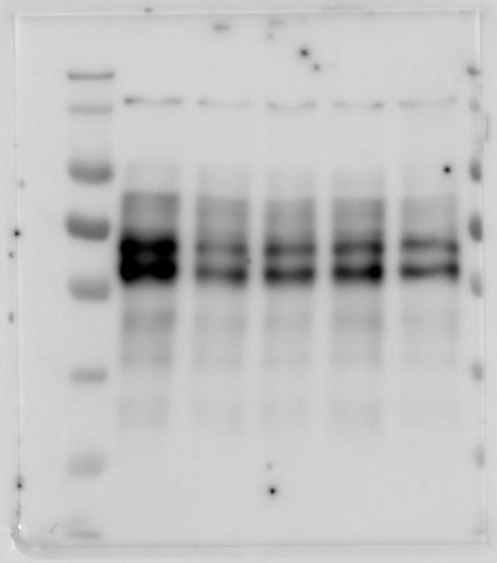
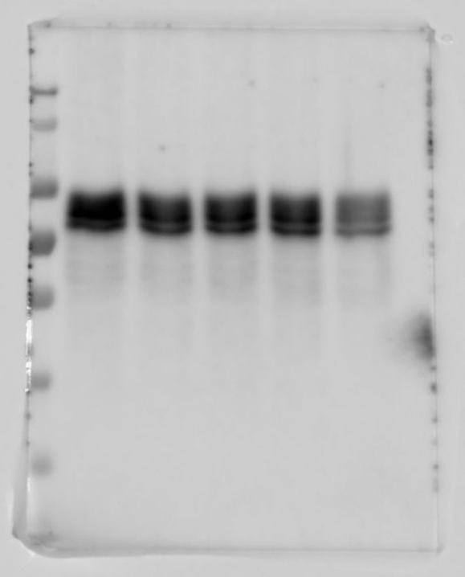
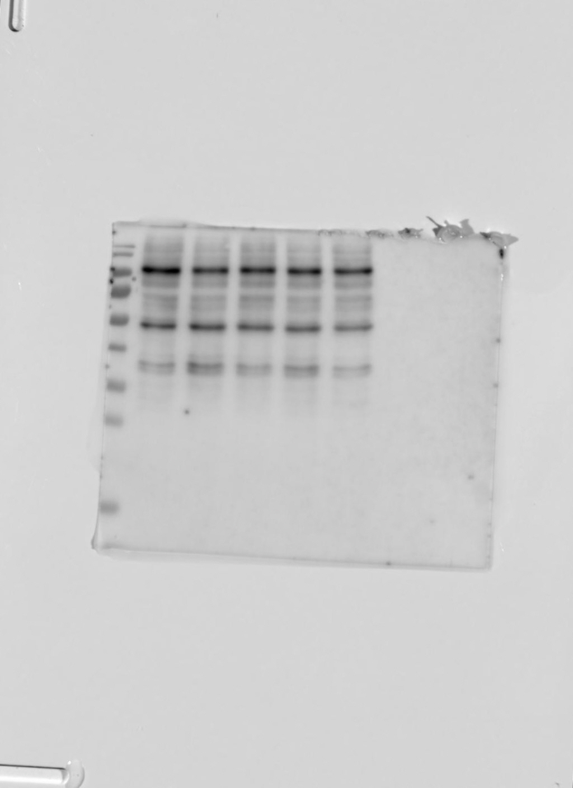
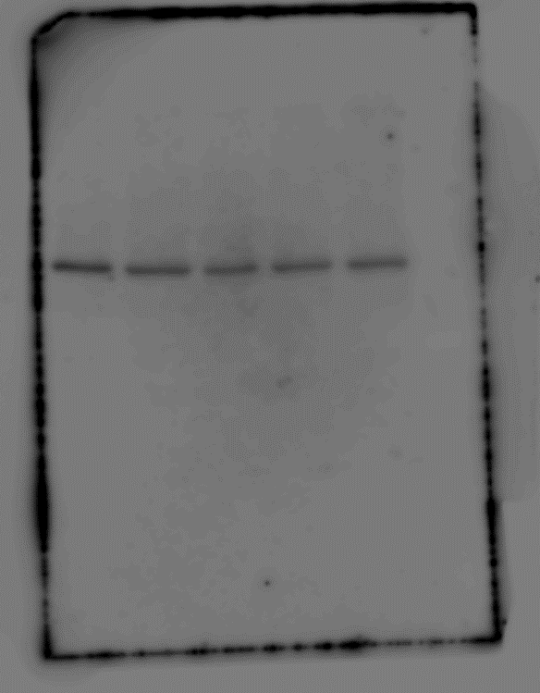
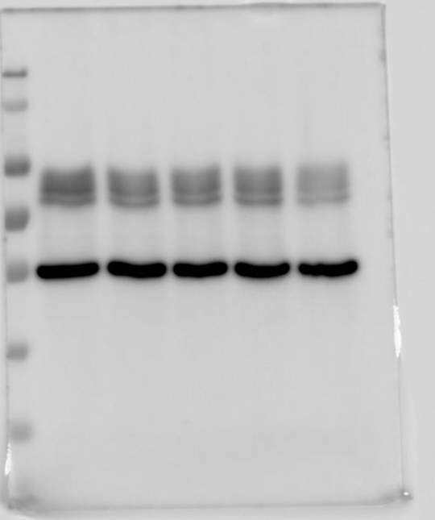
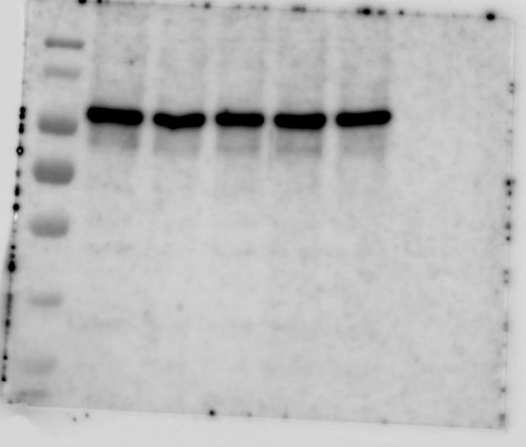
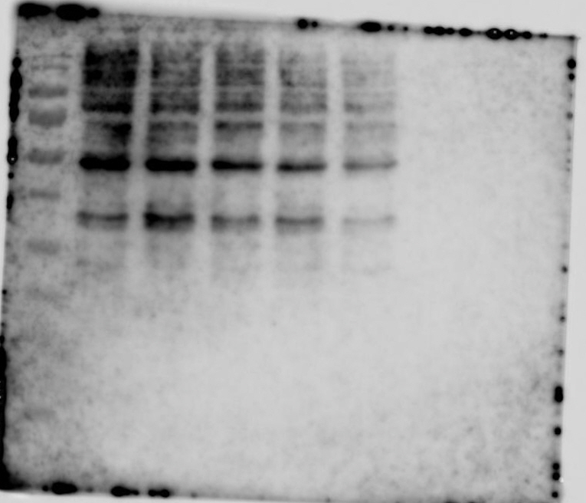
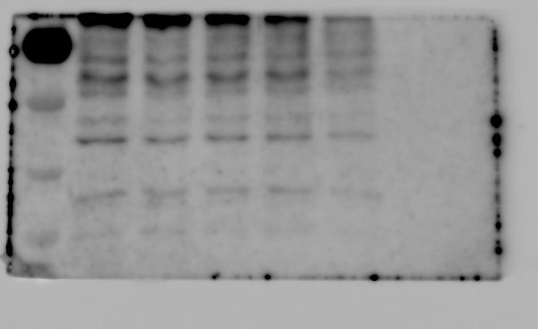
Donor #3
Source Data_Figure 4A
Donor #3
MW
(kDa)
LP 0 4 6 8 24 (hr)
MW
(kDa)
LP 0 4 6 8 24 (hr)
140KDa
140KDa
115KDa
115KDa
80KDa
80KDa
65KDa
65KDa
50KDa
50KDa
40KDa
40KDa
MITF
Tyrosinase
Donor #3
Donor #3
MW
(kDa)
MW
(kDa)
LP 0 4 6 8 24 (hr)
Donor #3
LP 0 4 6 8 24 (hr)
MW
(kDa)
LP 0 4 6 8 24 (hr)
140KDa
115KDa
80KDa
140KDa
140KDa
65KDa
115KDa
50KDa
115KDa
40KDa
80KDa
80KDa
65KDa
65KDa
50KDa
50KDa
40KDa
40KDa
p−β-catenin (S552)
tubulin
p−β-catenin (S675)
Donor #3
MW
(kDa)
Donor #3
Donor #3
LP 0 4 6 8 24 (hr)
MW
(kDa)
MW
(kDa)
140KDa
LP 0 4 6 8 24 (hr)
LP 0 4 6 8 24 (hr)
115KDa
140KDa
80KDa
115KDa
65KDa
65KDa
80KDa
50KDa
65KDa
50KDa
50KDa
40KDa
40KDa
40KDa
β-catenin (total)
LEF1
TCF4

Slide 4
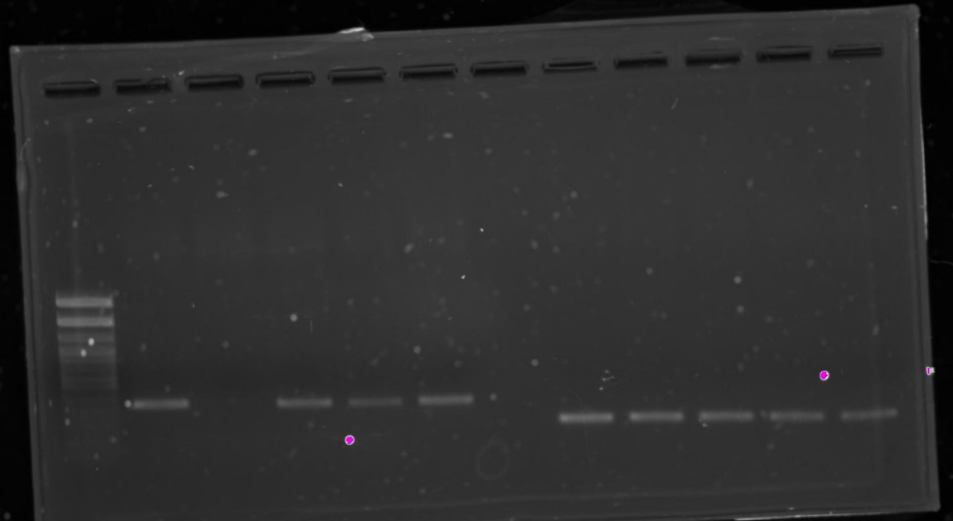
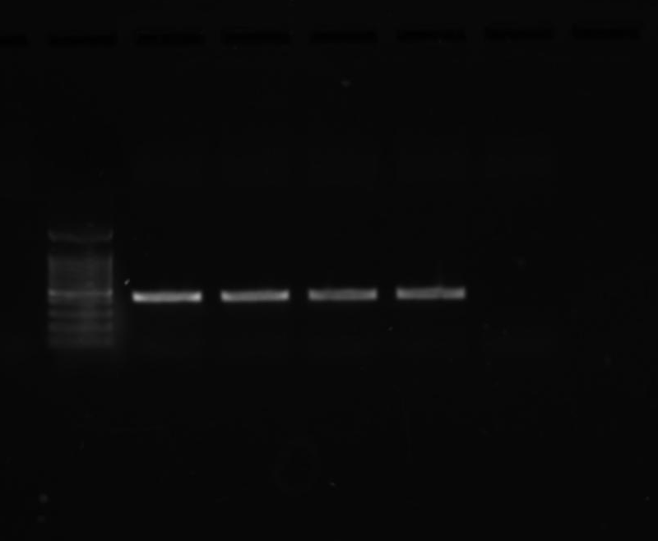
Source Data_Figure 4B
Tyrosinase
MITF
GAPDH

Slide 5
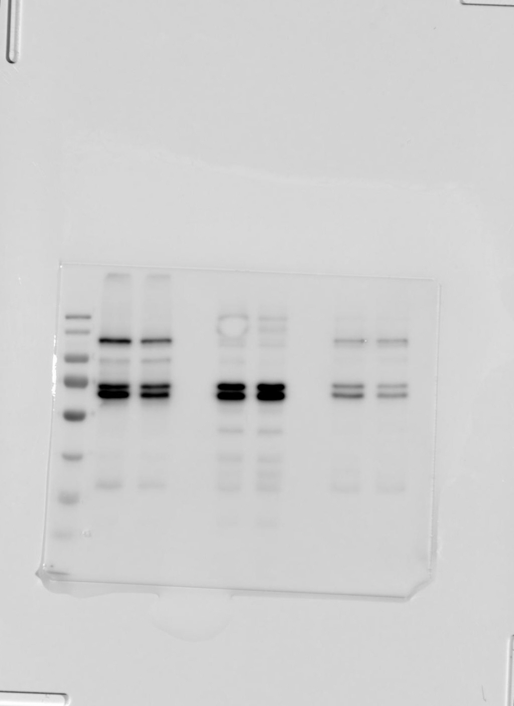
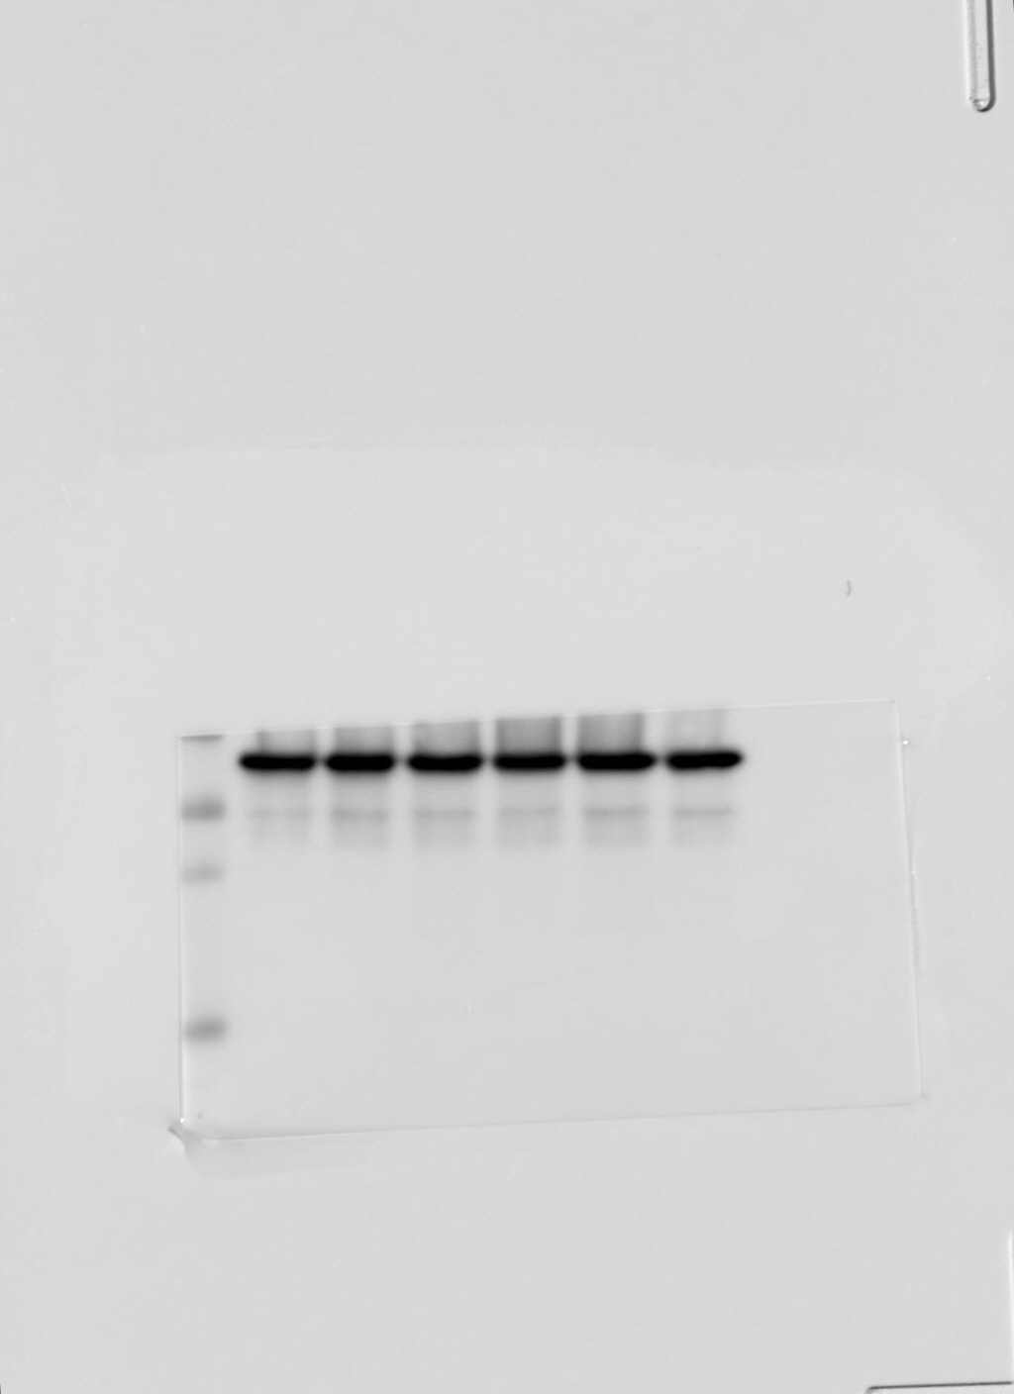
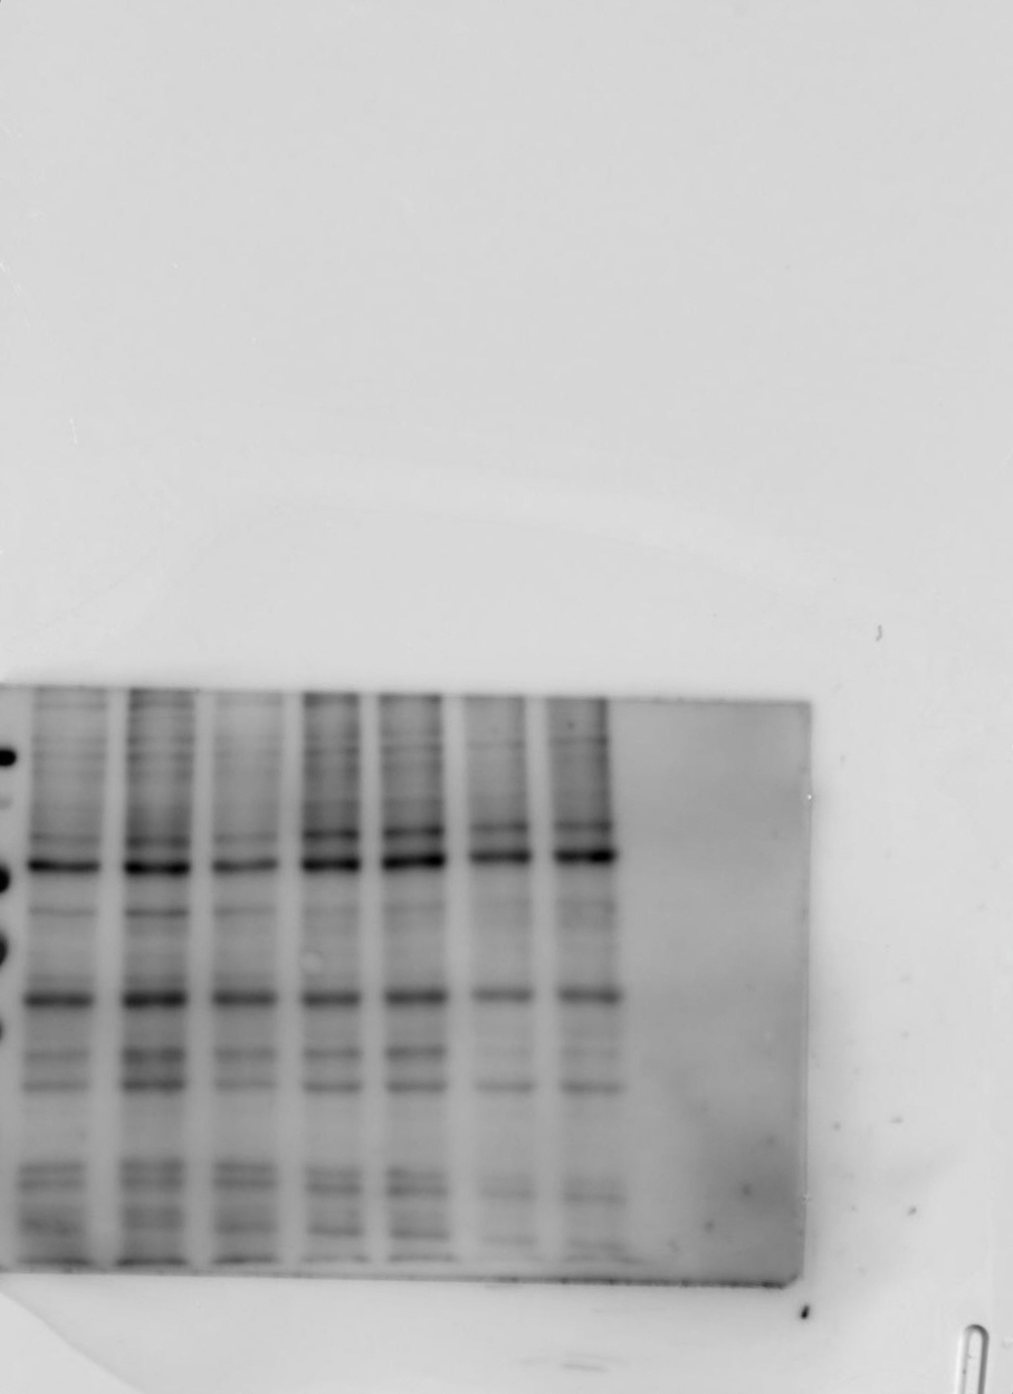
Source Data_Figure 4D
Donor #1
Donor #2
Donor #3
LP - + - + - +
Donor #1
Donor #2
Donor #3
Donor #1
Donor #2
Donor #3
140KDa
50KDa
140KDa
115KDa
115KDa
80KDa
40KDa
80KDa
65KDa
65KDa
50KDa
50KDa
40KDa
40KDa
KEAP1
GAPDH
NRF2

Slide 6
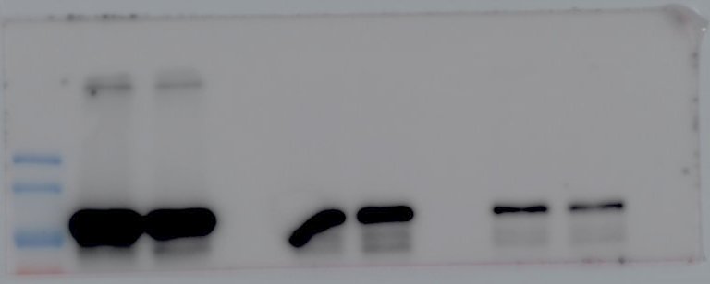
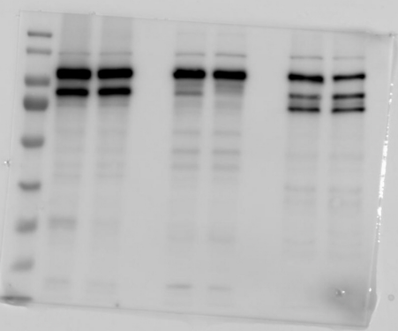
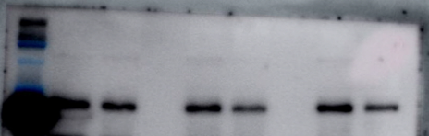
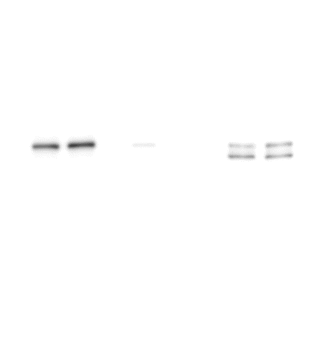
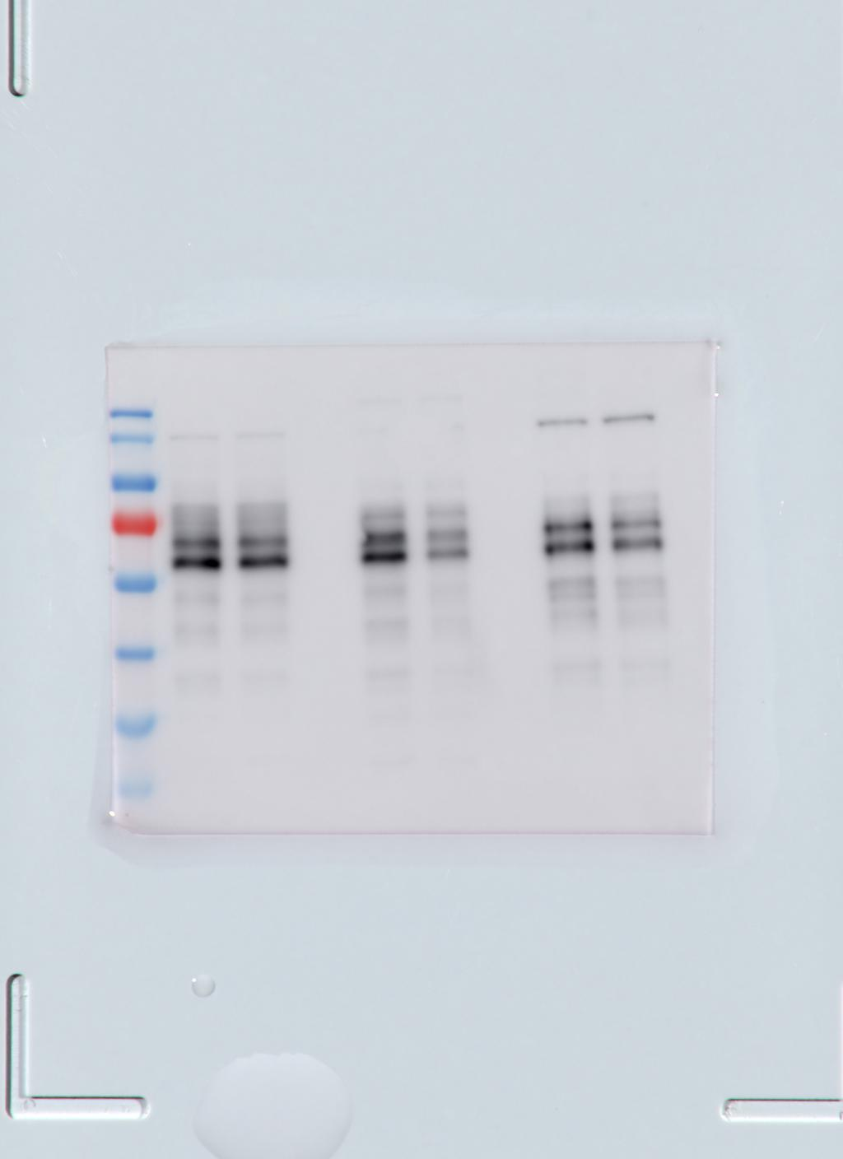
Source Data_Figure 5A
Whole
Cytosol
Nucleus
Whole
Cytosol
Nucleus
LP - + - + - +
LP - + - + - +
140KDa
115KDa
80KDa
140KDa
65KDa
115KDa
50KDa
80KDa
40KDa
p−β-catenin (S675)
β-catenin
Whole
Cytosol
Nucleus
LP - + - + - +
140KDa
115KDa
80KDa
Tyrosinase
Whole
Cytosol
Nucleus
Whole
Cytosol
Nucleus
Whole
Cytosol
Nucleus
LP - + - + - +
LP - + - + - +
LP - + - + - +
140KDa
115KDa
140KDa
50KDa
80KDa
115KDa
65KDa
80KDa
40KDa
50KDa
65KDa
tubulin
40KDa
50KDa
40KDa
MITF
LAMIN A

