Slide 1
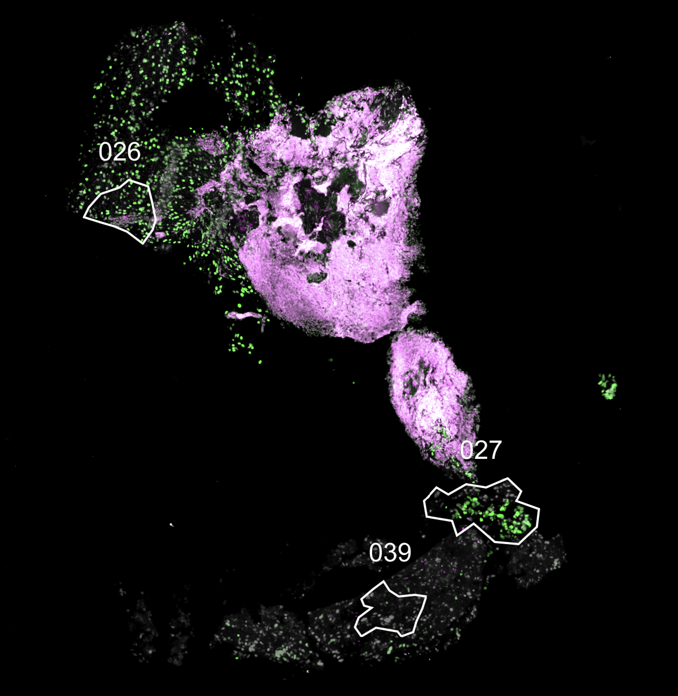
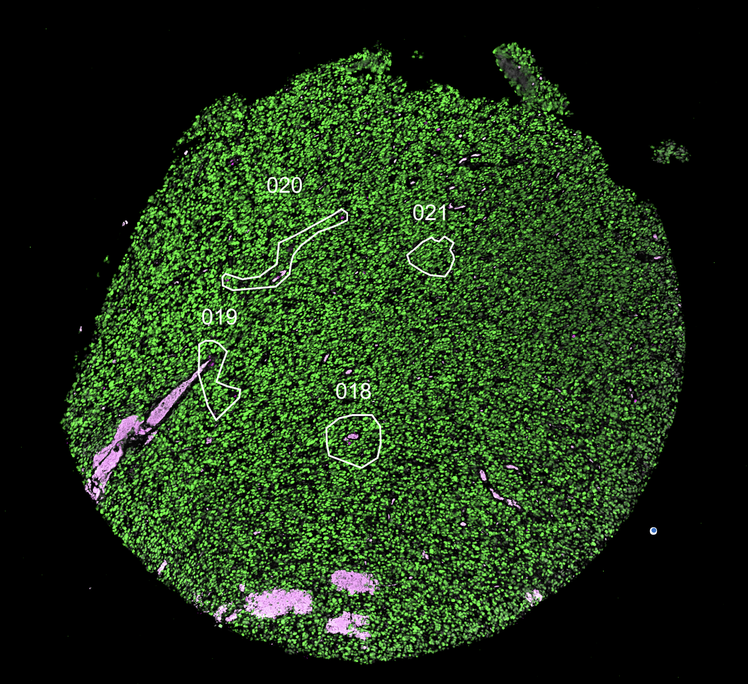
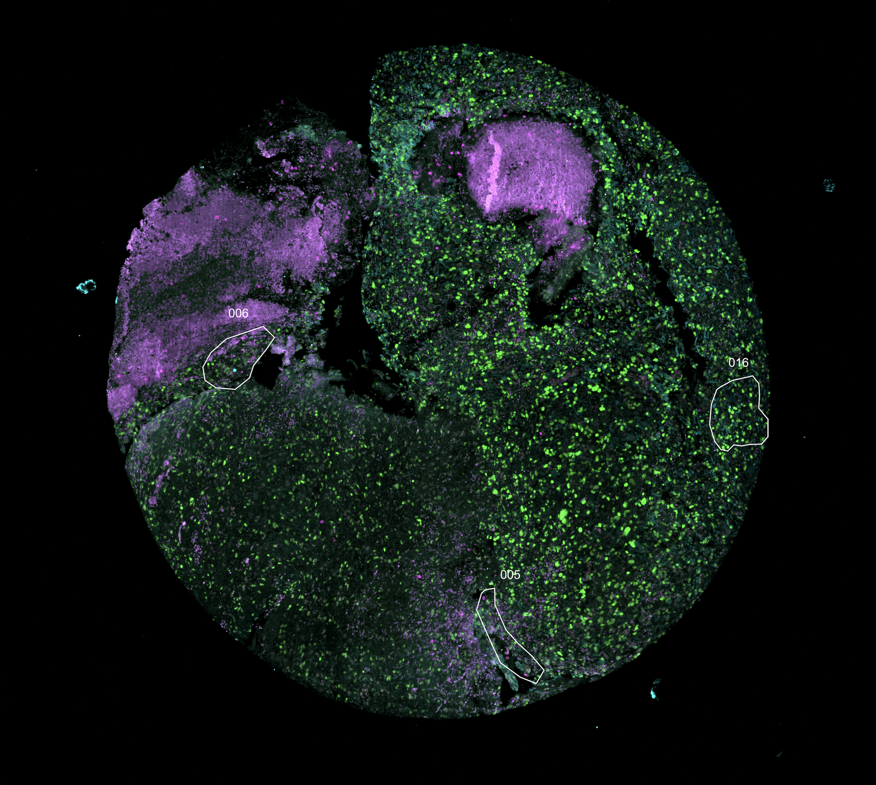
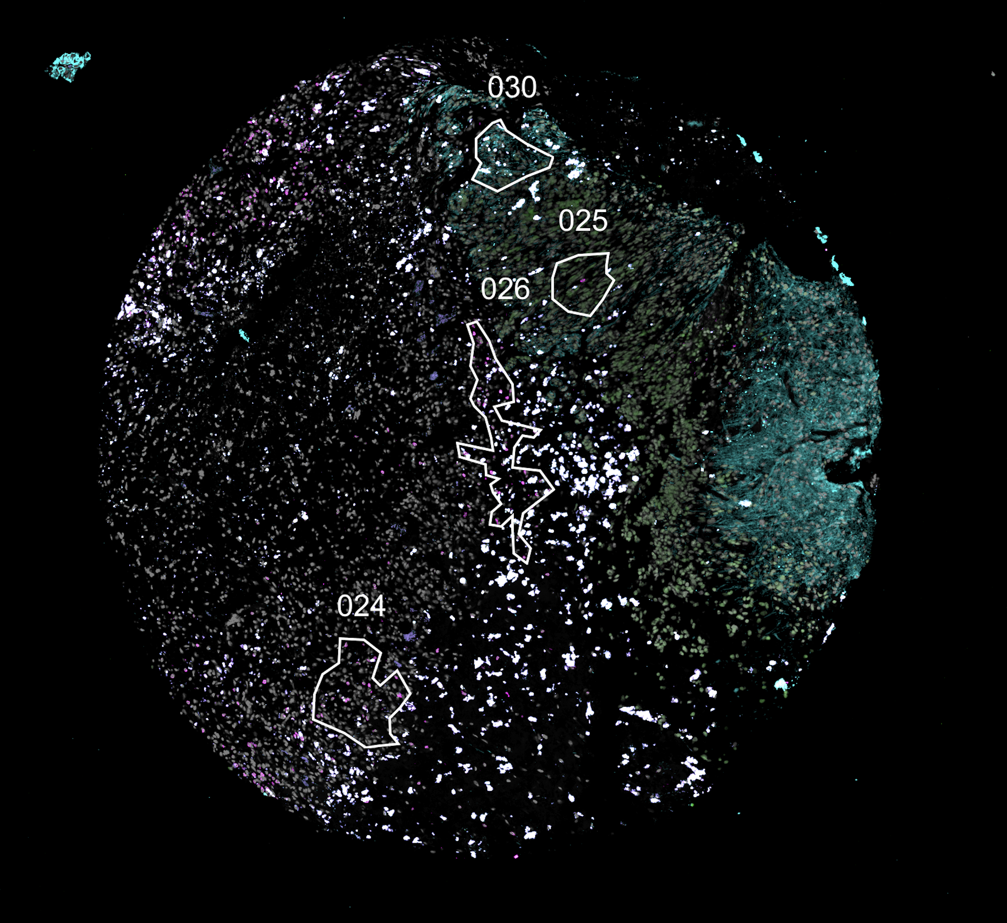
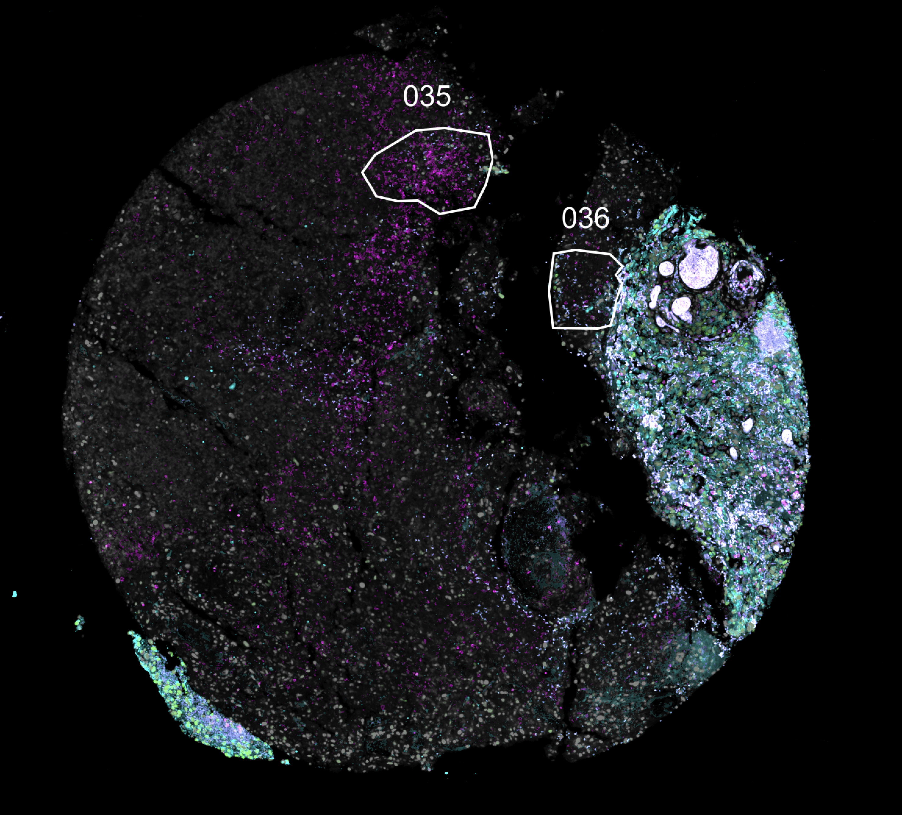
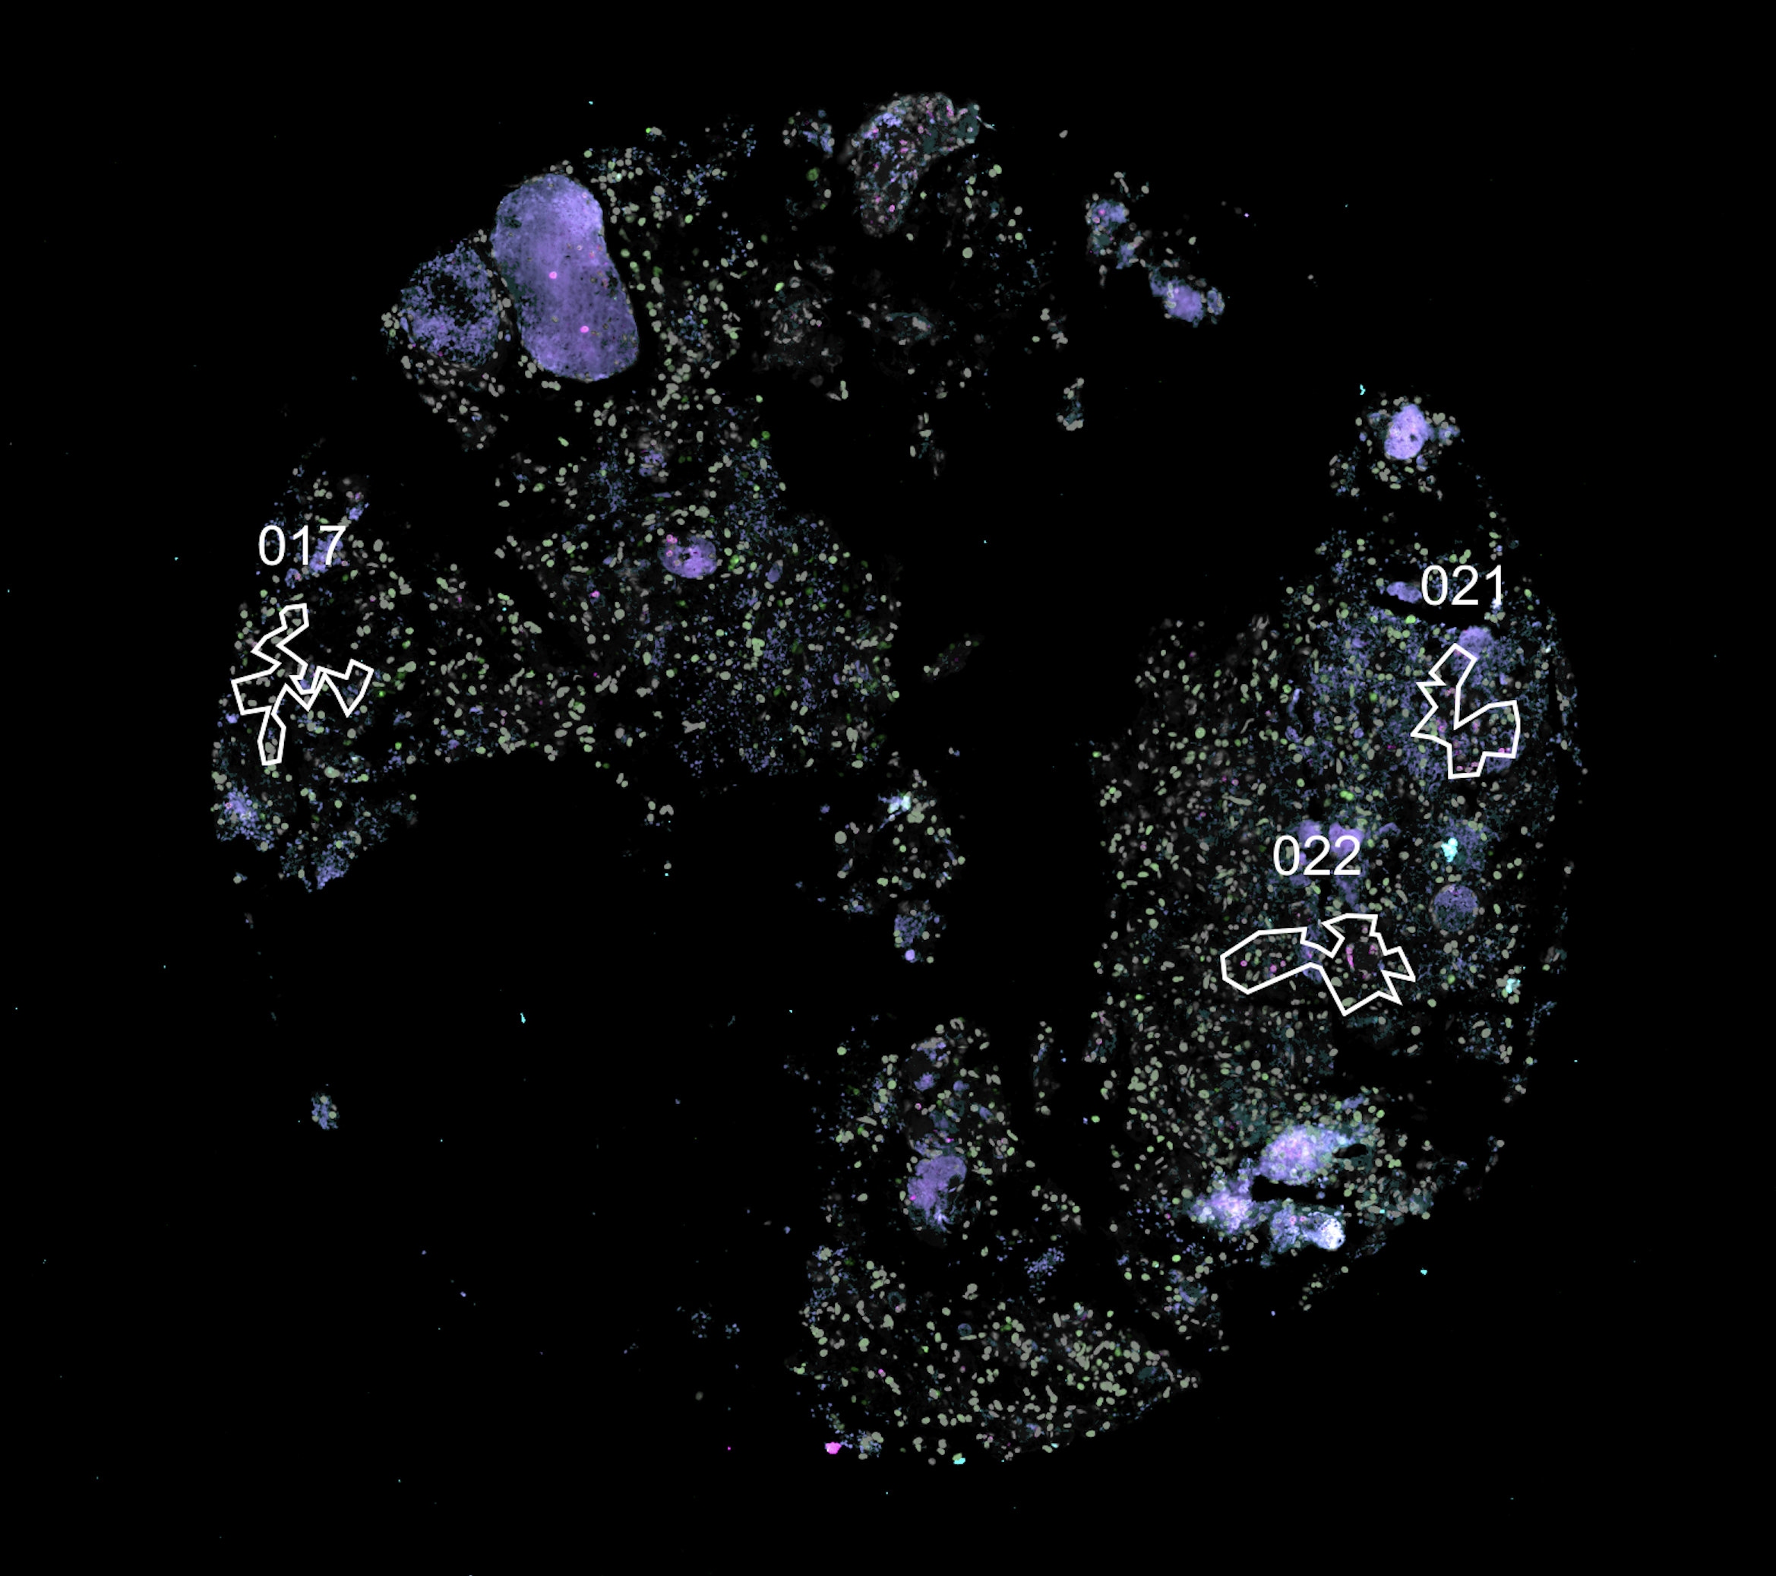
Sup Fig 1
A
Notes:
Sup Fig 1

Slide 2

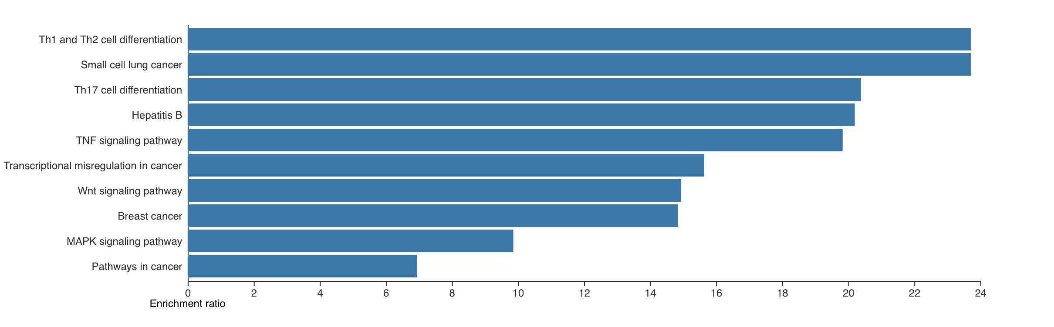
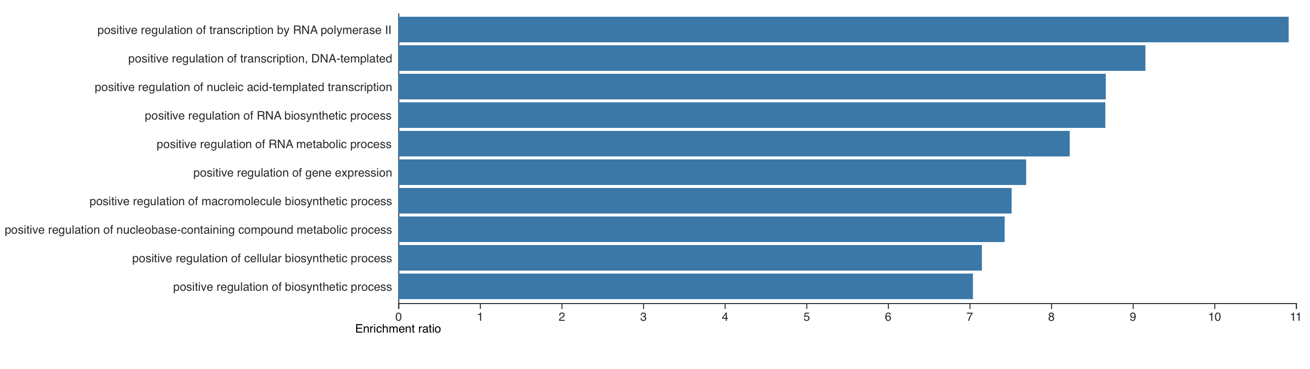
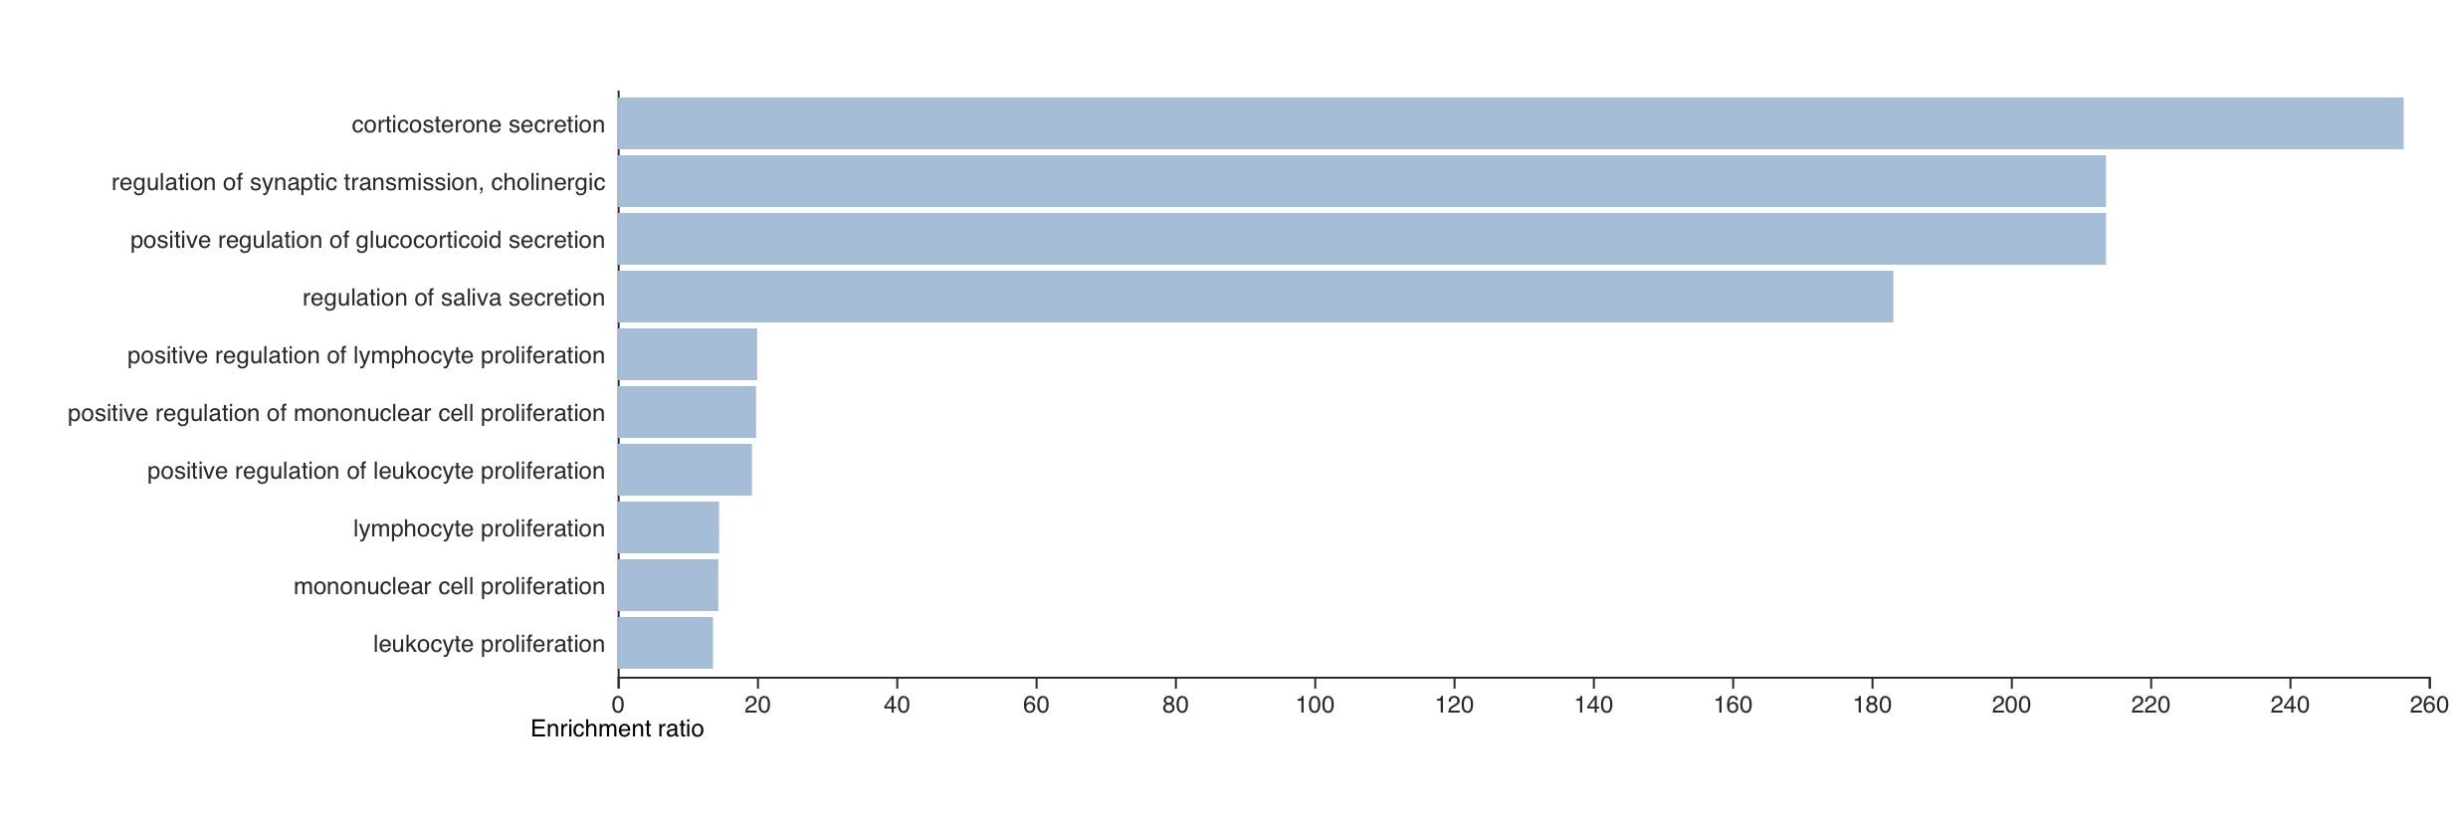
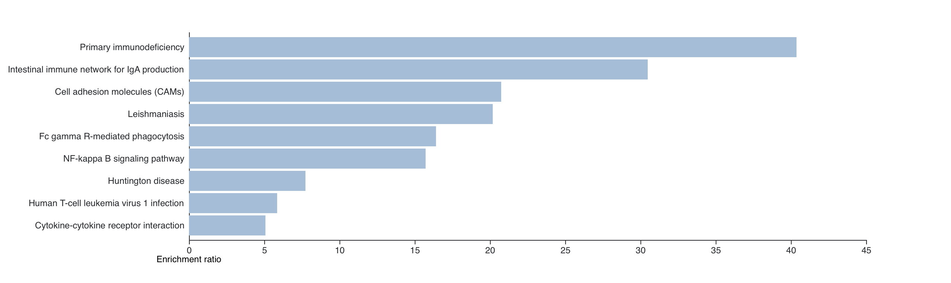
Sup Fig 2
A
B
ORA-Biological Processes
ORA-Pathway
Unlabeled Cells
Unlabeled Cells
Midbrain Control
Midbrain Control
Notes:
Sup Fig 2

Slide 3
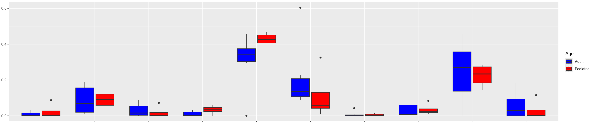
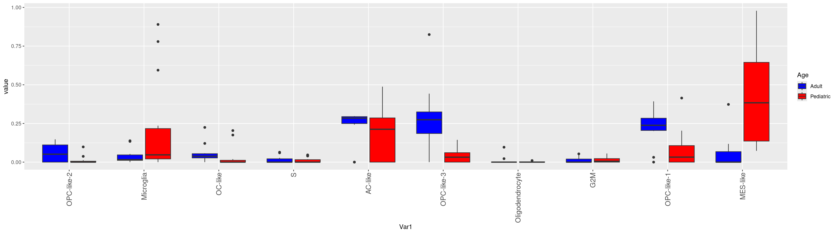
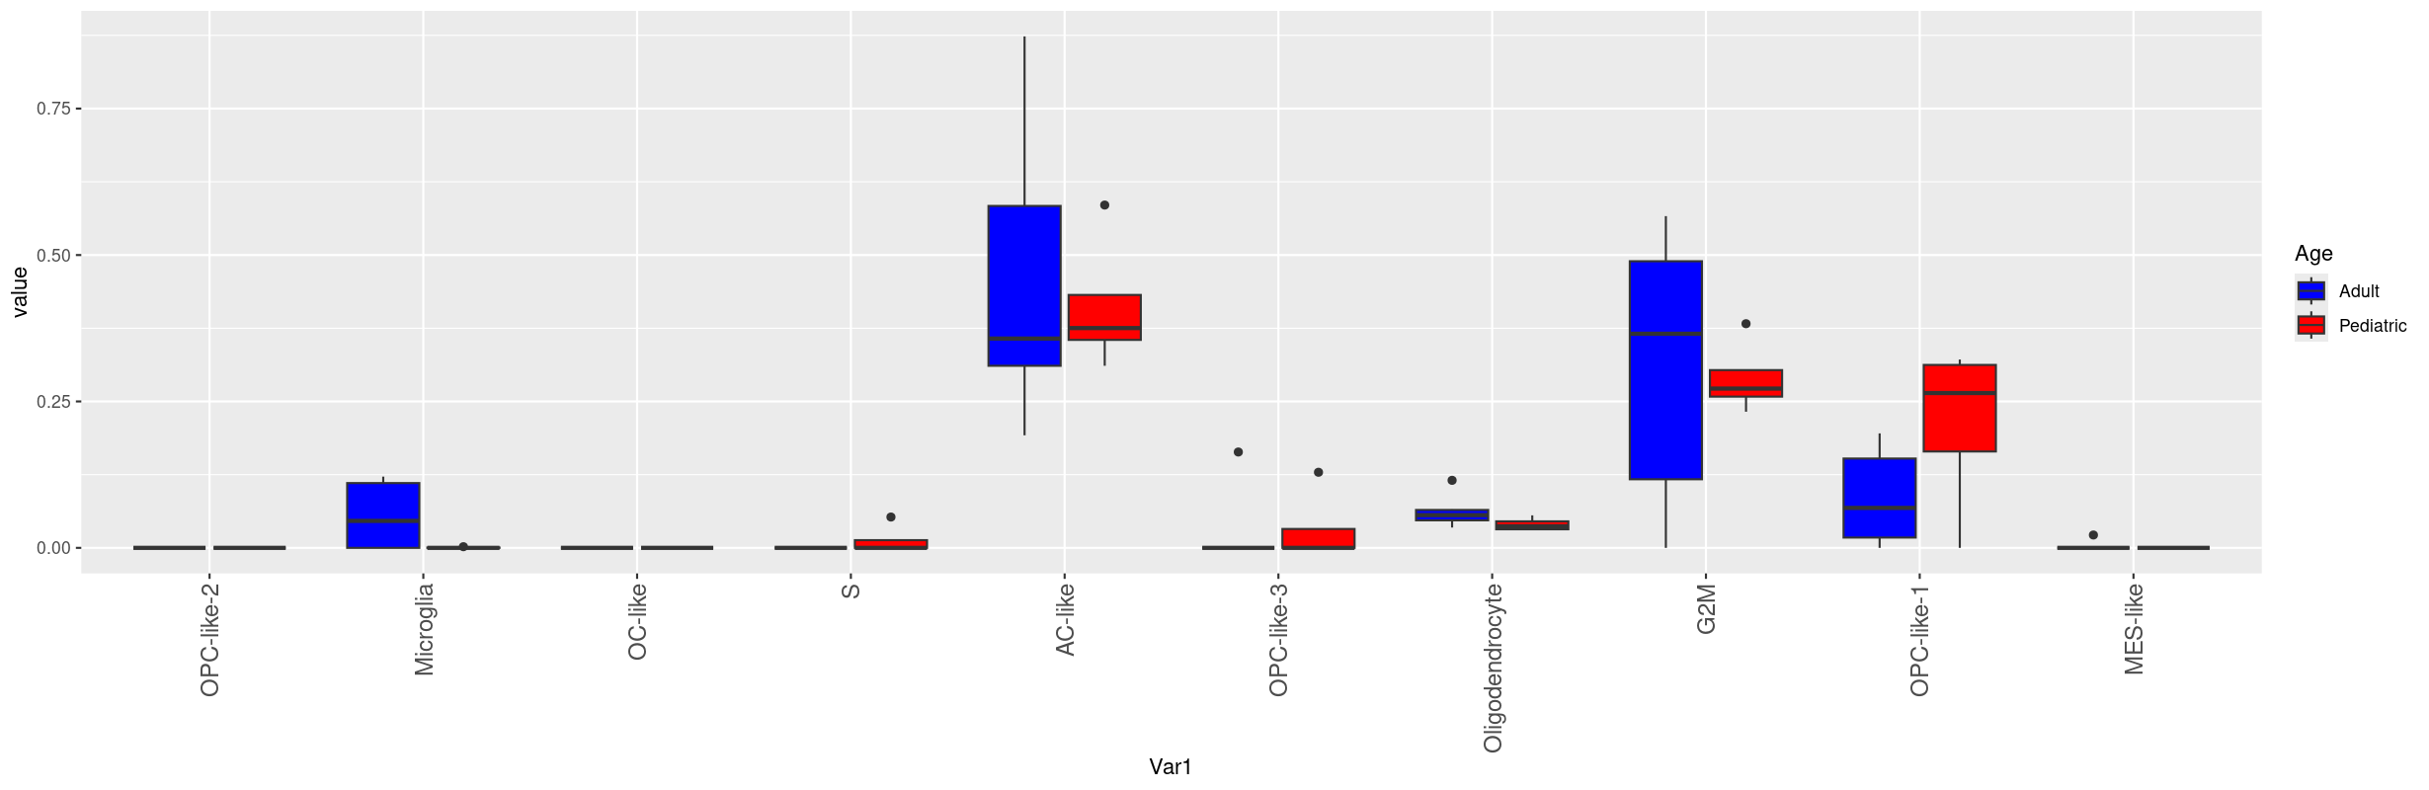
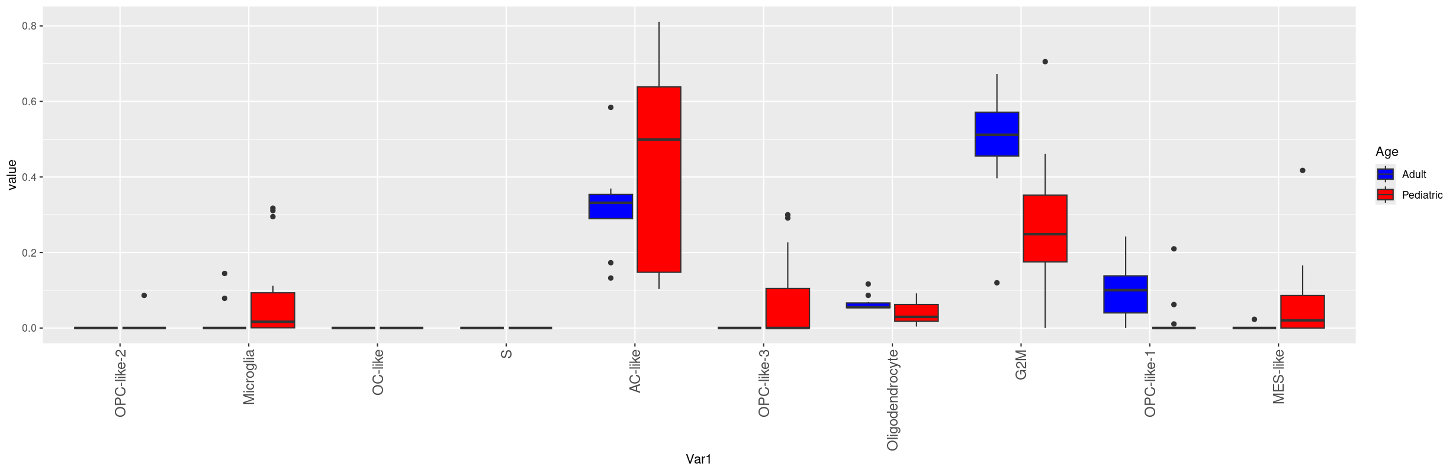
Sup Fig 3
A
Mutated
Scaled Expression
CIBERSORTX
TME
*
*
*
Mutated
B
Scaled Expression
*
*
ReDeconv
TME

Slide 4
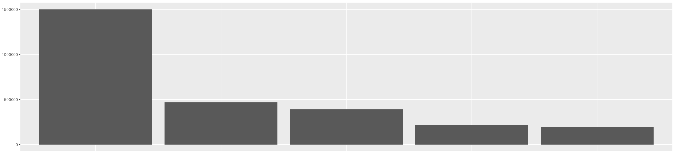
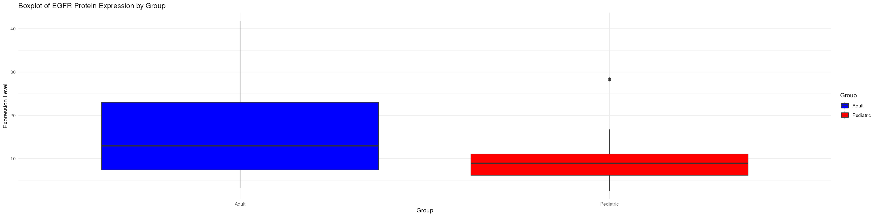
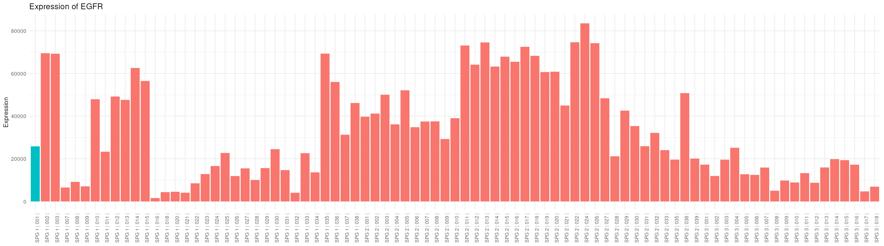
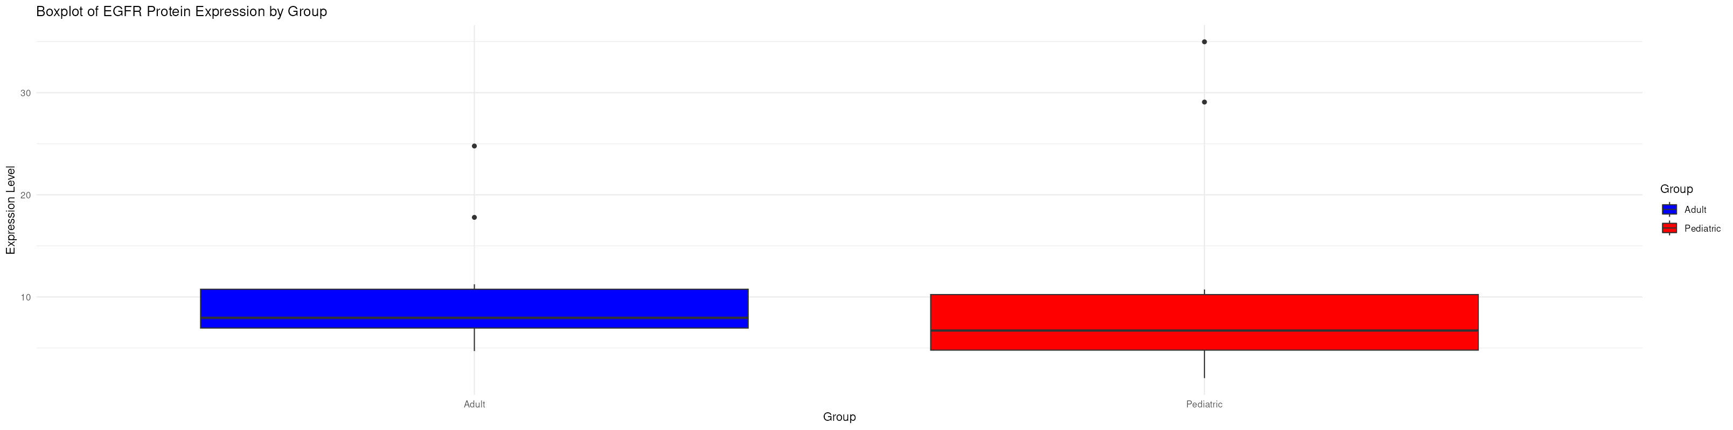
Sup Fig 4
A
EGFR Co-Expression
B
TME ROI
Histone H3
Expression
CD56
Synaptophysin
Expression
GFAP
Vimentin
EGFR
Mutated ROI
Expression
ROI
Notes:
Sup Fig 3

Slide 5
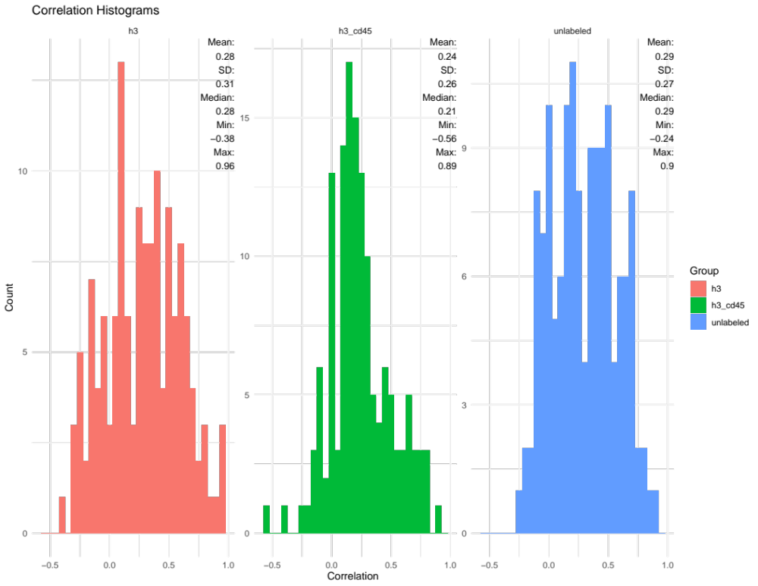
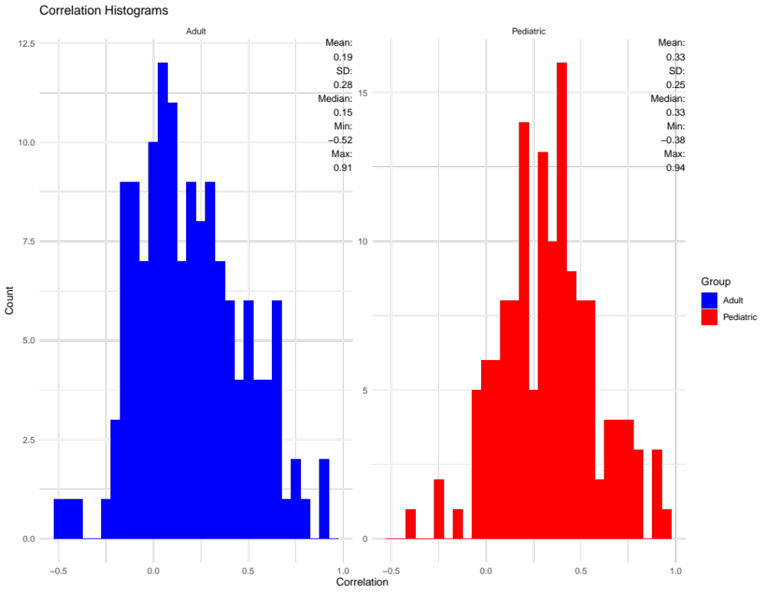

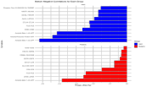
Sup Fig 5
A
B
Mutated
Non-Mutated
TME
Notes:
Sup Fig 4

Slide 6
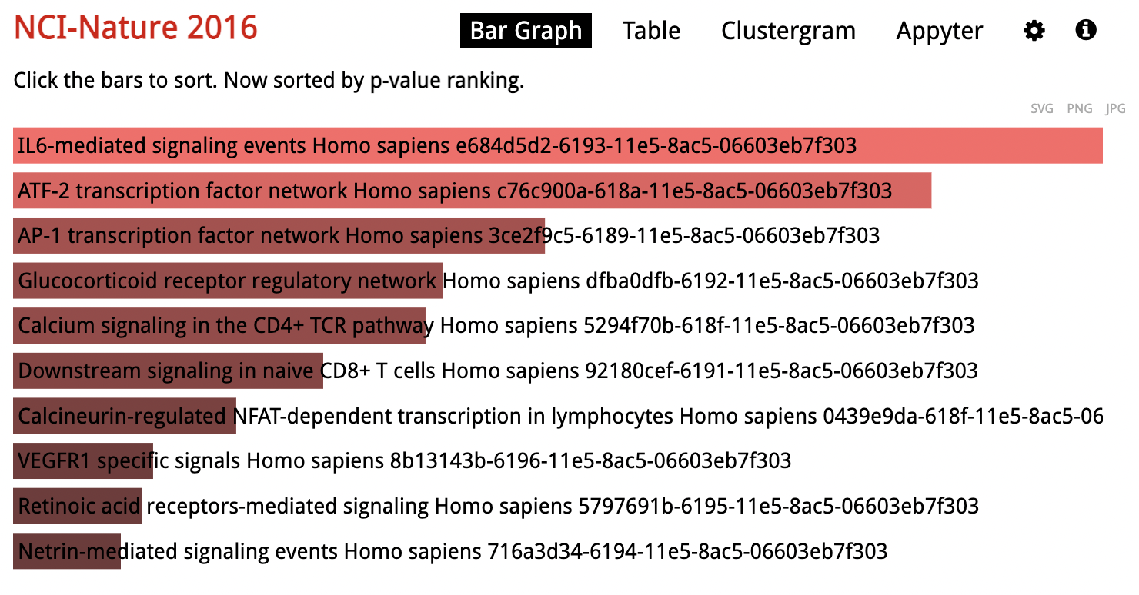
Sup Fig 6
Notes:
Sup Fig 5

