Slide 1
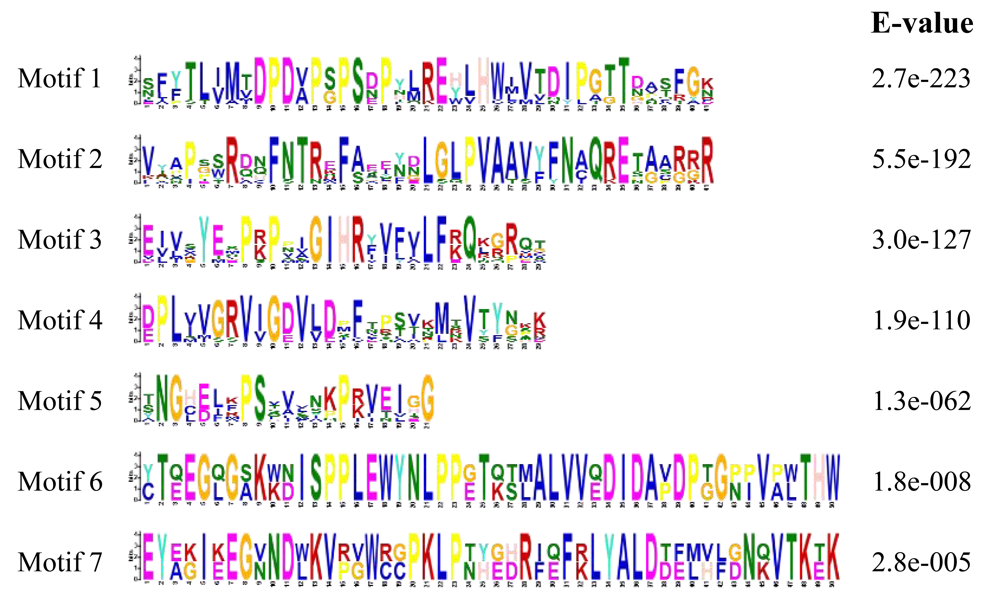

Slide 2
Figure S1 Sequence logos of 7 motifs in mung bean PEBP proteins.

