Slide 1
Supplemental Figure 2: Correlations for individual microbiome OTUs and the salivary analytes in T2DM patients with generalized (A; GG) and localized (B; LG) gingivitis, as well as generalized (C; GP), and localized (D; LP) periodontitis. The points denote the correlation coefficient for a specific OTU as shown on the X-axis (see Table 1). The point above or below the shaded rectangles distinguish the salivary analyte and associated OTU that exceeded significant positive or negative correlation values (p<0.01).

Slide 2
Supplemental Figure 1: Summation of total reads for the detected OTUs in the saliva samples from various subsets of subjects. Each point denotes the value for the sample from one subject. The horizontal bar denotes the mean reads for that group.
Total OTU Reads
NP GG LG GP LP
DWoP DWP

Slide 3
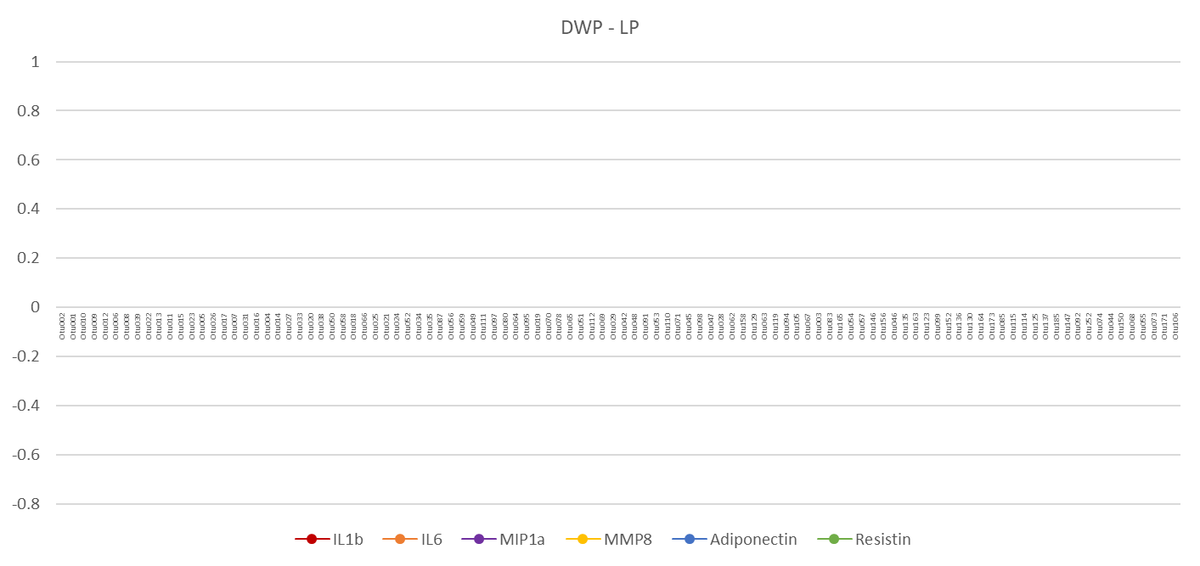
Supplemental Figure 2: Correlations for individual microbiome OTUs and the salivary analytes in T2DM patients with generalized (A; GG) and localized (B; LG) gingivitis, as well as generalized (C; GP), and localized (D; LP) periodontitis. The points denote the correlation coefficient for a specific OTU as shown on the X-axis (see Table 1). The point above or below the shaded rectangles distinguish the salivary analyte and associated OTU that exceeded significant positive or negative correlation values (p<0.01).
A

Slide 4
B

Slide 5
C

Slide 6
D

