Slide 1
Supplemental Information: Western blot_raw data
Original blots are listed by figure numbers.
Highlighted regions correspond to the figures in manuscript.

Slide 2
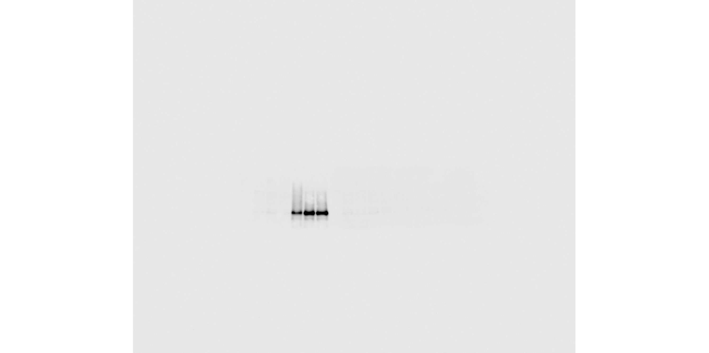
Figure 1A WWP1
-200kDa
-150kDa
-100kDa
-75kDa

Slide 3
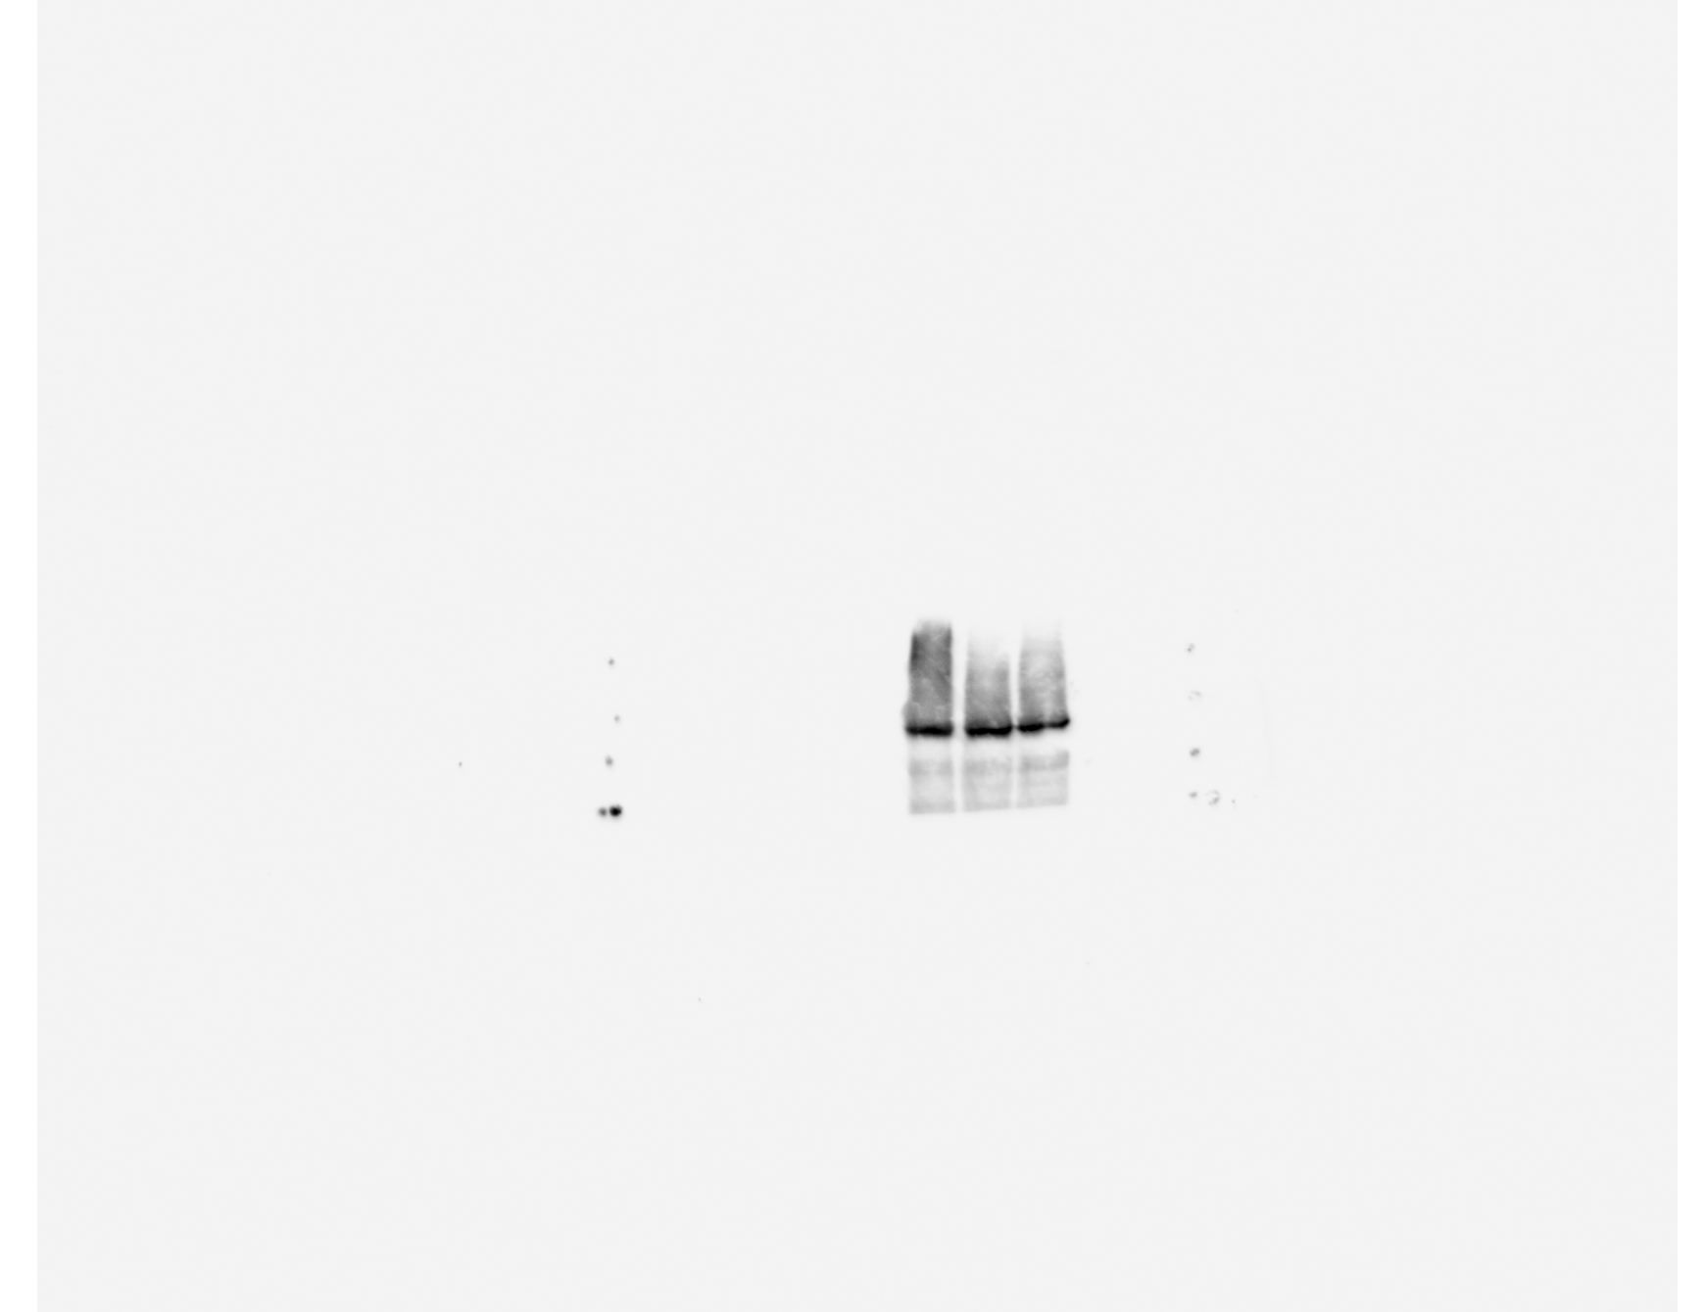
Figure 1A FLAG
-200kDa
-150kDa
-100kDa
-75kDa

Slide 4
Figure 1A, 2F Lamin B1
-75kDa
Figure 1A
Figure 2D
-50kDa

Slide 5
Figure 2B FLAG
-100kDa
-75kDa
-50kDa

Slide 6
Figure 2B Lamin B1
-75kDa
-50kDa

Slide 7
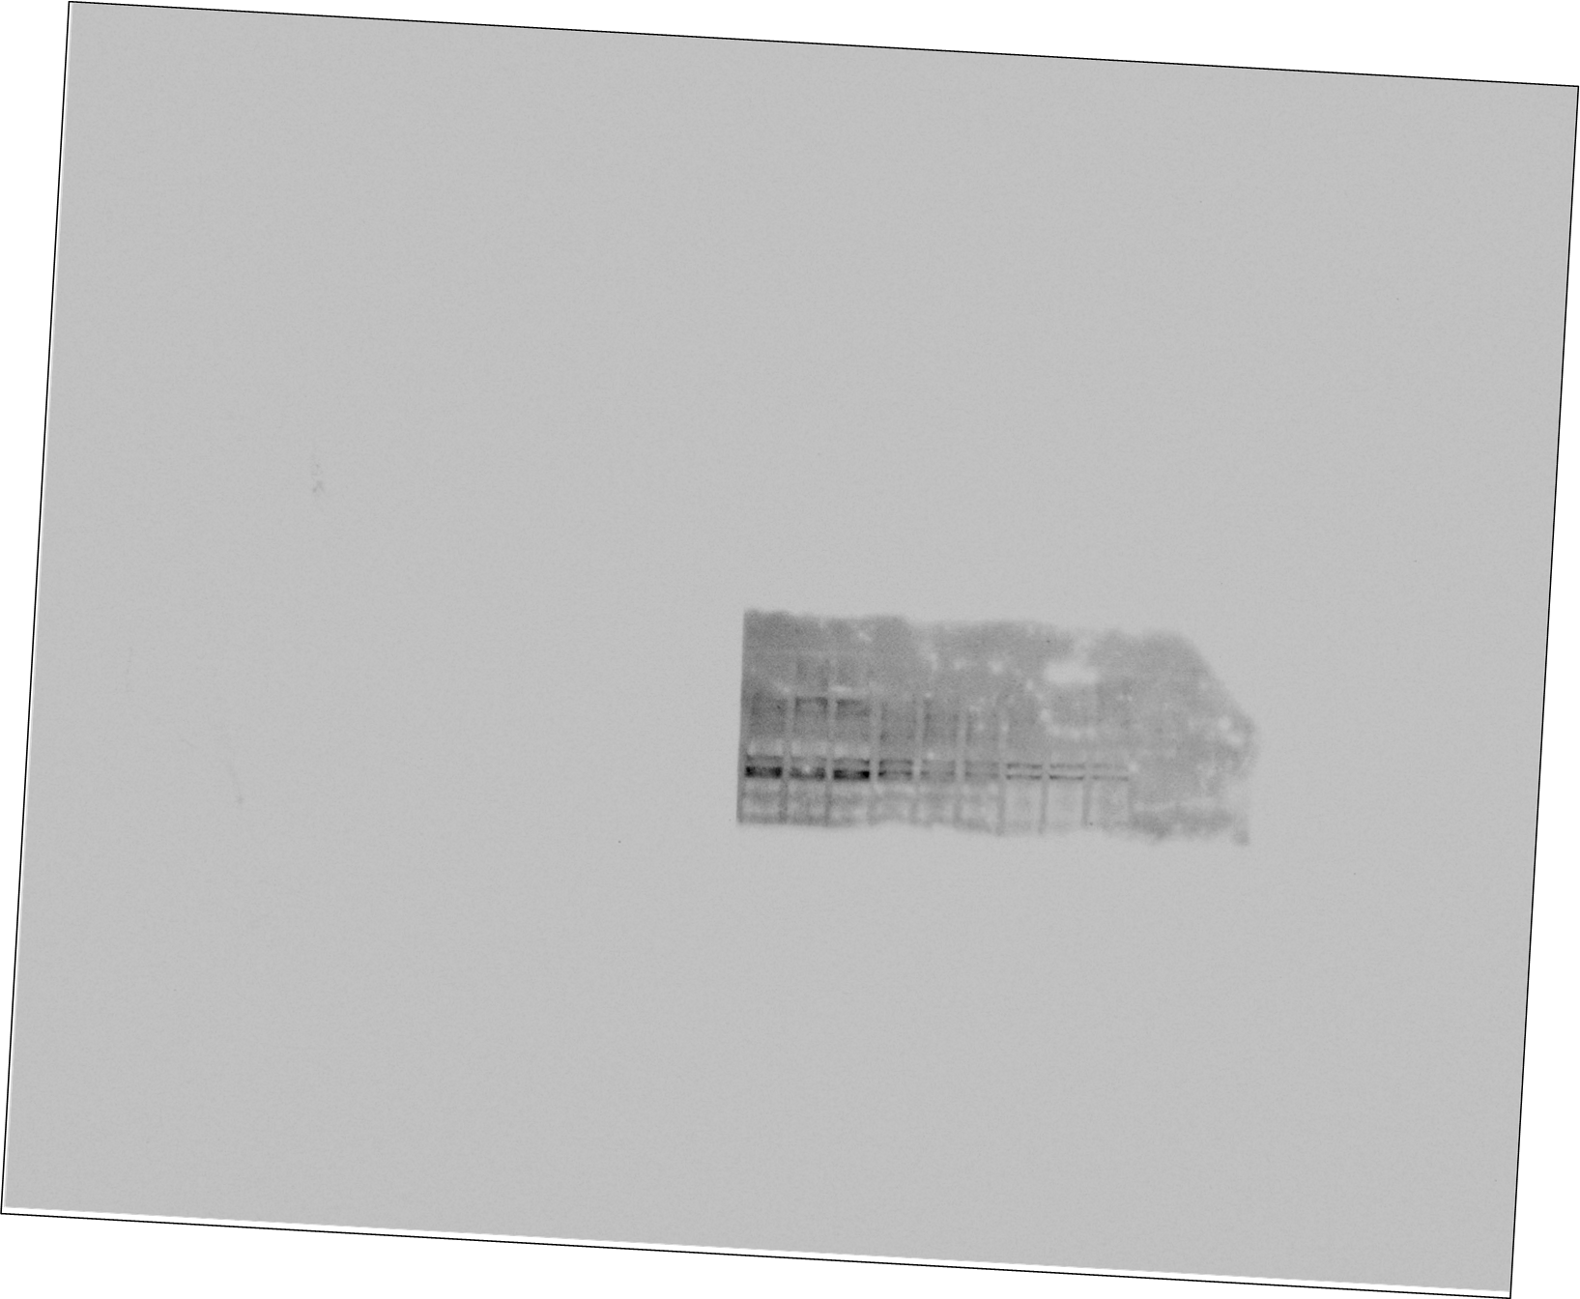
Figure 2F WWP1
-200kDa
-150kDa
-100kDa
-75kDa

Slide 8
Supplemental Figure 2 WWP1
-150kDa
-100kDa
-75kDa

Slide 9
Supplemental Figure 2 Lamin B1
-75kDa
-50kDa

