Slide 1
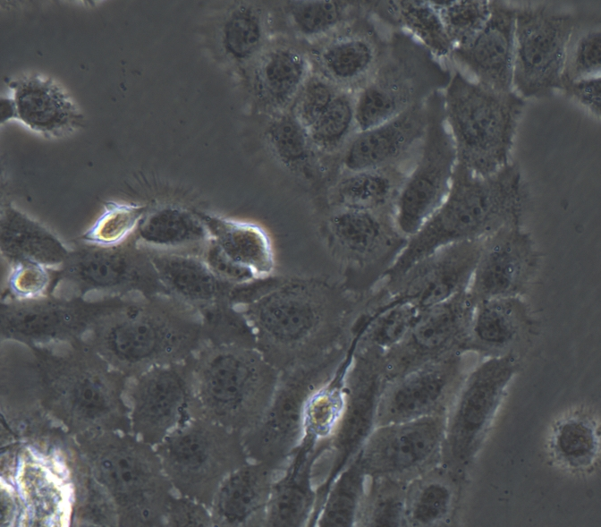
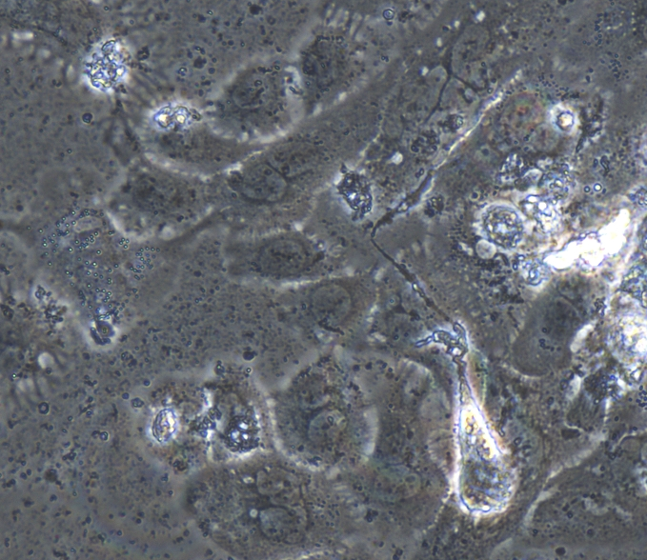
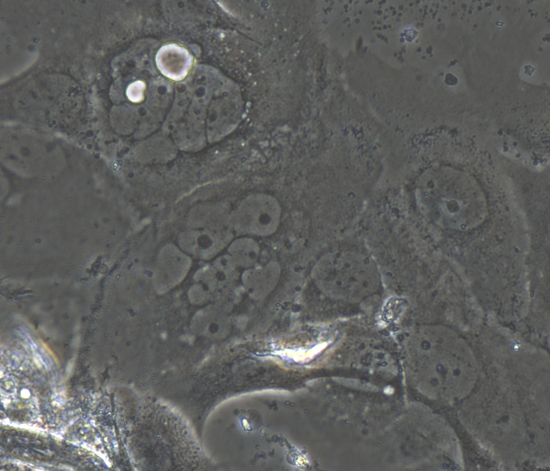
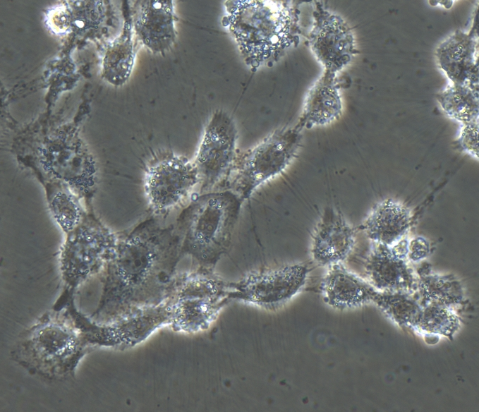
Figure S1 Cisplatin administration in TE11 cells.
TE11
(a)
(b)
(c)
(d)
100 μm

Slide 2
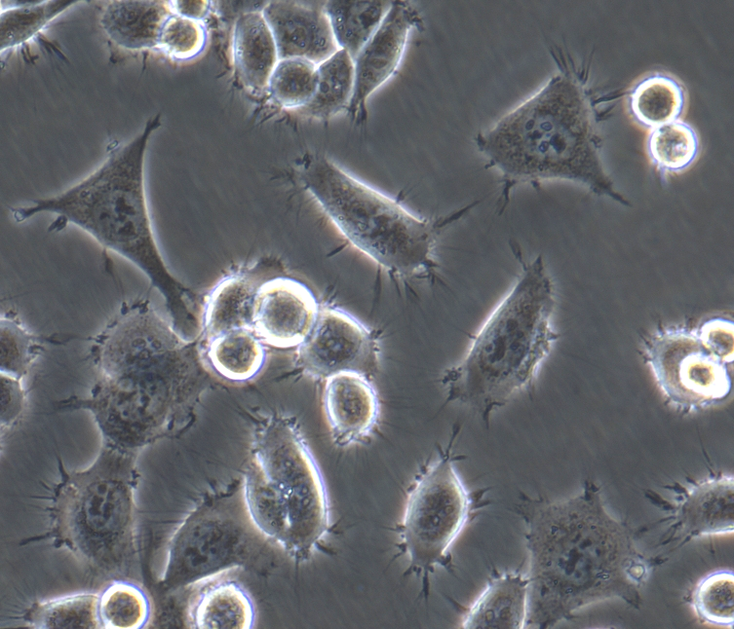
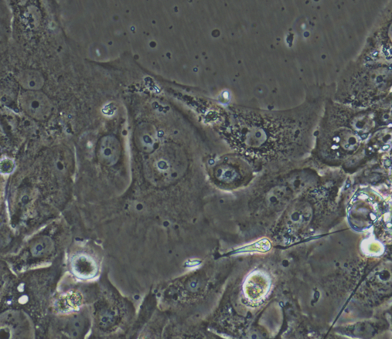
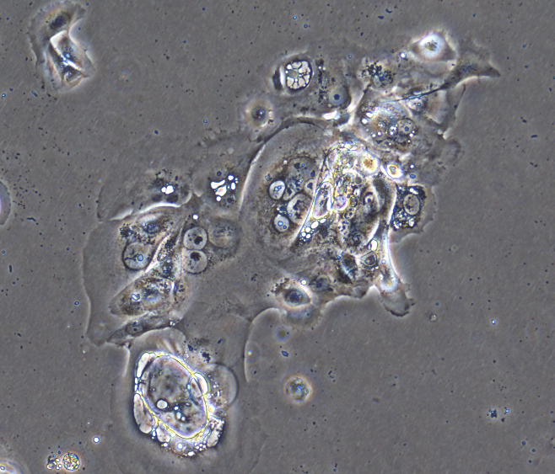
Figure S2 Cisplatin administration in TE8 cells.
TE8
(a)
(b)
(c)
(d)
100 μm

Slide 3
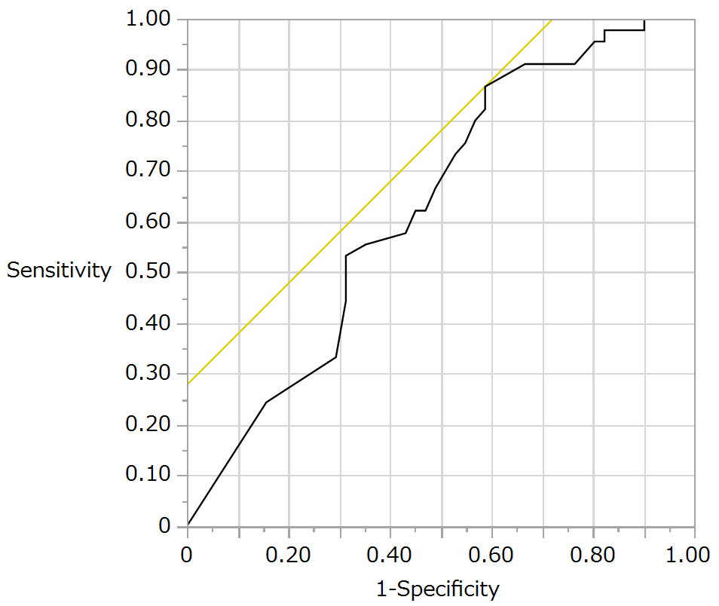
Figure S3 Receiver operating characteristic (ROC) analysis of HVS1 mutation and chemotherapy response.

Slide 4
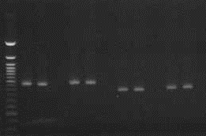
FigureS4 D-loop target sequence PCR primers and electrophoresis result.
Primer_Name | Gene/Chr | FP | RP | Len | From | To
A | D-loop | TCGTCGGCAGCGTCAGATGTGTATAAGAGACAGTTTAAACTATTCTCTGTTCTTTCATGGG | GTCTCGTGGGCTCGGAGATGTGTATAAGAGACAGATTGATTTCACGGAGGATGG | 416 | 16009 | 16424
B | D-loop | TCGTCGGCAGCGTCAGATGTGTATAAGAGACAGAGATAGGGGTCCCTTGACCA | GTCTCGTGGGCTCGGAGATGTGTATAAGAGACAGTCAATTGTTATTATTATGTCCTACAAGCA | 431 | 16385 | 247
C | D-loop | TCGTCGGCAGCGTCAGATGTGTATAAGAGACAGAGGCGAACATACCTACTAAAGTGT | GTCTCGTGGGCTCGGAGATGTGTATAAGAGACAGTGTGTGTGTGCTGGGTAGGAT | 342 | 183 | 524
D | D-loop | TCGTCGGCAGCGTCAGATGTGTATAAGAGACAGTCTGCCAAACCCCAAAAACAAAG | GTCTCGTGGGCTCGGAGATGTGTATAAGAGACAGGGGATGCTTGCATGTGTAATCT | 364 | 345 | 708
A
B
C
D
①
②
③
①
②
③
①
②
③
①
②
③
500bp
200bp

