Slide 1
Guidelines for the use of the “Reference genes” tool
of the TomExpress platform
https://beta.tomexpress.gbfwebtools.fr

Slide 2

Press the “Enter” button to access to TomExpress.

Slide 3
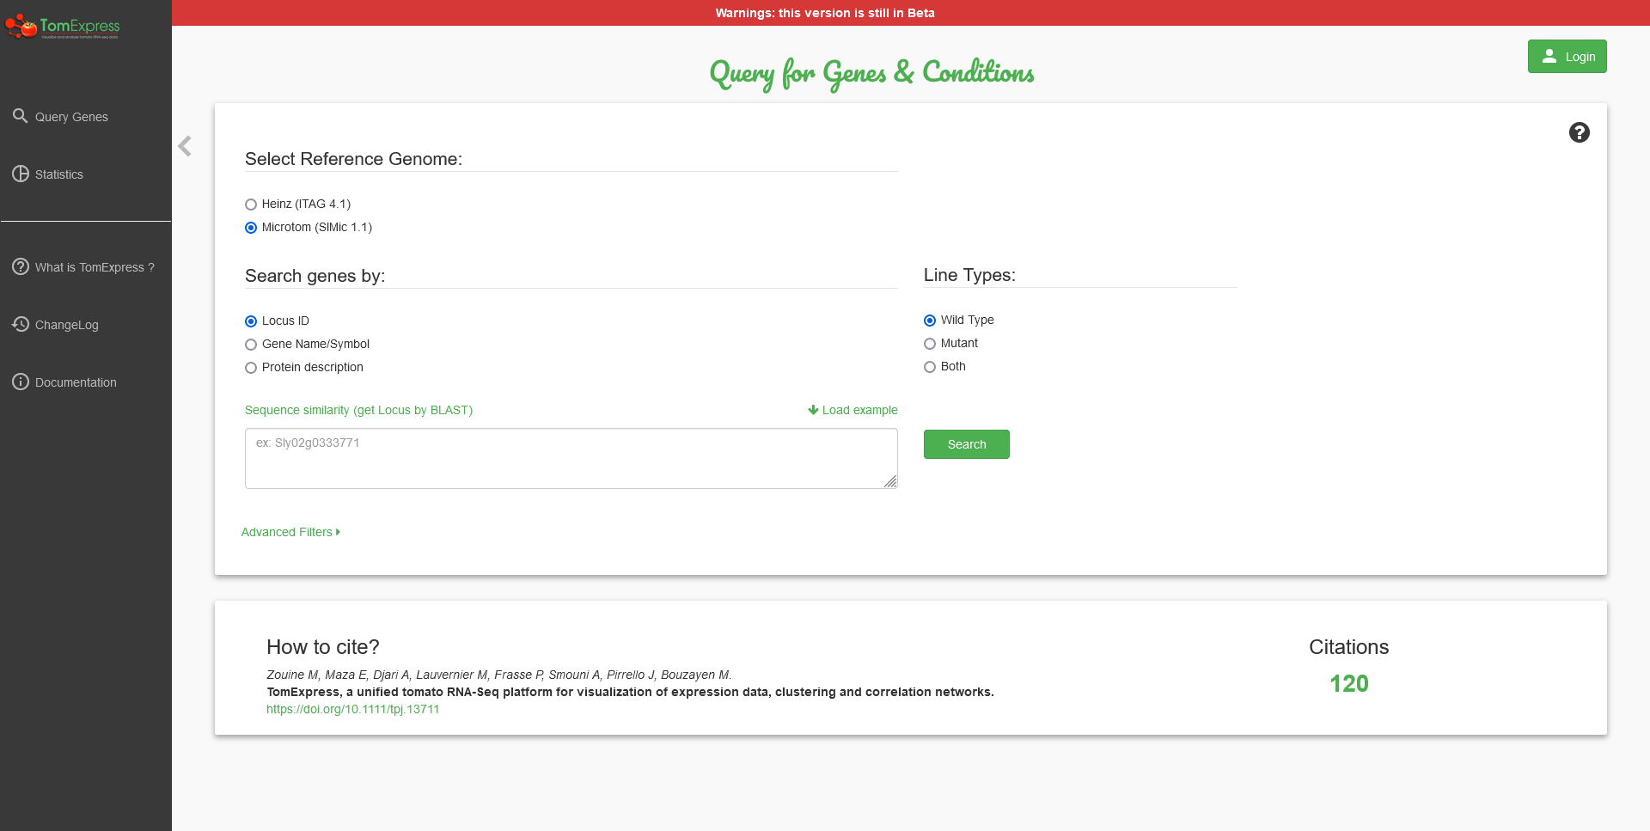
Press the “Login” button to create an account and log in.

Slide 4
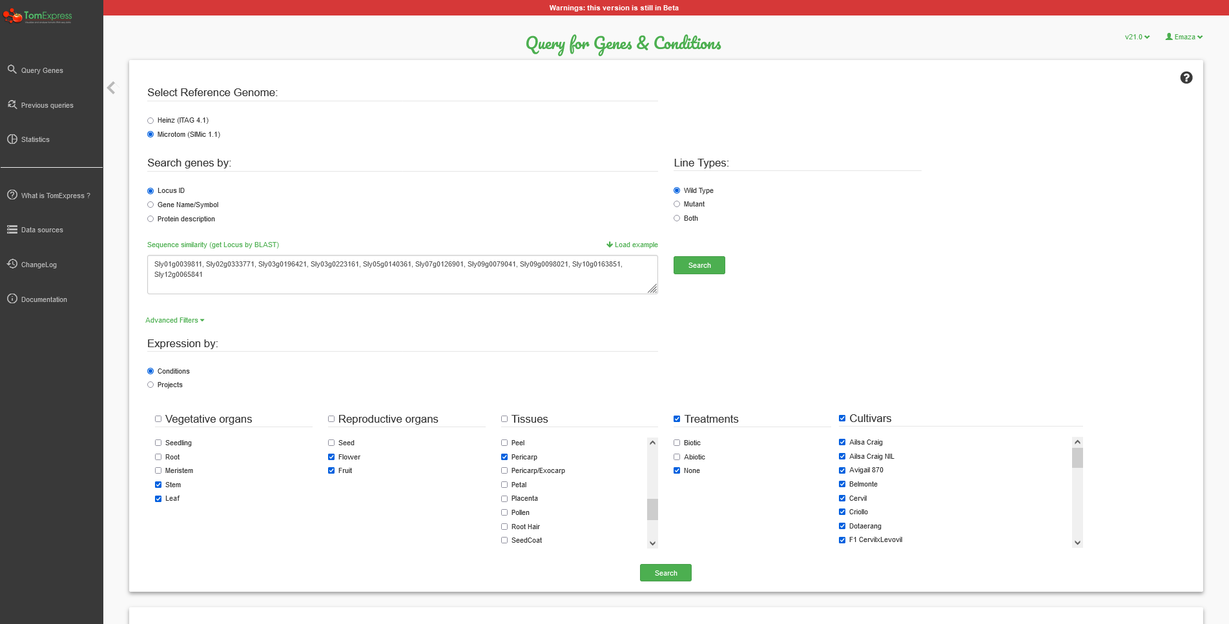
(1) Press “Load example” button to access to 10 predefined genes.
(3) Choose the desired conditions : Vegetative organs, Reproductive organs, Tissues, Treatments, and Cultivars.
(2) Press “Advanced Filters” button to query the desired conditions.
(4) Press “Search” button to extract expressions from corresponding genes and conditions.

Slide 5
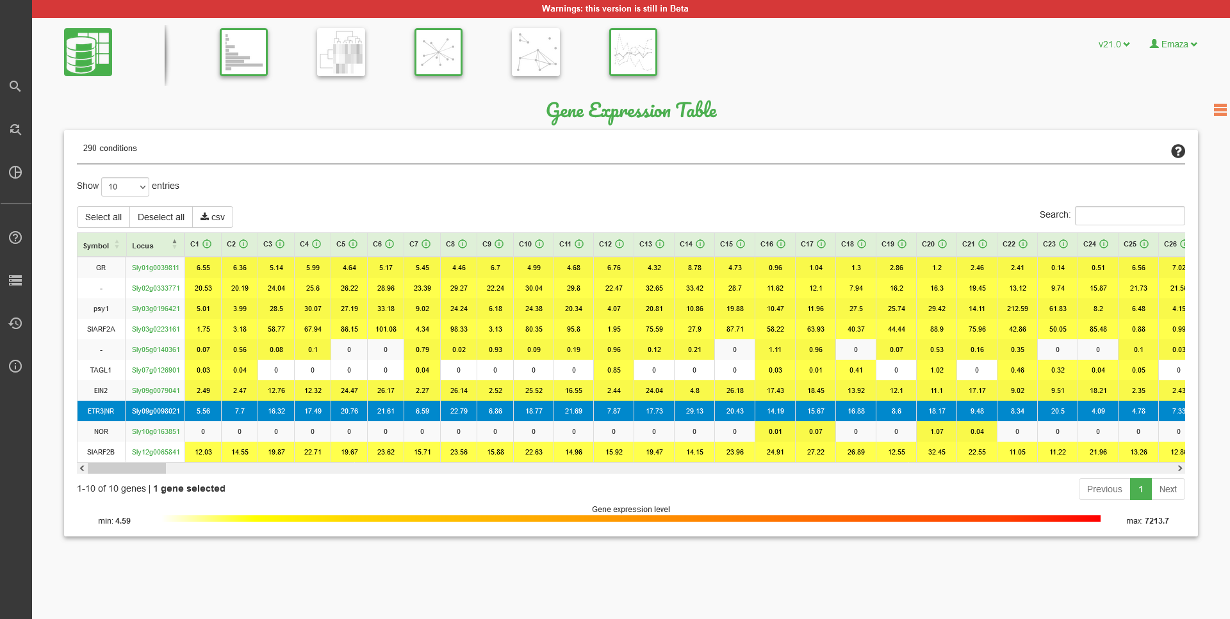
(2) Press the “Reference genes” button to proceed to the mining of reference gene candidates.
(1) Press the row of the desired target gene.

Slide 6
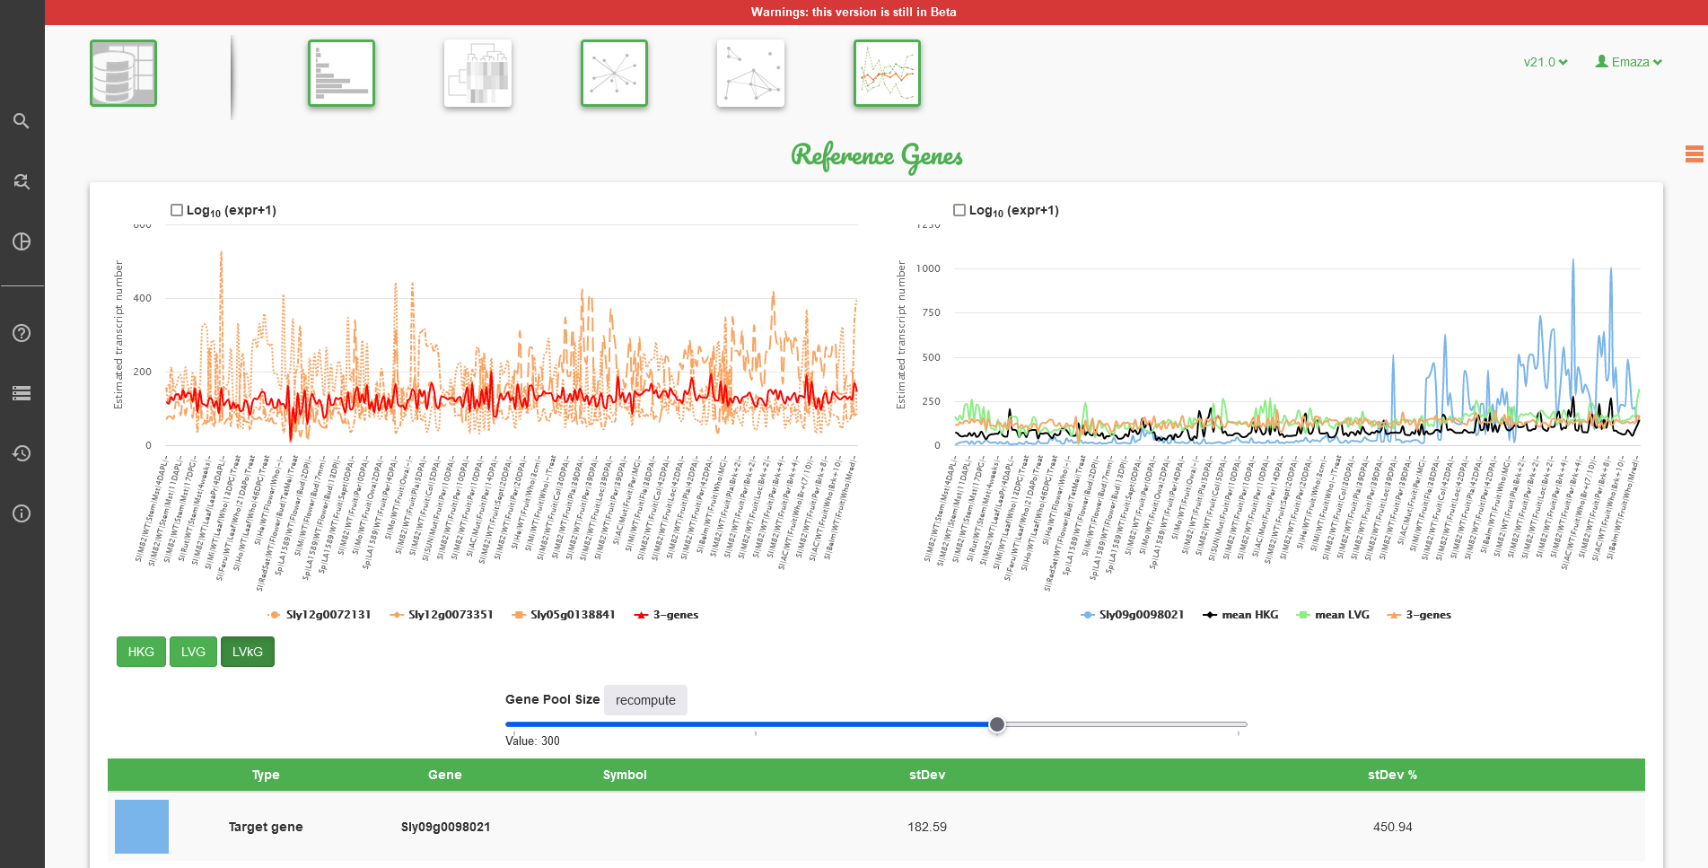
(a) The right graph shows the expression profiles of the target gene (blue line) and of the three mined reference gene candidates: the mean of the three HKGs (black line), the mean of the three LVGs (green line), and the best LV3G (orange line).
(b) The left graph shows the expression profiles of genes involved in a given method by pressing one of the buttons below: “HKG”, “LVG”, and “LVkG”.
(d) The data table below the graphs shows standard deviations of the reference gene candidates (in absolute value and in % of the mean HKG value).
(c) Choose the number of genes used for the mining of reference gene candidates, and press “recompute” to perform calculations. A bigger number will probably result on less variable expressions.

Slide 7
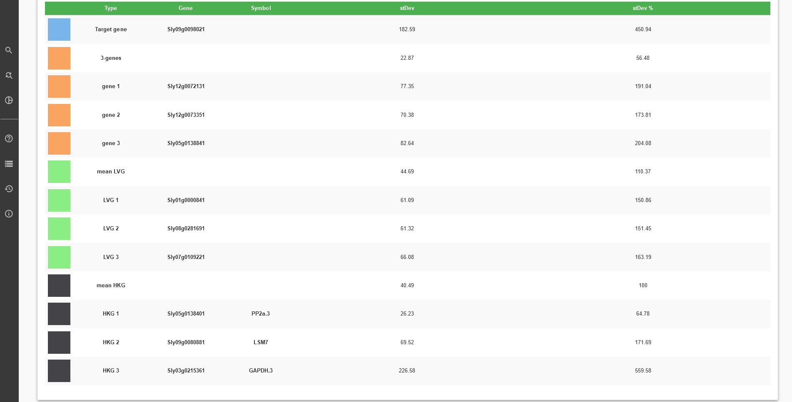
Standard deviations (in % of the mean HKG value) of the three mined reference gene candidates: the mean of the three HKGs (100%), the mean of the three LVGs, and the best LV3G.

