Slide 1
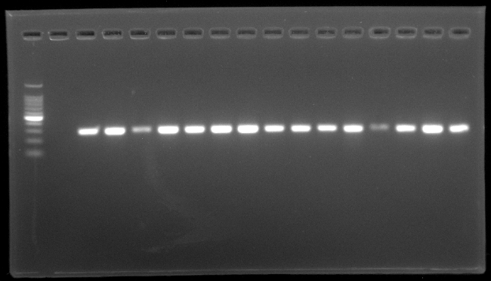
Zoonotic potential of methicillin-resistant Staphylococcus aureus isolated from pets and their owners in Bangladesh
Himangsu Sarker, Jayedul Hassan, A. K. M. Anisur Rahman, Darren R. Korber, Md. Mahbub Alam
M
NC
PC
1
2
3
4
5
6
7
8
9
10
11
12
13
14
279 bp
Supplementary Fig. 1. Representative photograph of amplification of nuc gene of S. aureus by PCR. Lanes: M, 100 bp size DNA marker; 1-14: DNA samples of S. aureus isolated in this study; PC, positive control; NC, negative control.

Slide 2
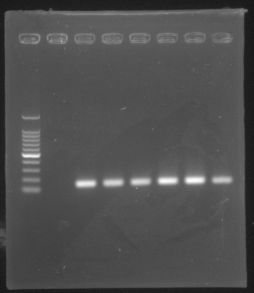
M
NC
PC
1
2
3
4
5
147 bp
Supplementary Fig. 2. Representative photograph of amplification of mecA gene of Methicillin resistant S. aureus (MRSA) by PCR. Lanes: M, 100 bp size DNA marker; 1-5, Methicillin resistant S. aureus (MRSA) isolated in this study; PC: positive control; NC, negative control.

Slide 3
Supplementary Fig. 3. Antibiotic susceptibility profiles of MRSA against 15 antimicrobials determined by disc diffusion method. The resistance pattern was described as resistant, intermediate and sensitive according to CLSI (CLSI, 2023) and the figure was generated on Microsoft Excel.

Slide 4
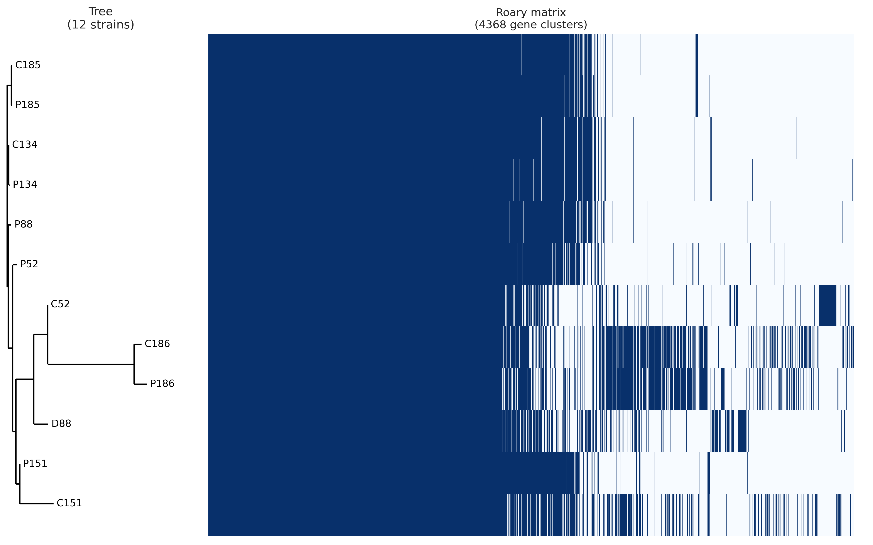
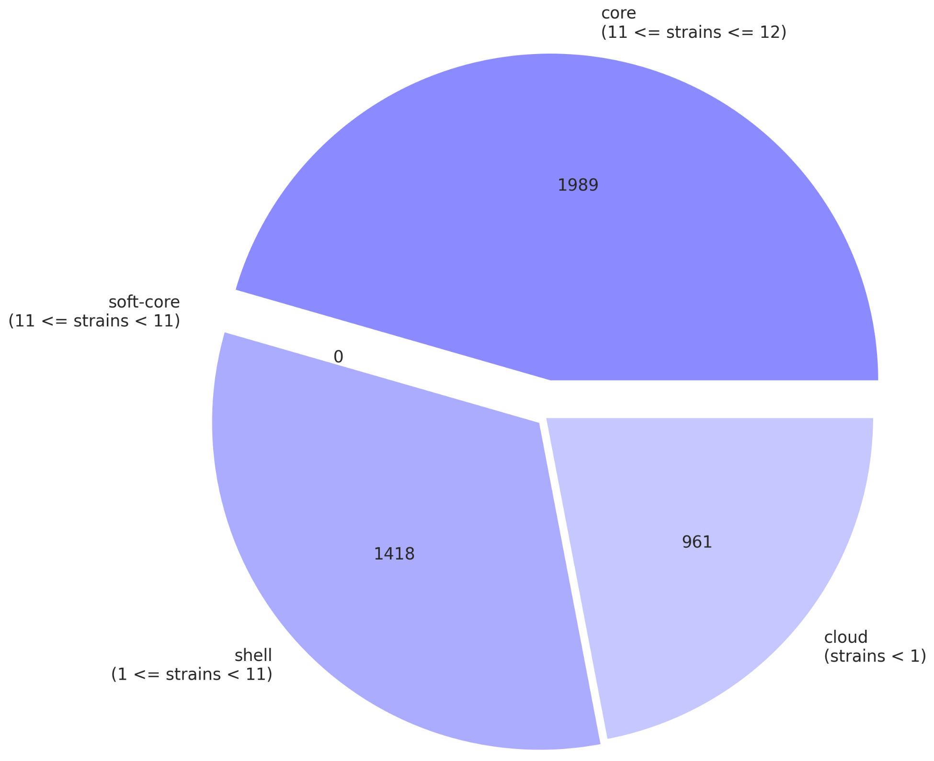
A
B
Supplementary Fig. 4. Pangenome analysis of S. aureus genomes described in this study. (A) breakdown of genes in the study genomes, (B) tree matrix constructed based on the presence and absence of core and accessory genes. Pangenome analysis was performed through Roary pangenome pipeline and the figures were prepared using roary_plots.py script..

Slide 5
Supplementary Fig. 5. Breakdown of genes in the pet-owner genome pairs. Gene breakdown was calculated by Pangenome analysis performed individually on the pairs. Types of genes are indicated by color shadings as indicated in the legends.

Slide 6
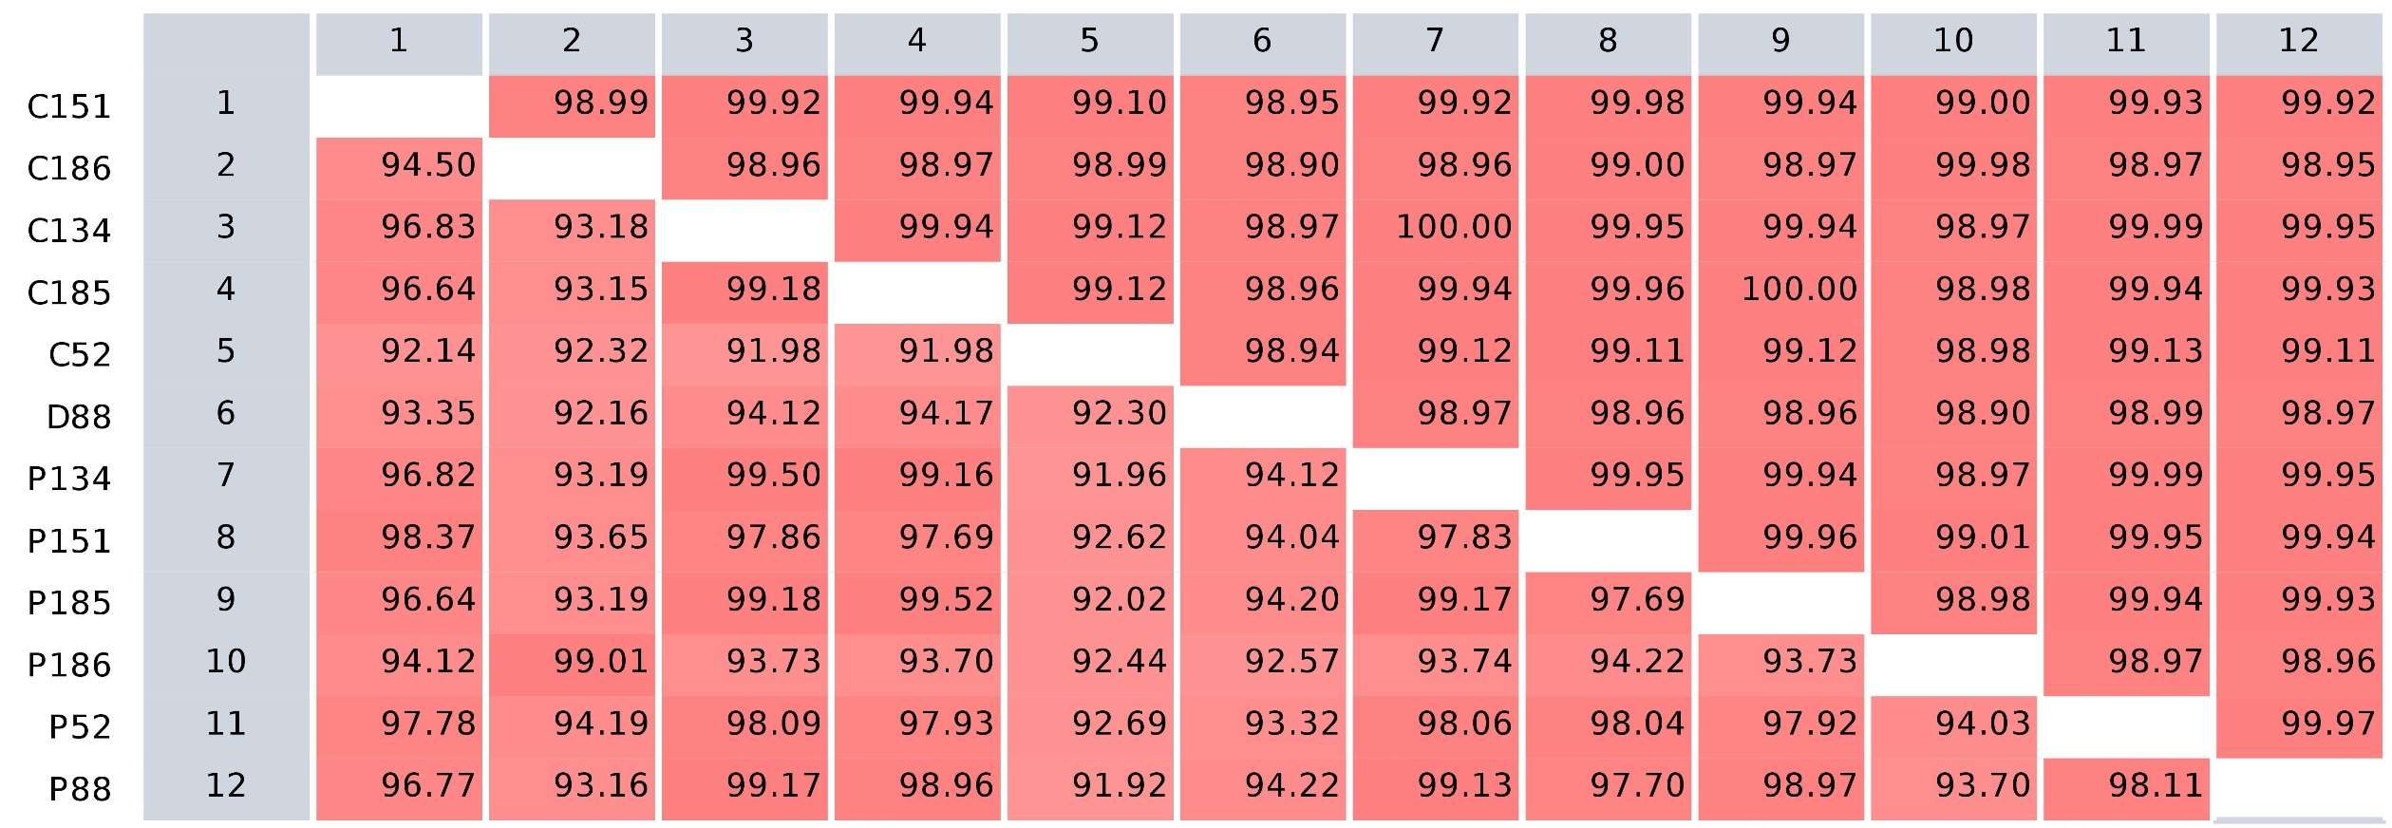
Supplementary Fig. 6. Pairwise comparison of S. aureus whole genome sequences described in this study. The left panel indicates the strain ID’s. The matrix shows the average sequence identity (upper) and protein identity (lower) between the genomes. The comparison was performed on CLC Genomics Workbench 24.0.2 (Qiagen Aarhus, Denmark).

