Slide 1
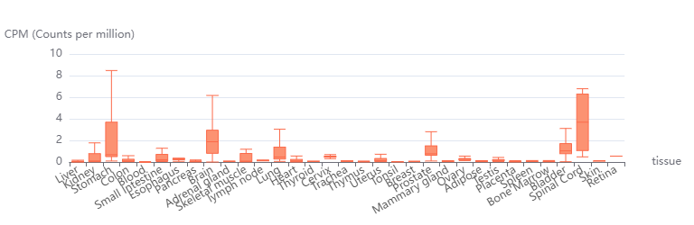
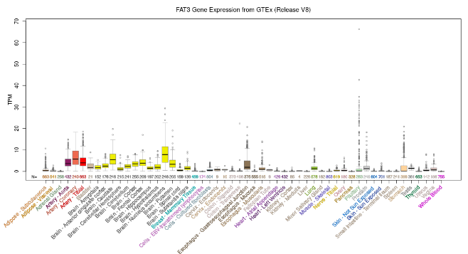
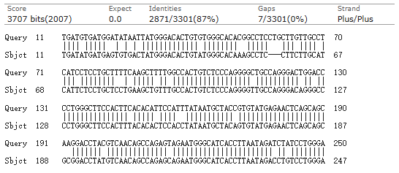
Figure S1
A
B
C
Figure S1. Gene expression profiles and homology analysis. (A) The expression of circFat3 (hsa_circ_0000348) in multiple tissues from the circAtlas database. (B) The expression of FAT3 in multiple tissues from the GTEx database. (C) The result of homology analysis between mmu_circ_0001746 and hsa_circ_0000348.

Slide 2
Figure S2
A
0 day
1 day
2 day
4 day
8 day
Standard
1 2 3 4
1 2 3 4
1 2 3 4
1 2 3 4
1 2 3 4
mt-co1
(195 bp)
28S rRNA
25℃ treatments
(105 bp)
circFat3
(276 bp)
B
C
25℃-circFat3/mt-co1/K value
25℃-circFat3/28S rRNA/K value
Linear
Linear
Quadratic
Quadratic
Relative levels
Cubic
Relative levels
Cubic
PMI (d)
PMI (d)
D
25℃ 1.5 day
25℃ 4 day
mt-co1
28S rRNA
circFat3
mt-co1
28S rRNA
circFat3
(195 bp)
(105 bp)
(276 bp)
(195 bp)
(105 bp)
(276 bp)
Figure S2. Construction and validation of 25℃ PMI models for nine-week-old mice using semi-quantitative RT-PCR. (A) The postmortem levels of mt-co1, 28S rRNA, and circFat3 in brain tissue at days 0, 1, 2, 4, and 8 at 25℃. (B) The linear, quadratic, and cubic equations constructed based on circFat3 and mt-co1 at 25℃. (C) The linear, quadratic, and cubic equations constructed based on circFat3 and 28S rRNA at 25℃. (D) The electrophoresis results of validation samples at 1.5 and 4 days for 25℃ models. The grouping of gels cropped from different gel was divided by the white space. The standard sample was used to eliminate the influence of exposure conditions.

