Slide 1
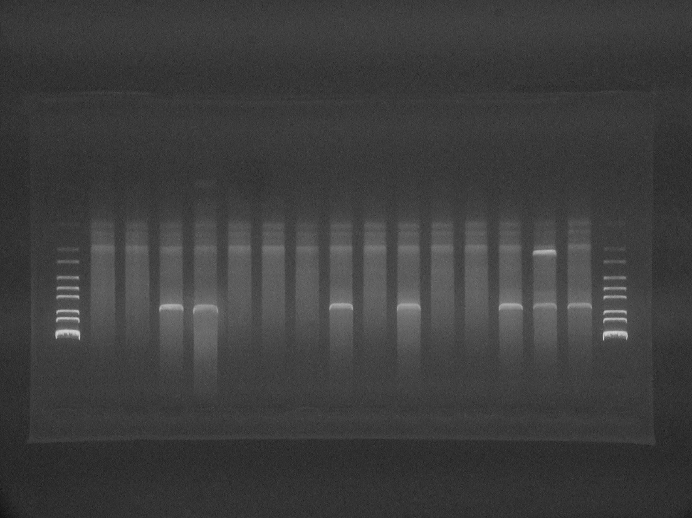
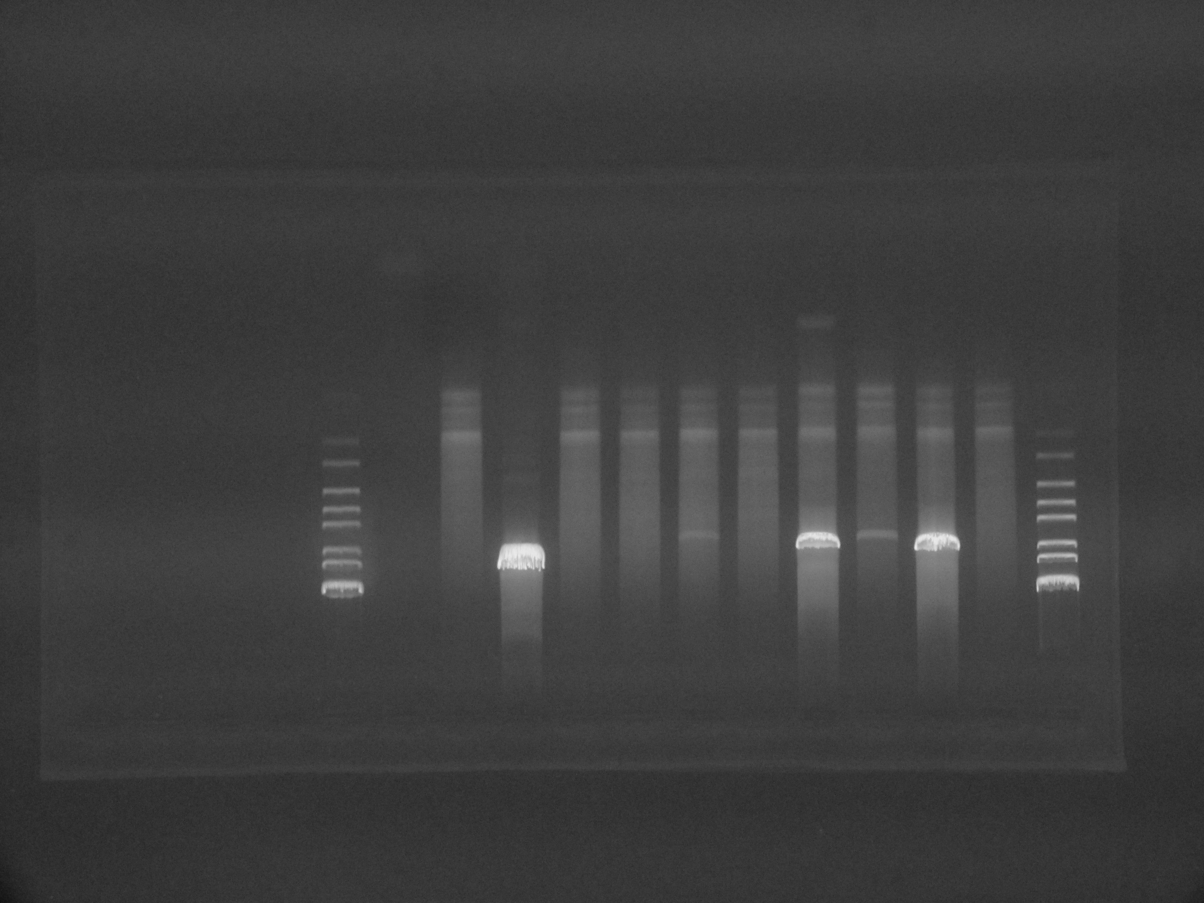

Supplemental Figure S1
(a)
NPT II promoter
HA
Agtrap cDNA
SV40poly A
Forward PCR primer
Reverse PCR primer
(b)
Tg 1 Tg 2 Tg 3 Tg 4 Tg 5 Tg 6 Tg 7 Tg 8 Tg 9 Tg 10 Tg 11 Tg 12 Tg 13 Tg 14 Tg 15 Tg 16 Tg 17 Tg 18 Tg 19 Tg 20 Tg 21 Tg 22 Tg 23 P.C. N.C
19.3
7.7
6.3
4.3
3.5
2.7
1.9
1.5
0.9
(kbp)
Tg18 through Tg23 died prior to weaning.
(c)
10
(d)
10
8
8
LC
6
Tg6 (PT-ATRAP-Tg)
6
Renal ATRAP mRNA expression
(ratio to LC)
Relative ATRAP
mRNA expression level
4
4
2
2
0
0
Heart
Kidney
Liver
Lung
Tg 1 Tg 6 Tg 8 Tg 12 Tg 1 3 Tg 1 7
ATRAP Transgenic mice founders
Kidney

Slide 2
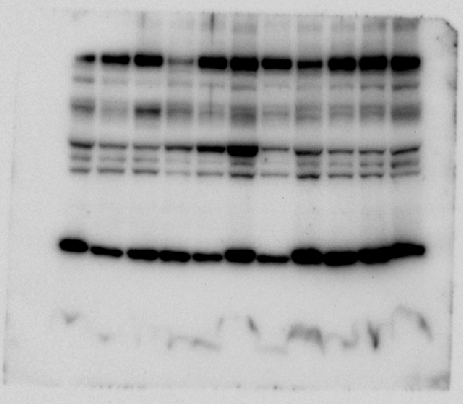
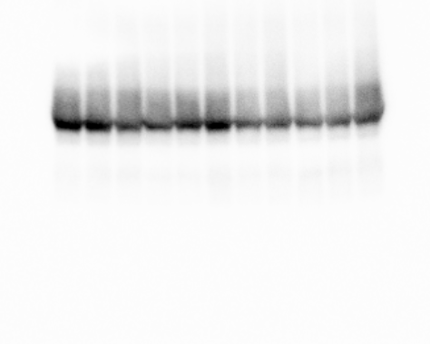
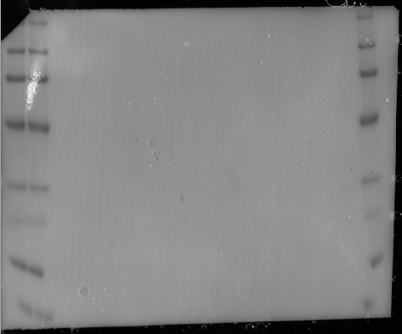
Supplemental Figure S2
αENaC (full-length membrane)
Marker size
137
96
73
Sham Nx Sham Nx
46
Sham Nx Sham Nx
Sham Nx Nx
31
21
18
6.3
Flotillin-2 (full-length membrane)
Marker size
Marker size
137
137
96
96
73
73
Sham Nx Sham Nx
Sham Nx Sham Nx
Sham Nx Nx
46
46
31
31
21
21
18
18
6.3
6.3
Full scan of the entire original blots incubated with αENaC and Flotillin-2. Panels are images optimized by ChemiDoc Touch (Bio-Rad Laboratories). Black box indicates the representative image shown in Fig. 1e.

Slide 3
Supplemental Figure S3
ATRAP (full-length membrane)
Marker size
Marker size
137
137
96
96
73
73
46
46
31
31
21
21
LC PT-Tg LC PT-Tg LC PT-Tg LC PT-Tg LC PT-Tg
18
18
6.3
6.3
GAPDH (full-length membrane)
Marker size
Marker size
137
137
96
96
73
73
46
46
LC PT-Tg LC PT-Tg LC PT-Tg LC PT-Tg LC PT-Tg
31
31
21
21
18
18
6.3
6.3
Full scan of the entire original blots incubated with ATRAP and GAPDH. Panels are images optimized by ChemiDoc Touch (Bio-Rad Laboratories). Black box indicates the representative image shown in Fig. 2a.

Slide 4
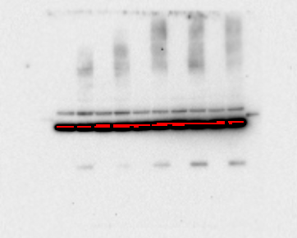
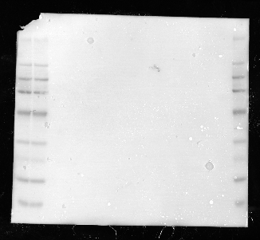
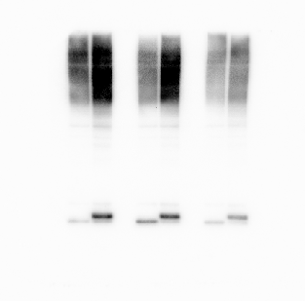
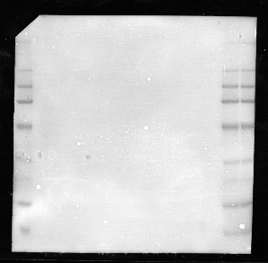
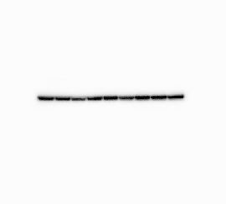
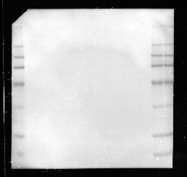
Supplemental Figure S4
HA (full-length membrane)
Marker size
Marker size
249
249
137
137
96
96
73
73
46
46
31
31
21
21
LC LC LC LC LC
PT-Tg PT-Tg PT-Tg PT-Tg PT-Tg
18
18
6.3
6.3
ATRAP (full-length membrane)
Marker size
Marker size
249
249
137
137
96
96
73
73
46
46
31
31
21
21
WT Tg KO WT Tg KO WT Tg KO
18
18
6.3
6.3
GAPDH (full-length membrane)
Marker size
Marker size
249
249
137
137
96
96
73
73
46
46
WT Tg KO WT Tg KO WT Tg KO
31
31
21
21
18
18
6.3
6.3

Slide 5
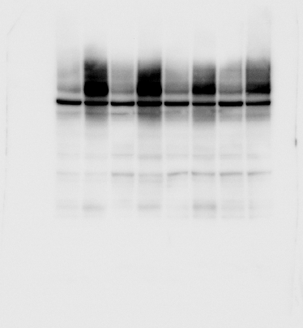
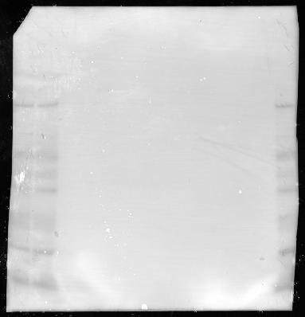
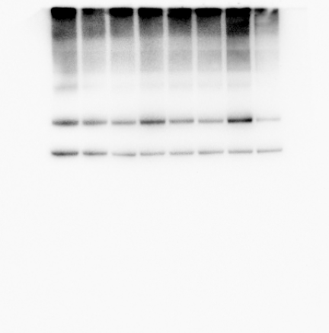
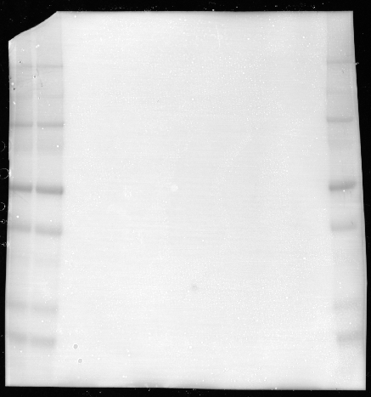
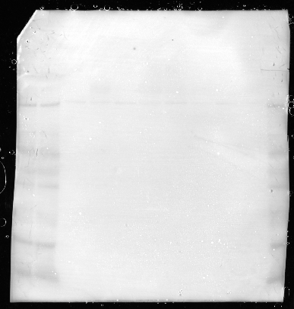
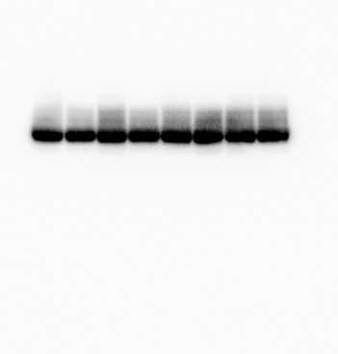
Supplemental Figure S5
SGLT2 (full-length membrane)
Marker size
Marker size
249
249
137
137
96
96
LS LN TS TN LS LN TS TN
73
73
Relative renal SGLT2
/ flotillin level (%)
46
46
31
31
21
21
Sham Nx Sham Nx
18
18
LC PT-Tg
6.3
6.3
NHE-3 (full-length membrane)
Marker size
Marker size
225
225
150
150
102
102
Relative renal NHE-3
/ flotillin level (%)
LS LN TS TN LS LN TS TN
76
76
52
52
38
31
31
24
24
Sham Nx Sham Nx
17
17
LC PT-Tg
12
12
Flotillin-2 (full-length membrane)
Marker size
Marker size
249
249
137
137
96
96
73
73
LS LN TS TN LS LN TS TN
46
46
31
31
21
21
18
18
6.3
6.3

Slide 6
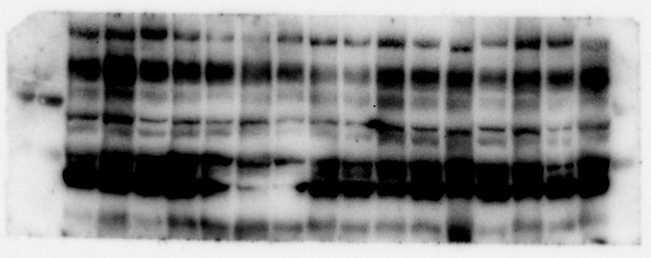
Supplemental Figure S6
αENaC (full-length membrane)
Marker size
137
96
73
46
Sham Nx Sham Nx
Sham Nx Sham Nx
Sham Nx Sham Nx
Sham Nx Sham Nx
31
LC PT-Tg
LC PT-Tg
LC PT-Tg
LC PT-Tg
Flotillin-2 (full-length membrane)
Marker size
Marker size
137
137
96
96
73
73
Sham Nx Sham Nx
Sham Nx Sham Nx
Sham Nx Sham Nx
Sham Nx Sham Nx
46
46
LC PT-Tg
LC PT-Tg
LC PT-Tg
LC PT-Tg
31
31
Full scan of the entire original blots incubated with αENaC and Flotillin-2. Panels are images optimized by ChemiDoc Touch (Bio-Rad Laboratories). Black box indicates the representative image shown in Fig. 4c.

