Slide 1
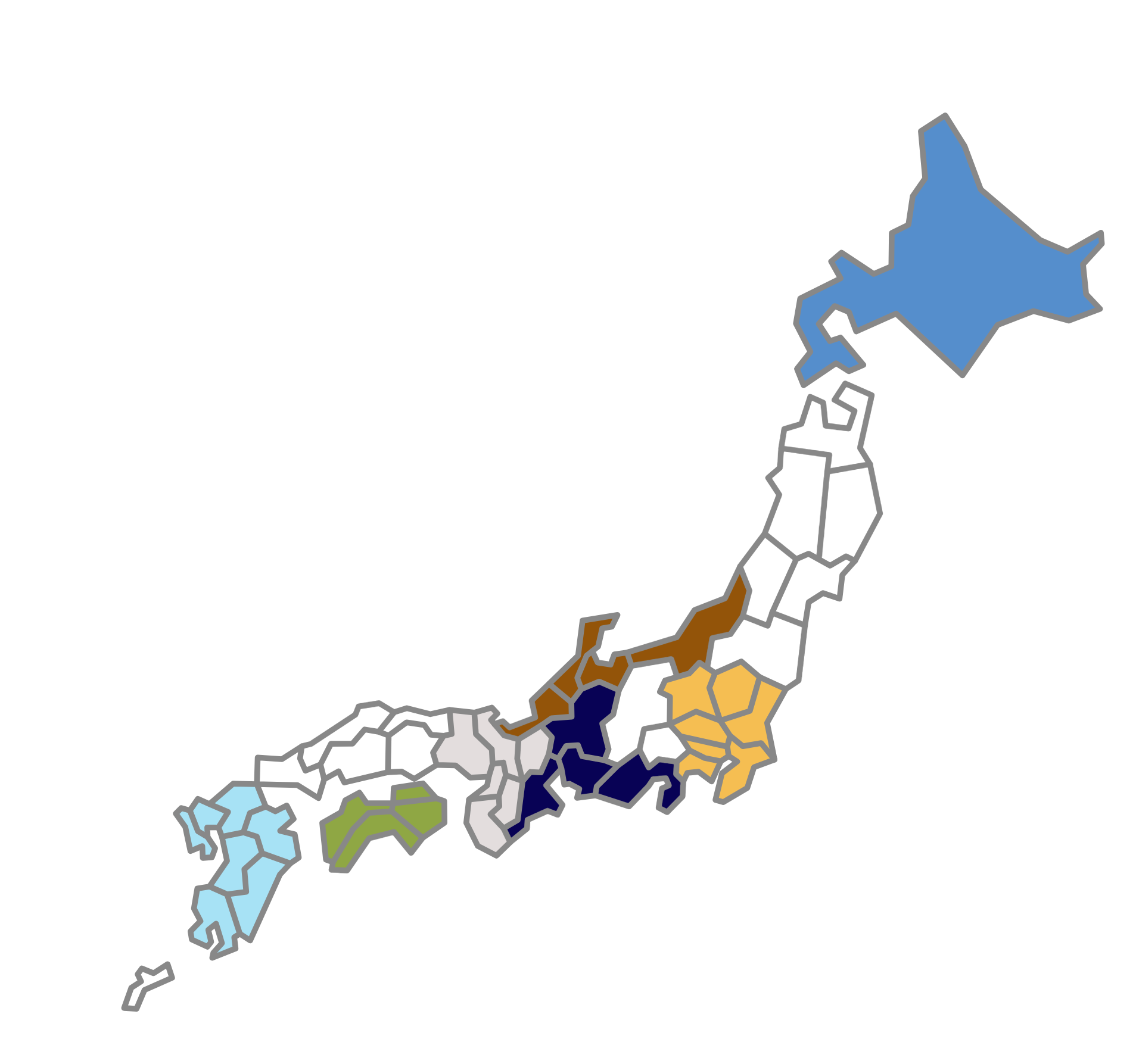
Supple Fig. 1
A
Origin of Japanese cystinuria patients
Jomon origin likely
1％
Hokkaido
Yayoi origin likely
8％
2％
Jomon origin likely
Kansai
Hokuriku
1％
Kyusyu
Unknown 3%
Kanto
Shikoku
Tokai
77％
1％
7％
B
% of the cohort

