Slide 1
S7
Drugs docking human platelet glycoprotein (CD41/61)
It was noticed that except ascorbate, all examined drugs can dock 3fcs via binding to many amino acids. Of these, acacetin, artemisinin, calcitriol, indirubin, kaempferol, phytic, quinapril, thymoquinone, tryptanthrin, enalapril, nitazoxanide, candesartan and enalapril docked 3fcs via binding many amino acids especially, (Cys528, Cys674), (Cys528), (Cys501) (Cys506, Cys486), (Cys486, Cys501, Cys503), (Cys528, Cys674), (Cys462), (Cys608), (Cys528, Cys674), (Cys674), (Cys528, Cys674) and (Cys674, Asn675), (Cys674), respectively, (black arrow). Except ferulic and methionine sulfoximine, all examined drugs can target the high predicted B-cell epitopes on 3fcs (red star).

Slide 2
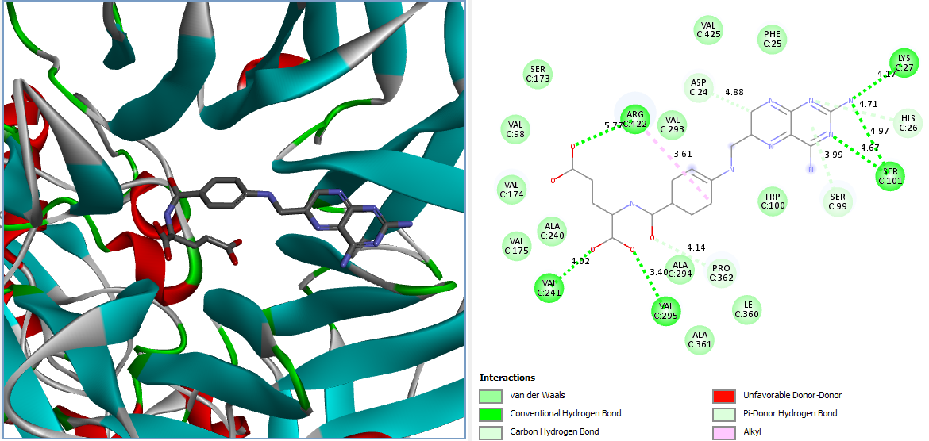
Fig. S7a : Aminopterin docked human CD41/61 (3fcs)

Slide 3
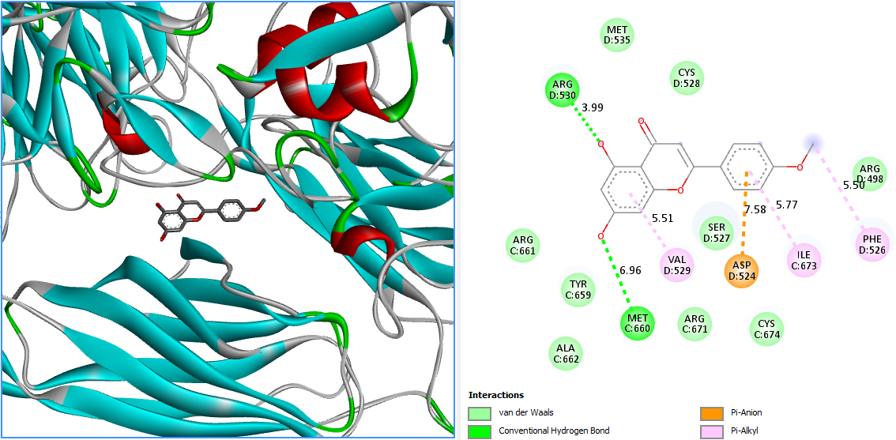
Fig. S7b : Acacetin docked human CD41/61 (3fcs)

Slide 4
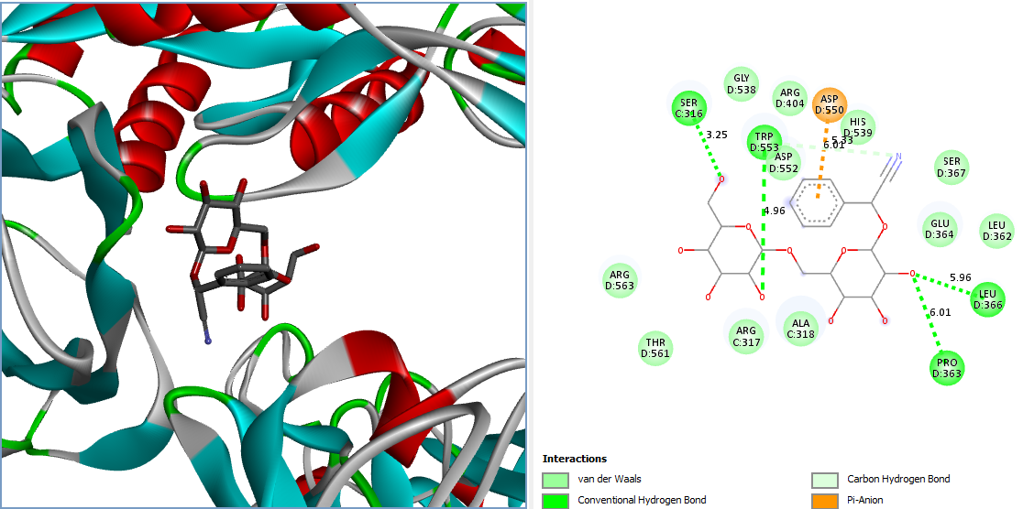
Fig. S7c : amygdalin docked human CD41/61 (3fcs)

Slide 5
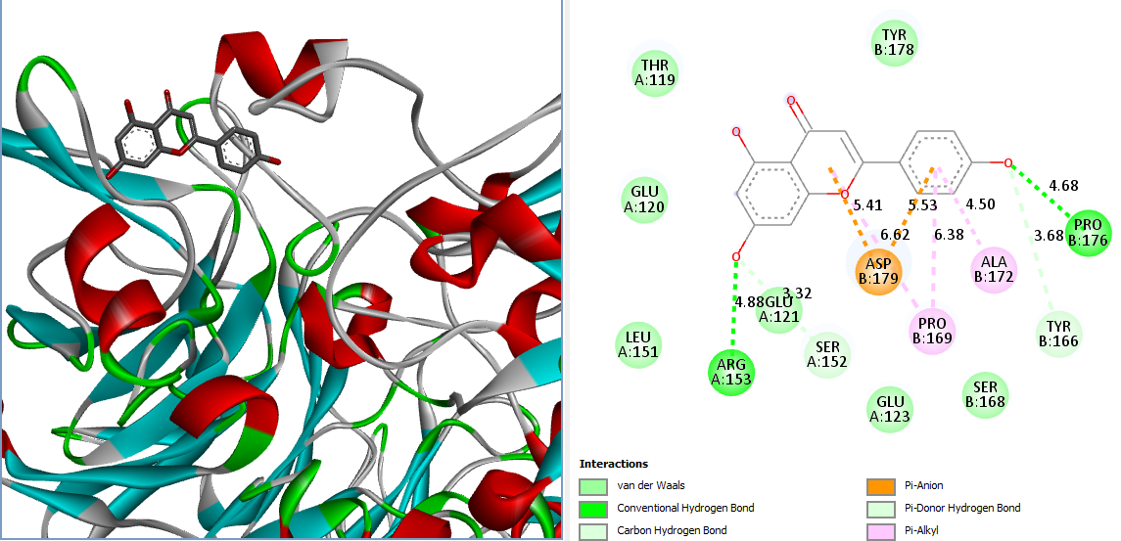
Fig. S7d: apigenin docked human CD41/61 (3fcs)

Slide 6
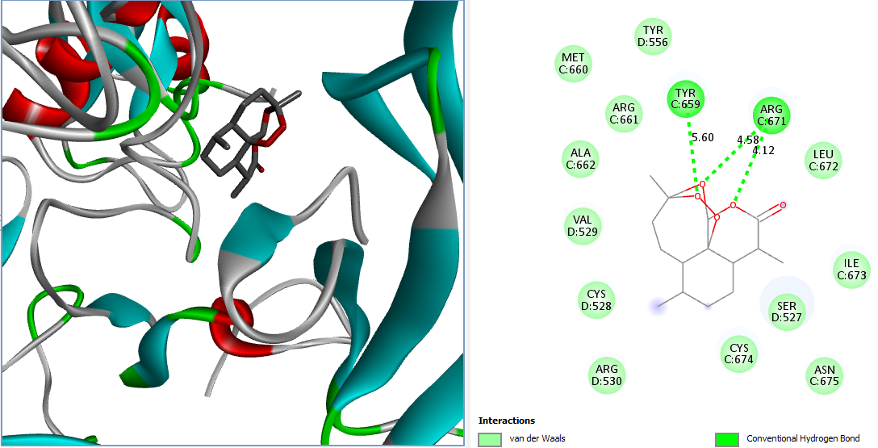
Fig. S7e: Artemisinin docked human CD41/61 (3fcs)

Slide 7
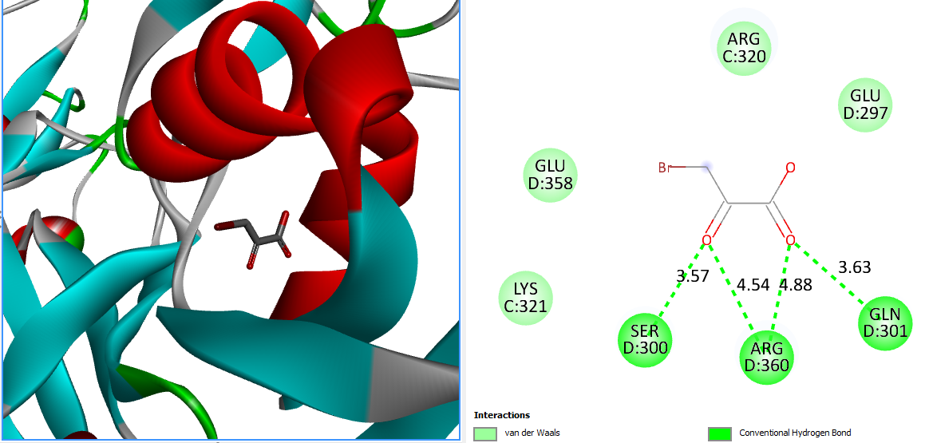
Fig. S7f:Bromopyruvate docked human CD41/61 (3fcs)

Slide 8
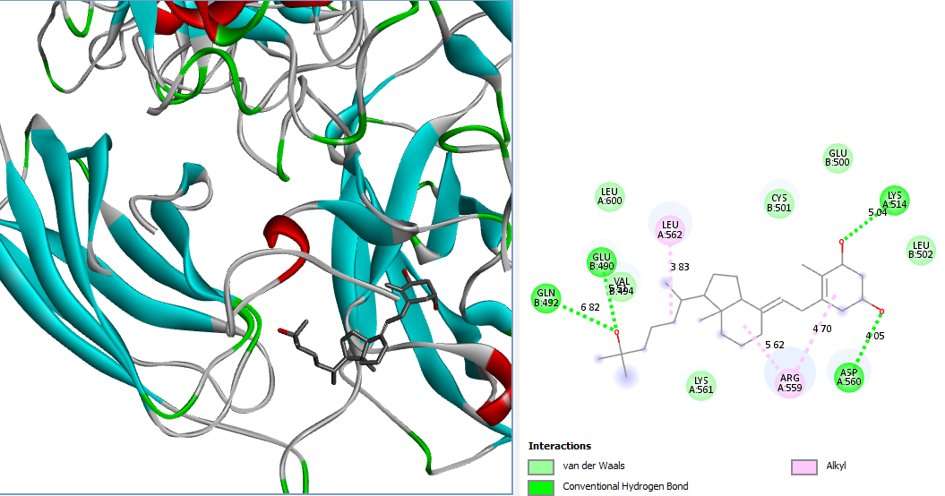
Fig. S7g: Calcitriol docked human CD41/61 (3fcs)

Slide 9
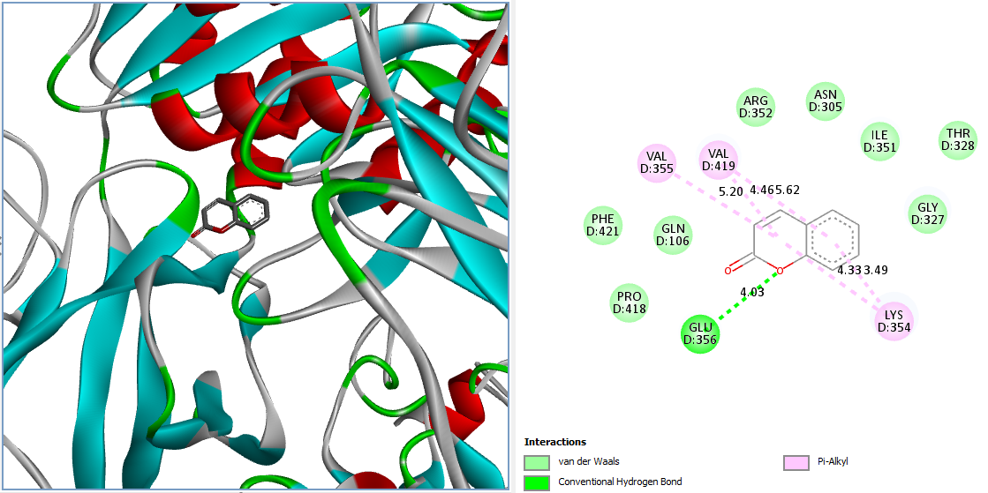
Fig. S7h: Coumarin docked human CD41/61 (3fcs)

Slide 10
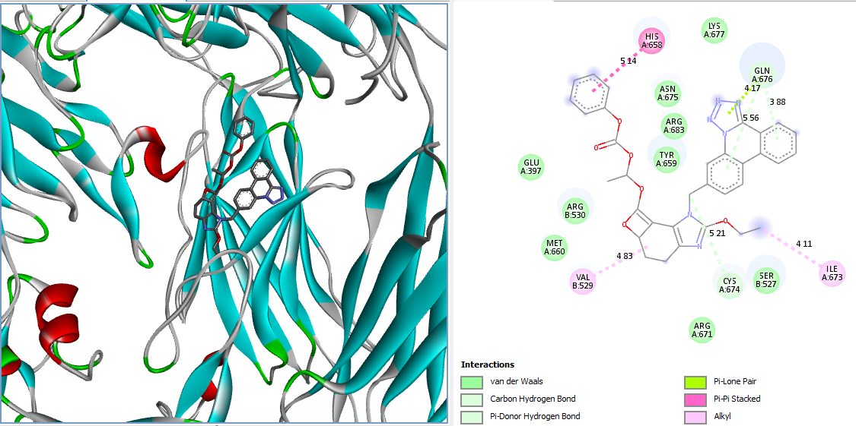
Fig. S7i: Candesartan docked human CD41/61 (3fcs)

Slide 11
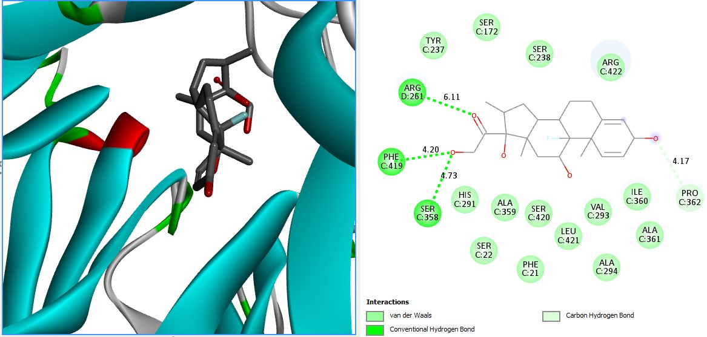
Fig. S7j: dexamethasone docked human CD41/61 (3fcs)

Slide 12
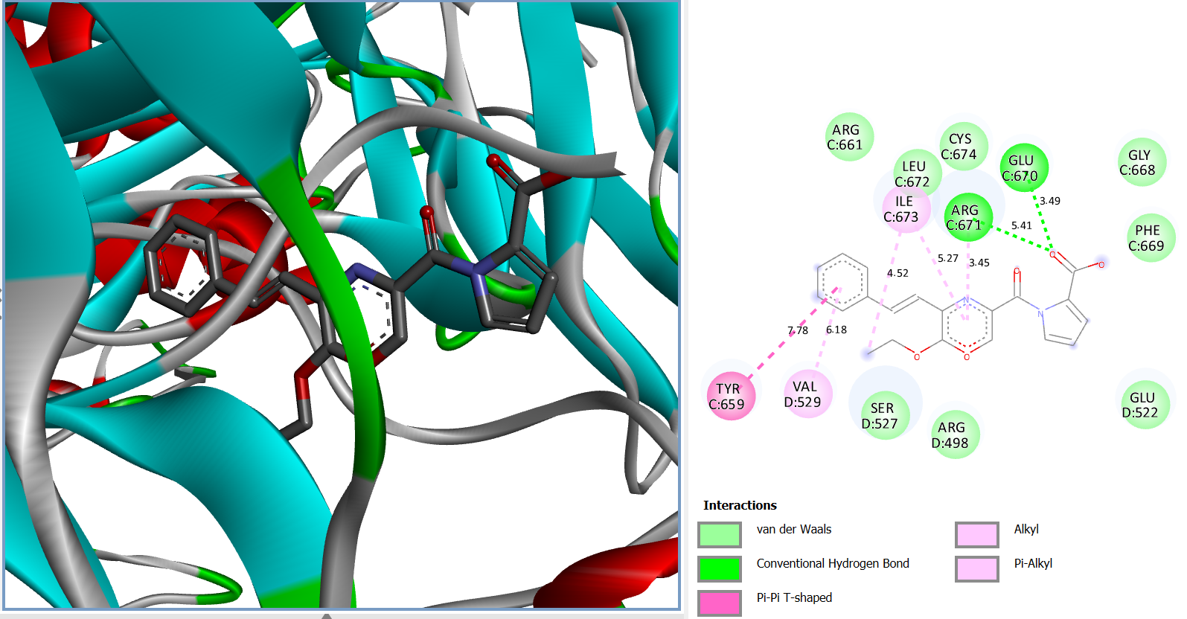
Fig. S7k: Enalapril docked human CD41/61 (3fcs)

Slide 13
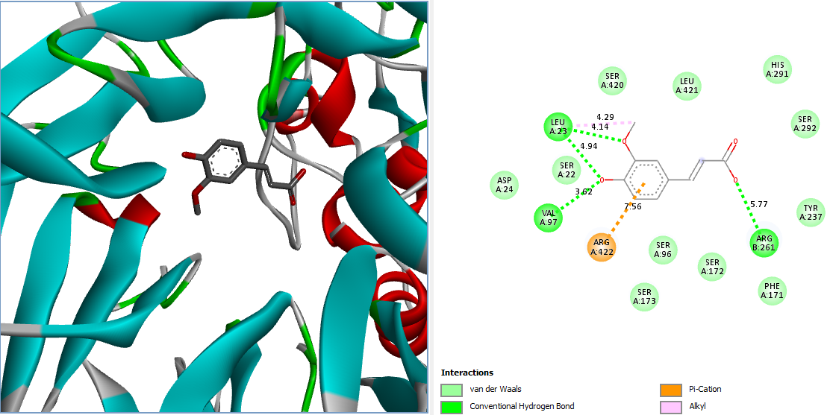
Fig. S7l: Ferulic docked human CD41/61 (3fcs)

Slide 14
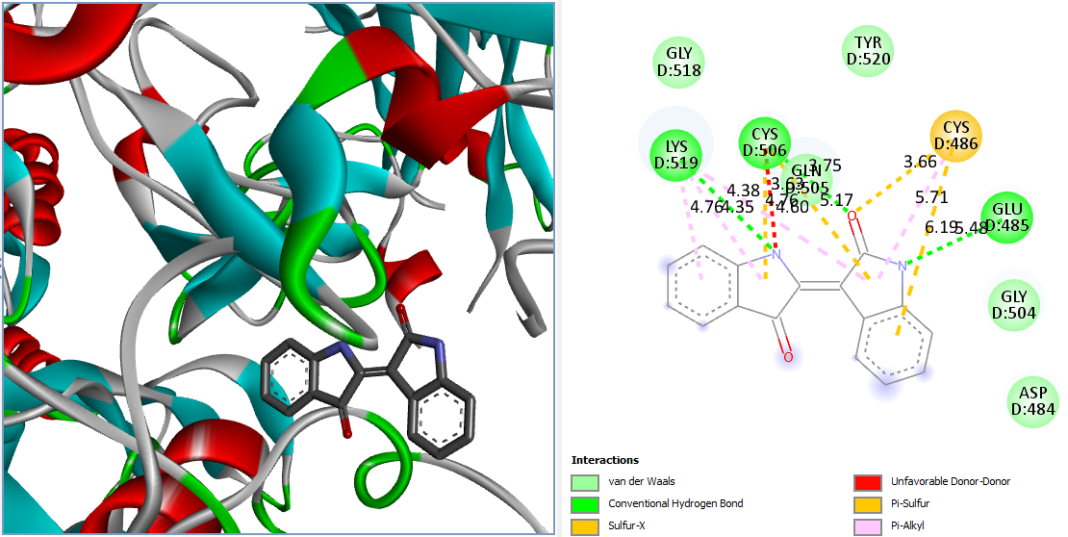
Fig. S7m: Indirubin docked human CD41/61 (3fcs)

Slide 15
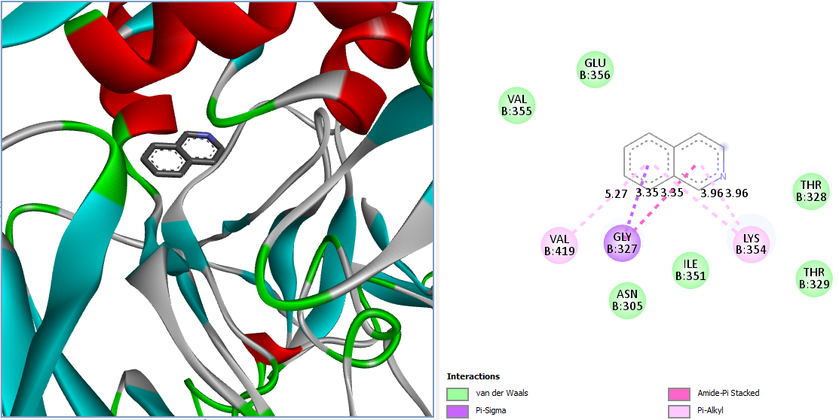
Fig. S7n: Isoquinolone docked human CD41/61 (3fcs)

Slide 16
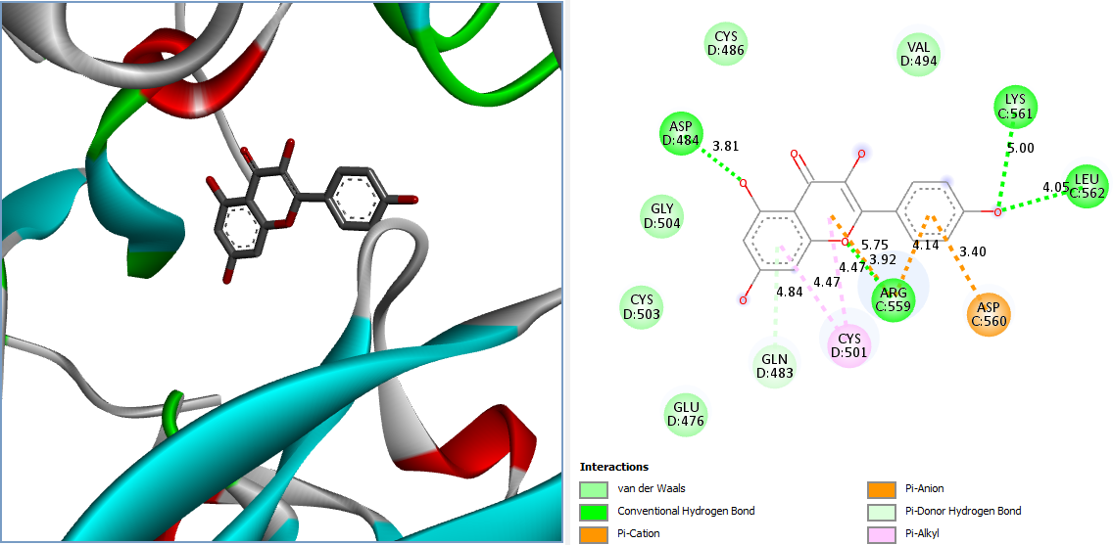
Fig. S7o: Kaempferol docked human CD41/61 (3fcs)

Slide 17
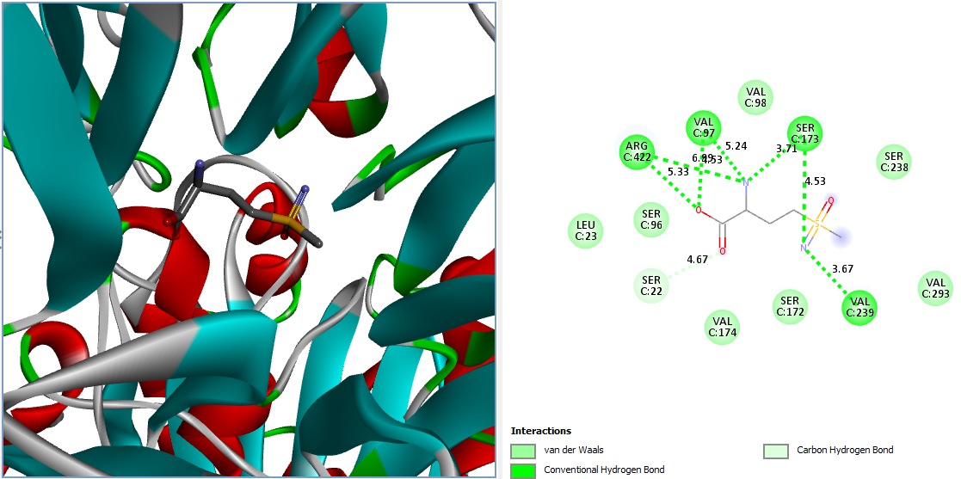
Fig. S7p: Methionine sulfoximine docking CD41/61 (3fcs)

Slide 18
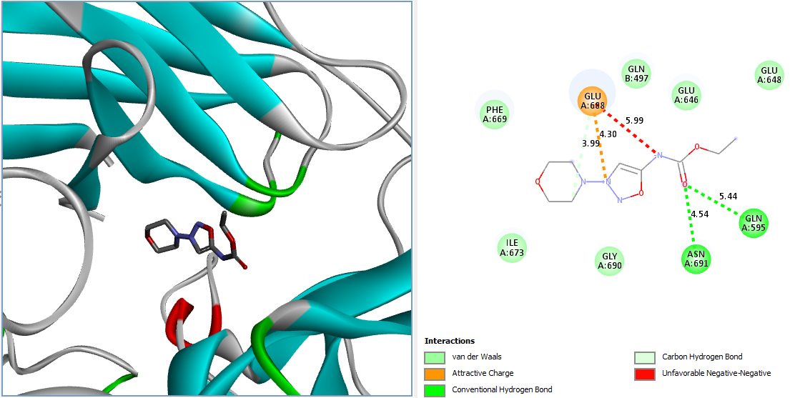
Fig. S7q: Molsidomine docked human CD41/61 (3fcs)

Slide 19
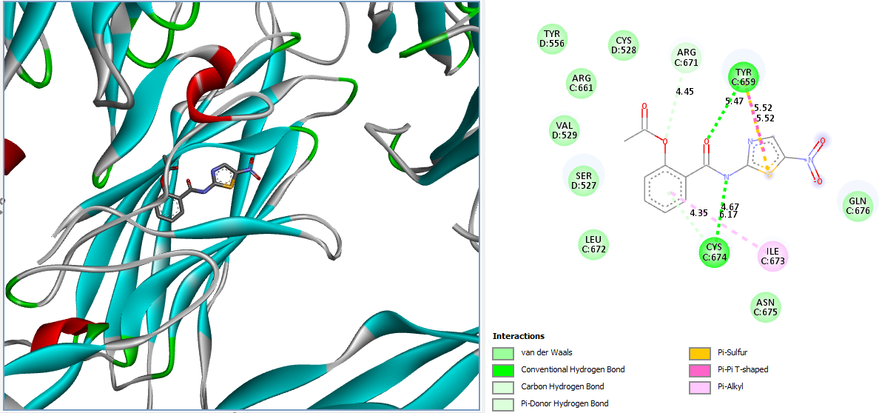
Fig. S7r: Nitazoxanide docked human CD41/61 (3fcs)

Slide 20
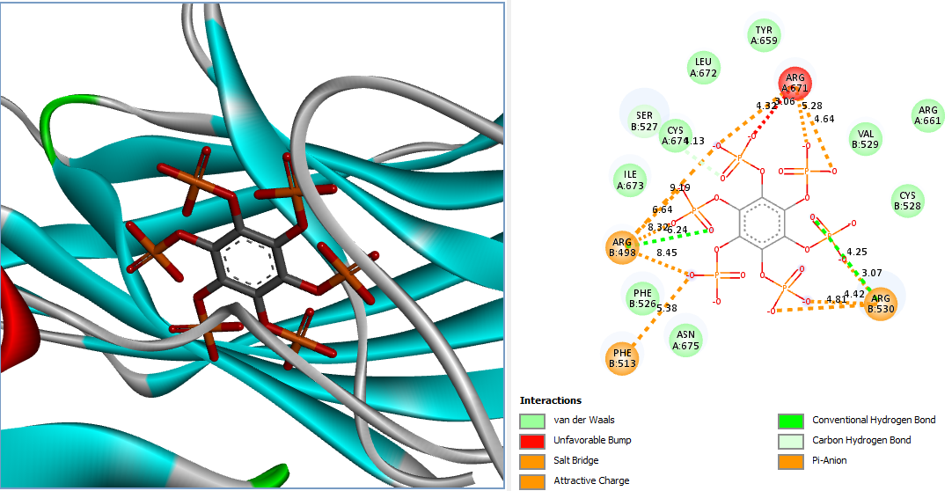
Fig. S7s: Phytic docked human CD41/61 (3fcs)

Slide 21
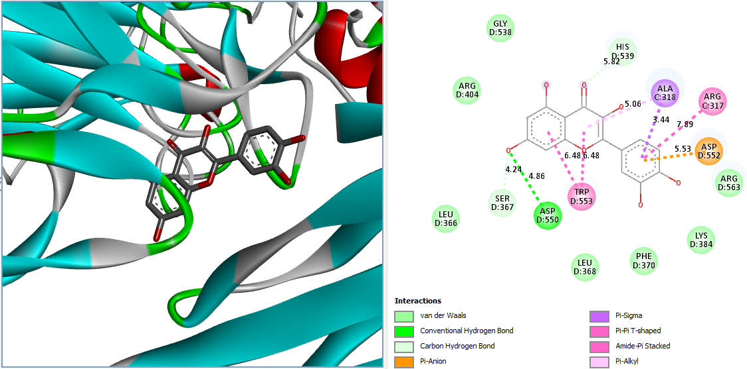
Fig. S7t: Quercetin docked human CD41/61 (3fcs)

Slide 22
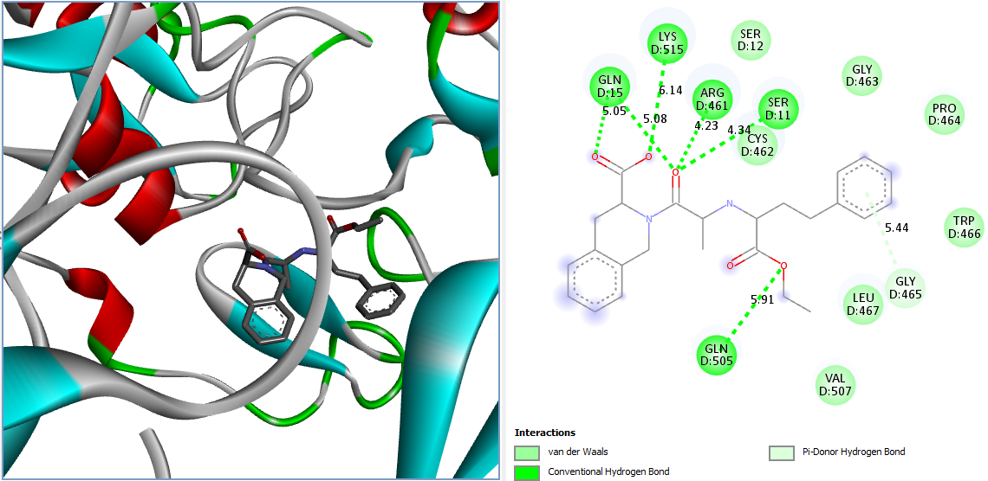
Fig. S7u: Quinapril docked human CD41/61 (3fcs)

Slide 23
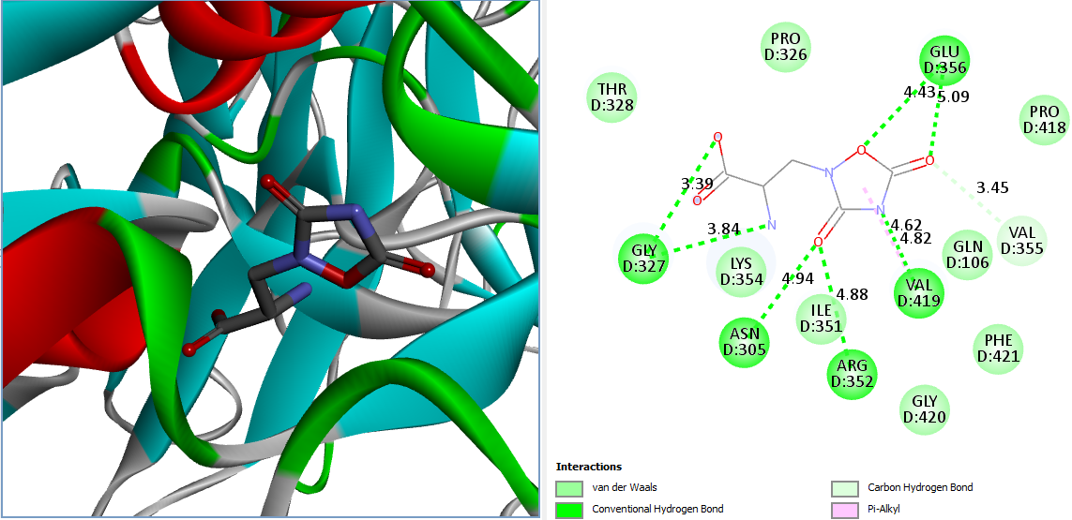
Fig. S7v: Quisqualic docked human CD41/61 (3fcs)

Slide 24
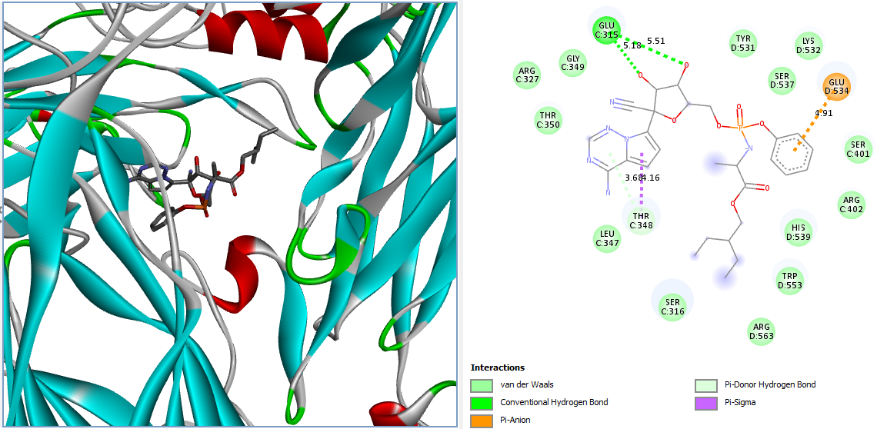
Fig. S7w: Remedsivir docked human CD41/61 (3fcs)

Slide 25
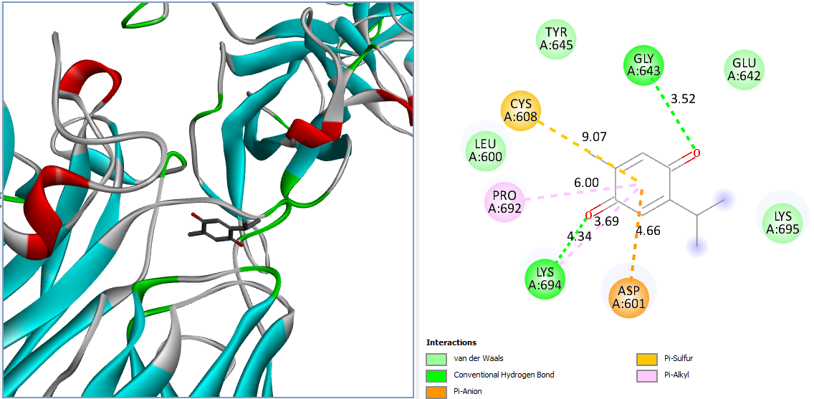
Fig. S7x: Thymoquinone docked human CD41/61 (3fcs)

Slide 26
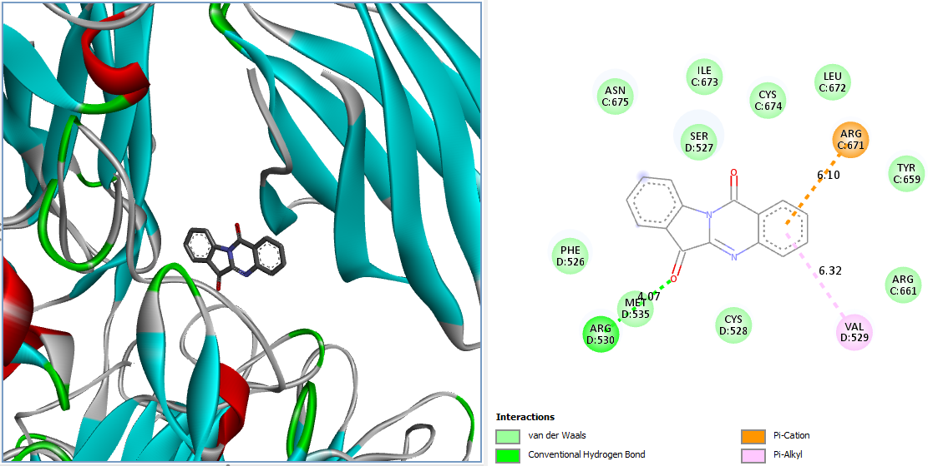
Fig. S7y: Tryptanthrin docked human CD41/61 (3fcs)

