Slide 1
S5
Drugs docking human IL-17A/IL-17RA (4hsa)
Table S5 showing summary of drug docking human IL-17A/IL-17RA (4hsa) via binding to critical residues for binding and glycosylation.
Drug | Targeted critical residues of IL-17A | Targeted critical residues of IL-17RA
Amygdalin |  | Cys245, Cys246, Cys272
Acacetin |  | Cys259, Leu260, Asn261, Asp262
Calcitriol |  | His212, Cys214
Ferulic |  | Thr90
Molsidomine | Asp29, Ser30
Quisqualic | Cys259
Aminopterin | Cys259, Cys263
Remdesivir | Arg101 | Trp31
Apigenin | Pro59, Arg101 | Trp31
Coumarin
Indirubin
Isoquinolone
Kaempferol
Thymoquinone
Tryptanthrin

Slide 2
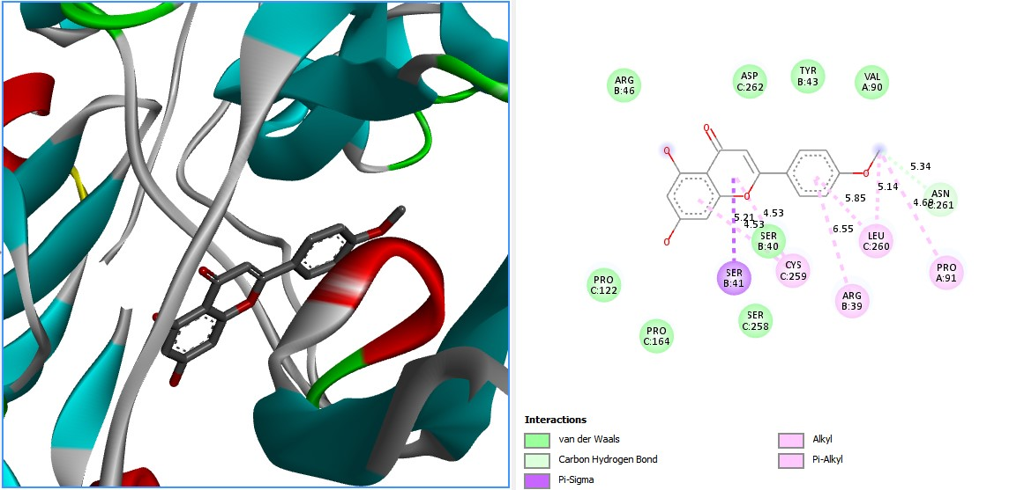
Fig. S2a : Acacetin docked human IL-17A/IL-17RA (4hsa)

Slide 3
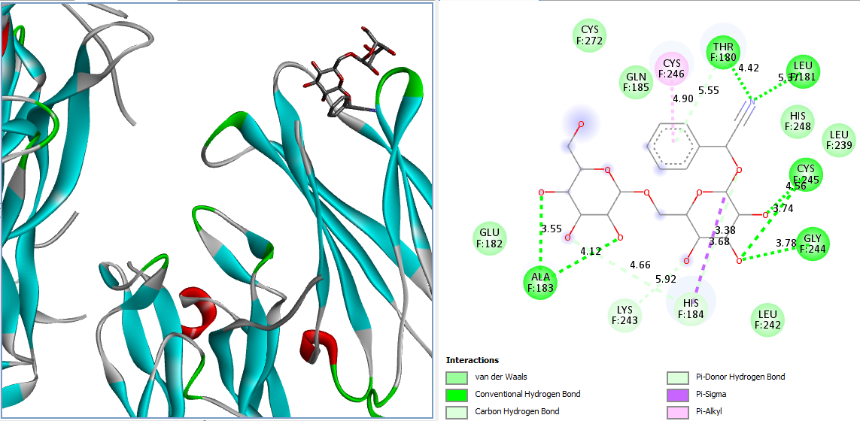
Fig. S2b : amygdalin docked human IL-17A/IL-17RA (4hsa)

Slide 4
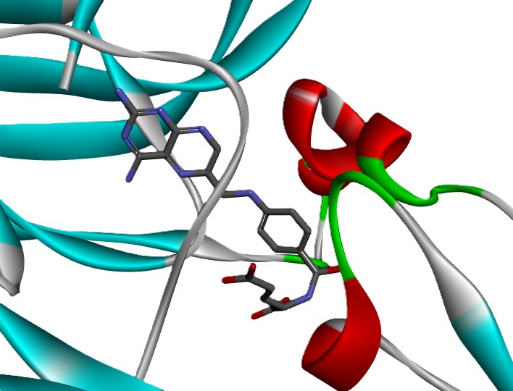
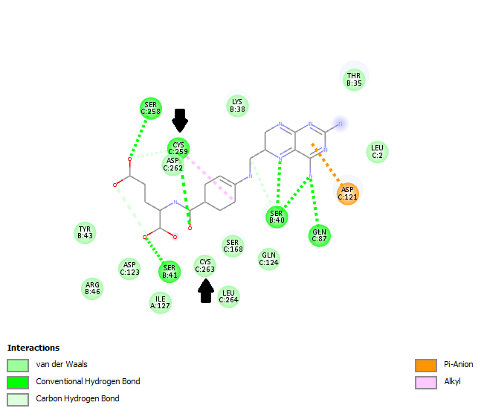
Fig. S2c : aminopterin docked human IL-17A/IL-17RA (4hsa)

Slide 5
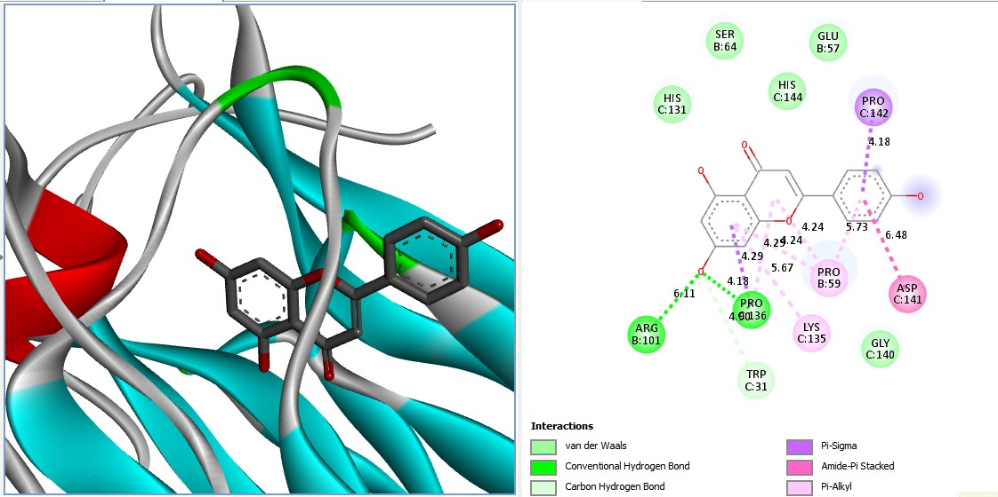
Fig. S2d: apigenin docked human IL-17A/IL-17RA (4hsa)

Slide 6
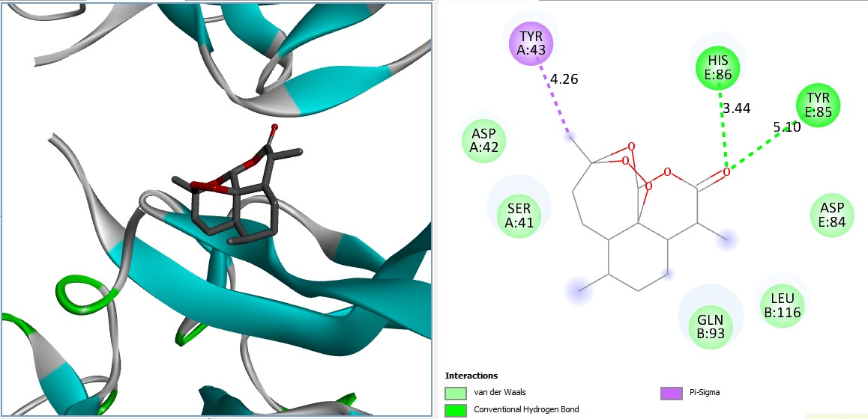
Fig. S2e: Aretmisinin docked human IL-17A/IL-17RA (4hsa)

Slide 7
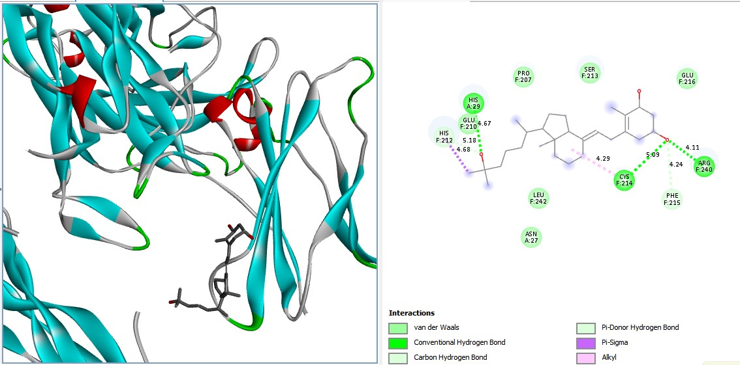
Fig. S2f: Calcitriol docked human IL-17A/IL-17RA (4hsa)

Slide 8
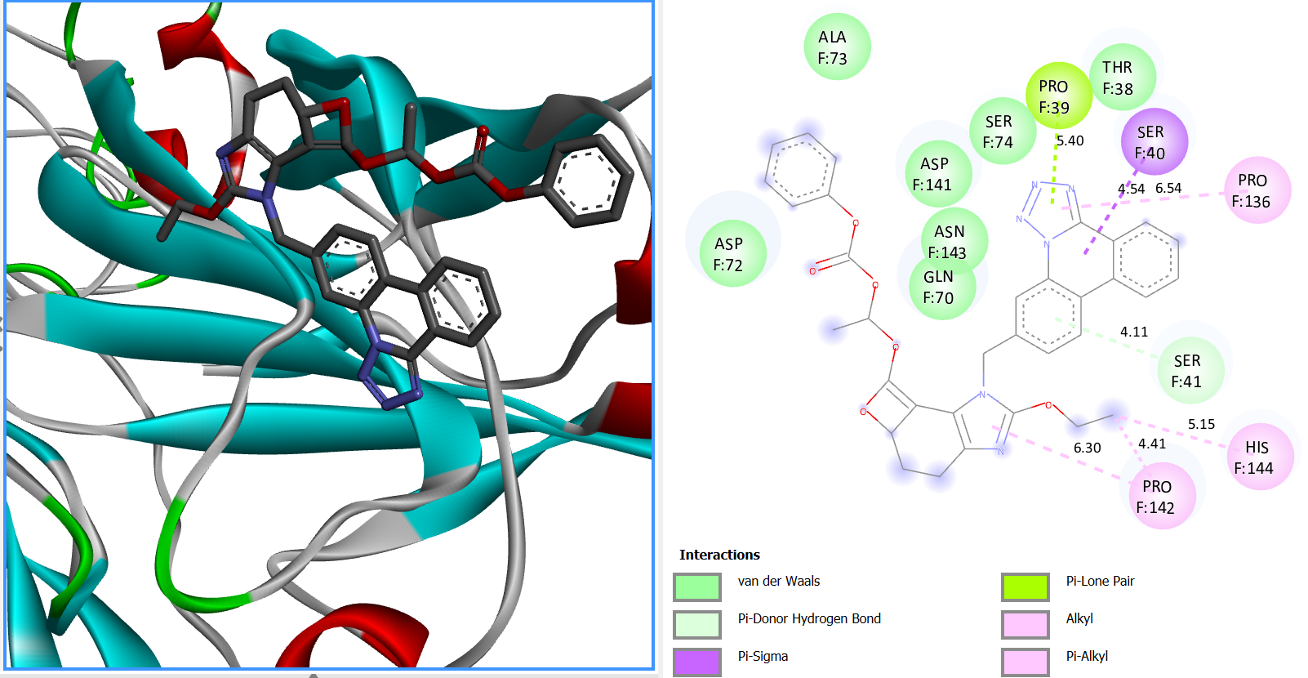
Fig. S2g: Candesartan docked human IL-17A/IL-17RA (4hsa)

Slide 9
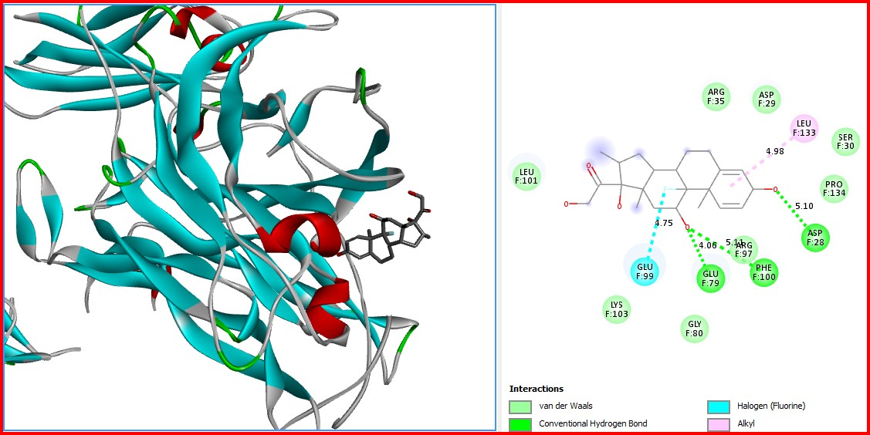
Fig. S2h: Dexamethasone docked human IL-17A/IL-17RA (4hsa)

Slide 10
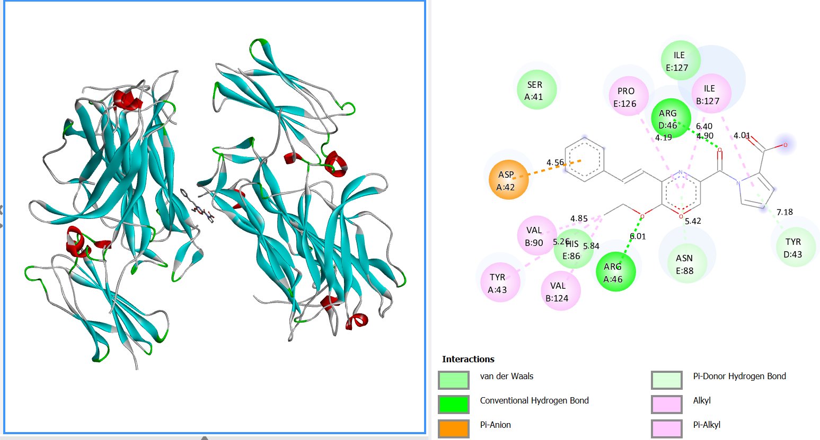
Fig. S2i: Enalapril docked human IL-17A/IL-17RA (4hsa)

Slide 11
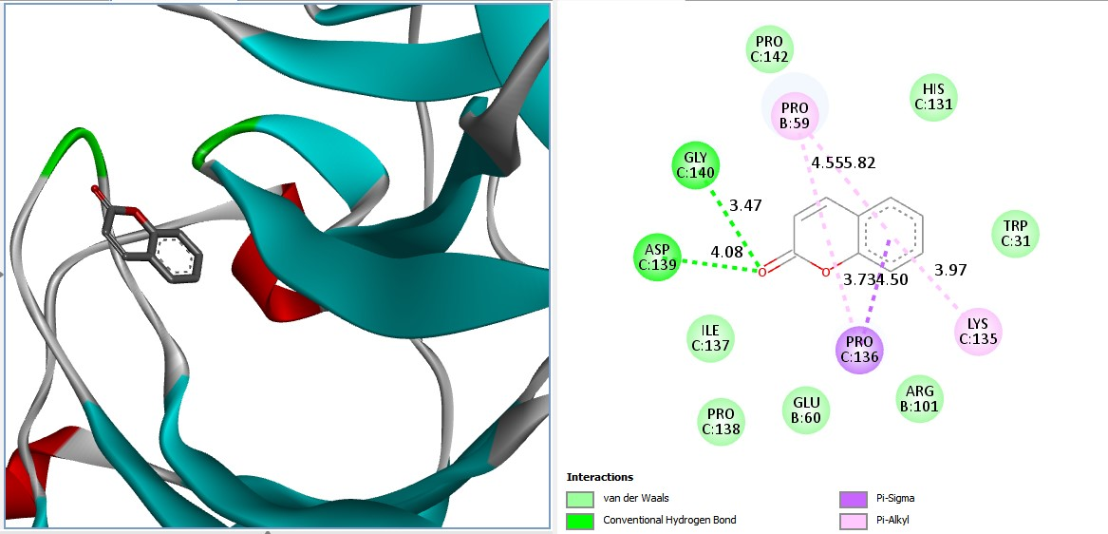
Fig. S2j: Coumarin docked human IL-17A/IL-17RA (4hsa)

Slide 12
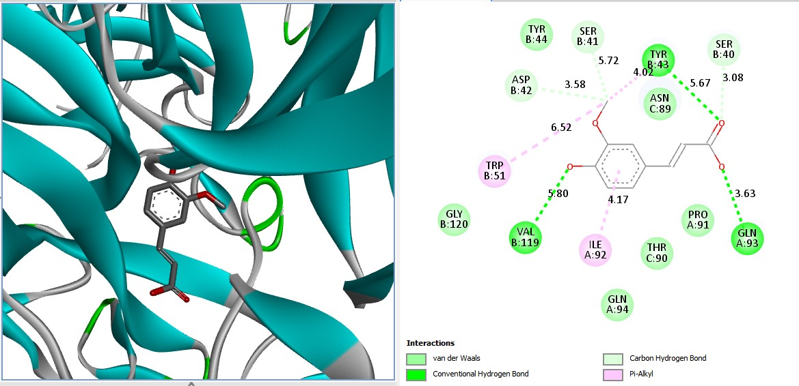
Fig. S2k: Ferulic docked human IL-17A/IL-17RA (4hsa)

Slide 13
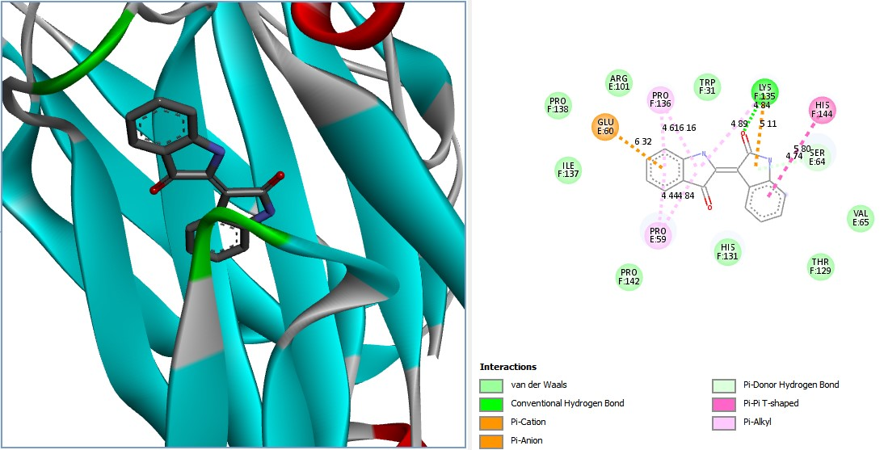
Fig. S2l: Indirubin docked human IL-17A/IL-17RA (4hsa)

Slide 14
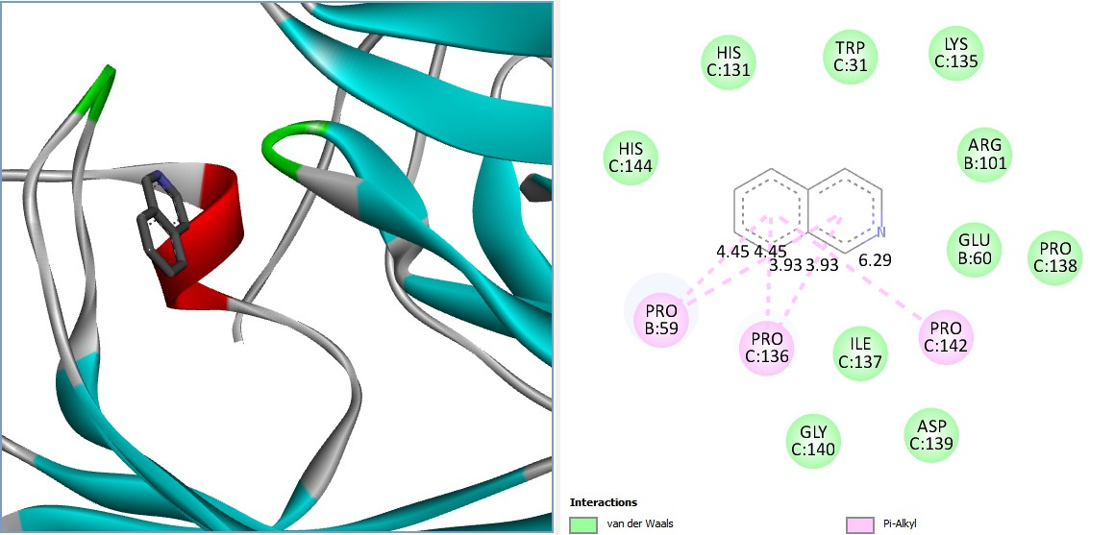
Fig. S2m: Isoquinolone docked human IL-17A/IL-17RA (4hsa)

Slide 15
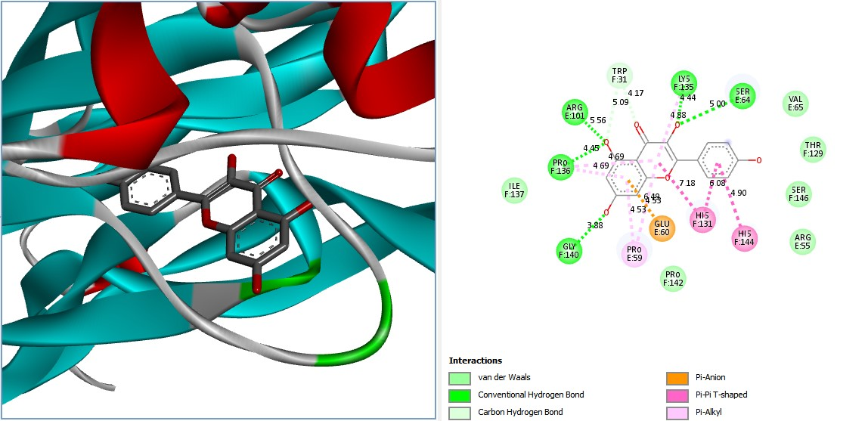
Fig. S2n: Kaempferol docked human IL-17A/IL-17RA (4hsa)

Slide 16
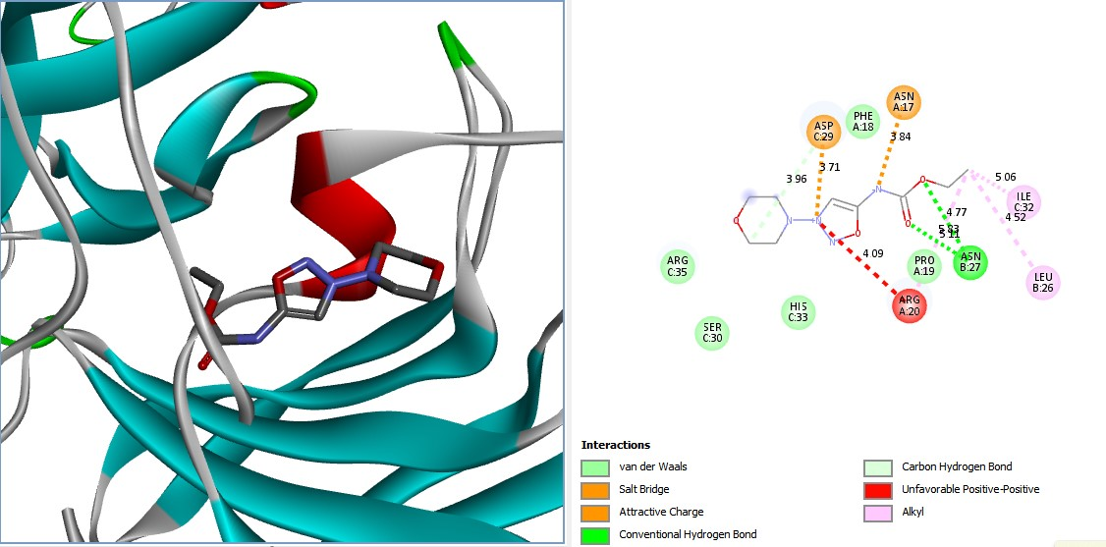
Fig. S2o: Molsidomine docked human IL-17A/IL-17RA (4hsa)

Slide 17
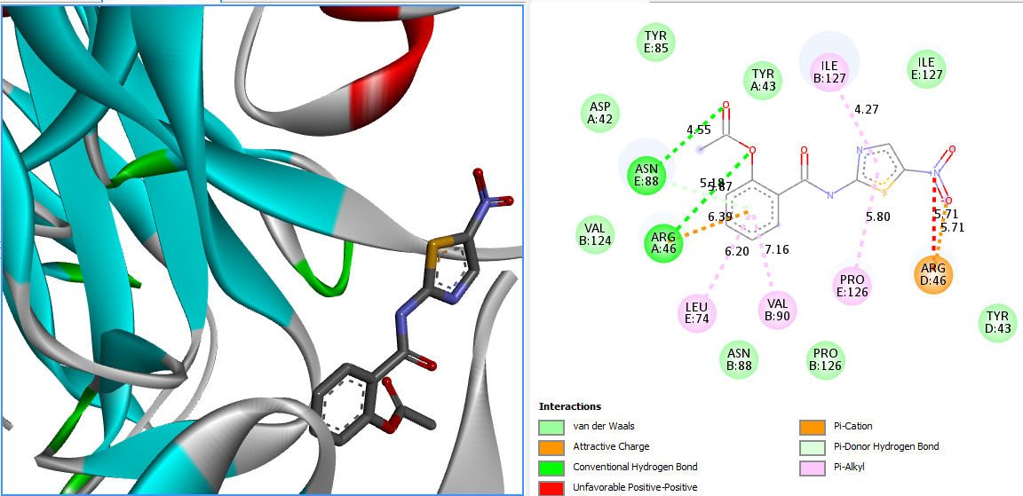
Fig. S2p: Nitazoxnide docked human IL-17A/IL-17RA (4hsa)

Slide 18
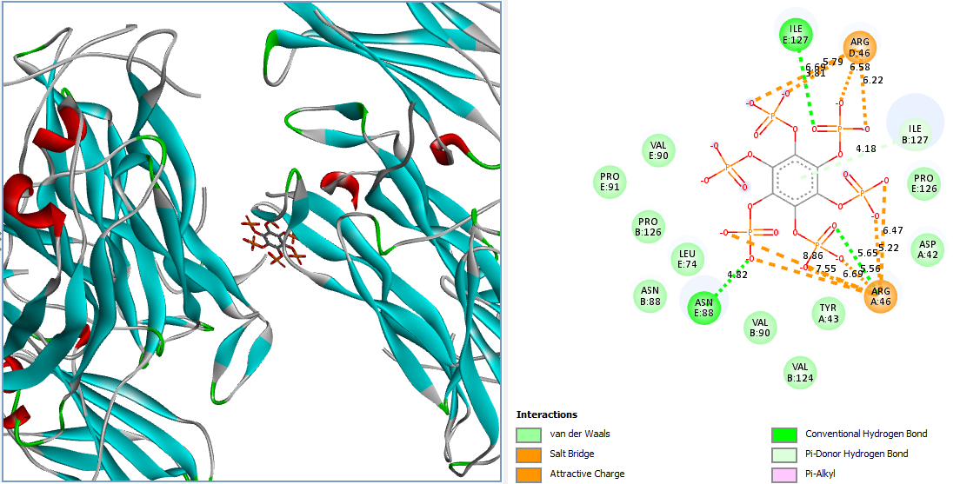
Fig. S2q: Phytic docked human IL-17A/IL-17RA (4hsa)

Slide 19
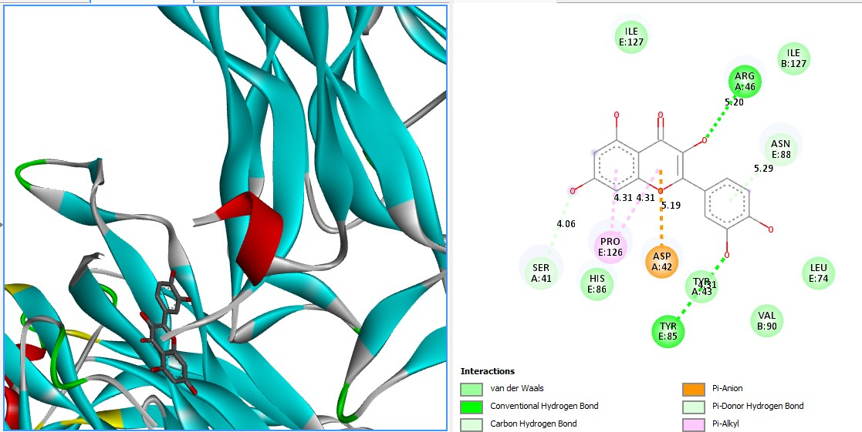
Fig. S2r: Quercetin docked human IL-17A/IL-17RA (4hsa)

Slide 20
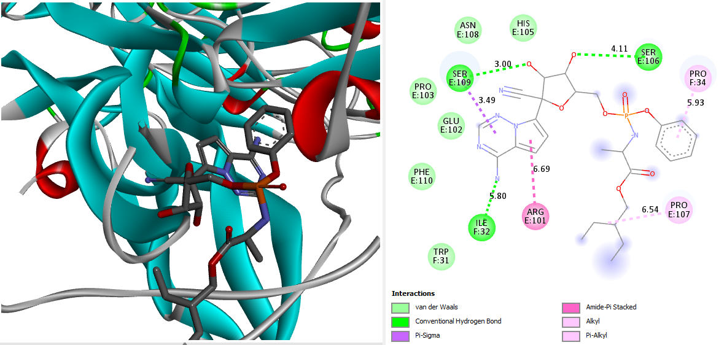
Fig. S2s: Remdesivir docked human IL-17A/IL-17RA (4hsa)

Slide 21
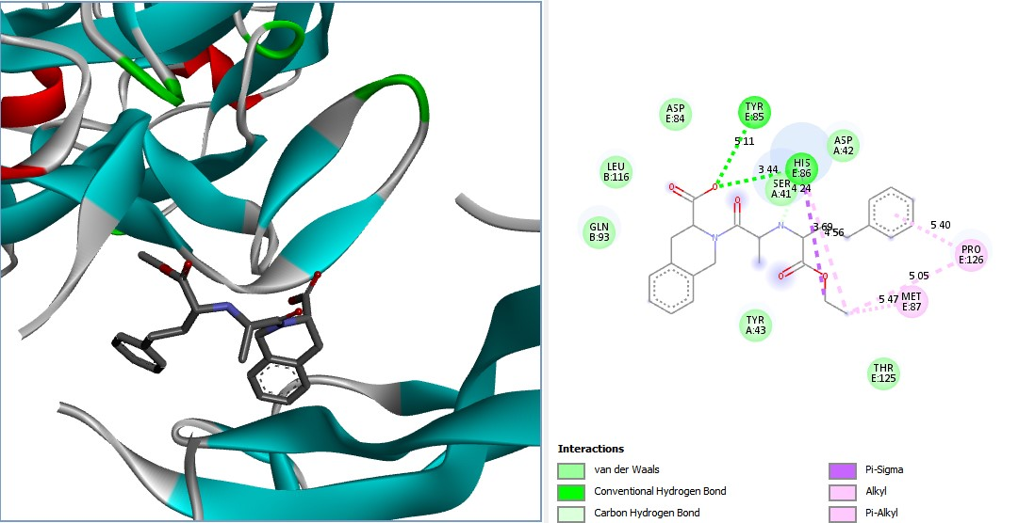
Fig. S2t: Quinapril docked human IL-17A/IL-17RA (4hsa)

Slide 22
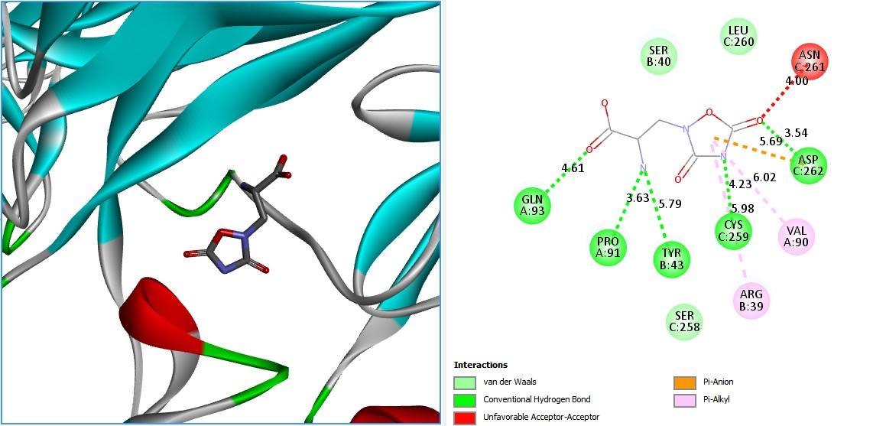
Fig. S2u: Quisqualic docked human IL-17A/IL-17RA (4hsa)

Slide 23
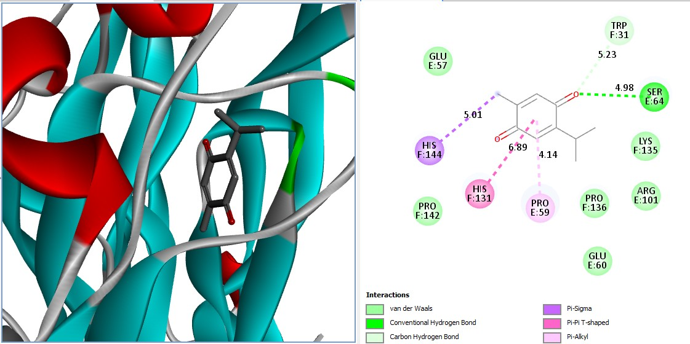
Fig. S2v: Thymoquinone docked human IL-17A/IL-17RA (4hsa)

Slide 24
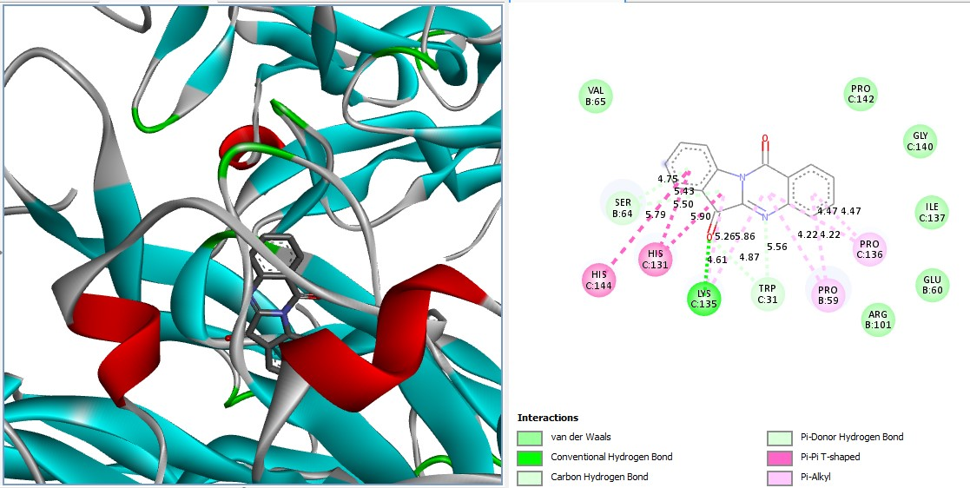
Fig. S2w: Tryptanthrin docked human IL-17A/IL-17RA (4hsa)

