Slide 1
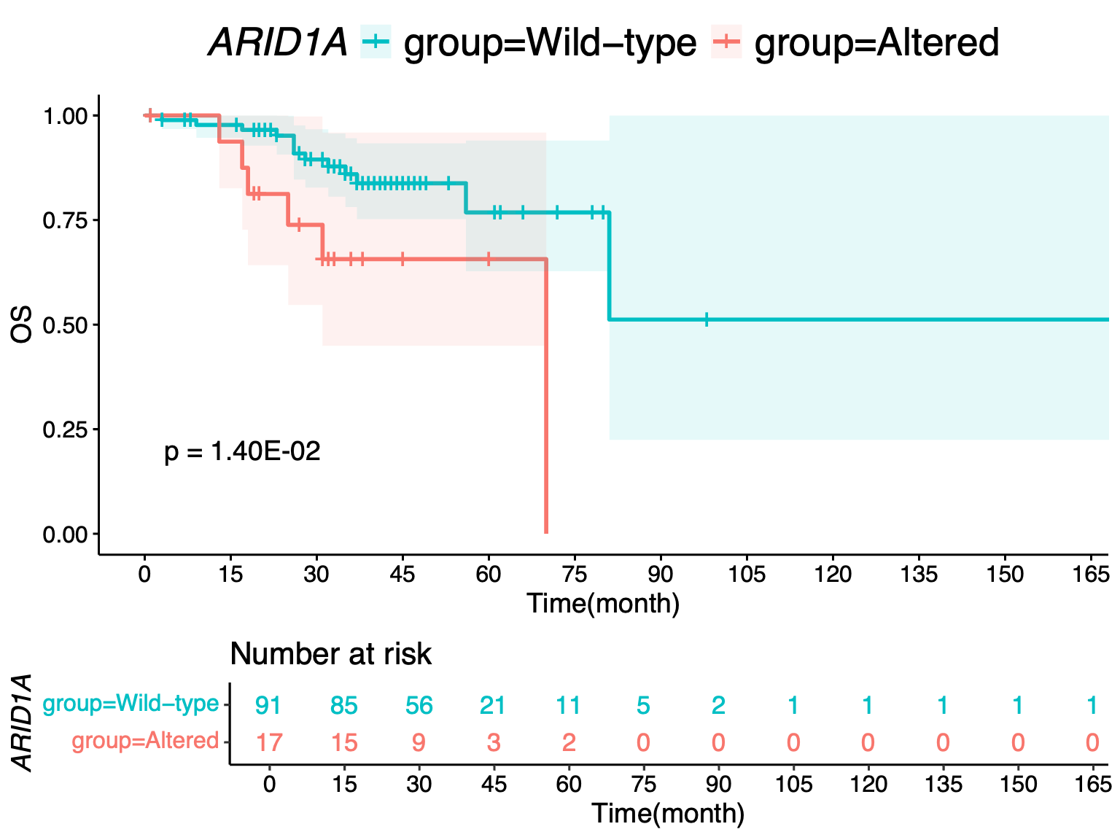
(A)
(B)
Gene | Number of altered sample | Number of wild-type | HR | Lower bound of 95% CI | Upper bound of 95% CI | p-value
ARID1A | 17 | 91 | 3.21 | 1.20 | 8.58 | 2.01E-02
Notes:
Supplementary Figure S1. Analysis of overall survival (A) Kaplan–Meier curve of overall survival between HGSOC patients with ARID1A mutation and wild-type (B) Univariate Cox proportional hazard regression analysis of overall survival
HR, Hazard ratio; CI, Confidence Interval

