Slide 1
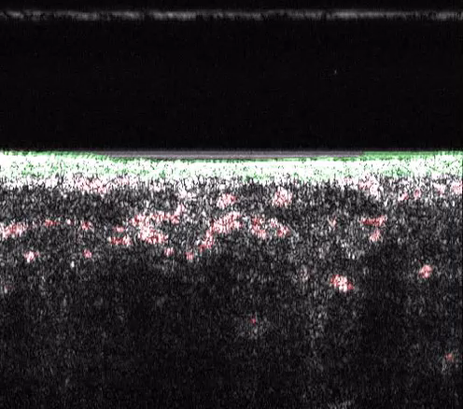
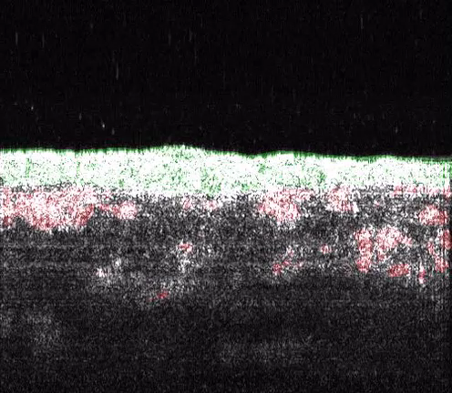
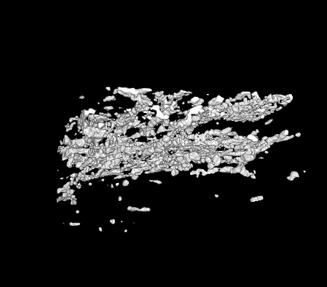
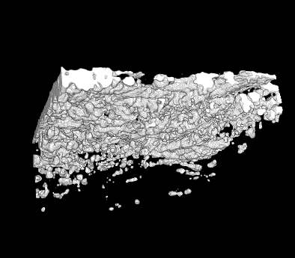
Supplementary Movie 1
SMovie 1
HSC-3/CAF d14
SMovie２
HSC-3/CAF d21
SMovie３
SMovie４
Notes:
Supplementary Movie 1, 2 Y-slice cross-sectional OCT images (X–Z slice) of the approximate ROI in the 3D HSC-3 cancer-CAF models cultured for 14 days (S1) and 21 days (S2), corresponding to Fig. 3B.
Supplementary Movie 3, 4 Rotating 3D OCT images of HSC-3 cancer-CAF models cultured for 14 days (S3) and 21 days (S4), corresponding to Fig. 6B.

