Slide 1
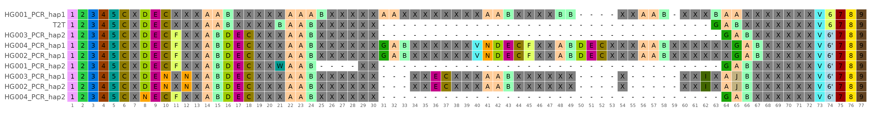
Suppl. File 3: Motif composition of the VNTR in the MUC1 gene for the samples HG001-4, comparing PCR runs for each and the T2T reference sequence. Each row shows the sequence of repeat motifs for a specific haplotype. Individual repeat motifs are represented by colored boxes. The specific sequence of a motif is identified by its color and the number displayed inside the box. The actual DNA sequences for each motif type (color and character combination) are provided in Suppl. File 1. Characters for specific motifs are chosen based on Kirby et al., 2013. Motifs not defined in Kirby et al., 2013 are shown in orange with an “N” and their sequence is shown in Suppl. File 1. White boxes signify a gap (a missing motif) at that position. The numbers along the bottom axis (1-77) denote the sequential position of each motif in the VNTR.
Article title: Analysis of clinically relevant large tandem repeats using nanopore sequencing
Authors: Silvia Madritsch, David Horner, Tamara Löwenstern, Nadja Brait, Vivienne Arnold, Andrea Wenzel, Denisa Weis, Markus Hengstschläger, Franco Laccone
Corresponding Author: Silvia Madritsch (silvia.madritsch@meduniwien.ac.at) Institute of Medical Genetics, Center for Pathobiochemistry and Genetics, Medical University of Vienna, Vienna, Austria

