Slide 1
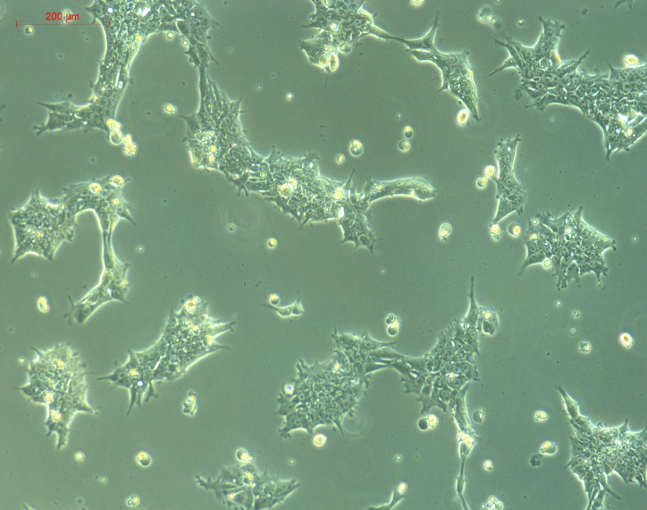
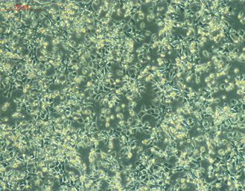
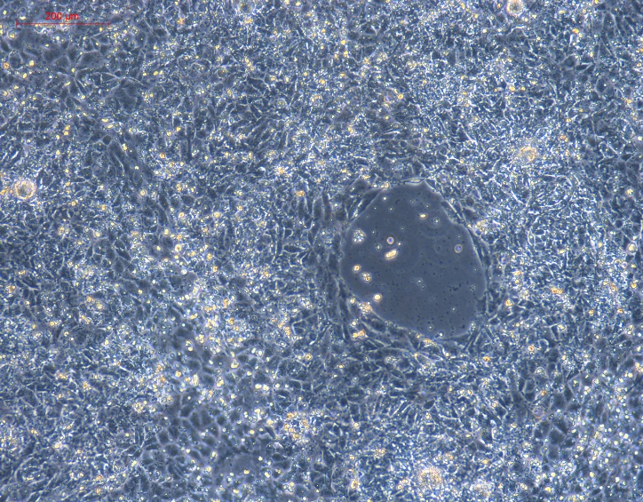
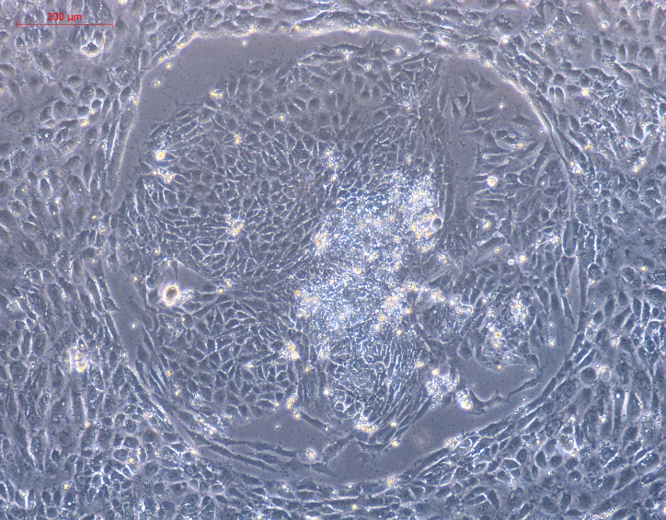
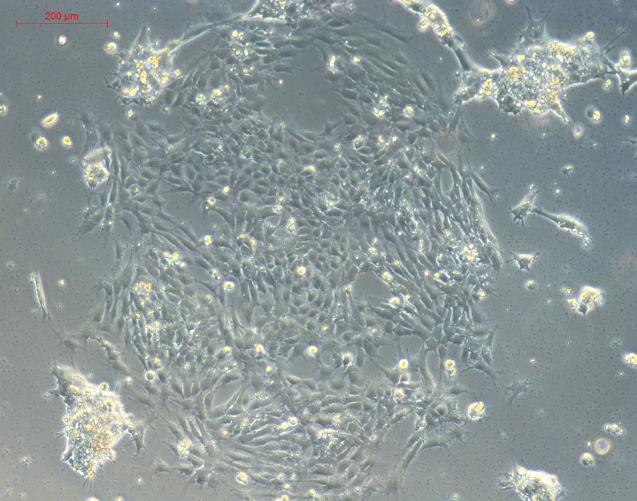
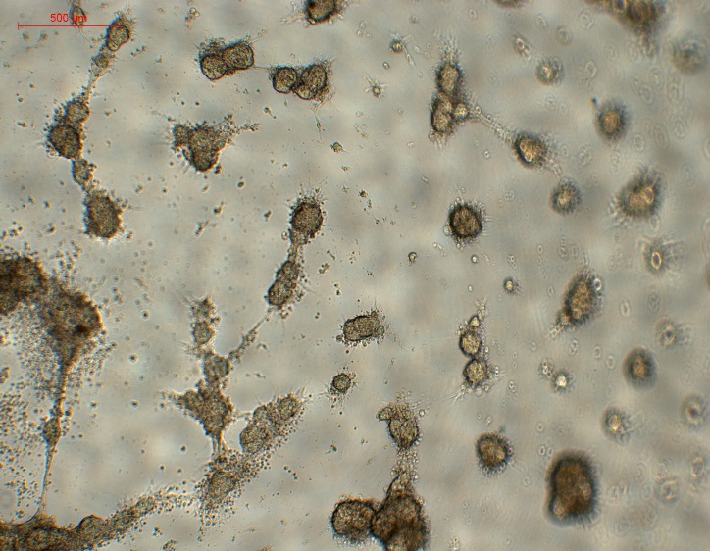
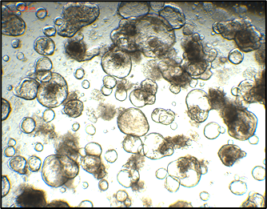
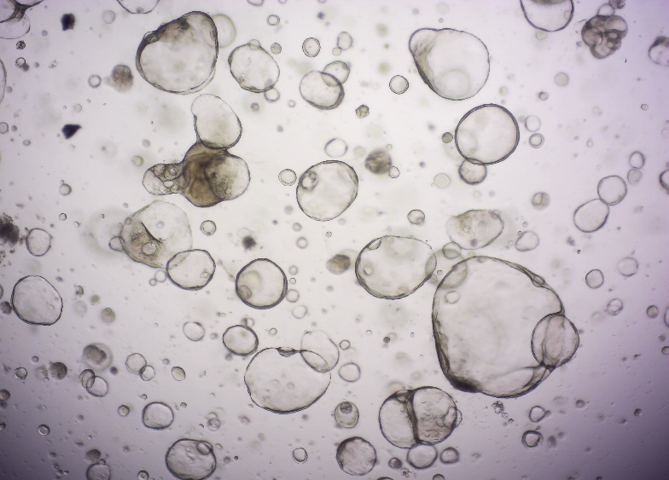
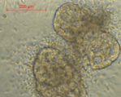
Figure S1
Day 1
hESC
Day 2
DE
Day 8
AFE
Day 12
VAFE
100×
100×
100×
100×
Day 16
VAFE
Day 24
Spheroid
Day 34
Lung organoid
Day 55
Passage #3
500 μm
100×
100×
40×
40×
40×

Slide 2
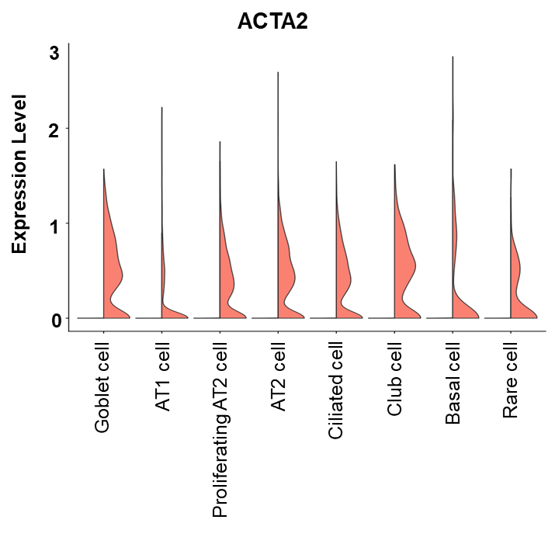
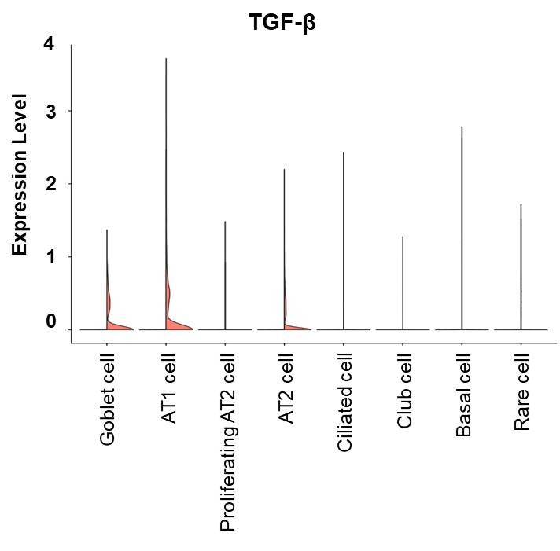
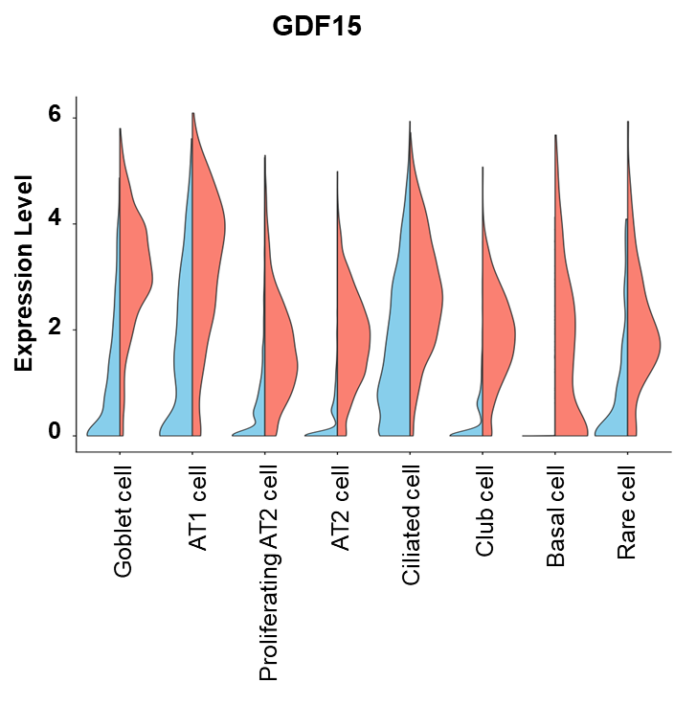
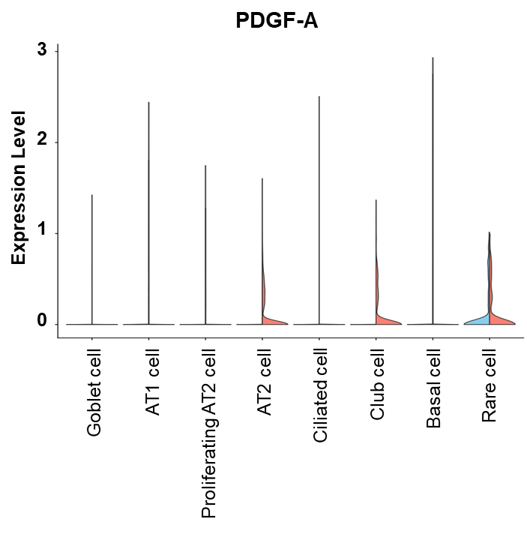
Figure S2
A
B
C
D
Normal
Irradiation
(4Gy x 2 times)

Slide 3
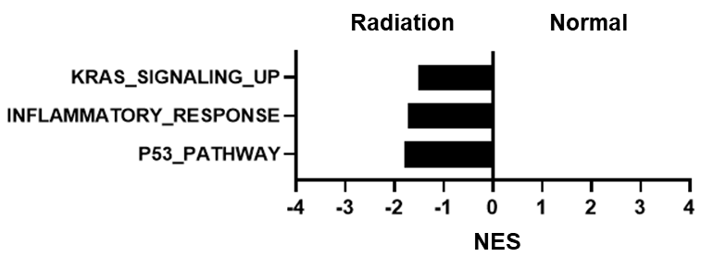
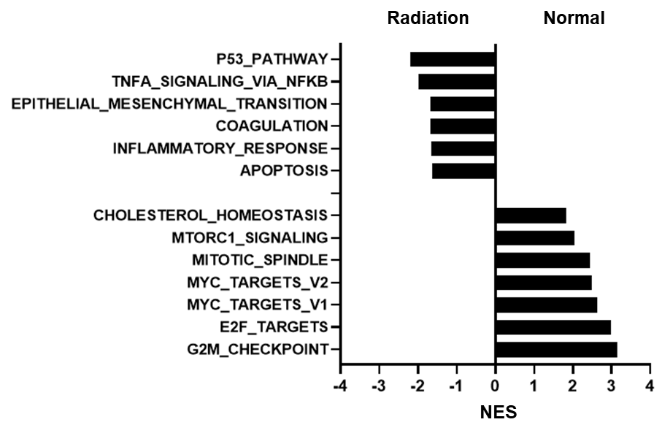
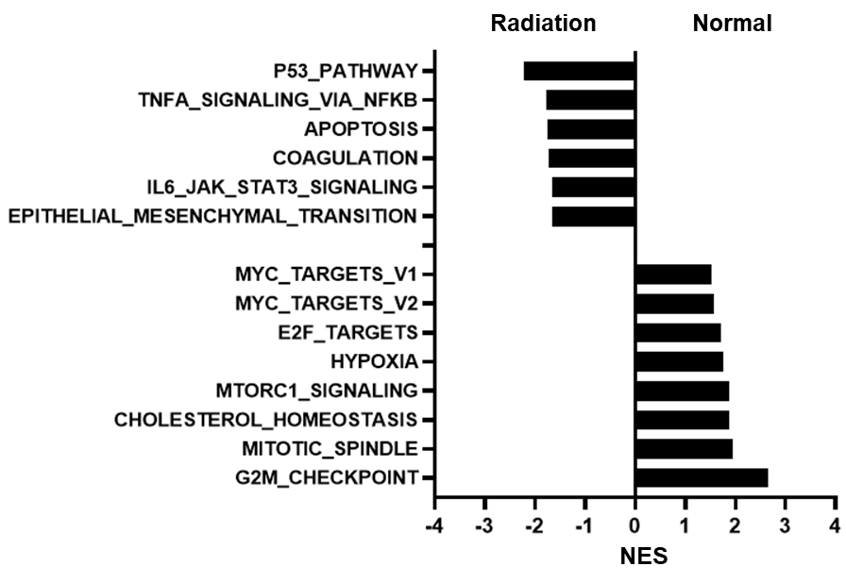
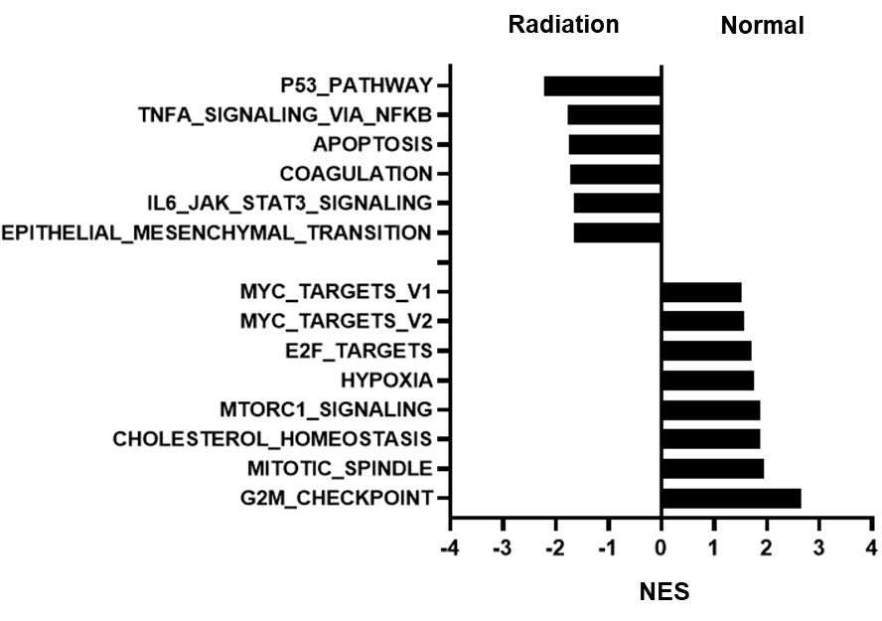
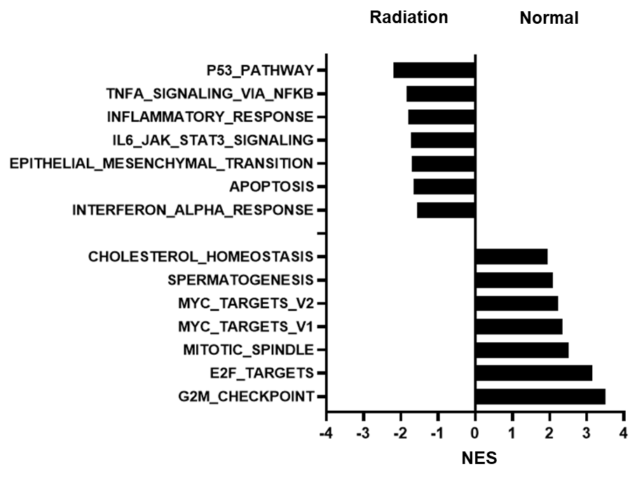
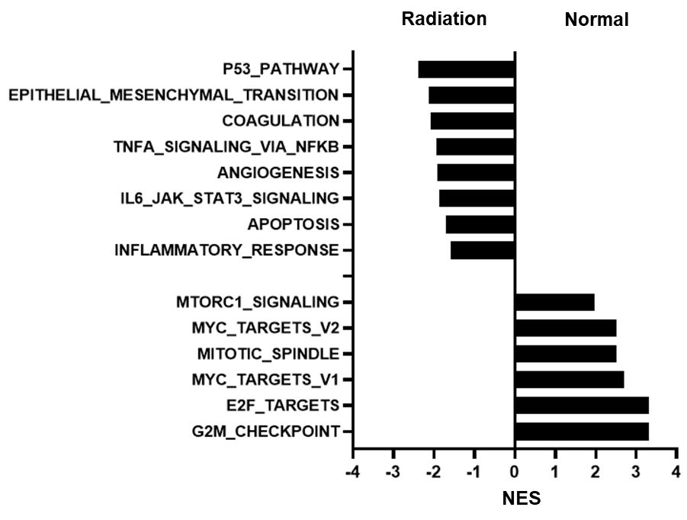
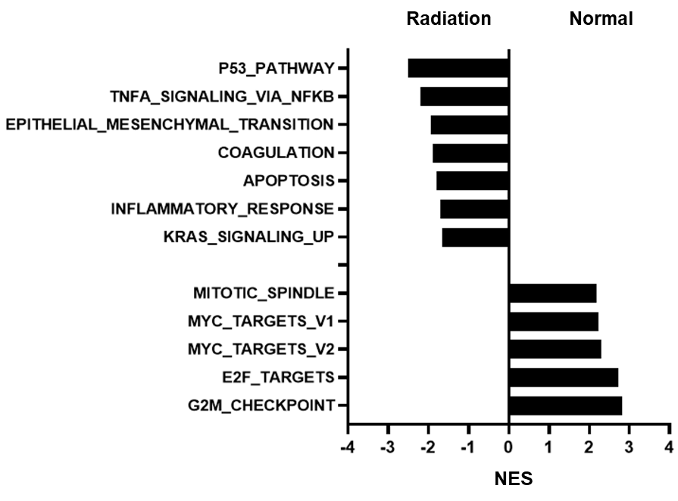
Figure S3
AT1 cell
Proliferating AT2 cell
AT2 cell
Basal cell
Goblet cell
Ciliated cell
Club cell

Slide 4
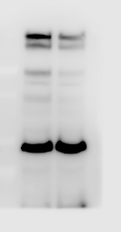
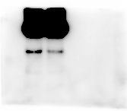

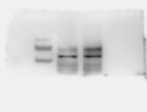
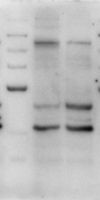
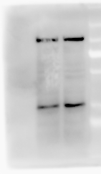
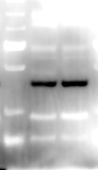
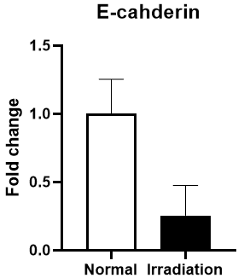
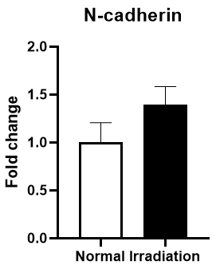
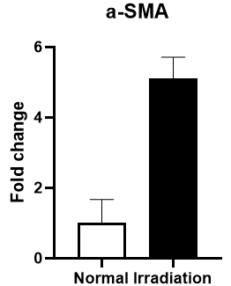
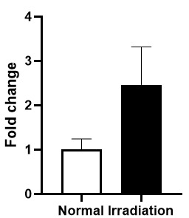
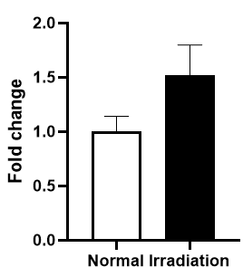
Figure S4
A
Normal
Irradiation
(4 Gy x 2 times)
Normal
Irradiation
(4 Gy x 2 times)
Normal
Irradiation
(4 Gy x 2 times)
250 kDa
70 kDa
250 kDa
N-cadherin
(140 kDa)
130 kDa
E-cadherin
(135 kDa)
130 kDa
100 kDa
55 kDa
Occludin
(54 kDa)
100 kDa
70 kDa
Normal
Irradiation
(4 Gy x 2 times)
55 kDa
35 kDa
35 kDa
100 kDa
70 kDa
Vimentin
(57 kDa)
25 kDa
55 kDa
Normal
Irradiation
(4 Gy x 2 times)
Normal
Irradiation
(4 Gy x 2 times)
Normal
Irradiation
(4 Gy x 2 times)
250 kDa
250 kDa
250 kDa
130 kDa
130 kDa
130 kDa
Collagen III
(138 kDa)
100 kDa
100 kDa
100 kDa
70 kDa
70 kDa
70 kDa
55 kDa
β-actin
(45 kDa)
55 kDa
35 kDa
α-SMA
(42 kDa)
55 kDa
35 kDa
35 kDa
25 kDa
25 kDa
B
E-cadherin
N-cadherin
α-SMA
Collagen III
Vimentin
p=0.07
p<0.005
p<0.05
p<0.05
p<0.05

Slide 5
Supplementary Figure 1. Stepwise differentiation of human embryonic stem cells (hESCs) into mature lung organoids (hLOs). Phase-contrast images depict the morphological progression from hESCs to fully developed human lung organoids over a 55-day differentiation protocol. Day 1–2: hESCs exhibit typical colony morphology and initiate differentiation into definitive endoderm (DE). Day 8: Cells transition into anterior foregut endoderm (AFE). Day 12: Formation of ventralized anterior foregut endoderm (VAFE) is observed as tightly packed epithelial-like colonies. Day 16–24: Cells begin patterning into lung progenitor domains and generate spheroid-like aggregates. Day 34–55: Spheroids are embedded in Matrigel, leading to the formation and maturation of three-dimensional bronchioalveolar organoids with distinct cystic structures resembling airway and alveolar compartments. Images were captured at 40× or 100× magnification using an inverted microscope.
Supplementary Figure 2. scRNA-seq reveals changes in pro-fibrotic cytokine gene expression across all epithelial cell populations constituting irradiated hLOs. Violin plots of ACTA2 (A), TGF-β (B), GDF-15 (C), and PDGF-A (D) show the log-transformed, normalized expression levels of indicated genes in clusters of normal or irradiated cells, as revealed by scRNA-seq analysis of organoids.
Supplementary Figure 3. Gene ontology (GO) enrichment analysis of AT1, proliferating AT2, AT2, basal, goblet, ciliated, or club cells. Normalized enrichment scores (NES) indicate the distribution of GO categories across a list of genes ranked by hypergeometric score. Terms with a positive NES represent gene categories upregulated in normal hLOs, whereas terms with a negative NES indicate gene categories downregulated by irradiation.
Supplementary Figure 4. Western blot analysis showing changes in epithelial and mesenchymal marker expression following repeated γ-ray irradiation of hLOs. (A) Uncropped gels for western blot analysis in Figure4(A). (B) Mean pixel density of each bands was measured by ImageJ program. One of three similar results is shown.

