Slide 1
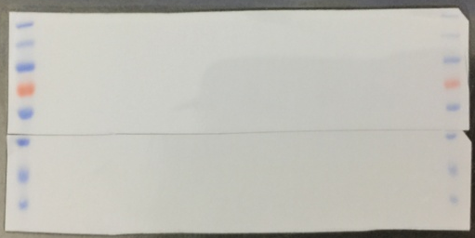
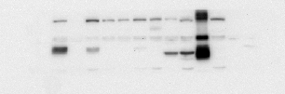

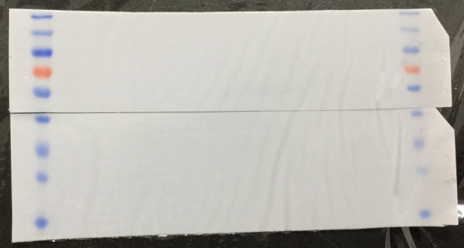




Figure 1
mammary gland
small intestine
Retina (-1w)
uterus
kidney
muscle
testicle
A
lens
ovary
spleen
brain
blood
liver
mammary gland
small intestine
←FZD4
Retina (-1w)
uterus
kidney
muscle
testicle
lens
ovary
spleen
brain
blood
liver
60 kDa
36 kDa
←FZD4
←GAPDH
←GAPDH
B
Retina
Retina
2ms
6ms
0d
1m
3ms
lens
cornea
2ms
6ms
-1w
2ws
sclera
0d
1m
3ms
lens
cornea
1y
-1w
2ws
1y
sclera
*
←FZD4
60 kDa
36 kDa
←FZD4
←GAPDH
←GAPDH

Slide 2
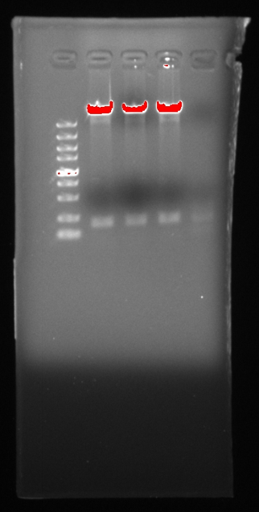
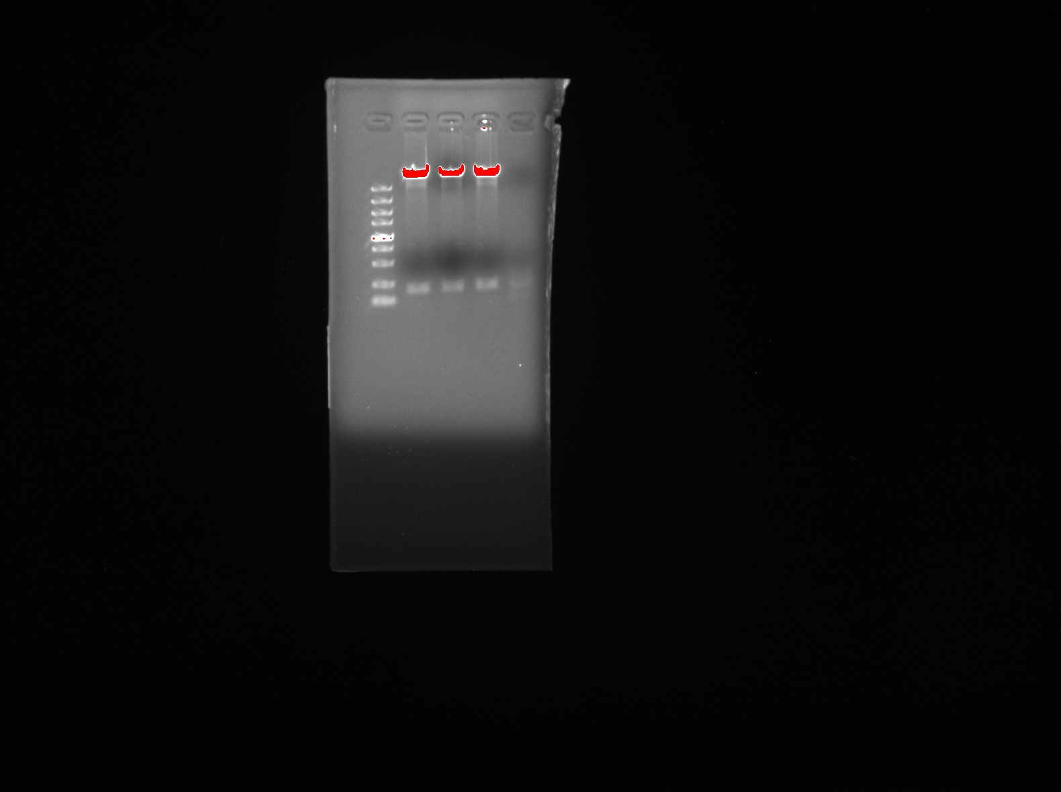
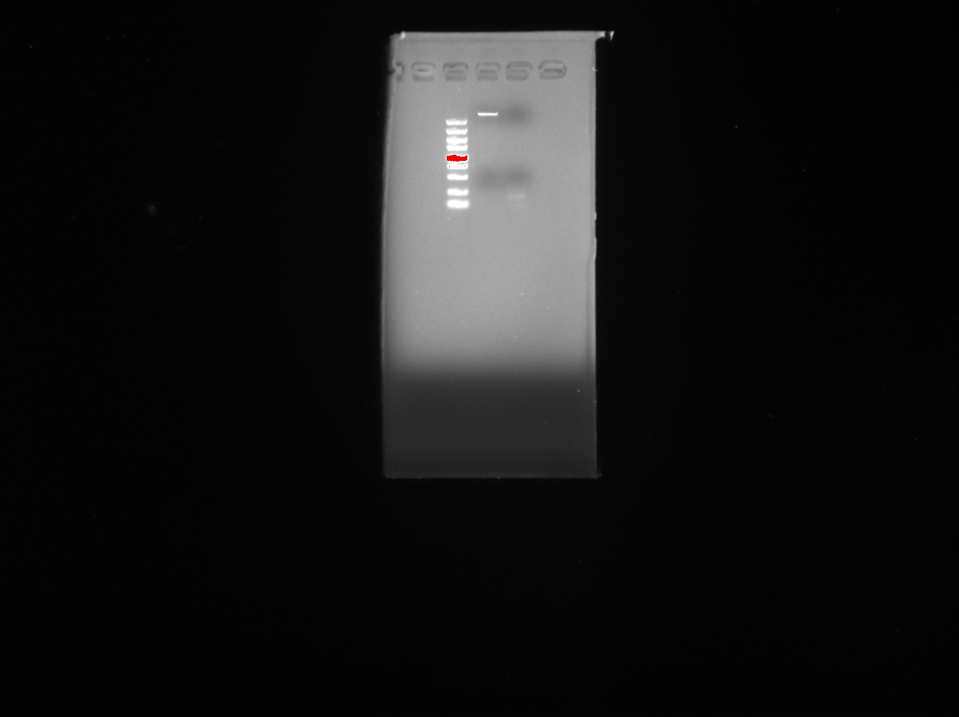
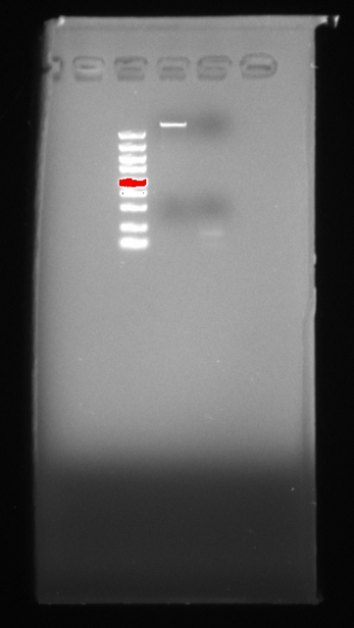
Figure 2
M 1 2 3 4
B
—8000bp
M 1 2 3 4
5000
3000
2000
1500
1000
750
500
250
100
—8000bp
—179bp
5000
3000
2000
1500
1000
750
500
250
100
—179bp
C
M 1 2
5000
3000
2000
1500
1000
750
500
250
100
—8000bp
M 1 2
—179bp
5000
3000
2000
1500
1000
750
500
250
100
—8000bp
—179bp

Slide 3
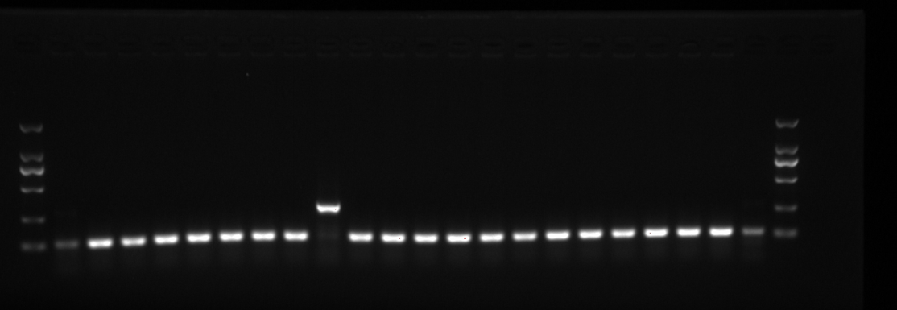
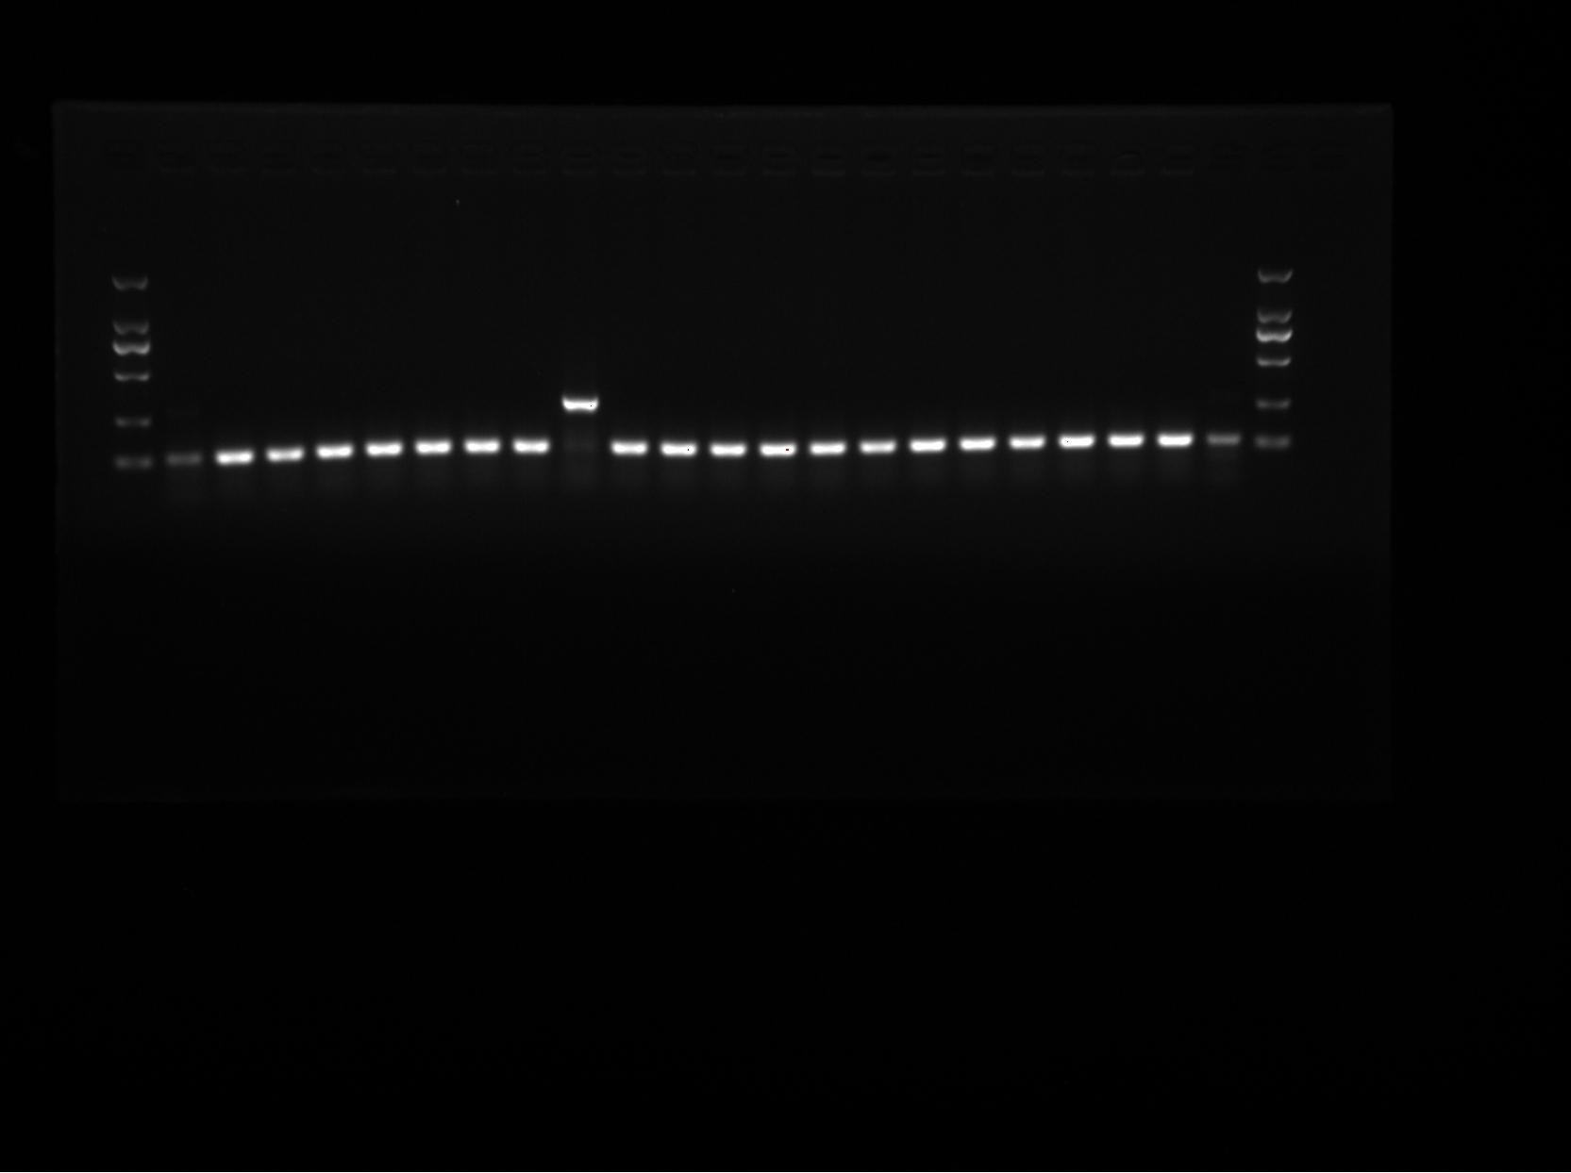
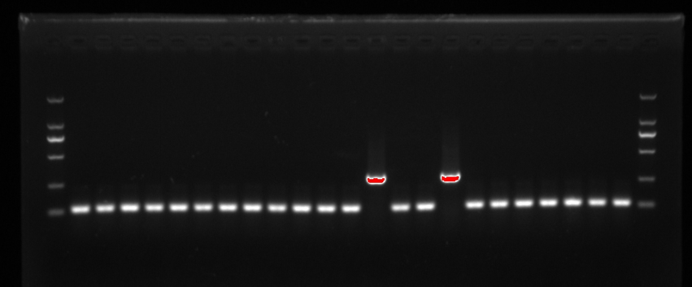
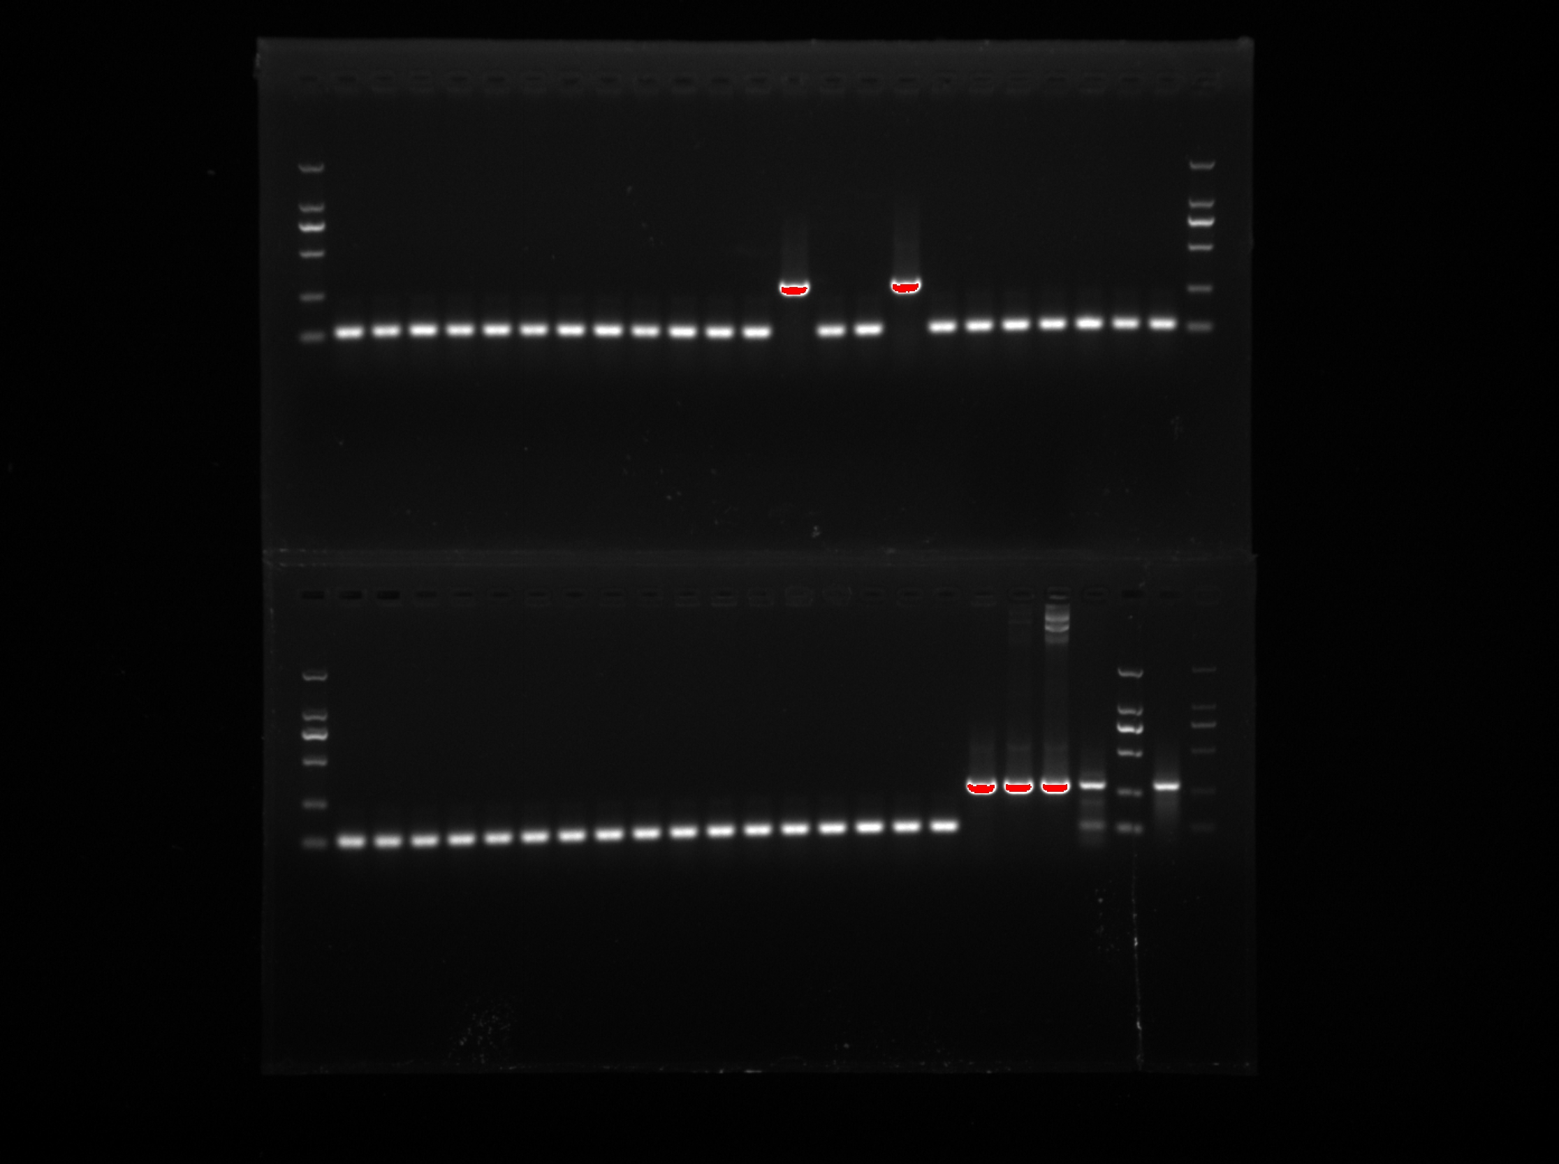
Figure 2
M 1 2 3 4 5 6 7 8 9 10 11 12 13 14 15 16 17 18 19 20 21 22 M
2000
1000
750
500
250
100
—285bp
D
M 1 2 3 4 5 6 7 8 9 10 11 12 13 14 15 16 17 18 19 20 21 22 M
2000
1000
750
500
250
100
—285bp
M 92 93 94 95 96 97 98 99 100 101 102 103 104 105 106 107 108 109 110 111 112 113 114 M
2000
1000
750
500
250
100
—285bp
E
M 92 93 94 95 96 97 98 99 100 101 102 103 104 105 106 107 108 109 110 111 112 113 114 M
2000
1000
750
500
250
100
—285bp

Slide 4
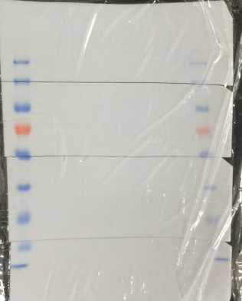

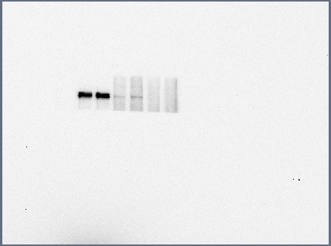
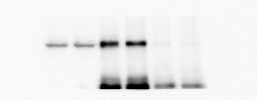
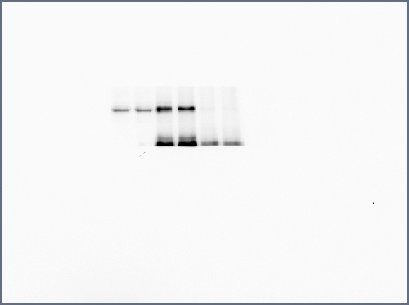
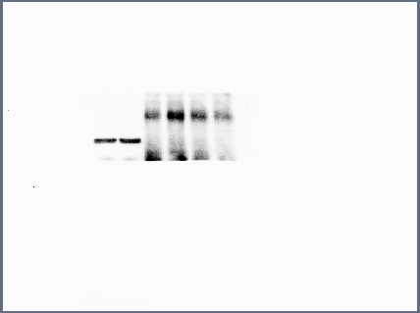
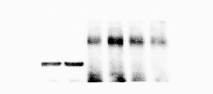


Figure 4
IP: GFP
IP: IgG
IP: GFP
IP: IgG
FZD4-WT
Input-WT
FZD4-MU
Input-MU
IgG-WT
IgG-MU
FZD4-WT
Input-WT
FZD4-MU
Input-MU
IgG-WT
IgG-MU
← LRP5
179 kDa
87 kDa
35 kDa
13 kDa
← LRP5
← FZD4-GFP
← FZD4-GFP
← TSPAN12
← TSPAN12
← NDP-MYC
← NDP-MYC

Slide 5
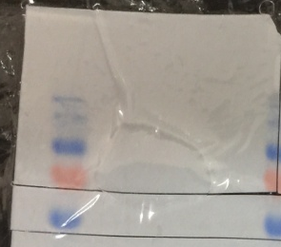


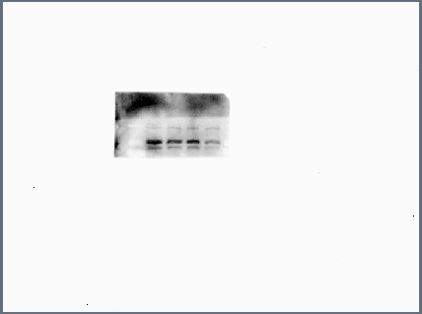

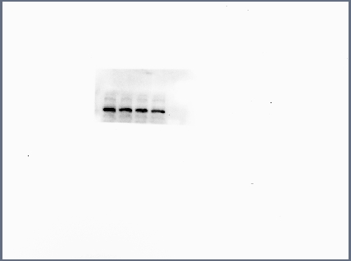
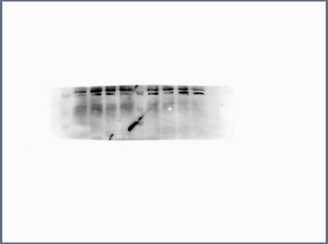



Figure 6
P-β-catenin+tubulin
A
FZD4 WT+NDP
FZD4 WT+RSPO1
FZD4 MU+NDP
FZD4 MU+RSPO1
FZD4 WT+RSPO1
β-catenin+tubulin+VEGF
FZD4 MU+NDP
FZD4 MU+RSPO1
FZD4 WT+NDP
←p-β-catenin
92 kDa
92 kDa
27 kDa
55 kDa
←p-β-catenin
← β-catenin
← β-catenin
← VEGF-A
←Tubulin
← VEGF-A
←Tubulin

Slide 6
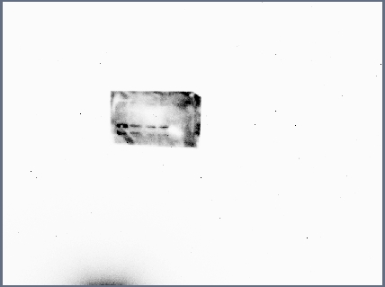

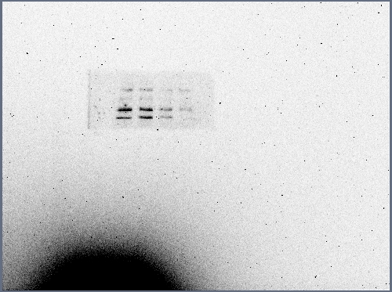
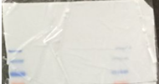
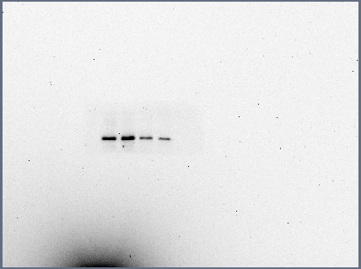
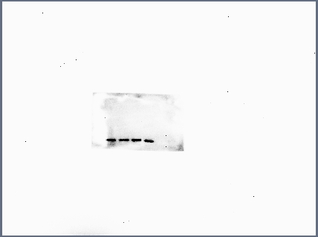

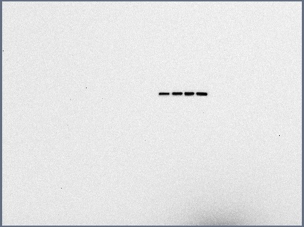
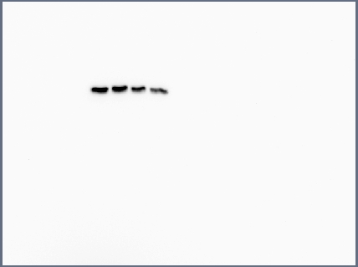

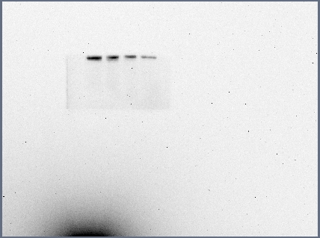

Figure 6
A (the second replicate)
A (the third replicate)
FZD4 WT+RSPO1
FZD4 WT+NDP
FZD4 WT+RSPO1
FZD4 WT+NDP
FZD4 MU+RSPO1
FZD4 MU+NDP
FZD4 MU+RSPO1
FZD4 MU+NDP
β-catenin
β-catenin
← P- β-catenin
←P-β-catenin
←β-catenin
P-β-catenin+tubulin
←β-catenin
←Tubulin
P-β-catenin+tubulin
←Tubulin
← VEGF-A
VEGF-A

