Slide 1
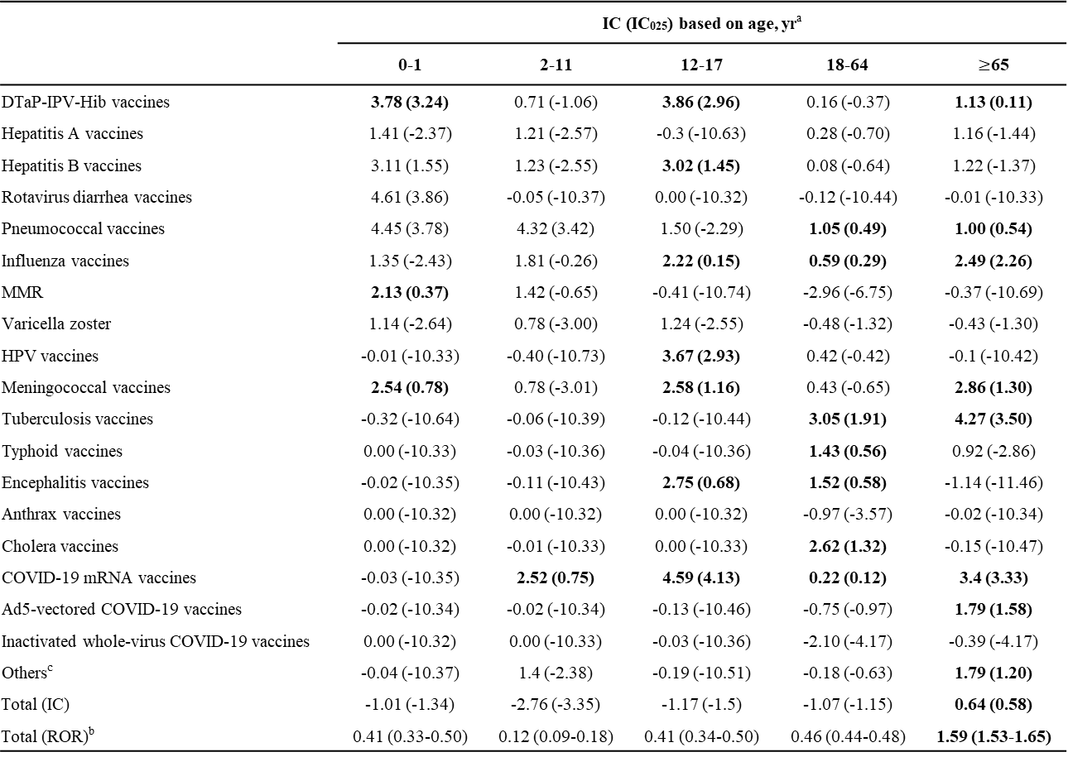
Supplementary Table S3. Disproportionality analysis of vaccine-associated acute kidney injury based on specific age subgroups
 | IC (IC₀₂₅) based on age, yrª
 | 0-1 | 2-11 | 12-17 | 18-64 | $≥$65
DTaP-IPV-Hib vaccines | 3.78 (3.24) | 0.71 (-1.06) | 3.86 (2.96) | 0.16 (-0.37) | 1.13 (0.11)
Hepatitis A vaccines | 1.41 (-2.37) | 1.21 (-2.57) | -0.3 (-10.63) | 0.28 (-0.70) | 1.16 (-1.44)
Hepatitis B vaccines | 3.11 (1.55) | 1.23 (-2.55) | 3.02 (1.45) | 0.08 (-0.64) | 1.22 (-1.37)
Rotavirus diarrhea vaccines | 4.61 (3.86) | -0.05 (-10.37) | 0.00 (-10.32) | -0.12 (-10.44) | -0.01 (-10.33)
Pneumococcal vaccines | 4.45 (3.78) | 4.32 (3.42) | 1.50 (-2.29) | 1.05 (0.49) | 1.00 (0.54)
Influenza vaccines | 1.35 (-2.43) | 1.81 (-0.26) | 2.22 (0.15) | 0.59 (0.29) | 2.49 (2.26)
MMR | 2.13 (0.37) | 1.42 (-0.65) | -0.41 (-10.74) | -2.96 (-6.75) | -0.37 (-10.69)
Varicella zoster | 1.14 (-2.64) | 0.78 (-3.00) | 1.24 (-2.55) | -0.48 (-1.32) | -0.43 (-1.30)
HPV vaccines | -0.01 (-10.33) | -0.40 (-10.73) | 3.67 (2.93) | 0.42 (-0.42) | -0.1 (-10.42)
Meningococcal vaccines | 2.54 (0.78) | 0.78 (-3.01) | 2.58 (1.16) | 0.43 (-0.65) | 2.86 (1.30)
Tuberculosis vaccines | -0.32 (-10.64) | -0.06 (-10.39) | -0.12 (-10.44) | 3.05 (1.91) | 4.27 (3.50)
Typhoid vaccines | 0.00 (-10.33) | -0.03 (-10.36) | -0.04 (-10.36) | 1.43 (0.56) | 0.92 (-2.86)
Encephalitis vaccines | -0.02 (-10.35) | -0.11 (-10.43) | 2.75 (0.68) | 1.52 (0.58) | -1.14 (-11.46)
Anthrax vaccines | 0.00 (-10.32) | 0.00 (-10.32) | 0.00 (-10.32) | -0.97 (-3.57) | -0.02 (-10.34)
Cholera vaccines | 0.00 (-10.32) | -0.01 (-10.33) | 0.00 (-10.33) | 2.62 (1.32) | -0.15 (-10.47)
COVID-19 mRNA vaccines | -0.03 (-10.35) | 2.52 (0.75) | 4.59 (4.13) | 0.22 (0.12) | 3.4 (3.33)
Ad5-vectored COVID-19 vaccines | -0.02 (-10.34) | -0.02 (-10.34) | -0.13 (-10.46) | -0.75 (-0.97) | 1.79 (1.58)
Inactivated whole-virus COVID-19 vaccines | 0.00 (-10.32) | 0.00 (-10.33) | -0.03 (-10.36) | -2.10 (-4.17) | -0.39 (-4.17)
Others^{c} | -0.04 (-10.37) | 1.4 (-2.38) | -0.19 (-10.51) | -0.18 (-0.63) | 1.79 (1.20)
Total (IC) | -1.01 (-1.34) | -2.76 (-3.35) | -1.17 (-1.5) | -1.07 (-1.15) | 0.64 (0.58)
Total (ROR)^{b} | 0.41 (0.33-0.50) | 0.12 (0.09-0.18) | 0.41 (0.34-0.50) | 0.46 (0.44-0.48) | 1.59 (1.53-1.65)
Note: The numbers in bold indicate a statistical significance. Abbreviations: Ad5, adenovirus type-5; CI, confidence interval; COVID-19, coronavirus disease 2019; DTaP-IPV-Hib, diphtheria, tetanus, pertussis, polio and Hemophilus influenza type b; HPV, human papillomavirus; IC, information component; MMR, measles, mumps and rubella; ROR, reporting odds ratio. ªA positive value of the IC₀₂₅ was considered significant. ^{b}A lower end of the ROR 95% CI ≥1 was considered significant. ^{c}Other vaccines included brucellosis, plague, typhus, leptospirosis, rabies, yellow fever, smallpox, Ebola, and dengue vaccines.

Slide 2
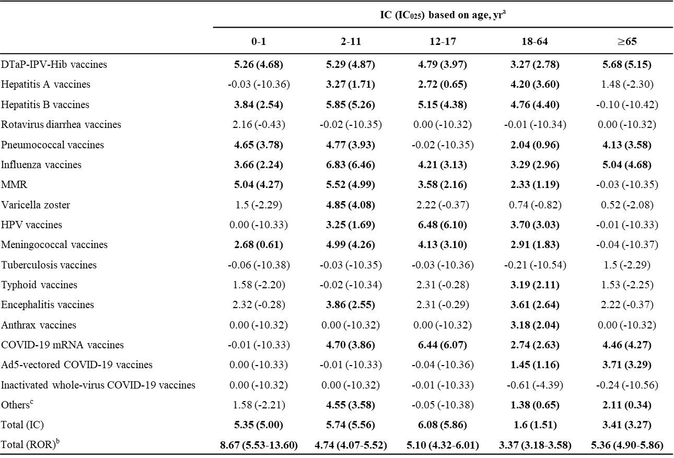
Supplementary Table S4. Disproportionality analysis of vaccine-associated glomerulonephritis based on specific age subgroups
 | IC (IC₀₂₅) based on age, yrª
 | 0-1 | 2-11 | 12-17 | 18-64 | $≥$65
DTaP-IPV-Hib vaccines | 5.26 (4.68) | 5.29 (4.87) | 4.79 (3.97) | 3.27 (2.78) | 5.68 (5.15)
Hepatitis A vaccines | -0.03 (-10.36) | 3.27 (1.71) | 2.72 (0.65) | 4.20 (3.60) | 1.48 (-2.30)
Hepatitis B vaccines | 3.84 (2.54) | 5.85 (5.26) | 5.15 (4.38) | 4.76 (4.40) | -0.10 (-10.42)
Rotavirus diarrhea vaccines | 2.16 (-0.43) | -0.02 (-10.35) | 0.00 (-10.32) | -0.01 (-10.34) | 0.00 (-10.32)
Pneumococcal vaccines | 4.65 (3.78) | 4.77 (3.93) | -0.02 (-10.35) | 2.04 (0.96) | 4.13 (3.58)
Influenza vaccines | 3.66 (2.24) | 6.83 (6.46) | 4.21 (3.13) | 3.29 (2.96) | 5.04 (4.68)
MMR | 5.04 (4.27) | 5.52 (4.99) | 3.58 (2.16) | 2.33 (1.19) | -0.03 (-10.35)
Varicella zoster | 1.5 (-2.29) | 4.85 (4.08) | 2.22 (-0.37) | 0.74 (-0.82) | 0.52 (-2.08)
HPV vaccines | 0.00 (-10.33) | 3.25 (1.69) | 6.48 (6.10) | 3.70 (3.03) | -0.01 (-10.33)
Meningococcal vaccines | 2.68 (0.61) | 4.99 (4.26) | 4.13 (3.10) | 2.91 (1.83) | -0.04 (-10.37)
Tuberculosis vaccines | -0.06 (-10.38) | -0.03 (-10.35) | -0.03 (-10.36) | -0.21 (-10.54) | 1.5 (-2.29)
Typhoid vaccines | 1.58 (-2.20) | -0.02 (-10.34) | 2.31 (-0.28) | 3.19 (2.11) | 1.53 (-2.25)
Encephalitis vaccines | 2.32 (-0.28) | 3.86 (2.55) | 2.31 (-0.29) | 3.61 (2.64) | 2.22 (-0.37)
Anthrax vaccines | 0.00 (-10.32) | 0.00 (-10.32) | 0.00 (-10.32) | 3.18 (2.04) | 0.00 (-10.32)
COVID-19 mRNA vaccines | -0.01 (-10.33) | 4.70 (3.86) | 6.44 (6.07) | 2.74 (2.63) | 4.46 (4.27)
Ad5-vectored COVID-19 vaccines | 0.00 (-10.33) | -0.01 (-10.33) | -0.04 (-10.36) | 1.45 (1.16) | 3.71 (3.29)
Inactivated whole-virus COVID-19 vaccines | 0.00 (-10.32) | 0.00 (-10.32) | -0.01 (-10.33) | -0.61 (-4.39) | -0.24 (-10.56)
Others^{c} | 1.58 (-2.21) | 4.55 (3.58) | -0.05 (-10.38) | 1.38 (0.65) | 2.11 (0.34)
Total (IC) | 5.35 (5.00) | 5.74 (5.56) | 6.08 (5.86) | 1.6 (1.51) | 3.41 (3.27)
Total (ROR)^{b} | 8.67 (5.53-13.60) | 4.74 (4.07-5.52) | 5.10 (4.32-6.01) | 3.37 (3.18-3.58) | 5.36 (4.90-5.86)
Note: The numbers in bold indicate a statistical significance. Abbreviations: Ad5, adenovirus type-5; CI, confidence interval; COVID-19, coronavirus disease 2019; DTaP-IPV-Hib, diphtheria, tetanus, pertussis, polio and Hemophilus influenza type b; HPV, human papillomavirus; IC, information component; MMR, measles, mumps and rubella; ROR, reporting odds ratio. ªA positive value of the IC₀₂₅ was considered significant. ^{b}A lower end of the ROR 95% CI ≥1 was considered significant. ^{c}Other vaccines included brucellosis, plague, typhus, leptospirosis, rabies, yellow fever, smallpox, Ebola, and dengue vaccines.

Slide 3
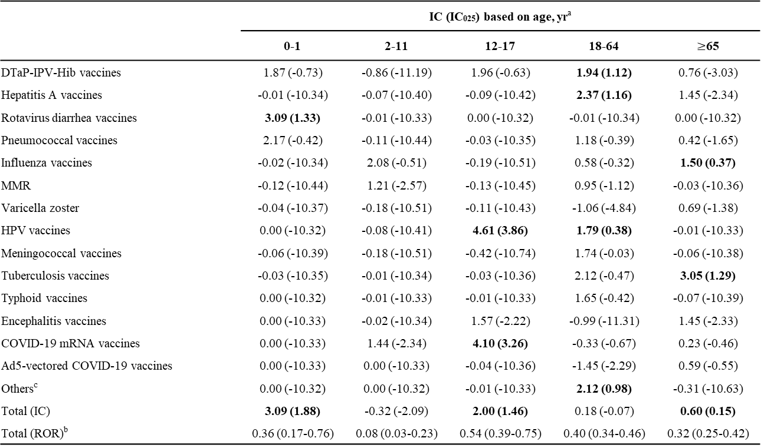
Supplementary Table S5. Disproportionality analysis of vaccine-associated tubulointerstitial nephritis based on specific age subgroups
 | IC (IC₀₂₅) based on age, yrª
 | 0-1 | 2-11 | 12-17 | 18-64 | $≥$65
DTaP-IPV-Hib vaccines | 1.87 (-0.73) | -0.86 (-11.19) | 1.96 (-0.63) | 1.94 (1.12) | 0.76 (-3.03)
Hepatitis A vaccines | -0.01 (-10.34) | -0.07 (-10.40) | -0.09 (-10.42) | 2.37 (1.16) | 1.45 (-2.34)
Rotavirus diarrhea vaccines | 3.09 (1.33) | -0.01 (-10.33) | 0.00 (-10.32) | -0.01 (-10.34) | 0.00 (-10.32)
Pneumococcal vaccines | 2.17 (-0.42) | -0.11 (-10.44) | -0.03 (-10.35) | 1.18 (-0.39) | 0.42 (-1.65)
Influenza vaccines | -0.02 (-10.34) | 2.08 (-0.51) | -0.19 (-10.51) | 0.58 (-0.32) | 1.50 (0.37)
MMR | -0.12 (-10.44) | 1.21 (-2.57) | -0.13 (-10.45) | 0.95 (-1.12) | -0.03 (-10.36)
Varicella zoster | -0.04 (-10.37) | -0.18 (-10.51) | -0.11 (-10.43) | -1.06 (-4.84) | 0.69 (-1.38)
HPV vaccines | 0.00 (-10.32) | -0.08 (-10.41) | 4.61 (3.86) | 1.79 (0.38) | -0.01 (-10.33)
Meningococcal vaccines | -0.06 (-10.39) | -0.18 (-10.51) | -0.42 (-10.74) | 1.74 (-0.03) | -0.06 (-10.38)
Tuberculosis vaccines | -0.03 (-10.35) | -0.01 (-10.34) | -0.03 (-10.36) | 2.12 (-0.47) | 3.05 (1.29)
Typhoid vaccines | 0.00 (-10.32) | -0.01 (-10.33) | -0.01 (-10.33) | 1.65 (-0.42) | -0.07 (-10.39)
Encephalitis vaccines | 0.00 (-10.33) | -0.02 (-10.34) | 1.57 (-2.22) | -0.99 (-11.31) | 1.45 (-2.33)
COVID-19 mRNA vaccines | 0.00 (-10.33) | 1.44 (-2.34) | 4.10 (3.26) | -0.33 (-0.67) | 0.23 (-0.46)
Ad5-vectored COVID-19 vaccines | 0.00 (-10.33) | 0.00 (-10.33) | -0.04 (-10.36) | -1.45 (-2.29) | 0.59 (-0.55)
Others^{c} | 0.00 (-10.32) | 0.00 (-10.32) | -0.01 (-10.33) | 2.12 (0.98) | -0.31 (-10.63)
Total (IC) | 3.09 (1.88) | -0.32 (-2.09) | 2.00 (1.46) | 0.18 (-0.07) | 0.60 (0.15)
Total (ROR)^{b} | 0.36 (0.17-0.76) | 0.08 (0.03-0.23) | 0.54 (0.39-0.75) | 0.40 (0.34-0.46) | 0.32 (0.25-0.42)
Note: The numbers in bold indicate a statistical significance. Abbreviations: Ad5, adenovirus type-5; CI, confidence interval; COVID-19, coronavirus disease 2019; DTaP-IPV-Hib, diphtheria, tetanus, pertussis, polio and Hemophilus influenza type b; HPV, human papillomavirus; IC, information component; MMR, measles, mumps and rubella; ROR, reporting odds ratio. ªA positive value of the IC₀₂₅ was considered significant. ^{b}A lower end of the ROR 95% CI ≥1 was considered significant. ^{c}Other vaccines included brucellosis, plague, typhus, leptospirosis, rabies, yellow fever, smallpox, Ebola, and dengue vaccines.

Slide 4
Supplemental Table S6. Clinical characteristics and concurrent reported events in vaccines with significant disproportionate signals of renal adverse reaction
 | AKI |  | GN |  |  |  |  |  |  |  |  |  |  |  |  |  | TIN
 | COVID-19 mRNA vaccines |  | DTaP-IPV- Hib vaccines | Hepatitis A vaccines | Hepatitis B vaccines | Pneumo- coccal vaccines | Influenza vaccines | MMR | HPV vaccines | Meningo- coccal vaccines | Typhoid Vaccines | Encephalitis vaccines | Anthrax vaccines | COVID-19 mRNA vaccines | Ad5-vectored COVID-19 vaccines |  | HPV vaccines | COVID-19 mRNA vaccines | Othersª
N observed | 4,326 |  | 215 | 45 | 155 | 87 | 304 | 85 | 137 | 55 | 16 | 27 | 10 | 1,852 | 234 |  | 31 | 200 | 11
Age, yr
0-1 | 0 (0.0) |  | 34 (15.8) | 0 (0.0) | 7 (4.5) | 15 (17.2) | 6 (2.0) | 19 (22.4) | 0 (0.0) | 3 (5.5) | 1 (6.3) | 2 (7.4) | 0 (0.0) | 0 (0.0) | 0 (0.0) |  | 0 (0.0) | 0 (0.0) | 0 (0.0)
2-11 | 4 (0.1) |  | 61 (28.4) | 5 (11.1) | 32 (20.6) | 16 (18.4) | 83 (27.3) | 40 (47.1) | 5 (3.6) | 21 (38.2) | 0 (0.0) | 7 (25.9) | 0 (0.0) | 16 (0.9) | 0 (0.0) |  | 0 (0.0) | 1 (0.5) | 0 (0.0)
12-17 | 51 (1.2) |  | 17 (7.9) | 3 (6.7) | 19 (12.3) | 0 (0.0) | 10 (3.3) | 6 (7.1) | 73 (53.3) | 11 (20.0) | 2 (12.5) | 2 (7.4) | 0 (0.0) | 81 (4.4) | 0 (0.0) |  | 20 (64.5) | 16 (8.0) | 0 (0.0)
18-64 | 1,167 (27.0) |  | 46 (21.4) | 31 (68.9) | 83 (53.5) | 10 (11.5) | 100 (32.9) | 9 (10.6) | 25 (18.2) | 10 (18.2) | 10 (62.5) | 12 (44.4) | 9 (90.0) | 833 (45.0) | 130 (55.6) |  | 6 (19.4) | 93 (46.5) | 9 (81.8)
≥65 | 2,508 (58.0) |  | 40 (18.6) | 1 (2.2) | 0 (0.0) | 36 (41.4) | 86 (28.3) | 0 (0.0) | 0 (0.0) | 0 (0.0) | 1 (6.3) | 2 (7.4) | 0 (0.0) | 330 (17.8) | 63 (26.9) |  | 0 (0.0) | 23 (11.5) | 0 (0.0)
Female | 1,911 (44.2) |  | 83 (38.6) | 16 (35.6) | 77 (49.7) | 35 (40.2) | 125 (41.1) | 40 (47.1) | 120 (87.6) | 18 (32.7) | 5 (31.3) | 12 (44.4) | 1 (10.0) | 937 (50.6) | 121 (51.7) |  | 29 (93.5) | 109 (54.5) | 2 (18.2)
Median (IQR) time to onset, d | 1.9 (1.4-2.4) |  | 16.4 (6.4-26.5) | 6.1 (1.9-11.3) | 6.3 (2.0-12.3) | 21.7 (10.8-33.0) | 18.2 (9.3-27.4) | 4.5 (2.0-7.0) | 26.4 (14.4-37.5) | 4.3 (1.0-7.5) | 12.2 (3.0-24.0) | 67.8 (1.1-114.4) | 1.0 (1.0-1.0) | 7.2 (4.6-9.9) | 8.9 (1.5-16.4) |  | 9.7 (4.2-52.1) | 2.0 (1.0-2.0) | 2.0 (2.0-6.0)
Serious outcome | 385 (8.9) |  | 79 (36.7) | 11 (24.4) | 26 (16.8) | 23 (26.4) | 112 (36.8) | 25 (29.4) | 31 (22.6) | 17 (30.9) | 4 (25.0) | 15 (55.6) | 0 (0.0) | 463 (25.0) | 124 (53.0) |  | 2 (6.5) | 46 (23.0) | 1 (9.1)
Concomitant adverse events, %
Coronary | 15.2 |  | 0.0 | 0.0 | 1.9 | 1.1 | 1.6 | 0.0 | 2.2 | 0.0 | 0.0 | 0.0 | 10.0 | 1.4 | 0.4 |  | 3.2 | 1.0 | 0.0
Arrhythmia | 22.9 |  | 4.2 | 2.2 | 3.2 | 4.6 | 8.9 | 2.4 | 5.8 | 0.0 | 0.0 | 3.7 | 10.0 | 4.8 | 6.4 |  | 9.7 | 3.0 | 9.1
Heart failure | 28.5 |  | 1.9 | 2.2 | 4.5 | 3.4 | 7.9 | 1.2 | 0.7 | 0.0 | 0.0 | 0.0 | 60.0 | 4.5 | 6.0 |  | 0.0 | 6.0 | 0.0
Other cardiac diseases | 12.8 |  | 8.4 | 4.4 | 8.4 | 1.1 | 2.3 | 1.2 | 0.7 | 0.0 | 0.0 | 3.7 | 20.0 | 2.9 | 8.5 |  | 12.9 | 2.0 | 0.0
Hyperthermia | 16.3 |  | 13.0 | 11.1 | 7.7 | 13.8 | 7.9 | 7.1 | 13.1 | 5.5 | 12.5 | 3.7 | 10.0 | 6.2 | 3.0 |  | 32.3 | 10.5 | 0.0
Eosinophilia | 1.4 |  | 0.0 | 0.0 | 1.3 | 0.0 | 0.0 | 0.0 | 0.0 | 0.0 | 0.0 | 0.0 | 0.0 | 1.1 | 0.4 |  | 12.9 | 2.0 | 0.0
Thrombocytopenia and leucopenia | 7.7 |  | 4.7 | 0.0 | 4.5 | 8.0 | 0.3 | 4.7 | 5.8 | 0.0 | 6.3 | 0.0 | 10.0 | 1.0 | 2.1 |  | 0.0 | 3.5 | 0.0
Pulmonary | 33.4 |  | 6.5 | 2.2 | 14.2 | 9.2 | 13.5 | 5.9 | 10.2 | 5.5 | 0.0 | 11.1 | 50.0 | 6.2 | 4.3 |  | 16.1 | 7.0 | 0.0
Infections | 24.3 |  | 14.0 | 6.7 | 12.3 | 14.9 | 6.6 | 15.3 | 12.4 | 12.7 | 0.0 | 7.4 | 30.0 | 4.3 | 4.3 |  | 19.4 | 9.0 | 0.0
Abdominal^{b} | 17.5 |  | 11.6 | 13.3 | 9.0 | 11.5 | 7.6 | 14.1 | 5.8 | 5.5 | 18.8 | 11.1 | 50.0 | 5.0 | 3.8 |  | 12.9 | 3.5 | 54.5
Hepato-biliary | 10.6 |  | 6.5 | 4.4 | 5.8 | 10.3 | 4.3 | 2.4 | 3.6 | 1.8 | 6.3 | 3.7 | 10.0 | 1.2 | 0.0 |  | 12.9 | 3.0 | 0.0
Endocrine | 12.0 |  | 8.8 | 2.2 | 13.5 | 6.9 | 3.9 | 9.4 | 7.3 | 1.8 | 12.5 | 0.0 | 20.0 | 4.8 | 3.8 |  | 16.1 | 6.5 | 27.3
Muscular | 7.5 |  | 4.2 | 6.7 | 11.0 | 4.6 | 3.0 | 4.7 | 5.8 | 0.0 | 0.0 | 18.5 | 40.0 | 4.1 | 3.0 |  | 3.2 | 2.5 | 0.0
Neurologic | 38.6 |  | 16.7 | 33.3 | 14.2 | 12.6 | 12.8 | 10.6 | 21.2 | 10.9 | 31.3 | 11.1 | 70.0 | 11.3 | 9.8 |  | 12.9 | 13.0 | 27.3
Psychiatric | 10.1 |  | 7.4 | 4.4 | 1.9 | 4.6 | 3.0 | 9.4 | 3.6 | 3.6 | 12.5 | 3.7 | 50.0 | 1.8 | 1.7 |  | 16.1 | 7.0 | 0.0
Osteoarticular and rheumatologic | 4.8 |  | 16.3 | 17.8 | 22.6 | 9.2 | 12.5 | 5.9 | 23.4 | 3.6 | 18.8 | 22.2 | 80.0 | 9.8 | 7.7 |  | 16.1 | 4.5 | 0.0
Dermatologic | 4.3 |  | 11.2 | 2.2 | 9.7 | 8.0 | 4.9 | 11.8 | 16.8 | 1.8 | 0.0 | 0.0 | 60.0 | 4.2 | 2.1 |  | 0.0 | 5.0 | 0.0
Anaphylaxis | 0.4 |  | 2.3 | 0.0 | 1.3 | 4.6 | 0.0 | 1.2 | 0.0 | 0.0 | 0.0 | 0.0 | 0.0 | 0.4 | 0.0 |  | 6.5 | 1.0 | 0.0
Ophthalmologic | 1.1 |  | 4.7 | 0.0 | 2.6 | 8.0 | 3.0 | 1.2 | 5.8 | 0.0 | 6.3 | 0.0 | 0.0 | 1.6 | 0.9 |  | 35.5 | 2.5 | 27.3
Note: Values are reported as n (%) or median (IQR). Concurrent reported events were classified according to the classification criteria of Supplementary Table S2. Abbreviations: Ad5, adenovirus type-5; AKI, acute kidney injury; COVID-19, coronavirus disease 2019; DTaP-IPV-Hib, diphtheria, tetanus, acellular pertussis, polio and Hemophilus influenzae type b; GN, glomerulonephritis; HPV, human papillomavirus; MMR, measles, mumps and rubella; TIN, tubulointerstitial nephritis. ªOther vaccines included brucellosis, plague, typhus, leptospirosis, rabies, yellow fever, smallpox, Ebola, and dengue vaccines. ^{b}Aseptic and non-hepatic concomitant adverse events were included

