Slide 1
Supplementary Figure S1
Supplementary Figure S1: Coliform Contamination Distribution Across Various Locations in Lahore. The bar graph illustrates the percentage distribution of coliform contamination levels across six locations in Lahore: Mustafaabad, Charar, Shareefpura, Chungi Amar Sidhu, Kharas Mohalla, and Kot Khawaja Saeed. Contamination levels are categorized into six ranges: 01-99 CFU/mL, 100-499 CFU/mL, 500-999 CFU/mL, 1000-1999 CFU/mL, 2000-5000 CFU/mL, and 5001 and above CFU/mL. Each bar represents the percentage of samples within each contamination range for the respective locations, providing a comparative overview of coliform contamination across the study areas. Note that Kirianwala is not shown due to the low number of positive samples.

Slide 2
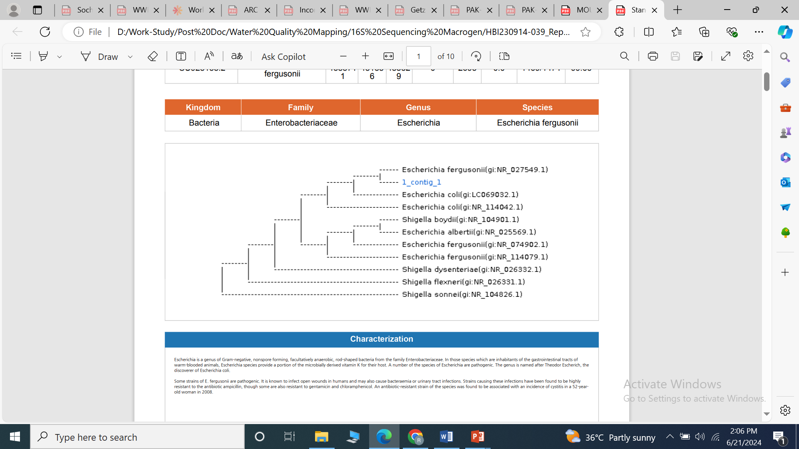
Supplementary Figure S2
Supplementary Figure 2: Phylogenetic Analysis of the Coliform Colony Isolated from Sample Number 1. This phylogenetic tree represents the genetic relationships of the coliform colony isolated from Sample Number 1. The isolates are classified within the Kingdom Bacteria, Family Enterobacteriaceae, Genus Escherichia, and Species Escherichia fergusonii. The tree illustrates the genetic similarity between the coliform colony from Sample Number 1 (labeled as "1_contig_1") and other known strains of Escherichia fergusonii, identified by their respective GenBank accession numbers.

Slide 3
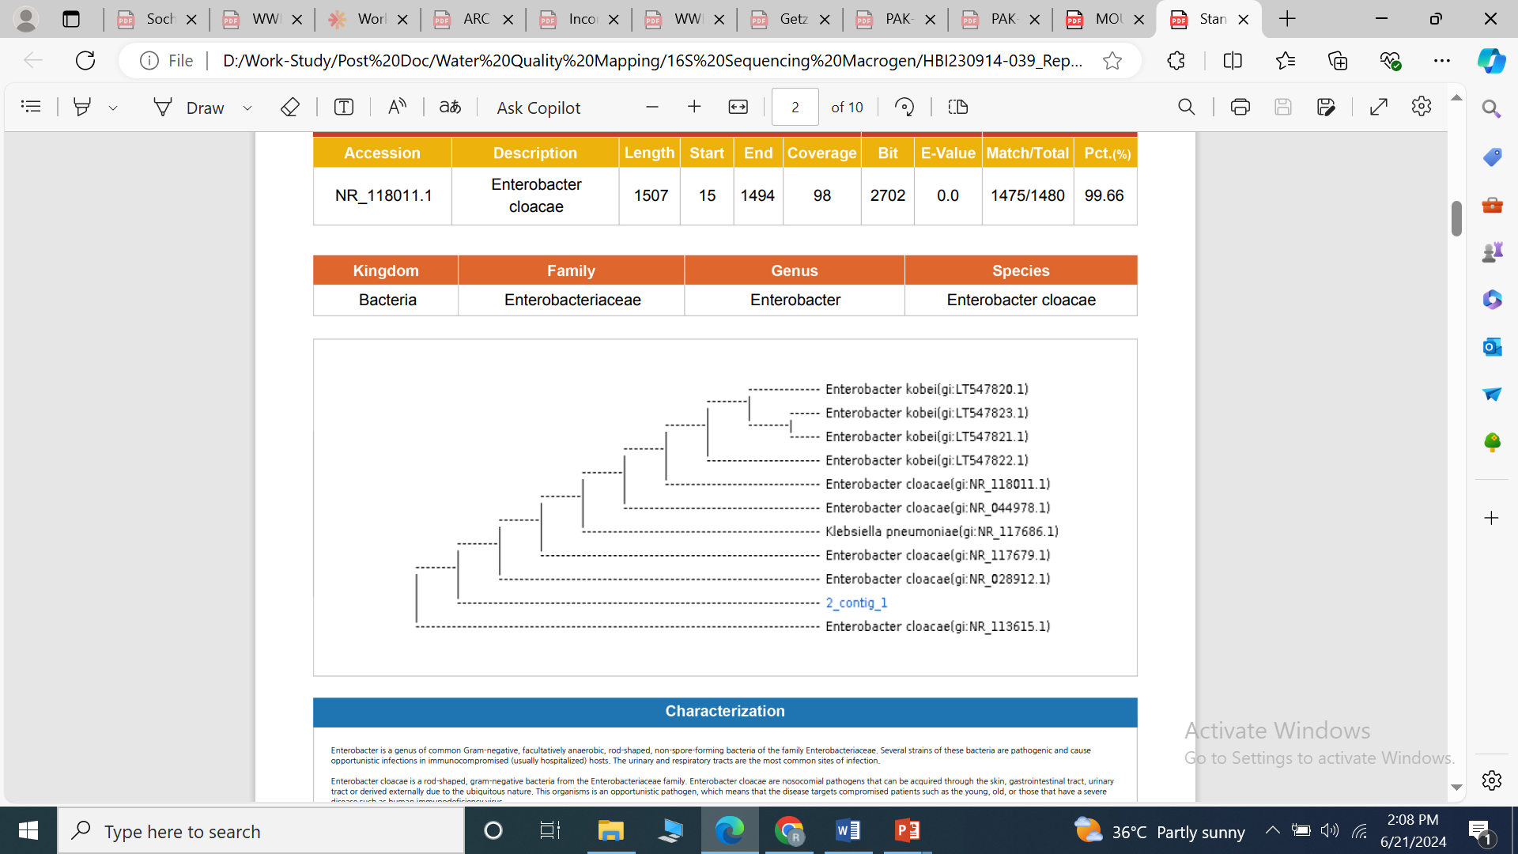
Supplementary Figure S3
Supplementary Figure 3: Phylogenetic Analysis of the Coliform Colony Isolated from Sample Number 2. This phylogenetic tree represents the genetic relationships of the coliform colony isolated from Sample Number 2. The isolates are classified within the Kingdom Bacteria, Family Enterobacteriaceae, Genus Enterobacter, and Species Enterobacter cloacae. The tree illustrates the genetic similarity between the coliform colony from Sample Number 2 (labeled as "2_contig_1") and other known strains of Enterobacter cloacae, identified by their respective GenBank accession numbers.

Slide 4
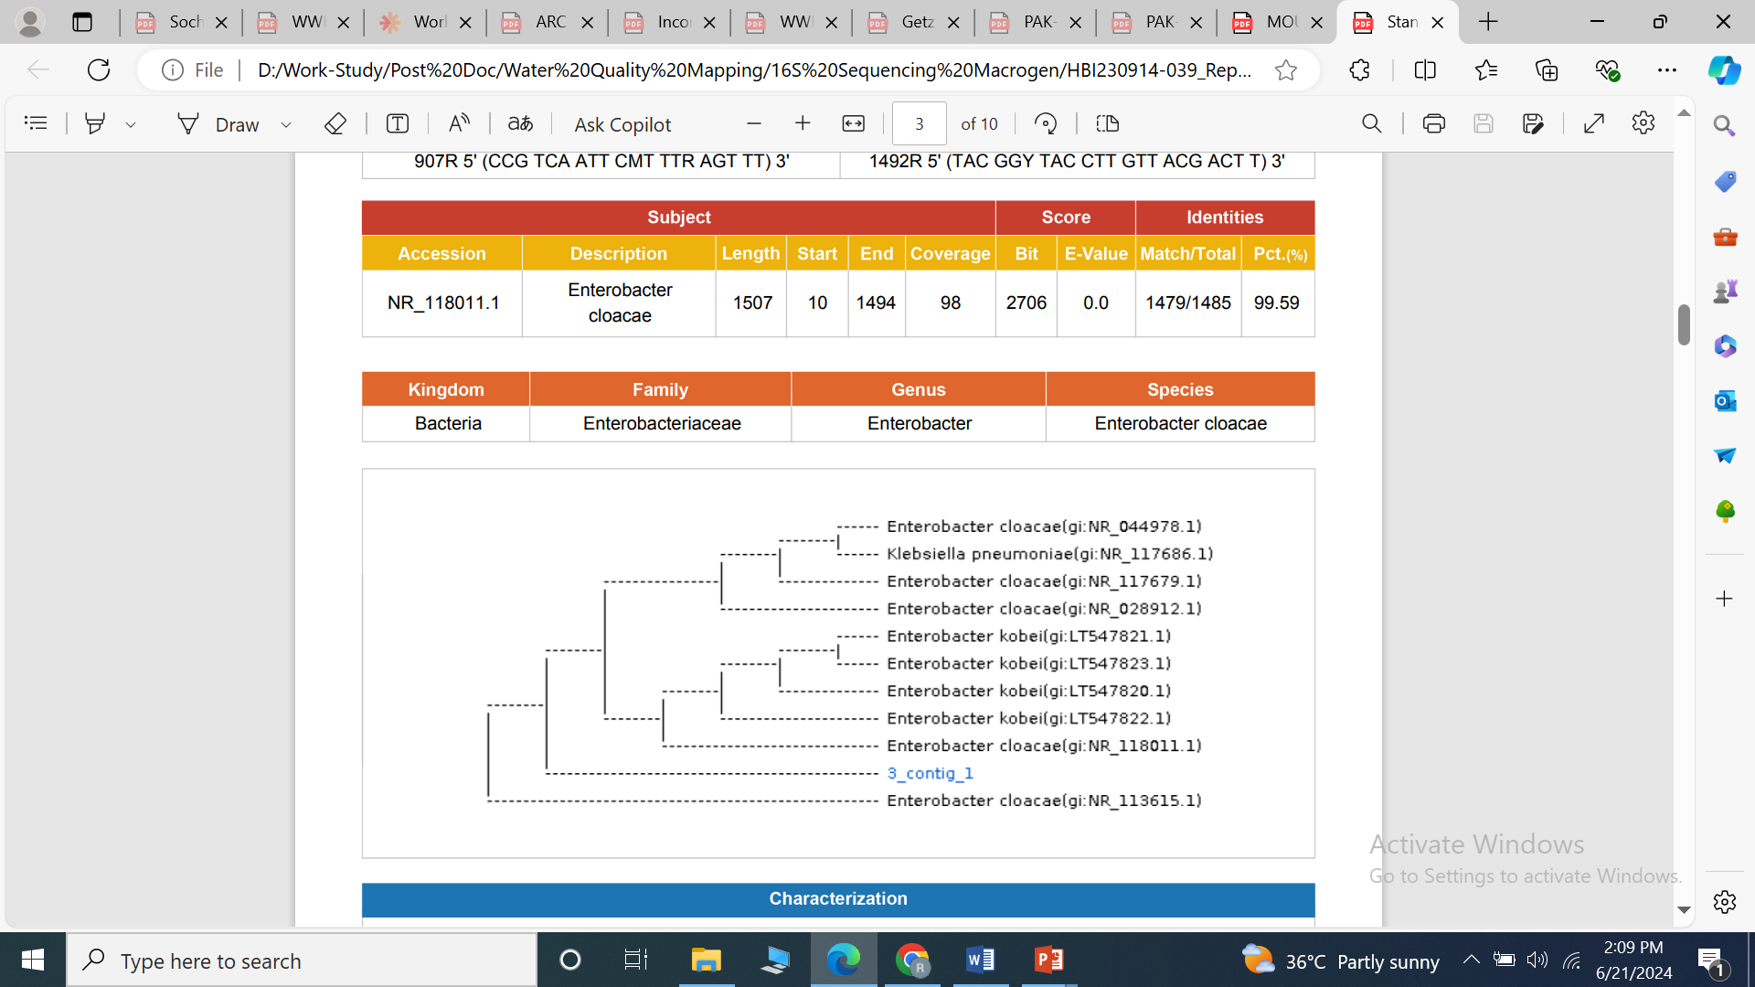
Supplementary Figure S4
Supplementary Figure 4: Phylogenetic Analysis of the Coliform Colony Isolated from Sample Number 3. This phylogenetic tree represents the genetic relationships of the coliform colony isolated from Sample Number 3. The isolates are classified within the Kingdom Bacteria, Family Enterobacteriaceae, Genus Enterobacter, and Species Enterobacter cloacae. The tree illustrates the genetic similarity between the coliform colony from Sample Number 3 (labeled as "3_contig_1") and other known strains of Enterobacter cloacae, identified by their respective GenBank accession numbers.

Slide 5
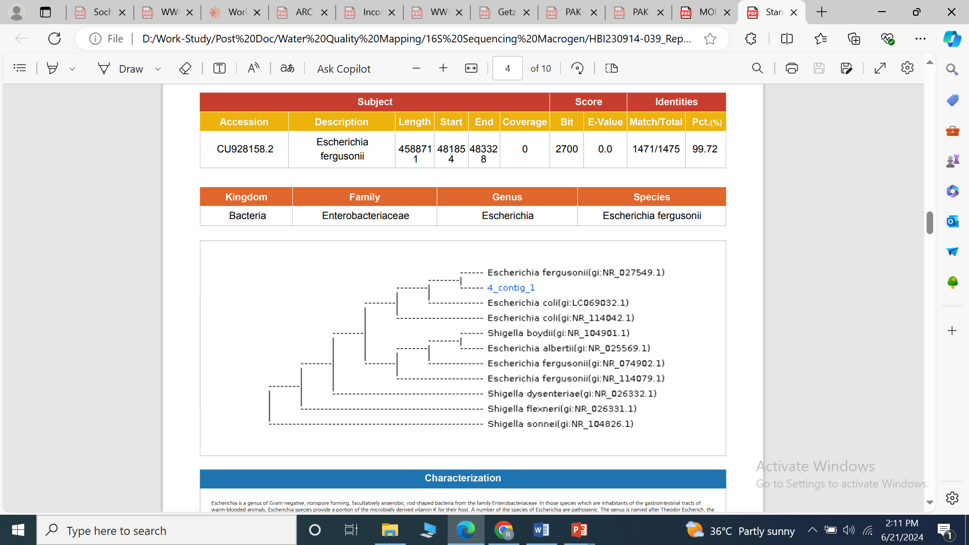
Supplementary Figure S5
Supplementary Figure 5: Phylogenetic Analysis of the Coliform Colony Isolated from Sample Number 4. This phylogenetic tree represents the genetic relationships of the coliform colony isolated from Sample Number 4. The isolates are classified within the Kingdom Bacteria, Family Enterobacteriaceae, Genus Escherichia, and Species Escherichia fergusonii. The tree illustrates the genetic similarity between the coliform colony from Sample Number 4 (labeled as "4_contig_1") and other known strains of Escherichia fergusonii, identified by their respective GenBank accession numbers.

Slide 6
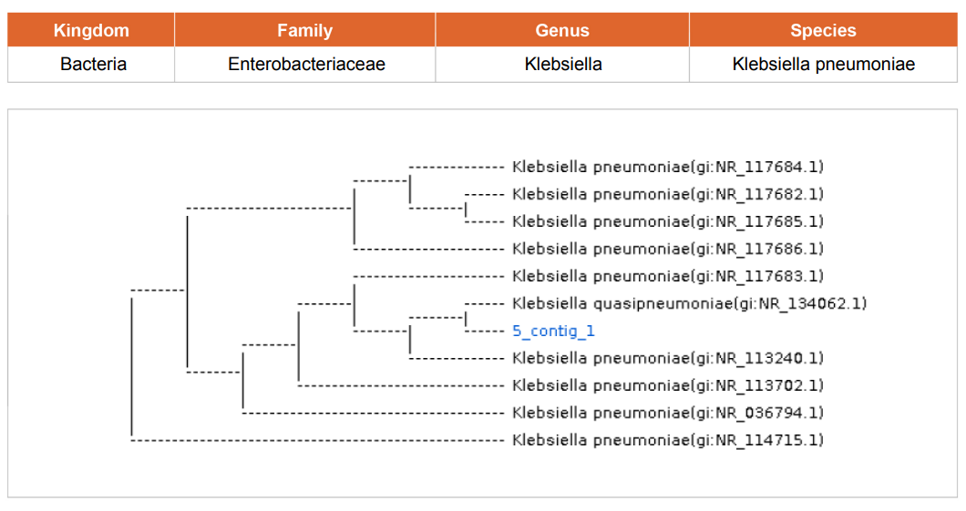
Supplementary Figure S6
Supplementary Figure 6: Phylogenetic Analysis of the Coliform Colony Isolated from Sample Number 5. This phylogenetic tree represents the genetic relationships of the coliform colony isolated from Sample Number 5. The isolates are classified within the Kingdom Bacteria, Family Enterobacteriaceae, Genus Klebsiella, and Species Klebsiella pneumoniae. The tree illustrates the genetic similarity between the coliform colony from Sample Number 5 (labeled as "5_contig_1") and other known strains of Klebsiella pneumoniae, identified by their respective GenBank accession numbers.

Slide 7
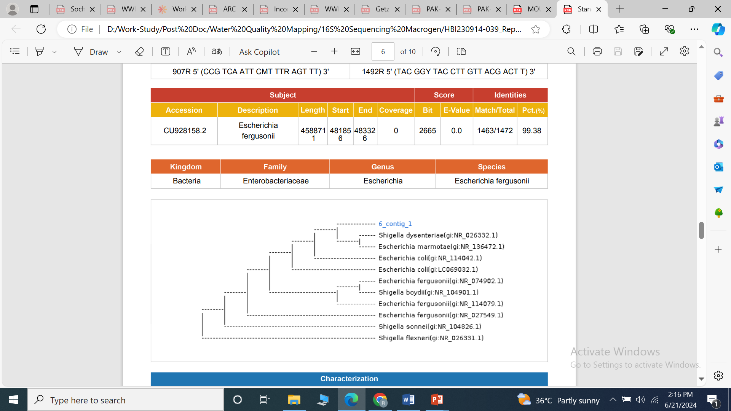
Supplementary Figure S7
Supplementary Figure 7: Phylogenetic Analysis of the Coliform Colony Isolated from Sample Number 6. This phylogenetic tree represents the genetic relationships of the coliform colony isolated from Sample Number 6. The isolates are classified within the Kingdom Bacteria, Family Enterobacteriaceae, Genus Escherichia, and Species Escherichia fergusonii. The tree illustrates the genetic similarity between the coliform colony from Sample Number 6 (labeled as "6_contig_1") and other known strains of Escherichia fergusonii, identified by their respective GenBank accession numbers.

Slide 8
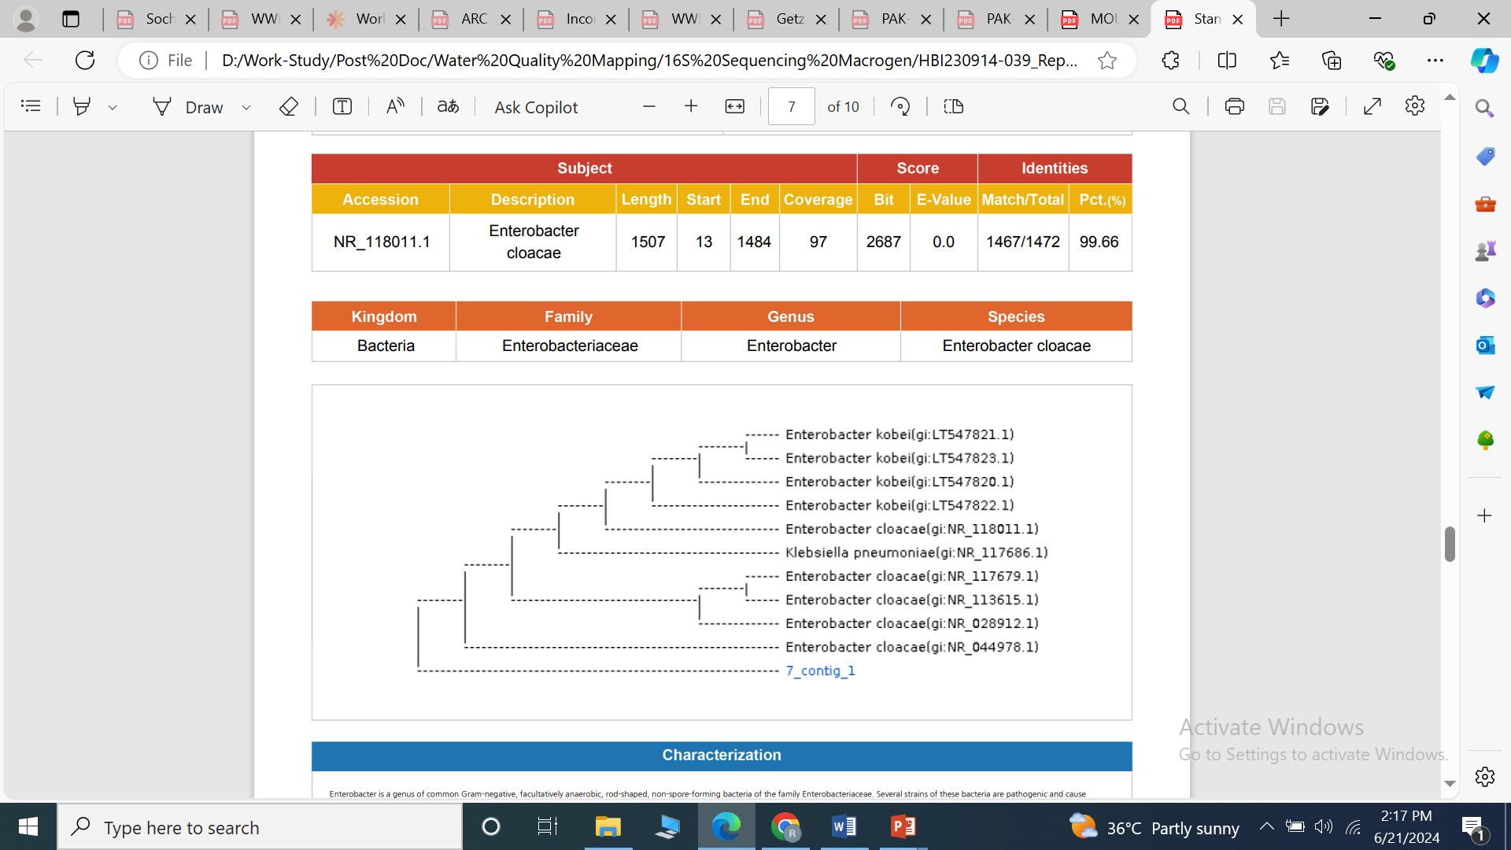
Supplementary Figure S8
Supplementary Figure 8: Phylogenetic Analysis of the Coliform Colony Isolated from Sample Number 7. This phylogenetic tree represents the genetic relationships of the coliform colony isolated from Sample Number 7. The isolates are classified within the Kingdom Bacteria, Family Enterobacteriaceae, Genus Enterobacter, and Species Enterobacter cloacae. The tree illustrates the genetic similarity between the coliform colony from Sample Number 7 (labeled as "7_contig_1") and other known strains of Enterobacter cloacae, identified by their respective GenBank accession numbers.

Slide 9
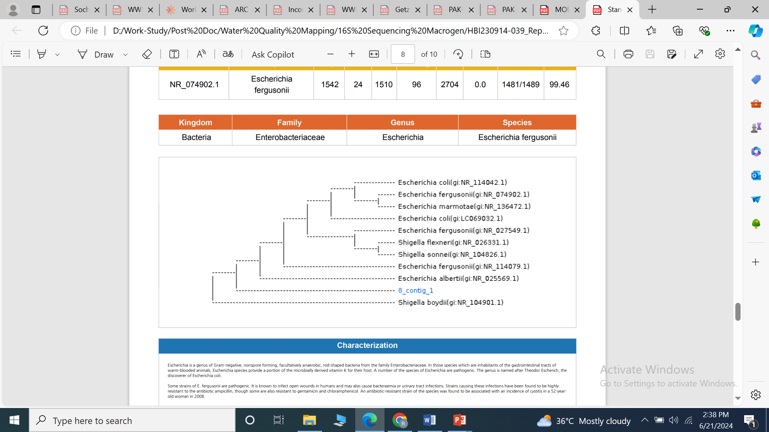
Supplementary Figure S9
Supplementary Figure 9: Phylogenetic Analysis of the Coliform Colony Isolated from Sample Number 8. This phylogenetic tree represents the genetic relationships of the coliform colony isolated from Sample Number 8. The isolates are classified within the Kingdom Bacteria, Family Enterobacteriaceae, Genus Escherichia, and Species Escherichia fergusonii. The tree illustrates the genetic similarity between the coliform colony from Sample Number 8 (labeled as "8_contig_1") and other known strains of Escherichia fergusonii, identified by their respective GenBank accession numbers.

Slide 10
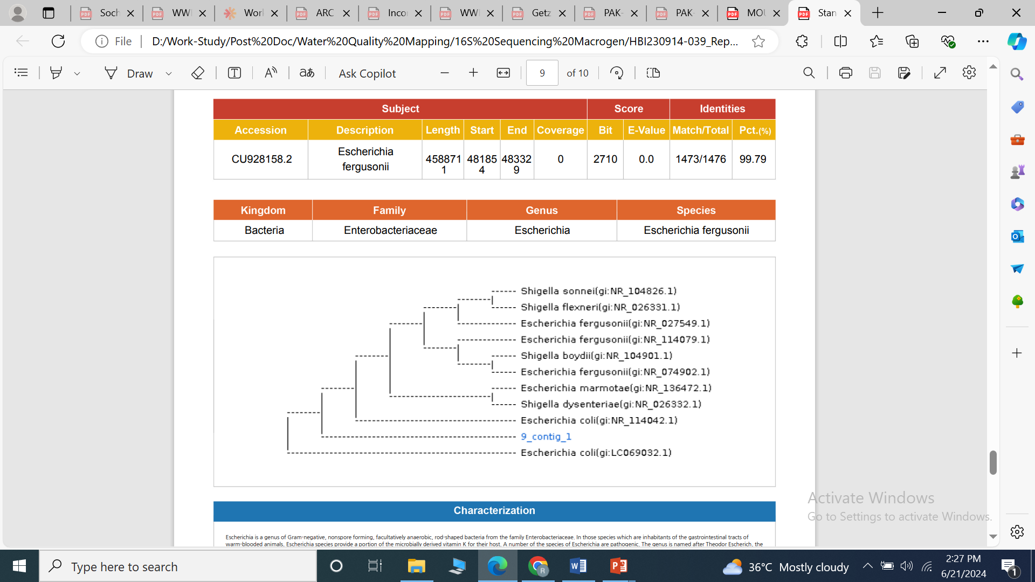
Supplementary Figure S10
Supplementary Figure 10: Phylogenetic Analysis of the Coliform Colony Isolated from Sample Number 9. This phylogenetic tree represents the genetic relationships of the coliform colony isolated from Sample Number 9. The isolates are classified within the Kingdom Bacteria, Family Enterobacteriaceae, Genus Escherichia, and Species Escherichia fergusonii. The tree illustrates the genetic similarity between the coliform colony from Sample Number 9 (labeled as "9_contig_1") and other known strains of Escherichia fergusonii, identified by their respective GenBank accession numbers.

Slide 11
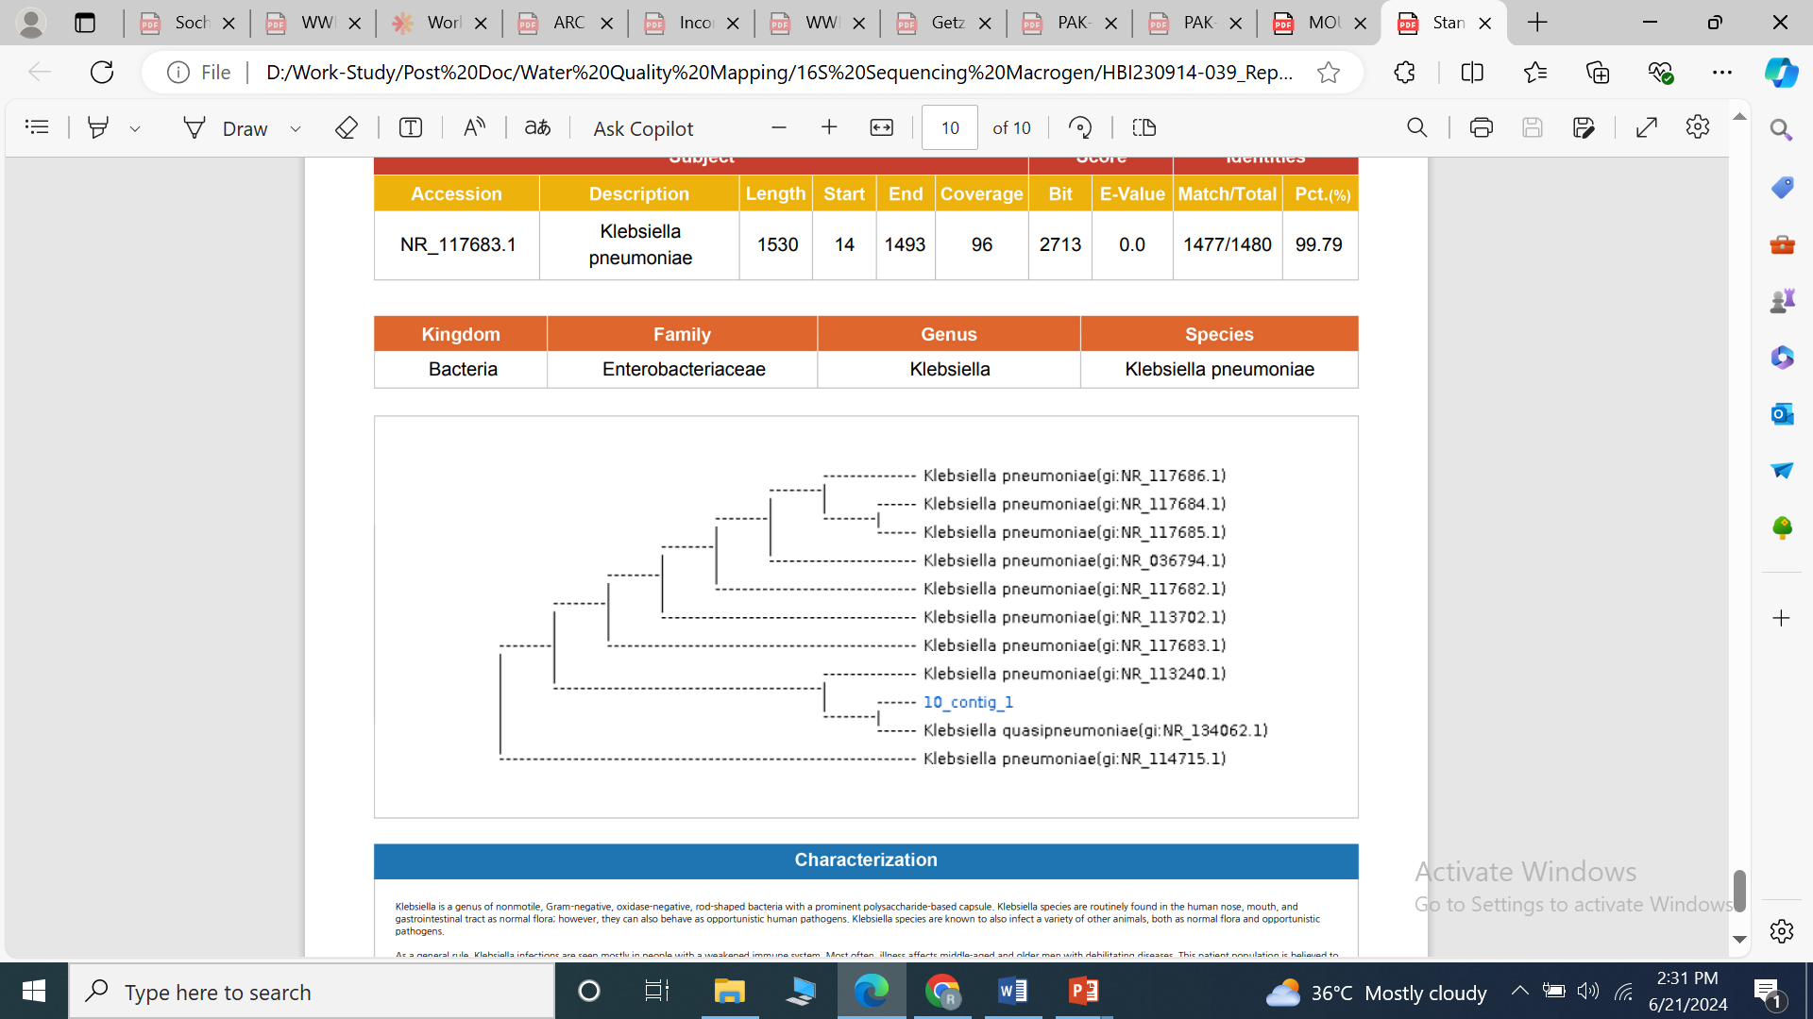
Supplementary Figure S11
Supplementary Figure 11: Phylogenetic Analysis of the Coliform Colony Isolated from Sample Number 10. This phylogenetic tree represents the genetic relationships of the coliform colony isolated from Sample Number 10. The isolates are classified within the Kingdom Bacteria, Family Enterobacteriaceae, Genus Klebsiella, and Species Klebsiella pneumoniae. The tree illustrates the genetic similarity between the coliform colony from Sample Number 10 (labeled as "10_contig_1") and other known strains of Klebsiella pneumoniae, identified by their respective GenBank accession numbers.

Slide 12
Supplementary Figure S12
(a)
(b)
Supplementary Figure 12: Correlation Between Coliform Positive Households and Reporting of Symptoms. The scatter plots illustrate the correlation between the percentage of coliform positive households and the percentage of households reporting symptoms. (a) shows the relationship with the equation y=1.05x−0.5256y=1.05x−0.5256 and an R2R2 value of 0.4562, indicating the proportion of variability in symptom prevalence explained by coliform contamination levels. (b) presents the relationship with Kirianwala removed from the analysis, showing the equation y=2.6486x−76.282y=2.6486x−76.282 and an R2R2 value of 0.9633, highlighting the increased explanatory power when this area is excluded.

