Slide 1
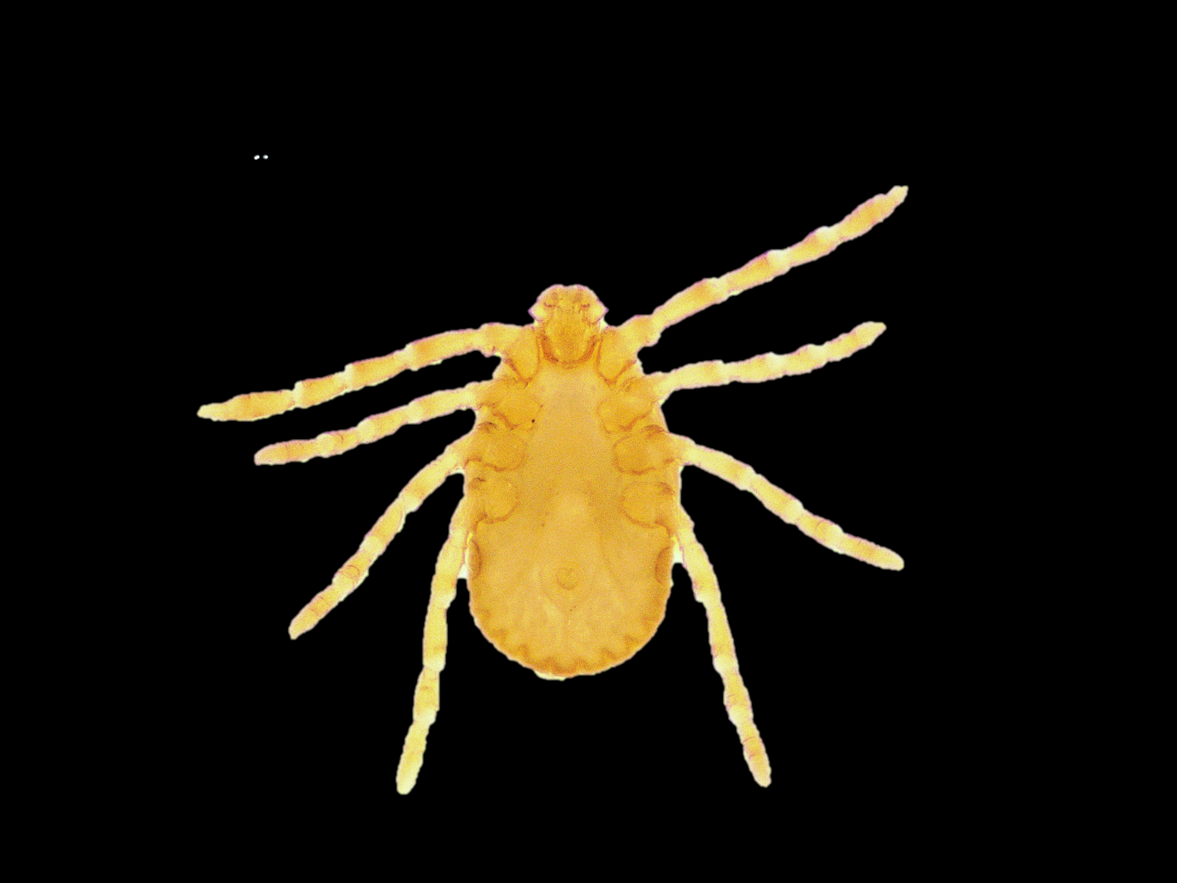
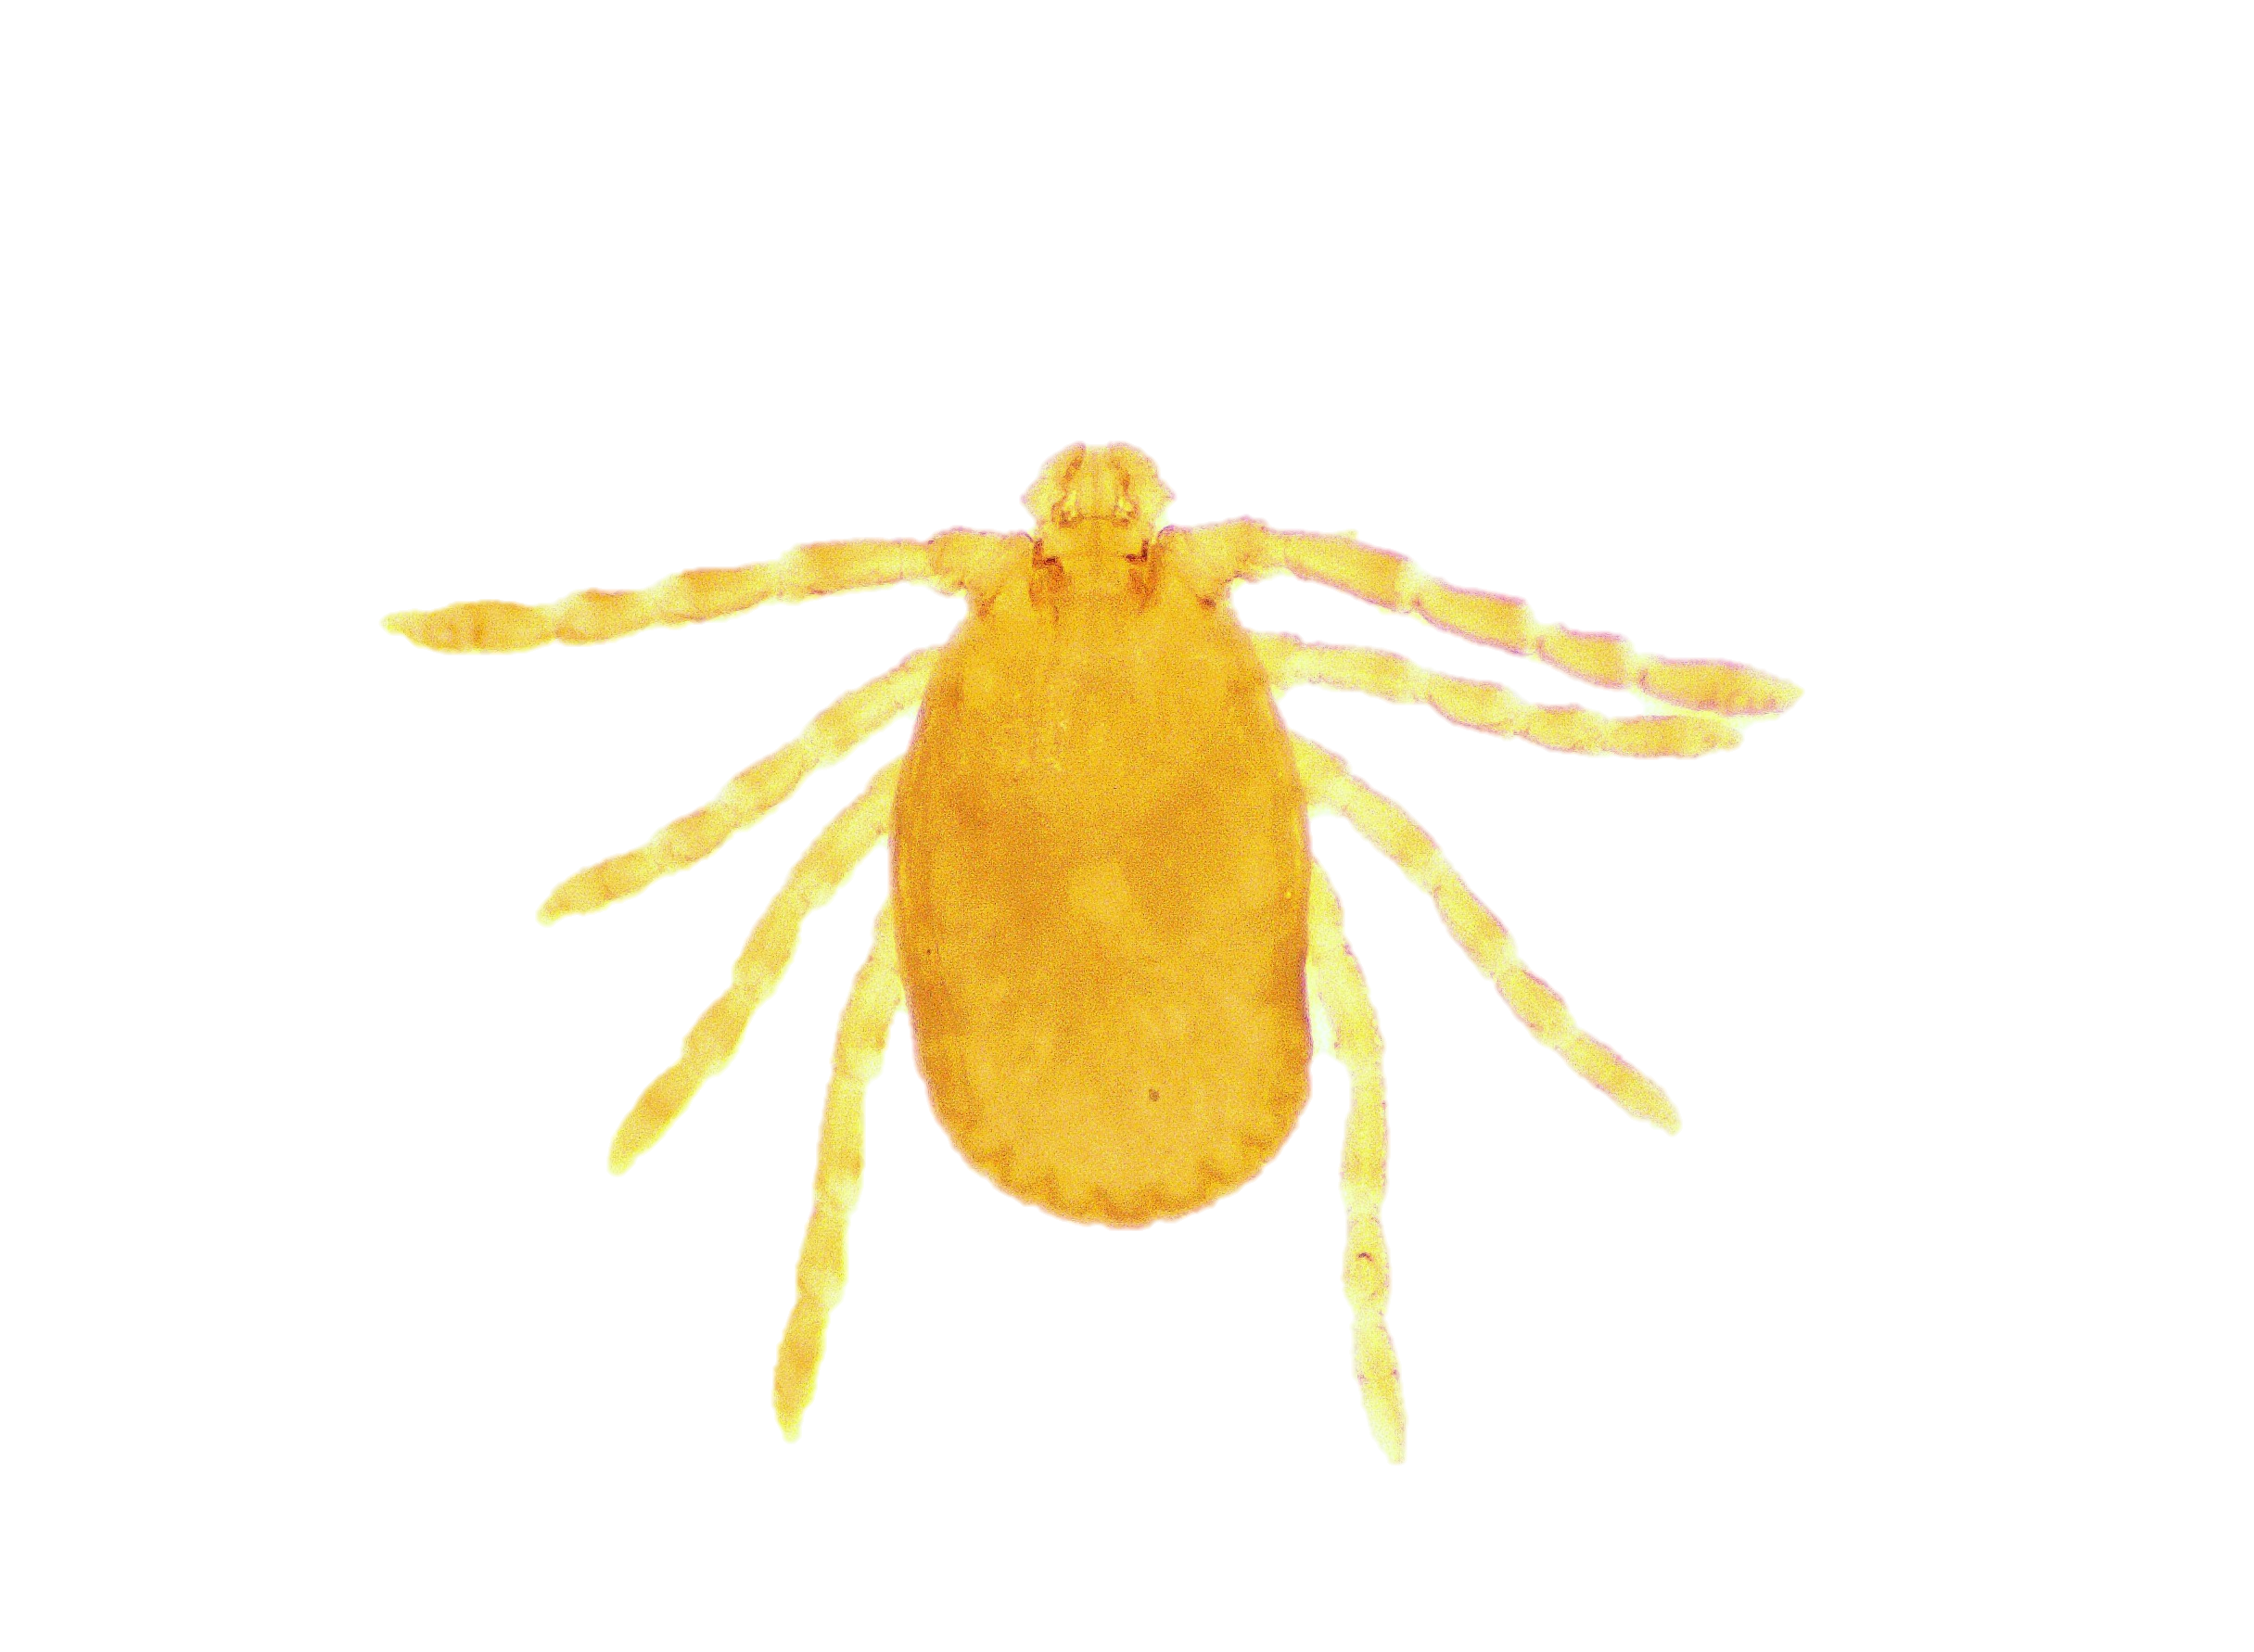
Ha. bispinosa Nymph
DORSAL SIDE
VENTRAL SIDE

Slide 2
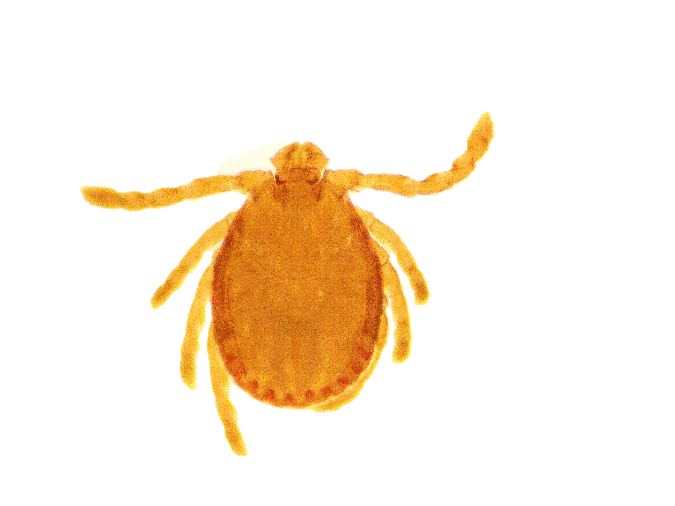
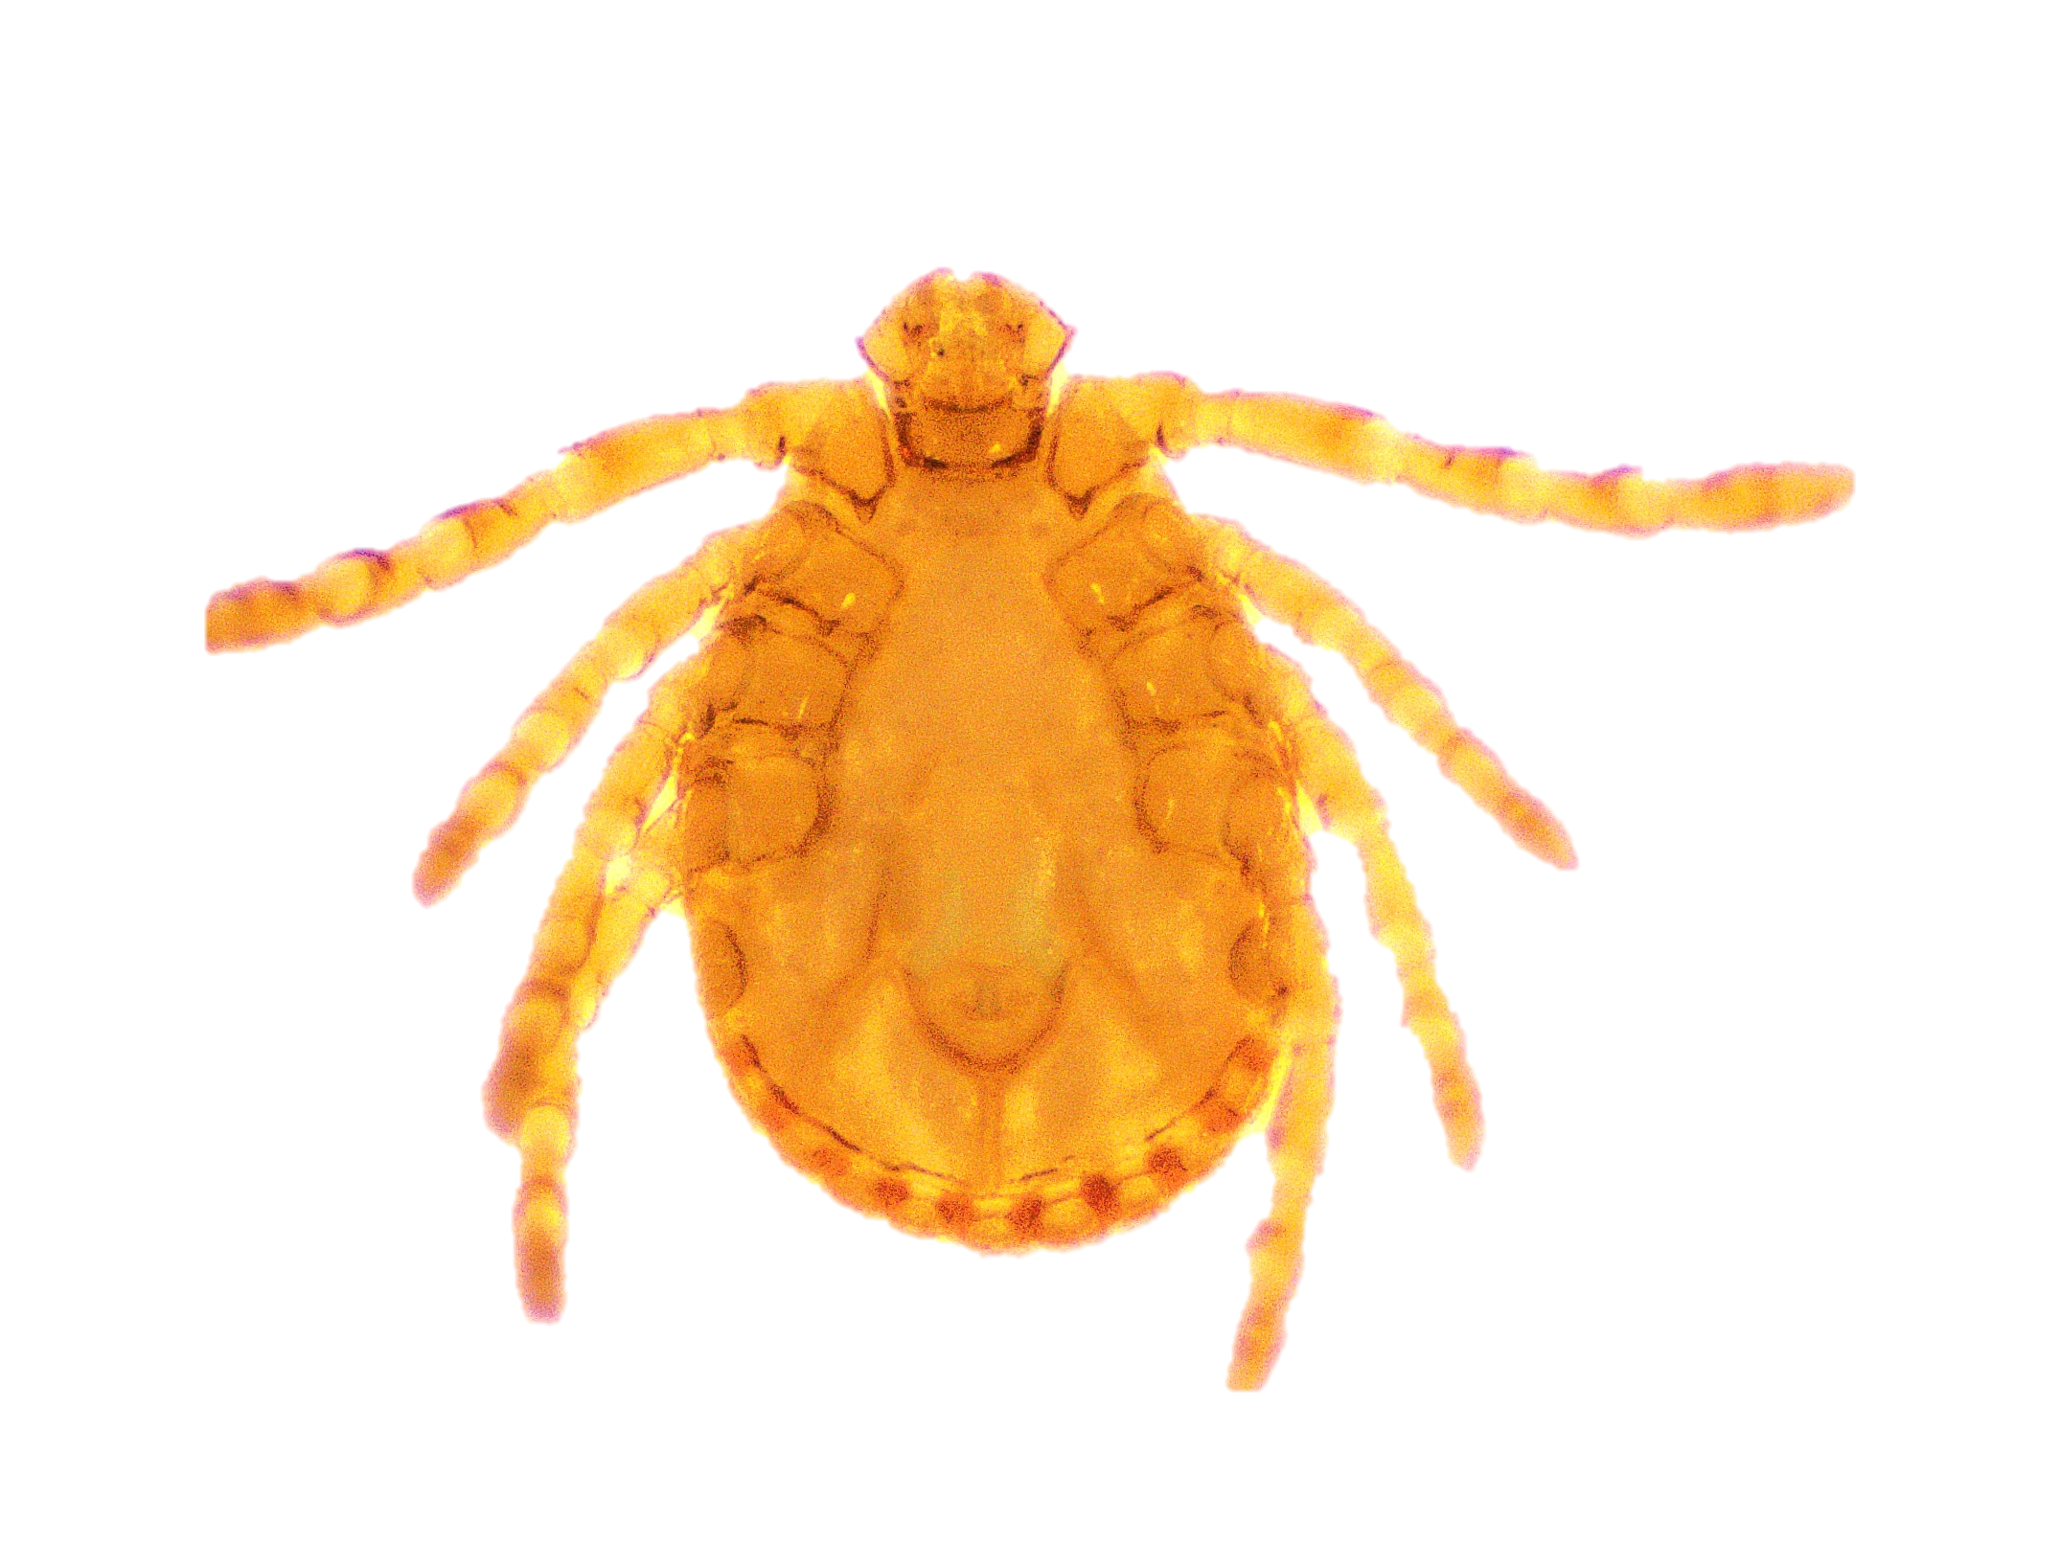
Ha. Intermedia Nymph
Dorsal side
Ventral side

Slide 3
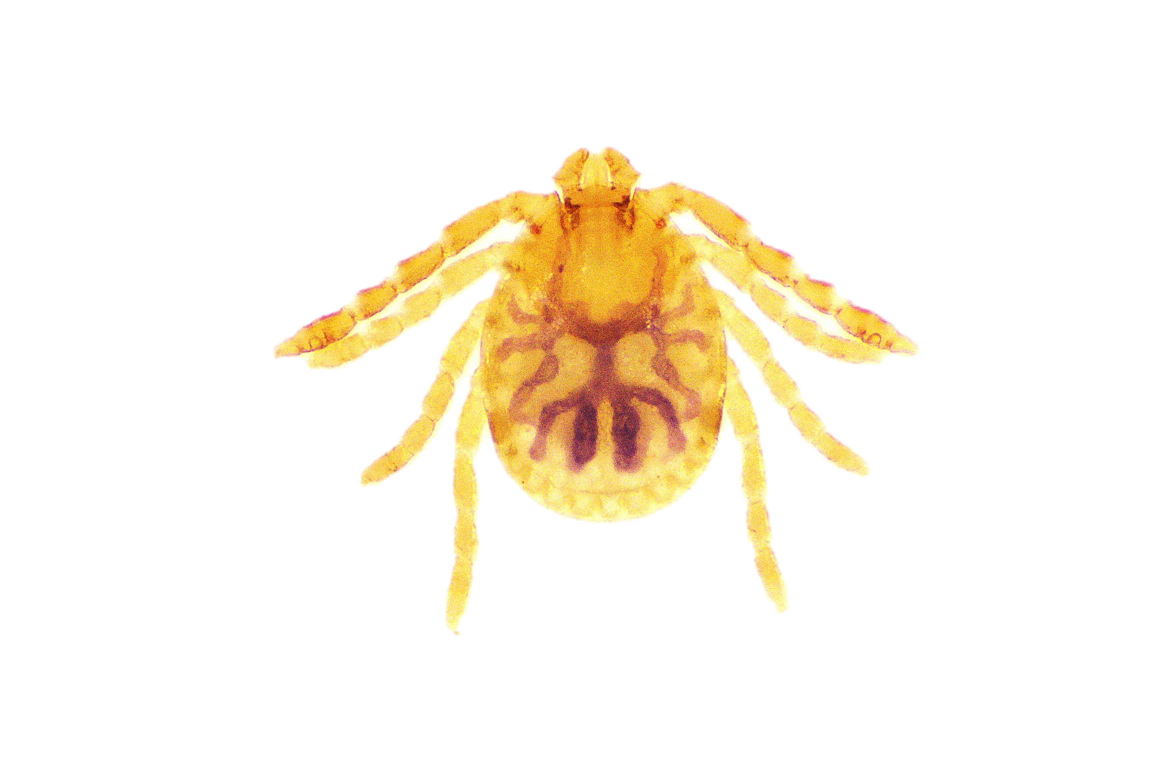
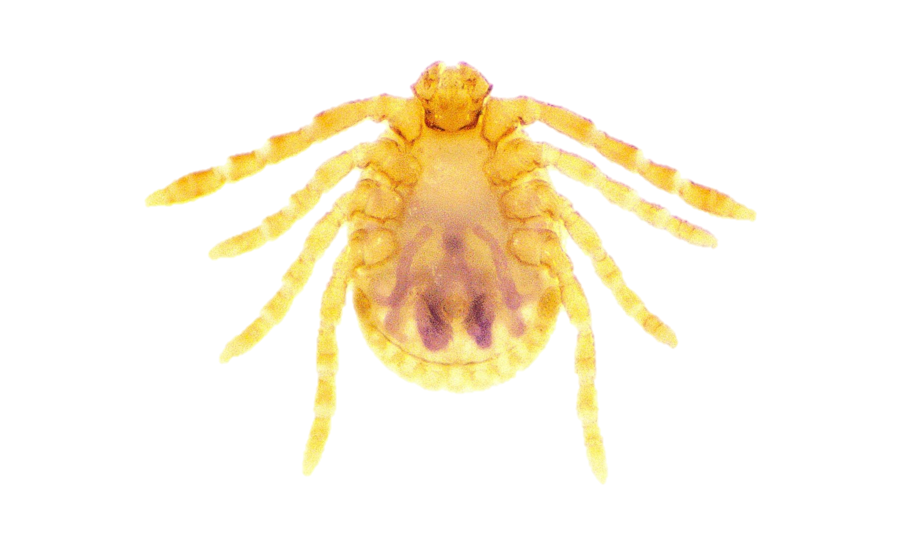
Ha. Aculeata Nymph
Dorsal SIDE
VENTRAL SIDE

Slide 4
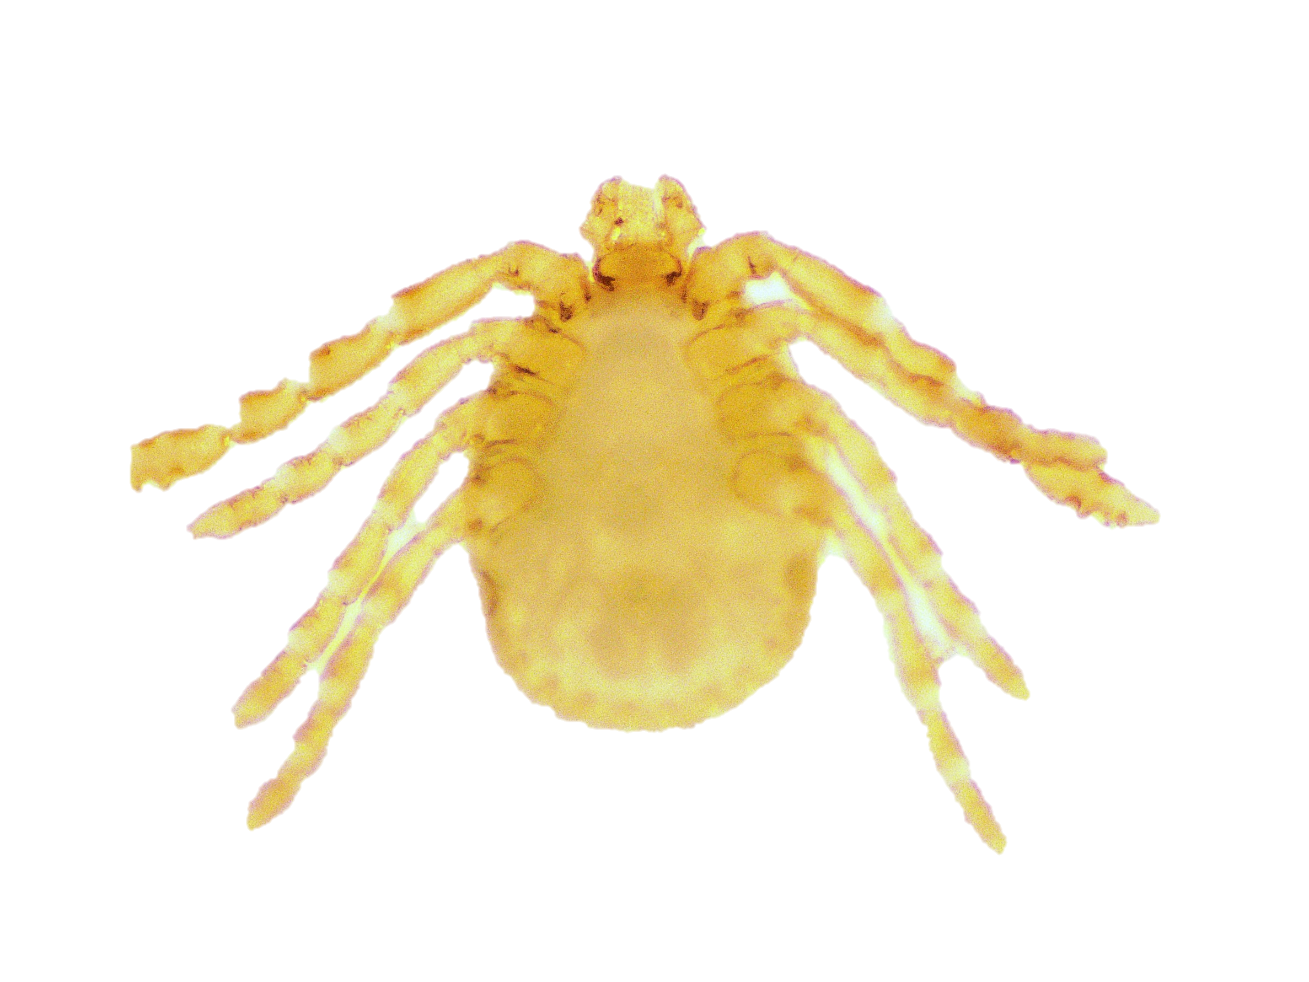
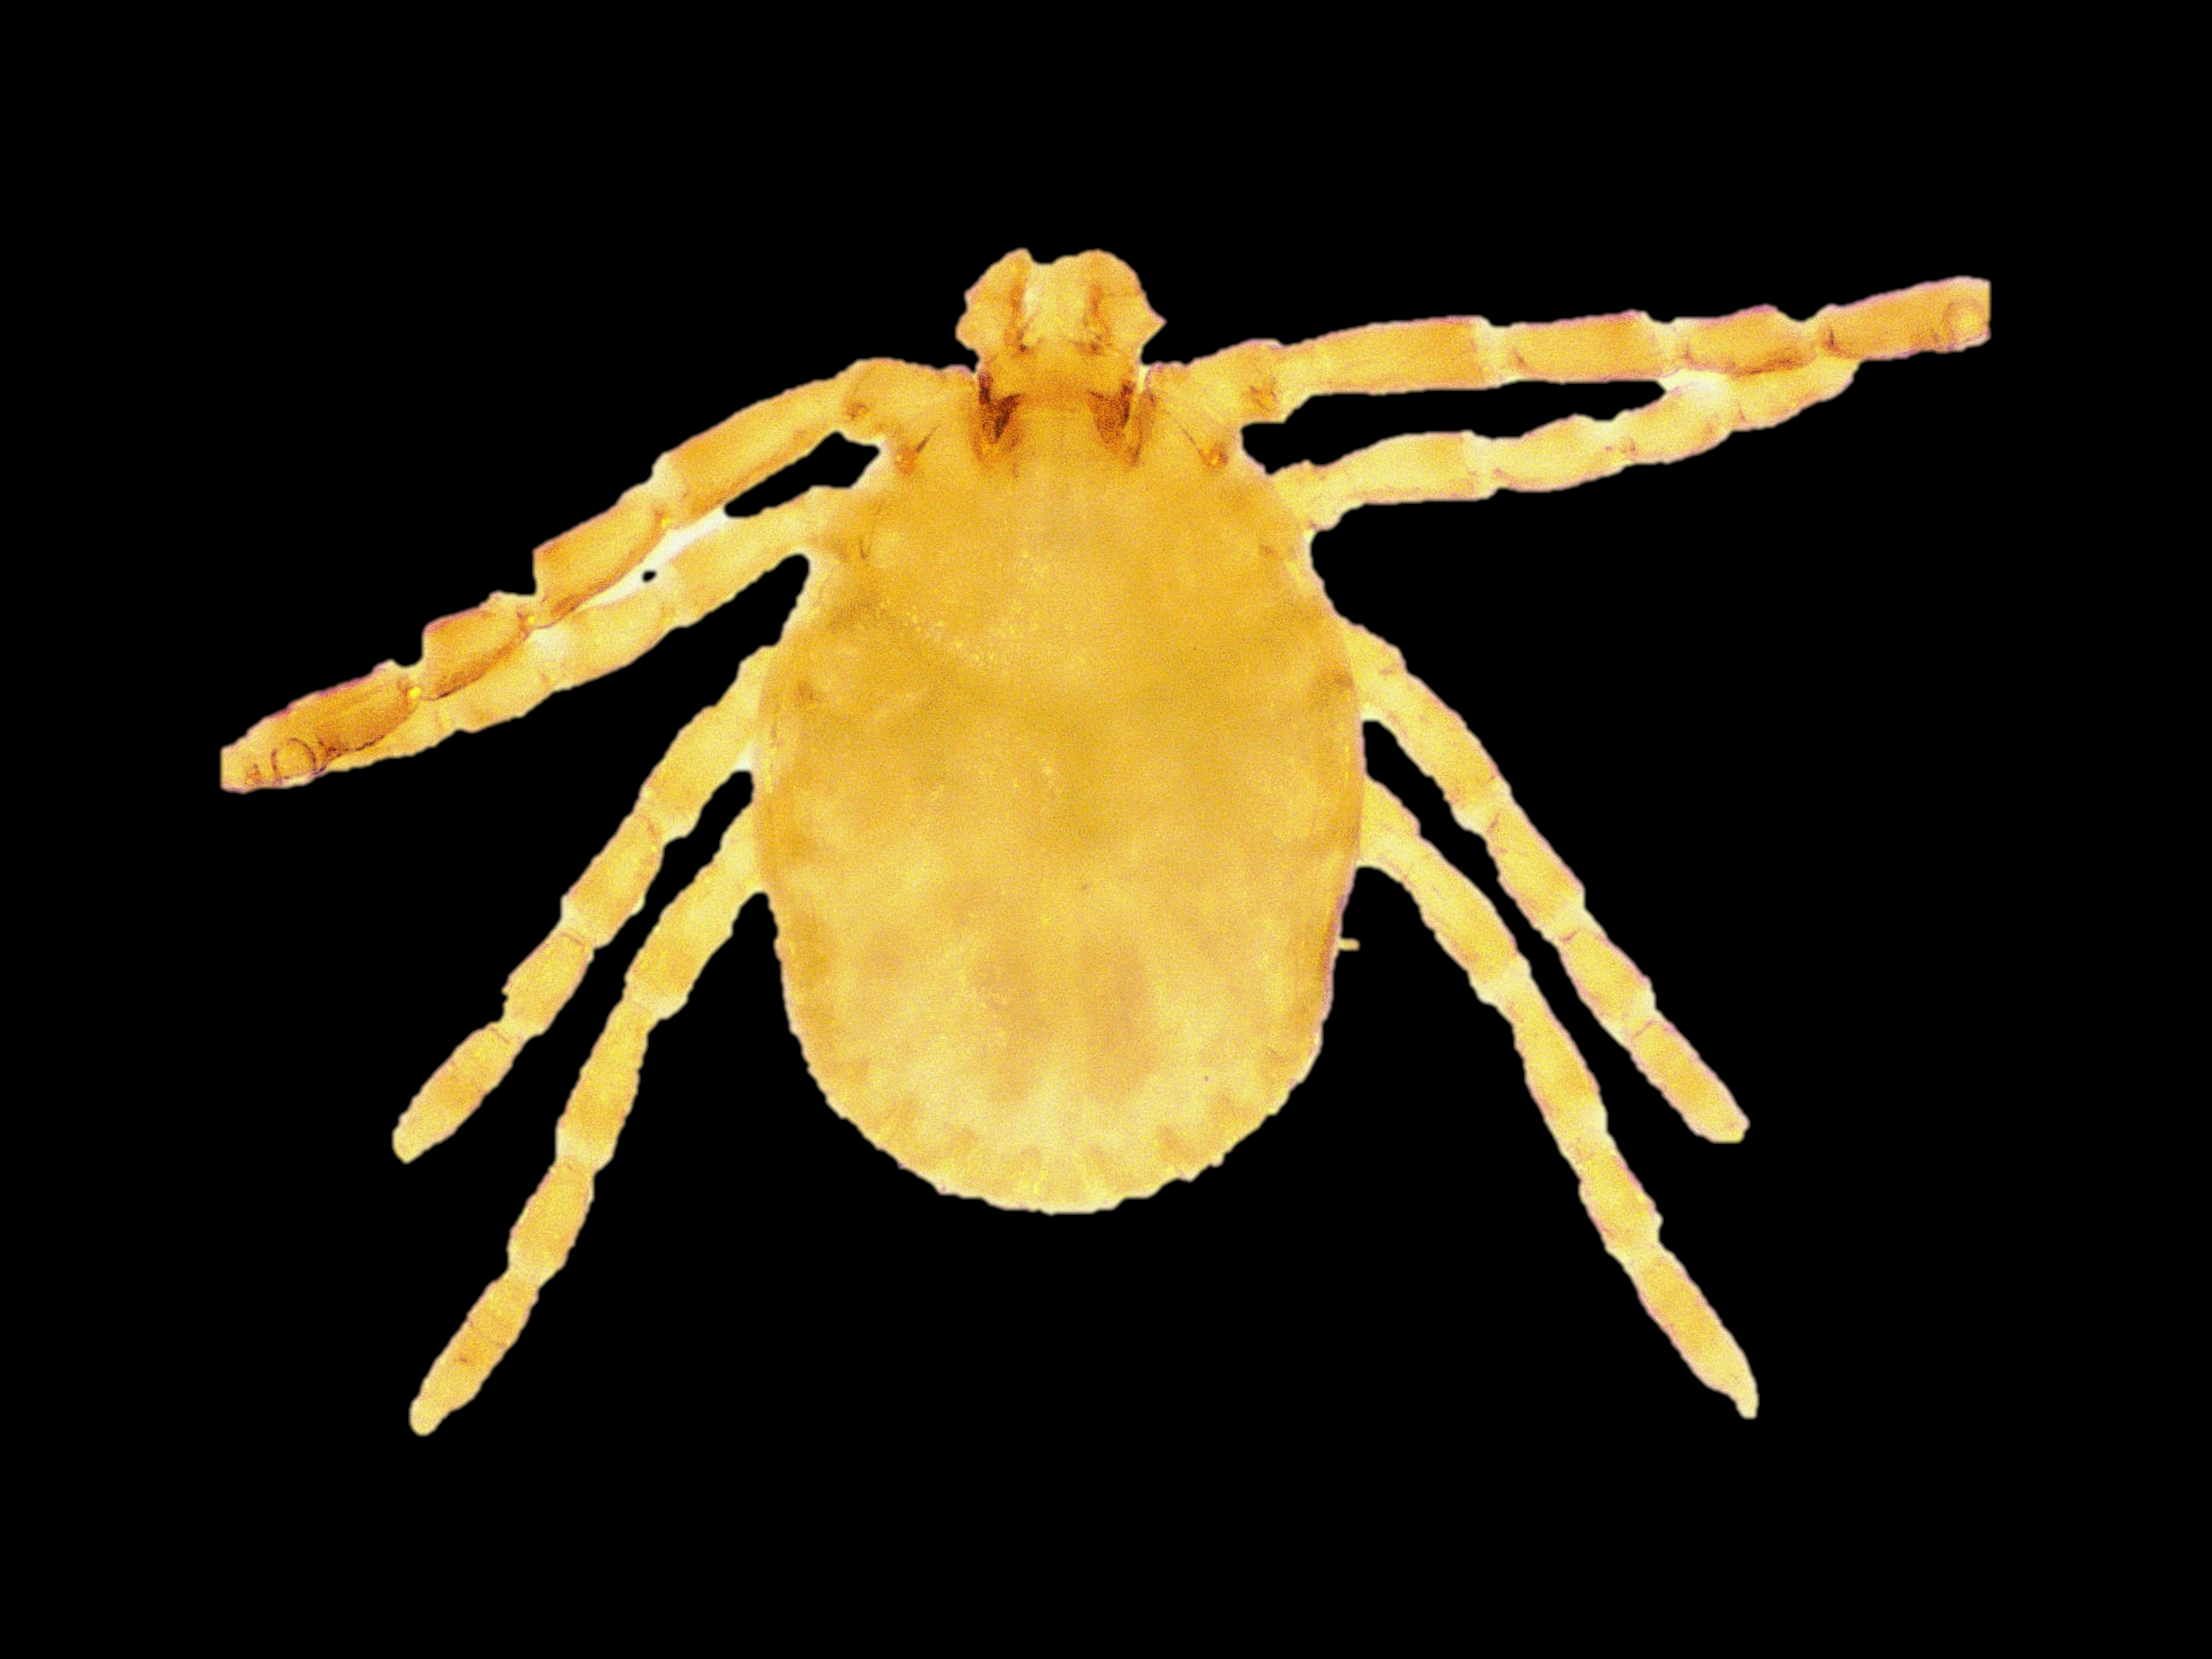
Ha. cuspidata nymph
DORSAL SIDE
VENTRAL SIDE

Slide 5
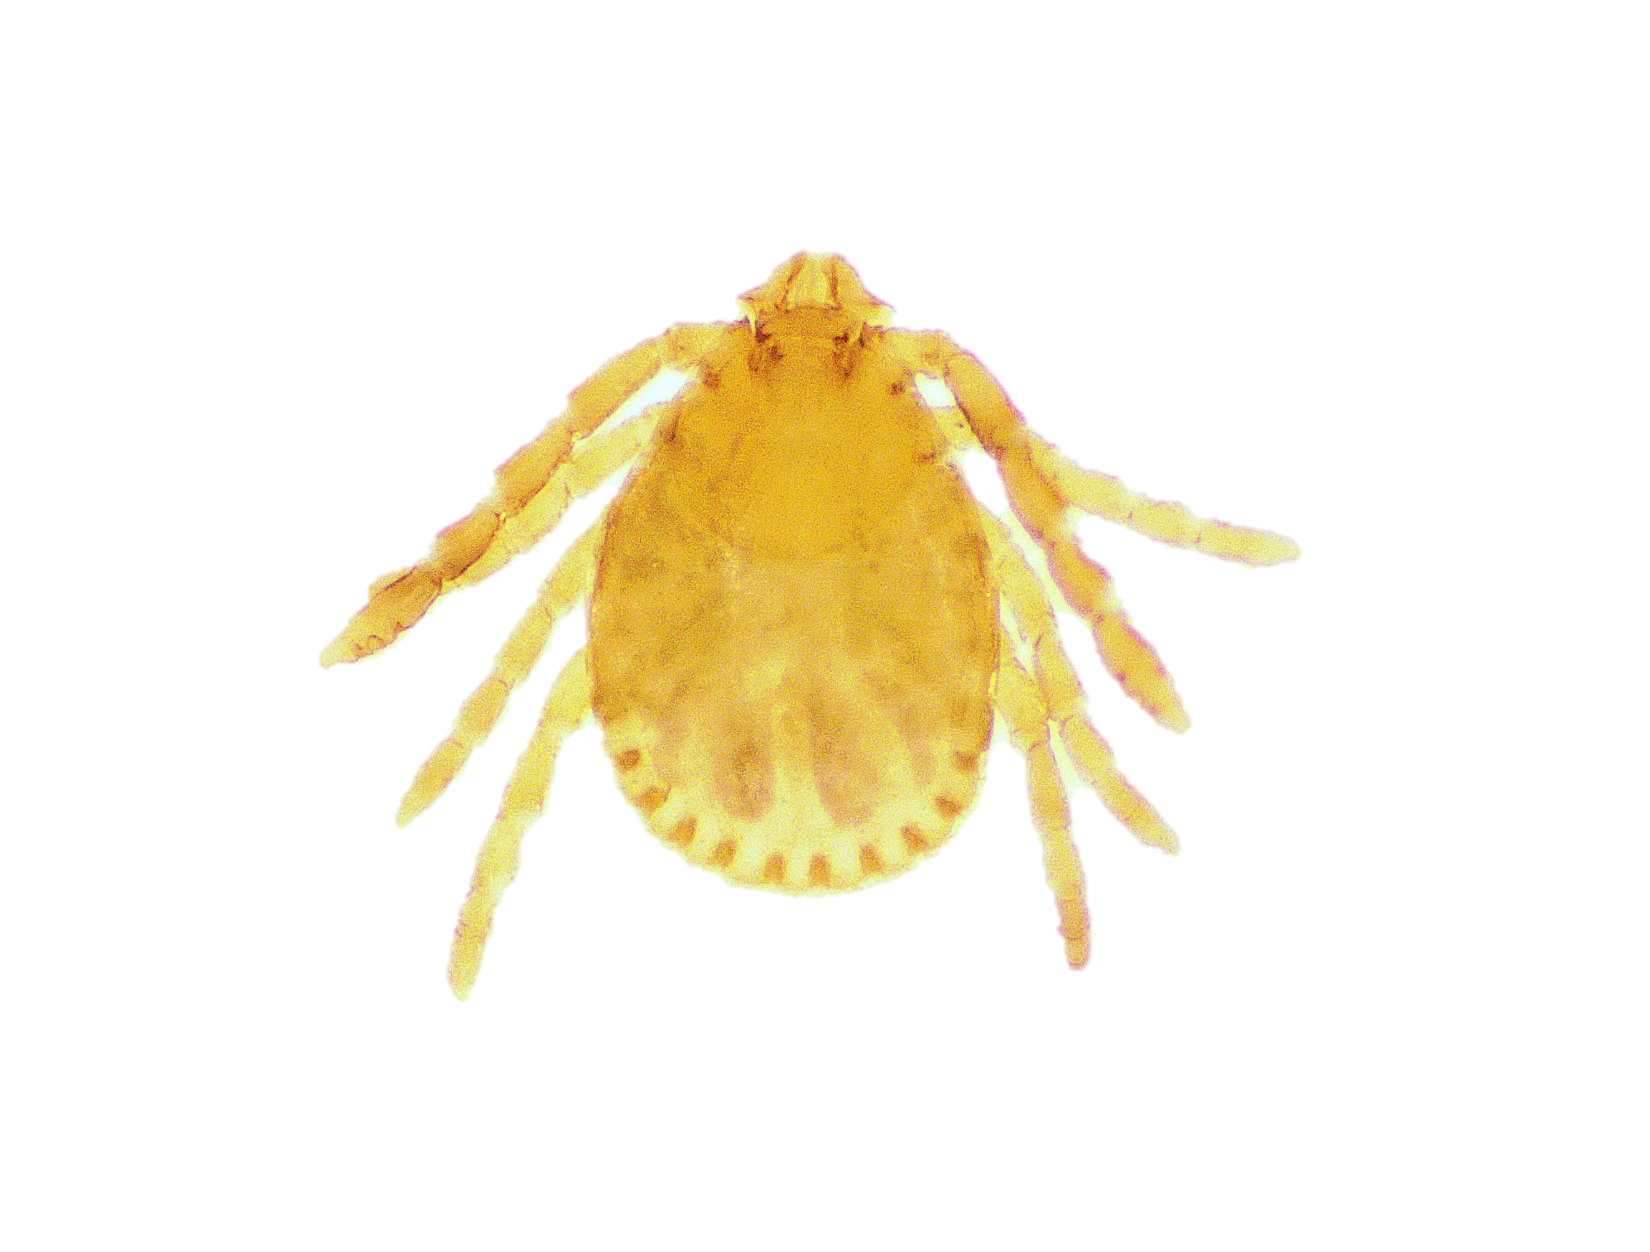
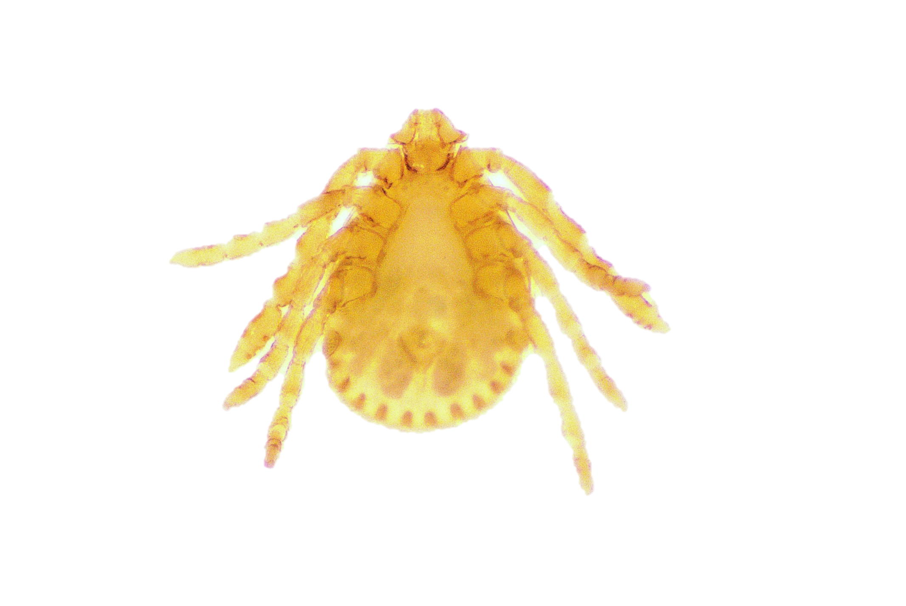
Ha. kyasanurensis nymph
Dorsal side
Ventral side

Slide 6
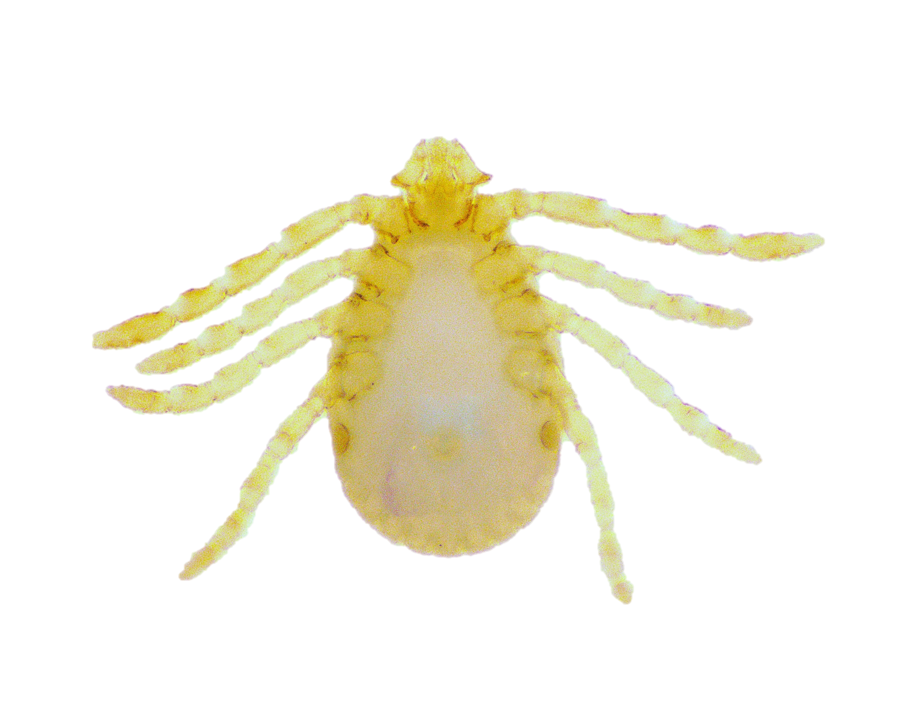
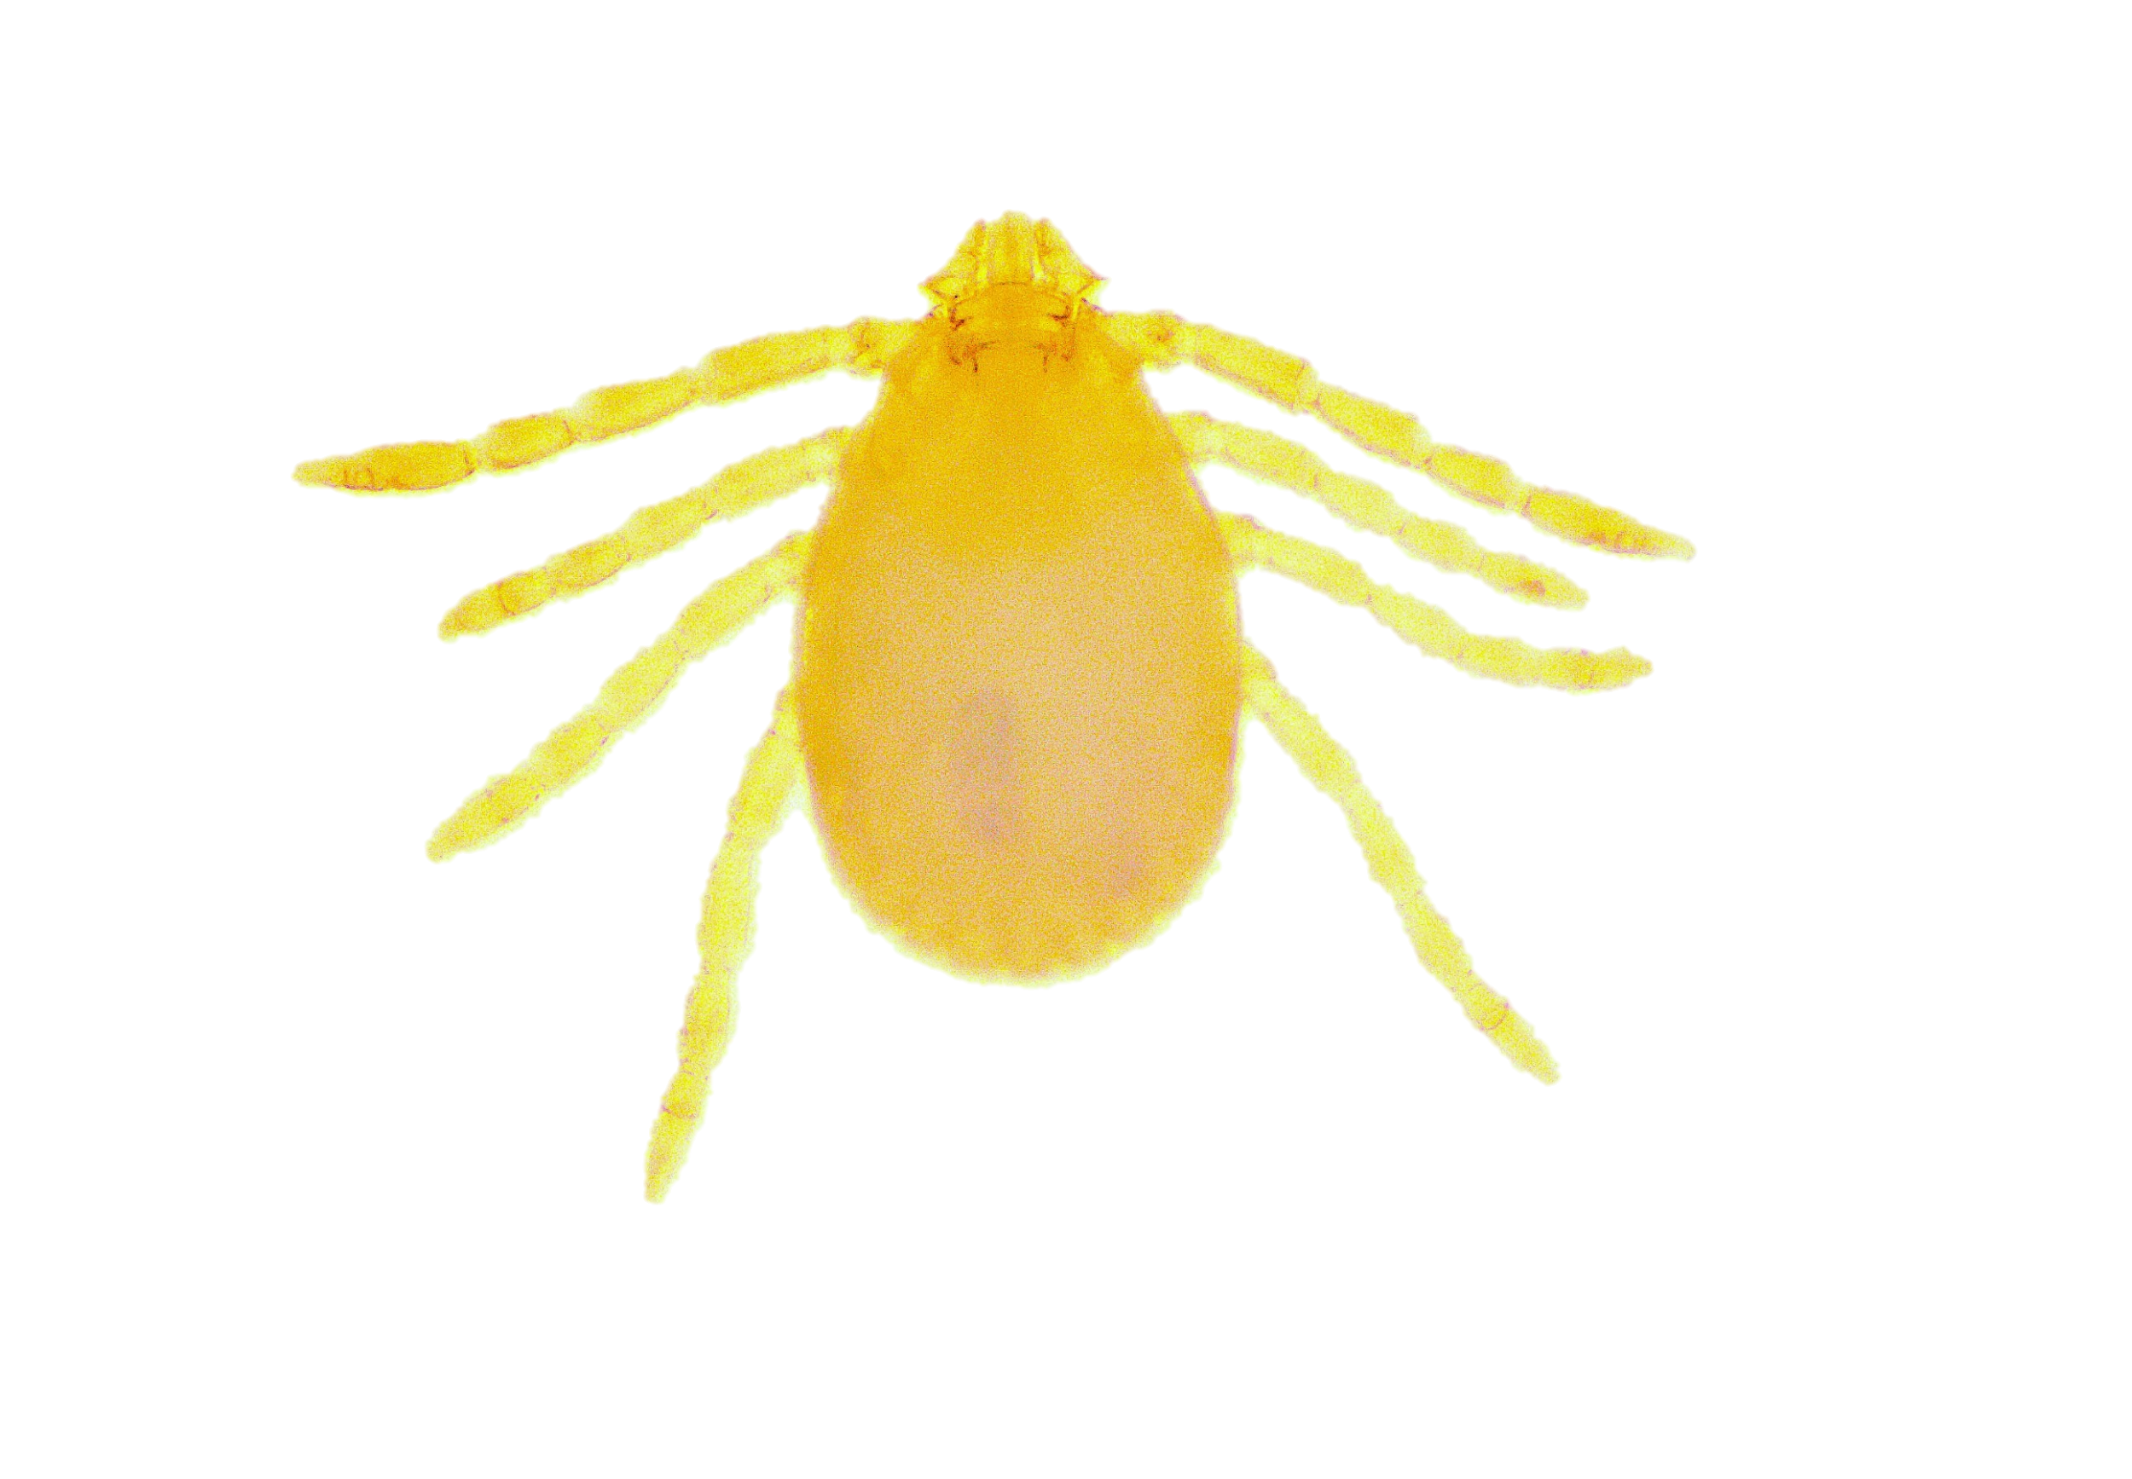
Ha. minuta nymph
Dorsal side
Ventral side

Slide 7
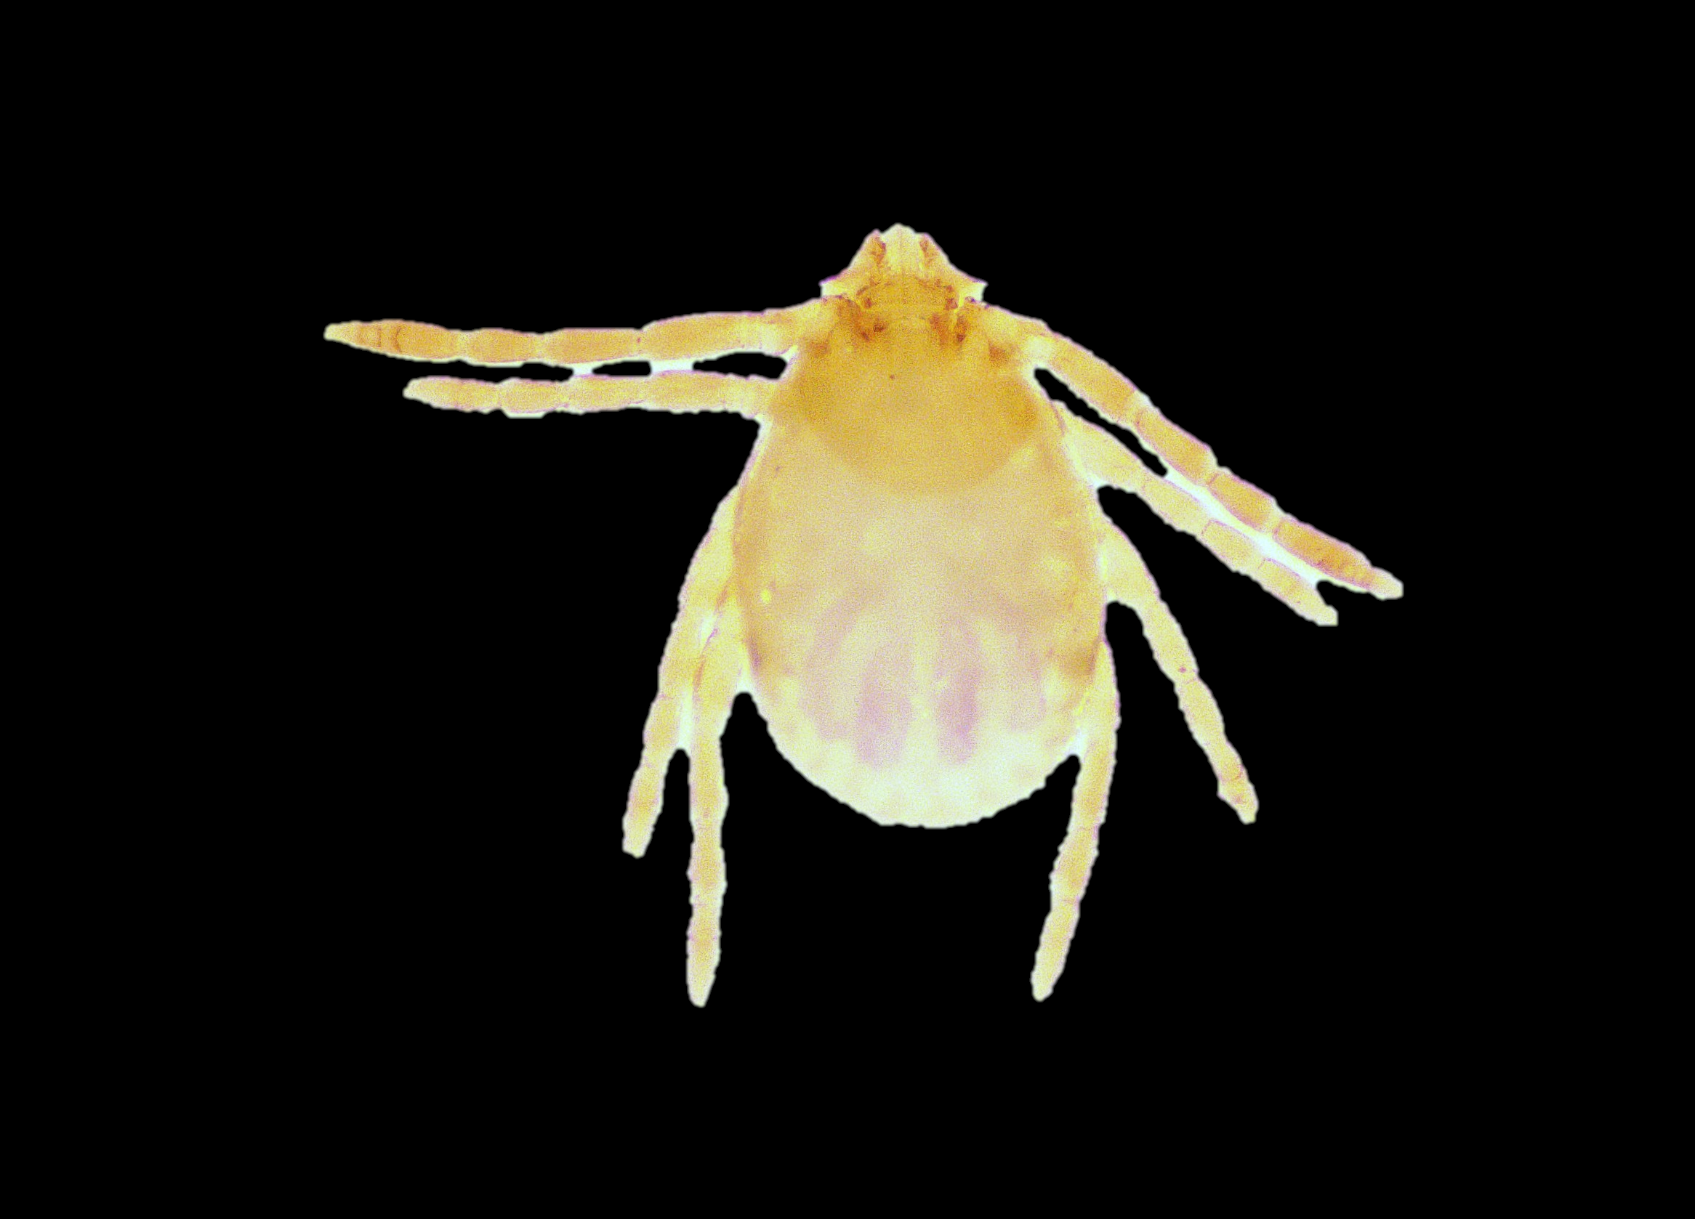
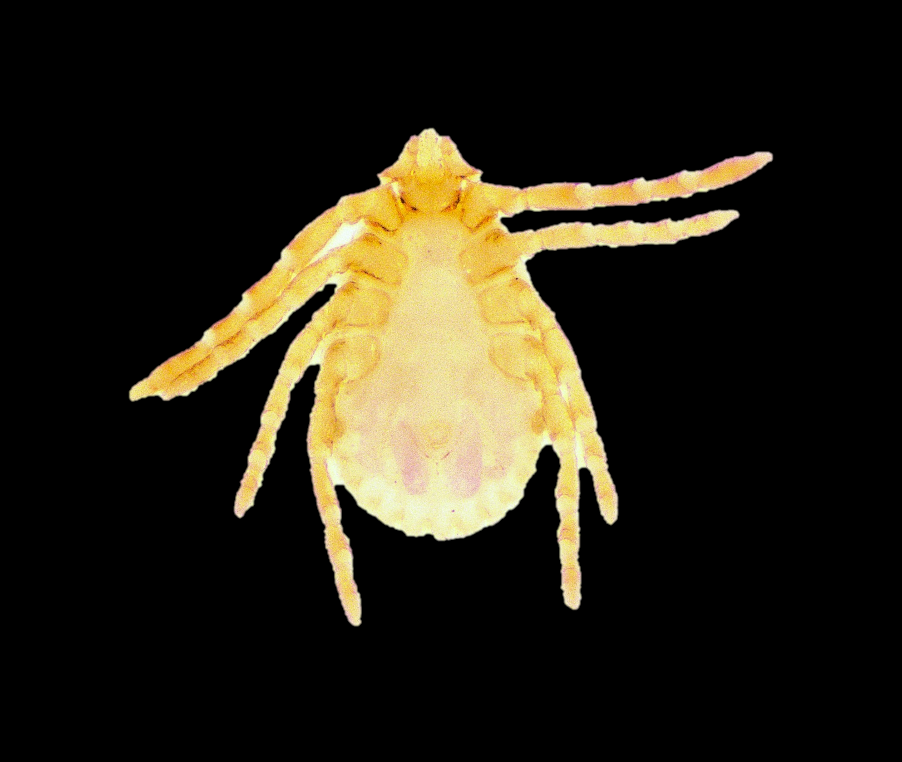
Ha. papuana kinneari nymph
Dorsal side
Ventral side

Slide 8
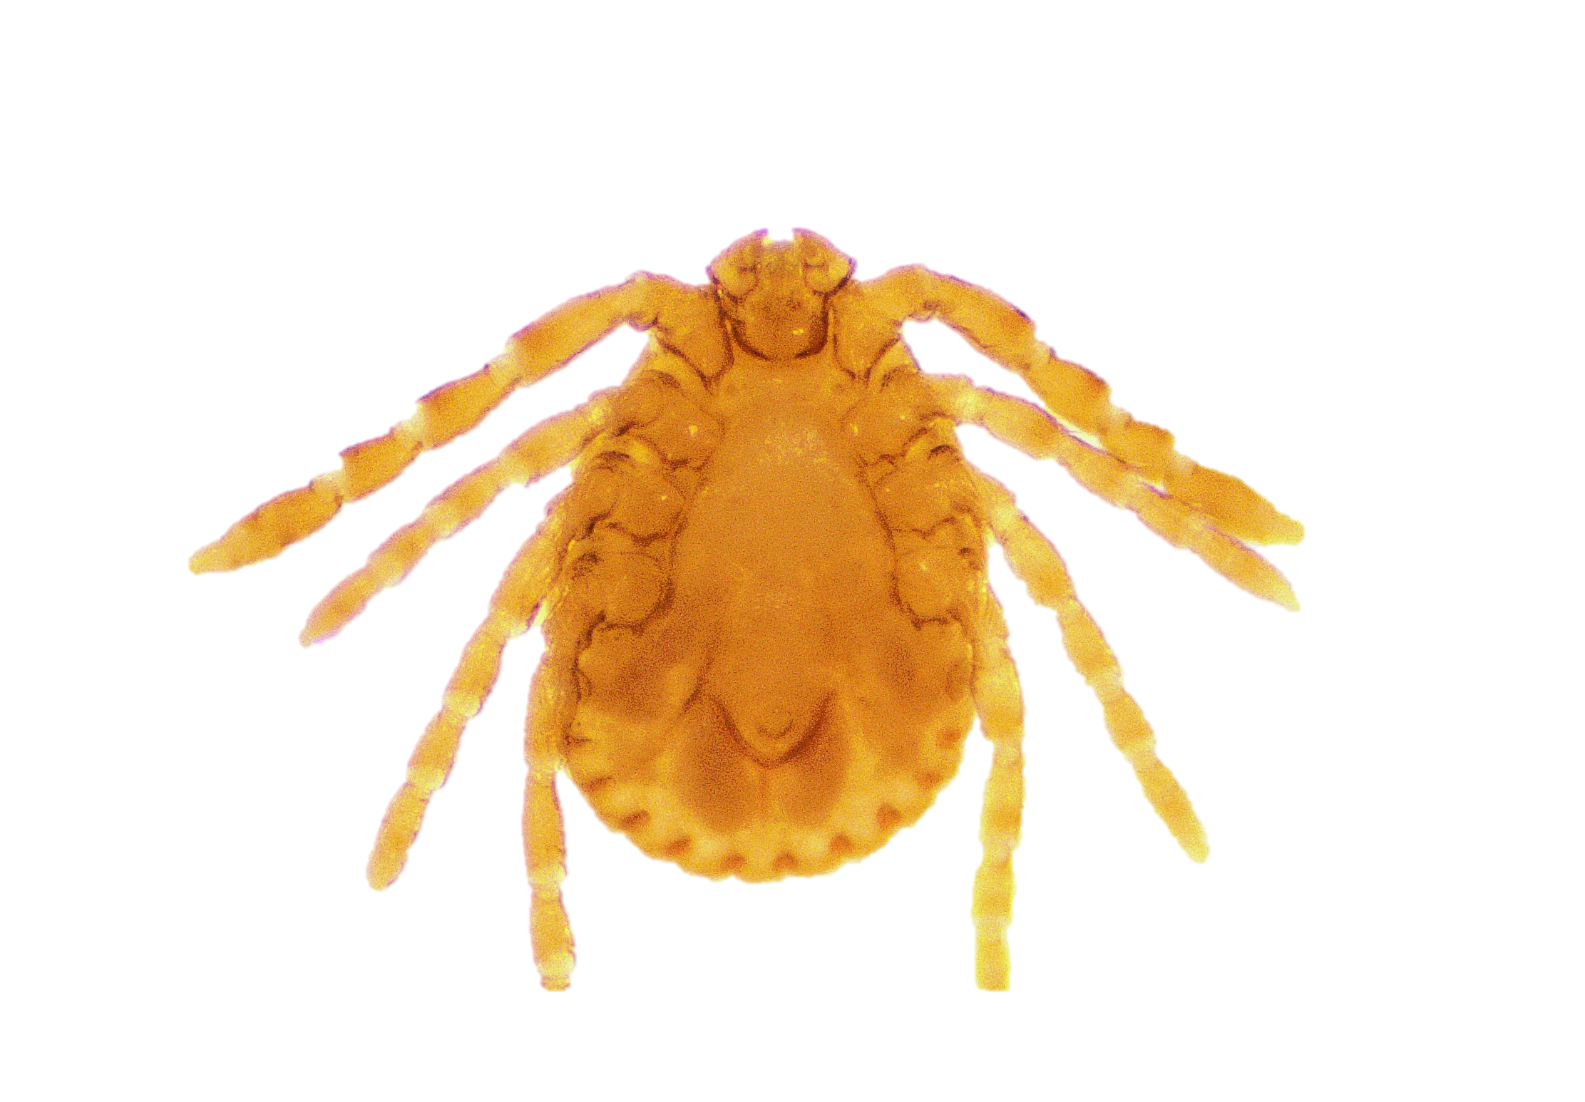
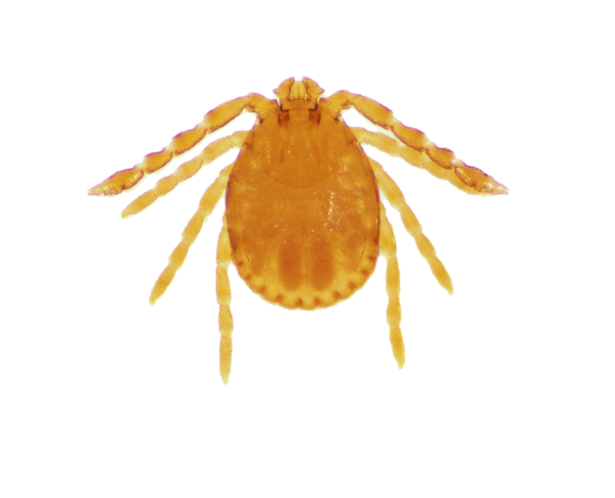
Ha. paraturturis nymph
Dorsal side
Ventral side

Slide 9

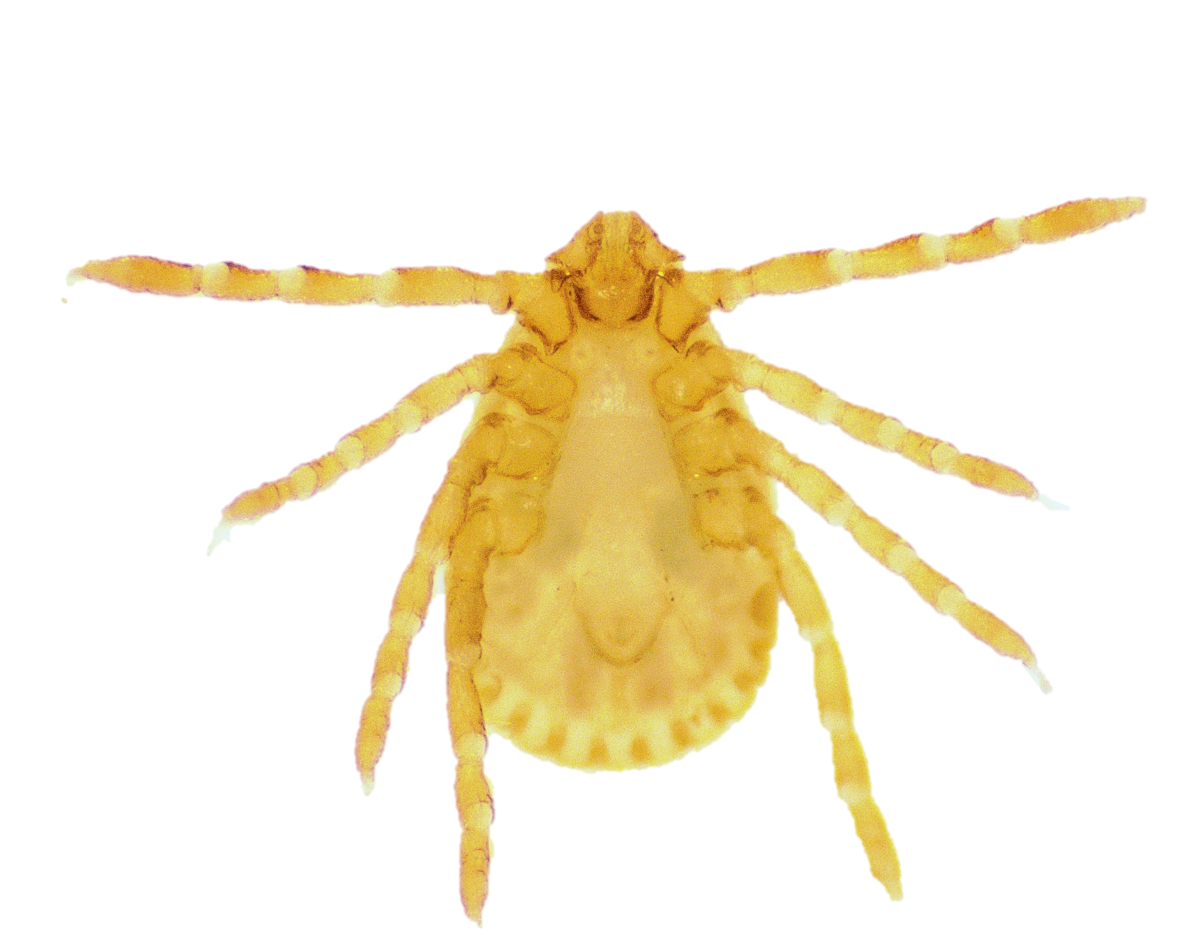
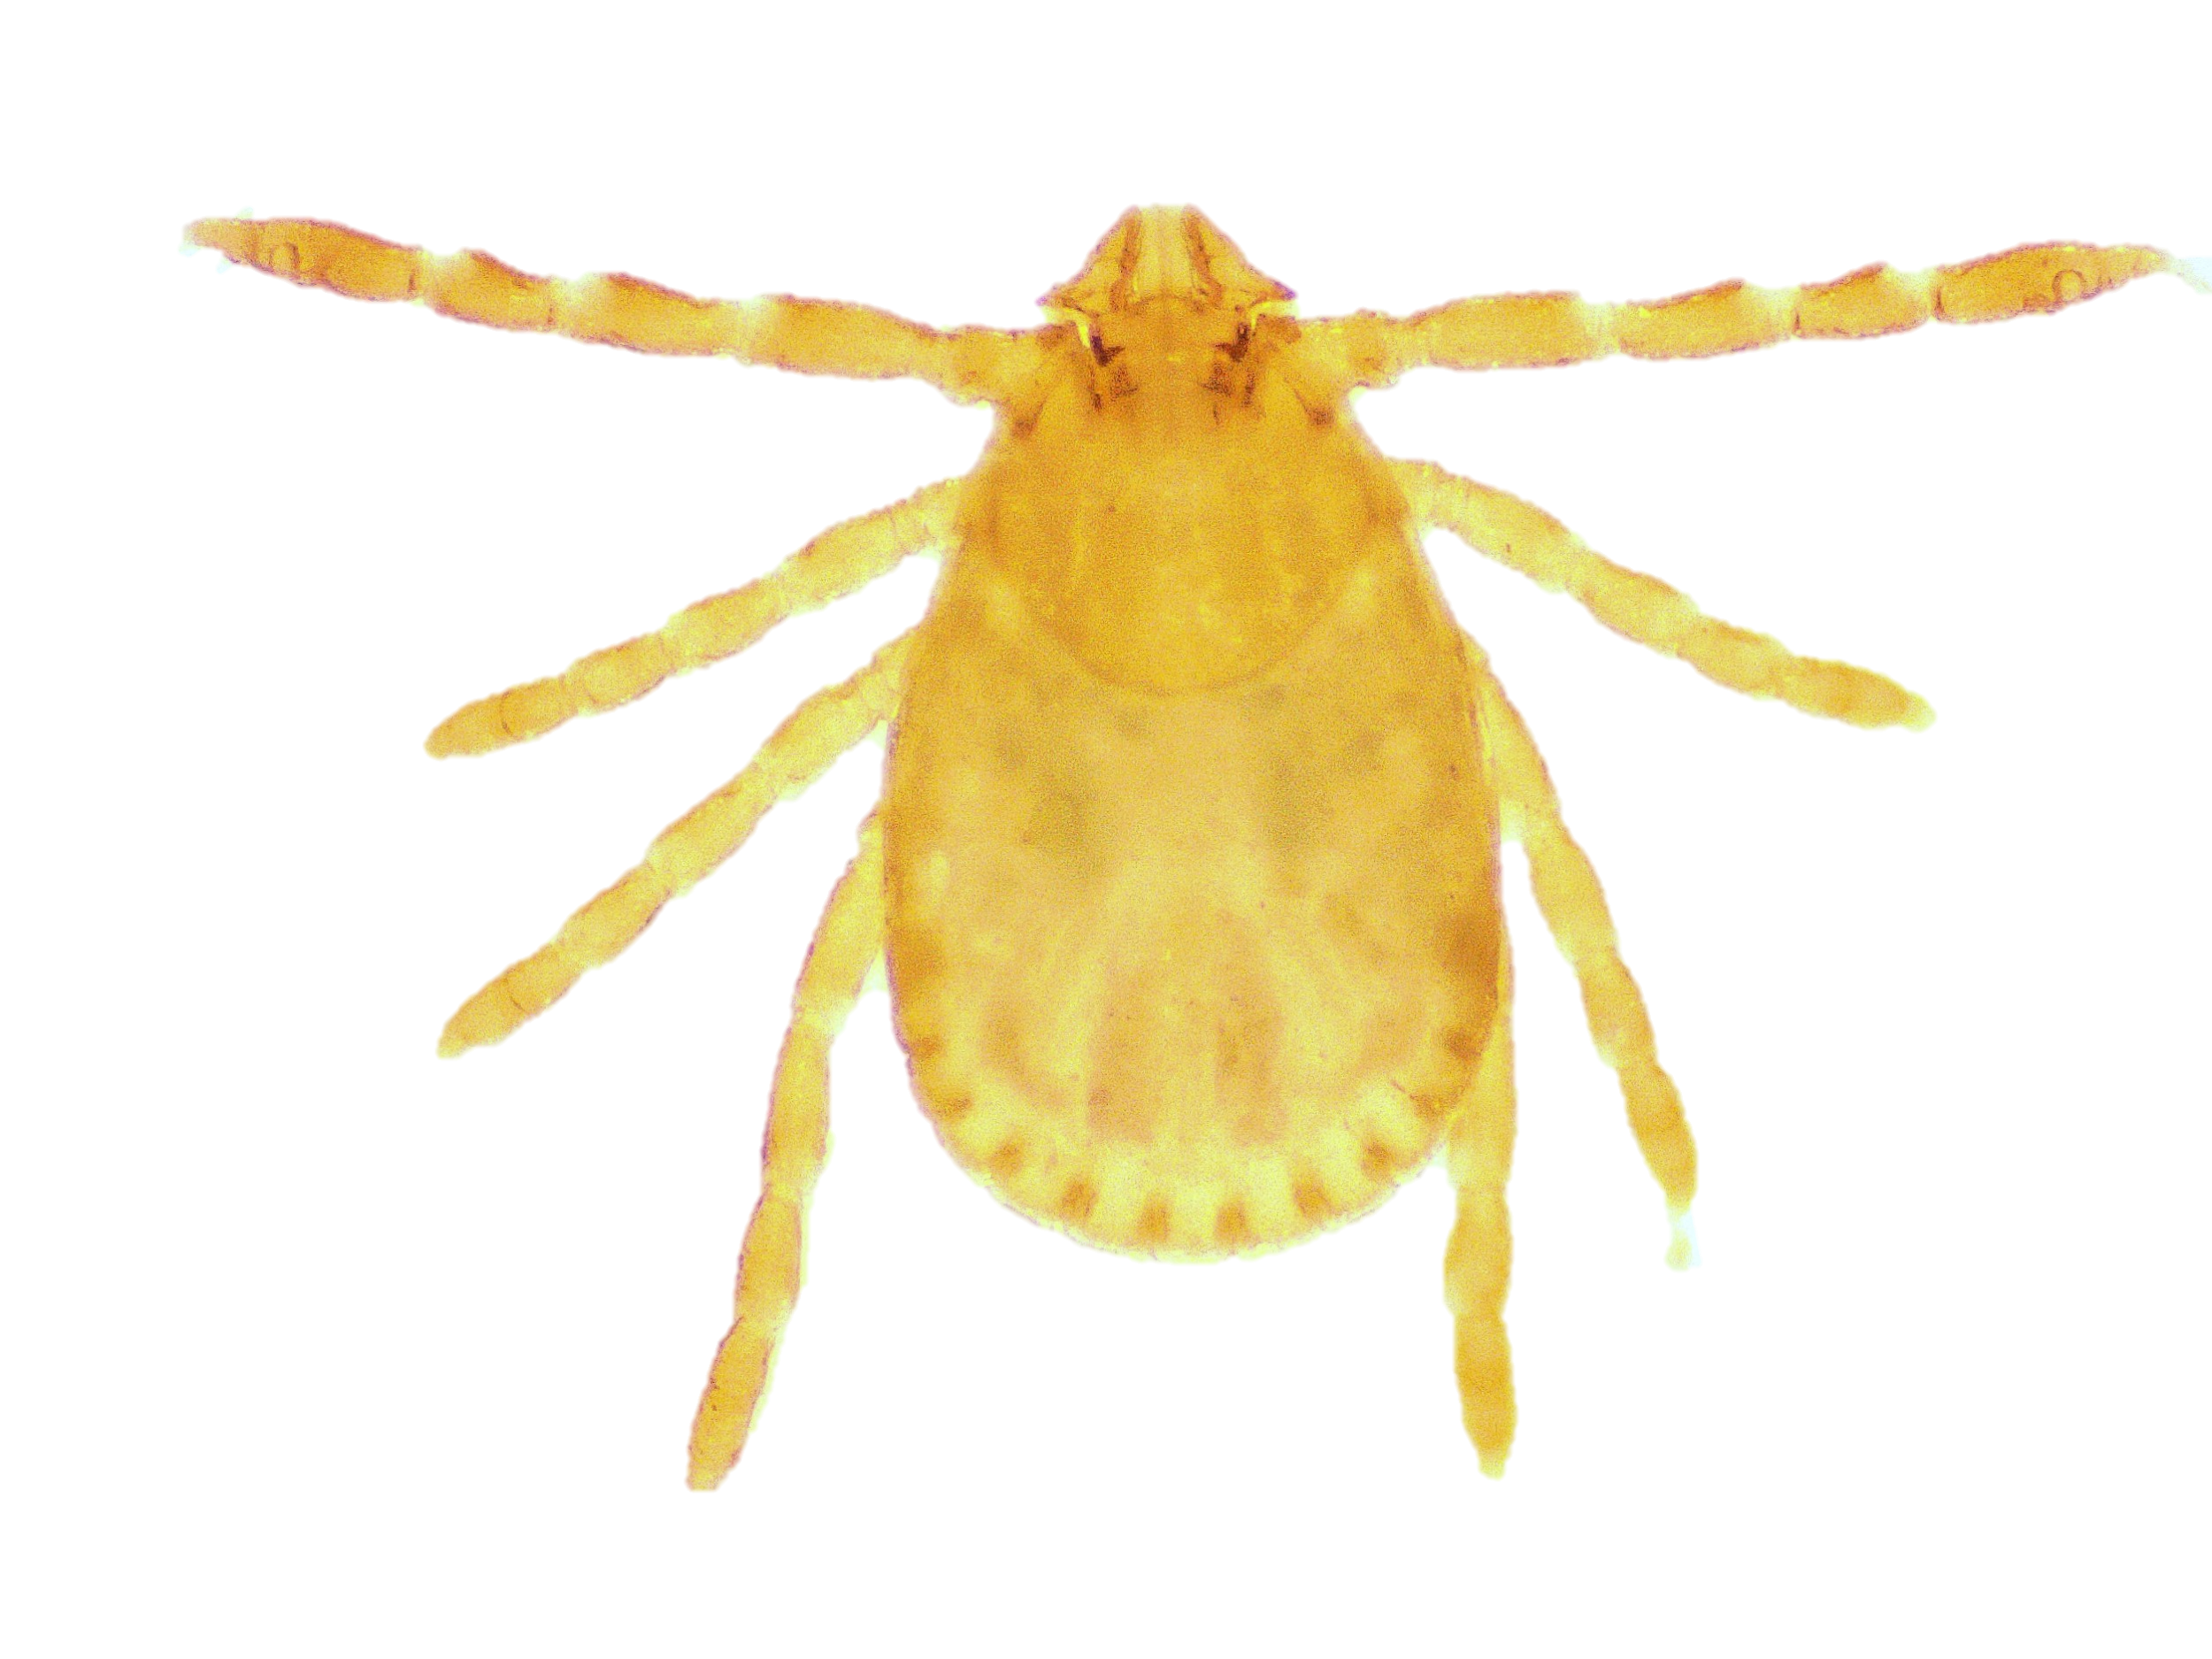
Ha. spinigera nymph
Dorsal side
Ventral side

Slide 10
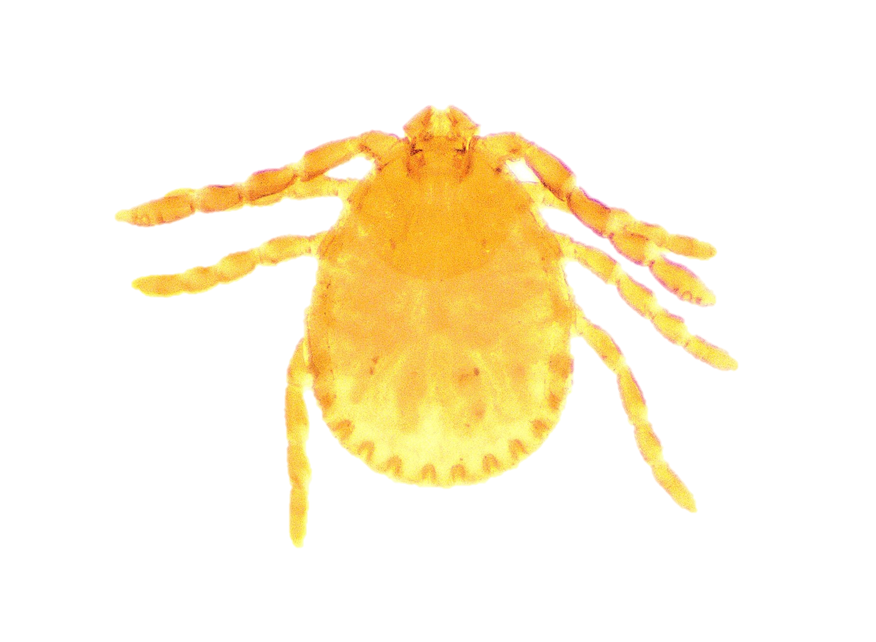
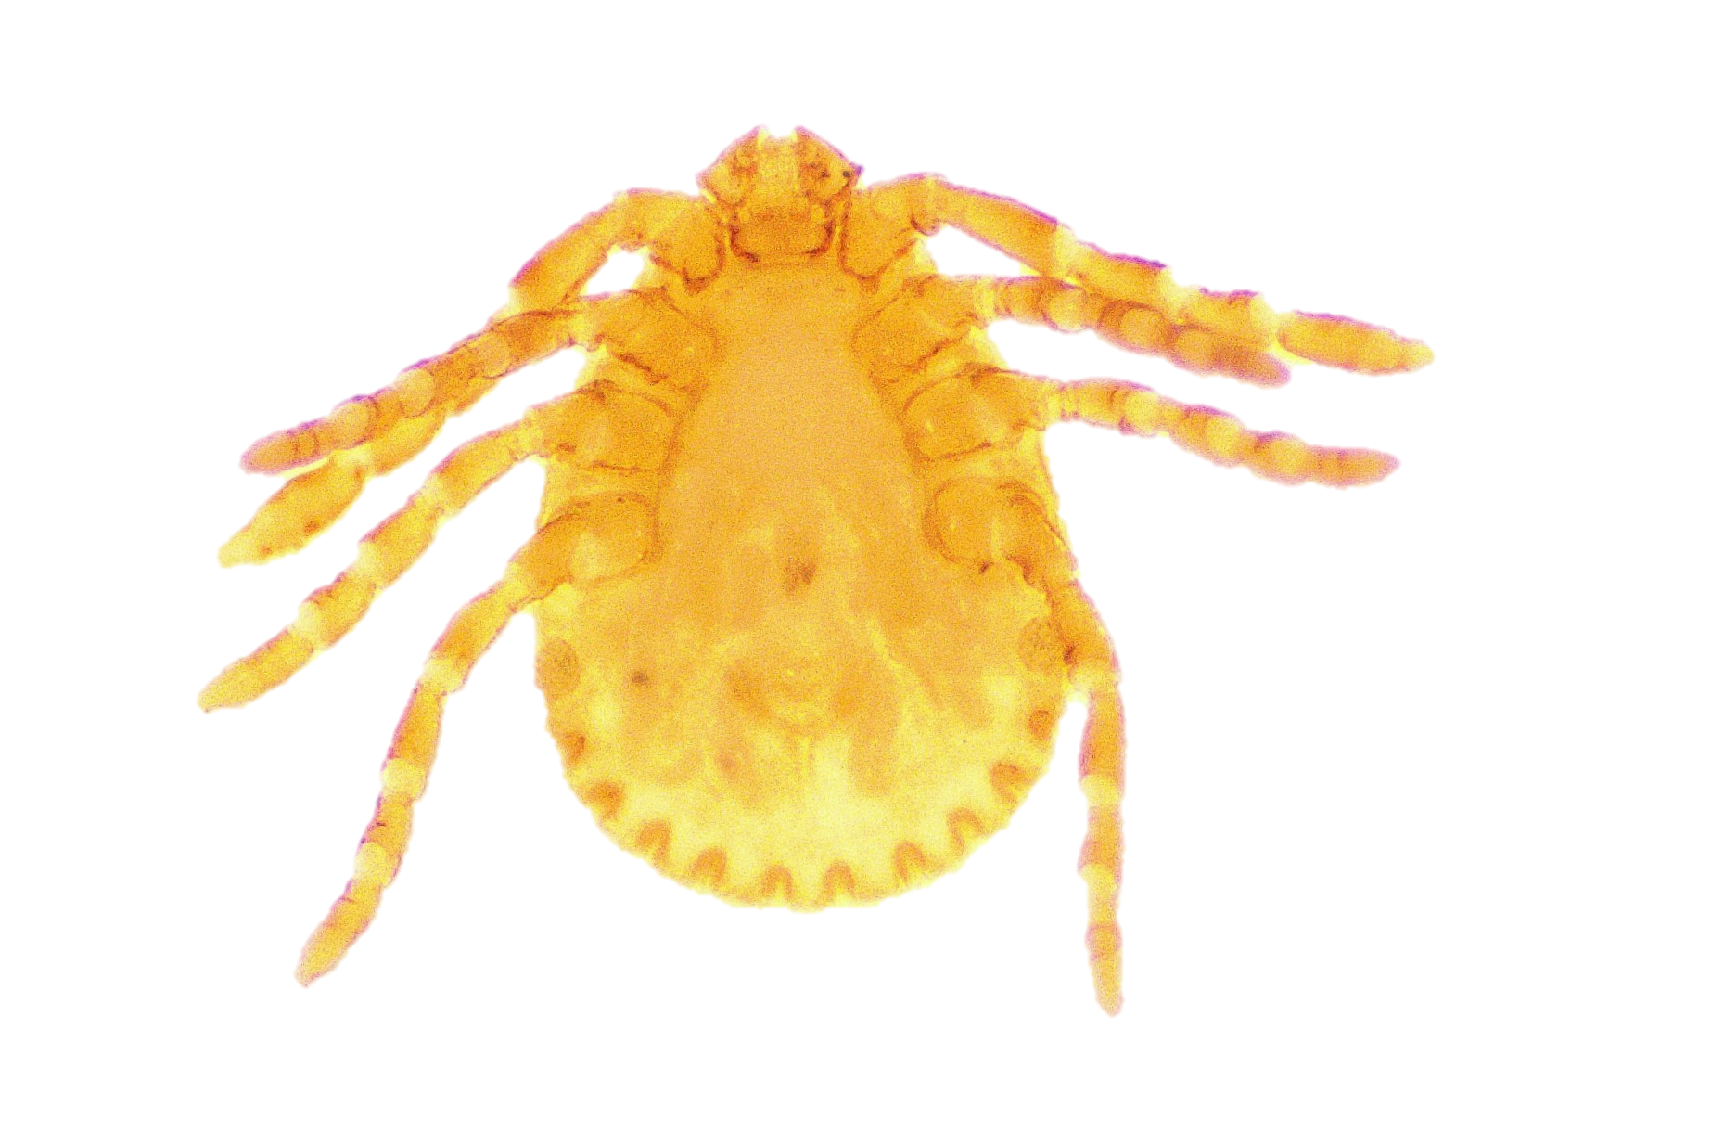
Ha. turturis nymph
Dorsal side
Ventral side

Slide 11
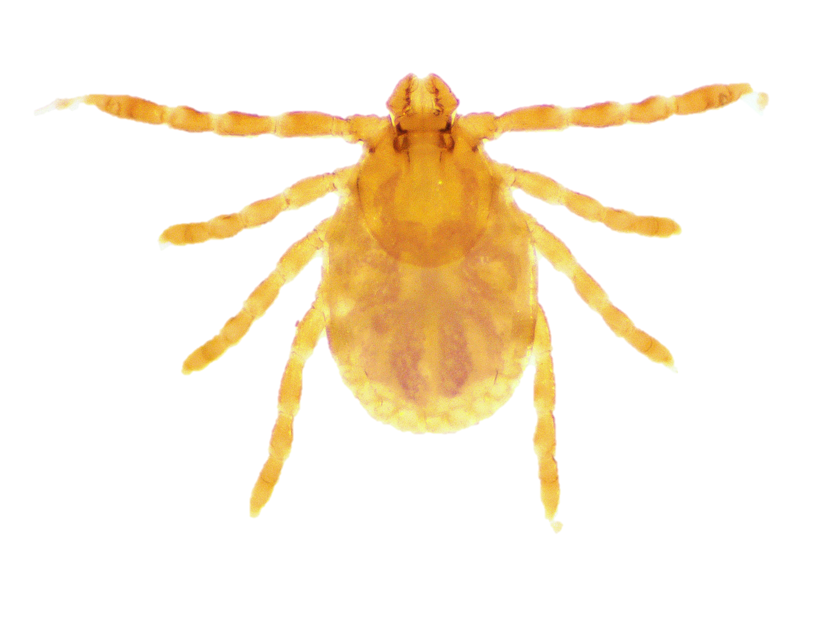
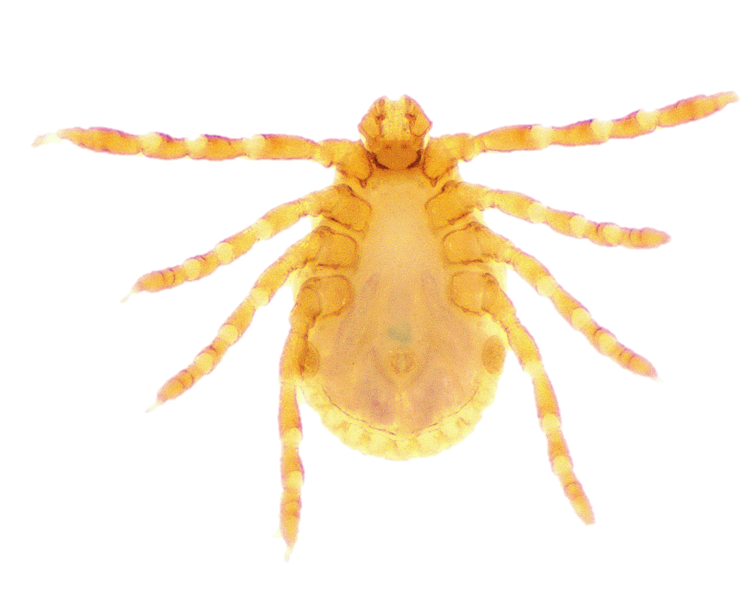
Ha. wellingtoni nymph
Dorsal side
Ventral side

