Slide 1
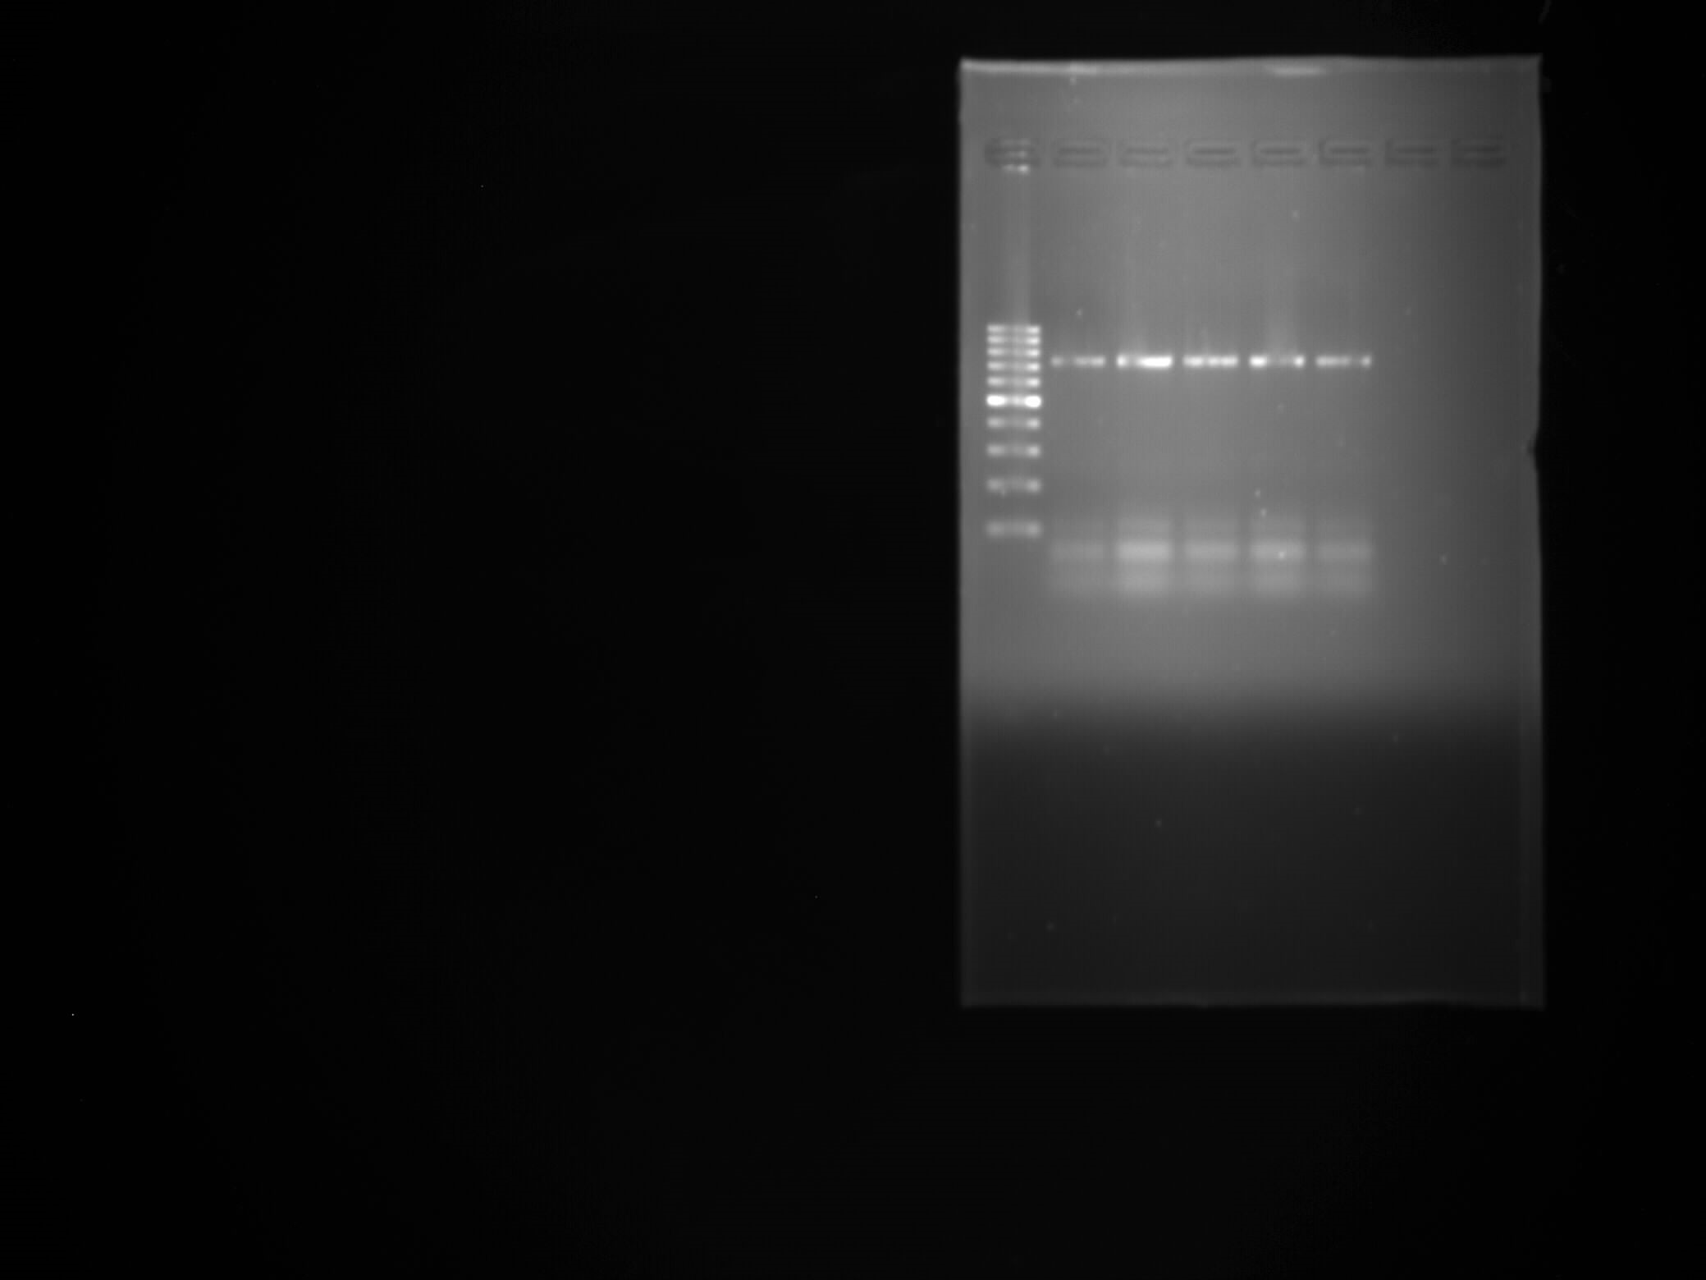
Drulisvirus
1000
728 bp
500
300
200
100
capsid protein gene of the genus Drulisvirus (728 bp)

Slide 2
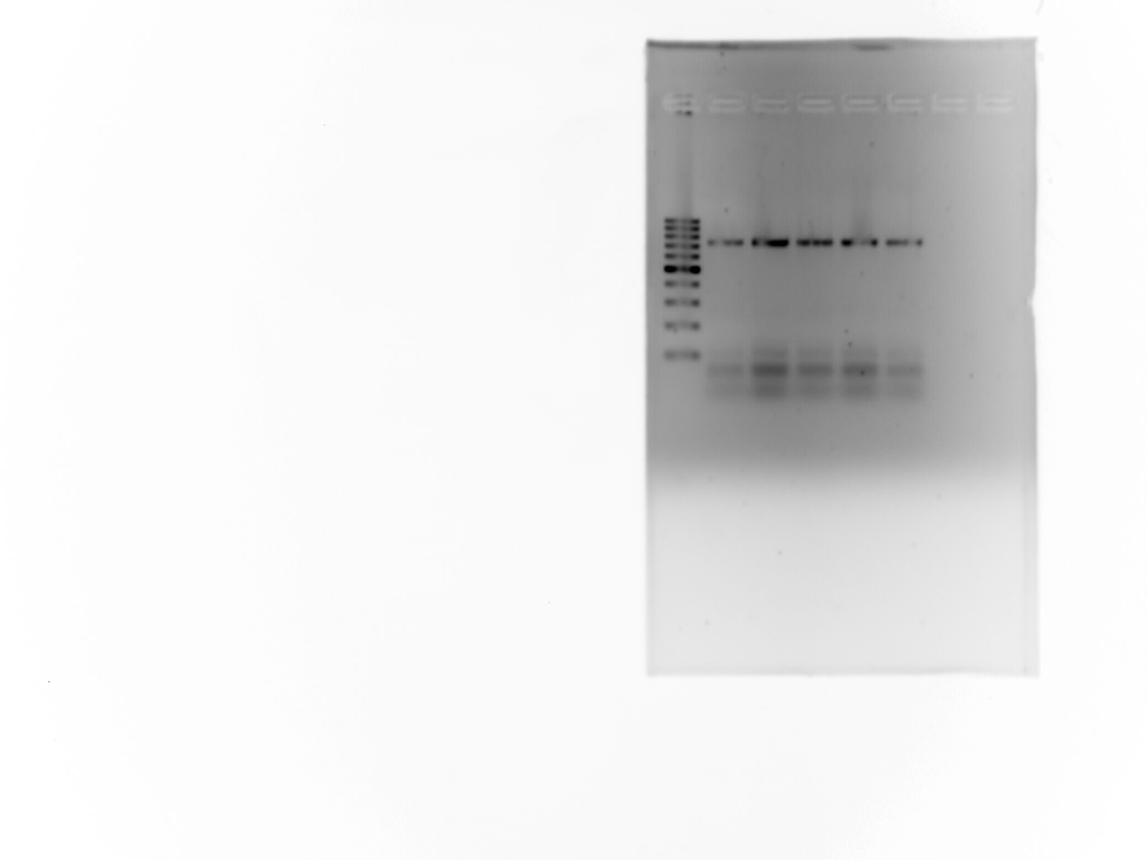
Drulisvirus (inverted gel image)

Slide 3
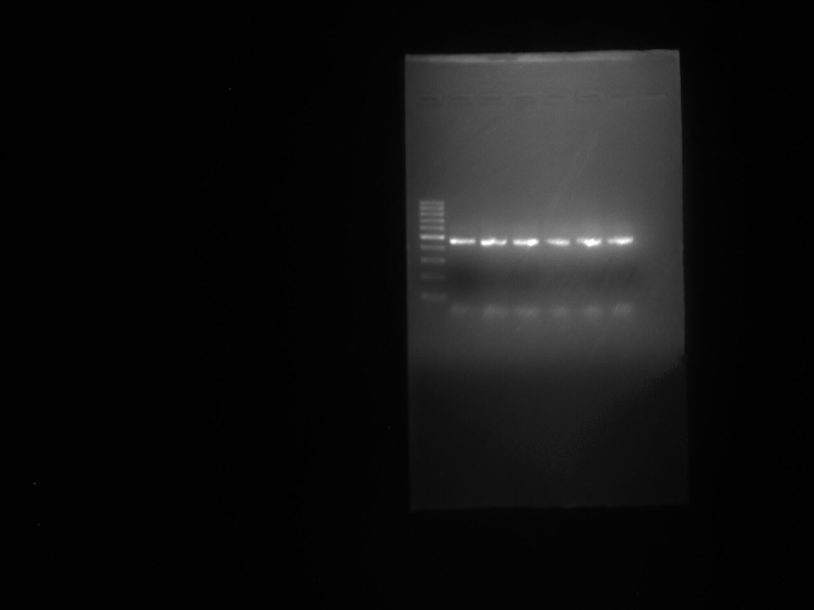
Przondovirus
1000
500
463 bp
300
200
100
internal virion protein D of the genus Przondovirus (463 bp)

Slide 4
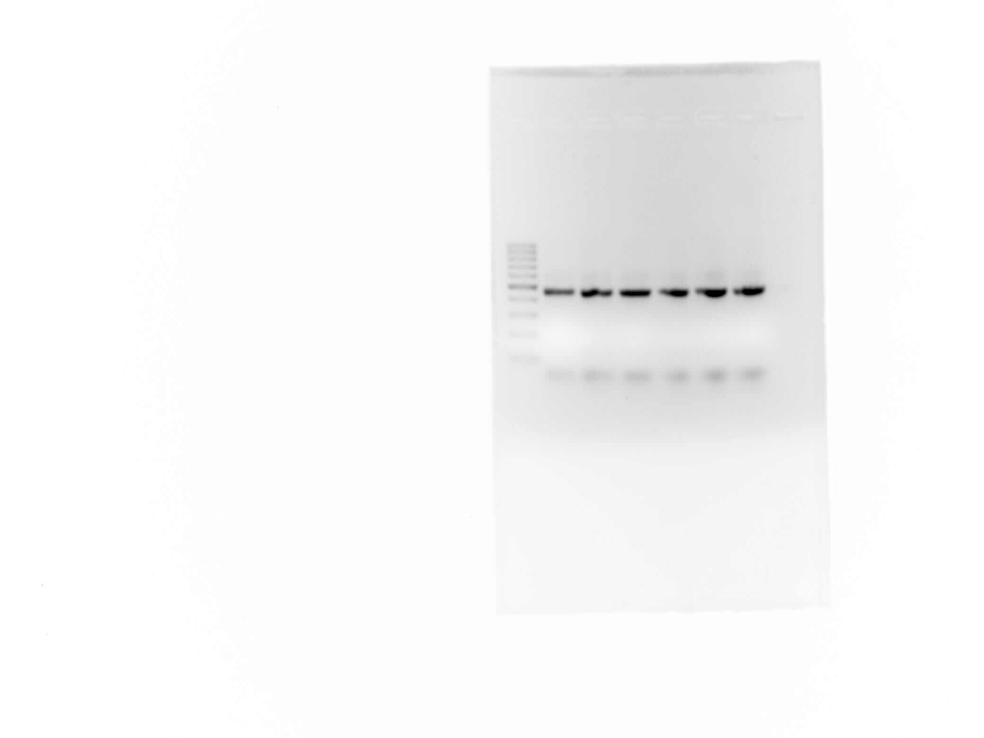
Przondovirus (inverted gel image)

Slide 5
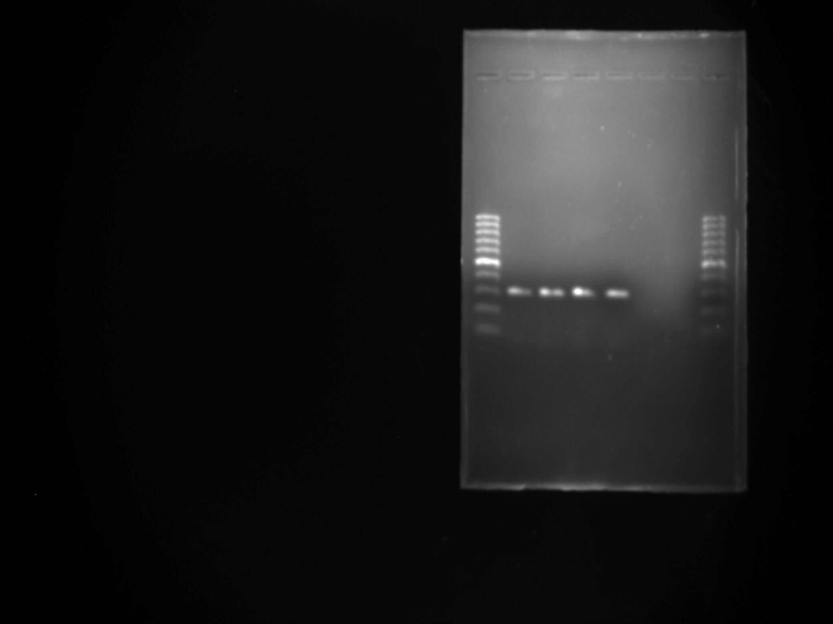
Mydovirus
1000
500
302 bp
300
200
100
putative helicase gene of the genus Mydovirus (302 bp)

Slide 6
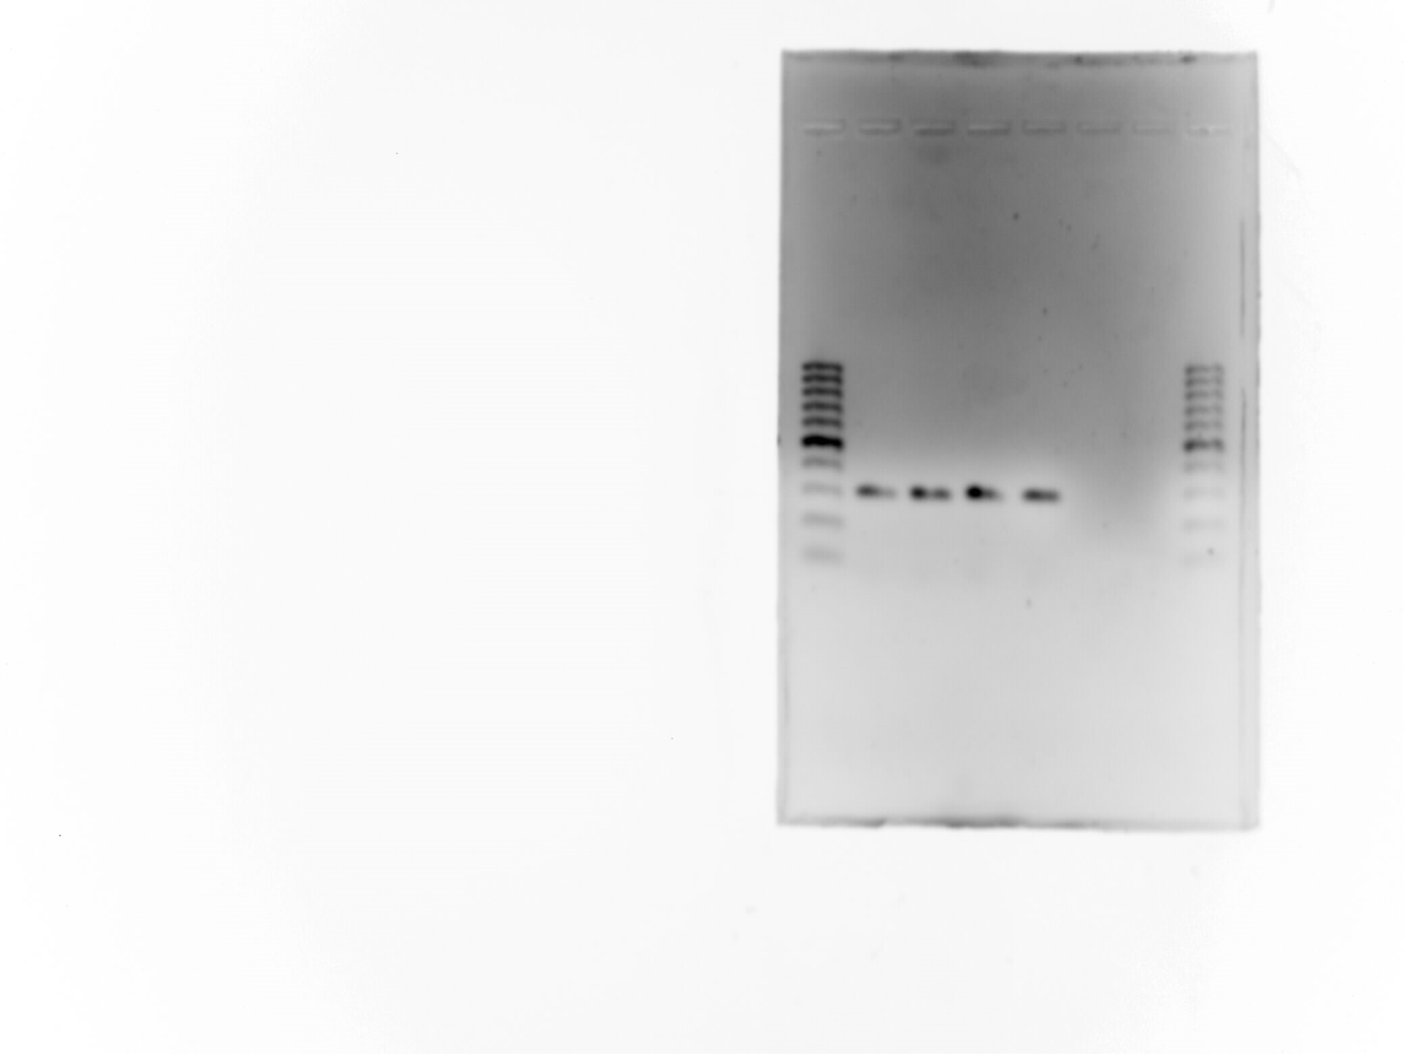
Mydovirus (inverted gel image)

Slide 7
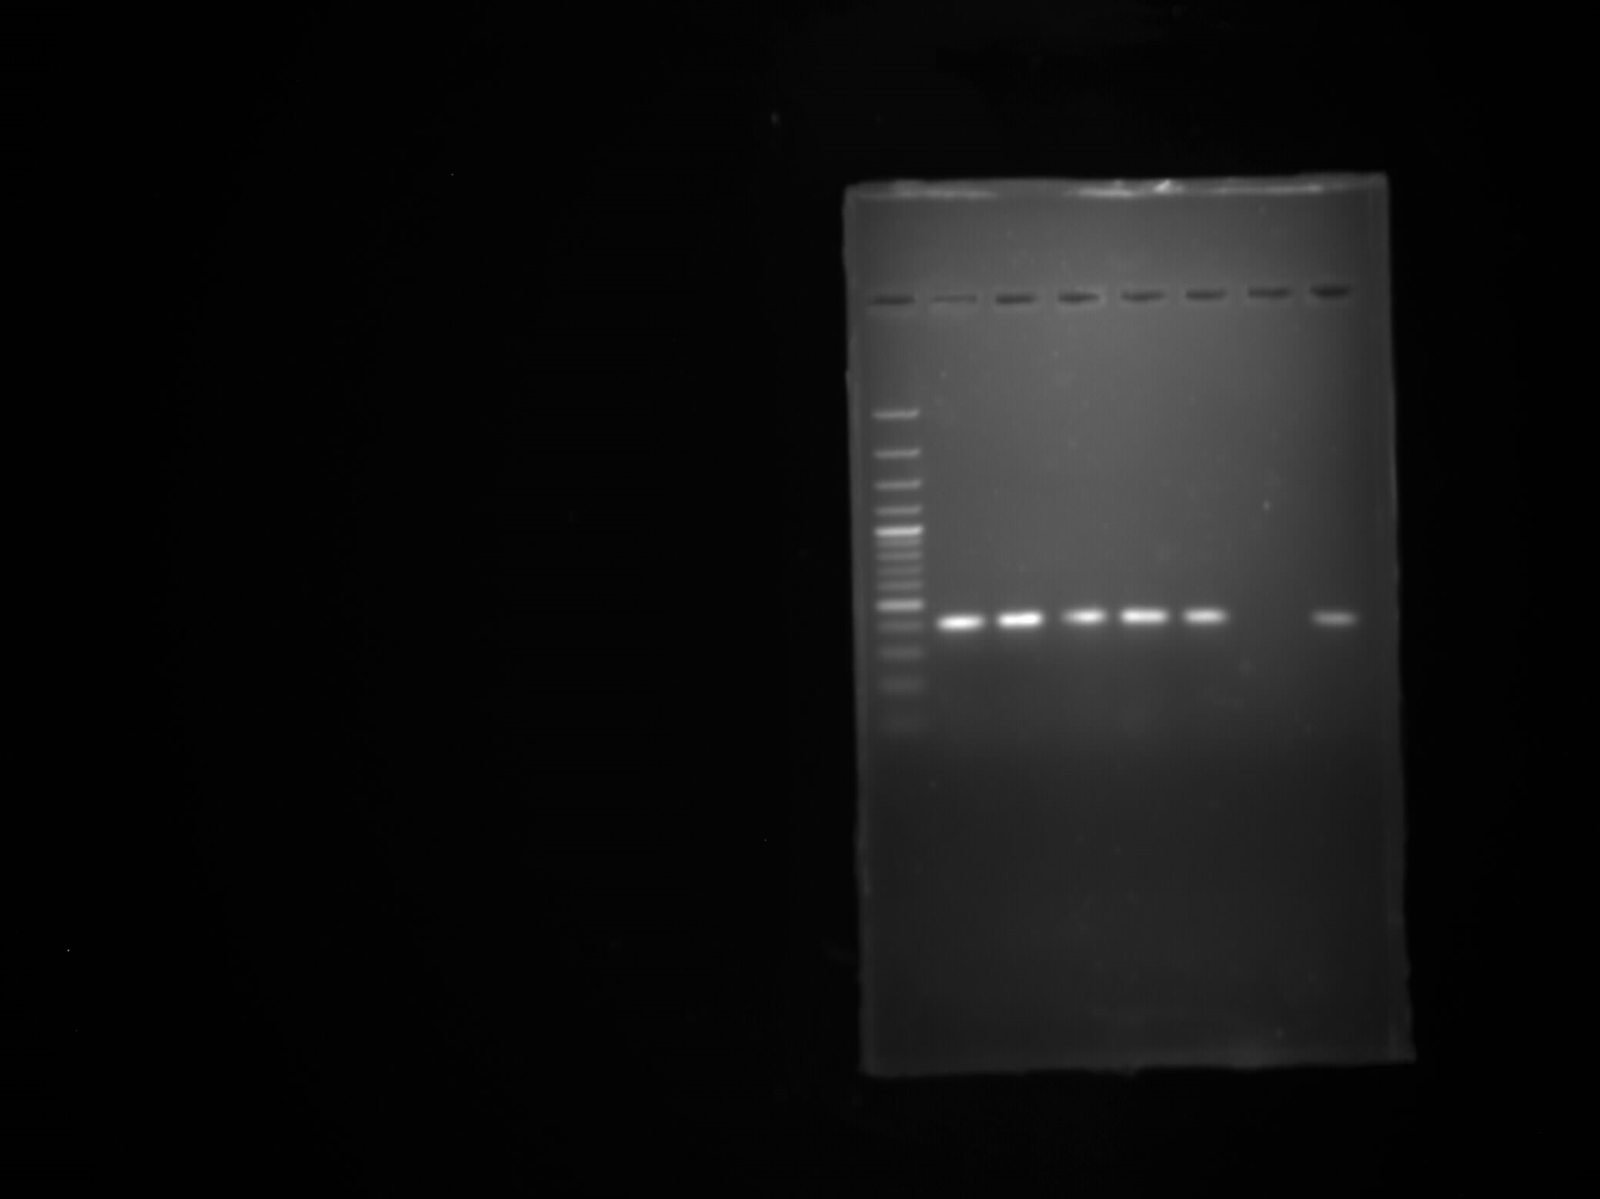
Slopekvirus
1000
500
411 bp
300
200
100
putative base plate gene of the genus Slopekvirus (411 bp)

Slide 8
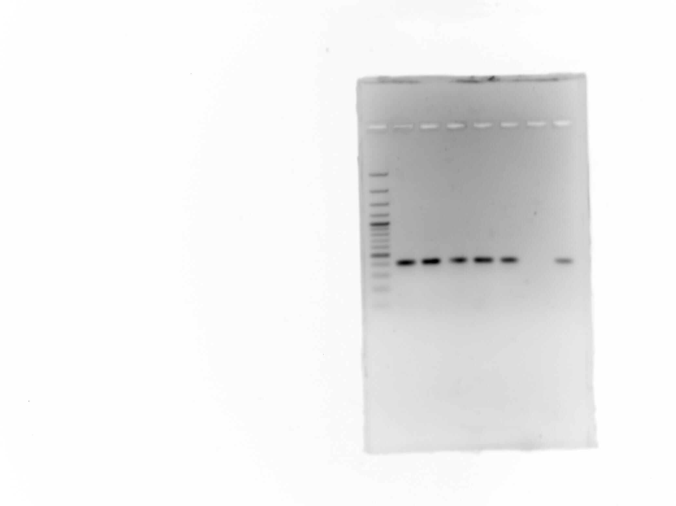
Slopekvirus (inverted gel image)

Slide 9
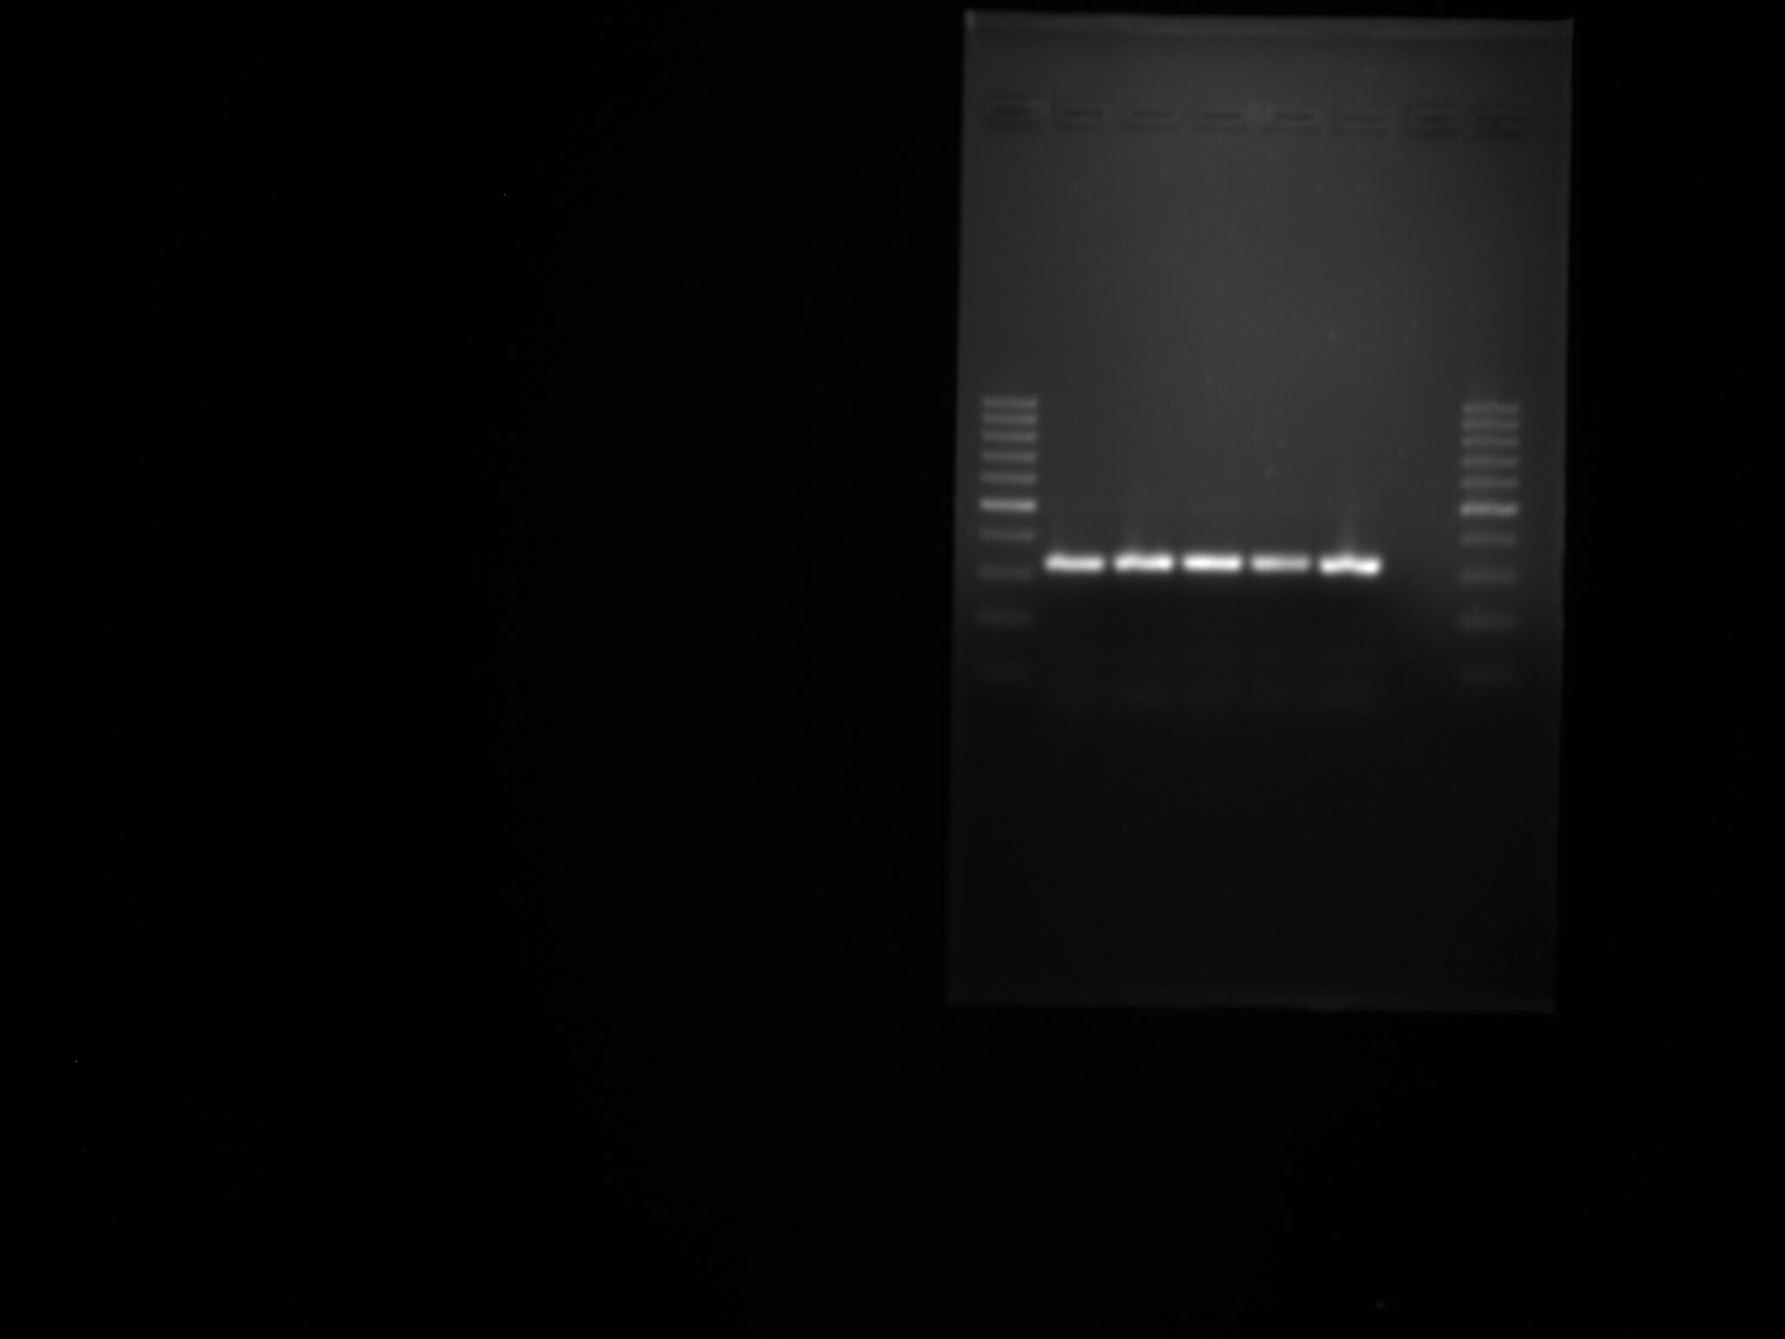
Taipeivirus
1000
500
326 bp
300
200
100
Putative tail tube associated baseplate protein gene of the genus Taipeivirus (326 bp)

Slide 10
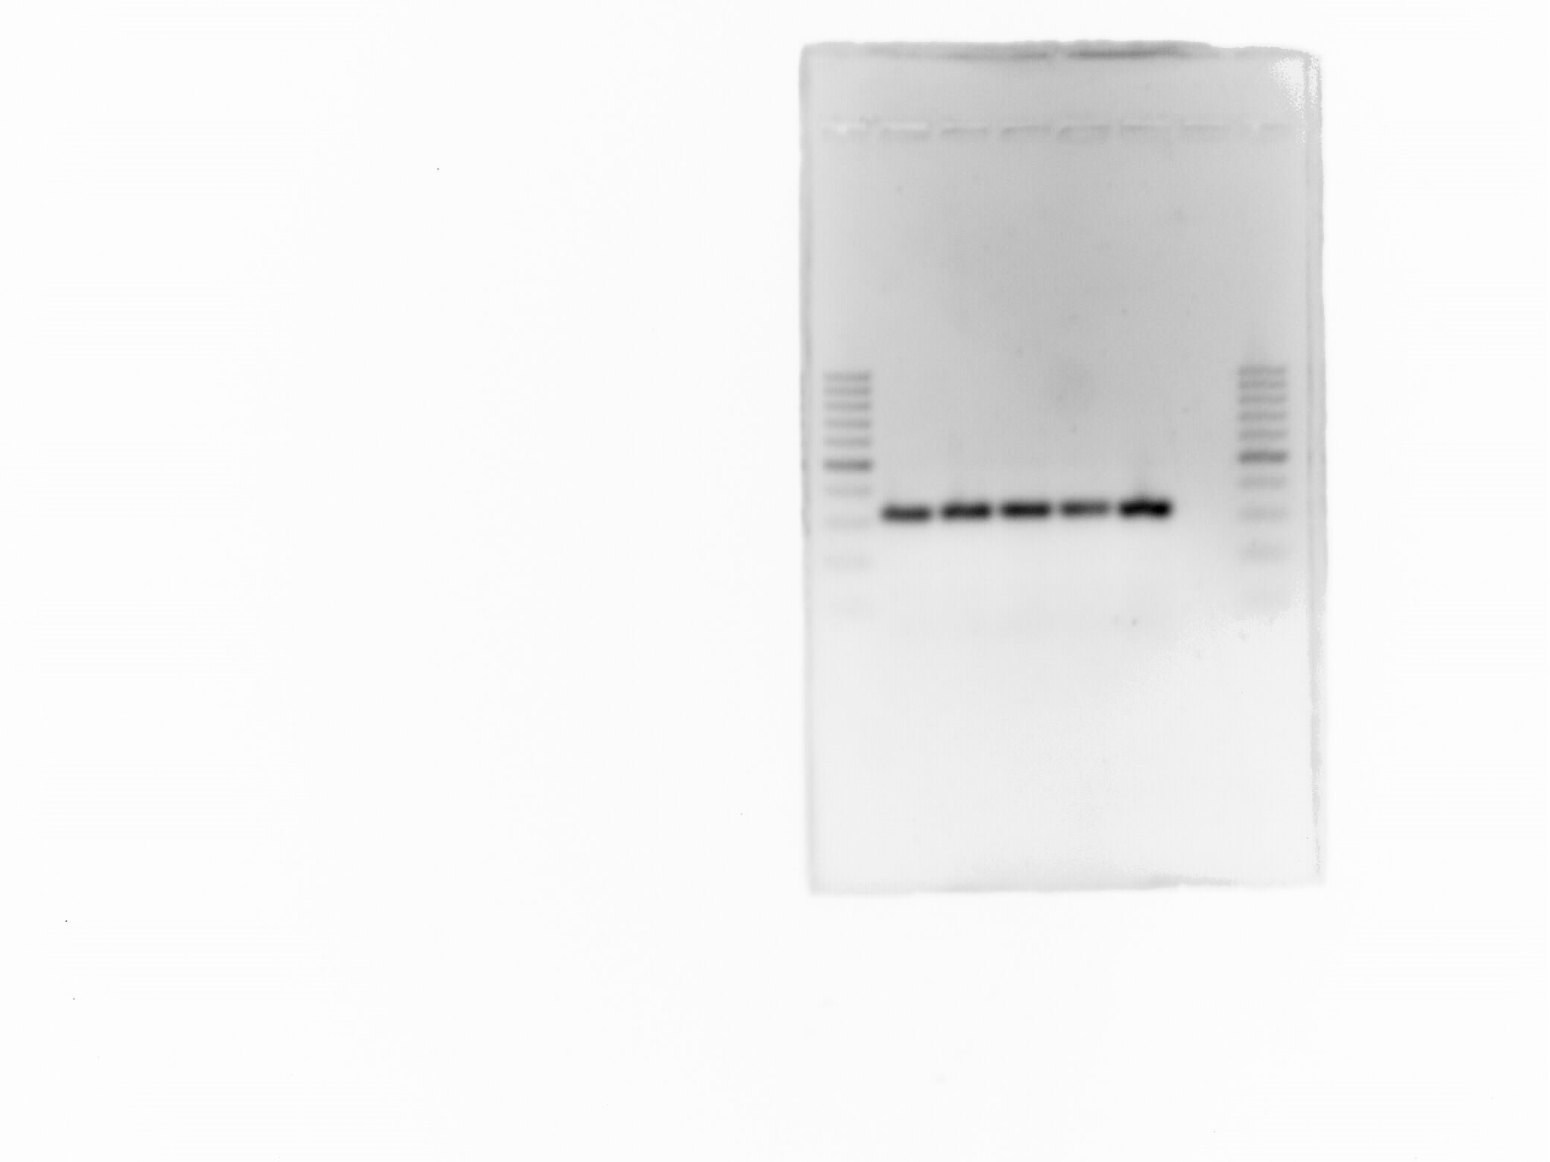
Taipeivirus (inverted gel image)

Slide 11
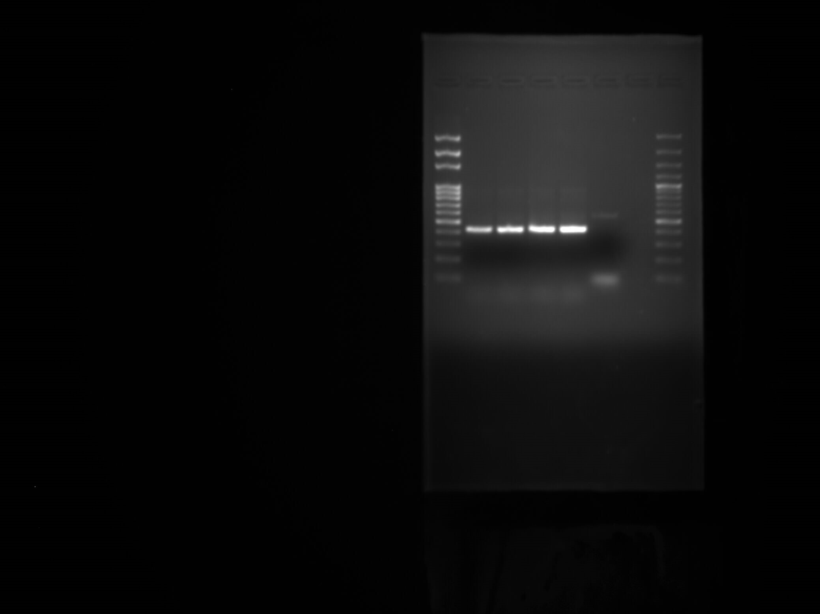
Webervirus
1000
500
422 bp
300
200
100
putative major head subunit precursor gene of the genus Webervirus (422 bp)

Slide 12
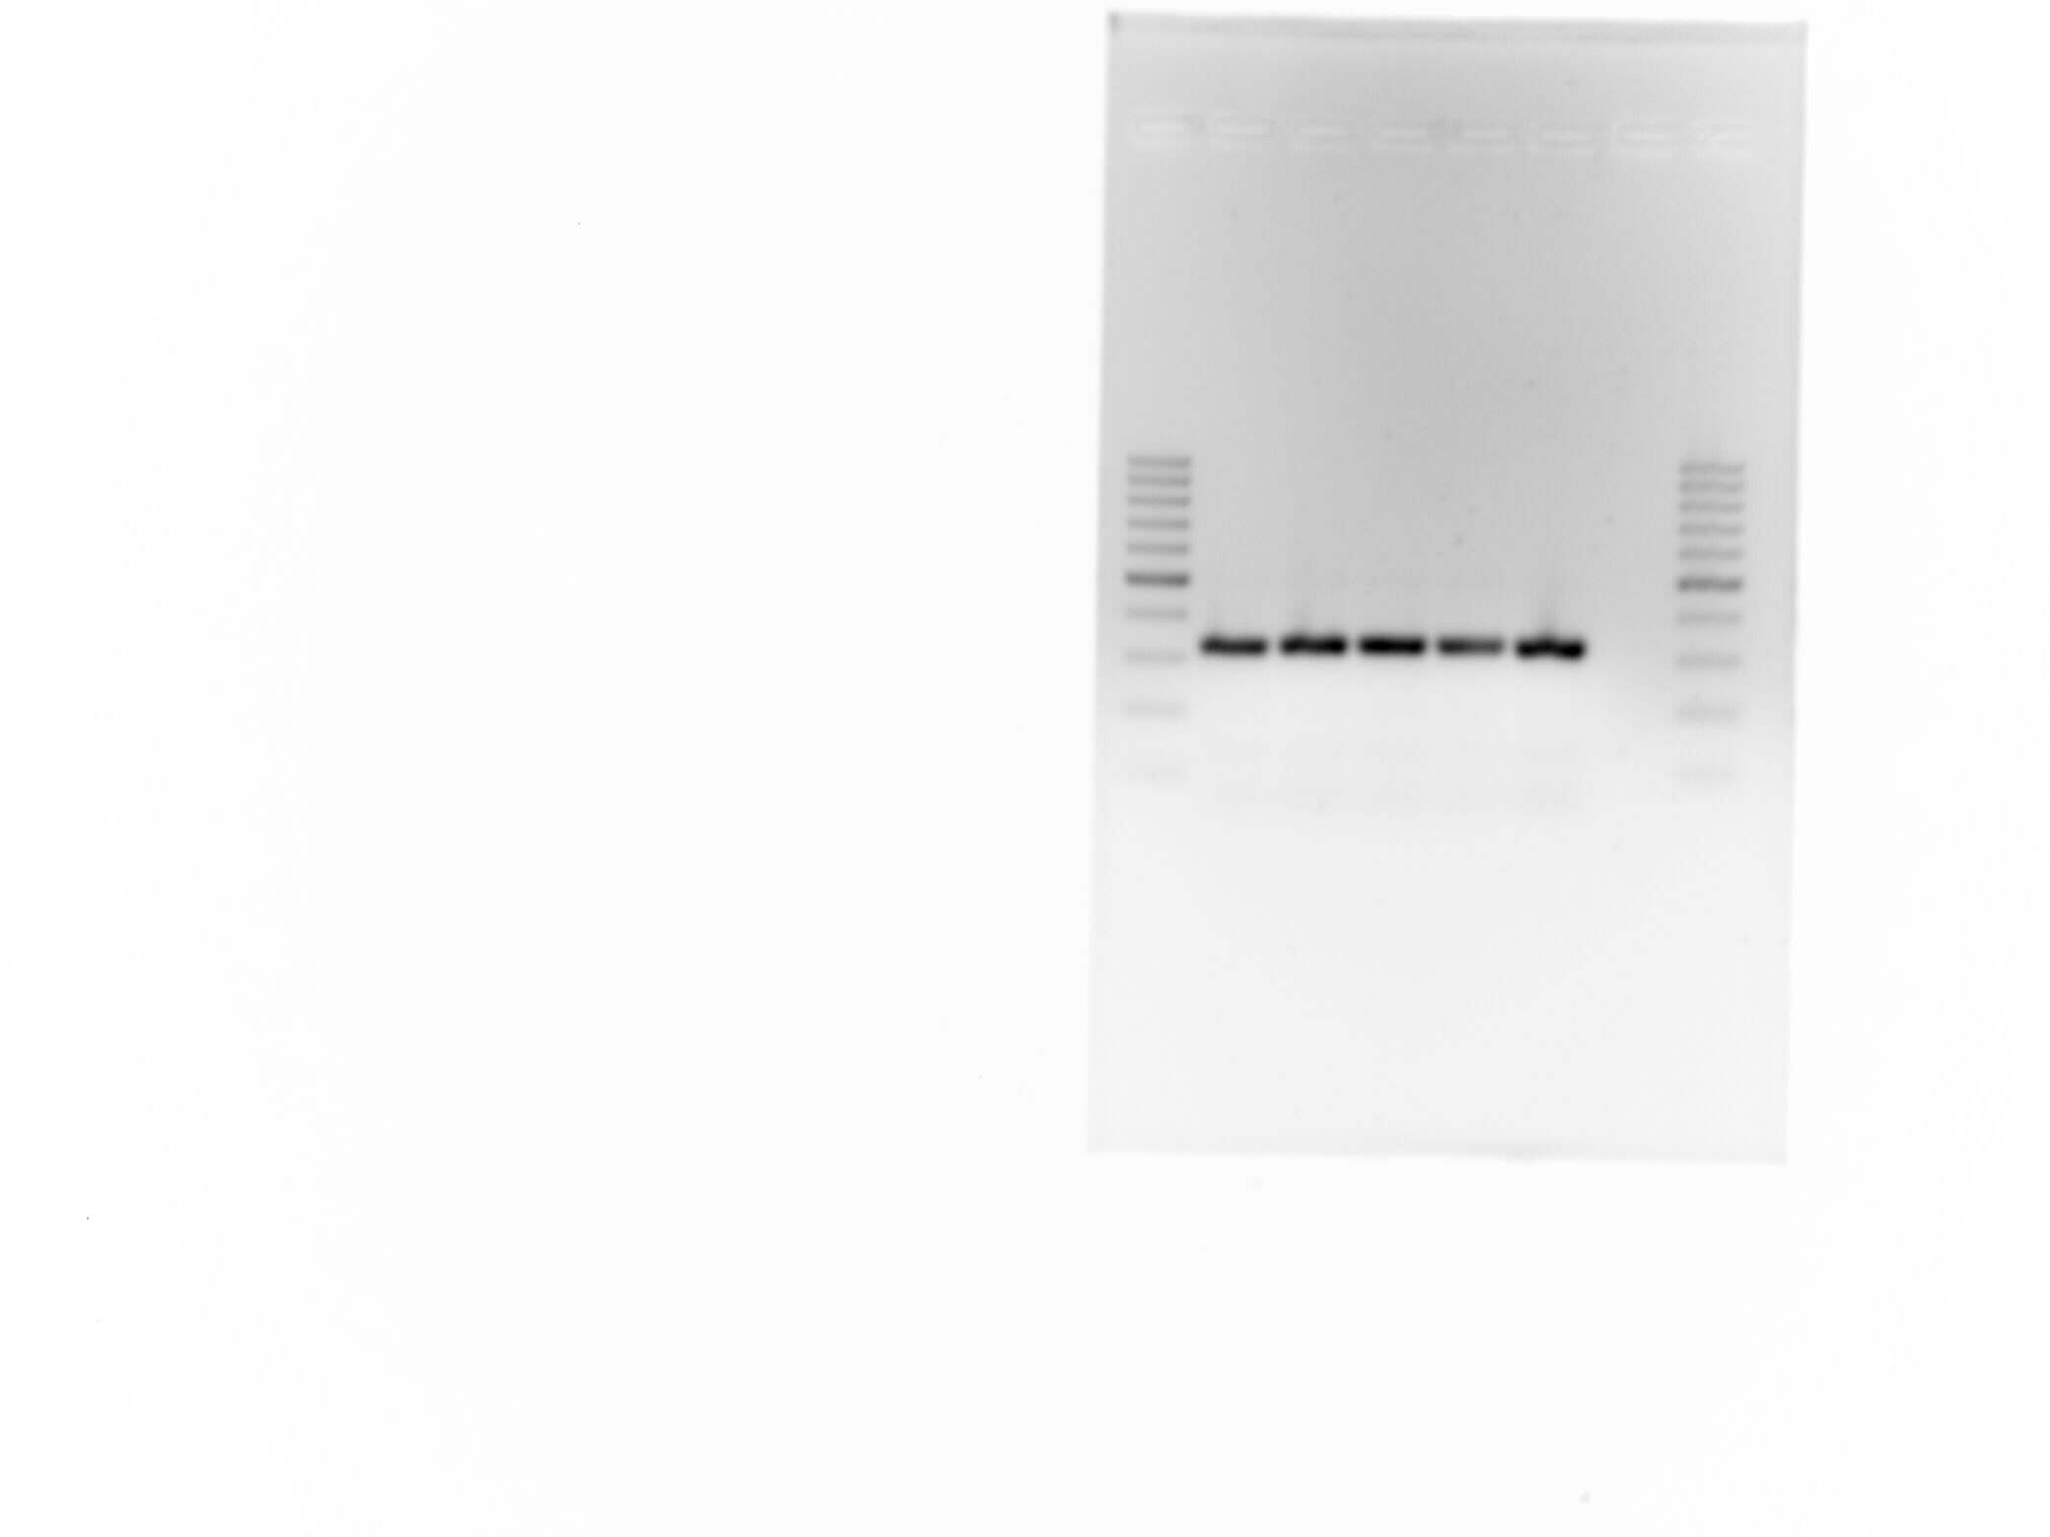
Webervirus (inverted gel image)

