Slide 1
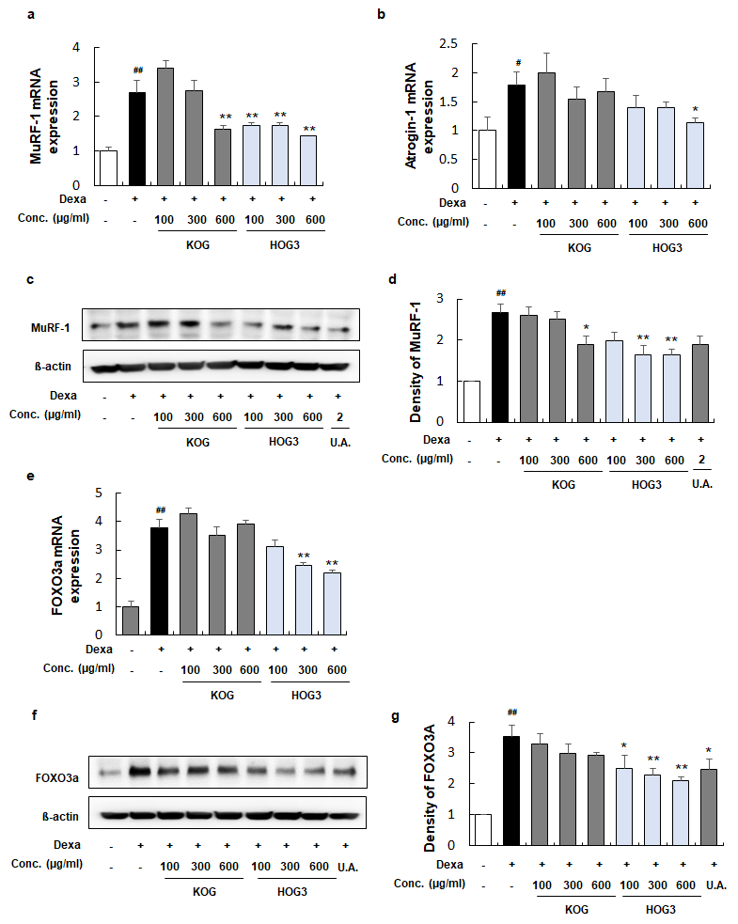
(Submission ID: cb63da45-8c01-4658-b937-12874f42e446)_4
Hot melt extruded Kyungohkgo attenuates skeletal muscle atrophy by inhibiting FOXO3a/MuRF-1/atrogin-1
Uncropped western blot gels
Figure 4

Slide 2
Figure 4(c)
MuRF-1
Set1
Set1
MuRF1
β-actin
Set2
MuRF1
Set2
β-actin
Set3
MuRF1
Set3
β-actin

Slide 3
Figure 4(c)
FOXO3a
Set1
FOXO3a
β-actin
Set2
FOXO3a
β-actin
Set3
FOXO3a
β-actin

