Slide 1
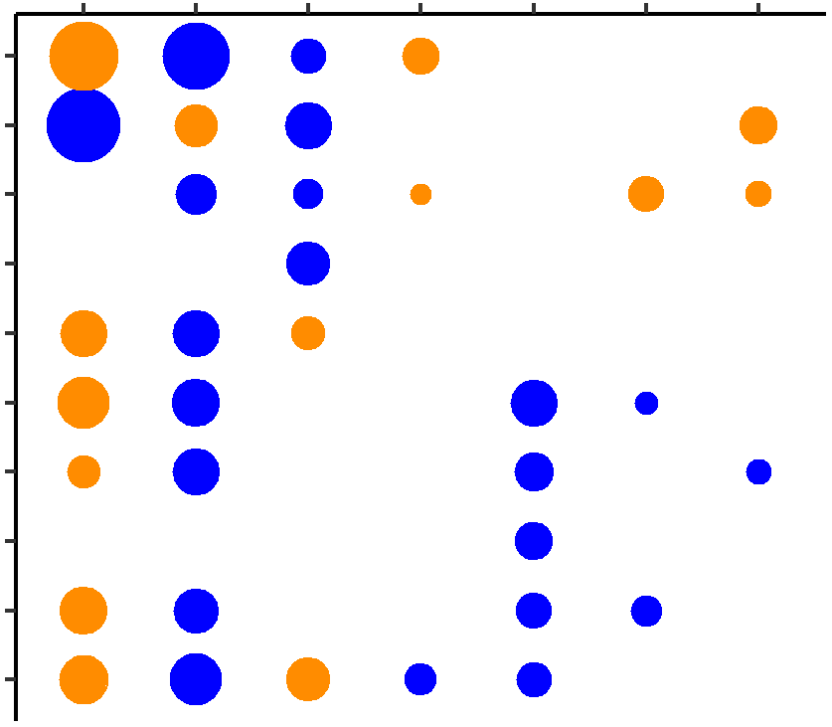

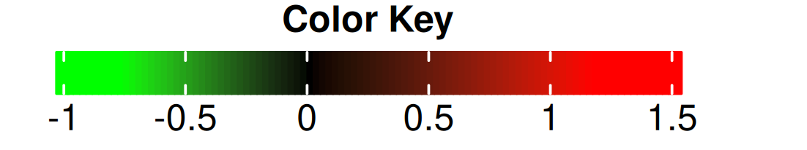
a
Challenge test
WARM
COOL
HD-LO
RFI
NCHL
TS-EMS
PPH
psmd2
ramp1
sirt1
smad1
atp1a2
bmp1
calcrl
col5a1
spred2
thrb
Fold-Change
Up-regulated
Down-regulated
b
col5a1
atp1a2
thrb
spred2
bmp1
calcrl
psmd2
sirt1
smad1
ramp1
COOL
PPH
NCHL
TS-EMS
RFI
HD-LO
WARM
(vs. CTRL)

