Slide 1
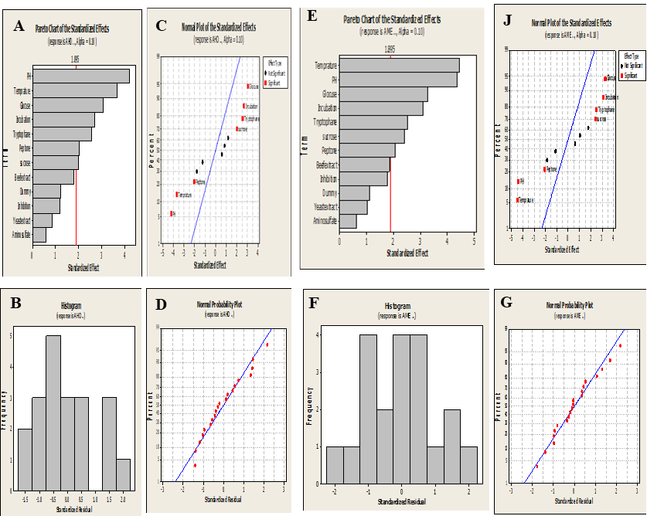
Fig. S1. Chemical validation of the purified AME from the filtrates of A. allternata, as the most potent AME producers

