Slide 1
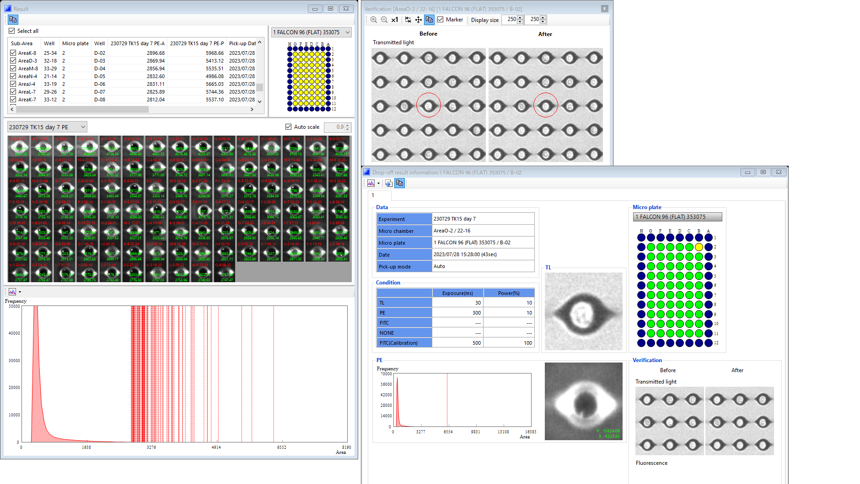
(a)
(b)
Supplemental Figure 1. Representative analysis data from Cell Picking System and single-cell isolation
(a) Magnified image of an individual well in the immunochamber. The snapshot of immunochamber was captured with a 30 ms exposure time. The fluorescence intensity of the PE area was calculated based on intensity at the edge of the immunochamber. Protein production levels were evaluated based on fluorescence intensity. The histogram shows the distribution of 100 cells isolated by Cell Picking System (representative data from OM_CPS Day 7). (b) Snapshot images of the target well containing a single cell and the surrounding. Each eye-shaped well has a diameter of 20 μm and is designed to accommodate only a single cell. The left image shows the immunochamber before cell picking, and the right image shows it after cell picking. A needle with a 20–24 μm aperture aspirated a single cell and transferred it into a 96-well plate. This step was successfully performed without aspirating surrounding cells.

