Slide 1
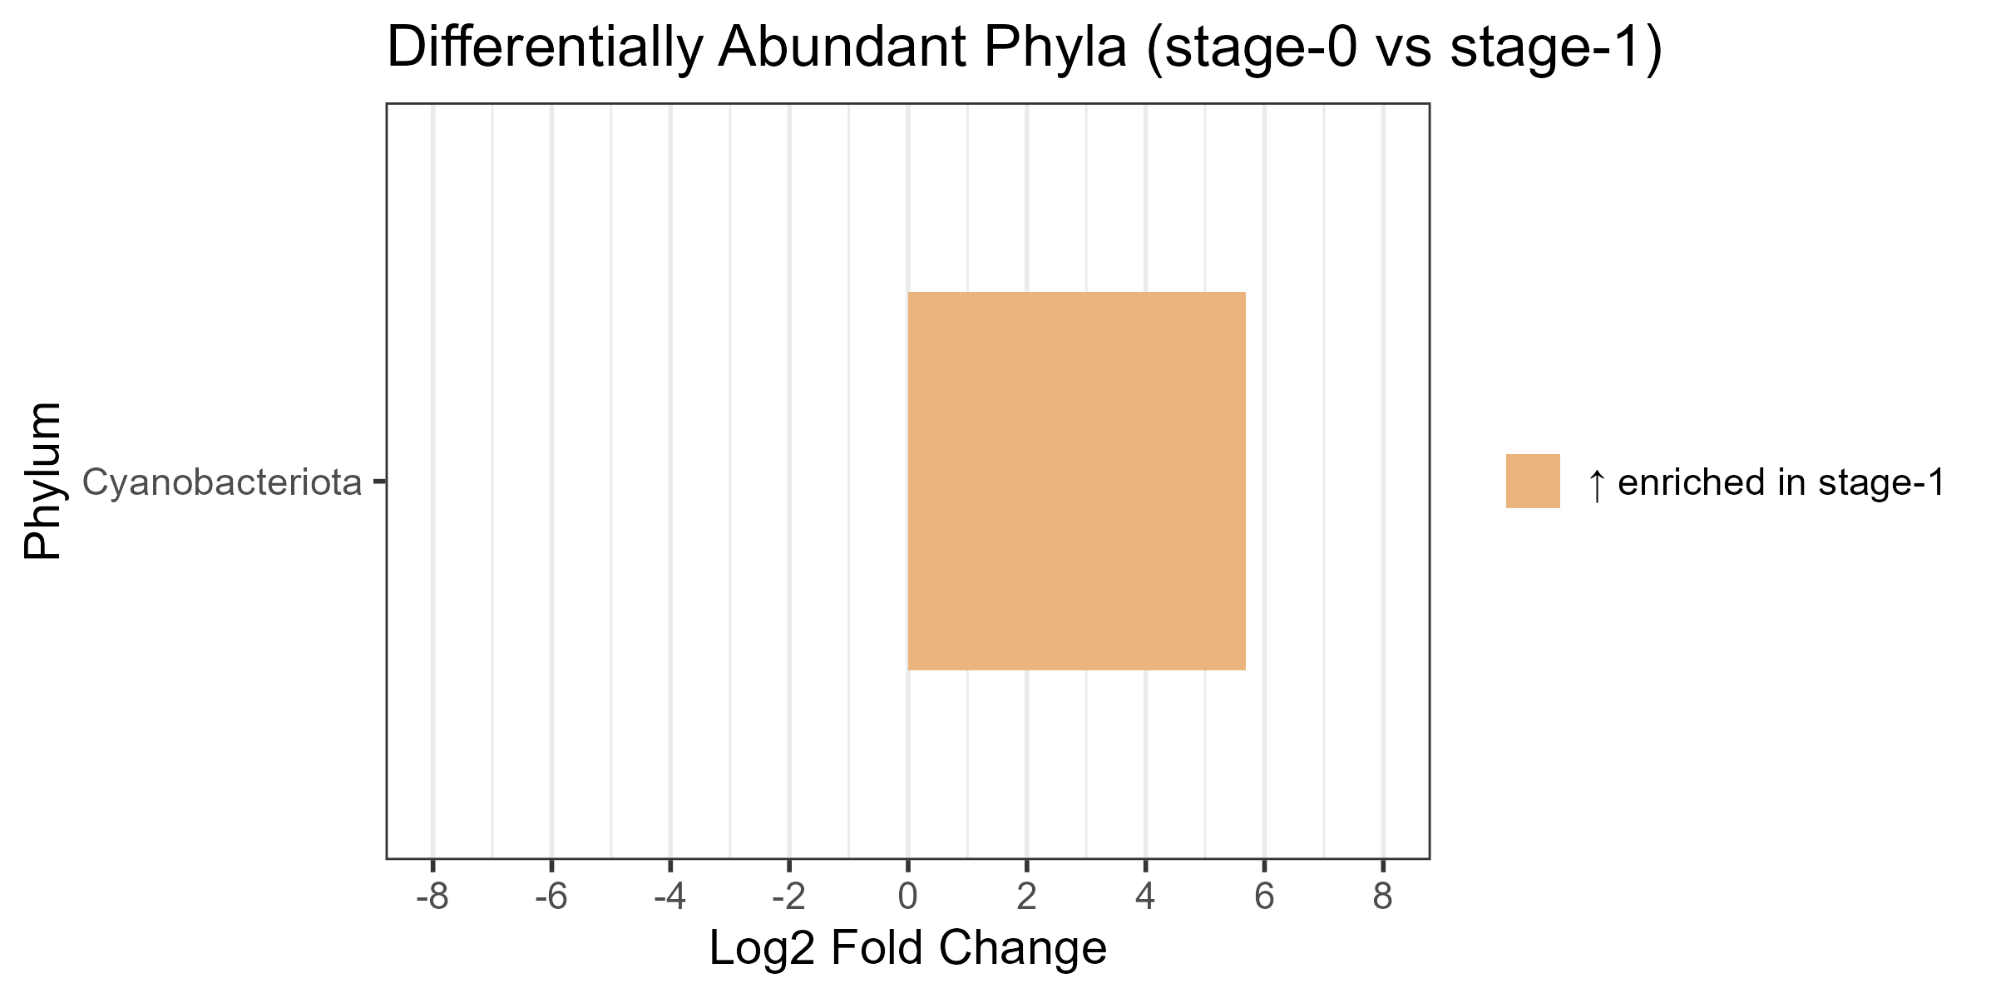
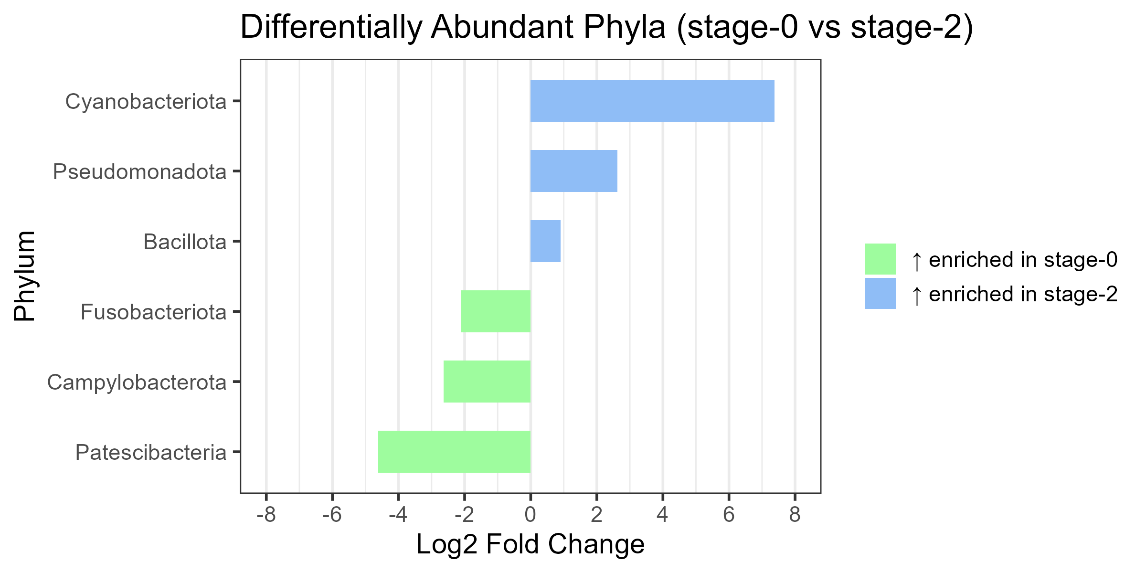
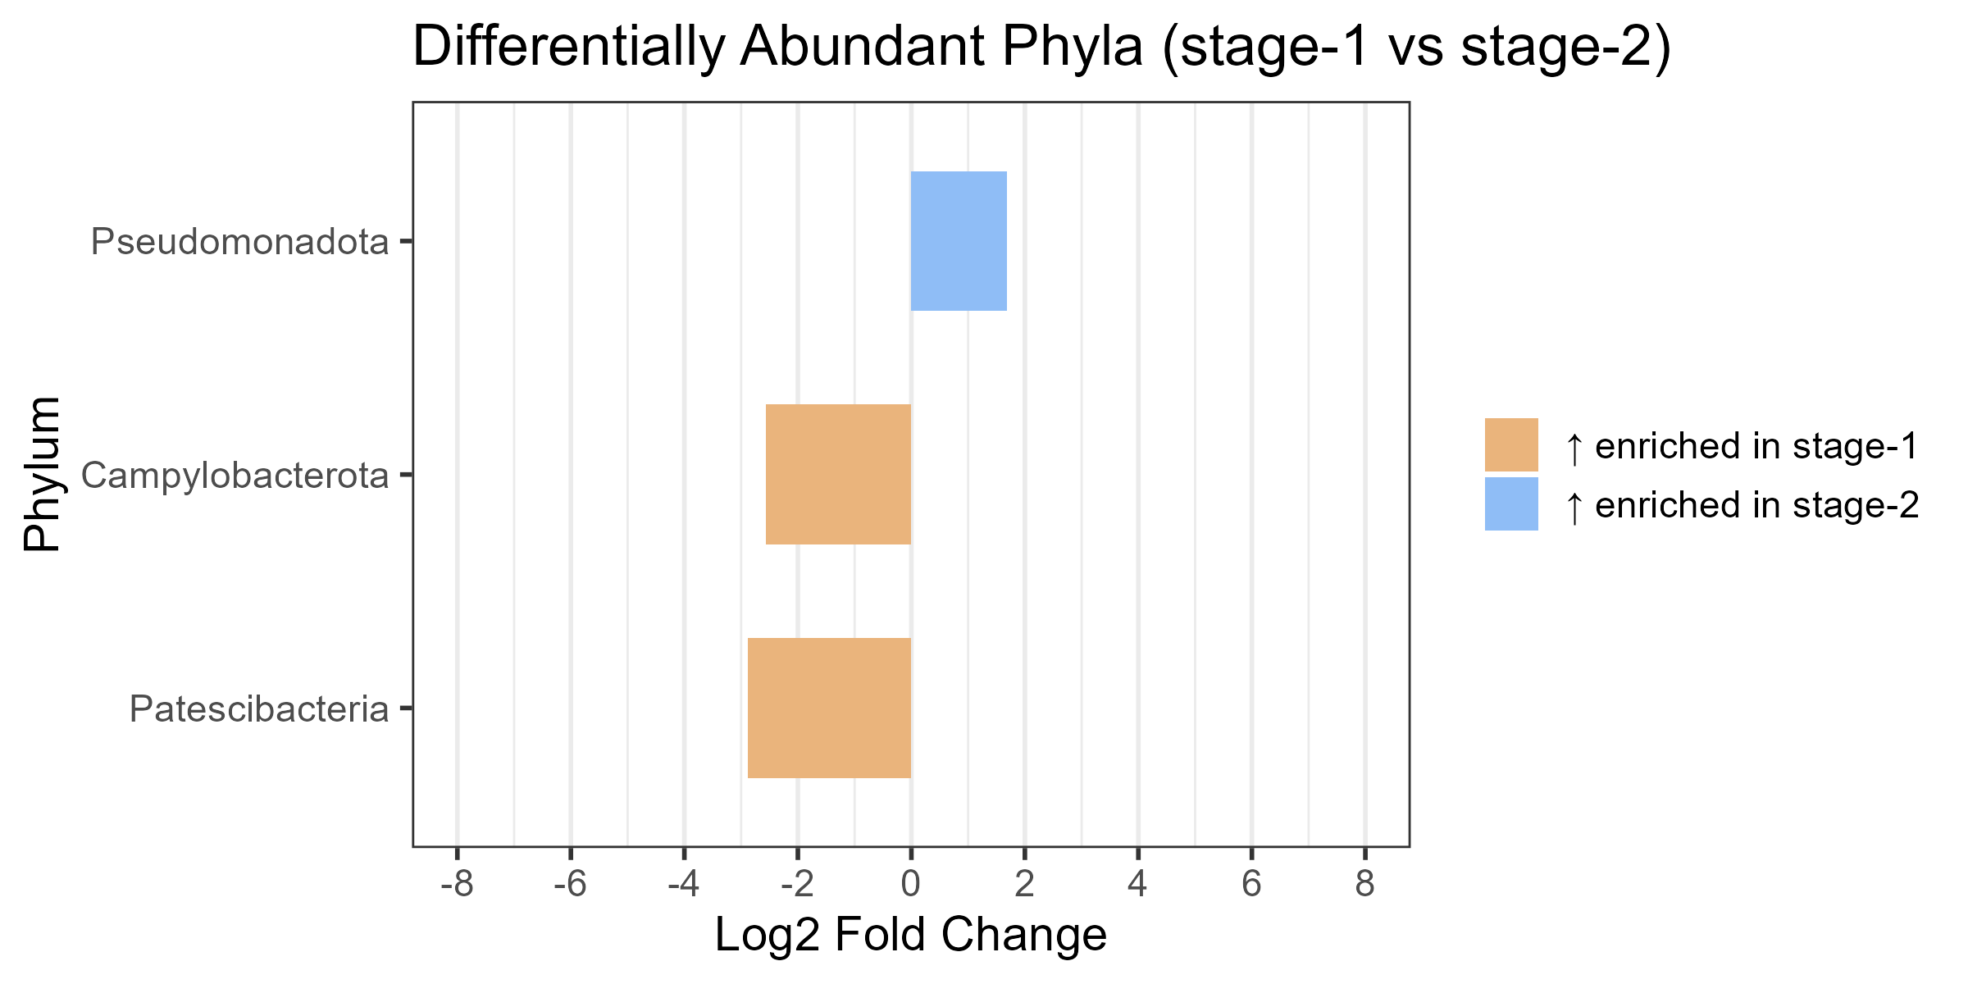
A
B
C
Supplementary Figure 1. Phylum-level differential abundance across ICU treatment stages.
Pairwise comparisons of bacterial phyla abundance using DESeq2 for 21 patients. Panels display significant Log2 fold changes (P < 0.05) for (A) Stage-0 vs. Stage-1, (B) Stage-0 vs. Stage-2, and (C) Stage-1 vs. Stage-2. Bars are colored according to the stage of enrichment: Green (Stage-0), Orange (Stage-1), and Blue (Stage-2).

Slide 2
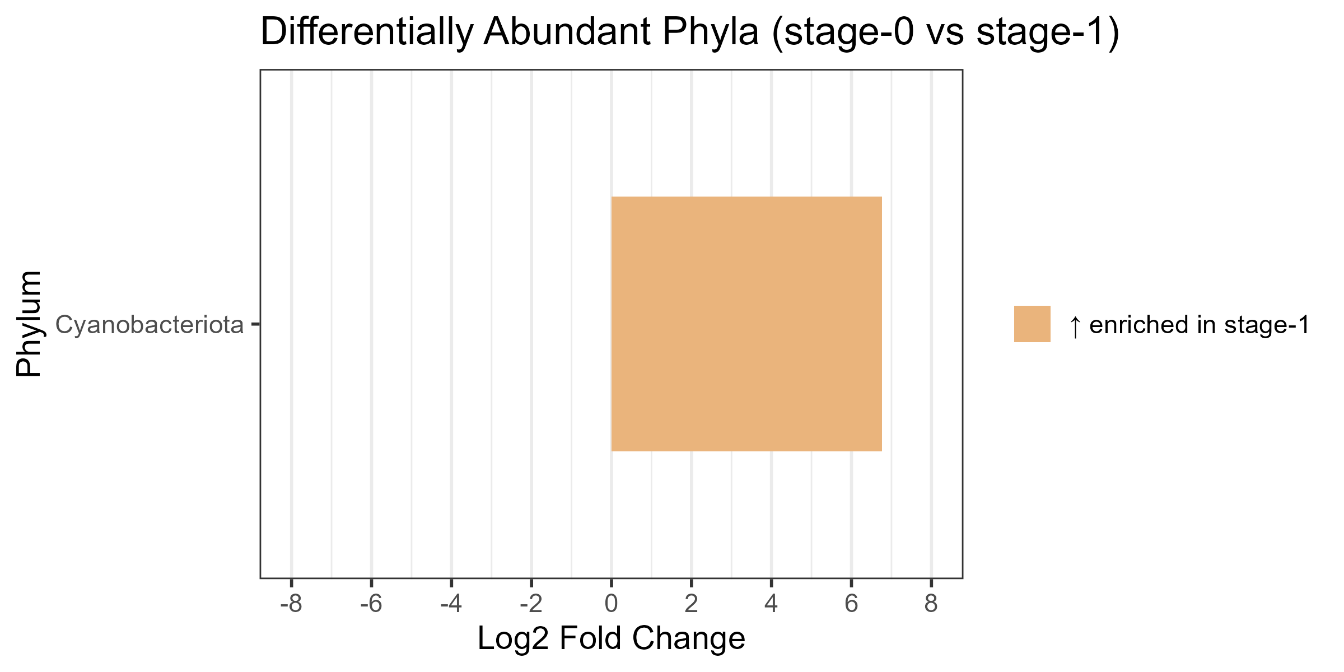
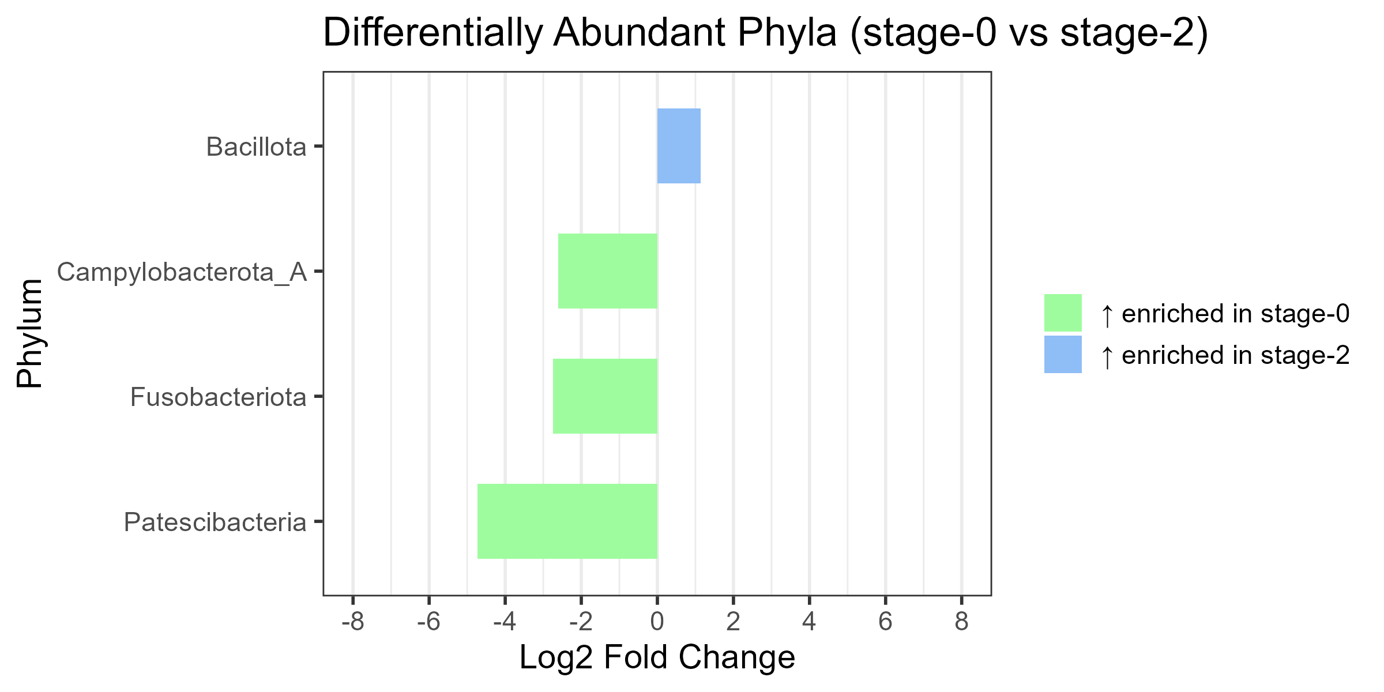
A
B
Supplementary Figure 2. Differential abundance of bacterial phyla in the 10-patient subset.
Bar plots displaying significant Log2 fold changes (P < 0.05) for pairwise comparisons: (A) Stage-0 vs. Stage-1 and (B) Stage-0 vs. Stage-2. Colors indicate the stage where the phylum is significantly enriched: Green (Stage-0), Orange (Stage-1), and Blue (Stage-2).

Slide 3
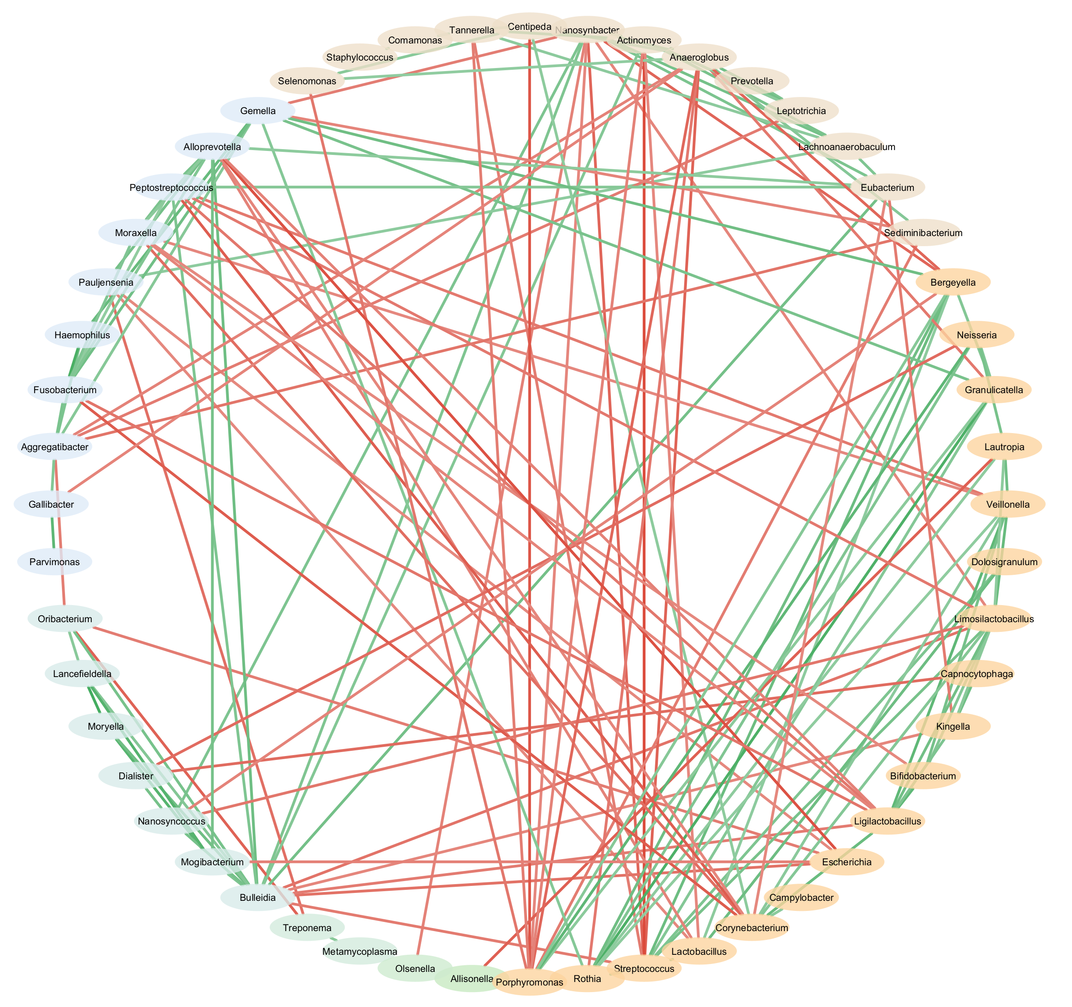
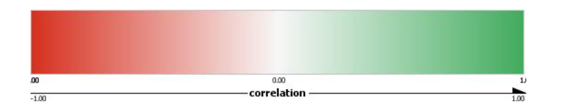
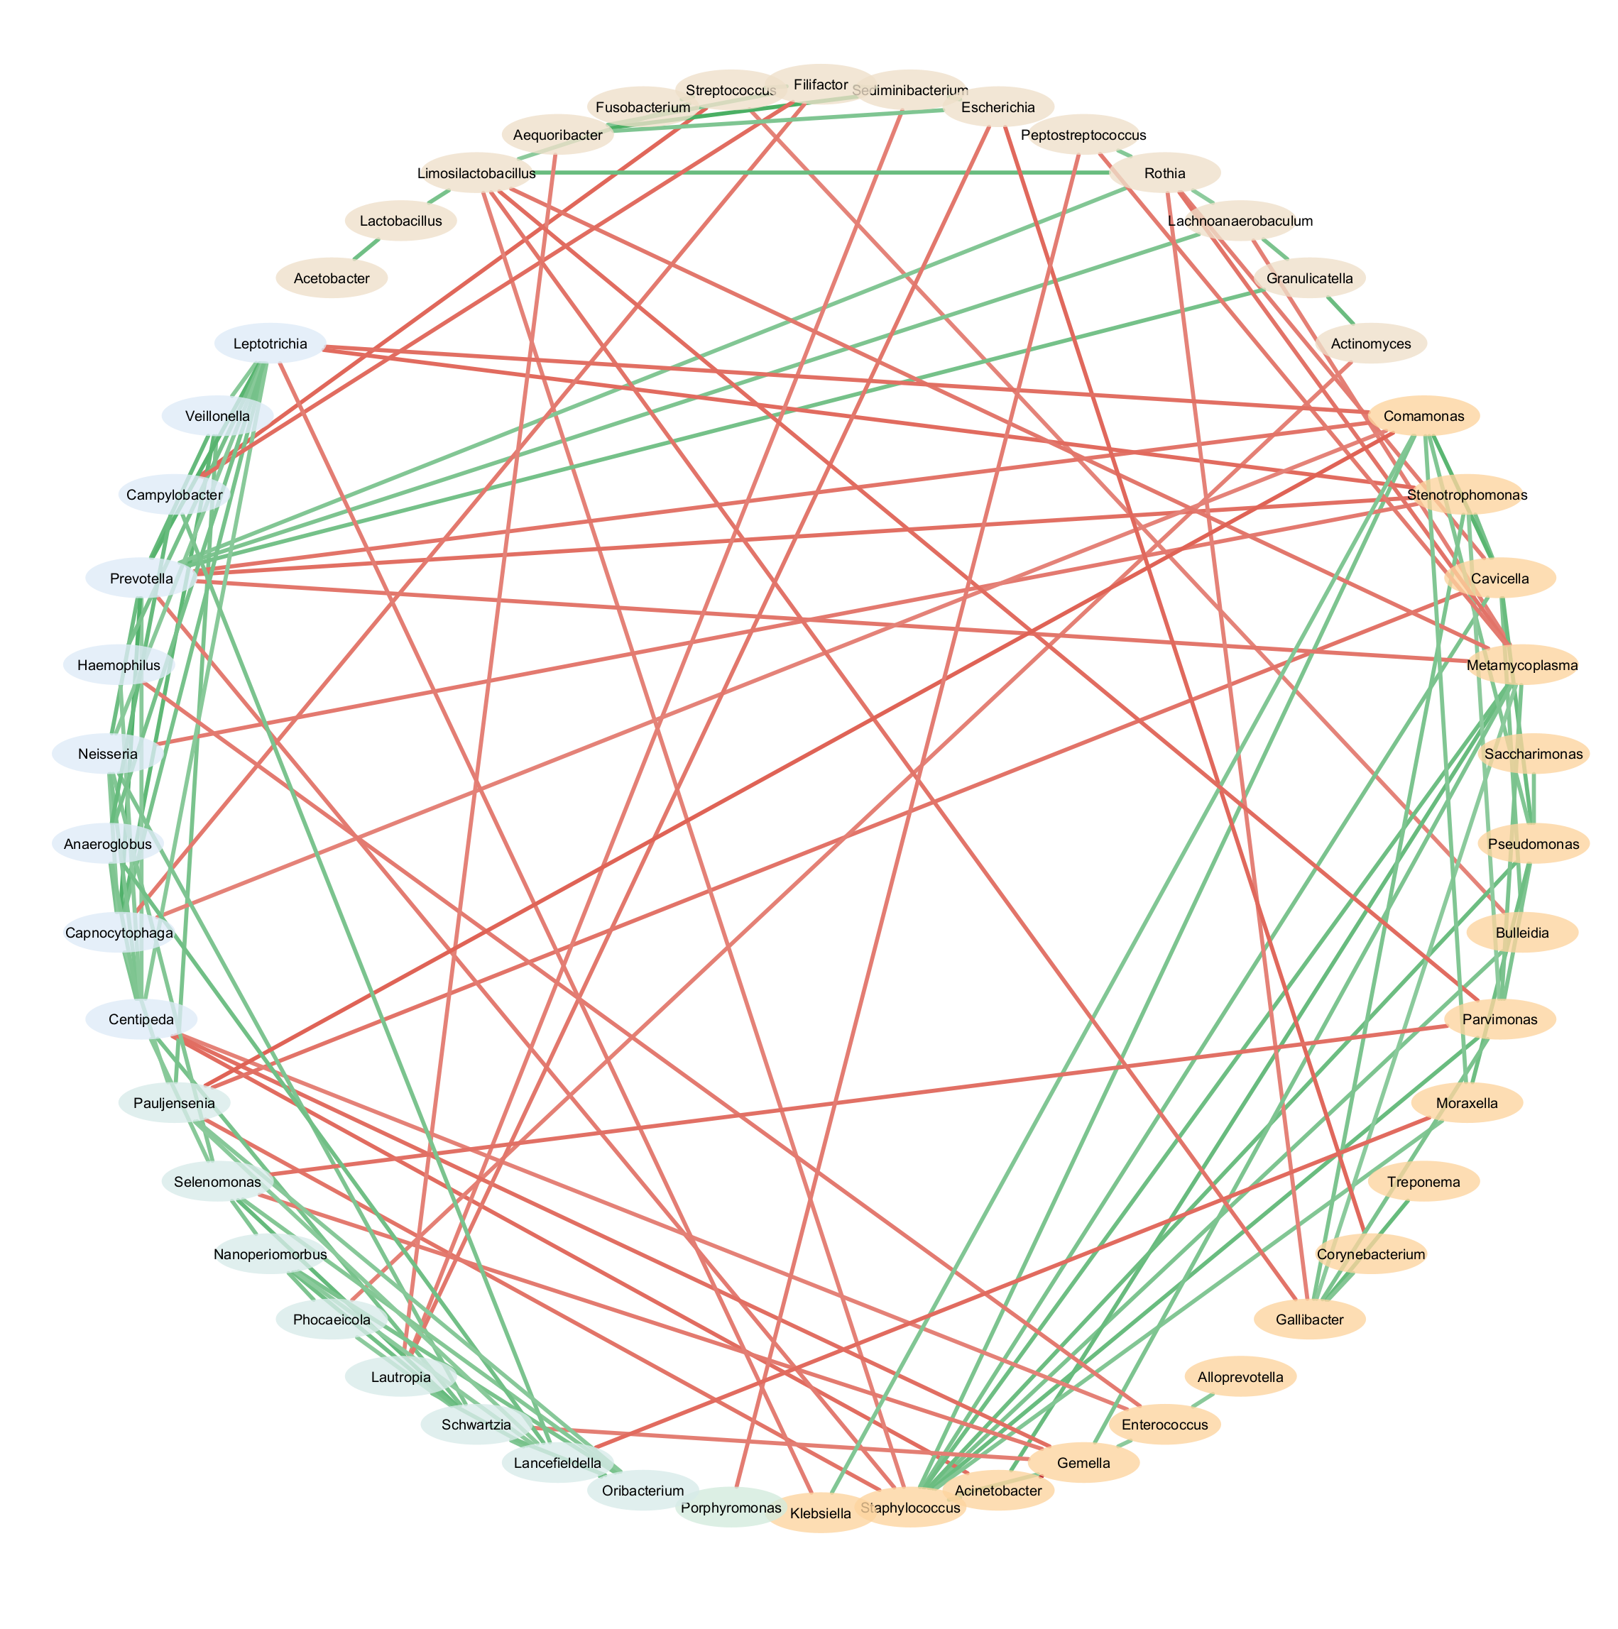
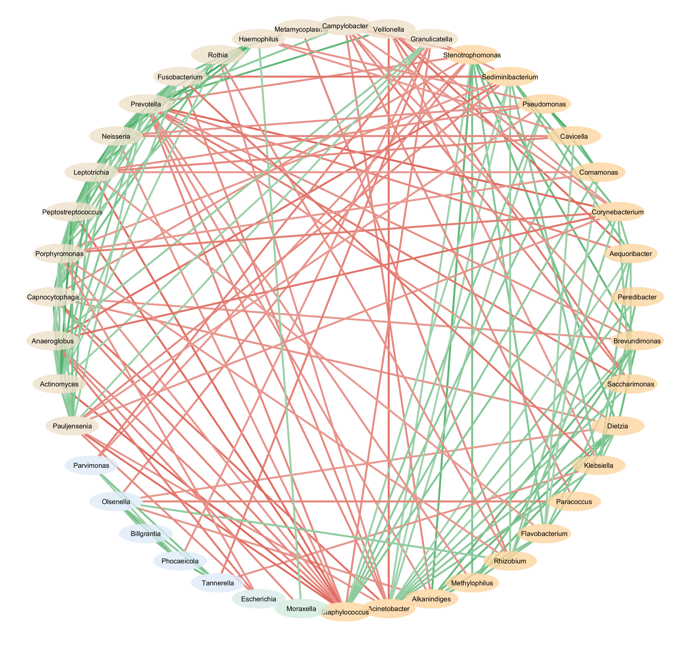
A
Stage-0
Number of nodes | 52
Number of edges | 150
Edge density | 0.113
Average clustering coefficient | 0.419
Positive vs negative ratio | 1.632
Mean degree | 5.769
-1.0
1.0
B
Stage-1
Number of nodes | 50
Number of edges | 129
Edge density | 0.105
Average clustering coefficient | 0.388
Positive vs negative ratio | 2.308
Mean degree | 5.160
-1.0
1.0
C
Stage-2
Number of nodes | 42
Number of edges | 180
Edge density | 0.209
Average clustering coefficient | 0.521
Positive vs negative ratio | 1.466
Mean degree | 8.571
-1.0
1.0
Supplementary Figure 3. Network topology statistics across ICU treatment stages in the subset of 10-patient. Co-occurrence network analysis illustrating the community structure alongside tables display key topological properties including number of nodes, edges, edge density, and average clustering coefficient for Stage-0 (A), Stage-1 (B), and Stage-2 (C). Edges represent significant associations between taxa, and correlation strengths are shown in the accompanying heatmap.

Slide 4
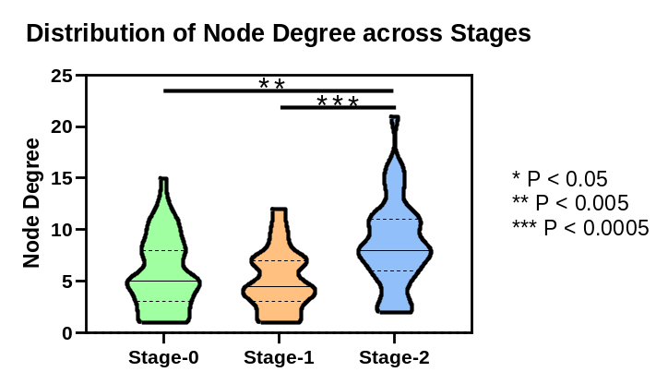
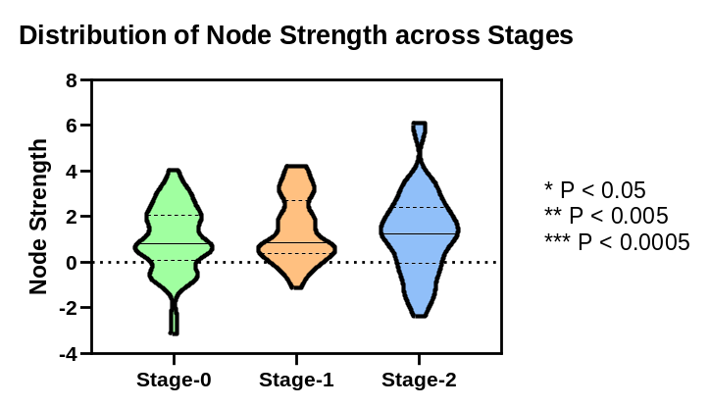
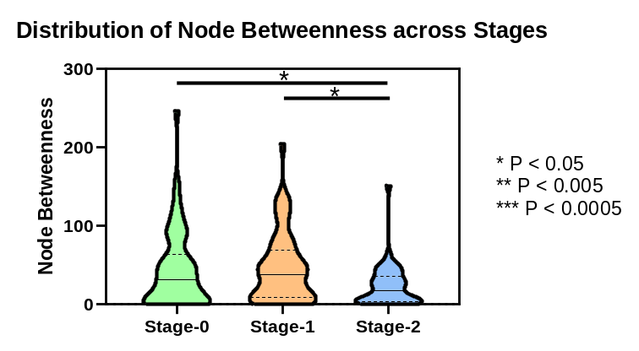
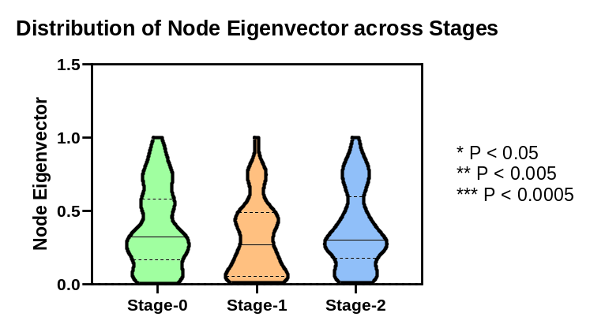
A
B
C
D
Supplementary Figure 4. Comparative analysis of node centrality distributions.
Violin plots comparing the distribution of Node Degree (A), Node Strength (B), Node Betweenness (C), and Node Eigenvector centrality (D) across Stage-0, Stage-1, and Stage-2. P values for stage-wise comparisons were calculated using Welch’s t-test. Significance levels are indicated by asterisks: * P < 0.05, ** P < 0.005, *** P < 0.0005.

Slide 5
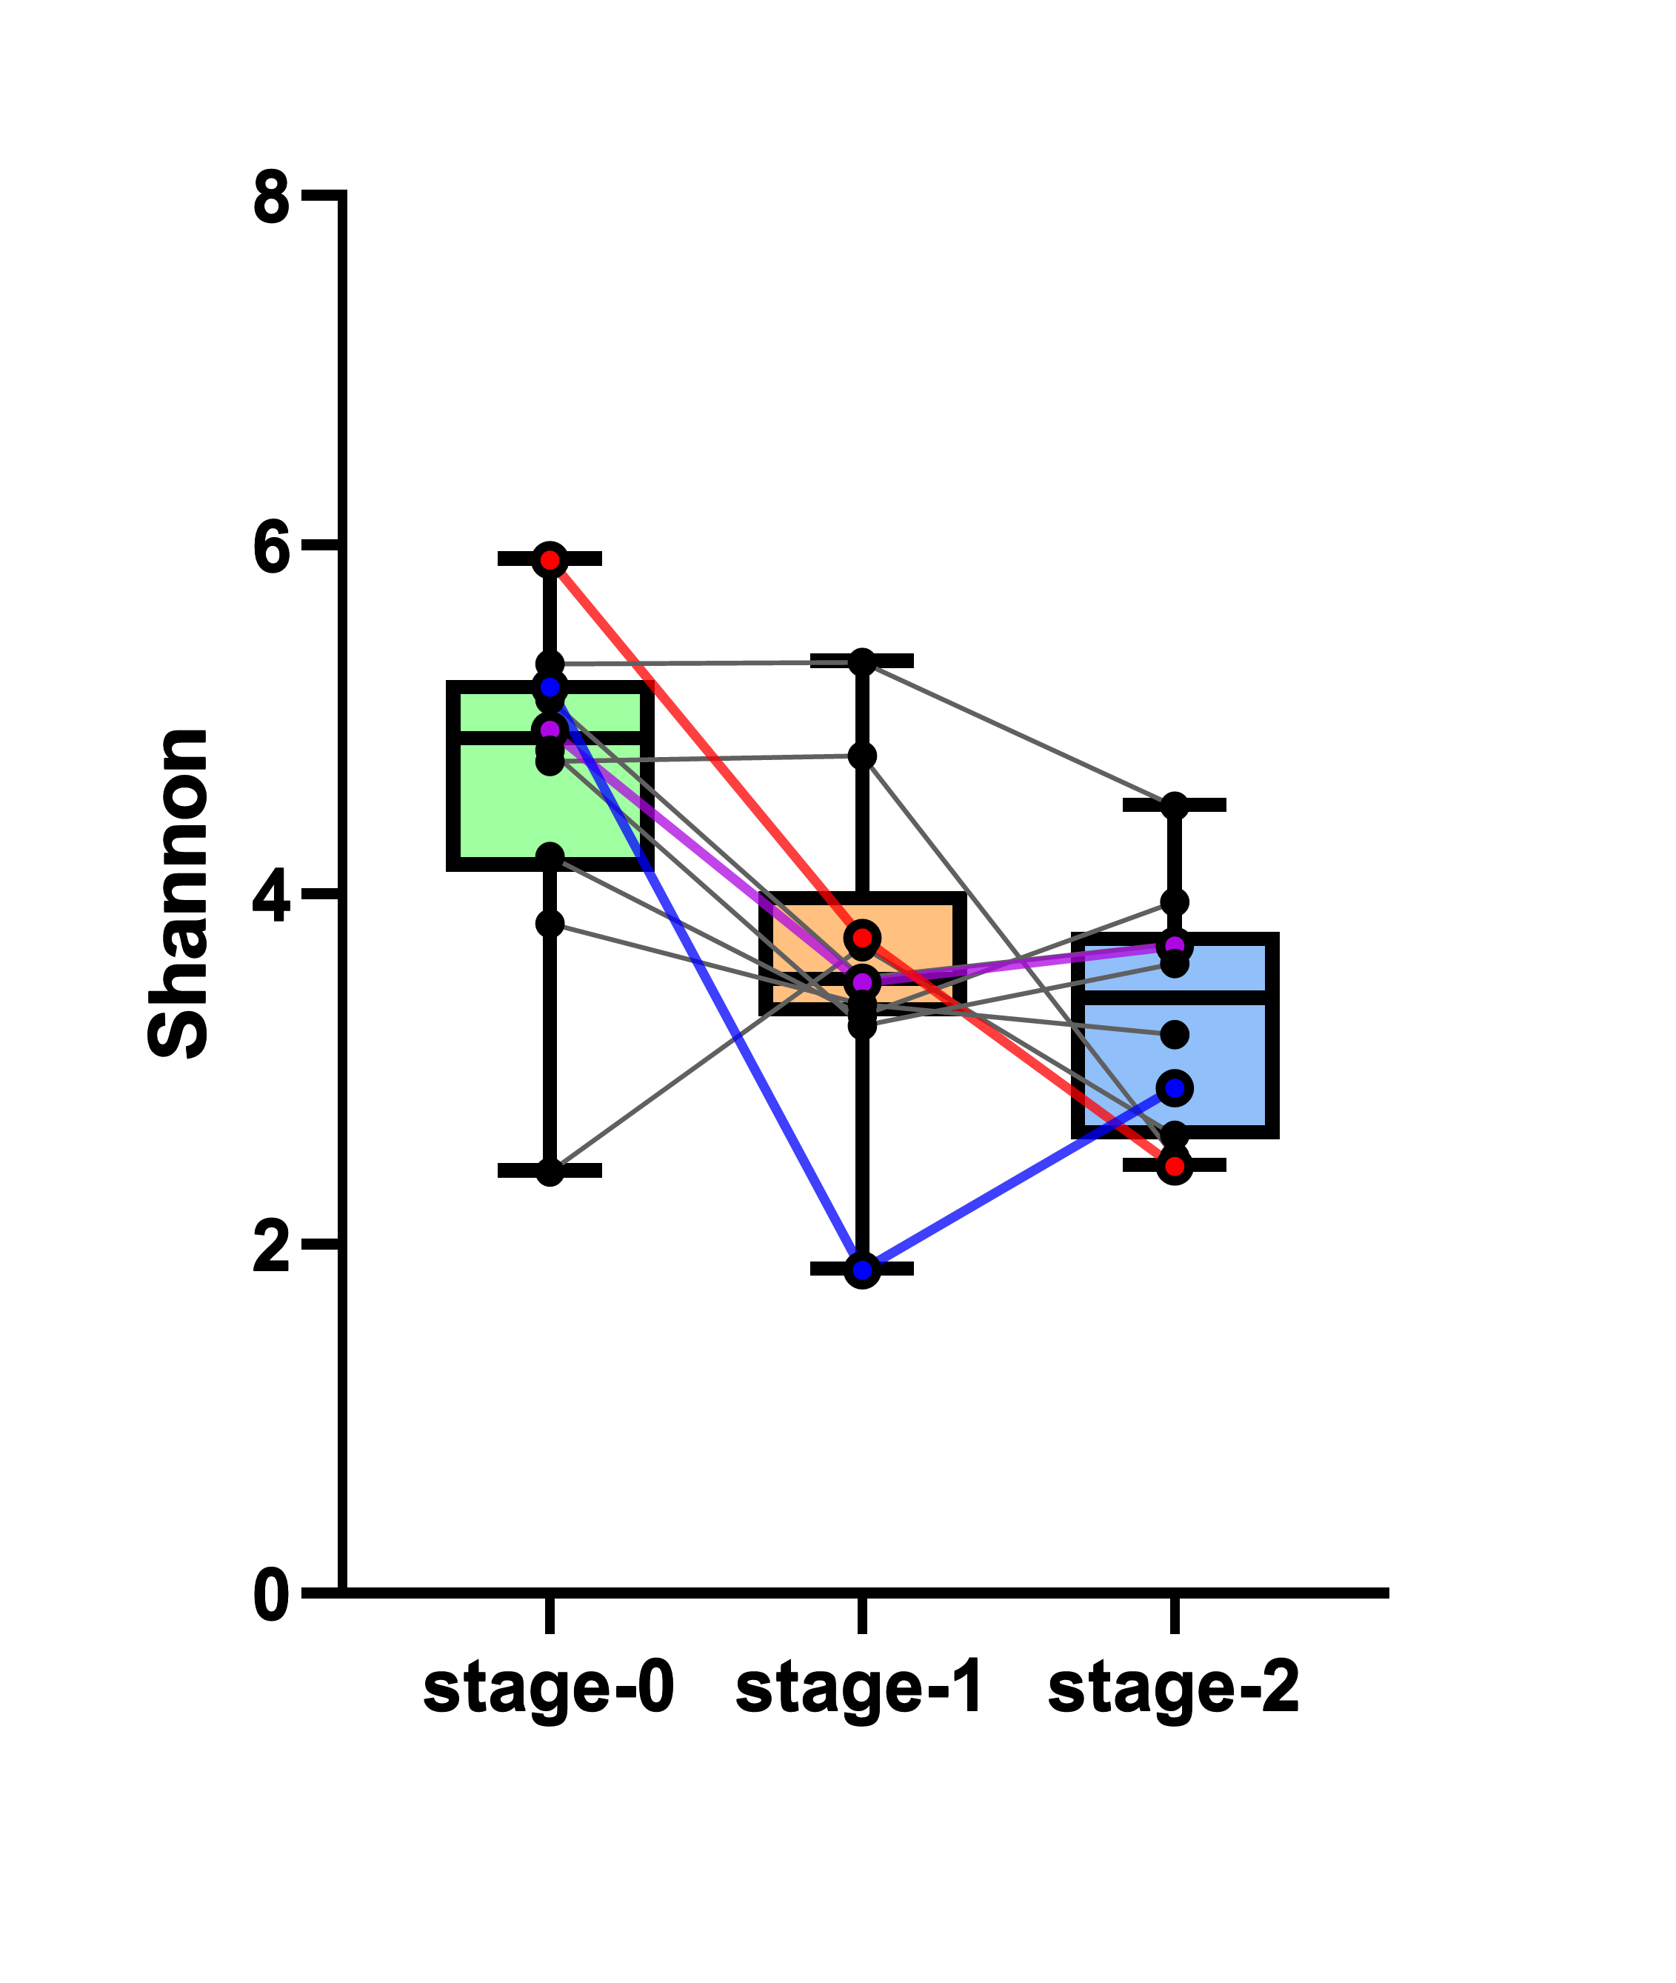
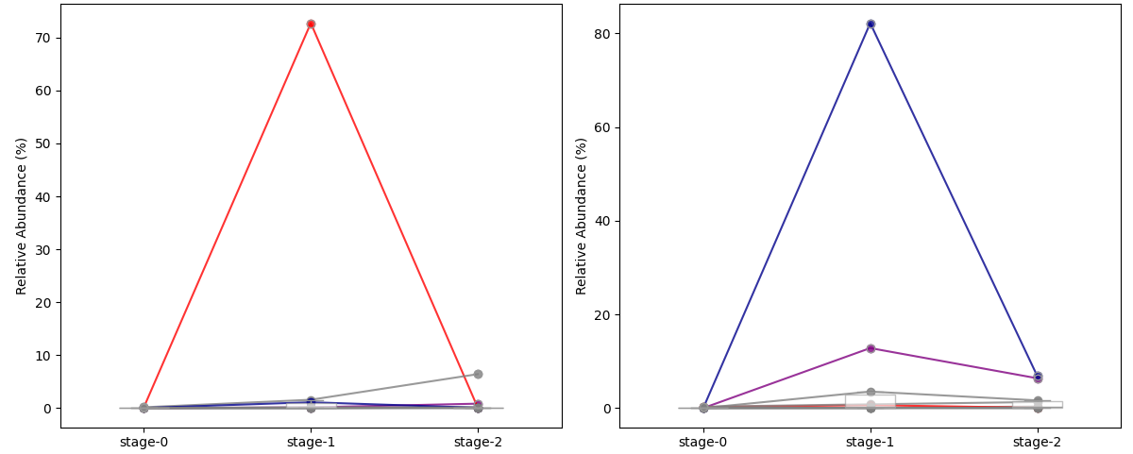
A
B
Stage-wise shift of genus Staphylococcus
Stage-wise shift of genus Acinetobacter
Supplementary Figure 5. Longitudinal microbial diversity and stage-wise expansion of HAP-associated pathogens. (A) Shannon alpha diversity across Stage-0, Stage-1, and Stage-2 for the longitudinal cohort (n=10). Box plots show the median, interquartile range, and range at each stage, with individual patient trajectories connected by lines. Gray lines represent the seven non-HAP patients; red (S. hominis-positive), blue, and purple (A. baumannii-positive) lines represent the three patients who developed culture-confirmed HAP at Stage-1. (B) Stage-wise relative abundance of Staphylococcus (left) and Acinetobacter (right) in the same cohort, with colored lines corresponding to the same three HAP patients as in panel A.

Slide 6
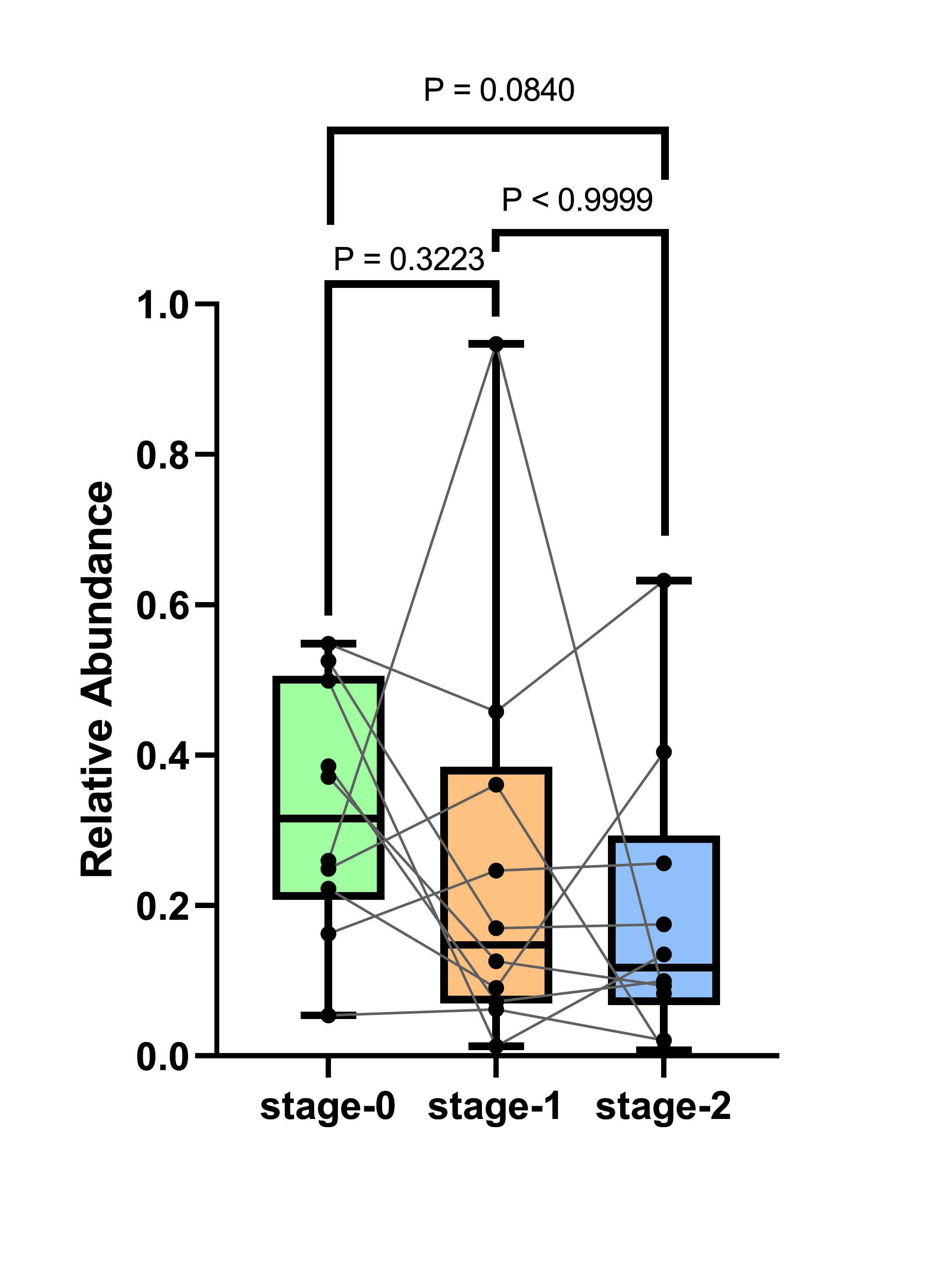
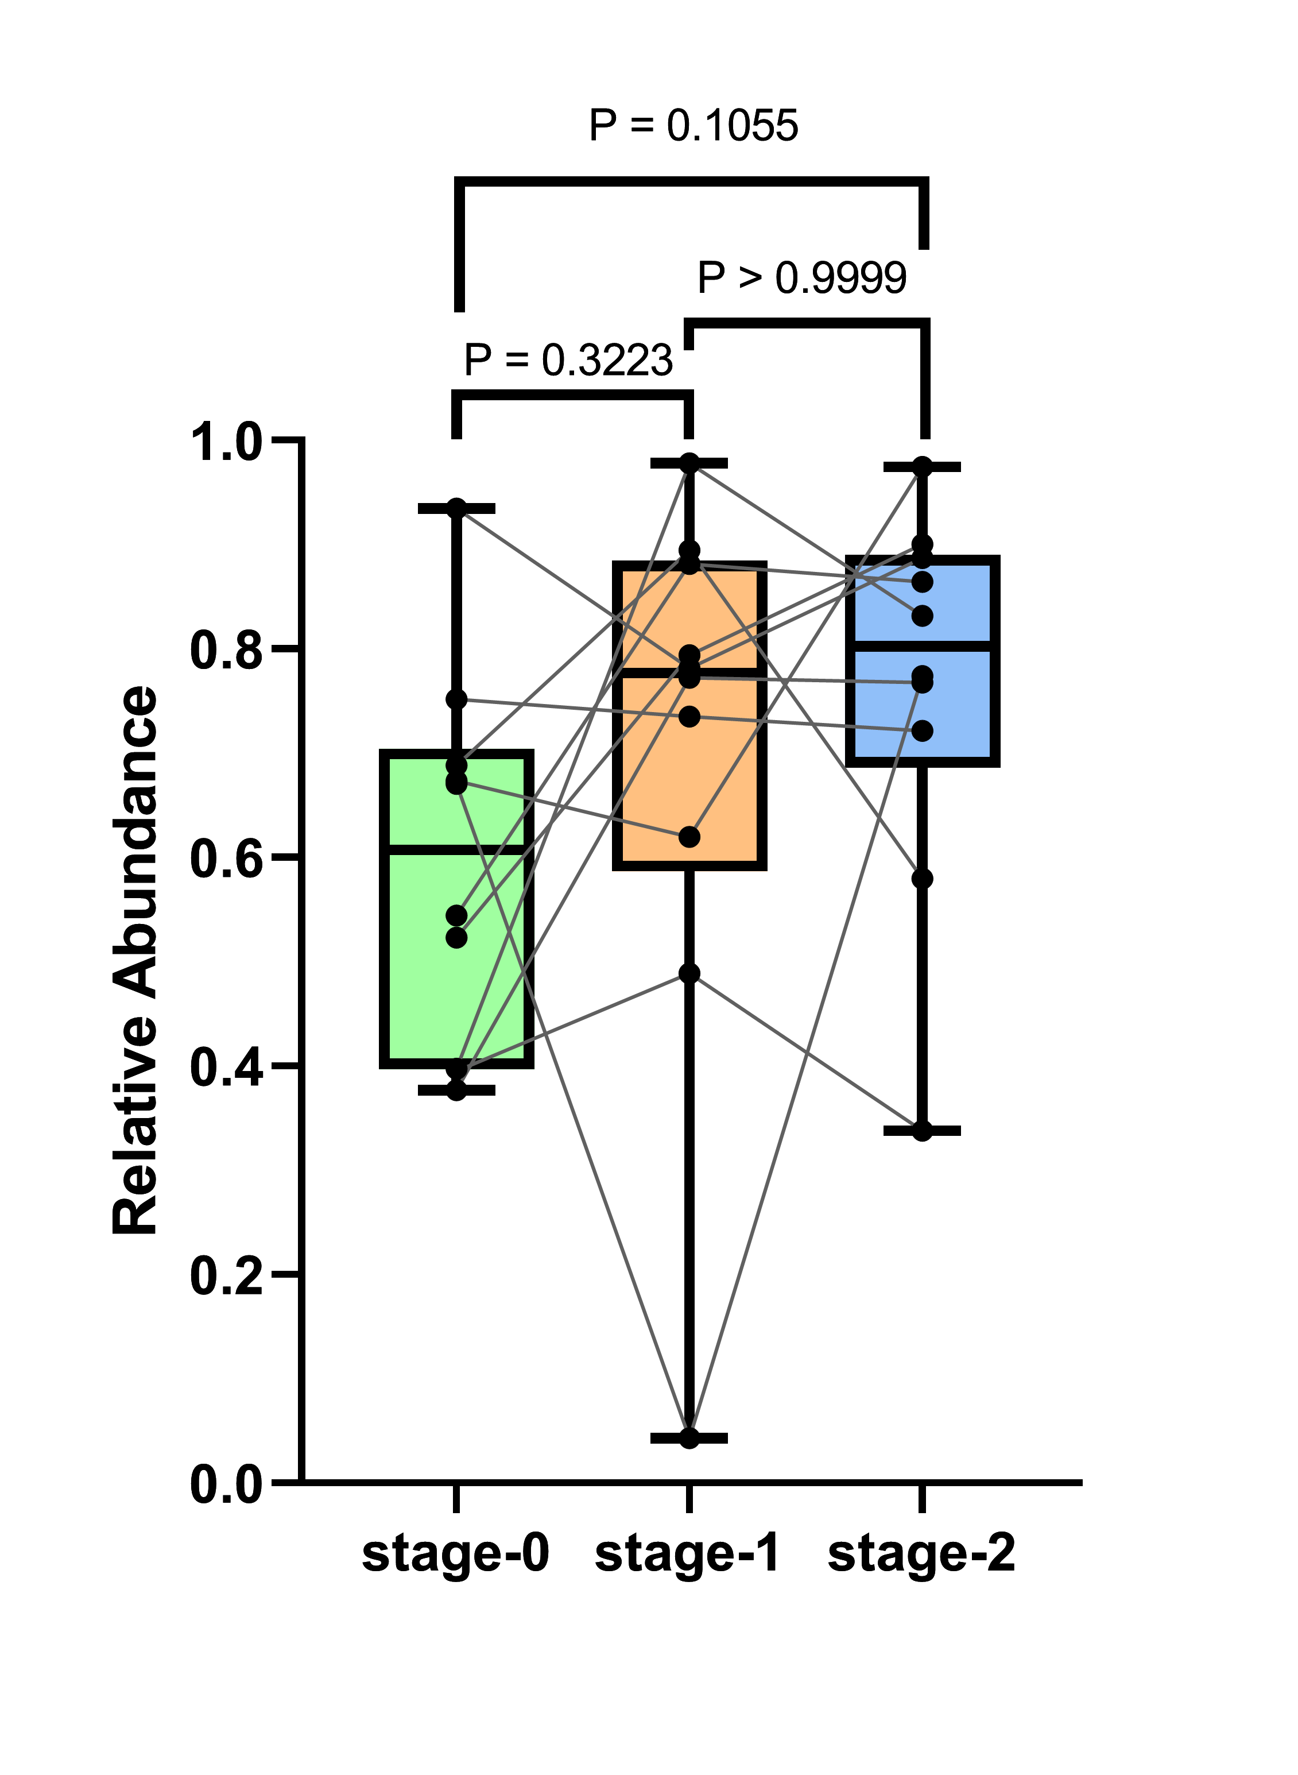
A
B
Gram_Neg_10 patients
Gram_Pos_10 patients
Supplementary Figure 6: (A) Gram-negative and (B) Gram-positive bacterial abundance trends across three stages. Box plots display median and interquartile range; lines connect paired samples from the same patient. P values for stage-wise comparisons were calculated using Welch’s t-test.

