Slide 1
Fig. S1. Heatmap visualization of community composition of 16S rRNA gene analysis .
The red frame in the figure indicates on the glacier ice, while the black frame indicates the glacier retreat area.

Slide 2
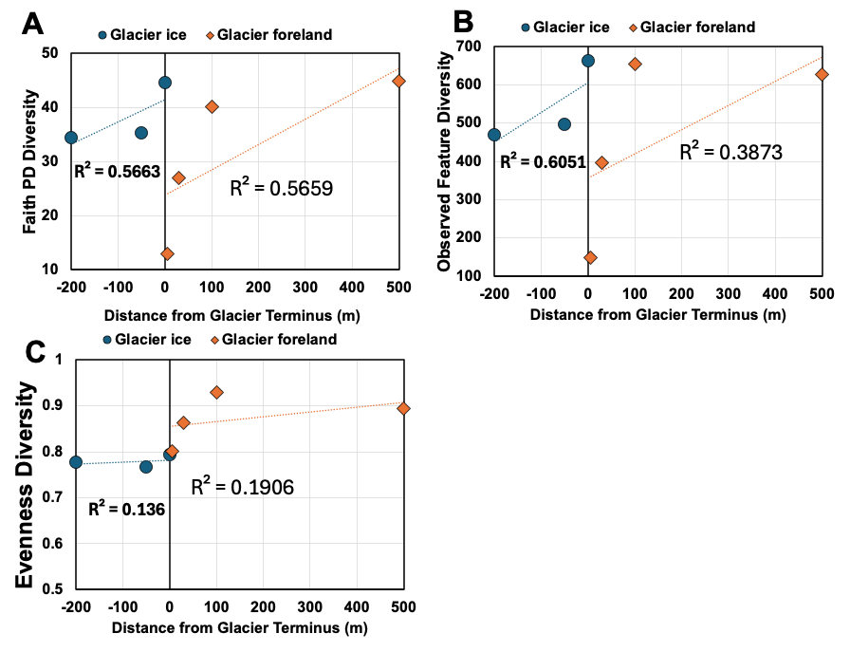
Fig. S2. Relationship between α-diversity indices of 16S rRNA and distance from the glacier terminus
(A) Faith PD diversity indices, (B) Observed Feature diversity indices, (C) Evenness diversity indices

Slide 3
Fig. S3. Heatmap visualization of community composition of ITS1 region analysis .
The red frame in the figure indicates on the glacier ice, while the black frame indicates the glacier retreat area.

Slide 4
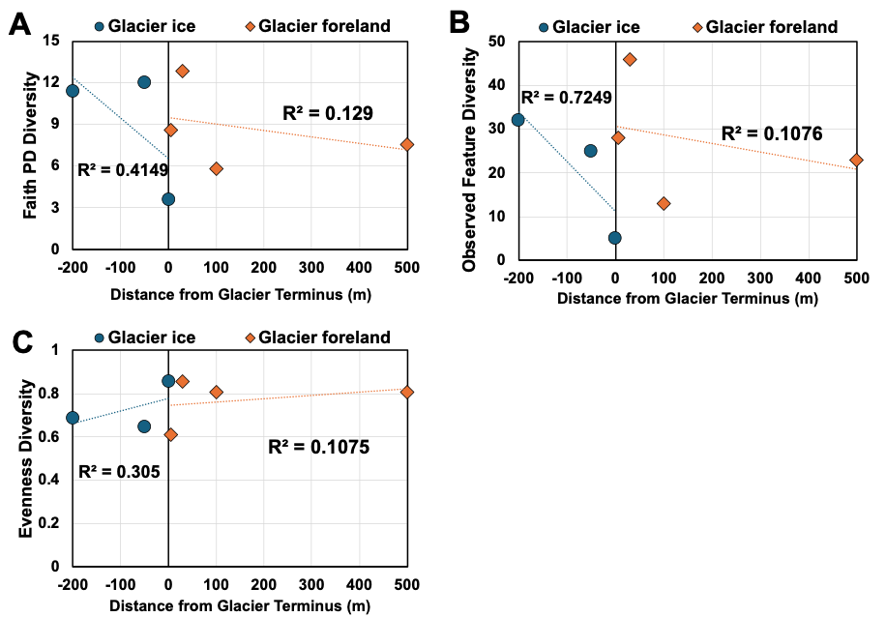
Fig. S4. Relationship between α-diversity indices of ITS 1 region and distance from the glacier terminus
  Faith PD diversity indices, (B) Observed Feature diversity indices, (C) Evenness diversity indices

