Slide 1
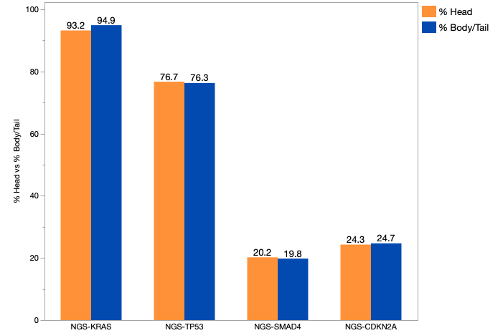
Supplementary Figure 1. Genes of interest in H versus B/T. Comparative analysis of KRAS, TP53, SMAD4, CDKN2A onco-genes in both primary tumor origins after NGS. Abbreviations: head (H), body/tail (B/T), next generation sequencing (NGS).
Test | Positive (Head) | Negative (Head) | % (Head) | Positive (Body/Tail) | Negative (Body/Tail) | % (Body/Tail) | P-value | Q-value
NGS-KRAS | 965 | 70 | 93.20% | 506 | 27 | 94.90% | 0.186 | 1
NGS-TP53 | 799 | 243 | 76.70% | 412 | 128 | 76.30% | 0.865 | 1
NGS-SMAD4 | 213 | 841 | 20.20% | 107 | 433 | 19.80% | 0.853 | 1
NGS-CDKN2A | 255 | 793 | 24.30% | 134 | 408 | 24.70% | 0.863 | 1

Slide 2
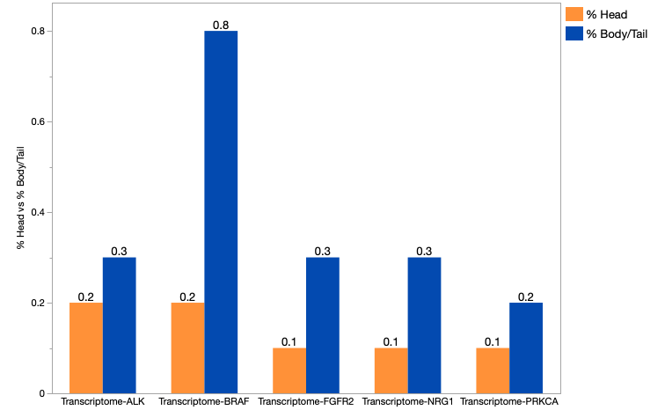
Supplementary Figure 2. Fusions (WTS) in pancreatic H vs. B/T primary tumors. Abbreviations: head (H), body/tail (B/T), next-generation sequencing (NGS).
Test | Positive (Head) | Negative (Head) | % (Head) | Positive (Body/Tail) | Negative (Body/Tail) | % (Body/Tail) | P-value | Q-value
Transcriptome-NRG1 | 1 | 1128 | 0.10% | 2 | 593 | 0.30% | 0.275 | 1
Transcriptome-FGFR2 | 1 | 1128 | 0.10% | 2 | 593 | 0.30% | 0.275 | 1
Transcriptome-PRKCA | 1 | 1128 | 0.10% | 1 | 594 | 0.20% | 1 | 1
Transcriptome-BRAF | 2 | 1127 | 0.20% | 5 | 590 | 0.80% | 0.052 | 1
Transcriptome-ALK | 2 | 1125 | 0.20% | 2 | 593 | 0.30% | 0.612 | 1

Slide 3
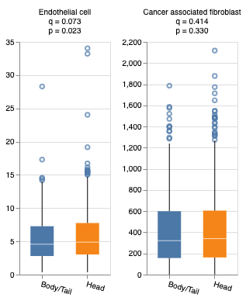
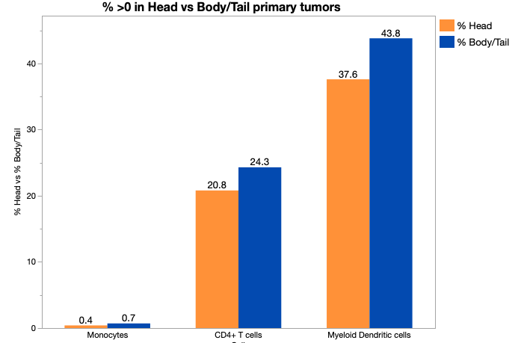
Supplementary Figure 3. Percent >0 in H vs B/T primary tumors. Abbreviations: head (H), body/tail (B/T)
Immune cell infiltration

Slide 4
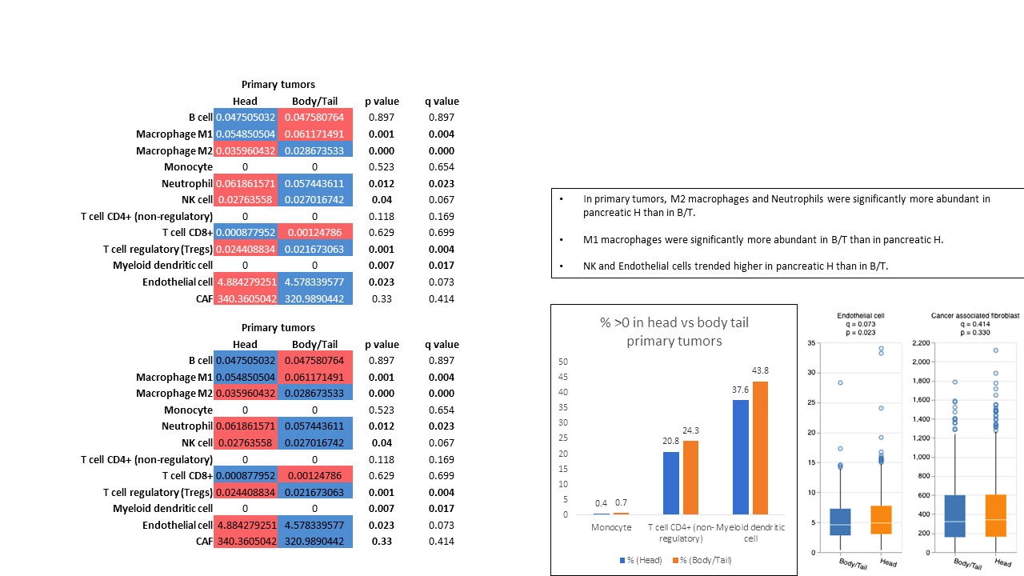
Supplementary Table 1. Median units are shown for the TIME. Where median values were “0”, the percent of nonzero values are shown. In primary tumors, M2 macrophages and Neutrophils were significantly more abundant in pancreatic H than in B/T. M1 macrophages were significantly more abundant in B/T than in pancreatic H. NK and Endothelial cells trended higher in pancreatic H than in B/T. Red: higher median value; Blue: lower median value.

