Slide 1
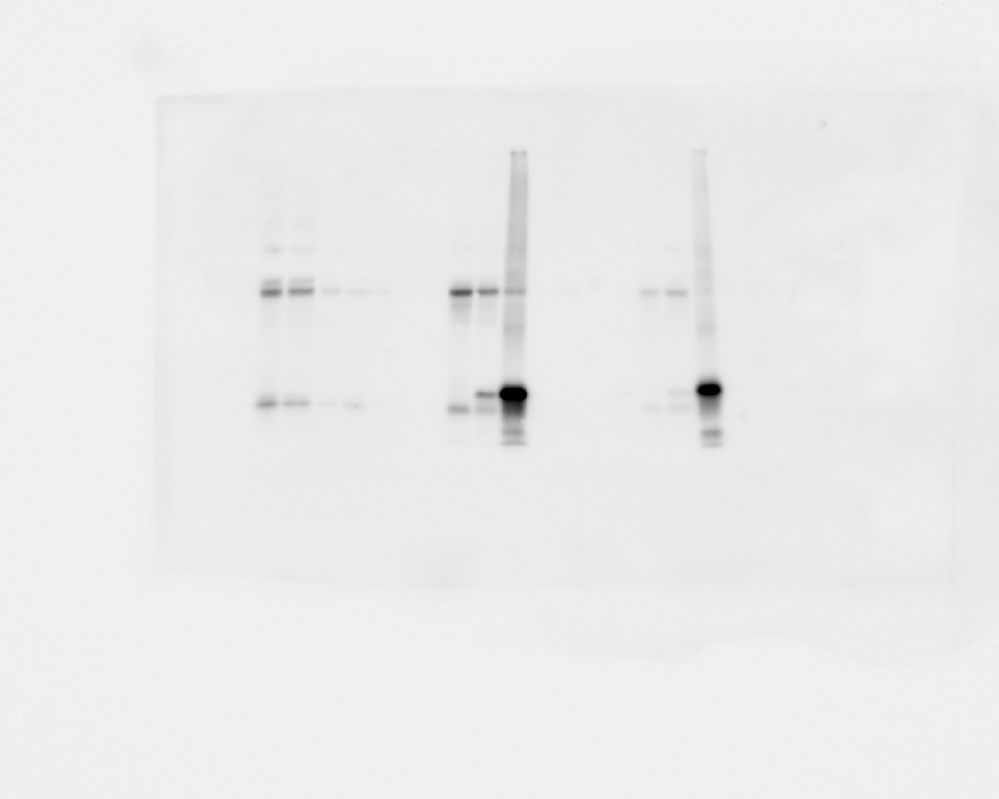
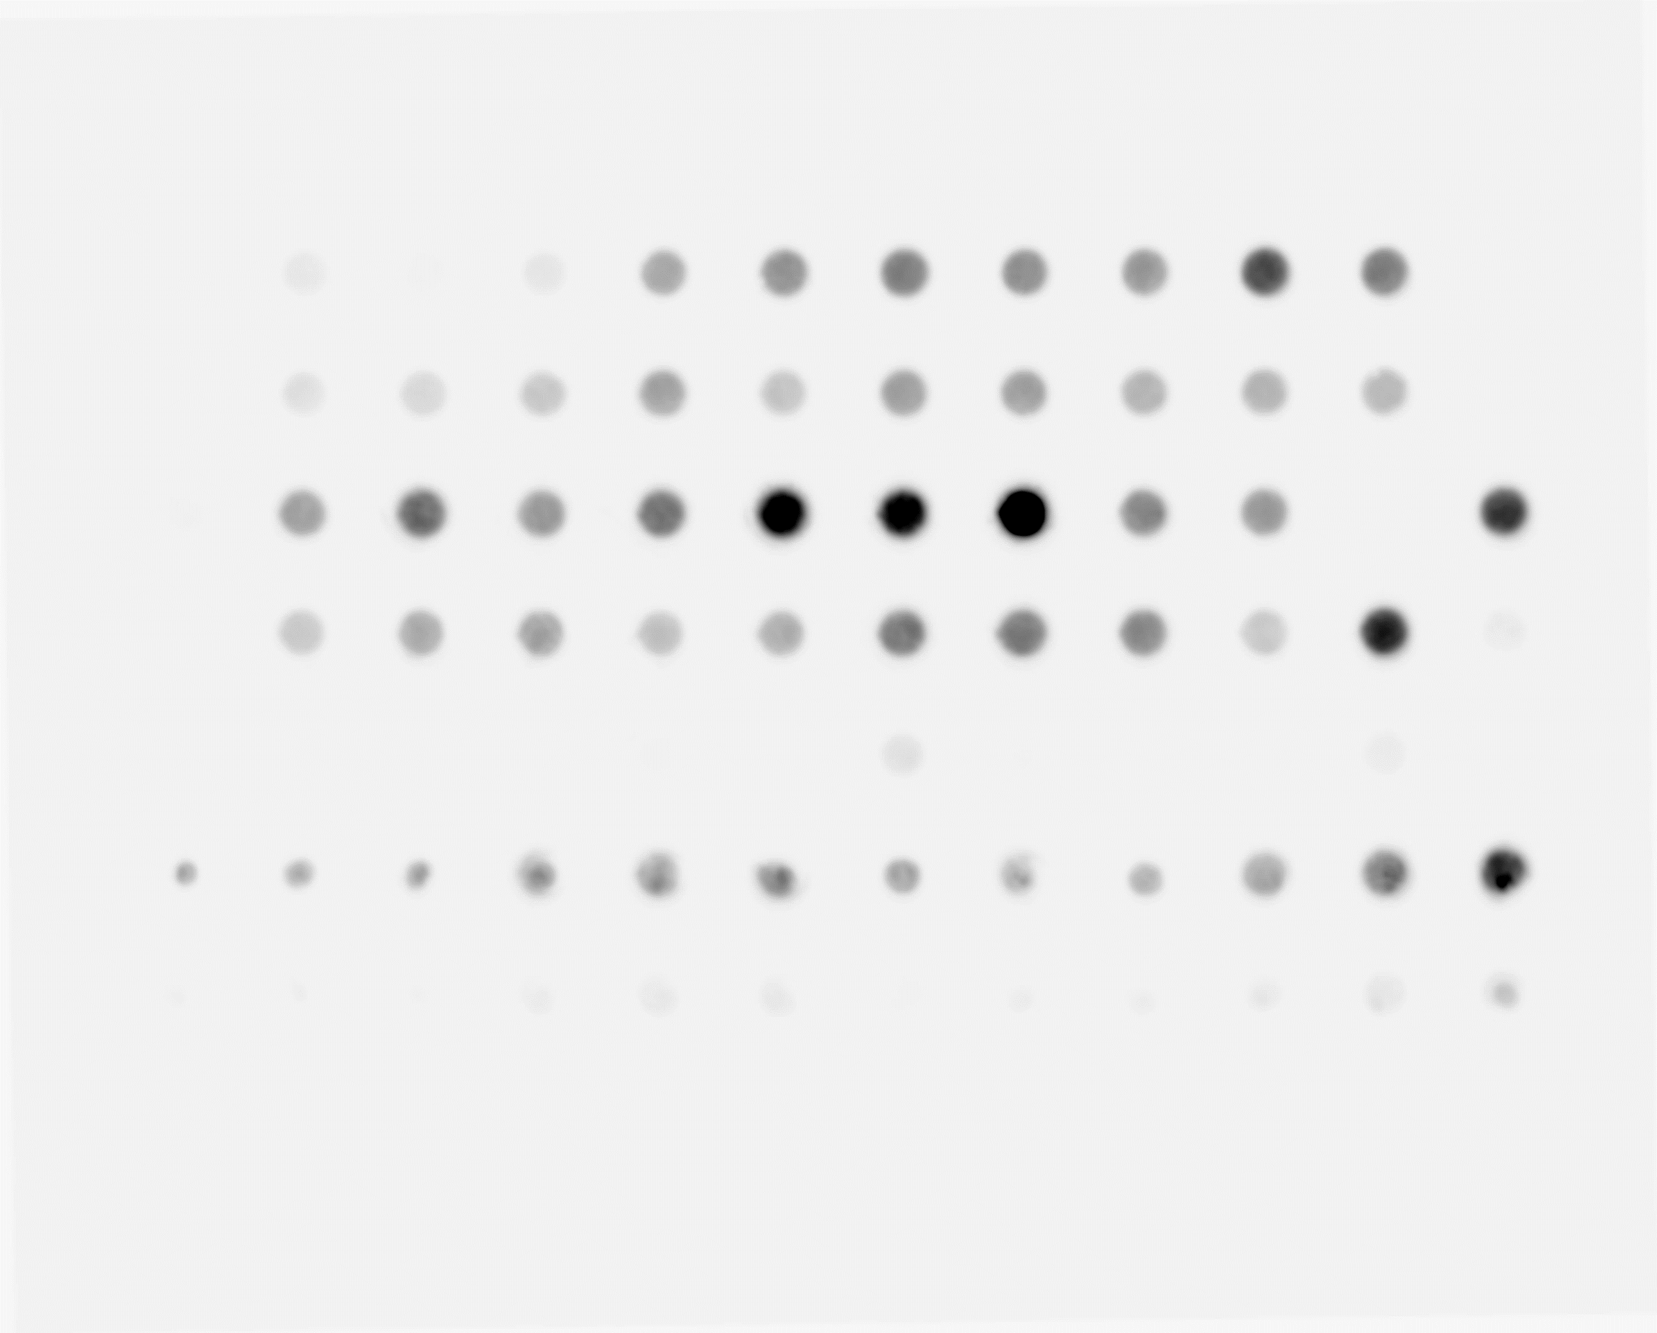
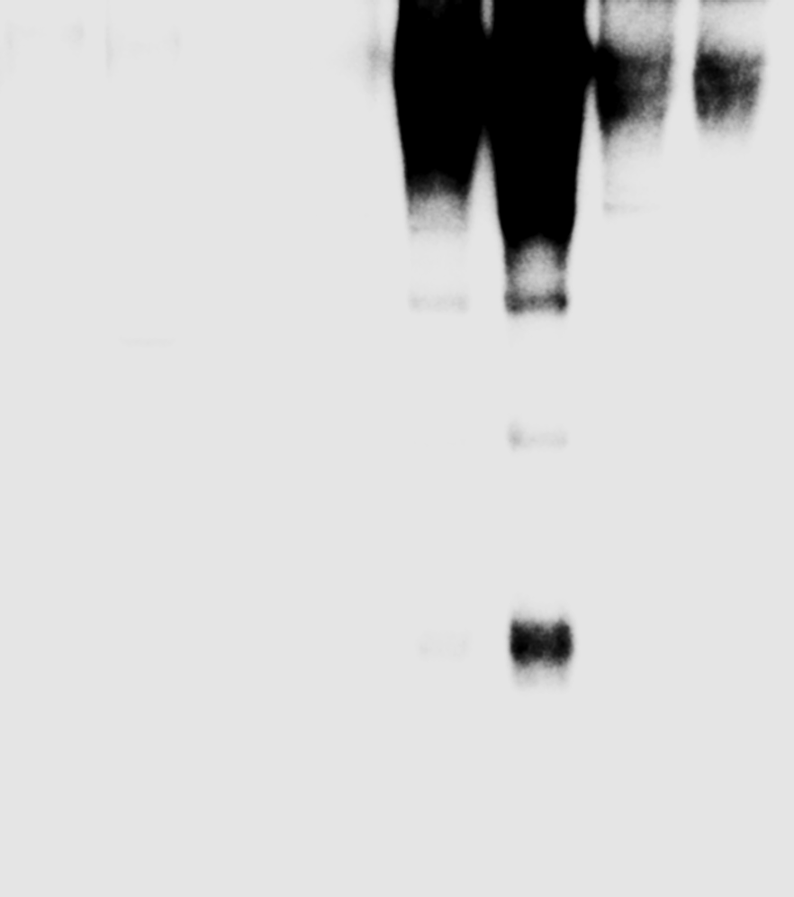
Uncropped Blots from Figure 1
b
IB: HA-UPRT
UPRT^{fl/fl}
UCP1;UPRT (4°C)
UCP1;UPRT (RT)
eWAT
Muscle
eWAT
Muscle
eWAT
Muscle
sWAT
Liver
Brain
sWAT
Liver
Brain
sWAT
Liver
Brain
BAT
BAT
BAT
50 kDa
35 kDa
c
RNA dot-blot
d
Not biotinylated
Biotinylated
UPRT^{fl/fl}
UCP1;UPRT
4TU
+
+
+
+
+
+
+
UPRT
-
-
+
+
-
-
+
+
RNA (µg)
+
1
10
1
10
1
10
1
eWAT
10
sWAT
BAT
150 nt
Liver
Pancreas
70 nt

Slide 2
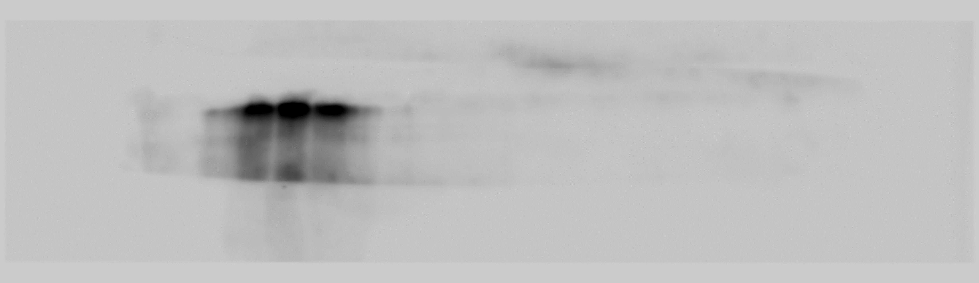

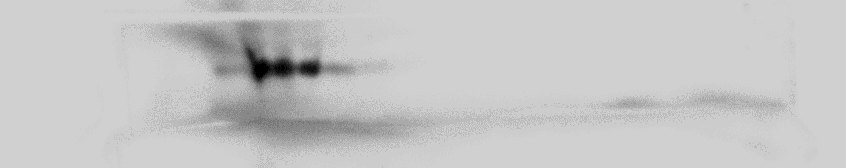
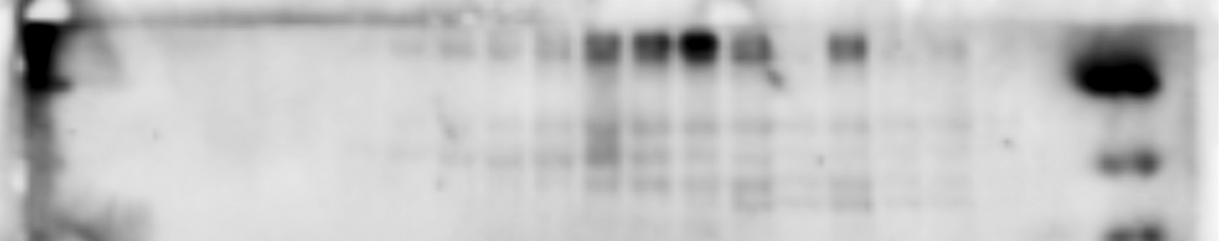
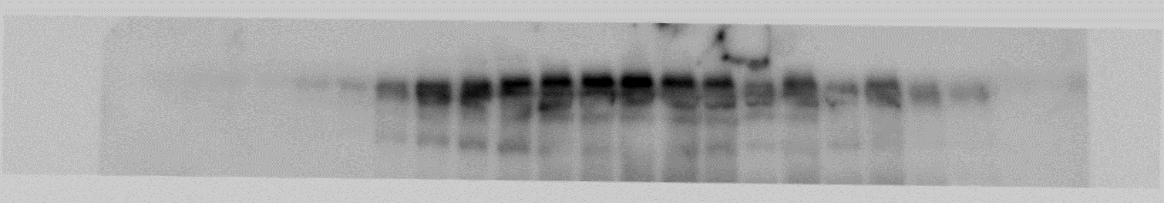
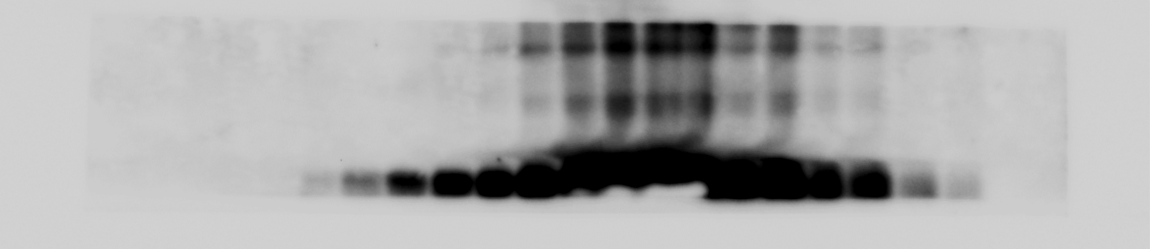
Uncropped blots from Figure 2
b
Fraction
1
2
3
4
5
6
7
8
9
10
11
12
13
14
15
16
17
18
19
Alix
100 kDa
Fraction
1
2
3
4
5
6
7
8
9
10
11
12
13
14
15
16
17
18
19
25 kDa
Cav-1
Fraction
1
2
3
4
5
6
7
8
9
10
11
12
13
14
15
16
17
18
19
25 kDa
CD9
Fraction
1
2
3
4
5
6
7
8
9
10
11
12
13
14
15
16
17
18
19
Ago2
100 kDa
70 kDa
50 kDa
Fraction
1
2
3
4
5
6
7
8
9
10
11
12
13
14
15
16
17
18
19
20
21
Apo-B100
260 kDa
Fraction
1
2
3
4
5
6
7
8
9
10
11
12
13
14
15
16
17
18
19
Apo-A1
25 kDa

Slide 3
Uncropped Blots from Figure 5
b
FoxO1 protein regulation by miRNAs (C2C12 cells)
miRNA (m)
Scramble
miR-122-5p
miR-99b-5p
miR-1a-3p
Insulin
-
-
-
+
+
+
-
-
-
+
+
+
-
-
-
+
+
+
-
-
-
+
+
+
FoxO1
100 kDa
70 kDa
miRNA (m)
Scramble
let-7f-5p
let-7a-5p
miR-203-3p
Insulin
-
-
-
+
+
+
-
-
-
+
+
+
-
-
-
+
+
+
-
-
-
+
+
+
FoxO1
100 kDa
70 kDa
miRNA (m)
Scramble
miR-20a-3p
miR-21a-5p
miR-22-3p
Insulin
-
-
-
+
+
+
-
-
-
+
+
+
-
-
-
+
+
+
-
-
-
+
+
+
100 kDa
FoxO1
70 kDa
g
Scramble
miR-1a-3p
PGC1α
PGC1α
CV
(100 kDa)
CIII
(50 kDa)
CIV
(35 kDa)
CII
CI
(15 kDa)

Slide 4
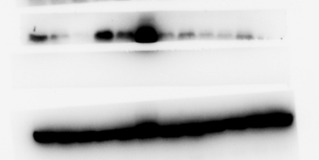
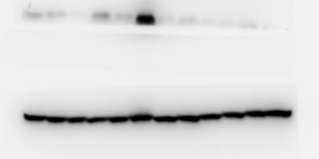
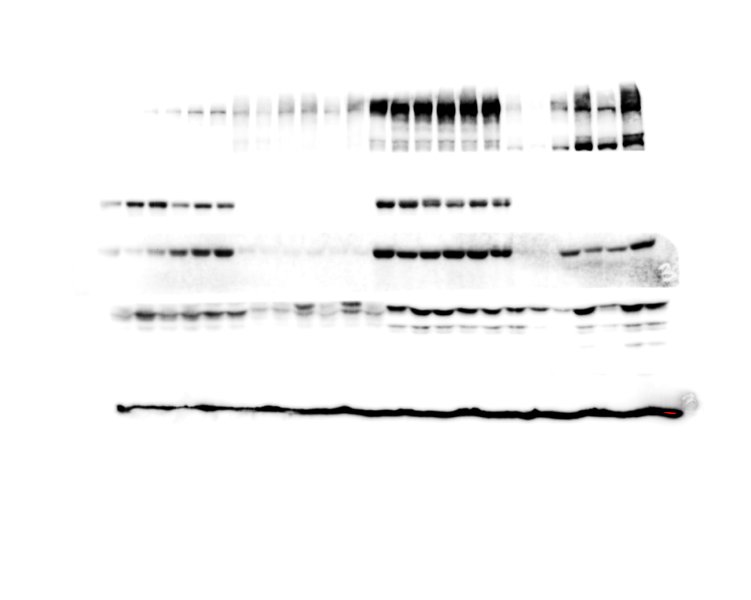
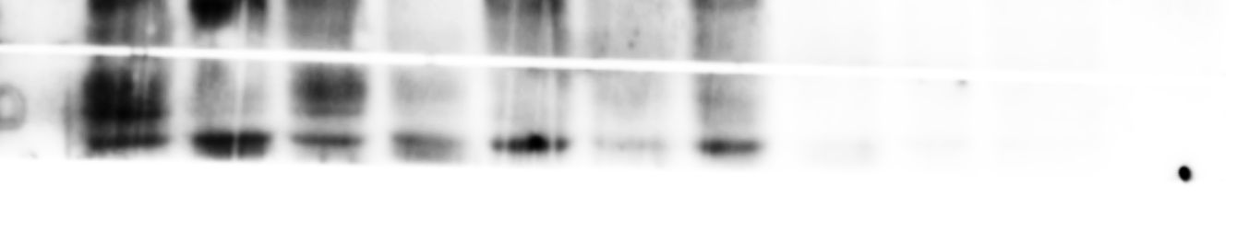
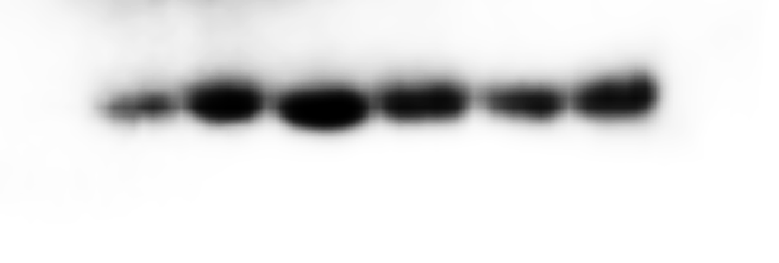
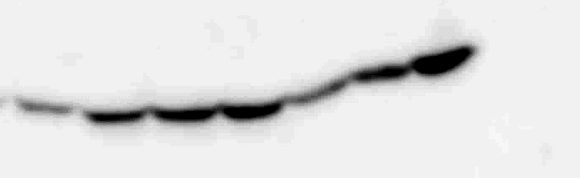
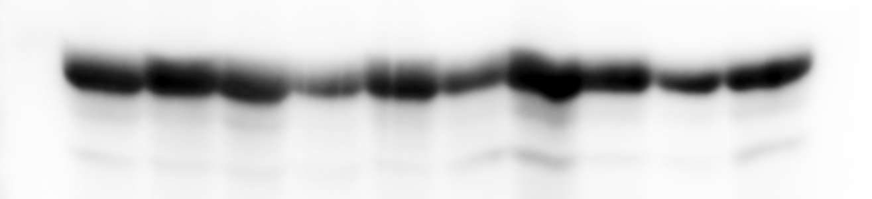
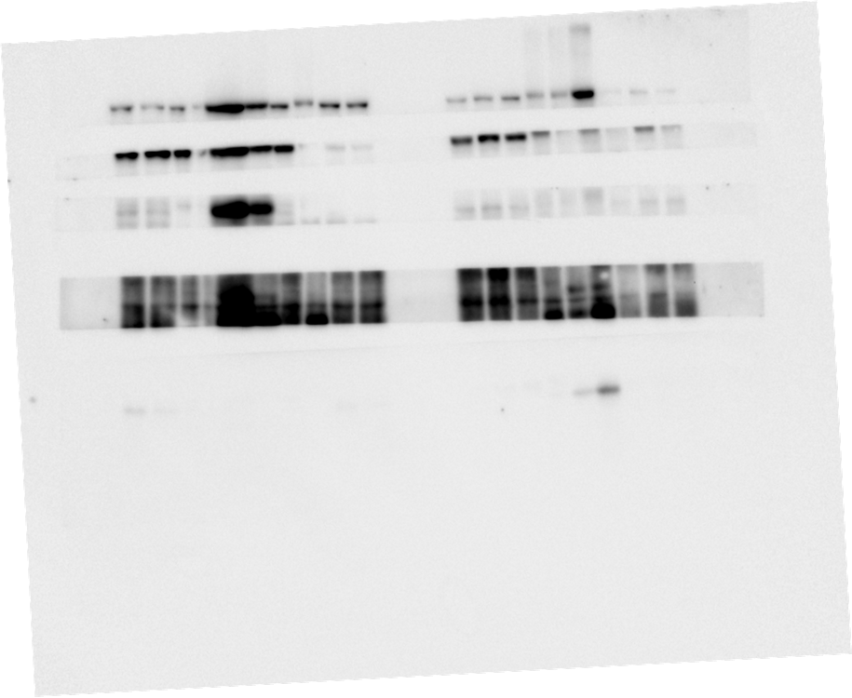
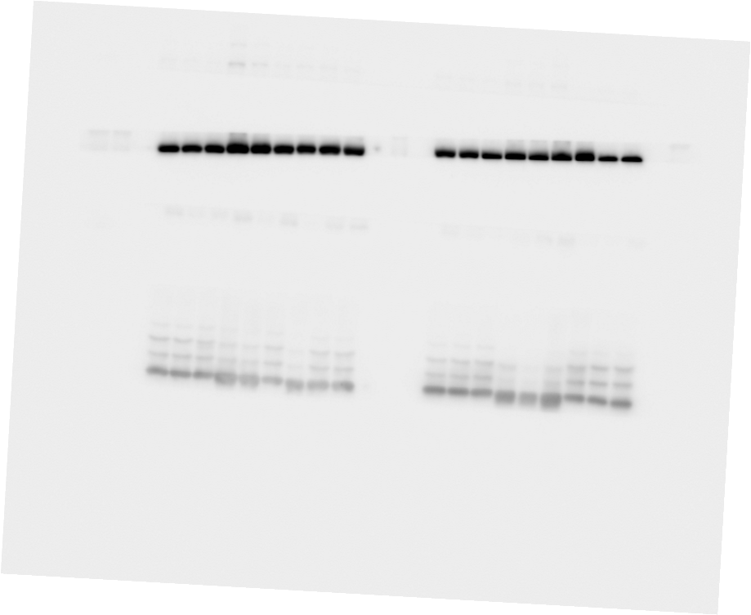
Uncropped blots from Figure 6
f
Longer exposure
Shorter exposure
WT
BAT;DicerKO
WT
BAT;DicerKO
Sal
INS
Sal
INS
Sal
INS
Sal
INS
p-Akt (S473)
p-Akt (S473)
(50 kDa)
(50 kDa)
Akt
(50 kDa)
Akt
(50 kDa)
h
WT
BAT;
DicerKO
WT
BAT;
DicerKO
p-AMPKα
PGC1α
(50 kDa)
(100 kDa)
AMPKα
(50 kDa)
CV (50 kDa)
FoxO1
CIV
(70 kDa)
(35 kDa)
(40 kDa)
CII
β-actin
CI
(15 kDa)
GAPDH
(40 kDa)
Uncropped blots from Figure 7
BAT;DicerKO
WT
Scr.
miR-1
100 kDa
FoxO1
70 kDa
(40 kDa)
GAPDH

Slide 5
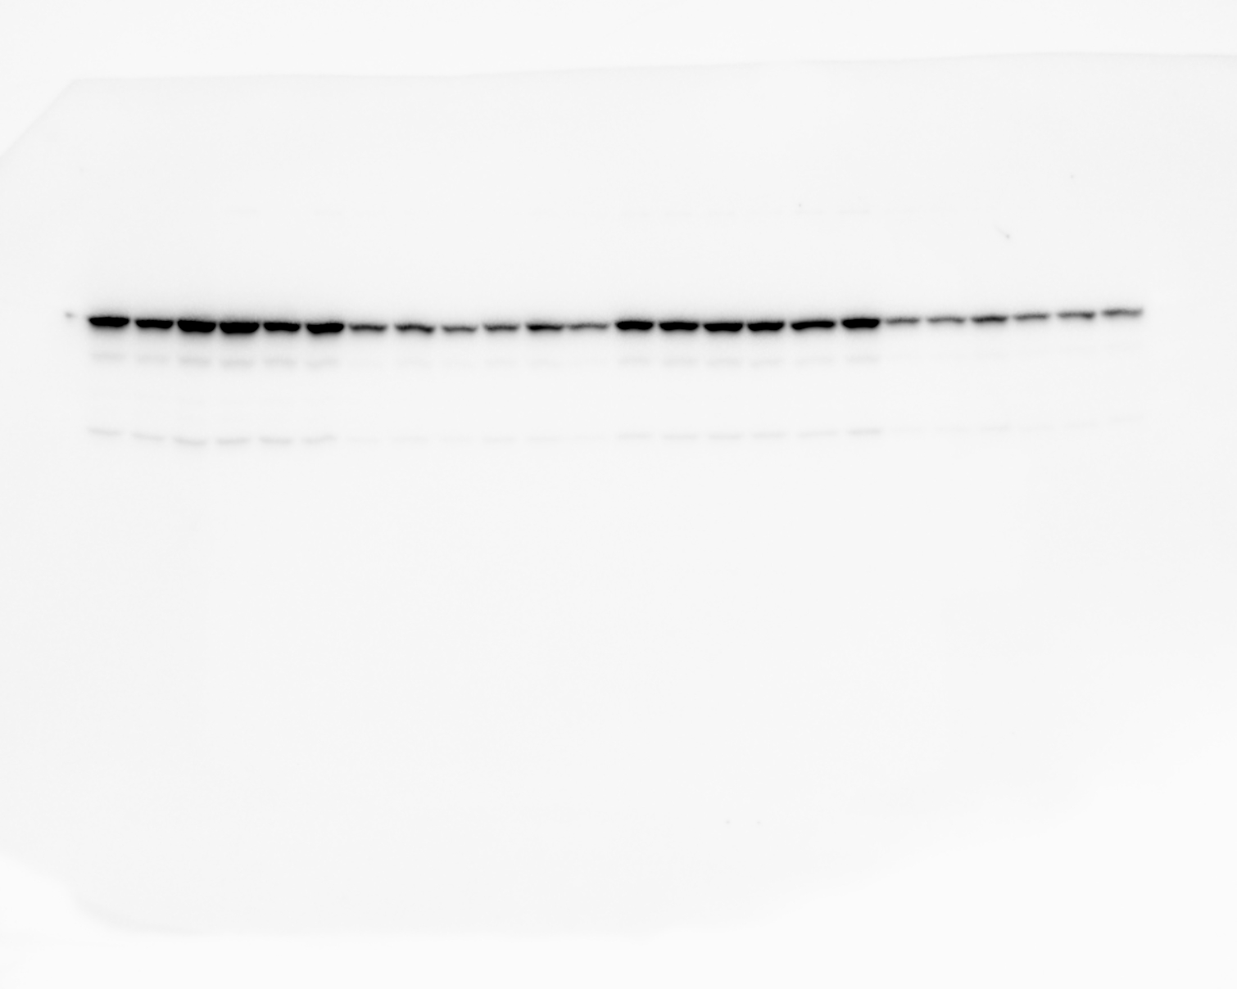
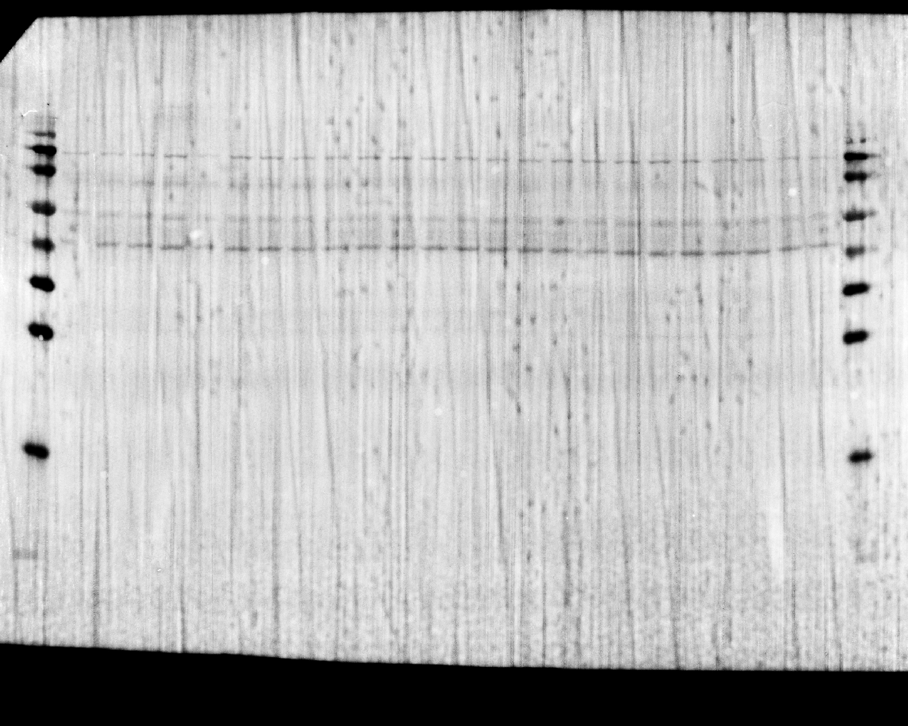
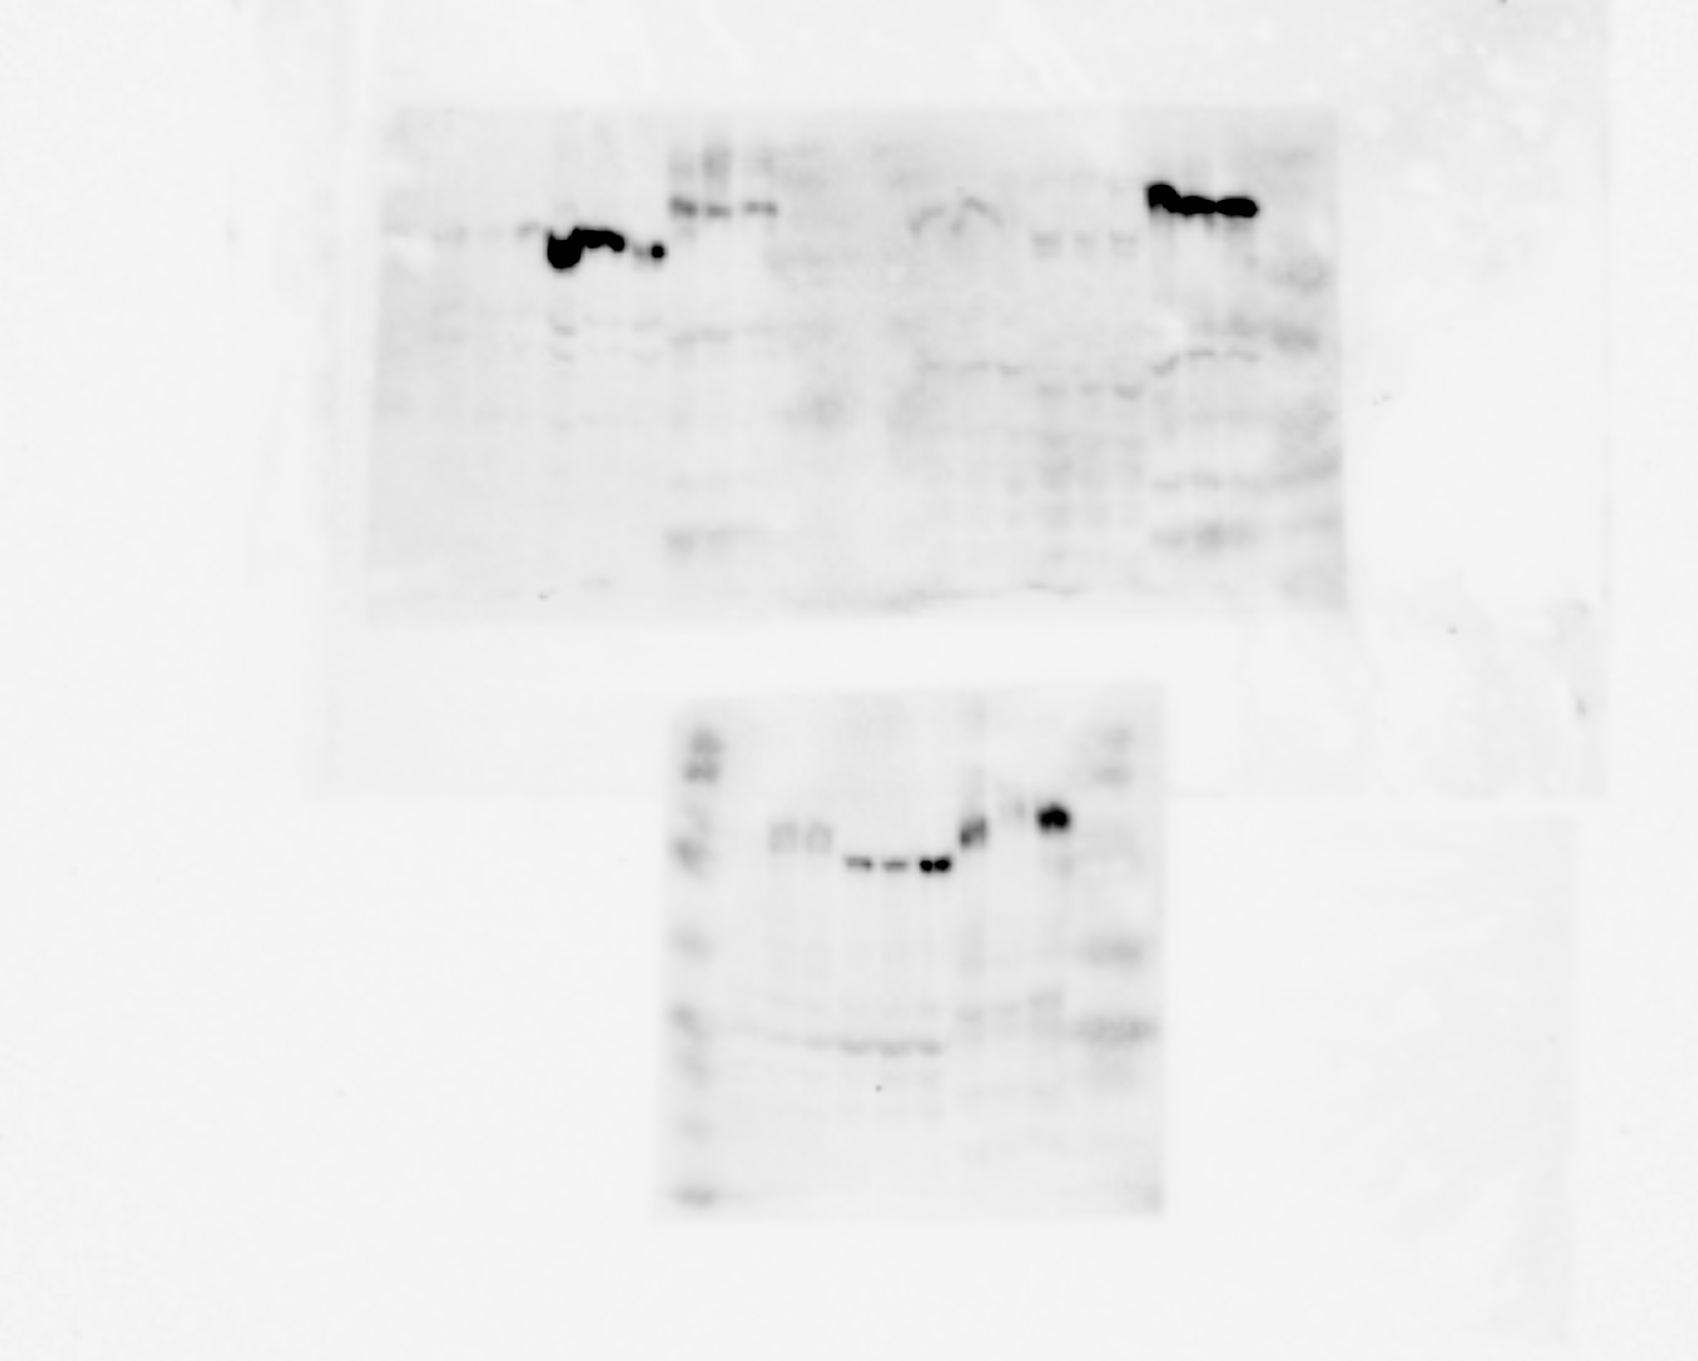
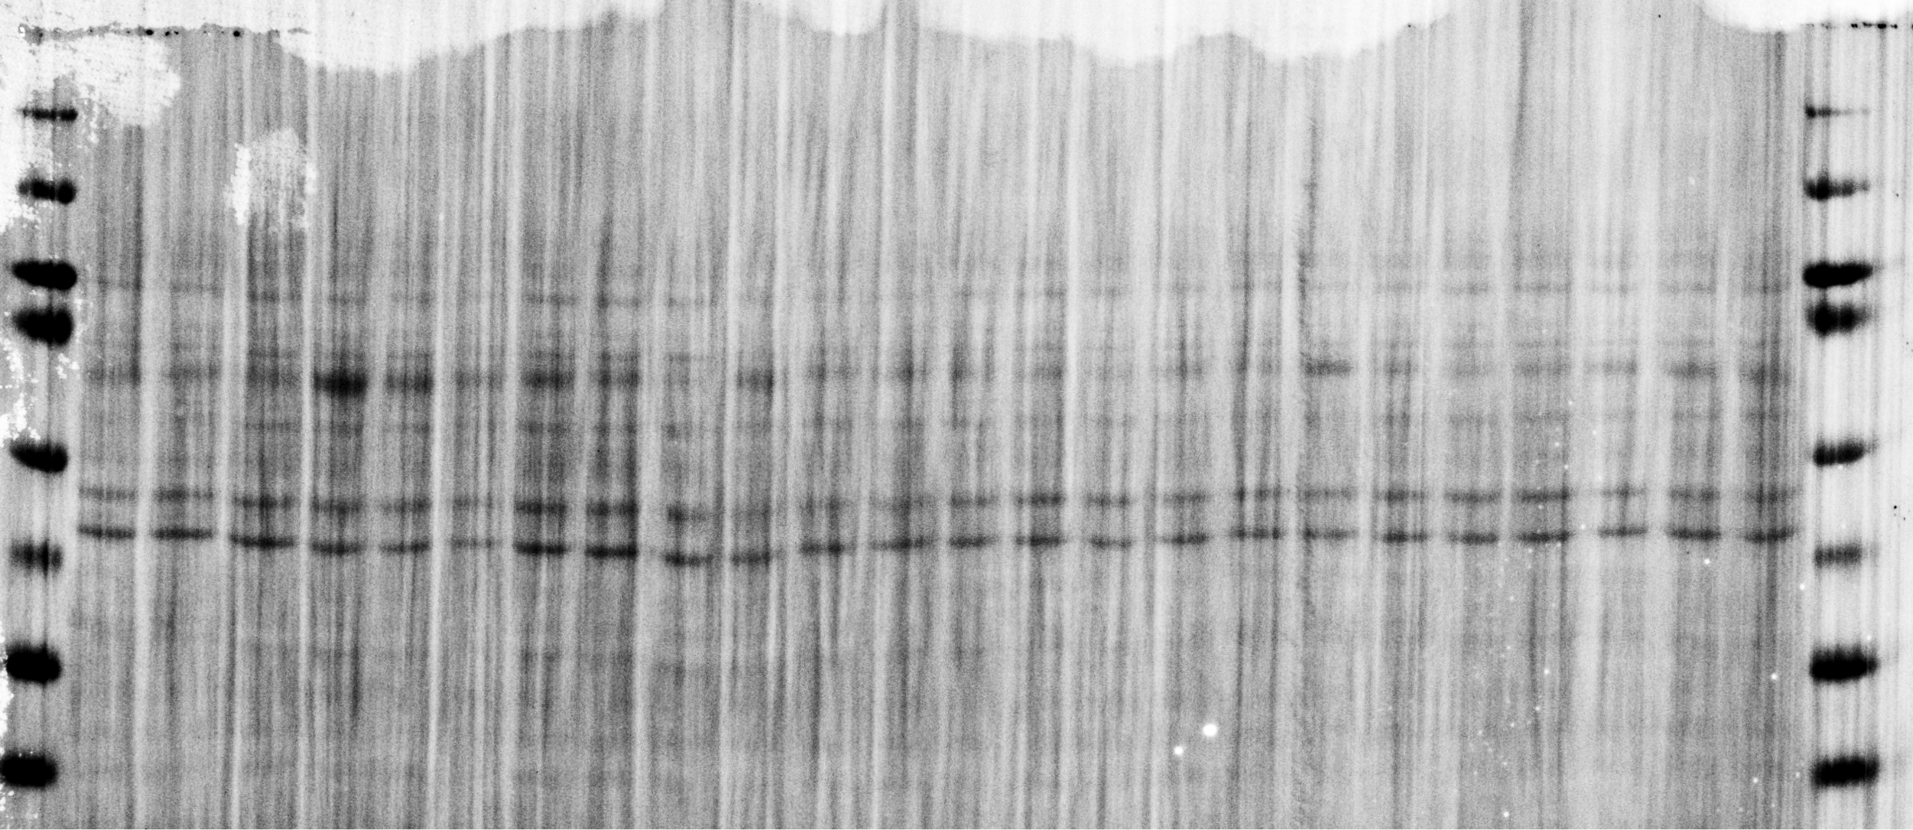
Uncropped Blots from Figure S8
b
Scramble
miR-1a-3p
Scramble
miR-1a-3p
Scramble
miR-1a-3p
Scramble
miR-1a-3p
140 kDa
70 kDa
100 kDa
70 kDa
50 kDa
40 kDa
35 kDa
25 kDa
Luciferase
Ponceau S
c
Ago2 pulldown (PD) with FLAG-T6B peptide
Flag-beads
T6B peptide
Flag-beads
T6B peptide
100 kDa
70 kDa
50 kDa
40 kDa
35 kDa
Ago2
Ponceau

