Slide 1
New Port Richey fulgurite
Analytical Request and Scan Parameters
The sample was fixed on the sample holder with dental wax
The entire volume was scanned in one field of view to visualize pores and different density phases inside the sample
The Paganin Phase Retrieval algorithm was applied to the projection images to enhance the different density feature inside the sample
Scan Parameters
Dataset name | Sample 3 - Mineral - FP_
Voxel size (µm) | 2.4 (Flat panel)
Voltage (kV) | 111
Filter | NA
Spot size | Medium
Scan type | Round
Rotation – Step (°) | 360 – 0.4°
Total scan time | 4h:14m
Field of View (mm) | 7 x 7 x 4
Projection image

Slide 2
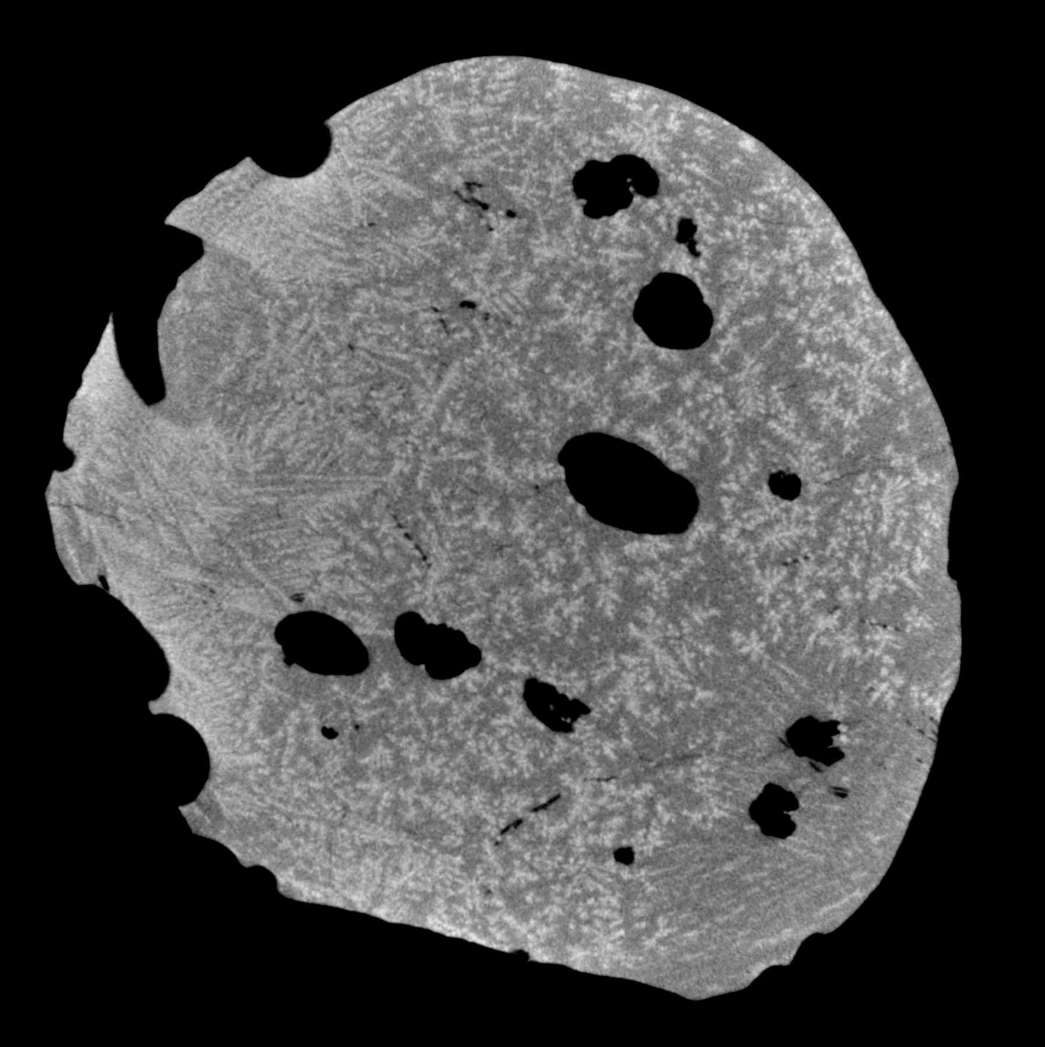
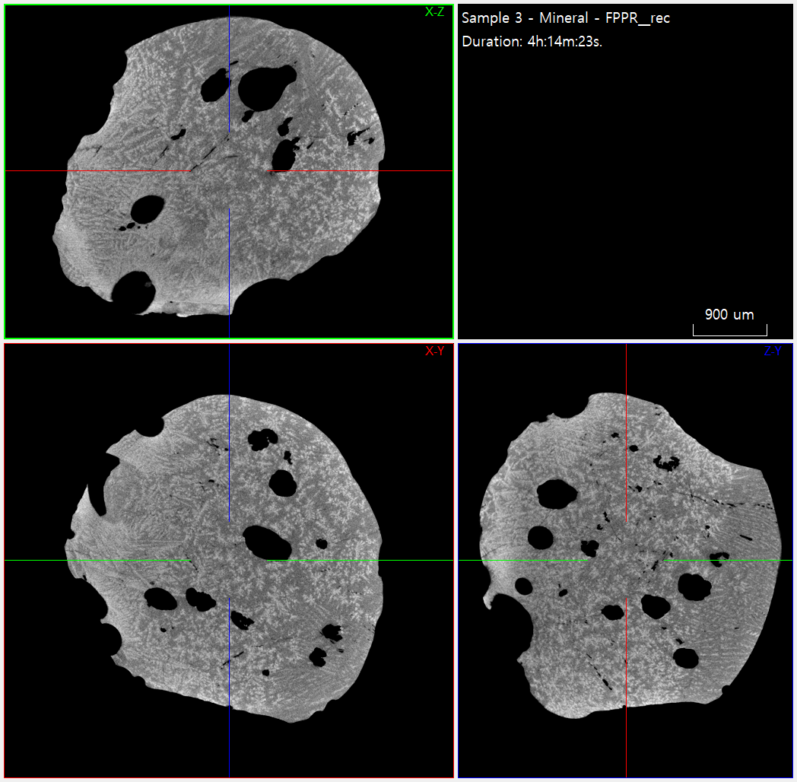
New Port Richey fulgurite

Slide 3
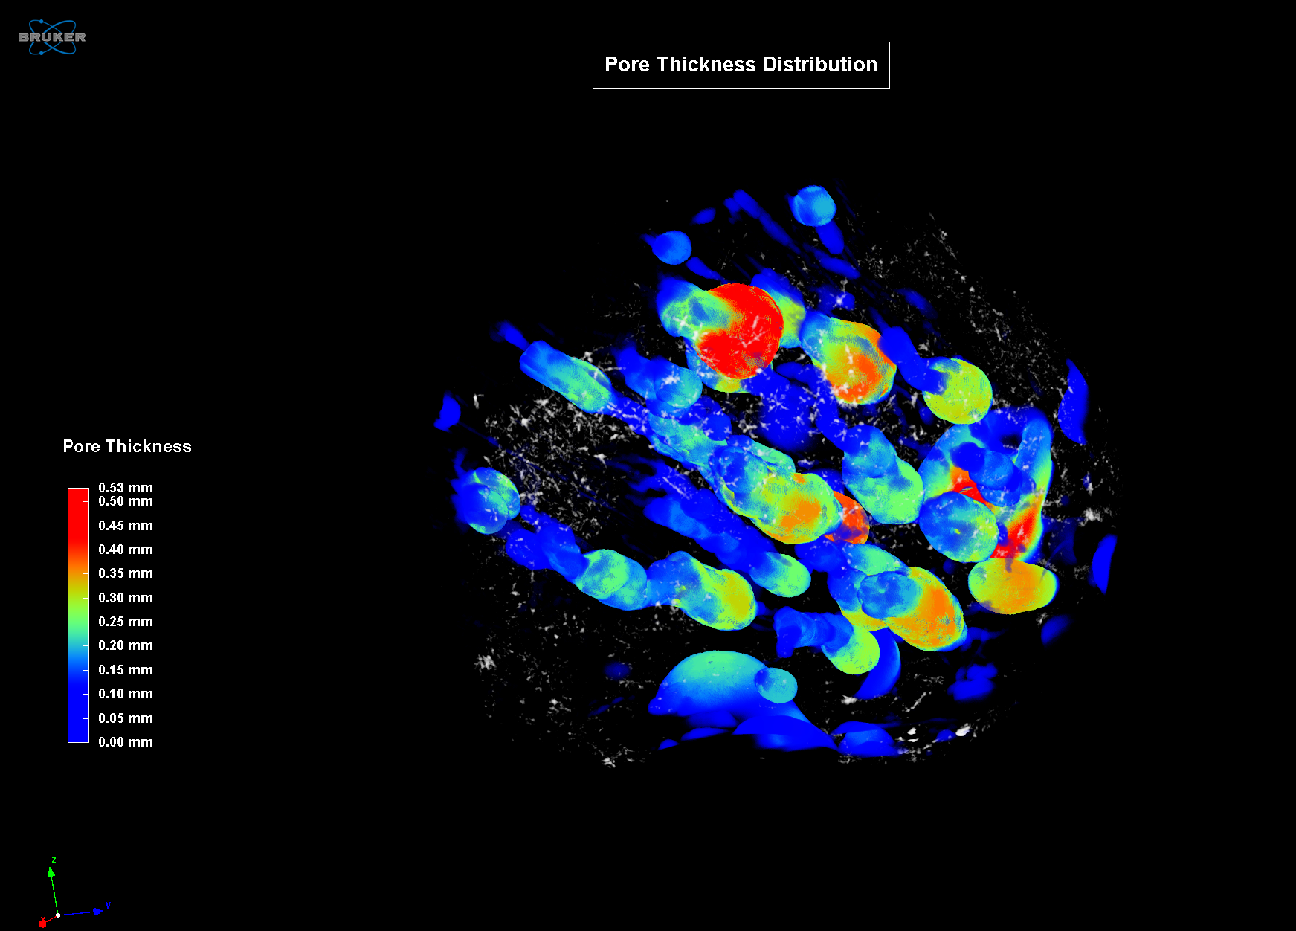
New Port Richey fulgurite
Pore Thickness Analysis
The video on the right shows the colour-coded 3D thickness distribution of the pore network inside the cement sample
Below is a thickness distribution plot of the analysis

Slide 4
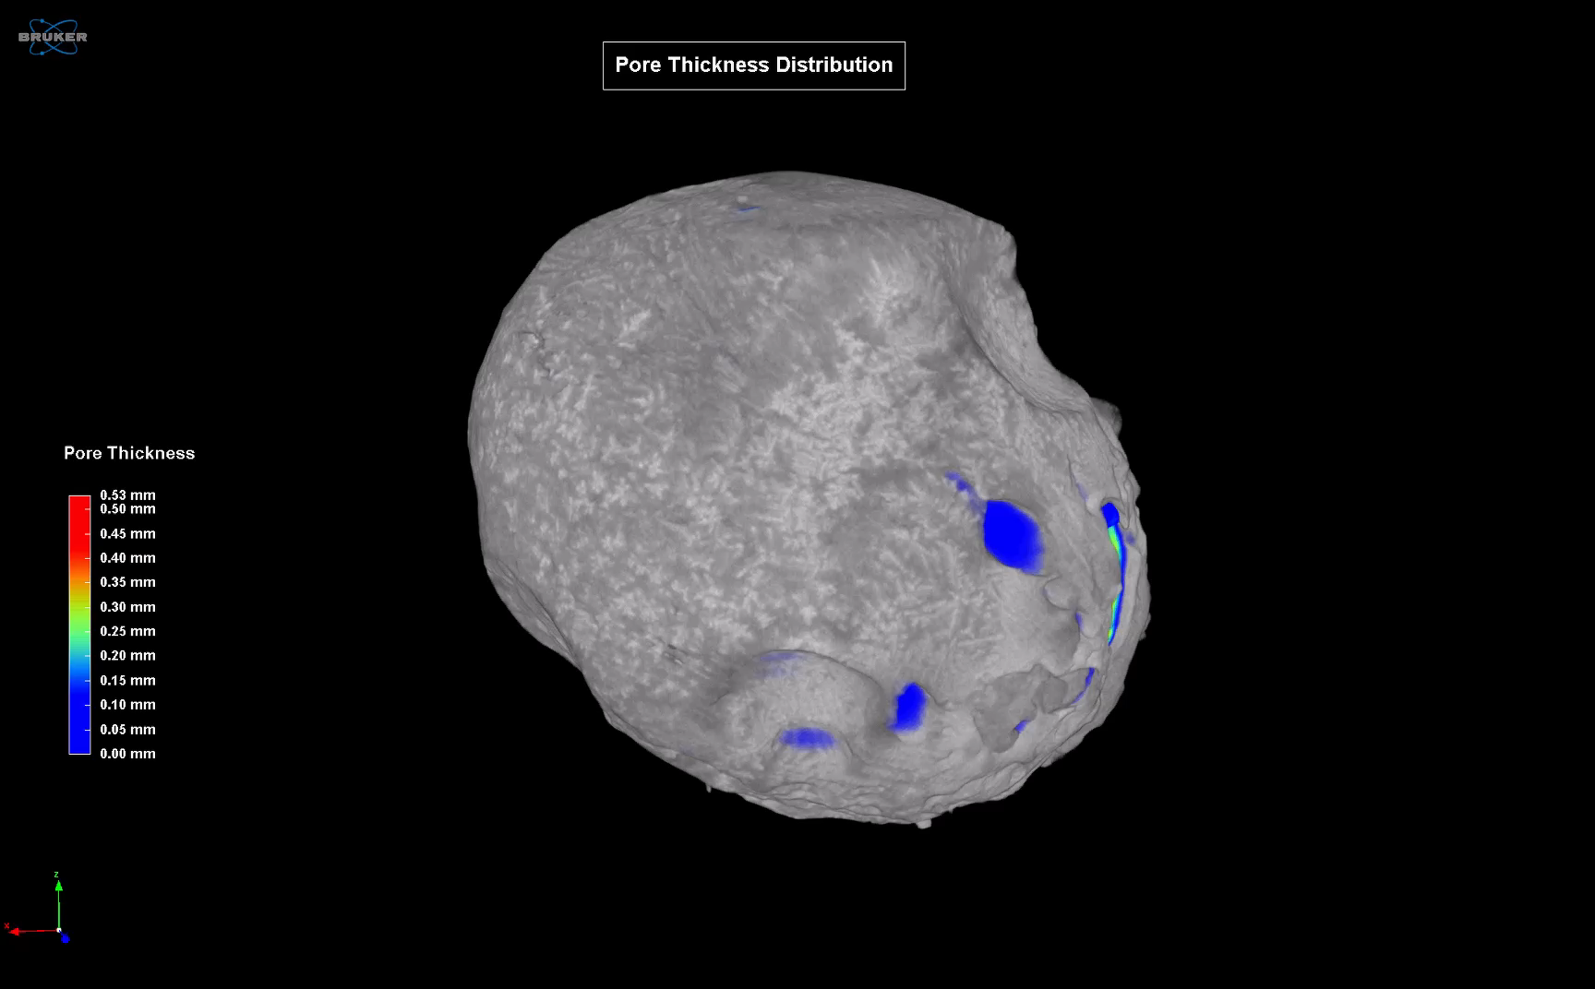
New Port Richey fulgurite
3D Video

