Slide 1
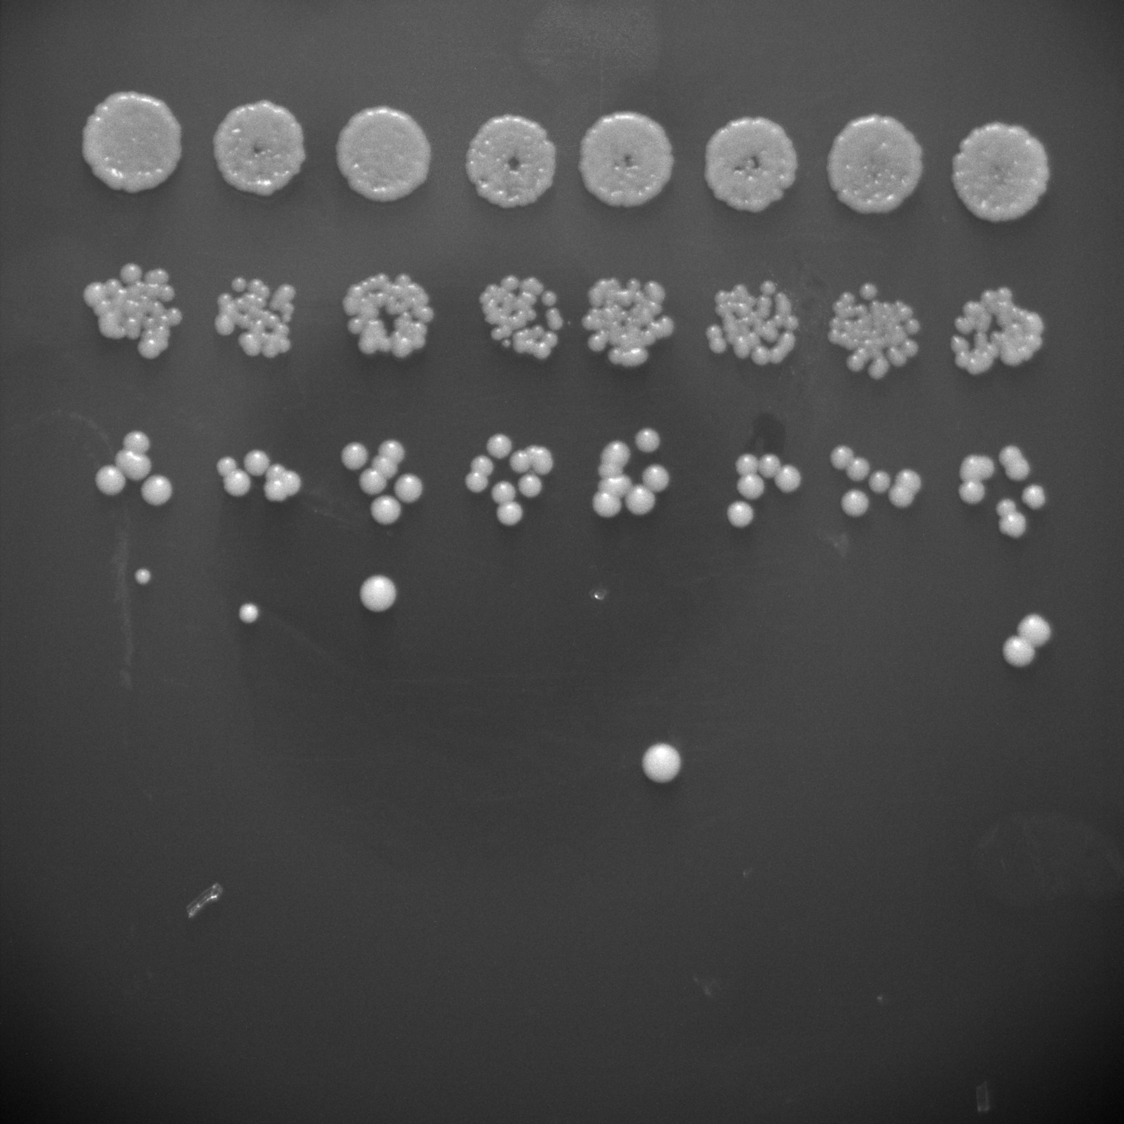
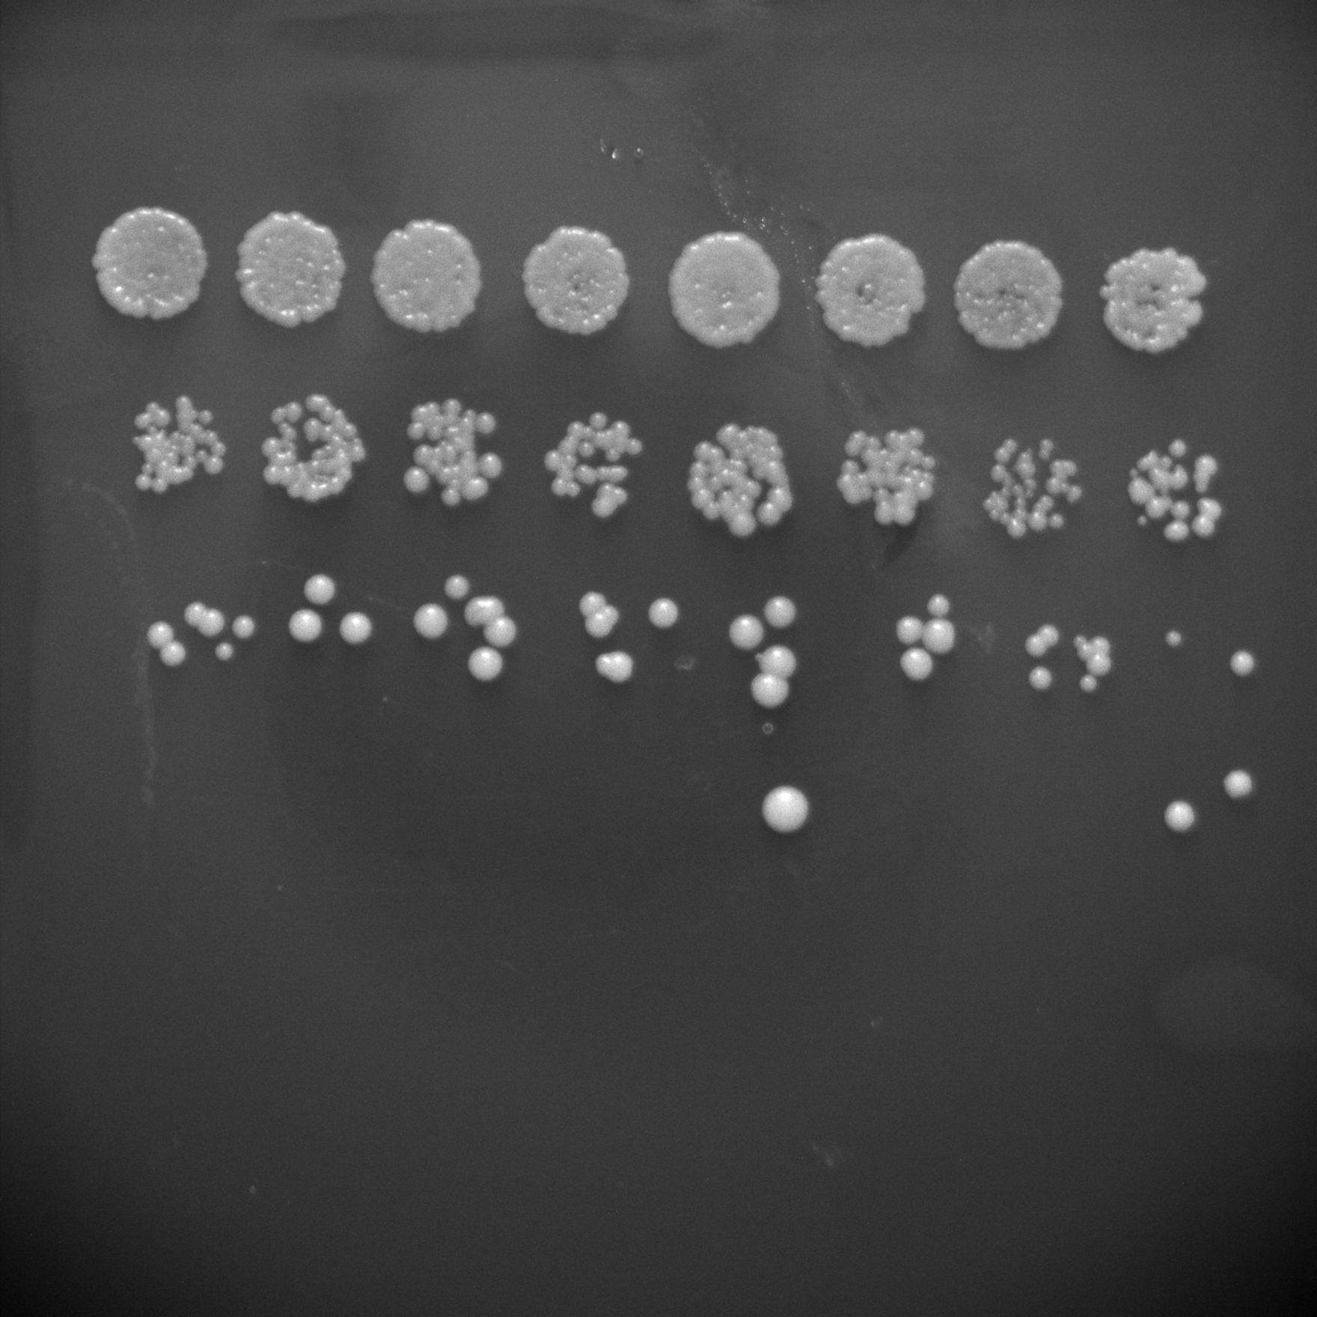
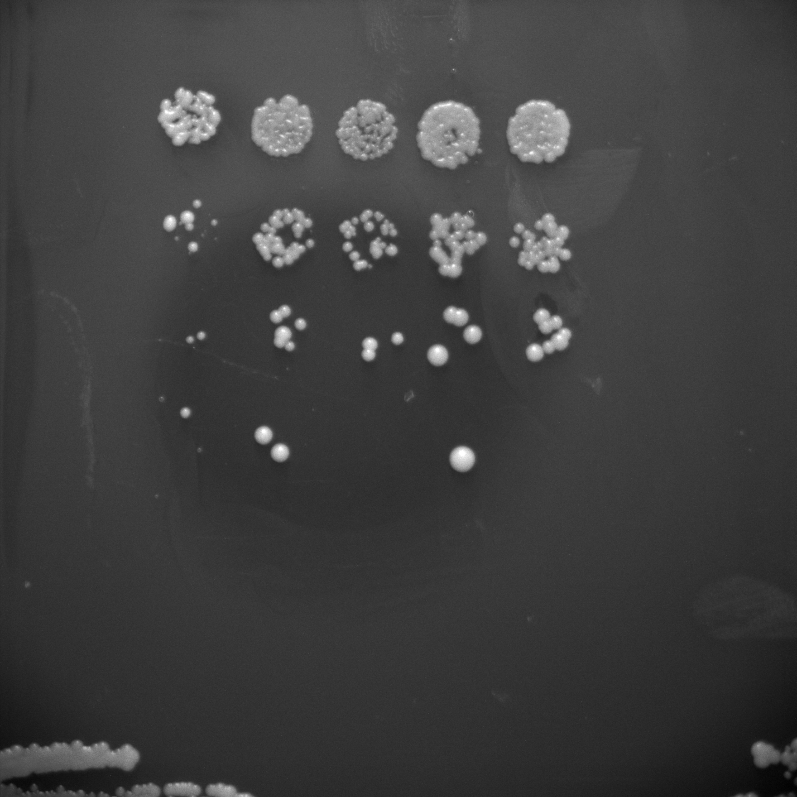
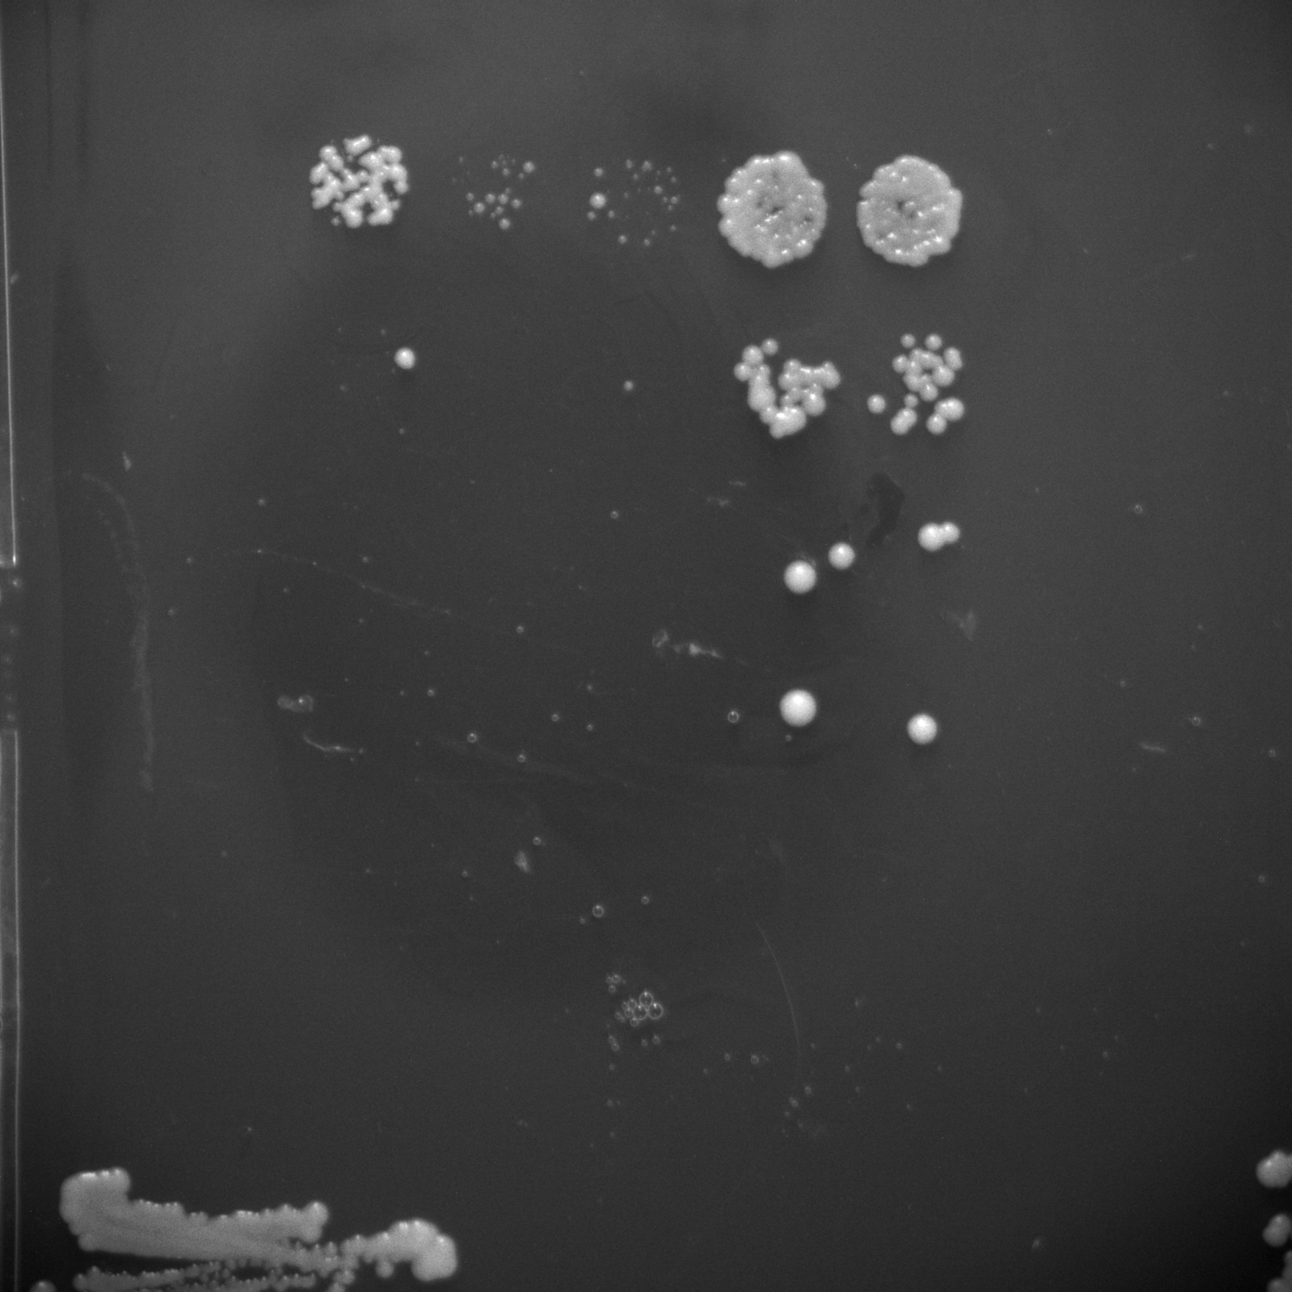
 | LE9x3 |  | DC5x1 |  | SIMOx1 |  | DC5x3
PAX6 | - | + | - | + | - | + | - | +
 | LE9x3 |  | DC5x1 |  | SIMOx1 |  | DC5x3
PAX6 | - | + | - | + | - | + | - | +
 | LE9x3 |  | DC5x1 |  | SIMOx1 |  | DC5x3
PAX6 | - | + | - | + | - | + | - | +
 | LE9x3 |  | DC5x1 |  | SIMOx1 |  | DC5x3
PAX6 | - | + | - | + | - | + | - | +
10-fold Serial Dilution
0ug/ml Geneticin Plate
200ug/ml Geneticin Plate
400ug/ml Geneticin Plate
800ug/ml Geneticin Plate

Slide 2
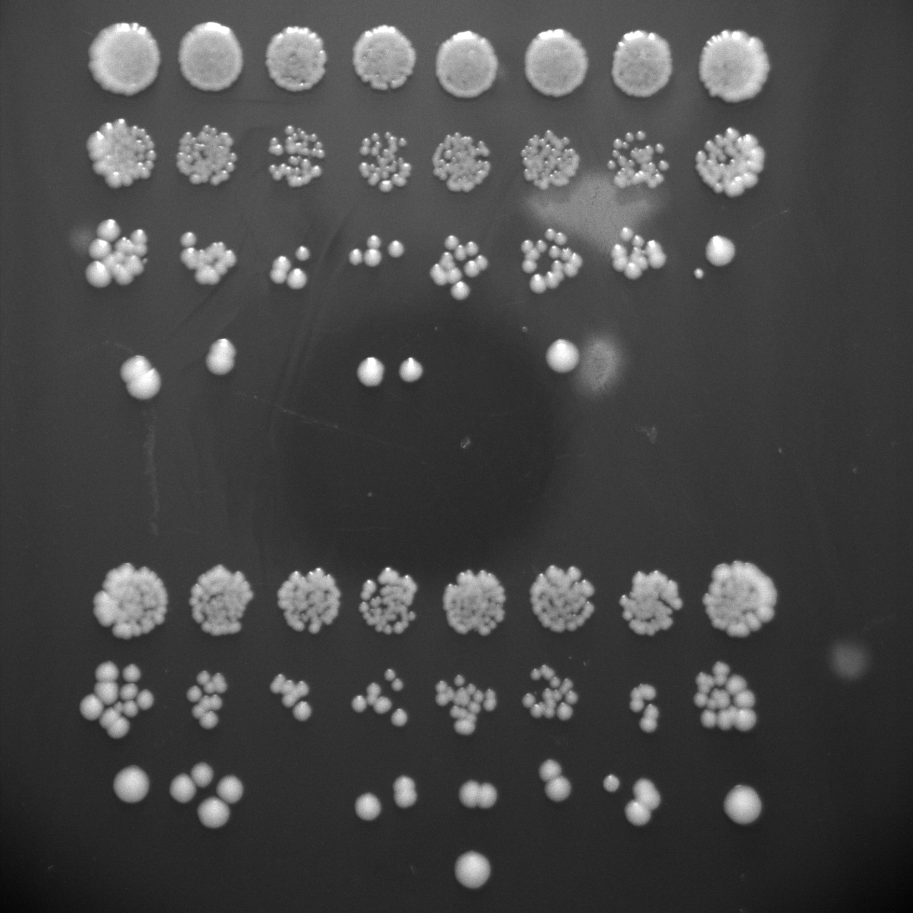
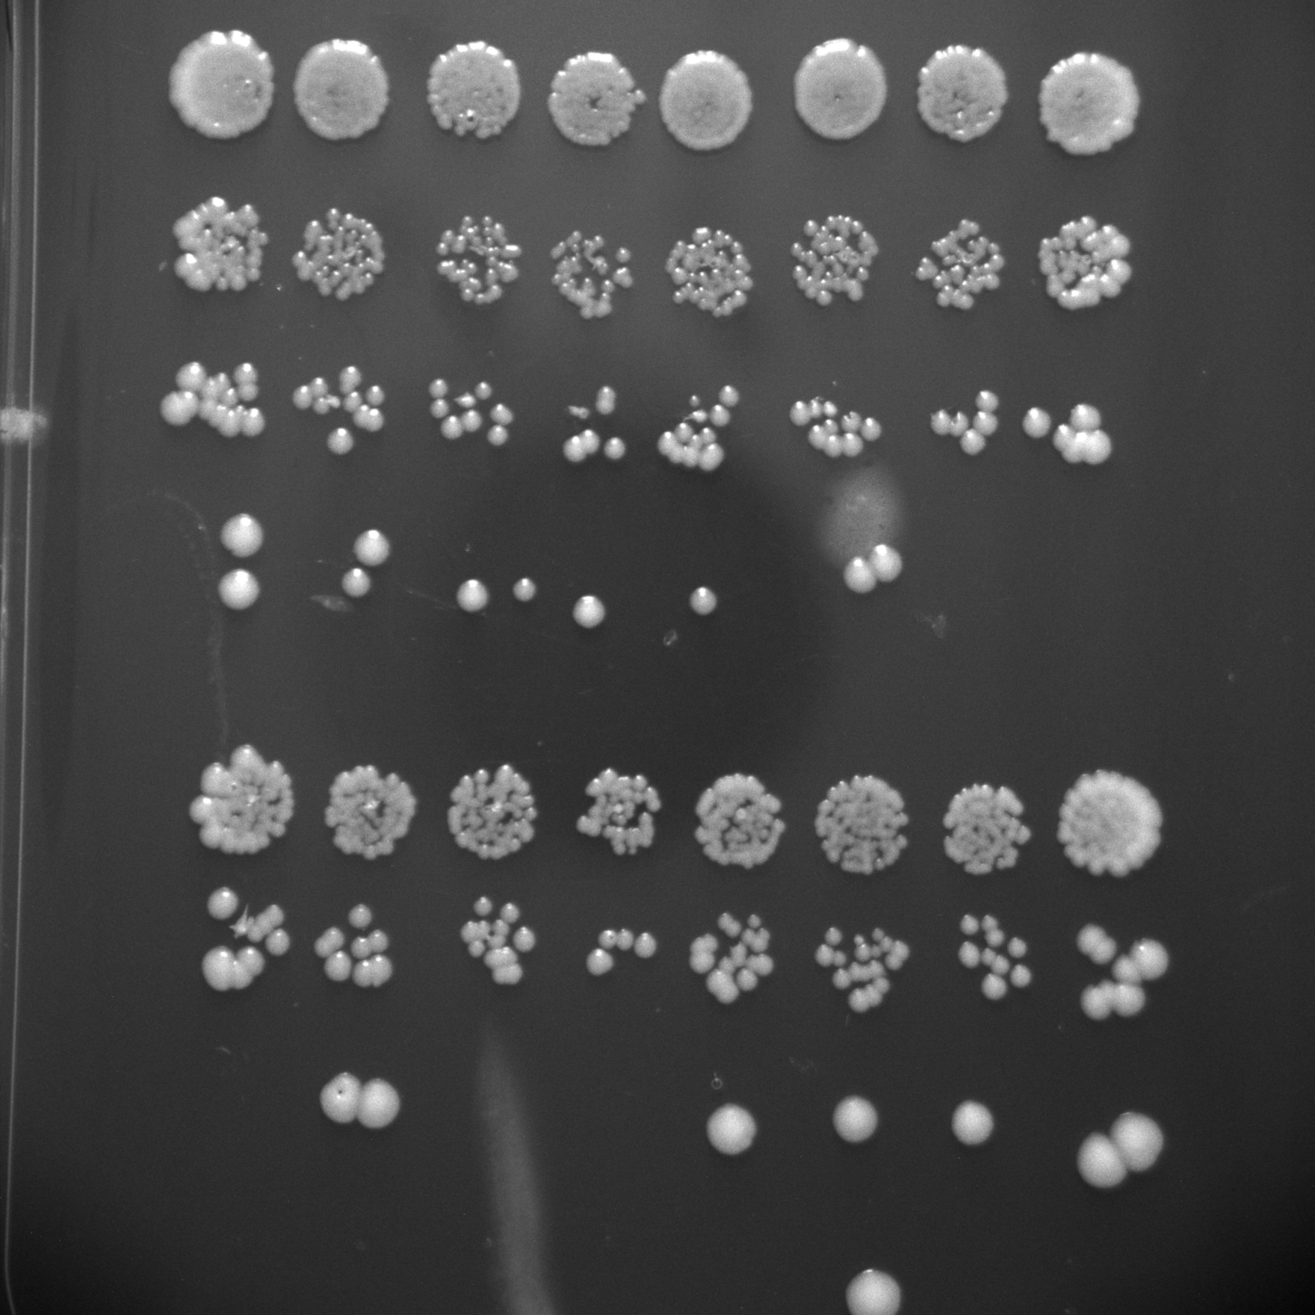
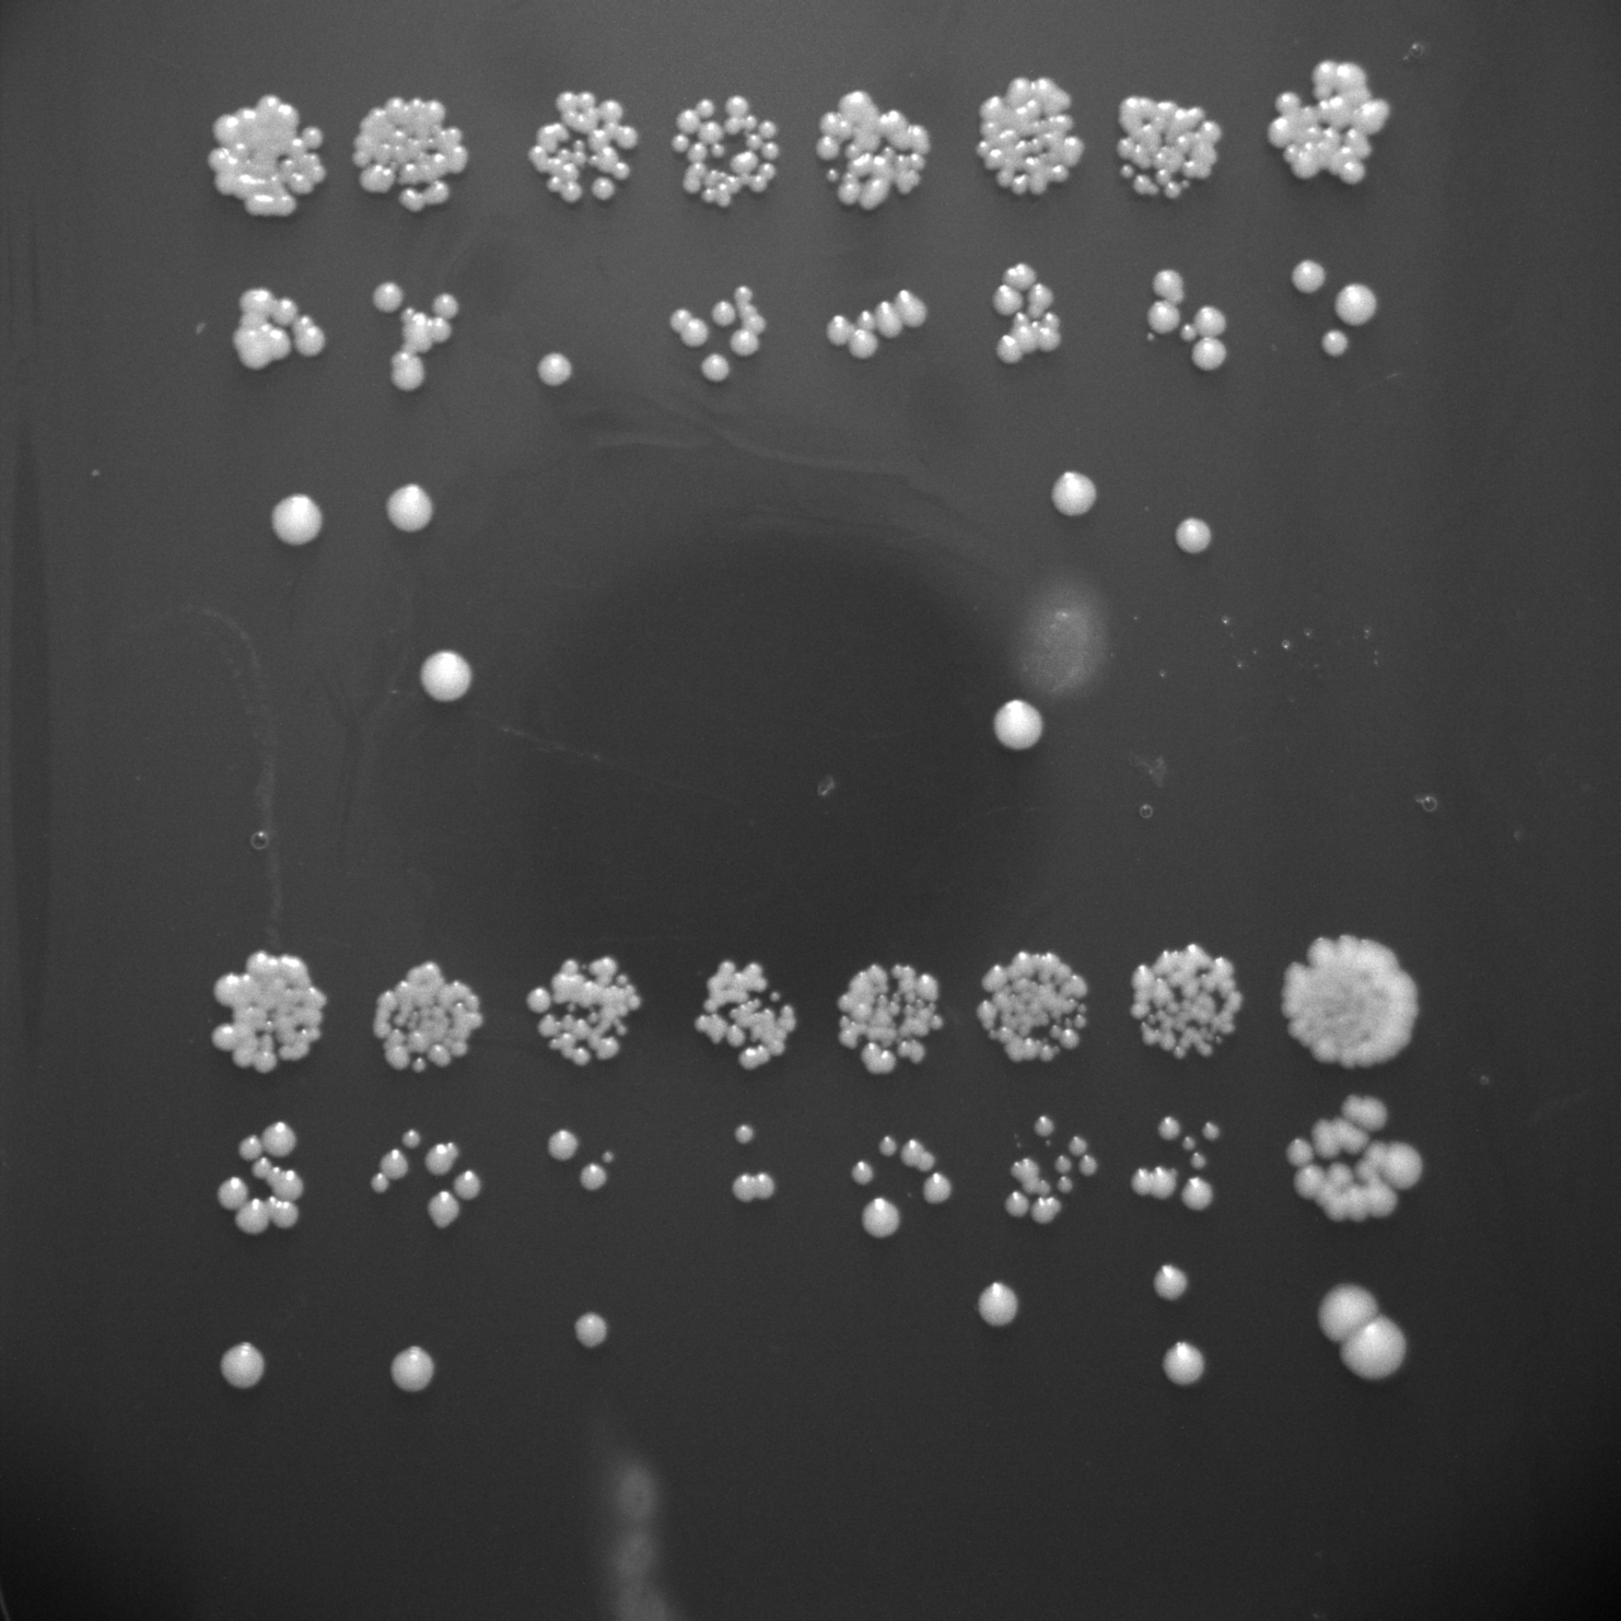
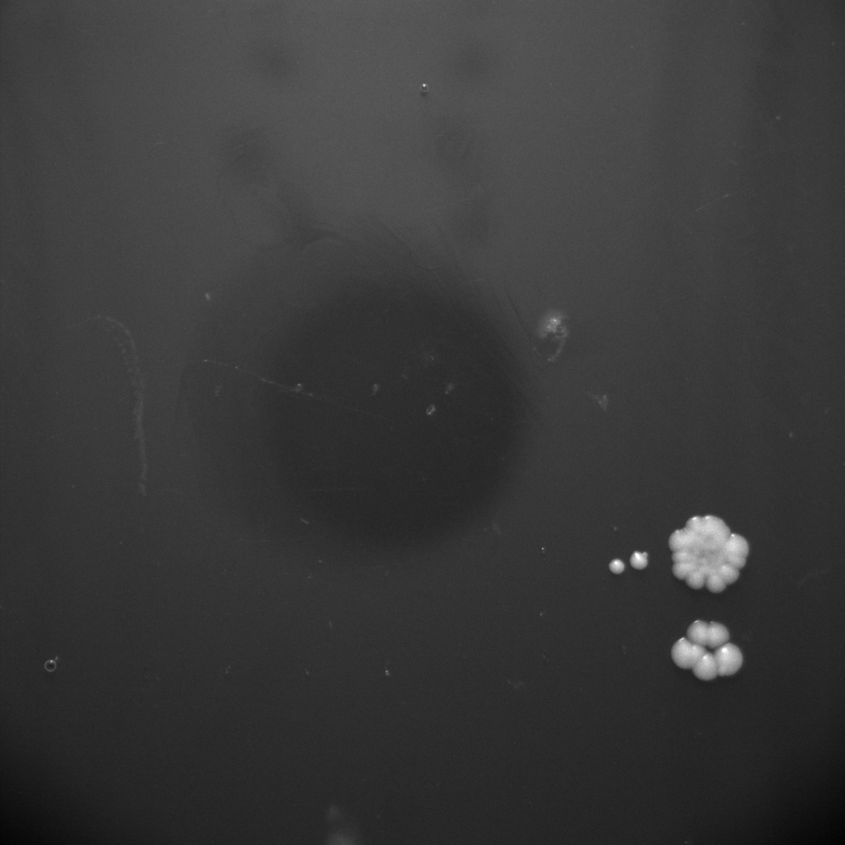
 | SIMOx3 |  | N-3 x1 |  | N-3 x3
PAX6 | - | + | - | + | - | +
 | SIMOx3 |  | N-3 x1 |  | N-3 x3
PAX6 | - | + | - | + | - | +
 | SIMOx3 |  | N-3 x1 |  | N-3 x3
PAX6 | - | + | - | + | - | +
 | SIMOx3 |  | N-3 x1 |  | N-3 x3
PAX6 | - | + | - | + | - | +
10-fold Serial Dilution
10-fold Serial Dilution
0ug/ml Geneticin Plate
200ug/ml Geneticin Plate
400ug/ml Geneticin Plate
800ug/ml Geneticin Plate

Slide 3
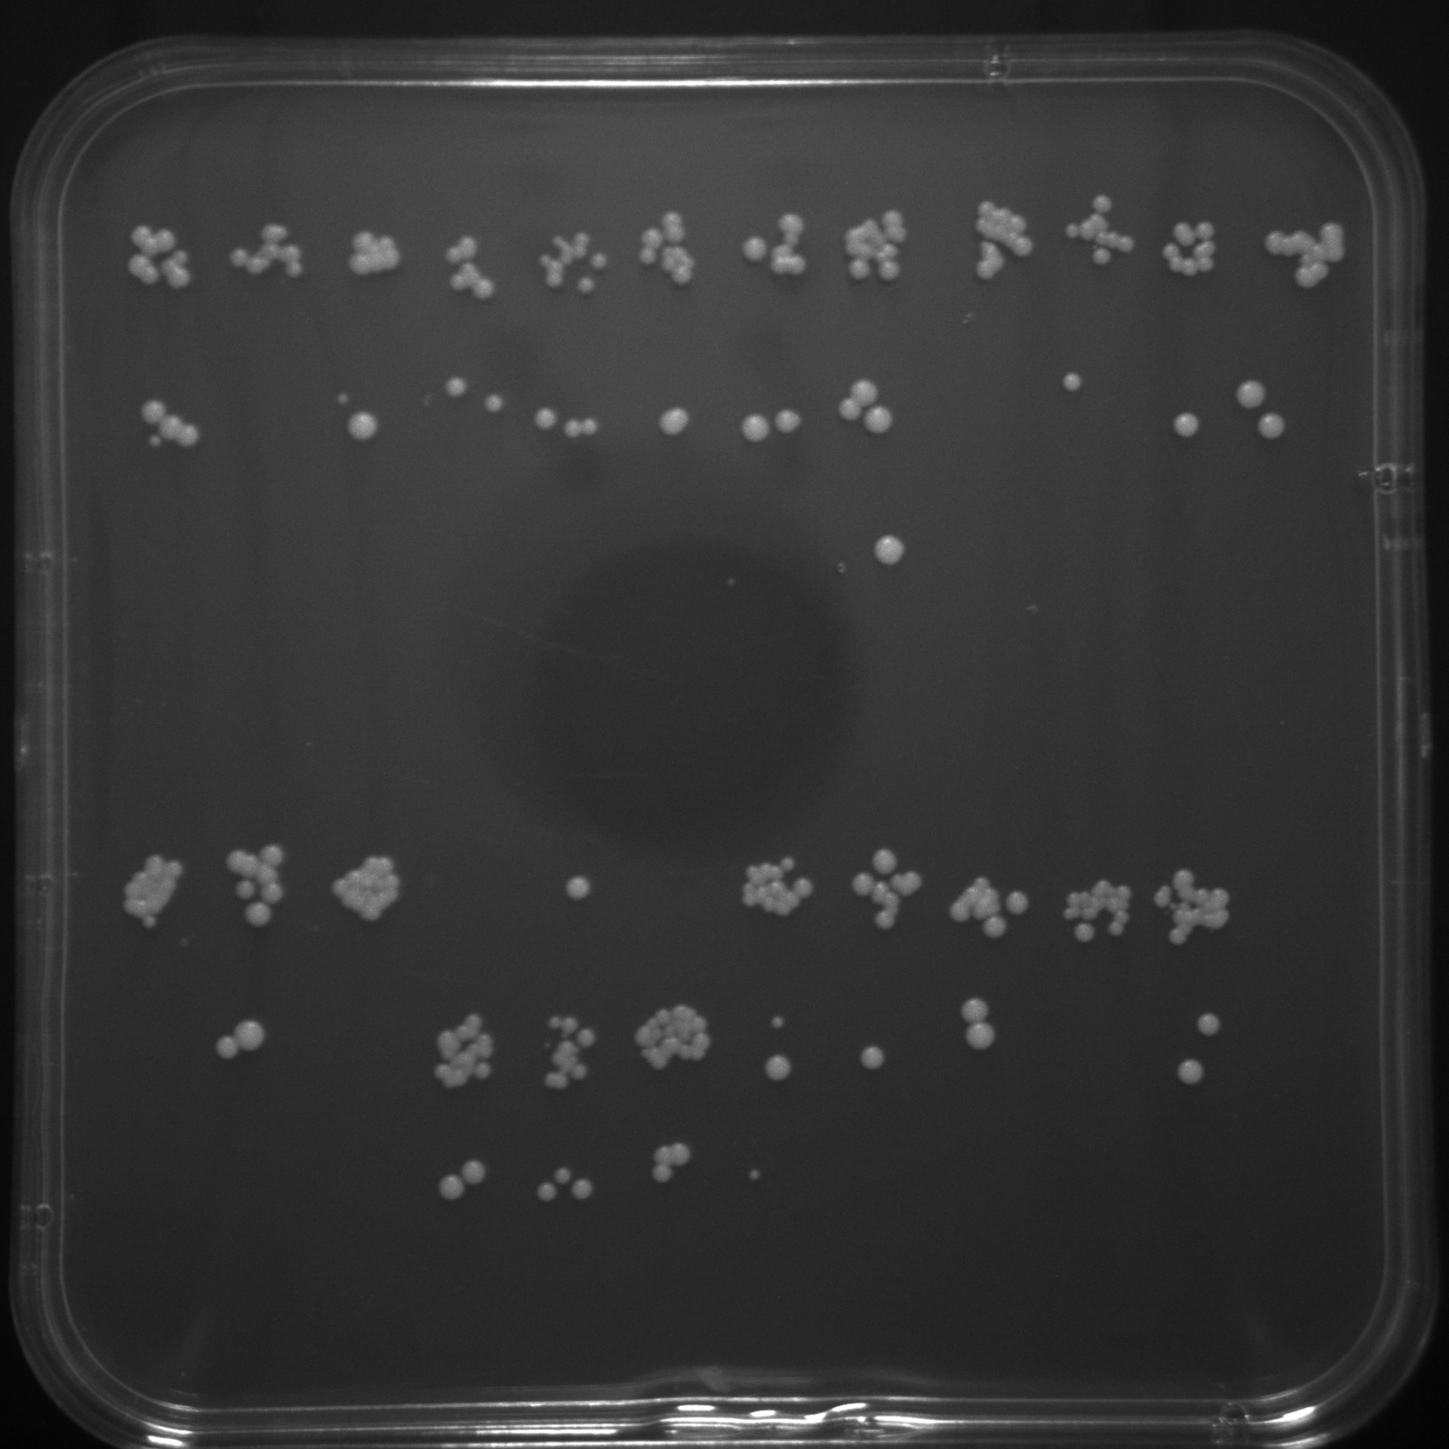
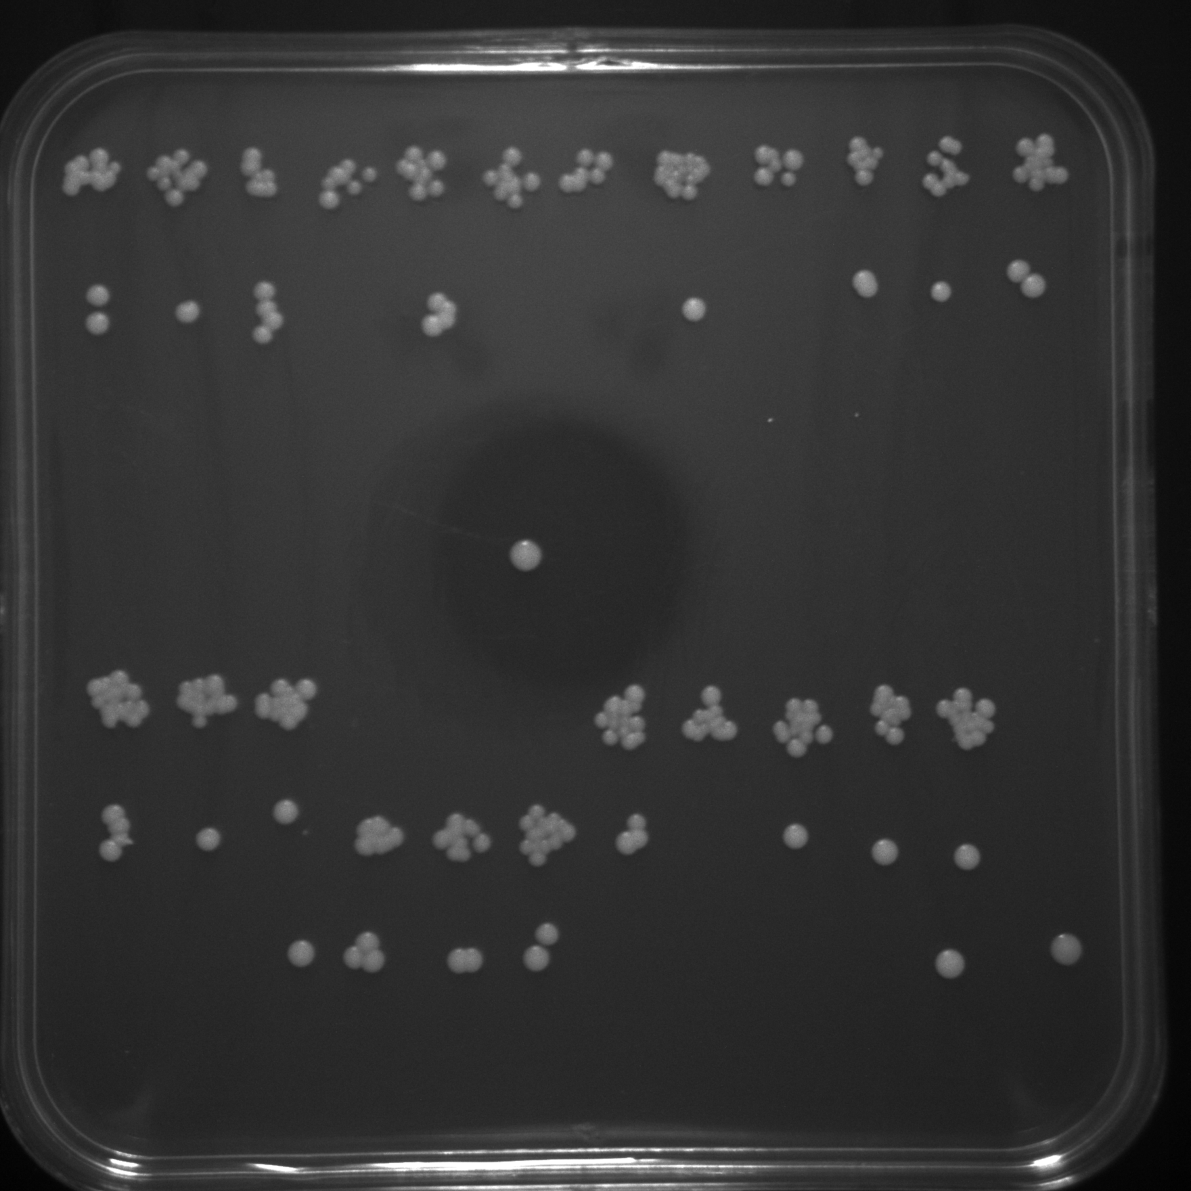
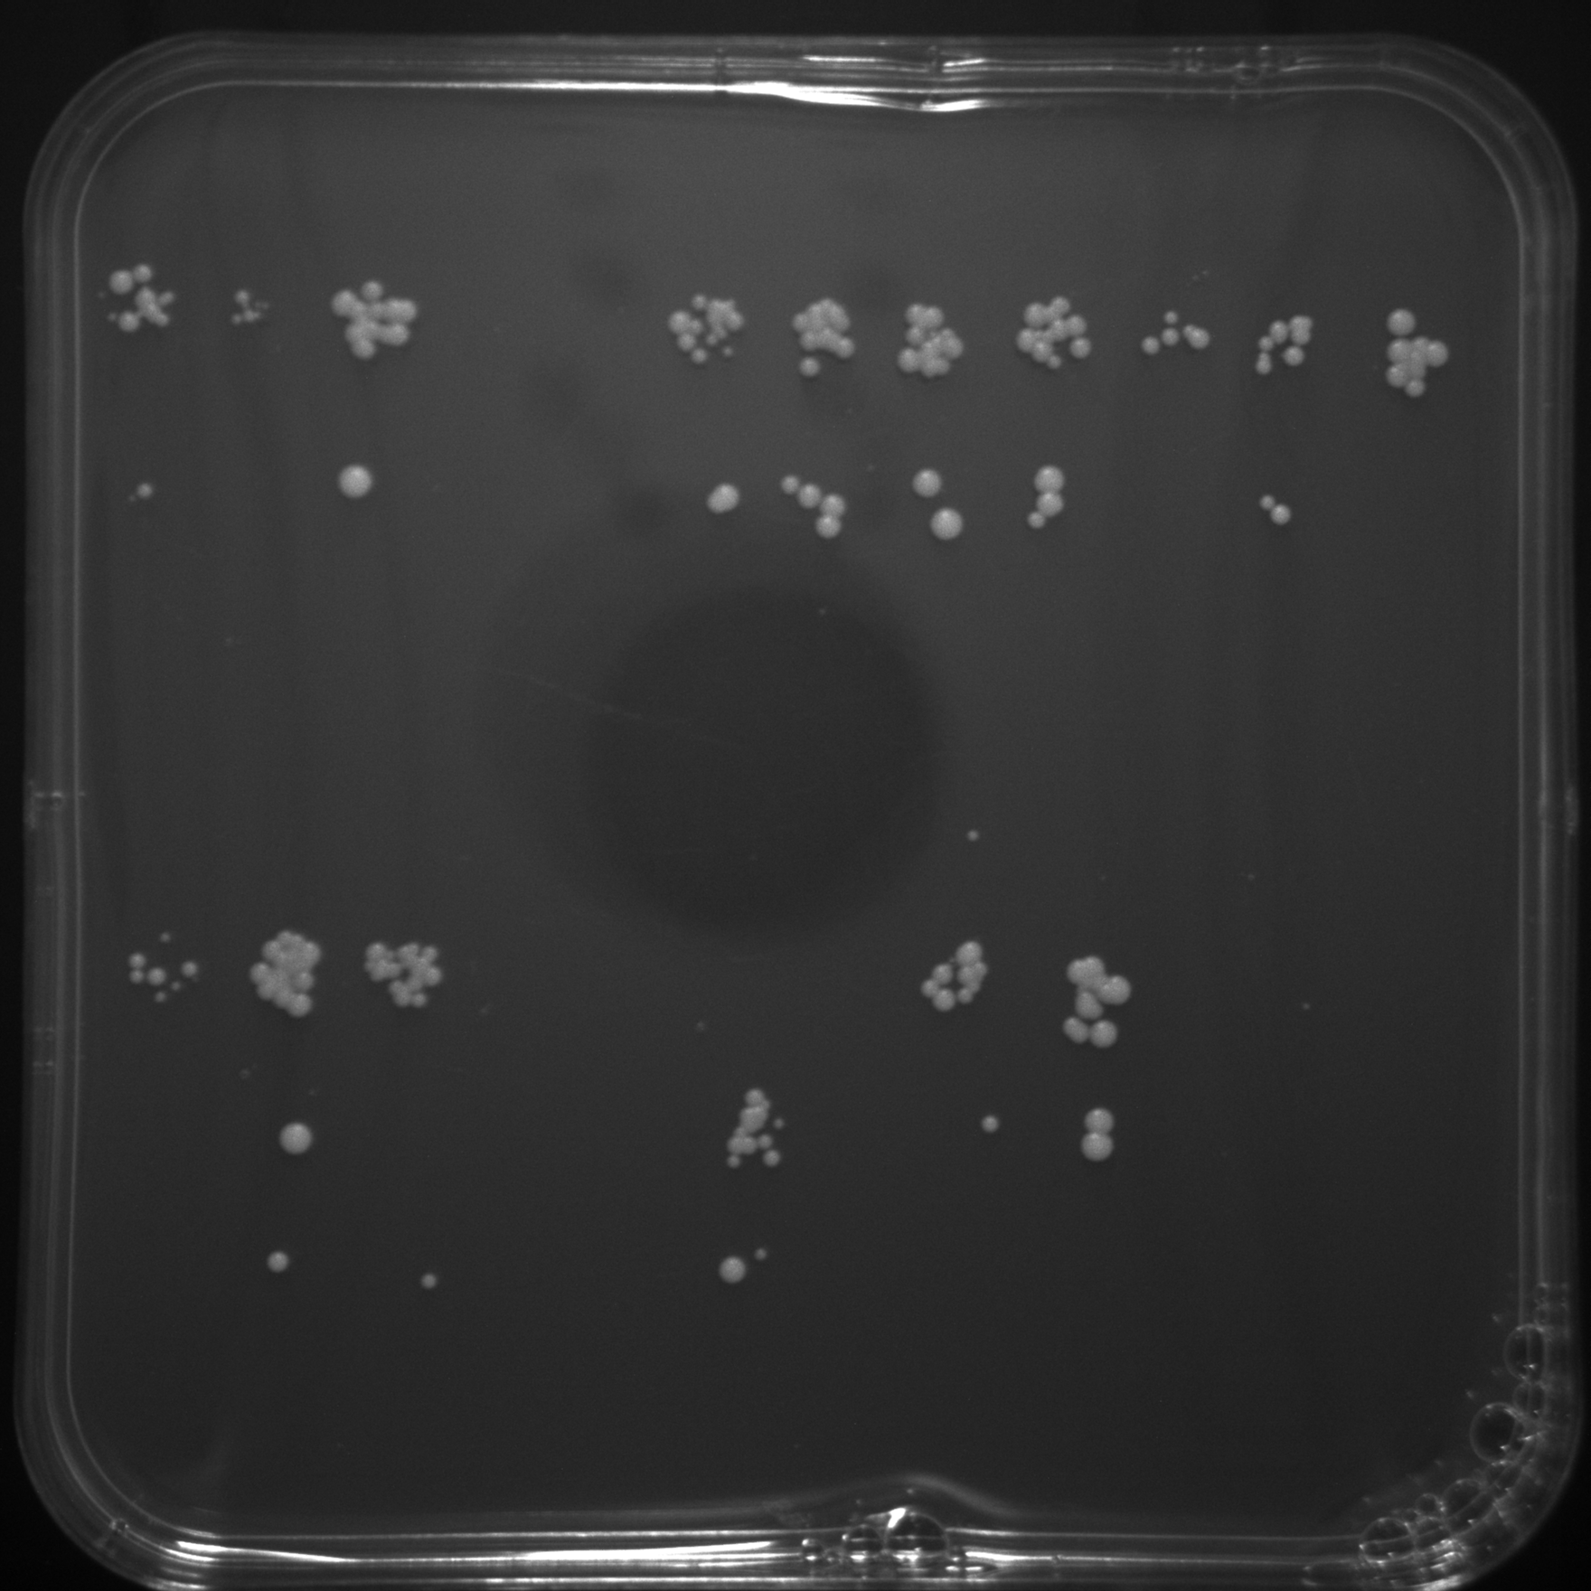
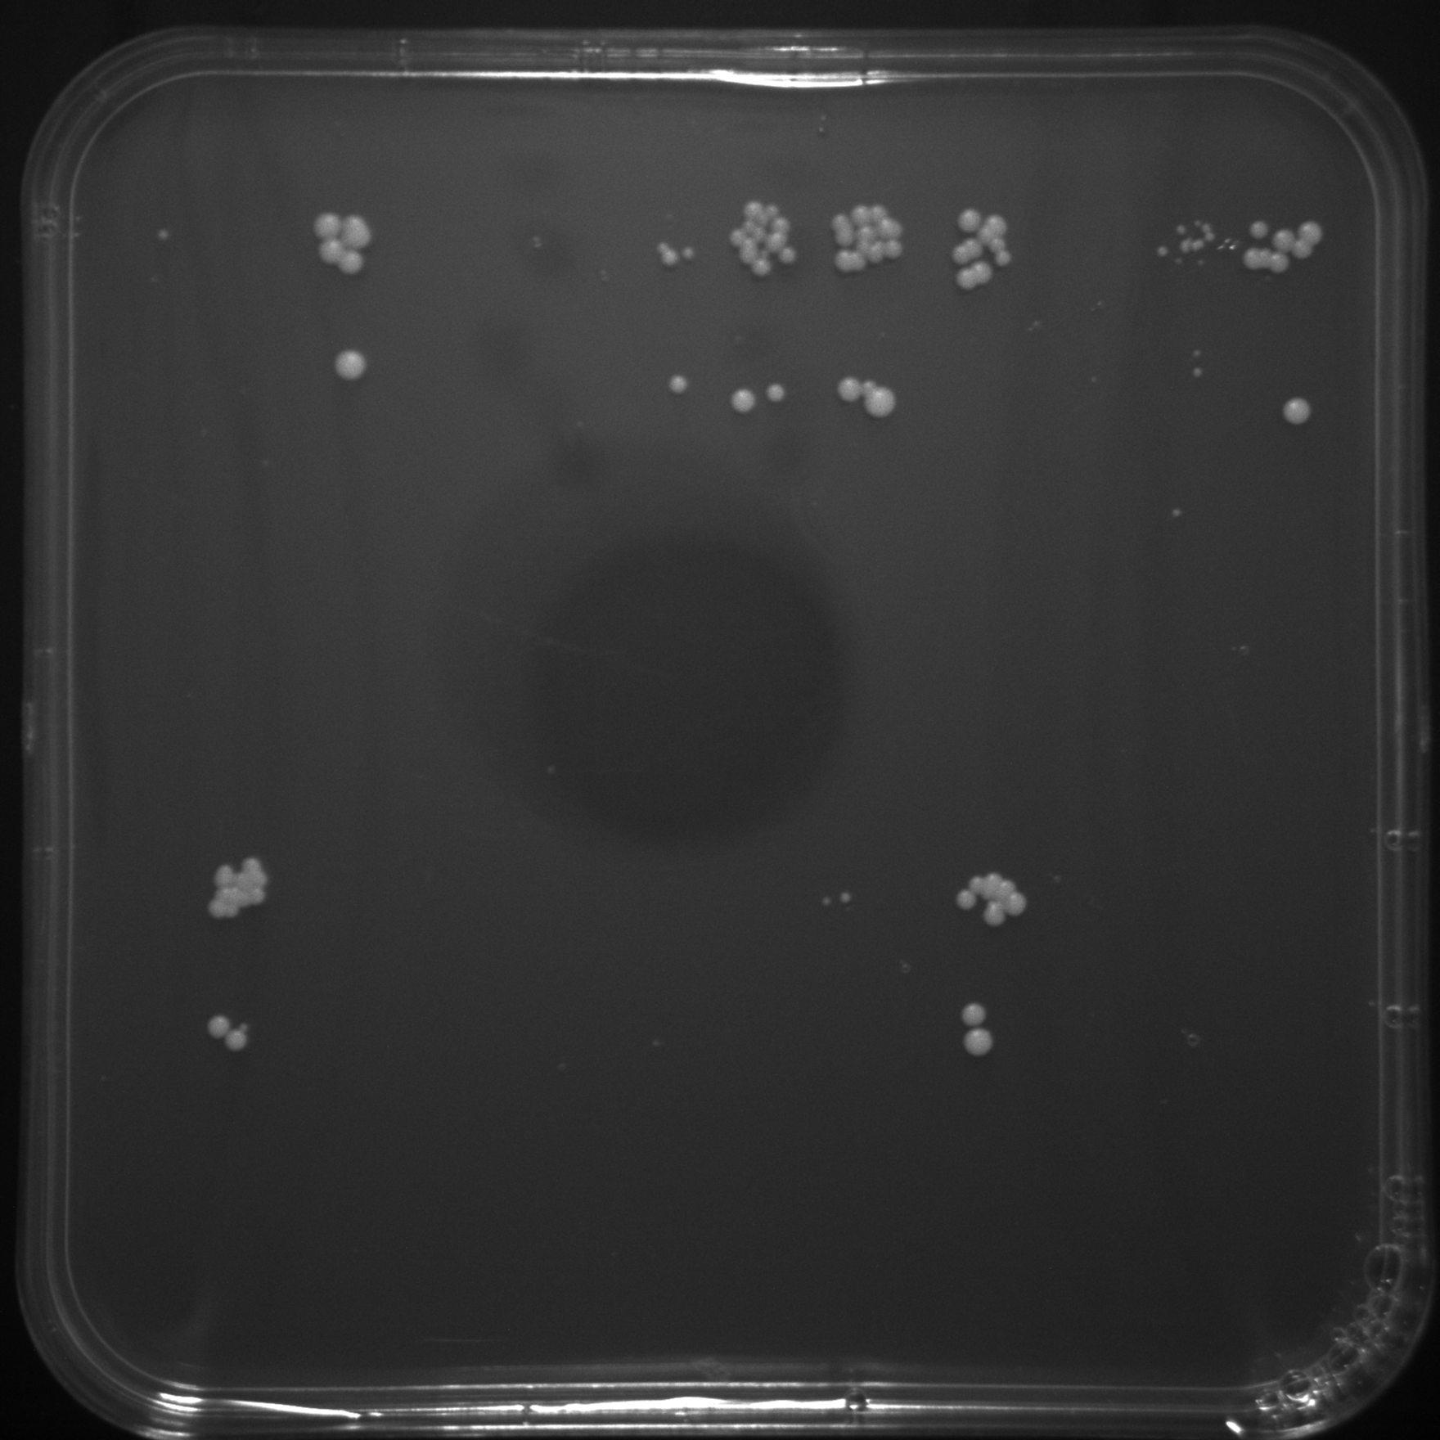
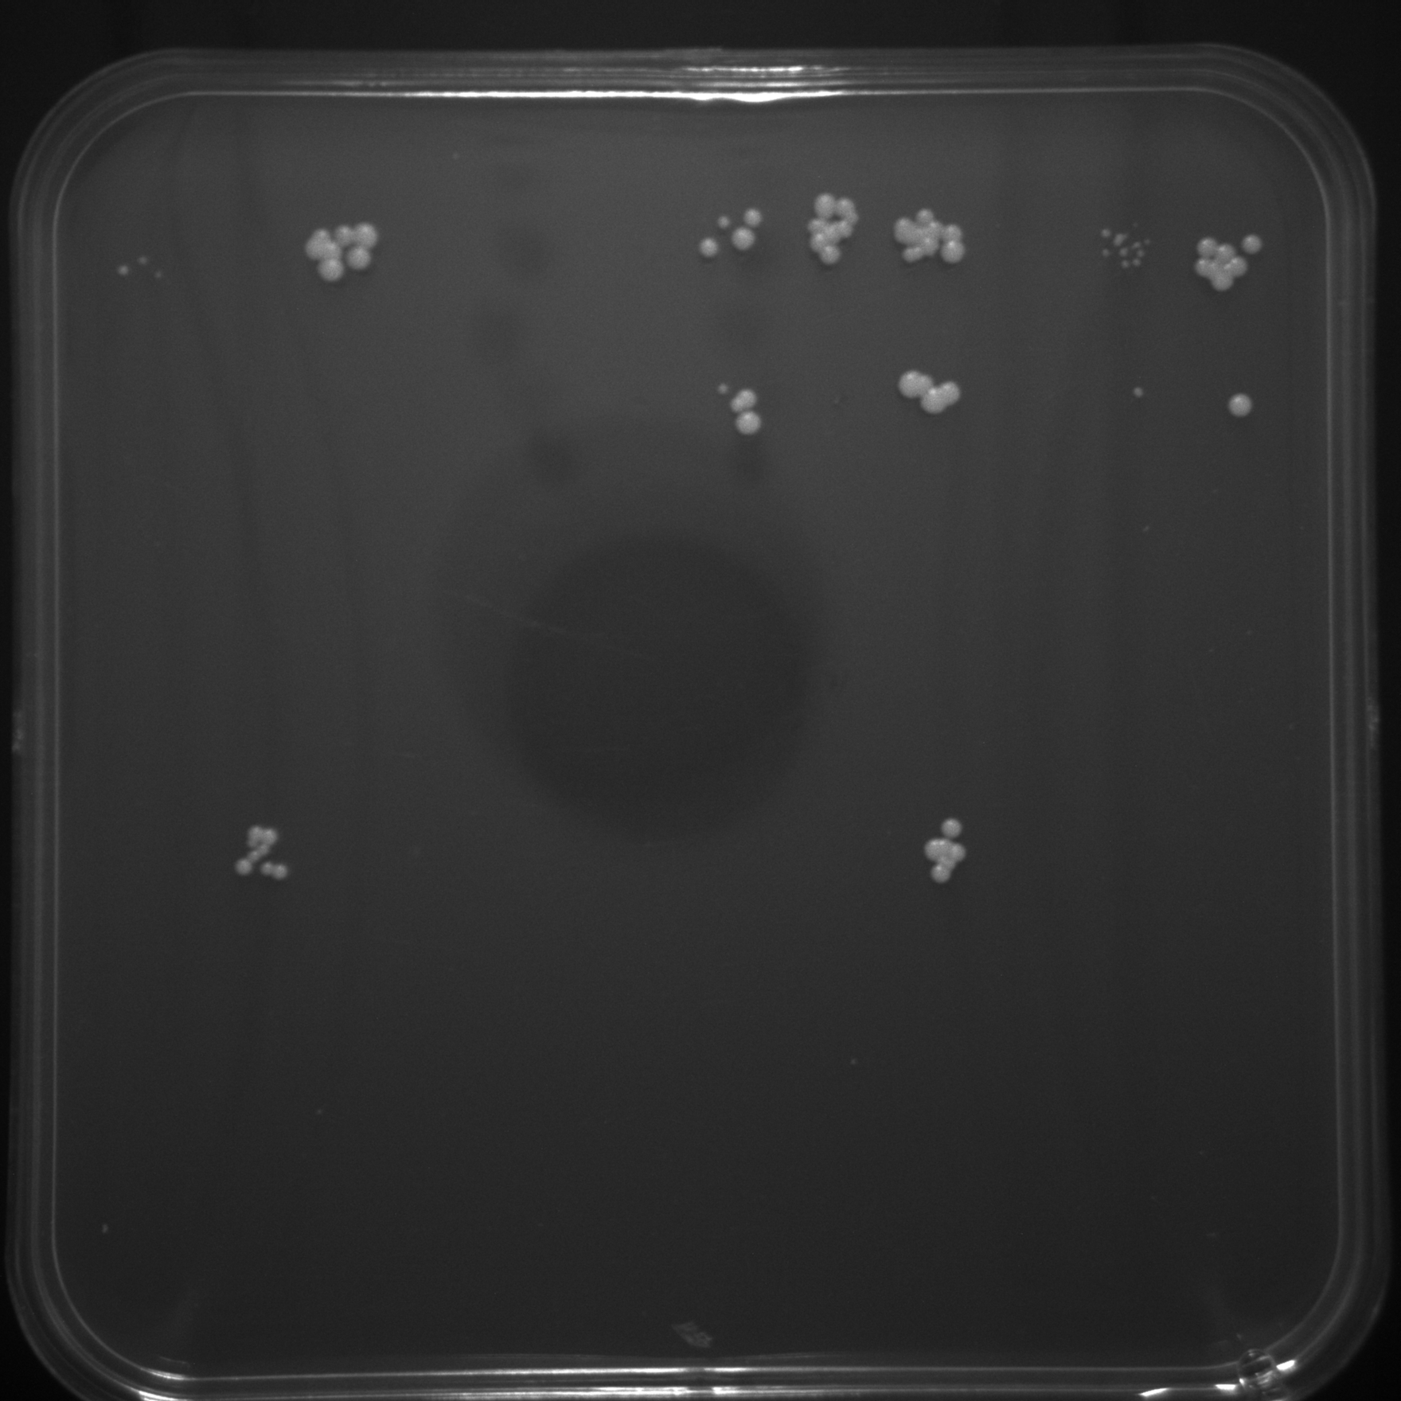
 | DCCON x3 | P6CON x3 | CRY x3 | ACACA | TFAP2A | FOXP2 | BLX x3 | P6 SELEX | FIMO | Synthetic Yeast Enhancer XS | Synthetic Yeast Enhancer Lb | Synthetic Yeast Enhancer XL
PAX6 | + | + | + | + | + | + | + | + | + | - | - | -
 | DCCON x3 | P6CON x3 | CRY x3 | ACACA | TFAP2A | FOXP2 | BLX x3 | P6 SELEX | FIMO | Synthetic Yeast Enhancer XS | Synthetic Yeast Enhancer Lb | Synthetic Yeast Enhancer XL
PAX6 | + | + | + | + | + | + | + | + | + | - | - | -
 | DCCON x3 | P6CON x3 | CRY x3 | ACACA | TFAP2A | FOXP2 | BLX x3 | P6 SELEX | FIMO | Synthetic Yeast Enhancer XS | Synthetic Yeast Enhancer Lb | Synthetic Yeast Enhancer XL
PAX6 | + | + | + | + | + | + | + | + | + | - | - | -
 | DCCON x3 | P6CON x3 | CRY x3 | ACACA | TFAP2A | FOXP2 | BLX x3 | P6 SELEX | FIMO | Synthetic Yeast Enhancer XS | Synthetic Yeast Enhancer Lb | Synthetic Yeast Enhancer XL
PAX6 | + | + | + | + | + | + | + | + | + | - | - | -
 | DCCON x3 | P6CON x3 | CRY x3 | ACACA | TFAP2A | FOXP2 | BLX x3 | P6 SELEX | FIMO | Synthetic Yeast Enhancer XS | Synthetic Yeast Enhancer Lb | Synthetic Yeast Enhancer XL
PAX6 | + | + | + | + | + | + | + | + | + | - | - | -
10-fold Serial Dilution
10-fold Serial Dilution
PAX6 | - | - | - | - | - | - | - | - | - | - | + | -
 | DCCON x3 | P6CON x3 | CRY x3 | ACACA | TFAP2A | FOXP2 | BLX x3 | P6 SELEX | FIMO | No DNA Element | No DNA Element | Media
PAX6 | - | - | - | - | - | - | - | - | - | - | + | -
 | DCCON x3 | P6CON x3 | CRY x3 | ACACA | TFAP2A | FOXP2 | BLX x3 | P6 SELEX | FIMO | No DNA Element | No DNA Element | Media
PAX6 | - | - | - | - | - | - | - | - | - | - | + | -
 | DCCON x3 | P6CON x3 | CRY x3 | ACACA | TFAP2A | FOXP2 | BLX x3 | P6 SELEX | FIMO | No DNA Element | No DNA Element | Media
PAX6 | - | - | - | - | - | - | - | - | - | - | + | -
 | DCCON x3 | P6CON x3 | CRY x3 | ACACA | TFAP2A | FOXP2 | BLX x3 | P6 SELEX | FIMO` | No DNA Element | No DNA Element | Media
PAX6 | - | - | - | - | - | - | - | - | - | - | + | -
 | DCCON x3 | P6CON x3 | CRY x3 | ACACA | TFAP2A | FOXP2 | BLX x3 | P6 SELEX | FIMO` | No DNA Element | No DNA Element | Media
0ug/ml Geneticin Plate
200ug/ml Geneticin Plate
400ug/ml Geneticin Plate
800ug/ml Geneticin Plate
1600ug/ml Geneticin Plate

