Slide 1
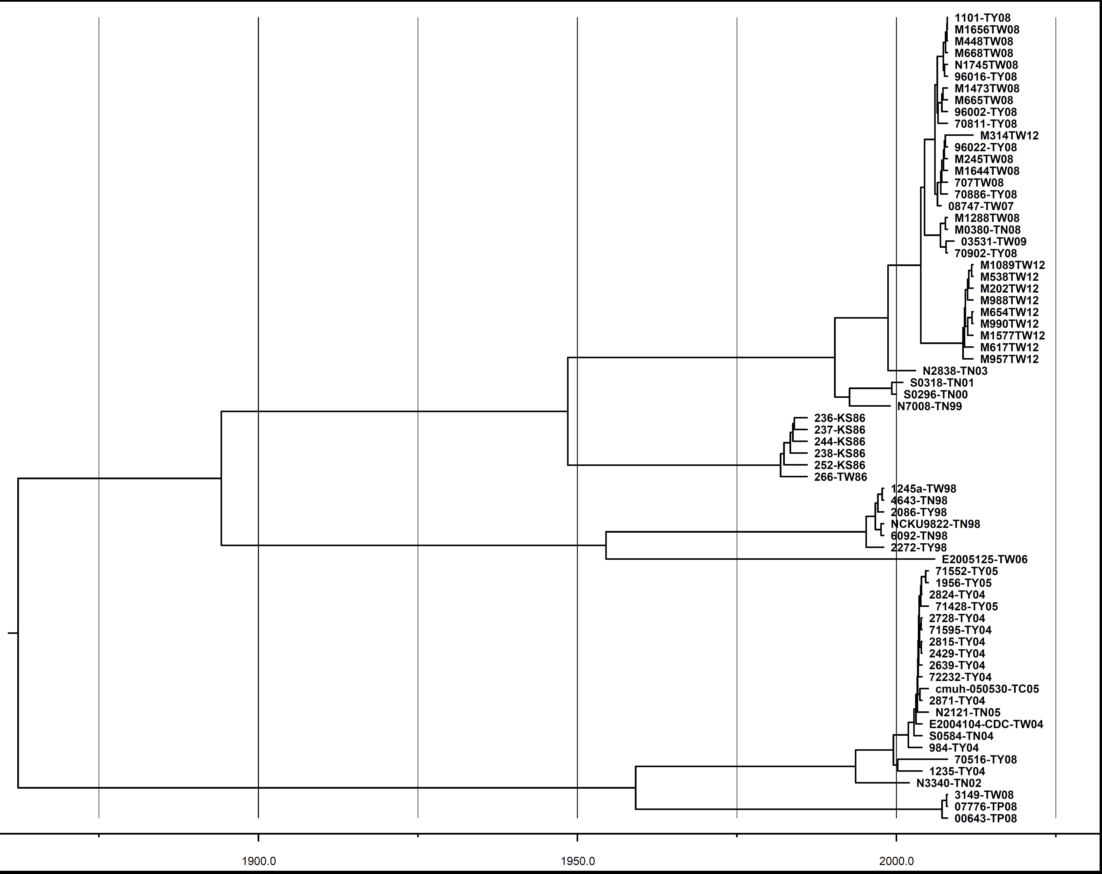
Supplementary figure 2
Genotype B5
Lineage 1 (2008)
2004.31
2003.82
Genotype B5
Lineage 2 (2012)
2010.44
Genotype B4
Genotype B1
Genotype C2
Genotype C4

