Slide 1
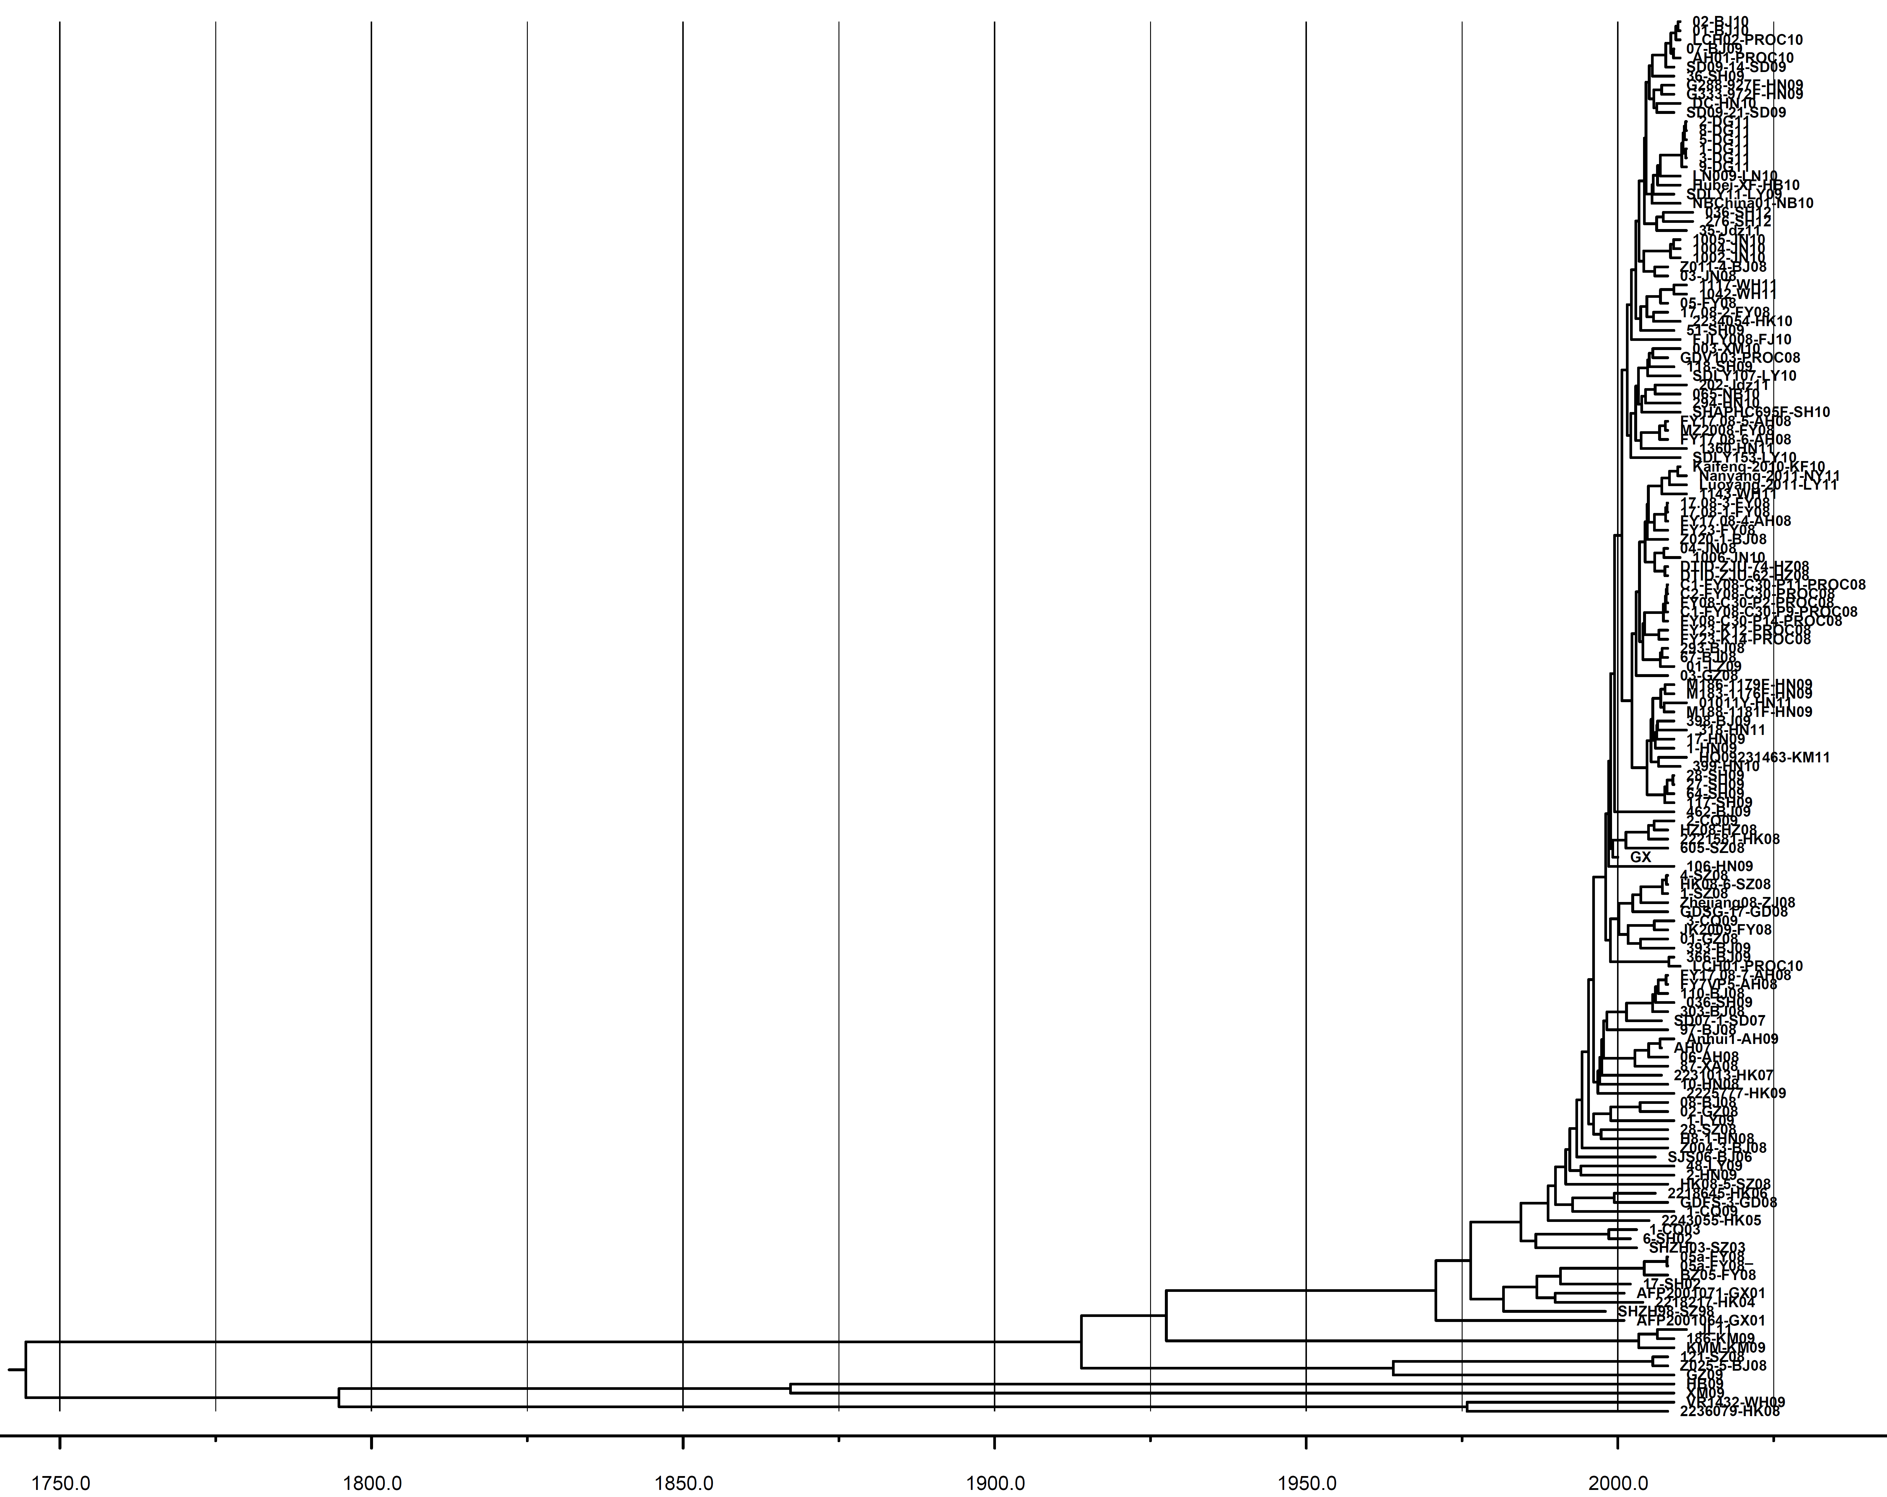
Supplementary figure 4
1984.45
1976.39
1970.80

