Slide 1
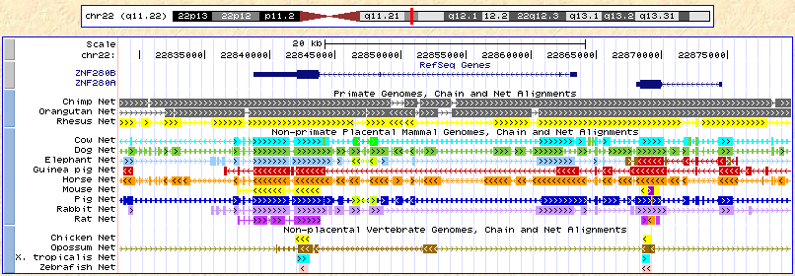
Additional file 6. The alignment of the ZNF280B/ZNF280A gene block across 17 species.

