Slide 1
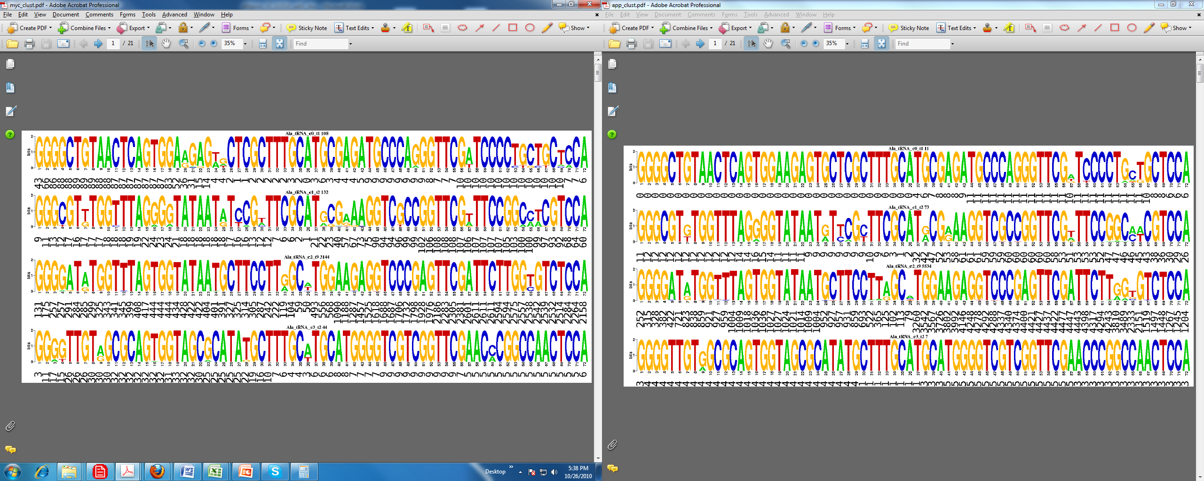
Mycelia
Appressoria

