Slide 1
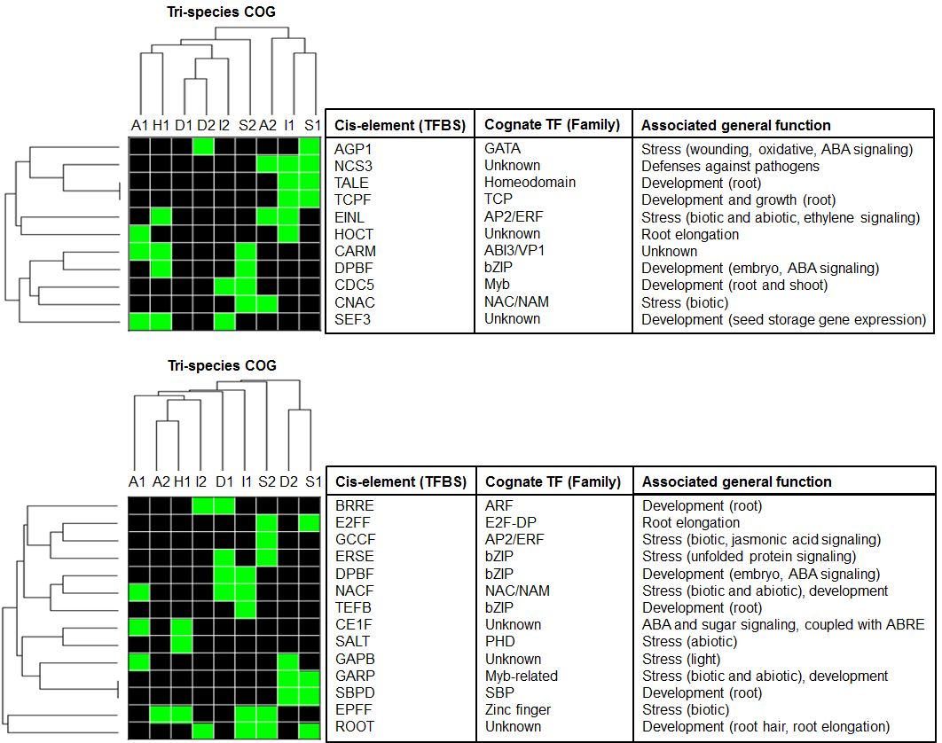
A
B
Motif present (1)
Motif absent (0)
Figure 9

