Slide 1
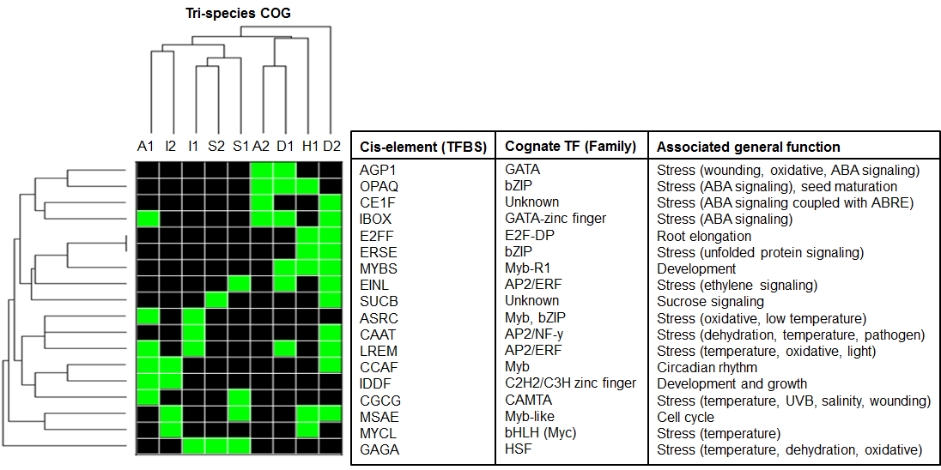
Motif present (1)
Motif absent (0)
Figure 6
Additional file 6

