Slide 1
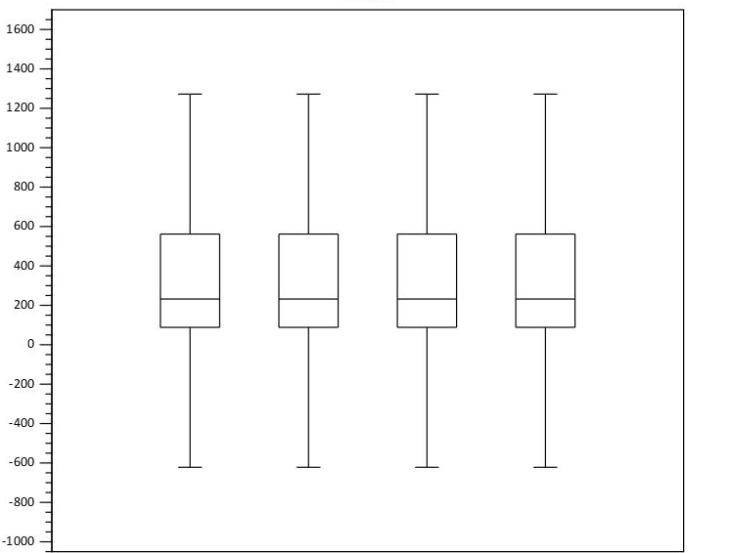
Normalized expression values
RNA-SeqFL1
RNA-SeqFL2
RNA-Seq STM1
RNA-Seq STM2

