Slide 1
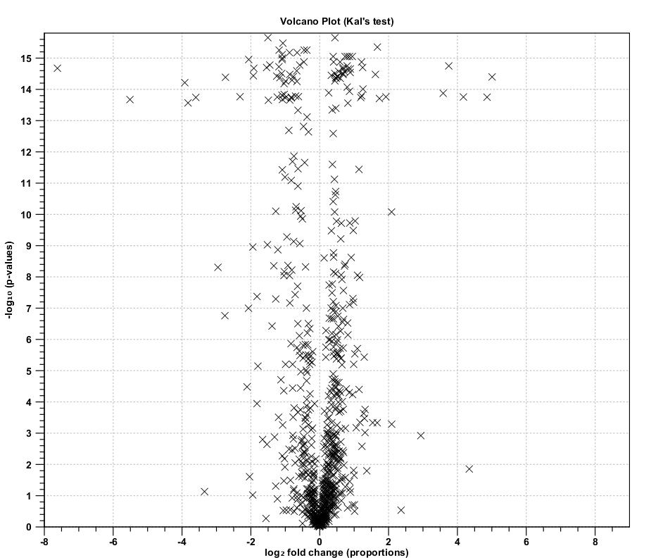
-log₁₀ (p-values)
Log₂ fold change (proportions)

