Slide 1
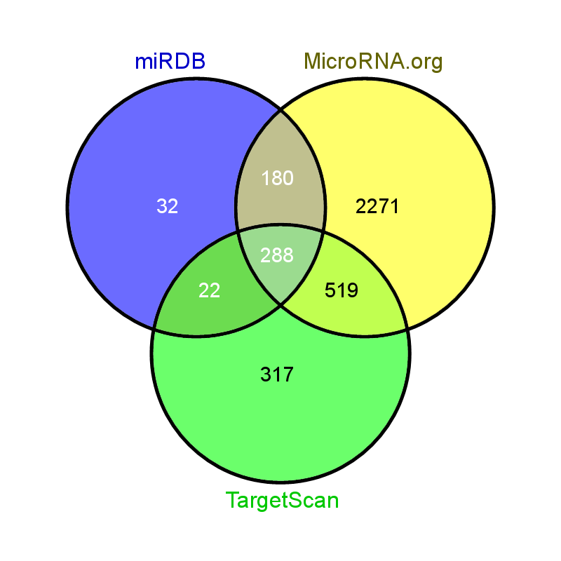
Target of hsa-miR-137

Slide 2

Target of hsa-miR-153

Slide 3

Target of hsa-miR-218

