Slide 1
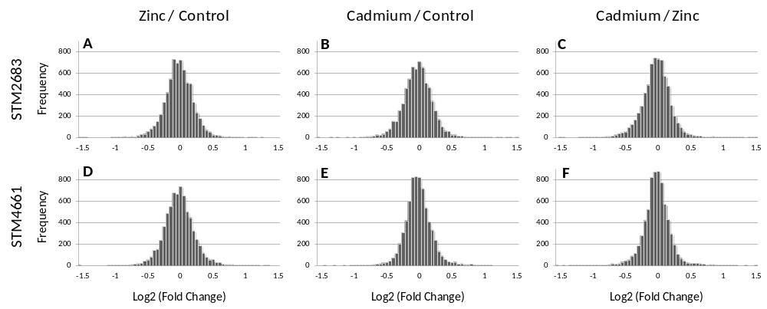
Additional file 4: Histogram representing the log2 fold changes obtained for all CDS and all comparisons. Histogram showing the numbers of CDS (Frequency) classified according to their log2 fold changes using intervals of 0.05 for STM2683 (A-C) and STM4661 (D-F) obtained from the three possible comparisons Zinc / Control (A and D), Cadmium / Control (B and E) or Cadmium / Zinc (C and F).

